Slide 1

Program Test and Debugging
Mr. Lee WS

Slide 2
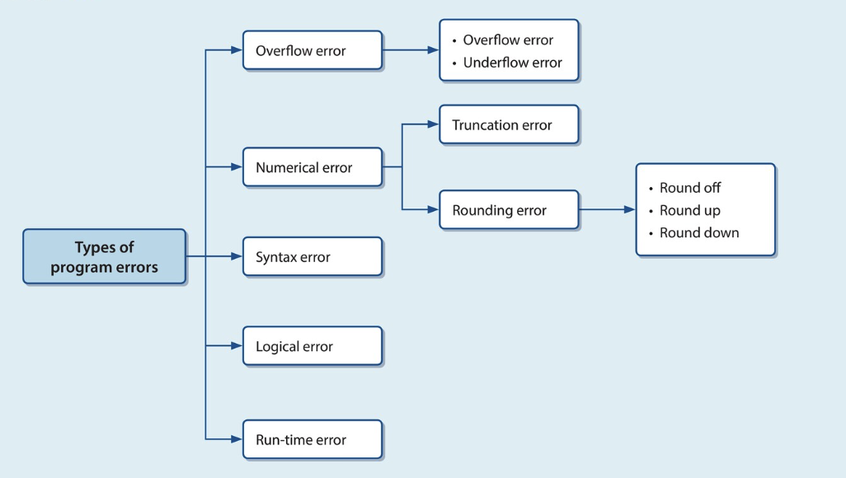
Revision
Please use 5 mins to recite all terms

Slide 3
Nearpod assessment
Nearpod: jqnzf

Slide 4
Tasks
Complete the classwork (Deadline: Today)
Assignment03 (TBC)
Assignment04 (Deadline: 8/11/23)

