Slide 1
Swapping and Sorting
Mr. Lee

Slide 2
Objectives:
After this lesson, students should be able to
Swap two variables
Dry-run a selection sort
Next lesson
Articulate the concepts of selection sort
Prior Knowledge
Students are able to operate 2D-array

Slide 3
Problems (5 mins):
How do you swap two data in two variables, A and B?
  Please write your pseudocode in Nearpod (5 mins)

Slide 4
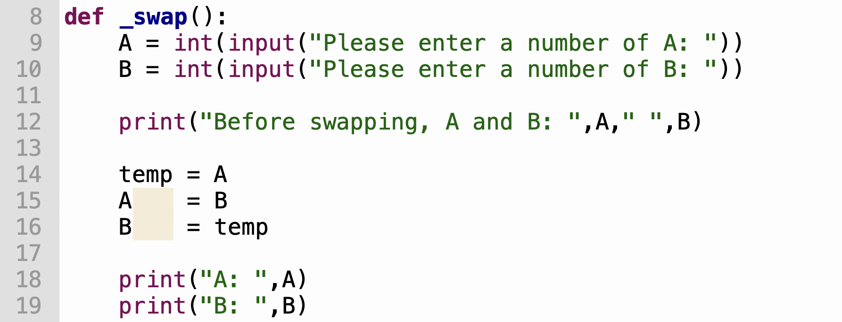
Swap
Question:
What is the purpose of temp?
Why do we need temp?

Slide 5

A bit challenging: swapping in an array (5 mins)
Write a pseudocode to swap two data in an array.
  Please write your pseudocode in Nearpod
  Arr1 = [3,4]

Slide 6
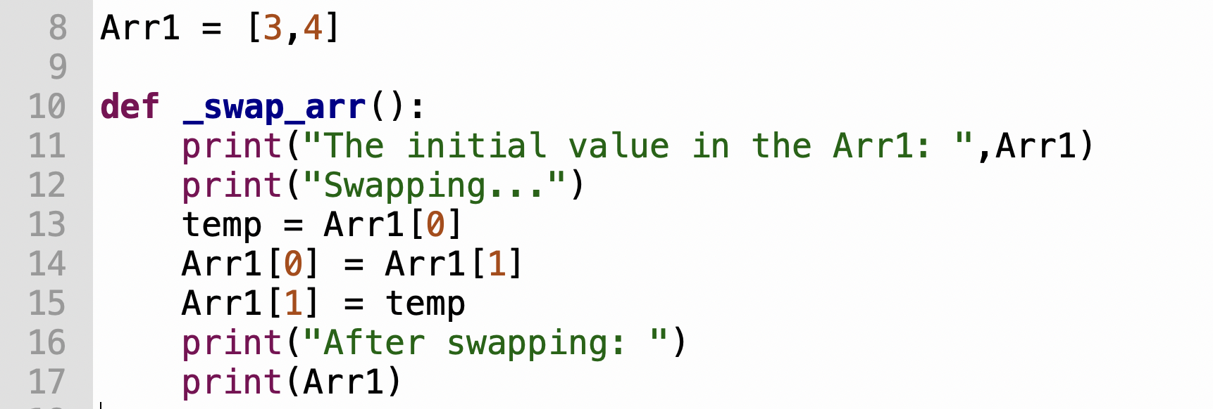
Swapping in an array

Slide 7
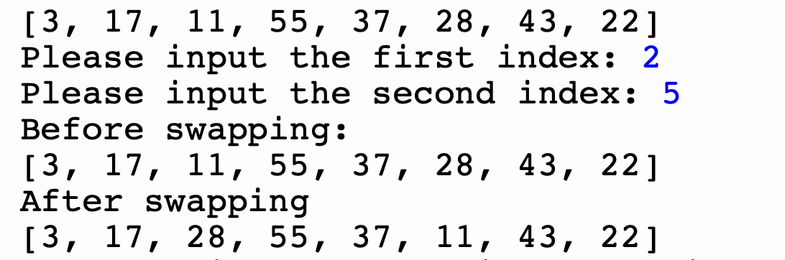
More challenging
(5 mins)
Using Thonny to implement a program to allow the user to enter two indexes for swapping.
You can talk with your classmates
Post the answer in OneNote → classwork
Sample:

Slide 8

Questions
What is sorting?
What is the output if we sort the following array in ascending order?
  Original: Arr2 = [3,17,11,55,37,28,43,22]
  After sorting: Arr2 = [3, 11, 17, 22, 28, 37, 43, 55]

Slide 9
Video:
https://www.youtube.com/watch?v=kZH0vWXs_Bk
Describe your idea in Nearpod

Slide 10
Idea of selection sort
Find the max or min (from the unsorted area)
Put it in the first location (sorted)
Find the max or min again (from the unsorted area)
Put it in the second location (sorted)
…

Slide 11
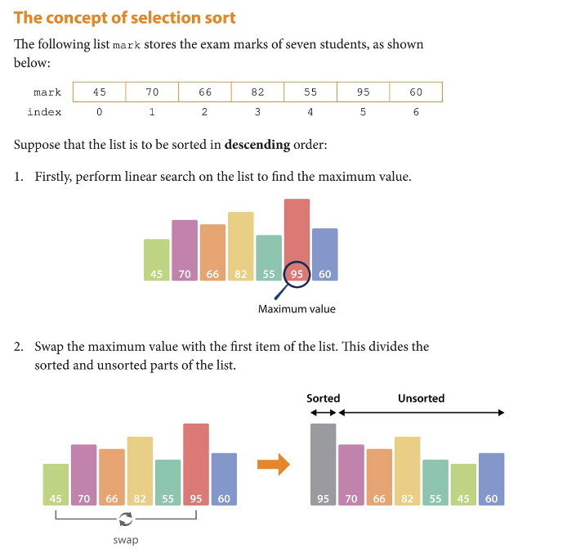
Idea of selection sort
Find the max or min (from the unsorted area)
Put it in the first location (sorted)
Find the max or min again (from the unsorted area)
Put it in the second location (sorted)

Slide 12
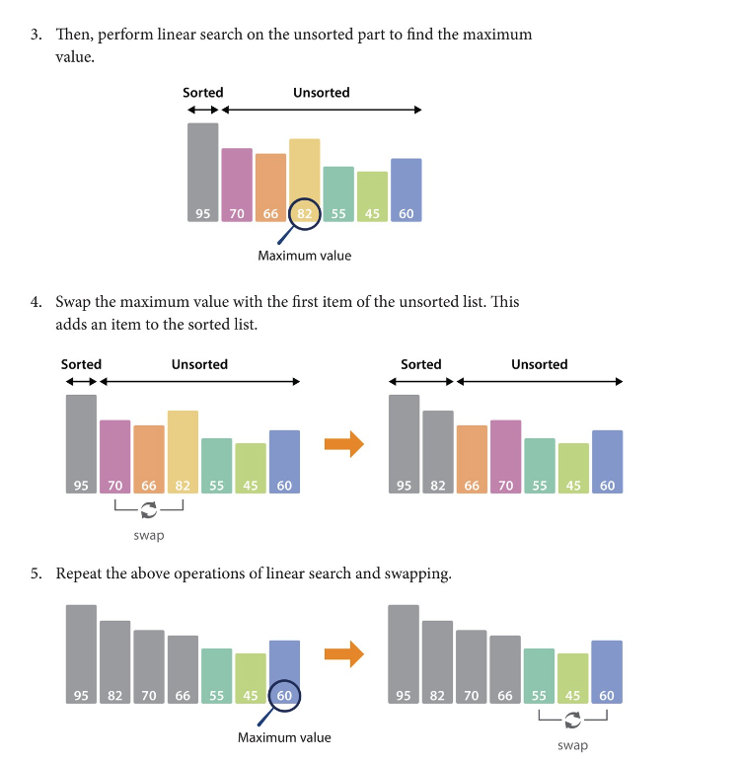
Idea of selection sort
Find the max or min (from the unsorted area)
Put it in the first location (sorted)
Find the max or min again (from the unsorted area)
Put it in the second location (sorted)

Slide 13
Summary
Swap
Selection sort
  Find the max or min
  Put it in the first location
  Repeat…
Tasks:
  Implement the selection sort in Python

