Slide 1
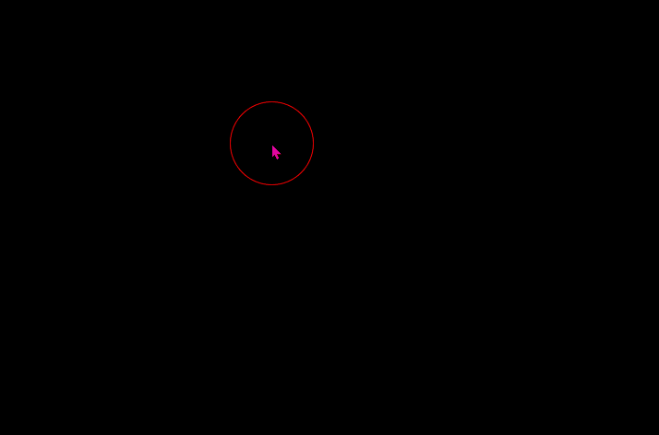
Task 1: Interactive Mask Creation
Create a Processing sketch (size: 720 x 480) to reproduce the interactive mask creation application (see the recorded animation below) using pixel-level image manipulation
  Keys: UP/DOWN → increase/decrease brush size; ENTER → clear the mask
  Note: the yellow circle is generated by the screen-recording software to show when the mouse is pressed and should not appear in your sketch
Use “Slide Show” to see the animation

Slide 2

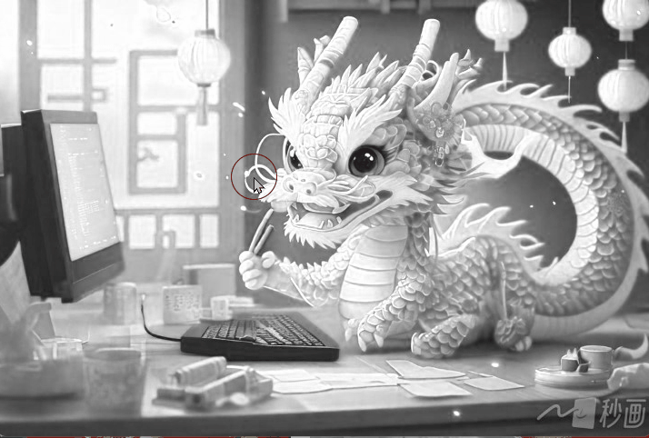
Task 2: Masked Image Processing
Based on Task 1, create a new Processing sketch (size: 720 x 480) to reproduce interactive masked image processing (see the animation below)
  From screen-recording software: yellow circle → left mouse pressed; blue circle → right mouse pressed;
  Keys: the same as those in Task 1
Source Image (available on Canvas)

Slide 3
Task 3: Masked Image Processing Effects
Following the ideas of Task 2, create an interactive Processing sketch to explore unique masked pixel-level image processing effects
  Use your own images (e.g., those created by GenAI)
    OPTIONAL: apply pixel-level image processing to individual frames of a video or stream from a webcam, instead of a single source image
  Enable interesting and original (a) mask creation and/or (b) image processing effects
    The focus of your sketch
    Mask creation and image
    processing effects can be
    completely different from
    those in Task 2
  Use a keyboard and/or mouse to achieve interactivity
(b) Pixel-level Processing
Source
Target
(a) Mask

Slide 4
Suggestions for Task 3
You’re encouraged to create a new sketch from scratch
A simple modification of an in-class example or the code for Task 2 will lead to a low mark for this task
A very straightforward combination of in-class examples will not help you get a good mark either
You are not encouraged to look for examples on the Internet
  A simple modification of an online example (with proper in-code citations and references) is even worse than a simple modification of an in-class example

