Slide 1
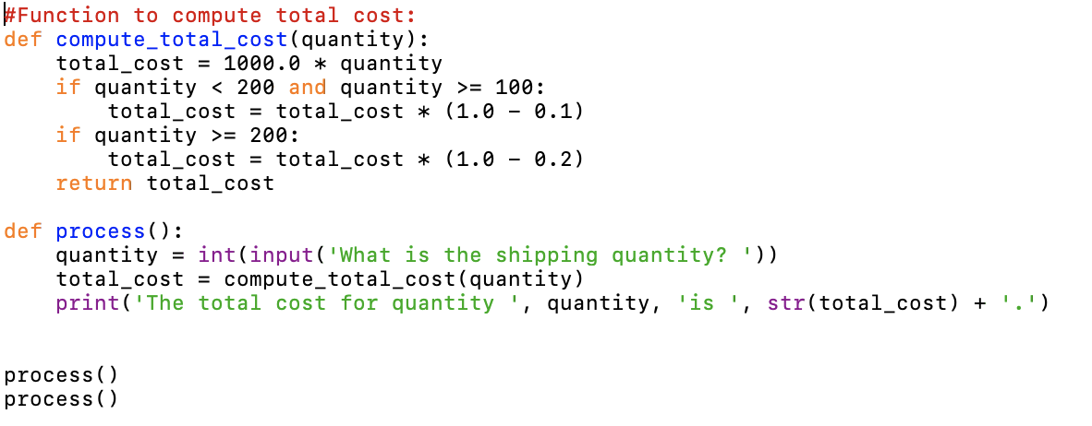
Lecture 5: Python Functions
A function is a named sequence of statements that performs a computation
  with arguments (values) passed to parameters (variables)
There are two kinds of functions in Python.
  Built-in functions: functions that are provided as part of Python - print(), input(), type(), float(), int(), max(), min(), len(), ...
  User-defined Functions: functions that we define ourselves and then use

Slide 2
Review of Lecture 5
What’s function?
  to store and reuse codes
  define, header, name, arguments, body, return, call, parameters
Built-in functions
  Import module before using its functions / variables
  Usage of dir() and help()
  Passing arguments
Debugging
  Save before run, define before use
  Use print() to checking whether a code is executed during debugging
User-defined functions
  Define and use - def and call
  Local variables defined in a function
  Flow of execution – detour
  Arguments, parameters, return values
  Multiple parameters / arguments
  Void functions and fruitful functions
  Why/How to organize functions
    Break into logical chunks
    Reusable, and easy to maintain
Positioned arguments and keyword arguments
Functions are objects

Slide 3
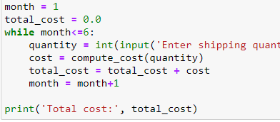
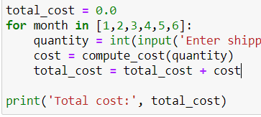
Lecture 6: Loop - Repeat the same steps
Computers are often used to automate repetitive tasks.
Repeating identical or similar tasks without making errors is something that computers do well and people do poorly.
Python provides several language features to make it easier.
  while loop (indefinite loop) and for loop (definite loop)

Slide 4
Review of Lecture 6
Loop: Repeat
  Iteration, iteration variable
while loop: Indefinite
  Iteration until condition is violated
for loop: definite
  Iteration for each item of a sequence
break and continue
Loop Patterns:
  Initialize, Iteration over each entry of data, and repeat updates
    Maximum of data
    Sum of data
    Counting of data
  Filtering of data by conditions, and use of Flag variables
  Use of None, is, and is not
    Minimum
Debugging
  print() and bisection debugging

Slide 5
CDS1001 – Strings and Files
The session will be recorded!

Slide 6
Examples of String Values and Variables
while True:
line = input('> ')
if line == 'done' :
break
print(line)
print('Done!')
String value:
  ‘Done!’
String variable:
  line
Comparison:
  ==
Operator:
  +, *, etc.
Convert function:
  str(1)
More operations and functions
  Slicing …
  search, uppercase, lowercase, startswith …

Slide 7
Case Study: Finding a Carrier’s Shipping Rate from a File

Slide 8
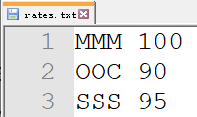


Finding a Carrier’s Shipping Rate from a File: Problem Description
FE plans to ship cargoes from Hong Kong to Los Angeles every month
FE receives shipping rates from multiple carriers, and store the rates in a text file (rates.txt)
  Carrier’s ID has 3 letters: AAA, ABC
  Followed by a space and a shipping rate
FE wants to know the shipping rate for a specific carrier
rates.txt
Output

Slide 9
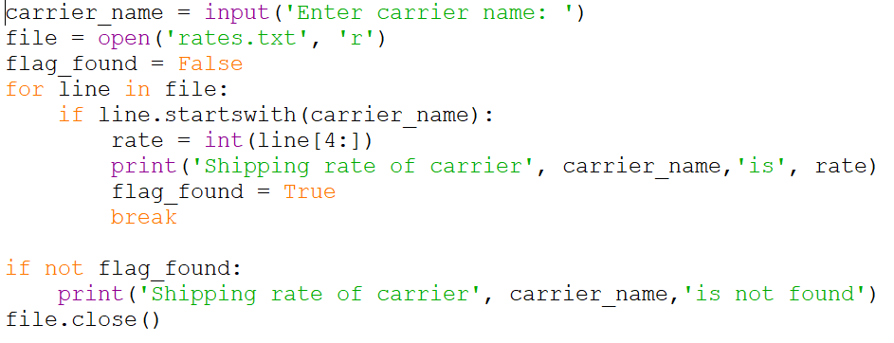
Finding a Carrier’s Shipping Rate from a File: Python Code for text processing
For each line read from the input file:
  Parse: If the line starts with the carrier_name, then
    Extract the shipping rate from the line, and print the rate
carrier_name and line are string variables
startswith() is a function on a string variable
line[4:] returns a slice of a string

Slide 10
String: Data Type

Slide 11
String Data Type
>>> str1 = "Hello"
>>> str2 = 'there’
>>> bob = str1 + str2
>>> print(bob)
Hellothere
>>> print(‘-’*10)
----------
>>> str3 = '123'
>>> str3 = str3 + 1
Traceback (most recent call last): File "<stdin>", line 1, in <module>
TypeError: cannot concatenate 'str' and 'int' objects
>>> x = int(str3) + 1
>>> print(x)
124
>>>
A string is a sequence of characters, which is a common type for text processing
A string literal uses quotes
'Hello' or "Hello"
For strings, + means “concatenate”, and * means “duplicate”
When a string contains numbers, it is still a string
We can convert numbers in a string into a number using int() or float()

Slide 12
Reading and Converting
We prefer to read data in using strings and then parse and convert the data as we need
This gives us more control over error situations and/or bad user input
Input numbers must be converted from strings
>>> name = input('Enter:')
Enter:Chuck
>>> print(name)
Chuck
>>> apple = input('Enter:')
Enter:100
>>> x = apple – 10
Traceback (most recent call last): File "<stdin>", line 1, in <module>
TypeError: unsupported operand type(s) for -: 'str' and 'int'
>>> x = int(apple) – 10
>>> print(x)
90

Slide 13
Escape Characters
To insert characters that are illegal in a string, use an escape character – backslash \ followed by the character to insert
  Error: txt = "We are the "Vikings" from the north."
  Correct: txt = "We are the \"Vikings\" from the north."
Common escape characters used in Python:
Code | Result | Code | Result
\” | Double Quote | \’ | Single Quote
\\ | Backslash | \n | New Line
\t | Tab | \b | Backspace
\r | Carriage Return
Question: How to use string to represent a path C:\CDS1001\Week7\T6\?

Slide 14
Summary of String
String type: a sequence of characters
Read/Convert

Slide 15
String:
Access Characters of a String

Slide 16
Looking Inside Strings: s[i]
We can get at any single character in a string using an index specified in square brackets, e.g., fruit[1]
The index value must be an integer and starts at zero
  E.g., fruit[1] is 2nd character of string fruit
The index value can be an expression that is computed
fruit
b
a
n
a
n
a
0
1
2
3
4
5
>>> fruit = 'banana'
>>> letter = fruit[1]
>>> print(letter)
a
>>> x = 3
>>> w = fruit[x - 1]
>>> print(w)
n

Slide 17
Error: Index Out of Range
You will get a python error if you attempt to index beyond the end of a string
So be careful when constructing index values and slices
b
a
n
a
n
a
0
1
2
3
4
5
>>> fruit = ‘banana'
>>> print(fruit[6])
Traceback (most recent call last): File "<stdin>", line 1, in <module>
IndexError: string index out of range
>>>

Slide 18
Negative Index: Backward
The index value can be negative.
Negative indices count backward from the end of the string
-6
-5
-4
-3
-2
-1
b
a
n
a
n
a
0
1
2
3
4
5
>>> fruit = 'banana'
>>> letter = fruit[-1]
>>> print(letter)
a
>>> x = 3
>>> w = fruit[-x]
>>> print(w)
a

Slide 19
Summary of String
String type : a sequence of characters
Read/Convert
Indexing strings []: forward and backward

Slide 20
String: Length of a String

Slide 21
Strings Have Length
The built-in function len gives us the length of a string
b
a
n
a
n
a
0
1
2
3
4
5
>>> fruit = 'banana'
>>> print(len(fruit))
6

Slide 22
len Function: len(s)
>>> fruit = 'banana'
>>> x = len(fruit)
>>> print(x)
6
A function is some stored code that we use. A function takes some input and produces an output.
len()
function
'banana'
(a string)
6
(a number)

Slide 23
len Function
>>> fruit = 'banana'
>>> x = len(fruit)
>>> print(x)
6
A function is some stored code that we use. A function takes some input and produces an output.
def len(inp):
blah
blah
for x in y:
blah
blah
'banana'
(a string)
6
(a number)

Slide 24
How to Get the Last Character of a String?
no letter in 'banana' with the index 6
>>> fruit = ‘banana’
>>> length = len(fruit)
>>> last = fruit[length]
IndexError: string index out of range
>>> fruit = ‘banana’
>>> length = len(fruit)
>>> last = fruit[length-1]
>>> last = fruit[-1]
To get the last character, you have to subtract 1 from length
Negative Index: count backward from the end
-6
-5
-4
-3
-2
-1
b
a
n
a
n
a
0
1
2
3
4
5

Slide 25
Looping Through a String
The loop condition is index < len(fruit)
Note that len(fruit) = 6
Using a while statement, an iteration variable, and the len function, we can construct an indefinite loop to look at each of the characters in a string individually
fruit = 'banana'
index = 0
while index < len(fruit):
letter = fruit[index]
print(index, letter)
index = index + 1
0 b
1 a
2 n
3 a
4 n
5 a

Slide 26
Looping Through Strings
A definite loop using a for statement is much more elegant
The iteration variable is completely taken care of by the for loop
b
a
n
a
n
a
fruit = 'banana'
for letter in fruit:
print(letter)

Slide 27
Looping Through Strings
A definite loop using a for statement is much more elegant
The iteration variable is completely taken care of by the for loop
fruit = 'banana'
for letter in fruit:
print(letter)
b
a
n
a
n
a
fruit = 'banana'
index = 0
while index < len(fruit):
letter = fruit[index]
print(index, letter)
index = index + 1

Slide 28
Looping and Counting
E.g., to count how many times ‘a’ appear in ‘banana’
This is a simple loop that loops through each character in a string and counts the number of times the loop encounters the 'a' character
word = 'banana'
count = 0
for letter in word :
if letter == 'a' :
count = count + 1
print(count)

Slide 29
Looking Deeper into in
The iteration variable “iterates” through the sequence (ordered set)
The block (body) of code is executed once for each value in the sequence
The iteration variable moves through all of the values in the sequence
Iteration variable
Six-character string
for letter in 'banana' :
print(letter)

Slide 30
Yes
Iteration Done?
No
b
a
n
a
n
a
Move to
next letter
print(letter)
for letter in 'banana' :
print(letter)
The iteration variable “iterates” through the string and the block (body) of code is executed once for each value in the sequence

Slide 31
Discussion: Reverse Traversal
Print each character of a given string on a separate line, except backwards
Write a loop that
  starts at the last character in the string and
  works its way backwards to the first character in the string
n = len(fruit)
i = -1
Flowchart
No
i >= -n?
Yes
print(fruit[i])
i = i - 1
-6
-5
-4
-3
-2
-1
b
a
n
a
n
a
0
1
2
3
4
5
End

Slide 32
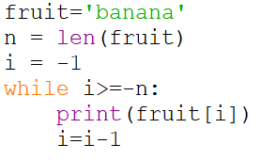
Discussion: Reverse Traversal
Which statement to use, while or for?
n = len(fruit)
i = -1
No
i >= -n?
Yes
print(fruit[i])
Can we use the for loop?
i = i - 1
End

Slide 33
Summary of String
String type : a sequence of characters
Read/Convert
Indexing strings []: forward and backward
Looping through strings
with for and while, and len()

Slide 34
String: more string operations

Slide 35
Slicing Strings s[i:j]
We can also look at any continuous section of a string using a colon operator
s[i:j] equals s[i]s[i+1]…s[j-1]
The second number is one beyond the end of the slice - “up to but not including”
If the second number is beyond the end of the string, it stops at the end
-9
-8
-7
-6
-5
-4
-3
-2
-1
s
H
o
n
g
K
o
n
g
0
1
2
3
4
5
6
7
8
>>> s = ‘Hong Kong'
>>> print(s[0:4])
Hong
>>> print(s[6:7])
o
>>> print(s[6:20])
ong
>>> print(s[-9:-6])
Hon

Slide 36
Slicing Strings s[:j] or s[i:]
s[:j]: If we leave off the first number, it is assumed to be the beginning of the string,
  i.e., equivalent to s[0:j]
s[i:]: if we leave off the last number of the slice, it is assumed to be the end of the string,
  i.e., equivalent to s[i:len(s)]
-9
-8
-7
-6
-5
-4
-3
-2
-1
s
H
o
n
g
K
o
n
g
0
1
2
3
4
5
6
7
8
>>> s='Hong Kong'
>>> print(s[:2])
Ho
>>> print(s[0:2])
Ho
>>> print(s[5:])
Kong
>>> print(s[5:len(s)])
Kong
>>> print(s[:])
Hong Kong
>>> print(s[0:len(s)])
Hong Kong
>>> print(s[-8:-3])
ong K

Slide 37
String Concatenation
When the + operator is applied to strings, it means “concatenation”
>>> a = 'Hello'
>>> b = a + 'There'
>>> print(b)
HelloThere
>>> c = a + ' ' + 'There'
>>> print(c)
Hello There
>>>

Slide 38
String Multiplication
When the * operator is applied to strings, it means “repeat” a string for multiple times
>>> a = 'Hello'
>>> b = a * 3
>>> print(b)
HelloHlloHello

Slide 39
Using in as a Logical Operator
The in keyword can also be used to check to see if one string is “in” another string
The in expression is a logical expression that returns True or False and can be used in an if statement
>>> fruit = 'banana'
>>> 'n' in fruit
True
>>> 'm' in fruit
False
>>> 'nan' in fruit
True
>>> if 'a' in fruit :
... print('Found it!')
...
Found it!
>>>

Slide 40
String Comparison
Two strings are equal:
if word == 'banana':
print('All right, bananas.')
Other comparison operations are based on in alphabetical order:
if word < 'banana':
print('Your word,' + word + ', comes before banana.')
elif word > 'banana':
print('Your word,' + word + ', comes after banana.')
else:
print('All right, bananas.')
All the uppercase letters come before all the lowercase letters:
Your word, Pineapple, comes before banana.

Slide 41
Strings are immutable (unchangeable)
String variables are immutable
Values of string variables cannot be changed
The best you can do is create a new string that is a variation on the original
>>> greeting = 'Hello, Hong Kong!'
>>> greeting[0] = ‘h'
TypeError: 'str' object does not support item assignment
How to change the first character of greeting to ‘h’?
>>> greeting = 'Hello, Hong Kong!'
>>> new_greeting = ‘h’ + greeting[1:]
>>> print(new_greeting)
hello, Hong Kong!

Slide 42
Summary of String
String type : a sequence of characters
Read/Convert
Indexing strings []: forward and backward
Looping through strings
with for and while, and len()
Slicing strings [2:4]
Concatenating strings with +
Repeating a string with *
String comparison
String is immutable

Slide 43
String:
Module of Functions for Strings

Slide 44
Review: Package, Modules, Functions, …
Python codes can be reused through modules and packages
A package consists of related modules
  To install package: pip install scipy
A module consists of related functions, classes, objects, etc.
  To import modules: import math
Package
Module
Function
Function
Function
Function
Class
Object
Module
Module
Module

Slide 45
String Module
String functions are in the string module
  It is a built-in module in Python’s standard library, and does not need to import
String functions are built into every string, and can be invoked by appending the function to the string variable (dot notation)
  E.g., s.lower(), s.upper(), …
  They are called methods of a string object
String functions do not modify the original string (immutable), but return a new string
>>> greet = 'Hello Bob'
>>> zap = greet.lower()
>>> print(zap)
hello bob
>>> print(greet)
Hello Bob
>>> print('Hi There'.lower())
hi there
>>>

Slide 46
Use dir() to list all the available functions for an object
>>> stuff = 'Hello world'
>>> type(stuff)
<class 'str'>
>>> dir(stuff)
['capitalize', 'casefold', 'center', 'count', 'encode', 'endswith', 'expandtabs', 'find', 'format', 'format_map', 'index', 'isalnum', 'isalpha', 'isdecimal', 'isdigit', 'isidentifier', 'islower', 'isnumeric', 'isprintable', 'isspace', 'istitle', 'isupper', 'join', 'ljust', 'lower', 'lstrip', 'maketrans', 'partition', 'replace', 'rfind', 'rindex', 'rjust', 'rpartition', 'rsplit', 'rstrip', 'split', 'splitlines', 'startswith', 'strip', 'swapcase', 'title', 'translate', 'upper', 'zfill']
https://docs.python.org/3/library/stdtypes.html#string-methods
Or simply type dir('')

Slide 47
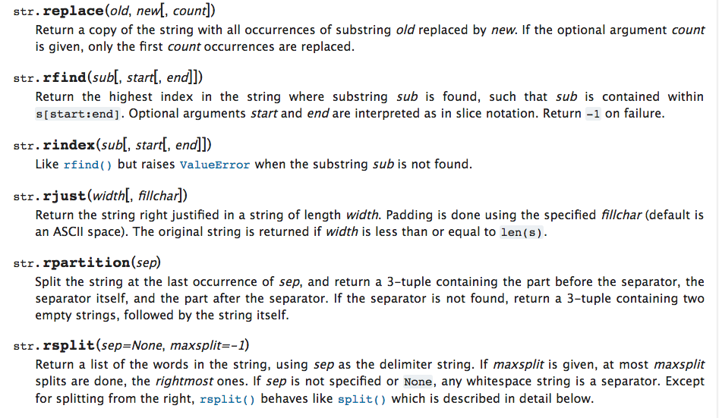

Slide 48
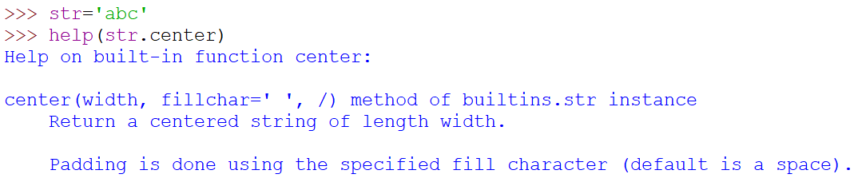
String Library: Examples
str.capitalize()
str.center(width[, fillchar])
str.startswith(prefix[, start[, end]])
str.endswith(suffix[, start[, end]])
str.find(sub[, start[, end]])
str.lstrip([chars])
str.replace(old, new[, count])
str.lower()
str.rstrip([chars])
str.strip([chars])
str.upper()
Use help() to find information about the functions
Or simply type help(''.center)

Slide 49
Searching a String s.find(ss)
We use the find() function to search for a substring within another string
find() finds the (non-negative) index of the first occurrence of the substring
If the substring is not found, find() returns -1
Remember that string position starts at zero
b
a
n
a
n
a
0
1
2
3
4
5
>>> fruit = 'banana'
>>> pos = fruit.find('na')
>>> print(pos)
2
>>> aa = fruit.find('z')
>>> print(aa)
-1

Slide 50
Making everything UPPER/LOWER CASE s.upper() / s.lower()
You can make a copy of a string in lower case or upper case
Case-Insensitive Search: search a string regardless of case
  Convert the string to lower case
  Use find() to search
>>> greet = 'Hello Bob'
>>> nnn = greet.upper()
>>> print(nnn)
HELLO BOB
>>> www = greet.lower()
>>> print(www)
hello bob
>>> res = greet.lower().find(‘bob’)
>>> print(res)
6

Slide 51
Search and Replace s.replace(ss, rs)
The replace() function is like a “search and replace” operation in a word processor
It replaces all occurrences of the search string (ss) with the replacement string (rs)
>>> greet = 'Hello Bob'
>>> nstr = greet.replace('Bob','Jane')
>>> print(nstr)
Hello Jane
>>> nstr = greet.replace('o','X')
>>> print(nstr)
HellX BXb
>>>

Slide 52
Stripping Whitespace s.lstrip() / s.rstrip() / s.strip()
Whitespace: characters space (‘ ’), tab (‘\t’), new line (‘\n’)
Sometimes we want to take a string and remove whitespace at the beginning and/or end
lstrip() and rstrip() remove whitespace at the left or right
strip() removes both beginning and ending whitespace
>>> greet = ' Hello Bob '
>>> greet.lstrip()
'Hello Bob '
>>> greet.rstrip()
' Hello Bob'
>>> greet.strip()
'Hello Bob'
>>>

Slide 53
Check Prefixes and Suffix
s.startswith(pf) / s.endswith(sf)
We want to know whether a given string starts with a certain prefix or ends with a certain suffix
  startswith(pf) returns True if the string starts with the value of pf
  endswith(sf) returns True if the string ends with the value of sf
>>> line = ‘Hello Bob'
>>> line.startswith(‘Hello')
True
>>> line.startswith(‘hello')
False
>>> line.endswith(‘Bob’)
True

Slide 54
Parsing and Extracting
Look into a string to find (parse) and get (extract) a substring.
Example: Pull out the second half of an email address from each line:
12
22
From kenfong@ln.edu.hk Sat Oct 15 09:14:16 2022
>>> data = 'From kenfong@ln.edu.hk Sat Oct 15 09:14:16 2022'
>>> atpos = data.find('@')
>>> print(atpos)
12
>>> sppos = atpos + data[atpos:].find(' ')
>>> print(sppos)
22
>>> host = data[atpos+1:sppos]
>>> print(host)
ln.edu.hk

Slide 55
Format Operator %: '%d %d' % (d1,d2)
The format operator % allows to replace parts of the strings with the data stored in variables.
1st operand is the format string, which contains some format sequences that specify how 2nd operand is formatted.
  %d indicates integer, %g indicates float number, %s indicates string
>>> camels = 42
>>> print('%d' % camels)
'42’
>>> print('In %d years I have spotted %g %s.' % (3, 0.1, 'camels'))
'In 3 years I have spotted 0.1 camels.’
>>> print('%d %d %d' % (1, 2))
TypeError: not enough arguments for format string
>>> print('%d' % 'dollars')
TypeError: %d format: a number is required, not str

Slide 56
Summary of String
String type : a sequence of characters
Read/Convert
Indexing strings []: forward and backward
Looping through strings
with for and while, and len()
Slicing strings [2:4]
Concatenating strings with +
Repeating a string with *
String comparison
String is immutable
String module in standard library
Searching in strings: find()
Replacing text: replace()
Stripping white space: strip(), lstrip(), rstrip()
String prefix and suffix: startswith(), endswith()
Parsing and Extracting
String Format: '%d %d' % (d1,d2)

Slide 57
DEBUGGING:
String Index Out of Range

Slide 58
String index out of range
“string index out of range” is a common error
To fix it, need to first identify the cause of the error
  Asking "What could go wrong here?“, "What crazy thing might our user do to crash our (seemingly) perfect program?“
Common causes of the error are:
  Empty string
  Beyond end of string

Slide 59
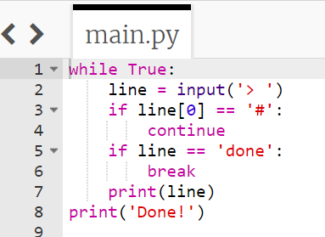
String index out of range
The code works fine until it is presented an empty line.
Then there is no zero-th character, so we get a traceback.
Two solutions to replace line 3
  if line.startswith('#’):
  if len(line) > 0 and line[0] == '#':
> hello there
hello there
> # don't print this
> print this!
print this!
>
Traceback (most recent call last):
File "copytildone.py", line 3, in <module>
if line[0] == '#':
IndexError: string index out of range

Slide 60
Summary of String
String type : a sequence of characters
Read/Convert
Indexing strings []: forward and backward
Looping through strings
with for and while, and len()
Slicing strings [2:4]
Concatenating strings with +
Repeating a string with *
String comparison
String is immutable
String module in standard library
Searching in strings: find()
Replacing text: replace()
Stripping white space: strip(), lstrip(), rstrip()
String prefix and suffix: startswith(), endswith()
Parsing and Extracting
String Format: %
Debugging for “index out of range”

Slide 61
Finding a Carrier’s Shipping Rate from a File: Python Code for text processing
For each line read from the input file:
  Parse: If the line starts with the carrier_name, then
    Extract the shipping rate from the line, and print the rate
File: Open, Read, Write, Close

Slide 62

It is time to go find some Data to mess with!
Software
What
Next?
Input
and Output
Devices
Central
Processing
Unit
Files in hard disk
Secondary
Memory
if x < 3: print
Main
Memory
From stephen.marquard@uct.ac.za Sat Jan 5 09:14:16 2008
Return-Path: <postmaster@collab.sakaiproject.org>
Date: Sat, 5 Jan 2008 09:12:18 -0500To: source@collab.sakaiproject.orgFrom: stephen.marquard@uct.ac.zaSubject: [sakai] svn commit: r39772 - content/branches/Details: http://source.sakaiproject.org/viewsvn/?view=rev&rev=39772
...

Slide 63
FILE: open for processing

Slide 64
File Processing
A text file can be thought of as a sequence of lines
From stephen.marquard@uct.ac.za Sat Jan 5 09:14:16 2008
Return-Path: <postmaster@collab.sakaiproject.org>
Date: Sat, 5 Jan 2008 09:12:18 -0500
To: source@collab.sakaiproject.org
From: stephen.marquard@uct.ac.za
Subject: [sakai] svn commit: r39772 - content/branches/
Details: http://source.sakaiproject.org/viewsvn/?view=rev&rev=39772
http://www.py4e.com/code/mbox-short.txt

Slide 65
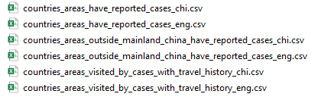
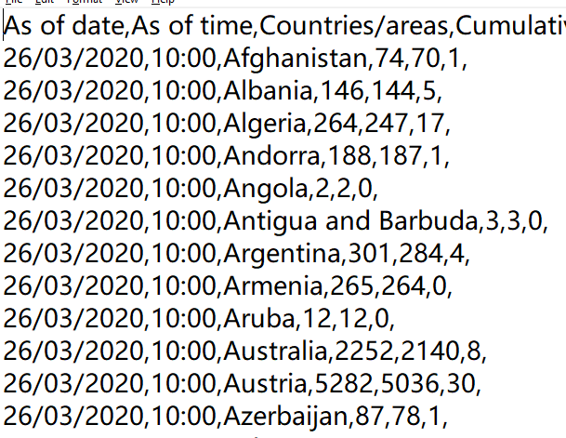
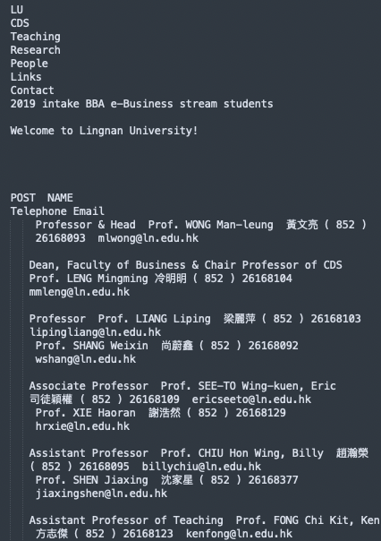
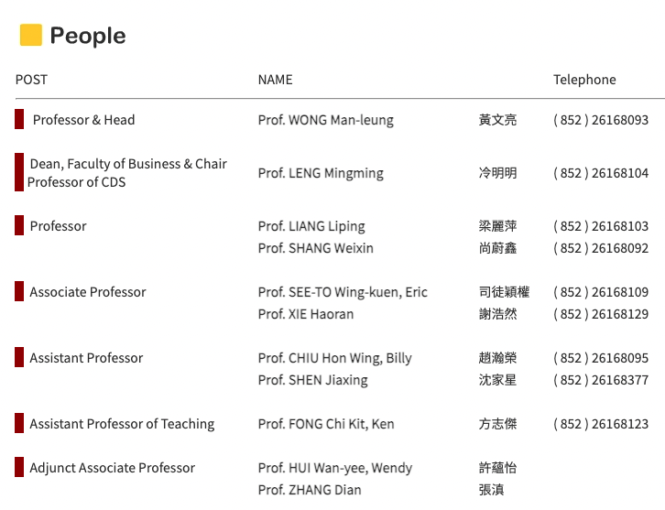
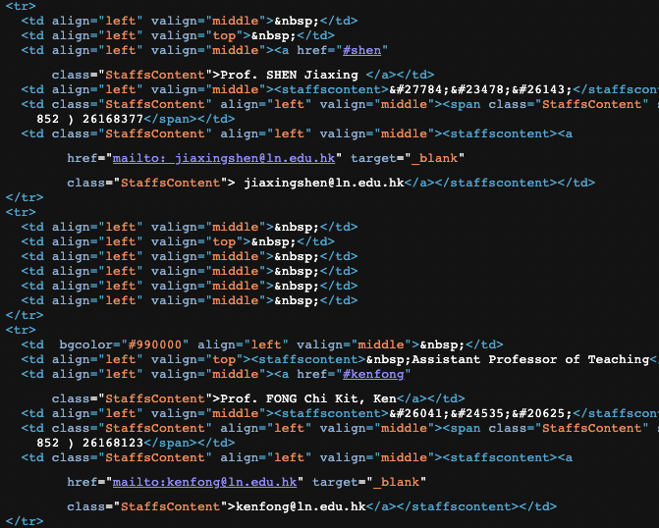
Text Files are Everywhere
csv data files
Web pages

Slide 66
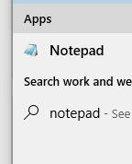
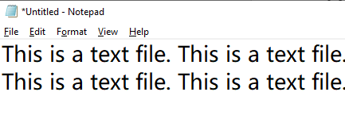
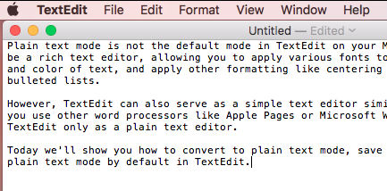

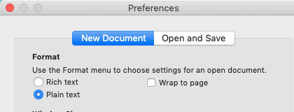
Create a Text File
Use Text Editor
  Windows: Notepad
  MacOS: TextEdit
    Preferences → Plain Text

Slide 67
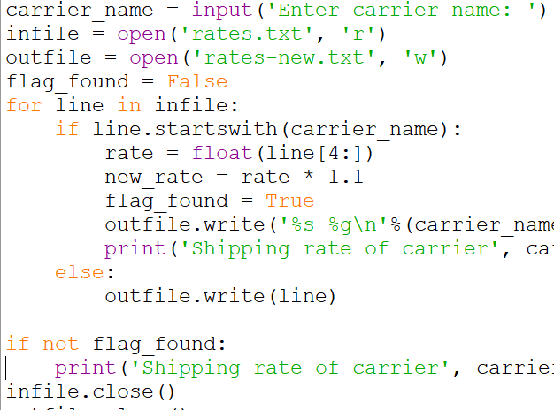
Opening a File
Before we can read the contents of the file, we must tell Python which file we are going to work with and what we will be doing with the file
This is done with the open() function
open() returns a “file handle” - a variable used to perform operations on the file
Similar to “File -> Open” in a Word Processor

Slide 68
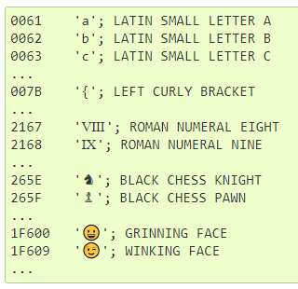
Using open()
fhand = open('mbox.txt', ‘r’, encoding=‘utf-8)
  handle = open(filename, mode)
  open() returns a handle used to manipulate the file
  filename is a string
  mode is optional and should be
    'r' if we are planning to read the file and
    'w' if we are going to write to the file
  encoding is optional to define how texts are encoded
Encoding: Unicode standard

Slide 69
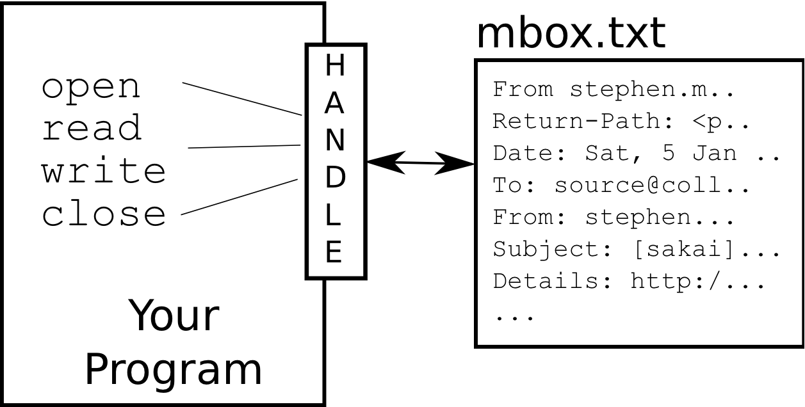
What is a Handle?
>>> fhand = open('mbox.txt')
>>> print(fhand)
<_io.TextIOWrapper name='mbox.txt' mode='r' encoding='UTF-8'>
The file handle is not the actual data contained in the file
It is a "handle" (interface) that we can use to read data.
You are given a handle if the requested file exists and you have the proper permissions to read the file.

Slide 70
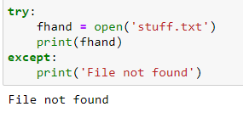
When Files are Missing
If the file does not exist, open will fail with a traceback and you will not get a handle to access the contents of the file:
>>> fhand = open('stuff.txt')
Traceback (most recent call last):
File "<stdin>", line 1, in <module>
FileNotFoundError: [Errno 2] No such file or directory: 'stuff.txt'
We can use try and except to deal more gracefully with the situation where we attempt to open a file that does not exist

Slide 71
The newline Character
We use a special (escape) character called the “newline” to indicate when a line ends
We represent it as \n in strings
Newline is still one character - not two
>>> stuff = 'Hello\nWorld!'
>>> stuff
'Hello\nWorld!'
>>> print(stuff)
Hello
World!
>>> stuff = 'X\nY'
>>> print(stuff)
X
Y
>>> len(stuff)
3

Slide 72
File Processing
A text file can be thought of as a sequence of lines
From stephen.marquard@uct.ac.za Sat Jan 5 09:14:16 2008
Return-Path: <postmaster@collab.sakaiproject.org>
Date: Sat, 5 Jan 2008 09:12:18 -0500
To: source@collab.sakaiproject.org
From: stephen.marquard@uct.ac.za
Subject: [sakai] svn commit: r39772 - content/branches/
Details: http://source.sakaiproject.org/viewsvn/?view=rev&rev=39772

Slide 73
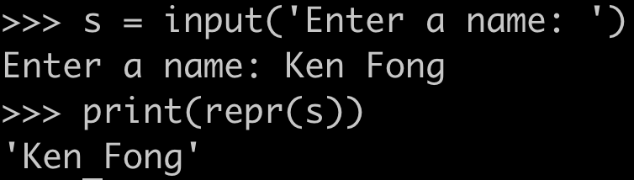
File Processing
A text file has newlines at the end of each line
From stephen.marquard@uct.ac.za Sat Jan 5 09:14:16 2008\n
Return-Path: <postmaster@collab.sakaiproject.org>\n
Date: Sat, 5 Jan 2008 09:12:18 -0500\n
To: source@collab.sakaiproject.org\n
From: stephen.marquard@uct.ac.za\n
Subject: [sakai] svn commit: r39772 - content/branches/\n
\n
Details: http://source.sakaiproject.org/viewsvn/?view=rev&rev=39772\n
Note: input function returns a string without the newline at the end:
repr() is a built-in function to return a string representation of an object

Slide 74
Summary of Files
Secondary storage, e.g., hard disk
A file can be treated as is a sequence of lines
Opening a file - file handle
  file_handle=open(file_name,’r’)
Closing a file
  File_handle.close()
File structure - newline character
  \n
  included when reading from a file (but not included from “input”)

Slide 75
Reading Files

Slide 76
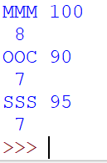
File Handle as a Sequence
A file handle open for read can be treated as a sequence of strings where each line in the file is a string in the sequence
  Each line includes ‘\n’ at the end
We can use the for statement to iterate through the sequence of strings of the file
file = open('rates.txt', 'r')
lowest_rate = None
lowest_carrier = None
for line in file:
print(line, len(line))

Slide 77
Counting Lines in a File
Open a file read-only
Use a for loop to read each line
Count the lines and print out the number of lines
fhand = open('mbox.txt', 'r')
count = 0
for line in fhand:
count = count + 1
print('Line Count:', count)
Line Count: 1910

Slide 78
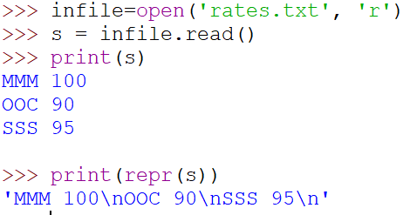
Reading the Whole File
We can read the whole file (newlines and all) into a single string
>>> fhand = open('mbox.txt')
>>> inp = fhand.read()
>>> print(len(inp))
94626
>>> print(inp[:20])
From stephen.marquar

Slide 79
Searching Through a File
Parsing-Extracting:
We can put an if statement in our for loop to only print lines that meet some criteria
fhand = open('mbox.txt')
for line in fhand:
if line.startswith('From:') :
print(line)

Slide 80
OOPS!
What are all these blank lines doing here?
From: stephen.marquard@uct.ac.za
From: louis@media.berkeley.edu
From: zqian@umich.edu
From: rjlowe@iupui.edu
...

Slide 81
OOPS!
What are all these blank lines doing here?
From: stephen.marquard@uct.ac.za\n
\n
From: louis@media.berkeley.edu\n
\n
From: zqian@umich.edu\n
\n
From: rjlowe@iupui.edu\n
\n
...
Each line from the file has a newline at the end
The print statement adds a newline to each line

Slide 82
Searching Through a File (fixed)
We can strip the whitespace (including \n) from the right-hand side of the string using rstrip() from the string library
The newline \n is considered “white space” and is stripped
fhand = open('mbox.txt')
for line in fhand:
line = line.rstrip()
if line.startswith('From:') :
print(line)
From: stephen.marquard@uct.ac.za
From: louis@media.berkeley.edu
From: zqian@umich.edu
From: rjlowe@iupui.edu
....

Slide 83
Skipping with continue
We can conveniently skip a line by using the continue statement
fhand = open('mbox.txt')
for line in fhand:
line = line.rstrip()
if not line.startswith('From:') :
continue
print(line)
How to find lines that contain Ken’s emails (kenfong@ln.edu.hk)?

Slide 84
Using in to Select Lines
We can look for a string anywhere in a line as our selection criteria
fhand = open('mbox.txt')
for line in fhand:
line = line.rstrip()
if not '@uct.ac.za' in line :
continue
print(line)
From stephen.marquard@uct.ac.za Sat Jan 5 09:14:16 2008
X-Authentication-Warning: set sender to stephen.marquard@uct.ac.za using –f
From: stephen.marquard@uct.ac.za
Author: stephen.marquard@uct.ac.za
From david.horwitz@uct.ac.za Fri Jan 4 07:02:32 2008
X-Authentication-Warning: set sender to david.horwitz@uct.ac.za using -f...

Slide 85
Using find to Select Lines
We can use find to determine whether the search string is anywhere in the line, using it as our selection criteria
fhand = open('mbox.txt')
for line in fhand:
line = line.rstrip()
if line.find('@uct.ac.za') == -1:
continue
print(line)
From stephen.marquard@uct.ac.za Sat Jan 5 09:14:16 2008
X-Authentication-Warning: set sender to stephen.marquard@uct.ac.za using –f
From: stephen.marquard@uct.ac.za
Author: stephen.marquard@uct.ac.za
From david.horwitz@uct.ac.za Fri Jan 4 07:02:32 2008
X-Authentication-Warning: set sender to david.horwitz@uct.ac.za using -f...

Slide 86
Prompt for File Name
fname = input('Enter the file name: ')
fhand = open(fname)
count = 0
for line in fhand:
if line.startswith('Subject:') :
count = count + 1
print('There were', count, 'subject lines in', fname)
Enter the file name: mbox-short.txt
There were 27 subject lines in mbox-short.txt

Slide 87
Bad File Names
Enter the file name: mbox.txt
There were 1797 subject lines in mbox.txt
Enter the file name: na na boo boo
File cannot be opened: na na boo boo
fname = input('Enter the file name: ')
try:
fhand = open(fname)
except:
print('File cannot be opened:', fname)
exit() #terminates the program
count = 0
for line in fhand:
if line.startswith('Subject:') :
count = count + 1
print('There were', count, 'subject lines in', fname)
We can use try and except to deal more gracefully with the situation where we attempt to open a file that does not exist

Slide 88
Summary of Files
Secondary storage, e.g., hard disk
A file can be treated as is a sequence of lines
Opening a file - file handle
  file_handle=open(file_name,’r’)
Closing a file
  File_handle.close()
File structure - newline character
  \n
  included when reading from a file (but not included from “input”)
Reading a file line by line with a
for loop
  for line in file_handle:
Read the whole file: read()
Searching for lines
  Use in, find, startswith, etc.
Reading file names
Dealing with bad files
  try and except

Slide 89
Writing and Closing Files

Slide 90
Writing and Closing Files
To write a file, open it with mode "w" as a second parameter:
The write method puts data into the file, returning the number of characters written.
  When write called again, it adds new data to the end, without adding “\n” at the end.
  The print statement automatically appends a newline, but the write method does not add the newline automatically.
When you are done writing and reading a file, you are suggested to close the file
  >>> fout = open('output.txt', 'w')
  >>> print(fout)
  <_io.TextIOWrapper name='output.txt' mode='w' encoding='cp1252’>
  >>> line1 = “Hello, Hong Kong!\n"
  >>> fout.write(line1)
  18
  >>> fout.close()

Slide 91
Summary of Files
Secondary storage, e.g., hard disk
A file can be treated as is a sequence of lines
Opening a file - file handle
  file_handle=open(file_name,’r’)
Closing a file
  File_handle.close()
File structure - newline character
  \n
  included when reading from a file (but not included from “input”)
Reading a file line by line with a
for loop
  for line in file_handle:
Read the whole file: read()
Searching for lines
  Use in, find, startswith, etc.
Reading file names
Dealing with bad files
  try and except
Writing files
  file_handle=open(file_name,’w’)
  file_handle.write(): \n not added
Close files
  file_handle.close()

Slide 92
Debugging for white spaces by using repr()

Slide 93
Debugging for white spaces by using repr()
When you are reading and writing files, you might run into problems with whitespace.
These errors can be hard to debug because spaces, tabs, and newlines are normally invisible
  Some systems use \n and some use \r or both to represent a newline
The built-in function repr() can help.
  It takes any object as an argument and returns a string representation of the object.
>>> s = '1 2\t 3\n 4'
>>> print(s)
1 2 3
4
>>> print(repr(s))
'1 2\t 3\n 4'

Slide 94
Summary of Files
Secondary storage, e.g., hard disk
A file can be treated as is a sequence of lines
Opening a file - file handle
  file_handle=open(file_name,’r’)
Closing a file
  File_handle.close()
File structure - newline character
  \n
  included when reading from a file (but not included from “input”)
Reading a file line by line with a
for loop
  for line in file_handle:
Read the whole file: read()
Searching for lines
  Use in, find, startswith, etc.
Reading file names
Dealing with bad files
  try and except
Writing files
  file_handle=open(file_name,’w’)
  file_handle.write() : \n not added
Close files
  file_handle.close()
Debugging white spaces: repr()

Slide 95
Objectives of Tutorial 6
Understand why strings and files are used in coding
Be able to understand and use strings and their basic operations and functions
Be able to understand and use files to read and write data
Be able to use dir() and help() to understand how to use built-in functions for strings and files
Be able to understand and apply the parsing-extracting pattern in coding for text processing

Slide 96
Guidelines for Tutorial 6
Follow the tutorial instruction to launch Python IDLE through Anaconda Navigation, and download files from Moodle for Tutorial 5
Complete Parts 1-4 led by the lecturer
Complete Part 5 independently
Follow Section 3 of the tutorial instruction to save the report and zip the report folder.
  The zip file is named as CDS1001T6Report{your student_id}.zip
Submit the zip file of the report folder to the Moodle. The submission due date is 7 NOV 23:55

Slide 97
Reminders
Submit your zip file for tutorial 5 by 24 OCT 23:55
Submit your zip file for tutorial 6 by 7 NOV 23:55
Feel free to contact the instructor if you have problems
  By email: kenfong@ln.edu.hk

