Slide 1
Review of Week 8: Lists
Programming = Algorithm + Data Structure
List is a sequence of any values
Access element of list using [index]
List is mutable, unlike string
Two ways to traverse a list using in, len(), range()
Simplifying a for loop using range()
List Operations: +, * , in, not in
Slice of a list: [start:end], [start:], [:end]
Methods for List
  list(), append(), extend(), pop(), del
Built-In functions for list
  max, min, sum, len
List and string:
  Similarity: sequence; Difference: mutable and immutable
  String → List: split(); Double Split Pattern
  List → String: join()
Objects, values, references, aliasing
Passing list as reference to a function
Debugging for lists:
    distinguish between modification and creation of an object
    check usage of methods and functions
    make copies
    check input file

Slide 2
Review of Week 9: Dictionary
Dictionary vs List
Dictionary Basics
  definition, value, assignment, in operator, len function, pop method, del operator
Dictionary as a set of counters
  use of get method() to handle counting pattern
Traversing dictionary for their keys, values, and items
  Use of methods keys(), values(), and items()
Advanced text parsing before using dictionary
  use of translate and maketrans methods of a string
Debugging for large data sets
Notes:
### count is a dictionary variable. What does sorted(count) do?
### count[name] indicates the number of times that a string name appears in a text. In the for loop that computes count[name], how shall we update count[name]?
### How to debug for large data sets?

Slide 3
Review of Week 9: Tuples
Tuples
  Like list, but Immutable
  Use as items or keys of dictionaries
  Assignment: (x,y) = (‘a’,’b’)
Comparing Tuples
Using tuples for soring a dictionary
  DSU Pattern
Comparing Strings, Lists, and Tuples
Debugging
  Shape Errors for compound data structure
  4R Debugging Strategy

Slide 4
The top 10 most common words
fhand = open('romeo.txt')
counts = {}
for line in fhand:
words = line.split()
for word in words:
counts[word] = counts.get(word, 0) + 1
lst = []
for key, val in counts.items():
newtup = (val, key)
lst.append(newtup)
lst = sorted(lst, reverse=True)
for val, key in lst[:10] :
print(key, val)
A Pattern of Data Processing: DSU
Decorate
  build a list of tuples with one or more sort keys preceding the elements from the sequence
Sort
  sort the list
Undercorate
  Extract the sorted elements of the sequence.

Slide 5
CDS1001 – Working with Excel SpreadSheets
The session will be recorded!

Slide 6
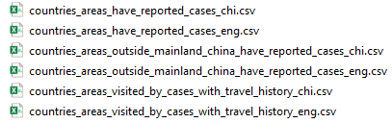
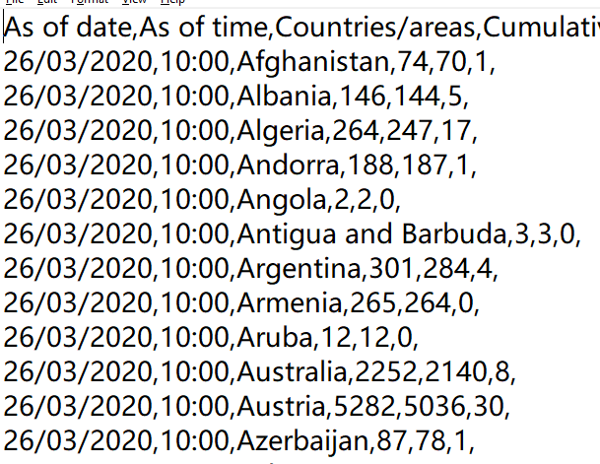

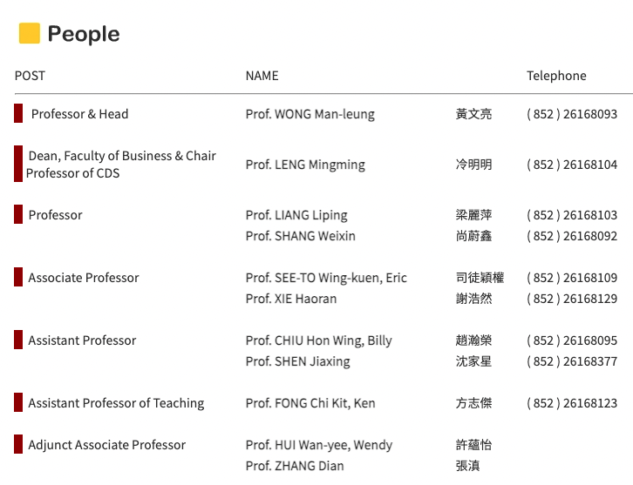
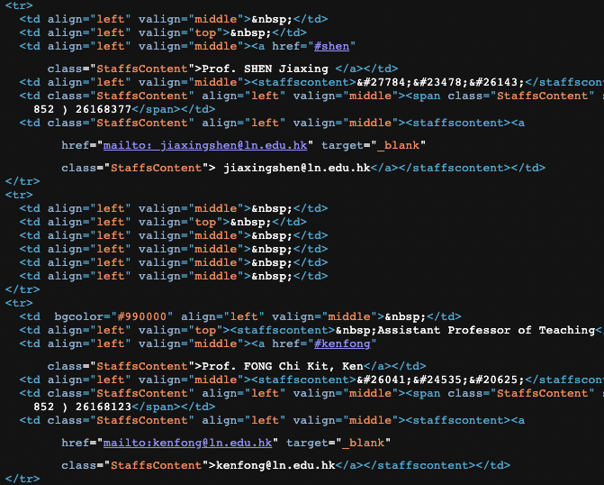
Text Files are Everywhere
csv data files
Web pages

Slide 7
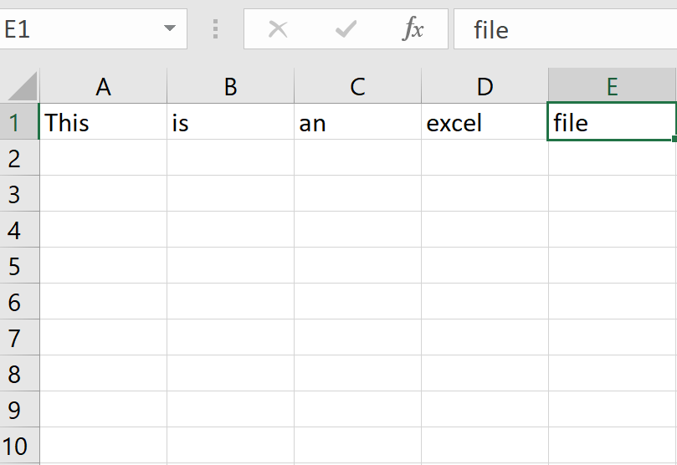
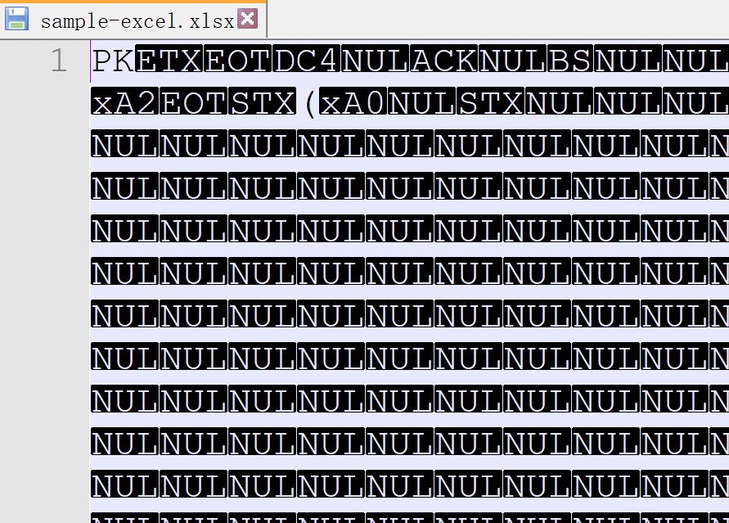
Other File Formats Widely Used
Excel File
Word File
Power Point File
PDF File
Pictures
Videos
An excel file opened in Excel
An excel file opened in a text editor
How to automate processing these files (open, read, write, etc.)?
Notes:
### What are other file formats?

Slide 8
Case study: Shipping rates analysis

Slide 9
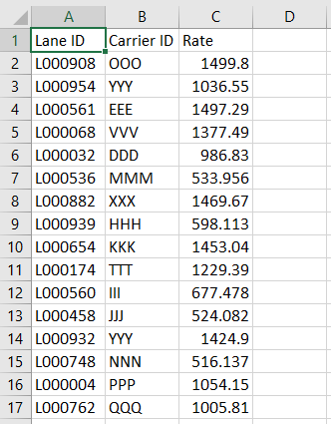
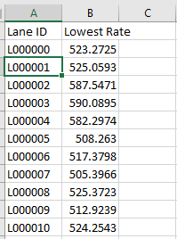
Lowest Shipping Rates for Multiple lanes: Problem Description
FE receives shipping rates from multiple carriers for multiple lanes, and store the rates in an excel file (rates.xlsx) with three columns
  Lane’s ID consists of ‘L’ followed by six digits: L123456
  Carrier’s ID consists of letters: MMM, OOCL
  Shipping rate is a float number
FE wants to obtain an excel file (lowest_rates.xlsx) that summarizes the lowest shipping rate for each lane
rates.xlsx
How to do it manually through Excel?
lowest_rate.xlsx
Notes:
Sort by lanes
Take min for each lane
### How to do it manually through Excel?
Boring and time consuming

Slide 10
Lowest Shipping Rates for Multiple lanes: How to accomplish this task by processing text files?
Algorithm
Copy the input Excel file to a text input file
Apply a python code to process the text input File, and generate an output text file
  For each line of the input text file:
    Parse: get lane_id, carrier_id, and rate - How?
    Update: if rate is lower than the current lowest shipping rate of lane_id, then update the current lowest shipping of lane_id
  Write the lowest shipping rates into an output text file
Copy the output text file to an output Excel File
Data Structure
How to keep the current lowest shipping rate for each lane_id?
  Use a “dictionary” with an index being the string of lane_id
  E.g. min_rate[‘L000000’], min_rate[‘‘L000001’], …
Notes:
### How to keep the current lowest shipping rate for each lane_id?

Slide 11
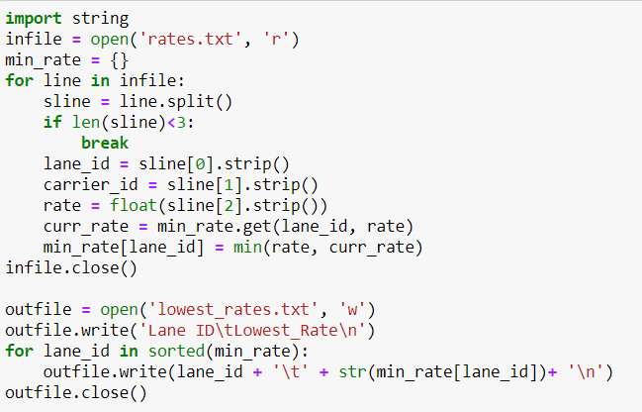
Code for Text File

Slide 12
Lowest Shipping Rates for Multiple lanes: Excel
Algorithm
For each line of the input excel file:
  Parse: get lane_id, carrier_id, and rate - How?
  Update: if rate is lower than the current lowest shipping rate of lane_id, then update the current lowest shipping of lane_id
Write the lowest shipping rates into the output excel file
  How?
Data Structure
How to keep the current lowest shipping rate for each lane_id?
  Use a “dictionary” with an index being the string of lane_id
  E.g. min_rate[‘L000000’], min_rate[‘‘L000001’], …
Notes:
Find a proper package (module)

Slide 13
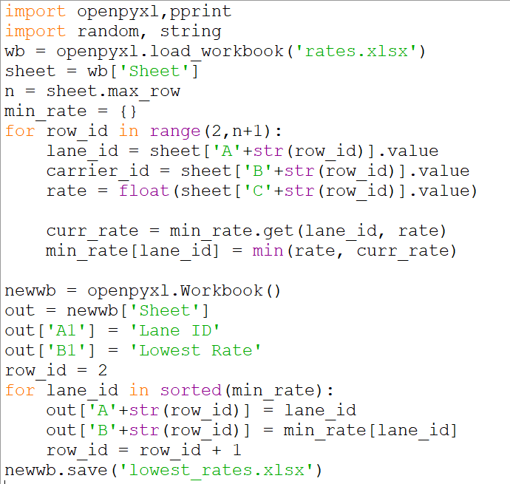
Lowest Shipping Rates for Multiple lanes: Code for Excel
Import openpyxl package
Wb and newwb are objects of excel workbooks for the input and output files
sheet and out are objects of spreadsheets of wb and newwb
wb[‘sheet’] is a spreadsheet of wb named “sheet”
out[‘A1’] is a cell of worksheet out

Slide 14
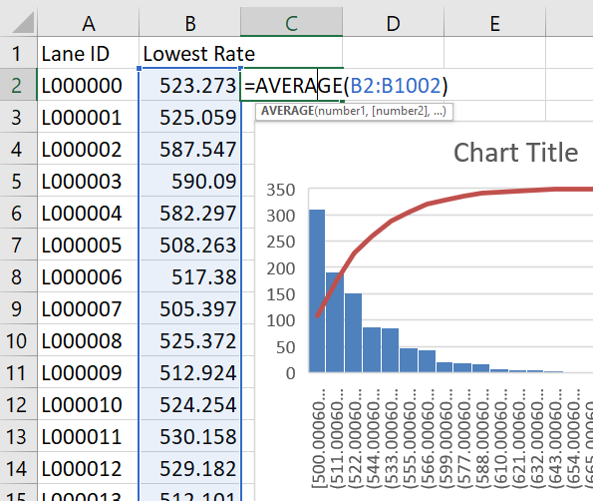
Excel
Excel is a popular and powerful spreadsheet application for Windows
Spreadsheets are commonly used in business data analysis:
  organize information into two-dimensional data structures,
  perform calculations with formulas,
  produce output as charts
Excel’s .xlsx file format for spreadsheets can be processed by
  MS Excel, and
  Free alternatives, such s LibreOffice Calc and OpenOffice Calc work, in Windows, Linux, and MacOS

Slide 15
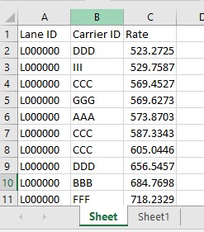
Excel Documents: Basic Concepts
Workbook
  an Excel spreadsheet document
Sheet
  an organization of two-dimensional data
  active sheet: currently using or last viewed
Column
  ranges from 1 to 1048576
Row
  from A to XFD - 1 to 16384.
Cell
  A box at a particular column and row of a sheet
workbook
column
cell
row
sheets

Slide 16
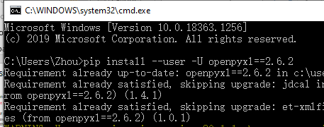
openpyxl Module
The openpyxl module allows your Python programs to read and modify Excel spreadsheet files.
  Automate the processing of excel files
Examples
  Copying, filtering, updating, comparing
Install
  In command prompt of windows or terminal of linux or macOS, type:
  pip install --user -U openpyxl==2.6.2
https://openpyxl.readthedocs.org/

Slide 17
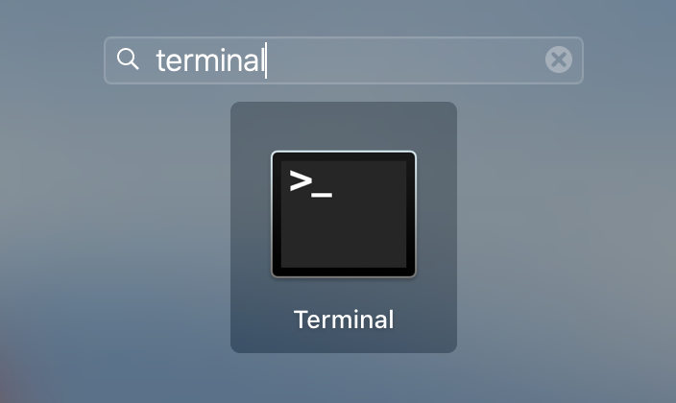

Installation of openpyxl Module
For MacOS
  In launchpad, enter terminal in search box to open terminal
  In terminal, type:
  pip install openpyxl
For Windows
  In search box of windows, enter cmd to open command prompt
  In command prompt, type:
  pip install openpyxl

Slide 18
Summary
Excel document: workbook, sheet, column, row, cell
openpyxl module: installation

Slide 19
OPENING and Reading Excel Documents

Slide 20
Opening and Reading Excel Documents (1)
Opening Excel Document with OpenPyXL
  Import openpyxl module
  Use openpyxl.load_workbook() function, which takes a string of filename as parameter and returns a value of the workbook data type
  Workbook object is similar to a File object for text files
>>> import openpyxl
>>> wb = openpyxl.load_workbook('example.xlsx')
>>> type(wb)
<class 'openpyxl.workbook.workbook.Workbook'>

Slide 21
Opening and Reading Excel Documents (2)
Getting Sheets from the Workbook
  sheetnames attribute of the Workbook object: Get a list of all the sheet names in the workbook
  square brackets with the sheet name string: Get a Worksheet object for the sheet
  Active attribute of a Workbook object: Get the workbook’s active sheet.
  Title attribute of a Worksheet object: Get the name of the worksheet.
>>> import openpyxl
>>> wb = openpyxl.load_workbook('example.xlsx')
>>> wb.sheetnames # The workbook's sheets' names.
['Sheet1', 'Sheet2', 'Sheet3']
>>> sheet3 = wb['Sheet3'] # Get a sheet from the workbook.
>>> sheet3
<Worksheet "Sheet3">
>>> type(sheet3)
<class 'openpyxl.worksheet.worksheet.Worksheet'>
>>> sheet3.title # Get the sheet's title as a string.
'Sheet3'
>>> sheet = wb.active # Get the active sheet.
>>> sheet
<Worksheet "Sheet1">

Slide 22
Opening and Reading Excel Documents (3)
Getting Cells from the Sheets
  Access a Cell object by its name.
    Eg. sheet['C1']
  Cell object has attributes, such as value, row, column, and coordinate
    Row are represented by numbers
    Columns are represented by letters or numbers
    The first row or column integer is 1, not 0.
  Access a cell object by cell() method
    Eg. sheet.cell(row=1, column=3)
  Worksheet object has max_column and max_row attributes
>>> c = sheet['B1']
>>> c.value
'Apples’
>>> 'Row %s, Column %s is %s' % (c.row, c.column, c.value)
'Row 1, Column B is Apples'
>>> 'Cell %s is %s' % (c.coordinate, c.value)
'Cell B1 is Apples’
>>> sheet.cell(row=1, column=2).value
'Apples’
>>> sheet.max_row
7
>>> sheet.max_column
3
Notes:
Use like a dictionary

Slide 23
Opening and Reading Excel Documents (4)
Getting Rows and Columns from the Sheets
  You can slice worksheet objects [Start Cell Name: End Cell Name] to get all the Cell objects in a row, column, or rectangular area of the spreadsheet.
    A sequence of rows of cells
  Then, you can loop over all the cells in the slice.
>>> sheet = wb['Sheet1']
>>> tuple(sheet['A1':'C3']) # Get all cells from A1 to C3.
((<Cell 'Sheet1'.A1>, <Cell 'Sheet1'.B1>, <Cell 'Sheet1'.C1>), (<Cell
'Sheet1'.A2>, <Cell 'Sheet1'.B2>, <Cell 'Sheet1'.C2>), (<Cell 'Sheet1'.A3>,
<Cell 'Sheet1'.B3>, <Cell 'Sheet1'.C3>))
>>> for rowOfCellObjects in sheet['A1':'C3']:
... for cellObj in rowOfCellObjects:
... print(cellObj.coordinate, cellObj.value)
Notes:
### Which data structure is similar to the Sheet class?
Dictionary?
List?
Keys are ordered

Slide 24
Opening and Reading Excel Documents (4)
Getting Rows and Columns from the Sheets
  rows and columns attribute of a worksheet object: access the values of cells in a particular row or column
    These attributes must be converted to lists with the list() function before you access them
    They can be then iterated over through for loop
>>> sheet = wb.active
>>> list(sheet.columns)[1] # Get second column's cells.
(<Cell 'Sheet1'.B1>, <Cell 'Sheet1'.B2>, <Cell 'Sheet1'.B3>, <Cell 'Sheet1'.
B4>, <Cell 'Sheet1'.B5>, <Cell 'Sheet1'.B6>, <Cell 'Sheet1'.B7>)
>>> for cellObj in list(sheet.columns)[1]:
print(cellObj.value)

Slide 25
Opening and Reading Excel Documents (5)
Summary and Tutorial (2.1)
  Install and import the openpyxl module
  Open and get a Workbook object, by openpyxl.load_workbook()
  Use the active or sheetnames attributes
  Get a Worksheet object
  Use indexing or the cell() sheet method with row and column keyword arguments
  Get a Cell object
  Read a Cell object’s value attributes
  Get lists of cells by slices, columns, and rows

Slide 26
Summary
Excel document: workbook, sheet, column, row, cell
openpyxl module: installation
Opening and reading excel documents

Slide 27
Writing Excel Documents

Slide 28
Writing Excel Documents
Creating and Saving Excel Documents
  Call the openpyxl.Workbook()
  function to create a new, blank Workbook object.
  The workbook will start off with a single sheet named Sheet.
  The spreadsheet file will not be saved until you call the save() workbook method.
>>> import openpyxl
>>> wb = openpyxl.Workbook()
>>> wb.sheetnames['Sheet']
>>> sheet = wb.active
>>> sheet.title
'Sheet'
>>> sheet.title = 'Spam Bacon Eggs Sheet' # Change title.
>>> wb.sheetnames
['Spam Bacon Eggs Sheet’]
>>> wb.save('example_copy.xlsx') # Save the workbook.

Slide 29
Writing Excel Documents
Creating and Removing Sheets
  Sheets can be added to and removed from a workbook with the create_sheet() method and del operator.
  The create_sheet() method returns a new Worksheet object named SheetX,
    which by default is set to be the last sheet in the workbook.
  del operator is like deleting a dictionary object
>>> wb.create_sheet()
<Worksheet "Sheet1">
>>> wb.create_sheet(index=0, title='First Sheet')
<Worksheet "First Sheet">
>>> wb.sheetnames
['First Sheet', 'Sheet', 'Sheet1']
>>> wb.create_sheet(index=2, title='Middle Sheet')
<Worksheet "Middle Sheet">
>>> wb.sheetnames
['First Sheet', 'Sheet', 'Middle Sheet', 'Sheet1’]
>>> del wb['Middle Sheet']
>>> del wb['Sheet1']
>>> wb.sheetnames
['First Sheet', 'Sheet']

Slide 30
Writing Excel Documents
Writing Values to Cells
  Writing values to cells is much like writing values to keys in a dictionary.
  Remember to call the save() method to save the changes after making changes of the workbook
>>> import openpyxl
>>> wb = openpyxl.Workbook()
>>> sheet = wb['Sheet']
>>> sheet['A1'] = 'Hello, world!' # Edit the cell's value.
>>> sheet['A1'].value
'Hello, world!’
>>> wb.save(‘output.xlsx') # Save the workbook.

Slide 31
Summary
Excel document: workbook, sheet, column, row, cell
openpyxl module: installation
Opening and reading excel documents
Writing excel documents
  Creating and removing worksheets
  Writing values, and save excel documents

Slide 32
Manipulating Excel Documents

Slide 33
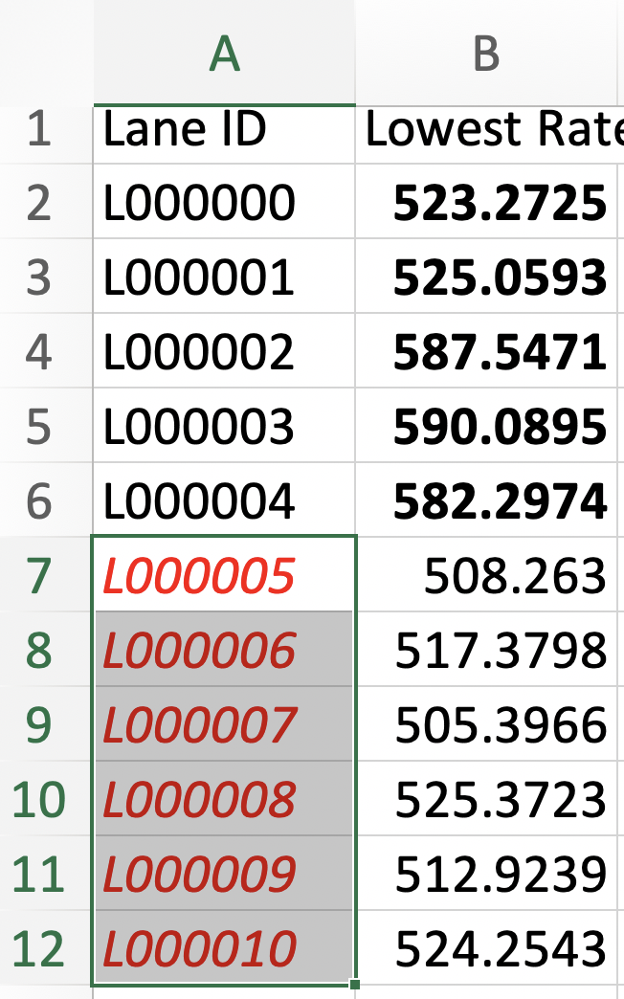
Setting the Font Style of Cells (1)
Styling certain cells, rows, or columns can help you emphasize important areas in your spreadsheet
  E.g., apply bold text to the potato, garlic, and parsnip rows.
  E.g., italicize every row with a cost per pound greater than $5

Slide 34
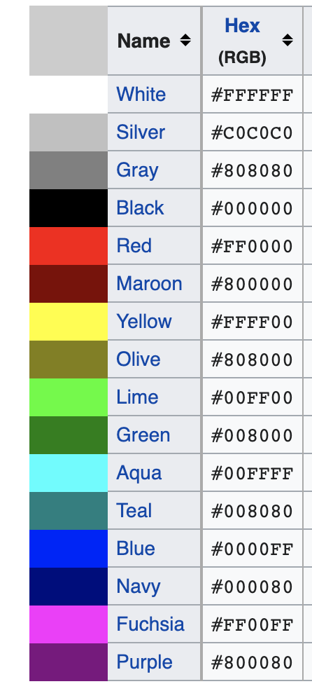
Setting the Font Style of Cells (2)
To customize font styles in cells, import the Font() function from the openpyxl.styles module
  E.g., Font(name=’Calibri’, size=25, bold=True, italic=True)
  help(openpyxl.styles.Font())
Assign a Font object to the font attribute of a sheet object
>>> from openpyxl.styles import Font
>>> italic12redFont = Font(size=12, italic=True, color=‘FF0000’)
>>> Sheet['A1'].font = italic12redFont
FF00000 is for red: see https://en.wikipedia.org/wiki/Web_colors#X11_color_names

Slide 35
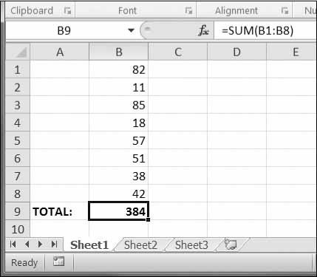
Formulas
Excel formulas, which begin with an equal sign, can configure cells to contain values calculated from other cells.
An Excel formula is set just like any other text value in a cell.
Python code is more readable
Read value of formular by setting data_only when reading workbook
>>> sheet['B9'] = '=SUM(B1:B8)’
>>> sheet['B9’] = ‘=IFERROR(TRIM(IF(LEN(VLOOKUP(F7, Sheet2!$A$1:$B$10000, 2, FALSE))>0,SUBSTITUTE(VLOOKUP(F7, Sheet2!$A$1:$B$10000, 2, FALSE), " ", ""),"")), "")’
>>> wb = load_workbook(filename = 'empty_book.xlsx’, data_only=True)
>>> print(wb[‘Sheet1’][B9])
384

Slide 36
Adjusting Rows and Columns (1)
Setting Row Height and Column Width
  Set row_dimensions and column_dimensions attributes of Worksheet objects
  row_dimensions and column_dimensions are dictionary-like values
  row_dimensions contains RowDimension objects and column_dimensions contains ColumnDimension
  objects
  RowDimension objects have attribute height, and ColumnDimension objects have attribute width
  Columns with widths of 0 or rows with heights of 0 are hidden from the user.
>>> sheet.row_dimensions[1].height = 70
>>> sheet.column_dimensions['B'].width = 20
Notes:
In Excel, adjusting the sizes of rows and columns is as easy as clicking and dragging the edges of a row or column header.
Python is quicker to set a row or column’s size based on its cells’ contents or set sizes in a large number of spreadsheets

Slide 37
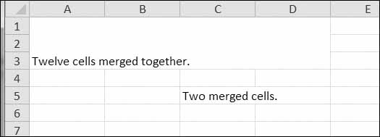
Adjusting Rows and Columns (2)
Merging and Unmerging Cells
  A rectangular area of cells can be merged into a single cell with the merge_cells() sheet method.
  set the value of the top-left cell of the merged group.
  To unmerge cells, call the unmerge_cells() sheet method.
>>> sheet.merge_cells('A1:D3') # Merge all these cells.
>>> sheet['A1'] = 'Twelve cells merged together.'
>>> sheet.merge_cells('C5:D5') # Merge these two cells.
>>> sheet['C5'] = 'Two merged cells.’
>>> sheet.unmerge_cells('A1:D3') # Split these cells up.
Notes:
In Excel, adjusting the sizes of rows and columns is as easy as clicking and dragging the edges of a row or column header.
Python is quicker to set a row or column’s size based on its cells’ contents or set sizes in a large number of spreadsheets

Slide 38
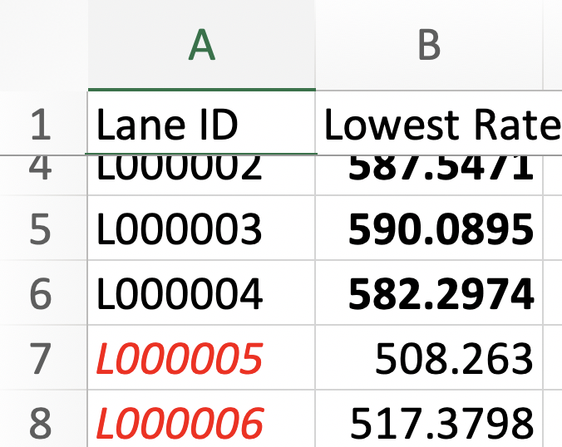
Adjusting Rows and Columns (3)
Freezing Panes
  For spreadsheets too large to be displayed all at once, it’s helpful to “freeze” a few of the top rows or leftmost columns onscreen.
  Frozen column or row headers, for example, are always visible to the user even as they scroll through the spreadsheet.

Slide 39
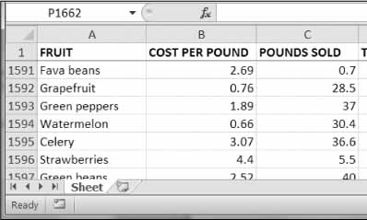
Adjusting Rows and Columns (3)
Freezing Panes
  Each Worksheet object has a freeze_panes attribute that can be set to a Cell object or a string of a cell’s coordinates.
  All rows above and all columns to the left of this cell will be frozen
  To unfreeze all panes, set freeze_panes to None or 'A1'
>>> sheet.freeze_panes = 'A2' # Freeze the rows above A2.
>>> wb.save('freezeExample.xlsx')

Slide 40
Charts
OpenPyXL supports creating bar, line, scatter, and pie charts using the data in a sheet’s cells.
  Create a Reference object from a rectangular selection of cells.
  Create a Series object by passing in the Reference object.
  Create a Chart object.
  Append the Series object to the Chart object.
  Add the Chart object to the Worksheet object, optionally specifying which cell should be the top-left corner of the chart.
Notes:
Create a Reference object from a rectangular selection of cells.
Create a Series object by passing in the Reference object.
Create a Chart object.
Append the Series object to the Chart object.
Add the Chart object to the Worksheet object, optionally specifying which cell should be the top-left corner of the chart.

Slide 41
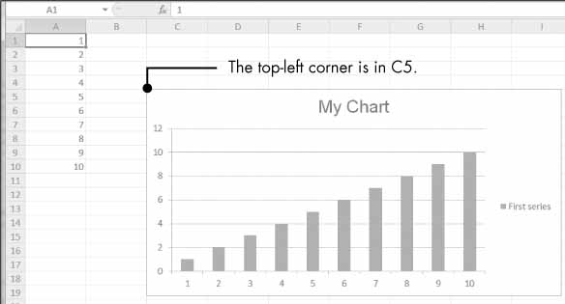
Worksheet obj
rectangular area of data
>>> refObj = openpyxl.chart.Reference(sheet, min_col=1, min_row=1, max_col=1, max_row=10)
>>> seriesObj = openpyxl.chart.Series(refObj, title='First series')
>>> chartObj = openpyxl.chart.BarChart()
>>> chartObj.title = 'My Chart'
>>> chartObj.append(seriesObj)
>>> sheet.add_chart(chartObj, 'C5')

Slide 42
Debugging for Large Datasets
Scale down the input
  If possible, starts with a small size of the dataset
  If there is an error,
    you can reduce the size to the smallest value that manifests the error, and
    then increase the size gradually as you find and correct errors
For example, if your program reads a large excel file but has an error
  Create a new file that only contains the first 10 lines of the large file
  Test your program on this smaller file
  If your program still has errors when reading this smaller file:
    check and correct the errors of your program
  Else add more lines to the new file, and go to test it again

Slide 43
Summary
Excel document: workbook, sheet, column, row, cell
openpyxl module: installation
Opening and reading excel documents
Writing excel documents
  Creating and removing worksheets
  Writing values, and save excel documents
Manipulating excel documents
  Font, formular, row & column adjustments, charts
Debugging for large excel files

Slide 44
CDS1001: Tutorial Exercises
Basics about Python Coding:
Tutorial 1: Coding environment for Python
Tutorial 2: Variables and simple data types
Tutorial 3: Conditions and flowcharts
Tutorial 4: Functions
Tutorial 5: Iterations
Tutorial 6: Strings and Files
Tutorial 7: Lists
  Deadline: 14 Nov 23:55
Tutorial 8: Dictionaries and Structured Data
  Deadline: 21 Nov 23:55
Basic Applications:
Tutorial 9: Working with Excel Files
  Deadline: 21 Nov 23:55
Tutorial 10: Acquiring and Exploring Data
  Deadline: 28 Nov 23:55
Individual Assignment:
Deadline: 23 Nov 23:59
Final Examination:
13 Dec 14:00 – 16:00 (SEKG03)

