Slide 1

Nested Loops 2
Mr. Lee WS

Slide 2
Objective
Prior knowledge,
  Students can dry run basic nested loop
After this lesson, students should be able to
  Implement basic for loops for nested loop

Slide 3
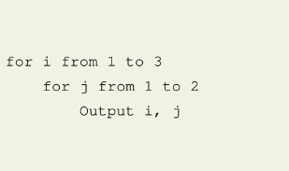
Previously
What is the output of the following Pseudocode?

Slide 4
Nearpod time!

Slide 5
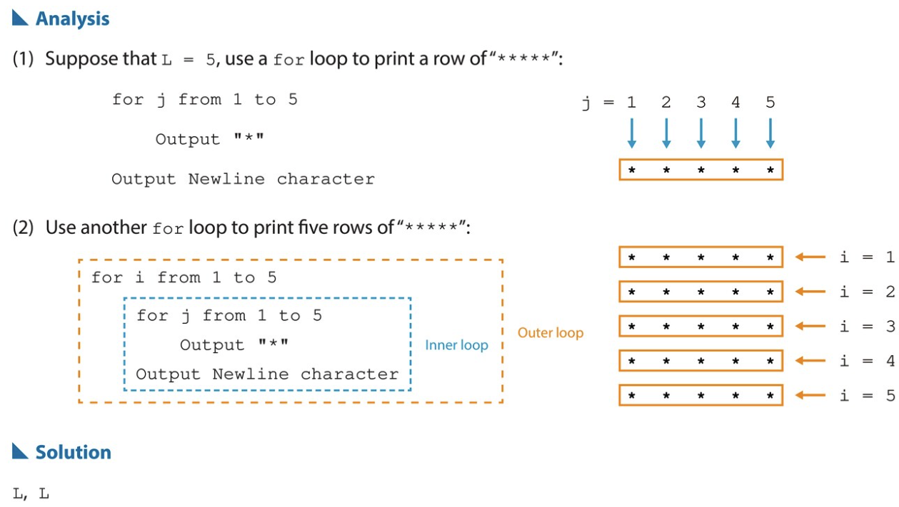
Solution

Slide 6
Challenging
Do you still remember how to find the sum of an array/list?
arr = [1, 2, 3, 4, 5]
i = 0 [why?]
sum = 0 [why?]
while i < 5
sum = sum + arr[i] [How?]
i = i + 1 [why?]

Slide 7
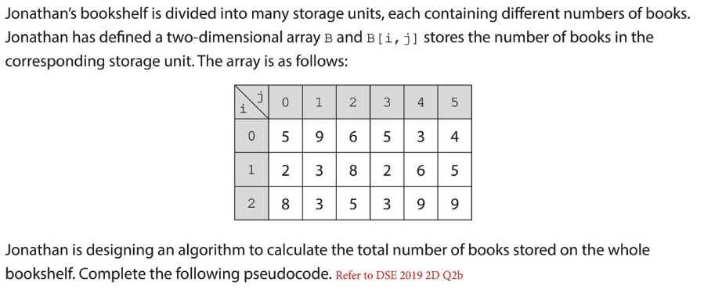
What about two-dimensional array?

Slide 8
Nearpod time!

Slide 9
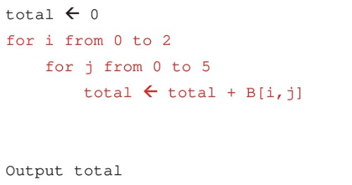
What about two-dimensional array?
Do remember!
Outer and Inner!!

Slide 10
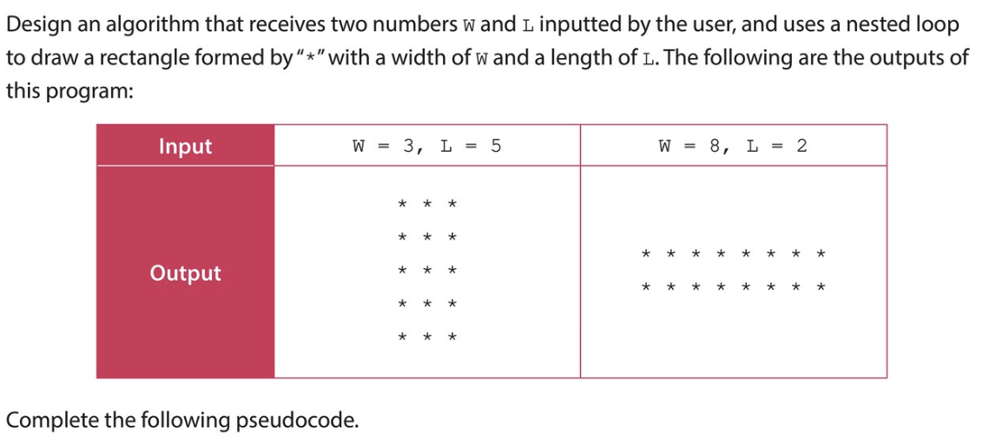
Summary
Dry-run nested loops
Guess the values in the for loops

Slide 11

Who’s he?

Slide 12
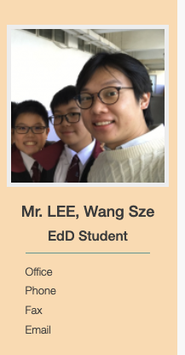
What are my challenges in recent years?

