Slide 1
Chapter 4:
Working with Chart and Pivot Table Objects

Slide 2
Chapter Objectives
After completing this chapter, you will be able to:
  create and manipulate Chart objects programmatically
  create frequency tables and draw histograms programmatically
  create and manipulate Pivot Table objects programmatically
  import data to and export data from Excel programmatically (Self-Study)

Slide 3
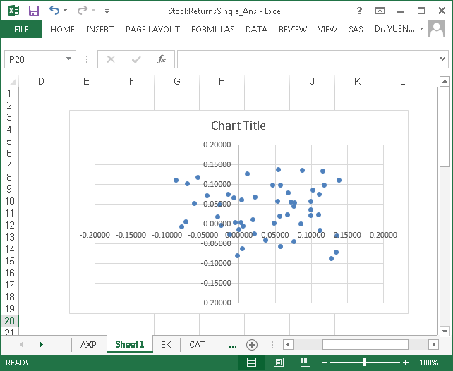
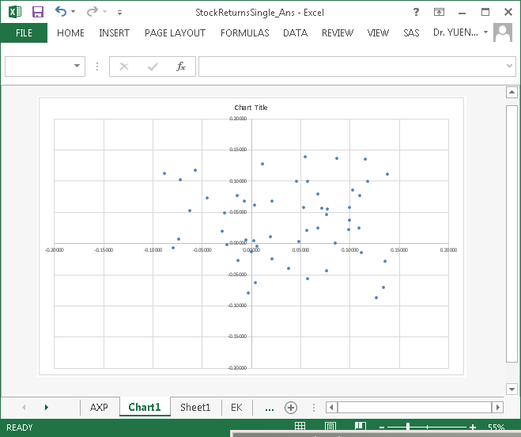
Working With Chart Objects
There are two types of Chart object, one is embedded in a worksheet, and the other is contained in a chart sheet.
Chart object embedded on a worksheet.
Chart object in chart sheet.

Slide 4
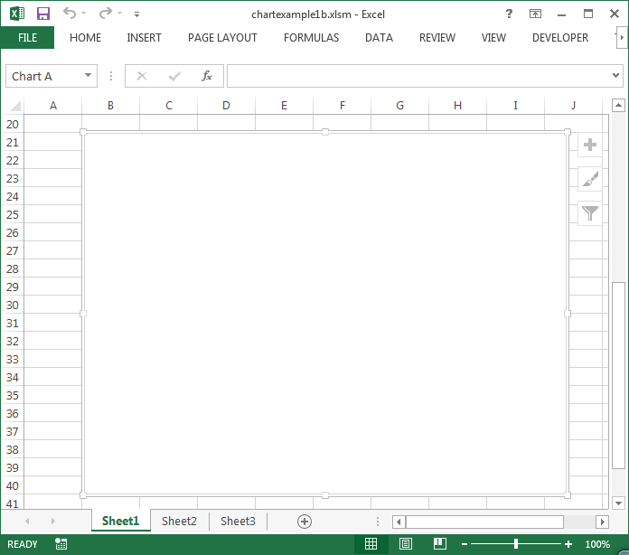
Working With Chart Objects
Embedded chart
  An embedded chart is contained in a container which floats on a worksheet.
    Any object embedded in a worksheet must be contained in a container. The container is called the Shape object.
      Shapes object is a collection of all kinds of objects
      (including charts, pictures,
      ActiveX controls, SmartArt, etc.)
      that can be drawn on the
      specified worksheet.
      An embedded chart is drawn inside
      the specified Shape object.

Slide 5
Working With Chart Objects
Use Macro Recorder to create the code
  Example 4.1: Open workbook ChartMacro1.xlsm. Select any cell outside the data region of Sheet1. Turn on the Macro Recorder. Then draw an embedded scatterplot of Y on X for Series A on the same worksheet.
    Steps:
      In Insert, click Scatter (X, Y).
      In Design, click Select Data. Select cells A2:B12 as the data range.
      In Design, click Add Chart Element | Axis Titles | Primary Horizontal. Then enter X.
      In Design, click Add Chart Element | Axis Titles | Primary Vertical. Then enter Y.
      Select the chart title. Then enter ‘Plot of Y on X’. Click any empty cell.
      Stop the Macro Recorder.
    Review the recorded code in the module.

Slide 6
Working With Chart Objects
Use Macro Recorder to create the code
  Example 4.1: (cont’d)
    Review the recorded code in the module.
      There are mainly three groups of statements.
        1. Create the chart shape (type of chart, chart location and size)
        2. Specify the data source (defined as a range of cells)
        3. Change the chart’s appearance, such as adding an x-axis title or a y-axis title, modifying the content of the chart title (the chart title is included by default), etc.
      Other statements are irrelevant and can be deleted.
    Note: The Macro Recorder created the two axes’ title statements incorrectly.

Slide 7
Creating An Embedded Chart Programmatically
First step: Create an embedded chart Shape object using the AddChart2 method of Shapes
  The syntax is:
    Wkbookref.Wkshtref.Shapes.AddChart2 _
    [Style:= numericvalue ,] xlChartType:= typeofchart, _
    [ Left:=leftpos, ] [Top:=toppos, ] [Width:=widithsize, ] [Height:= heightsize]
    Typeofchart includes xlBarClustered, xlColumnClustered, xlLine, xlPie, xlXYScatter, etc.
    The size and position of the embedded chart are determined by the leftpos, toppos, widithsize, and heightsize values. These values are measured in points. If they are not specified, default values will be applied. They can be changed in later statements.
  Warning: AddChart2 automatically draws all data series contained in the region of the active cell out of your control. To draw the chart in a controlled manner, the active cell must be outside any data range when the statement is executed.

Slide 8
Creating An Embedded Chart Programmatically
  A newly created Shapes object is not activated (or selected) by default.
    It must be selected programmatically (such as using the Select method) to complete the chart drawing in later steps. For example:
      Activesheet.Shapes.AddChart2(xlChartType:=xlXYScatter).Select
    A selected chart can be called an ActiveChart object in later statements, provided the worksheet containing the selected chart is still active.
    The added Shapes object can also be assigned to a Shape object variable for later reference. See the later section.

Slide 9
Creating An Embedded Chart Programmatically
Second step: Specify the data source using the SetSourceData method of the Chart object
  The syntax is:
    Chartobjectreference.SetSourceData _
    Source := rangeobjectreference [, PlotBy := roworcolumn ]
      Plotby specifies the way the data is to be plotted. Roworcolumn can either be xlColumns or xlRows. The default is xlColumns.
      It assumes all data specified by the Source will be included in the chart. It assumes the first column (or row) of rangeobjectreference is for the x-series and the second column (or row) is for the first y-series, the third column (or row) is for the second y-series, and so forth.
      Automatically handle column headers if included.
  For example:
    ActiveChart.SetSourceData Source := _ ActiveWorkbook.Worksheets("Sheet1").Range("A2:B12")

Slide 10
Creating An Embedded Chart Programmatically
Third step: Add axis title and chart title
  Each title element must be added to the chart first by using the SetElement method of the Chart object
  The syntax is:
    Chartobjectreference.SetElement Element := chartelementtype
    The SetElement method corresponds to the Set Element button of the referenced chart. This includes the control of Chart title, axes title, legend, etc.
    Possible values of chartelementtype are: msoElementTitle group for the chart title, msoElementPrimaryCategoryAxis group for the X axis, or msoElementPrimaryValueAxis group for the Y axis.
    The SetElement method controls the position of the specified element. For example, add the x-axis title below the x-axis:
    ActiveChart.SetElement _
    Element := msoElementPrimaryCategoryAxisTitleBelowAxis
    In Example 4.1, the two SetElement statements created by the Macro Recorder are incorrect.

Slide 11
Creating An Embedded Chart Programmatically
Third step: Add axis title and chart title
  Once an axis title is added, the title caption can be specified.
  To specify the contents of an added x-axis title:
    chartobjectreference.Axes(Type:=xlCategory [, AxisGroup:=xlPrimary] ) _
    .AxisTitle.Caption = "titletext"
  To specify the contents of an added y-axis title:
    chartobjectreference.Axes(Type:=xlValue [,AxisGroup:=xlPrimary]) _
    .AxisTitle.Caption = "titletext"

Slide 12
Creating An Embedded Chart Programmatically
Third step: Add axis title and chart title
  Specify the caption of the chart title object
    The chart title is already included by default. To change the contents of the title, define the Caption property of the ChartTitle object. The syntax is
    Chartobjectreference.ChartTitle.Caption = “titletext”
  If it is necessary to add a chart title object, use the SetElement method to specify the location of the title first, then define the caption. For example:
    ActiveChart.SetElement Element := msoElementChartTitleAboveChart
    ActiveChart.ChartTitle.Caption = "Plot of Y on X"
  Example 4.2: Refer to Sub ChartDemo1 in ChartMacro1.xlsm

Slide 13
Creating An Embedded Chart Programmatically
Referring to a non-active embedded chart
  Any embedded chart can be referred to programmatically by its parent shape object. The syntax is:
    wkbookref.wkshtref.Shapes(index)
    where the index is the index number or the name of the embedded Shapes object.
      The index number refers to the stacking order of the Shapes. For example:
      wkbookref.wkshtref.Shapes(1) refers to the Shape at the bottom of the stacked Shapes on worksheet wkshtref of workbook wkbookref.
      wkbookref.wkshtref.Shapes(wkbookref.wkshtref.Shapes.Count) refers to the Shape at the top of the stacked Shapes.
      Deleting a Shape or bringing a Shape forward or backward affects the index number of the Shapes. Use the index number with caution.
      The Name property of Shapes defines the name of a Shape object. The syntax is:
      shapesreference.Name = "nametext"

Slide 14
Creating An Embedded Chart Programmatically
Referring to a non-active embedded chart
  To activate an embedded chart, select its parent Shape object. The syntax is:
    wkbookref.wkshtref.Shapes(index).Select
    The wkbookref and wkshtref become the active workbook and active worksheet after the selection.
    A selected chart can be referred to as ActiveChart until another Shape object is selected.
  A non-active chart can be referred to as:
  wkbookref.wkshtref.Shapes(index).Chart
  Example 4.3: Refer to Sub ChartDemo2 in ChartMacro1.xlsm

Slide 15
Creating An Embedded Chart Programmatically
Referring to a non-active embedded chart
  Shapes and Chart objects can also be assigned to the respective type of object variable for later reference.
    For example:
      Dim shapeVar as Shape, chartVar as Chart
      Set shapeVar = shapesreference
      Set chartVar = shapesreference.Chart
    Example 4.4: Refer to Sub ChartDemo3 in ChartMacro1.xlsm
  To delete an embedded chart, delete its parent Shape object:
      shapesreference.Delete
      Or
      chartobjectreference.Parent.Delete

Slide 16
Creating An Embedded Chart Programmatically
X and Y Data series are not in the same block region
  The SetSourceData method cannot be used if the X and Y data series to be drawn are not in the same block region.
  To specify a pair of X-series and Y-series independently:
  Chartobjectreference.SeriesCollection.NewSeries
  Chartobjectreference.SeriesCollection(index).xValues = rangereference
  Chartobjectreference.SeriesCollection(index).Values = rangereference
  [ chartobjectreference.SeriesCollection(index).Name = _
  “textorrangereference” ]
    The index equals 1 for the first pair of series (x and y) to be plotted, 2 for the second pair of series, and so on. A separate NewSeries statement must precede the declaration of each pair of series.
    The name property sets the name of the pair of series that appears in the legend or default chart title. It is optional.
    The rangereference must not include the column header.
  Example 4.5: Refer to Sub ChartDemo4 in ChartMacro1.xlsm.

Slide 17
Creating An Embedded Chart Programmatically
Create an embedded chart with multiple pair of data series
  Example 4.6: Refer to ChartDemo5 in ChartMacro1.xlsm. Draw Series A in Sheet1 and Series C in Sheet2 on the same scatterplot. Embedded the scatterplot on Sheet1. Use the name of each series as the legend and display the legend below the x-axis of the plot.

Slide 18
Creating An Embedded Chart Programmatically
Create an embedded chart with multiple pairs of data series
  Example 4.6: Cont’d
    Partial code
With objChart
  'Define the data source for the first series
  .SeriesCollection.NewSeries
  .SeriesCollection(1).XValues = ThisWorkbook.Worksheets("sheet1").Range("a3", "a12")
  .SeriesCollection(1).Values = ThisWorkbook.Worksheets("sheet1").Range("b3", "b12")
  .SeriesCollection(1).Name = ThisWorkbook.Worksheets("sheet1").Range("a1").Value
  'Define the data source for the second series
  .SeriesCollection.NewSeries
  .SeriesCollection(2).XValues = ThisWorkbook.Worksheets("sheet2").Range("a3", "a12")
  .SeriesCollection(2).Values = ThisWorkbook.Worksheets("sheet2").Range("b3", "b12")
  .SeriesCollection(2).Name = ThisWorkbook.Worksheets("sheet2").Range("a1").Value
  . . .
  'Display the legend at the bottom
  .SetElement element:=msoElementLegendBottom
End with

Slide 19
Creating An Embedded Chart Programmatically
Create an embedded chart with multiple pairs of data series
  Excel tries to determine the current region containing the active cell automatically when the statement AddChart2 is being executed. The set of series selected may be incorrectly selected by the system (it depends on which cell is active or selected and the number of columns in the selected region). Use the following statements immediately after the AddChart2 statement to remove all unwanted series from the chart before defining the data series programmatically:
    'Do Until shapereference.Chart.SeriesCollection.Count = 0
    Do Until chartreference.SeriesCollection.Count = 0
    chartreference.SeriesCollection(1).Delete
    Loop
  Example 4.7: Refer to ChartDemo5b in ChartMacro1.xlsm.

Slide 20
Creating An Embedded Chart Programmatically
Create a chart object on a chart sheet
  There is a different set of statements for creating a chart object on a chart sheet. It is much easier to convert an embedded chart to a chart on a chart sheet.
  The syntax is
  worksheetreference.Shapes(index).Chart.Location _
      Where:= xlLocationAsNewSheet, Name := "sheettabname”
    Once converted, the chart can no longer be referred to as an embedded chart.
  A chart on a chart sheet can be referred to as workbookreference.Charts("sheet_tab_name")
  Example 4.8: Refer to Sub ChartDemo6 in ChartMacro1.xlsm.

Slide 21
Creating An Embedded Chart Programmatically
(Self-Study)
Create a chart object on a chart sheet
  A Chart object on a chart sheet can be referred to as workbookreference.Charts(index).
    Charts object is a collection of all chart sheets in the specified Workbook.
      The index is the chart sheet index number or the tab name of the chart sheet.
      For example, ActiveWorkbook.Charts(1) is the first (leftmost) chart sheet in the active workbook; ActiveWorkbook.Charts(Activeworkbook.Charts.Count) is the last (rightmost).
      Use the chart sheet index number with caution.
  A chart sheet is active if the user has selected it or has been activated programmatically.
    The chart in the active chart sheet can be referred to as the ActiveChart object.

Slide 22
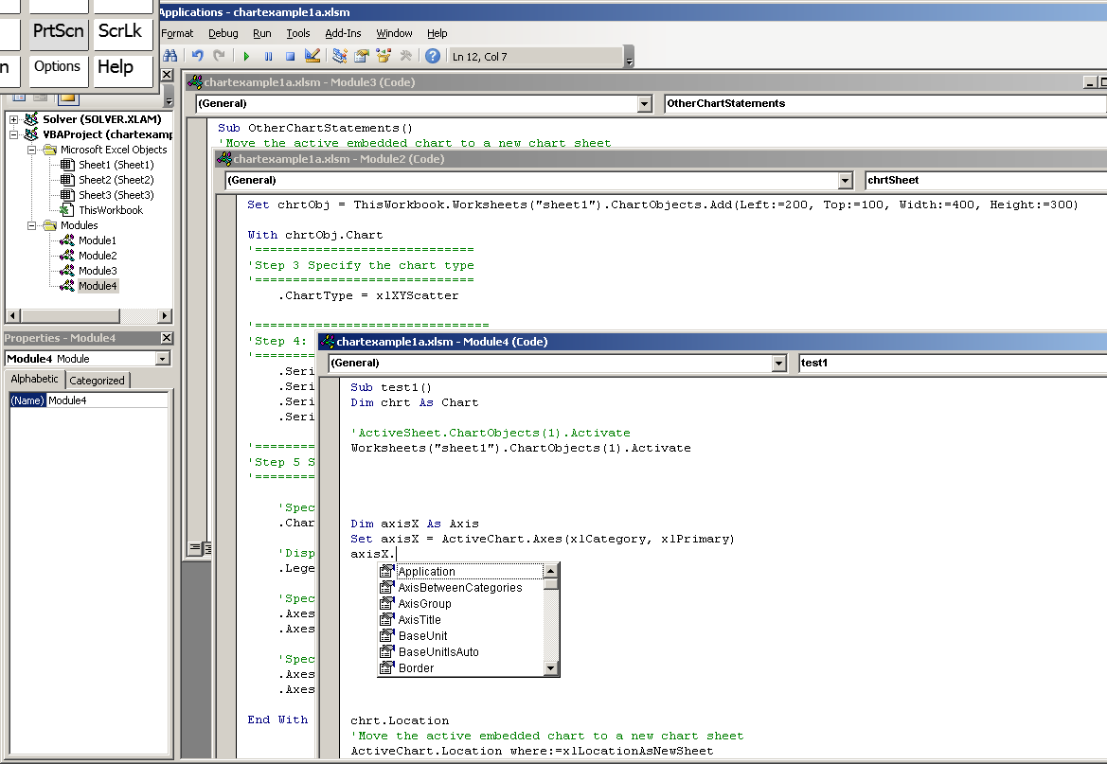
Creating An Embedded Chart Programmatically
(Self-Study)
Other statements
  Use Set object variables for the various objects down the hierarchy of a chart (such as ChartObject, Chart, Series, Axis, or Legend etc.) to guarantee Intellisense.
    For example, if you type ActiveChart.Axes(xlCategory, xlPrimary) and then a period, you won't get any Intellisense to help with Axis objects. But the following statements will:

Slide 23
Drawing A Histogram Programmatically
As from Excel 2016 can draw a frequency histogram under Insert Charts as usual. However, it does not report the distribution of the variable in a table form, you have no control over the bin width, and you cannot construct a relative frequency histogram using Insert Charts.
Drawing a histogram manually takes a lot of work. The frequency distribution table of the variable needs to be constructed first. Once the distribution table is built, a bar chart can be drawn. By applying appropriate modifications, it will become a frequency histogram or relative frequency histogram.

Slide 24
Drawing A Histogram Programmatically
Using the Excel Frequency function
  Excel Frequency function returns the number of values that fall within specific ranges, ignoring text values and blank cells.
  The syntax is:
    FREQUENCY(data_array, bins_array)
    data_array is a set of cells for which you want to count frequencies.
    bins_array is a set of bins for grouping the values.
  The Frequency formula must be entered as a multi-cell array formula. First, select a range of adjacent cells where you want to output the frequencies, then type the formula at the formula bar and press Ctrl+Shift+Enter to complete it.

Slide 25
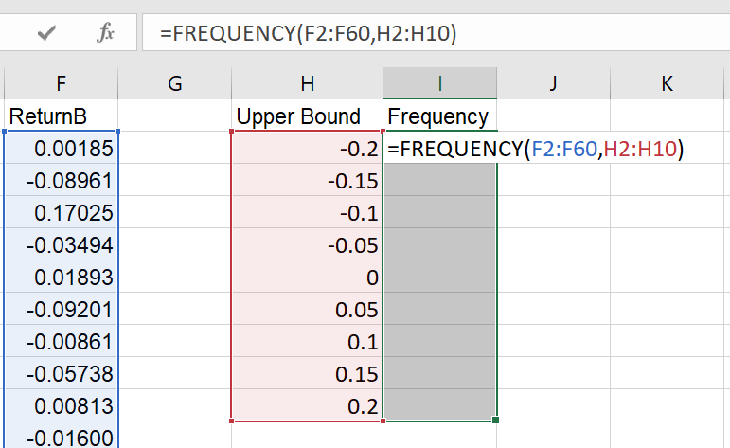
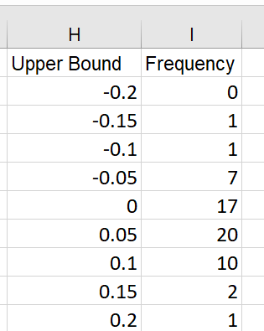
Drawing A Histogram Programmatically
Using the Excel Frequency function
  Example 4.9: Refer to Sheet1 in Histogram1.xlsm. Construct a frequency distribution table for ReturnB with bin sizes of 0.05 and a starting bin with an upper bound of -0.2.
    Select the cells I2:I10 for storing the derived frequencies.
    Enter the formula ‘=FREQUENCY(F2:F60, H2:H10)’ into the formula bar.
    Press Ctrl+Shift+Enter.
ReturnB <= -0.2
-0.2 < ReturnB <= -0.15
etc

Slide 26
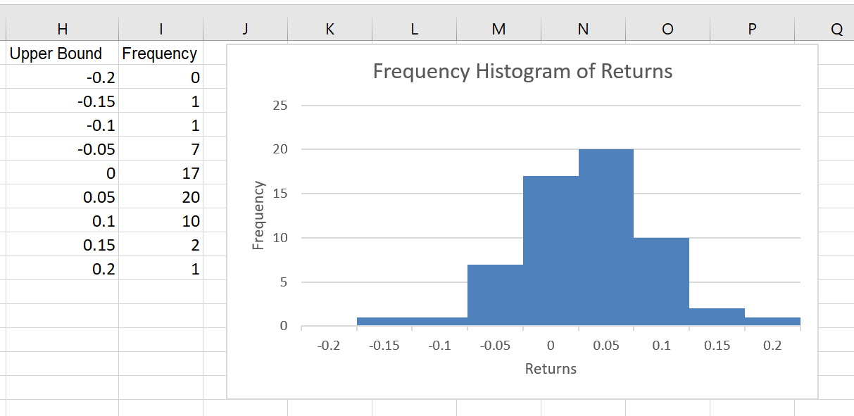
Drawing A Histogram Programmatically
Using the Excel Frequency function
  Example 4.9: Cont’d.
    UserForm frmHistogram1 constructs a frequency distribution and a frequency histogram at run time.
    To enter the Frequency function formula programmatically into the cells, set the property FormulaArray of the range of cells for the frequencies as:
Range(rfdFreq.Value).FormulaArray = "=frequency(" & rfdData.Value _
& "," & RfdBin.Value & ")"
Since the frequency table is linked to the data range, if the data changes, the table and the chart will be changed automatically.

Slide 27
Working with Pivot Table Objects
While the worksheet function Frequency is useful, it only works with numeric data.
If you try to draw a pie or bar chart for a categorical variable, you will need first to create the frequency distribution of the variable. This involves obtaining a list of items in the variable and counting the frequency for every item.
It is much easier to compute a categorical variable’s distribution with the Pivot Tables function.

Slide 28
Working with Pivot Table Objects
It is not practical (but you still can) to manipulate Pivot Table programmatically as the power of Pivot Table lies in the interactions between the user and the table through a series of drag-and-drop actions.
  For example, if a data set shows a daily company’s sales in each district with stores, you can easily view sales totals by month, district, or both by using the Pivot Table function.
Our purpose here is to use Pivot Table to create the distribution table for a categorical variable programmatically and for computing summary statistics of a numeric variable grouped by levels of a categorical variable.
  For example, to compute the total sales by region.

Slide 29
Working with Pivot Table Objects
Example 4.10. The "Data" sheet in PivotTableMacro.xlsm contains sales transaction records for a company. Suppose we would like to create a report on the Age distribution of the customers in the "Data" sheet.
  Turn on the Macro Recorder to record the code for creating a Pivot Table for the variable Age.
  Activate Sheet1.

Slide 30
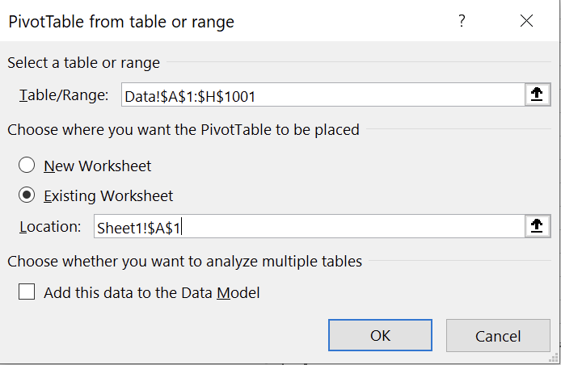
Working with Pivot Table Objects
Example 4.10: Cont’d.
  Steps to create a pivot table manually:
  1. Click Pivot Table in the Insert ribbon. In the Create PivotTable dialogue box, enter or confirm the address in the Table Range as the data you want to analyze. Choose the Existing worksheet and specify a location (A1, say) for the PivotTable report to be placed.

Slide 31
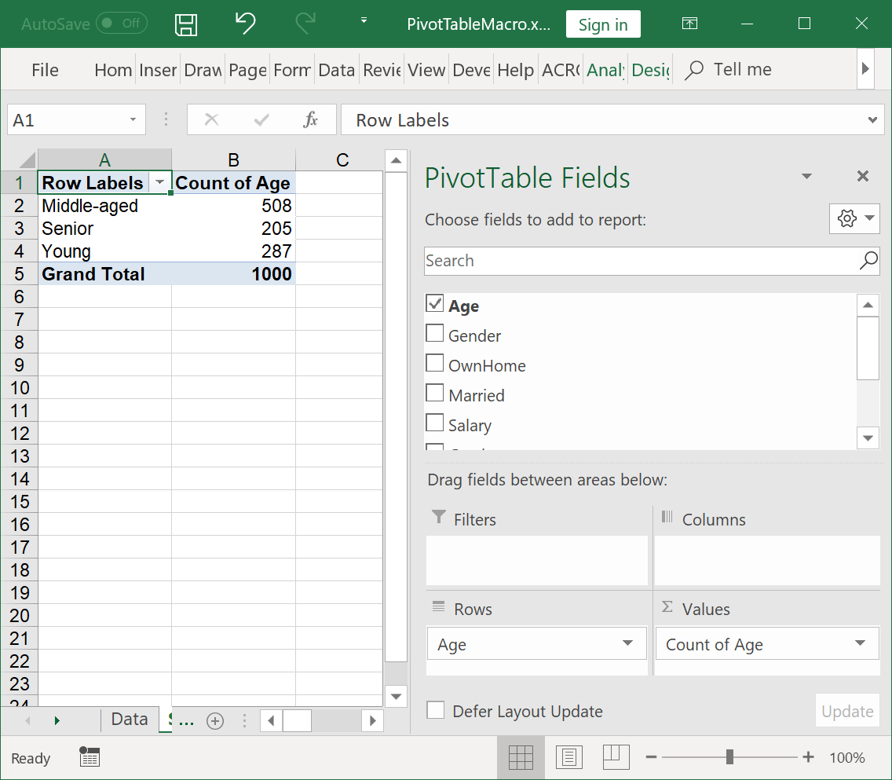
Working with Pivot Table Objects
Example 4.10: Cont’d
  Steps to create a pivot table manually:
    2. Drag Age to the Row Labels area and Age to Values area to create the frequency table.
      The default reported value for categorical value is Count. This can be changed from the dropdown list under the Values area.
      Grand Total is included by default.

Slide 32
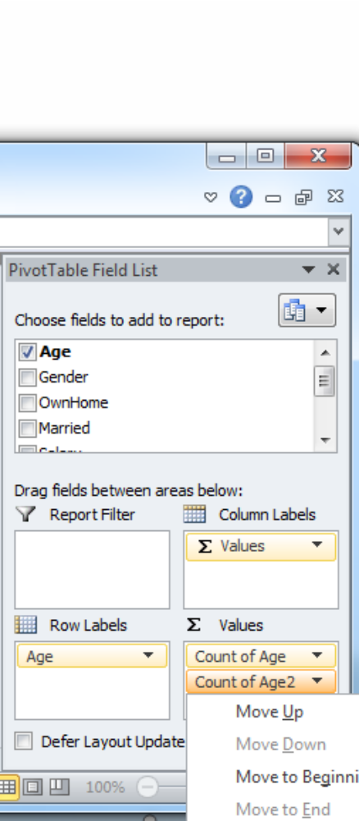
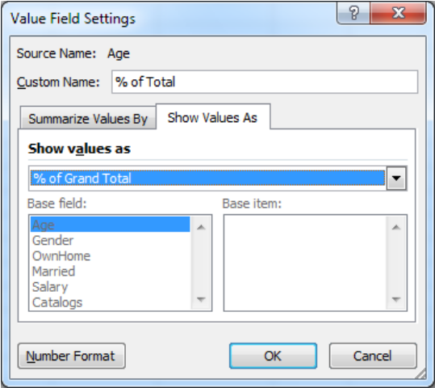
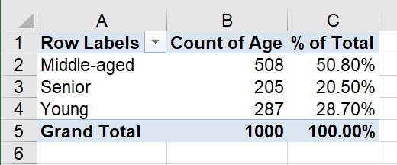
Working with Pivot Table Objects
Example 4.10: Cont’d
  Steps to create a pivot table manually:
    3. If the relative frequency is also wanted, drag Age into the Values field again. From the dropdown list of Count of Age 2, select Value Field Setting, then set Show Value As % of Grand Total. Enter "% of Total" into the Custom Name box.
    If you do not see the Field List, click FieldList in the Show group under the Analyze ribbon of PivotTable Tools.
  Stop the Macro Recorder.

Slide 33
Working with Pivot Table Objects
Example 4.10: Cont’d
  View the created VBA code.
    There are three groups of record code
      The code for creating the PivotTable object includes the pivot cache, source data, and table destination.
      Code for identifying variables to be included in rows (or/and columns).
      Code for the type of reported statistics.
    The recorded code cannot reproduce the same Pivot Table because the system incorrectly defined the involved pivot fields in the recorded code.

Slide 34
Working with Pivot Table Objects
Some properties and methods of PivotTable objects
  PivotCache object and PivotTable object
    For every pivot table, a PivotCache object holds a static copy of the source data in memory. The PivotCache object must be created first, and then a PivotTable object can be added.
    The syntax for creating a PivotCache object is:
workbookreference.PivotCaches.Create SourceType:=xlDatabase, _ SourceData:=rangereference
    It is often convenient to assign the created PivotCache object to a PivotCache type of variable for later reference. For example:
      Dim pivotCacheVar As PivotCache
      Set pivotCacheVar = _
      workbookreference.PivotCaches.Create( SourceType := xlDataBase, _
      ScourceData := rangereference )

Slide 35
Working with Pivot Table Objects
Some properties and methods of PivotTable objects
  PivotCache object and PivotTable object
    Once a PivotCache object is created, a PivotTable object can be created based on the data in the PivotCache. The syntax is:
  pivotcacheref.CreatePivotTable TableDestination := rangeref [ _
  , TableName := "tablename"]
      The rangerref specifies the location of the upper-left cell of the pivot table.
    After the pivot table is created, it can be referred to as worksheetreference.PivotTables(index)
      The index could be a numeric number—for example, worksheetreference.PivotTables(1) refers to the latest created table.
      The index could be "tablename" defined in the argument of the CreatePivotTable method. However, it is more convenient to assign the created table to a variable of PivotTable type.

Slide 36
Working with Pivot Table Objects
Some properties and methods of PivotTable objects
  Add a variable (field) to the row, column, or page area of the Pivot Table. The syntax is:
  pivottableref.PivotFields("fieldref").Orientation = propertyvalue
    The fieldref represents a variable (field) name to be added.
    The propertyvalue is either xlRowField, xlColumnField, or xlPageField.

Slide 37
Working with Pivot Table Objects
Some properties and methods of PivotTable objects
  Add a variable (field) to the values area of a pivot table. The syntax is:
    Pivottableref.PivotFields(“fieldref”).fieldproperty = fieldpropertyvalue
    where fieldproperty = fieldpropertyvalue can be one of the following:
      Orientation = xlDataField
      Function = xlSum, xlCount, xlAverage, xlMax, xlMin, xlStDev, xlVar etc.
      Calculation = xlPercentofTotal, xlPercentofColumn, xlPercentofRow etc.
      NumberFormat = "formatstring" such as "0.00%”.
  Example 4.11: See Sub PvTableDemo1 in PivotTableMacro.xlsm.

Slide 38
Working with Pivot Table Objects
Some properties and methods of PivotTable objects
  Convert a pivot table to a flat table
    TableRange2 property of a PivotTable object returns a Range object that represents the range containing the entire pivot table, including the page field if present.
    Use Copy method of TableRange2 to copy the entire pivot table, including the Page field if present, and then paste the copied table as a flat table. The syntax is
    pivottableref.TableRange2.Copy
    destinationrangeref.PasteSpecial Paste := xlPasteValuesAndNumberFormats
      destinationrangeref specifies the location of the upper-left cell of the destination.
      xlPasteValuesAndNumberFormats paste only the values and number formats of the selected object.
  Example 4.12: See Sub PvTableDemo2 in PivotTableMacro.xlsm.

Slide 39
Working with Pivot Table Objects
Some properties and methods of PivotTable objects
  TableRange2.Delete method
    Delete the entire pivot table, including page fields, if present. The syntax is:
    Pivottableref.TableRange2.Delete
  Turn off the field list
    The syntax is
      workbookreference.ShowPivotTableFieldList = False
      All filed lists in the workbook will be turned off.

Slide 40
Working with Pivot Table Objects
Some properties and methods of PivotTable objects
  Replace the row header text “Row Labels” with new text. The syntax is:
    pivottableref.CompactLayoutRowHeader = "newtext"
  Replace the Grand Total caption with given text:
  pivottableref.GrandTotalName = "newtext"

Slide 41
Working with Pivot Table Objects
Example 4.13. Refer to the Userform frmReports in SalesTableDemo2b.xlsm.
  Report the distribution of each selected categorical variable in either Pivot Table or flat table with the option to draw a pie chart for the distribution of the selected variable.
    A chart drawn from PivotTable is a PivotChart, over which you have no control.
    A chart drawn from a flat table is an embedded chart over which you have full control.
  Report the average amount spent for each level of a selected categorical variable in the Pivot Table or flat table. Option to draw a bar chart for the average amount spent by each level of the selected categorical variable.

Slide 42
Importing and Exporting Data (Self-Study)
Import data from an external text file
  Suppose a text file test1.txt contains the following lines
      City1,City2,30
      City3,City2,40
  In Excel, activate Macro Recorder
  Then from Ribbon, Data | From Text to import test1.txt
  Import the text file to the position A1 of the existing worksheet
  Stop the macro recorder

Slide 43
Importing and Exporting Data (Self-Study)
Import data from an external text file
  The recorded macro contains many statements. Only the followings are essential:
  'Import external data
  With ActiveSheet.QueryTables.Add(Connection:="TEXT;D:\test1.txt", _
  Destination:=Range("$A$1"))
  .FieldNames = True
  .TextFileStartRow = 1
  .TextFileParseType = xlDelimited
  .TextFileCommaDelimiter = True
  .AdjustColumnWidth = True
  .Refresh
  End With
  'Delete the connection between the workbook and the source text file
  ThisWorkbook.Connections(1).Delete

Slide 44
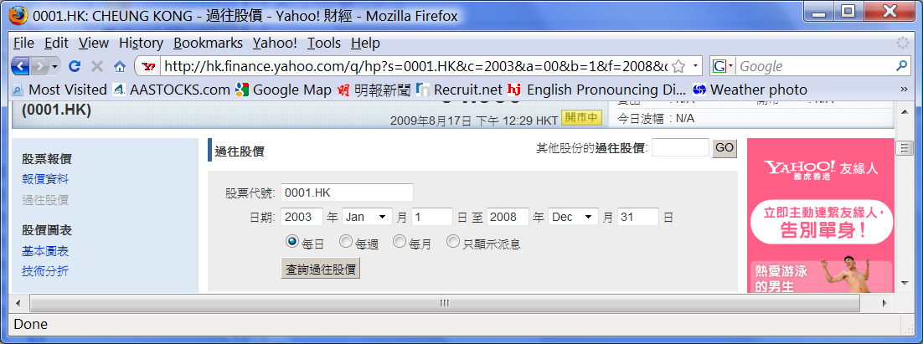
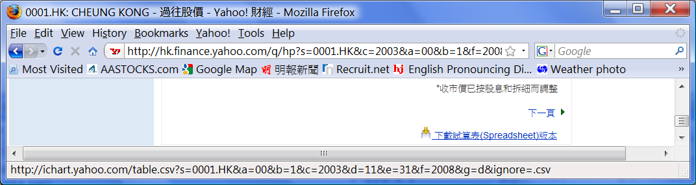
Importing and Exporting Data (Self-Study)
Import a CSV file from the web
  Example 4.14: Download the stock price data file from Yahoo finance.

Slide 45
Importing and Exporting Data (Self-Study)
Import a CSV file from the web
  Example 4.14: (Cont’d)
Sub stockPrice( )
Dim fname As String
fname = "text;http://ichart.yahoo.com/table.csv?s=0001.HK&a=00&b=1&c=2003" + _
"&d=11&e=30&f=2008&g=d&ignore=.csv"
With ActiveSheet.QueryTables.Add(Connection:=fname,Destination:=Range("$A$1"))
.TextFileStartRow = 1
.TextFileParseType = xlDelimited
.TextFileCommaDelimiter = True
.Refresh
End With
ThisWorkbook.Connections(1).Delete
End Sub

Slide 46
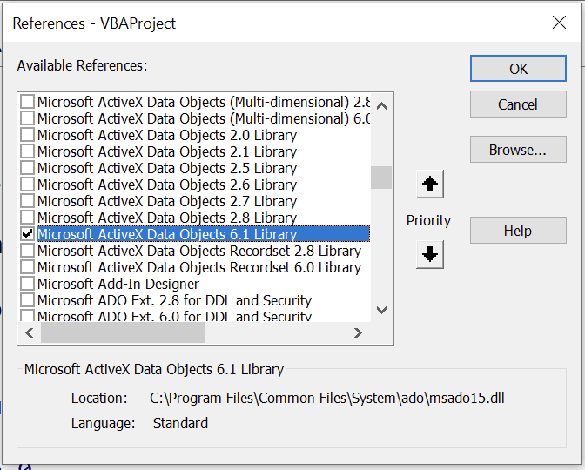
Importing and Exporting Data (Self-Study)
Import Access data file
  To read from the Access data file, add the reference for Microsoft ActiveX Data Objects in VBE.

Slide 47
Importing and Exporting Data (Self-Study)
Import Access data file
  Example 4.15: Import all records from table Customers of SalesOrders.accdb.
'This is an ADO (ActiveX Data Object) approach, there are many other methods.
Dim filePath As String, i As Integer
Dim conAccess As ADODB.Connection
Dim rsAccess As ADODB.Recordset
'Define path to the Access table
filePath = "d:\temp\SalesOrders.accdb"
'Establish Access connection
'Define a Connection object and specify the type of data base
Set conAccess = New ADODB.Connection
With conAccess
.Provider = "microsoft.ace.oledb.12.0"
.Open filePath
End With

Slide 48
Importing and Exporting Data (Self-Study)
Import Access data file
  Example 4.15: (Cont’d)
Identify the data table to be imported
Set rsAccess = New ADODB.Recordset
rsAccess.Open Source:="select * from customers", ActiveConnection:=conAccess
'Copy the header row from the table to worksheet
For i = 1 To rsAccess.Fields.Count
ActiveSheet.Range("a1").Offset(0, i - 1).Value = rsAccess.Fields(i - 1).Name
Next i
'Copy the records from the recordset
ActiveSheet.Range("a2").CopyFromRecordset rsAccess
'Close the data table
rsAccess.Close
'Close the connection to Access
conAccess.Close

Slide 49
Importing and Exporting Data (Self-Study)
Export data to a text file
  Excel saves the active worksheet as a .CSV or .txt file. There is a risk that all other worksheets will be lost unless the workbook has been saved before the action.
  To write a selected range of cells to a text file directly, use the Open statement:
    Open outputfilepath For Output As #filenumber
    The outputfielpath is the full file path, including the file name and extension, of the text file to be created. All directories involved in the path must exist already before the running of the statement. An existing file with the same name will be deleted.
    The filenumber ranges from 1 to 511. It is used in the running program for later reference to the file.

Slide 50
Importing and Exporting Data (Self-Study)
Export data to a text file
  The basic procedure for writing a text file is:
    Open or create the file by using the Open statement.
    Write selected data to the file using the Write #filenumber or Print #filenumber statement.
      Write: Write a series of values, each separated by a comma and enclosed in quotes. If the statement is ended with a semicolon, a carriage return/linefeed sequence is not inserted after each value.
      Print: Writes a series of values, with each value separated by a space character. If the statement is ended with a semicolon, a carriage return/linefeed sequence is not inserted after each value.
    Close the file by using the Close statement.

Slide 51
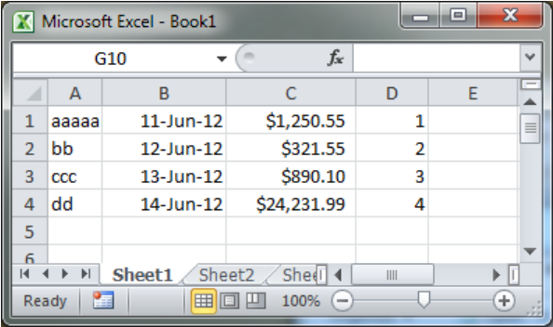
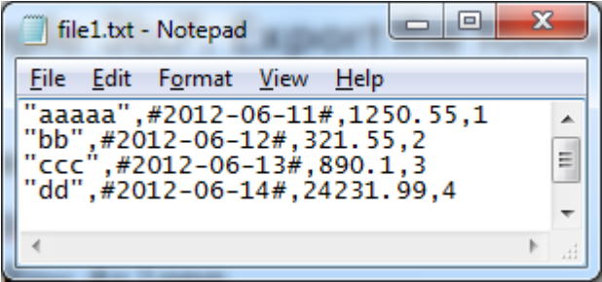
Importing and Exporting Data (Self-Study)
Export data to a text file
  Example 4.16: Export the following range of cells to a text file.
  Sub ex3b7( )
  Dim outFile As String, iRow As Long
  outFile = "d:\temp1\file1.txt"
  Open outFile For Output As #1
  With Worksheets("sheet1").Range("a1")
  For iRow = 0 To 3
  Write #1, .Offset(iRow, 0).Value; .Offset(iRow, 1).Value; _
  .Offset(iRow, 2).Value; .Offset(iRow, 3).Value
  Next iRow
  End With
  Close #1
  End Sub

