Slide 1




Individual Report and Assessment Brief
DS / EHPT
School of Built Environment, Engineering and Computing

Slide 2
Introduction

Slide 3
Assessment Components
Component | Weight | Deadline
1. Report | 50% | 23/04/2023 , 23:59
2. Quizzes | 50%
2.1. Weekly quizzes (on-line, open-book) | 10% | W/C 08/05/2023
2.2. Capture-the-flag (CTF) | 15% | W/C 08/05/2023
2.3. Final Quiz (on-site, supervised, closed-book) | 25% | W/C 08/05/2023
Reassessment and deferral (all components) |  | W/C 03/07/2023

Slide 4

General Notes
The report is your individual independent assessment component.
It is worth 50% of your module marks.
It should be 2000-3000 words in length. Penalties apply for under-running by more than 10%.
Avoid plagiarism!!! (if Turnitin reports plagiarism level higher than 30%, an official investigation will be run according to the LBU policy).

Slide 5

Assignment Summary
You need to describe a vulnerability of your choice (just one) and demonstrate a successful attack targeting that vulnerability.
You must demonstrate the following stages:
Information Gathering
Exploitation
Post-Exploitation
  Skip the footprinting
The assignment is purely based on the (i) scanning, (ii) exploitation and (iii) post-exploitation labs.

Slide 6
Tips
Read Report FAQ.
Use the Template.
Look through the marking criteria, good and bad report examples available on the VLE
Choose a remotely exploitable vulnerability.
Choose a vulnerability that allows you to perform all three stages of penetration testing (scanning, exploitation, post-exploitation).
If it requires social engineering, it is not a good choice.
If it bypasses the scanning stage, it is not a good choice.
If you do not choose an appropriate vulnerability, you could lose points!

Slide 7





Environment Options
Assignment workspace environment on Hacktivity
Your own virtual environment
Choose one of the vulnerabilities covered in the lab sheets

Slide 8
Finding a vulnerability

Slide 9
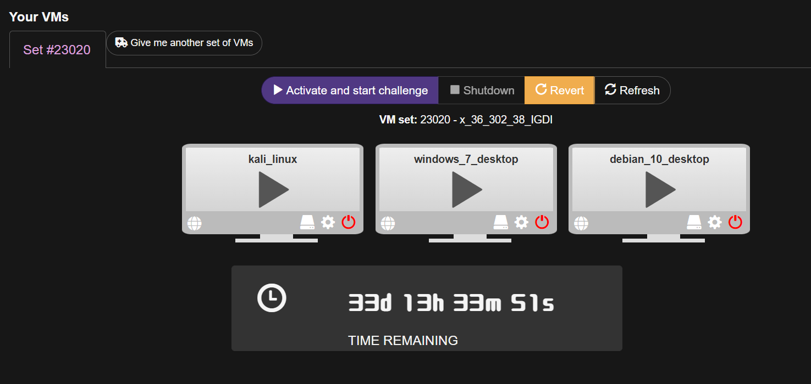
The assignment workspace environment
  It offers Kali (attacker) + blank state Windows 7 + blank state Debian Linux (potential targets).

Slide 10

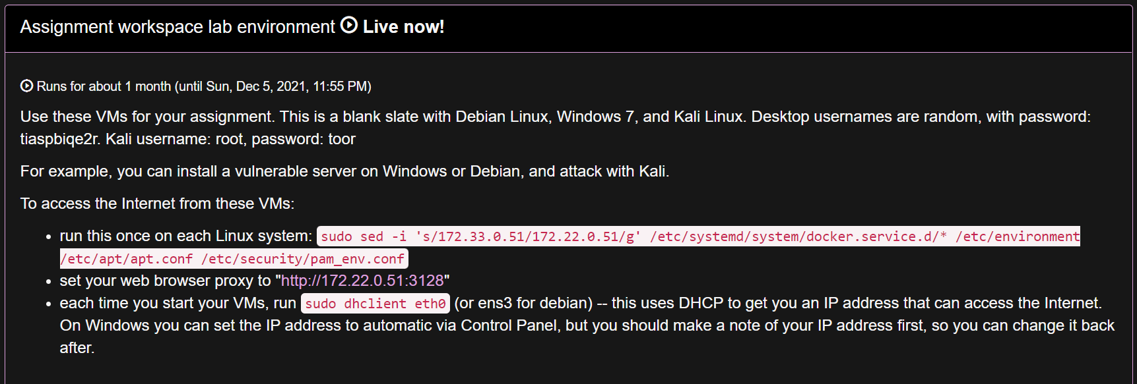
The assignment workspace environment on Hacktivity
  You have admin rights on all the VMs. VMs are blank state
  You might need to install vulnerable software (e.g. a vulnerable web server, file server, etc).
  There are instructions on how to access the Internet if you need to download and install software.

Slide 11
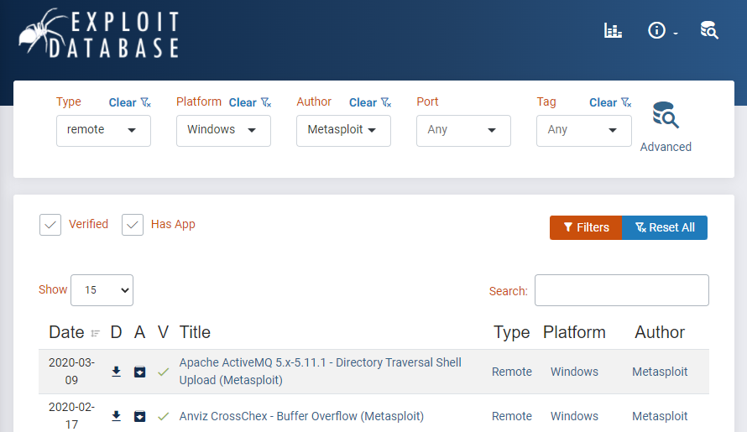
Exploit Database
  Great resource for finding exploits.
  Remember to use the advanced search.
  You can narrow your search to remotely exploitable vulnerabilities only, as well as those where vulnerable software is also available.
https://www.exploit-db.com/

Slide 12


Your own virtual environment
  Use your own desktop/laptop, plus a VM manager such as VMware Workstation Player or Oracle Virtual Box

Slide 13

Your own virtual environment
  Consider following these instructions.
  You can download ready-to-use VMs (Kali Linux, Windows 2k, Windows XP, Metasploitable2 Linux) from our repository.
  We will not support you through configuring your own local environment, so you will need to troubleshoot on your own.

Slide 14
Vulnerabilities covered in the lab sheets
  Use the module VMs released weekly on Hacktivity, as well as instructions provided in the lab sheets.

Slide 15

Lab environment on Hacktivity
  Use the scanning, exploitation and post-exploitation lab sheets.
  You can use the same environments provided for the weekly labs.
  You will only be able to score a maximum of 2 out of the 8 possible points for originality of attack chosen.

Slide 16
Hacktivity tips

Slide 17
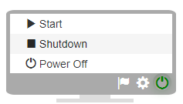
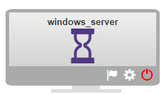
Preparation
Once, started restart the Windows VM by shutting it down, and starting it again – the first time it boots, it has the wrong IP address.
Remember to shut down instead of powering off, or you could end up booting the VM in safe mode.
wait...

Slide 18
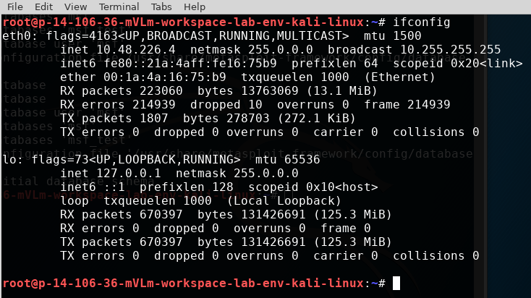
On the Kali VM
Identify the Kali’s IP address.
Identify a network range.

Slide 19
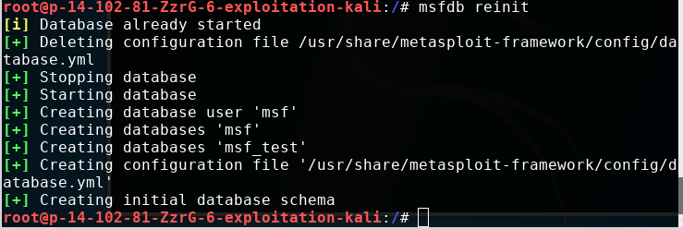
Reinitialise the MSF Database

Slide 20

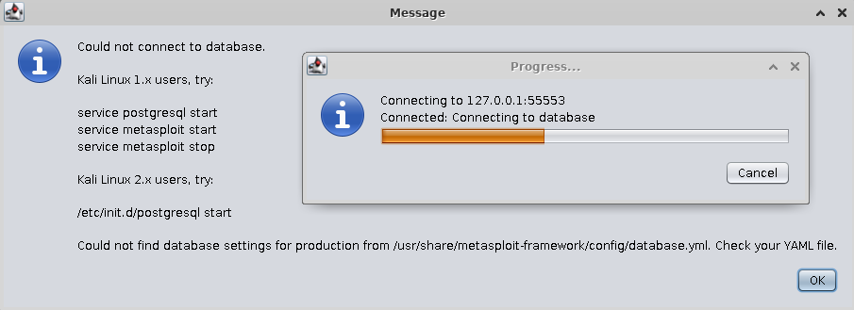

If you see this error…
You have forgotten to reinitialise the MSF database.

Slide 21
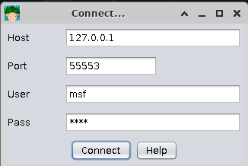
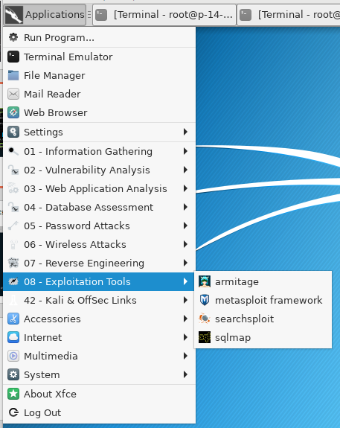
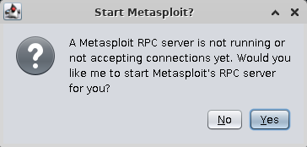
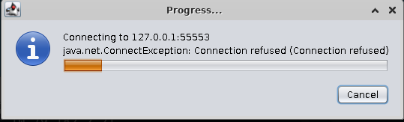
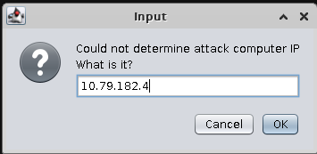
Running Armitage
Your Kali IP

Slide 22
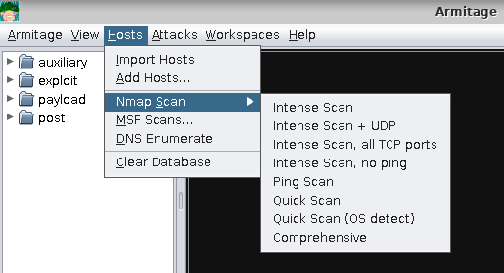
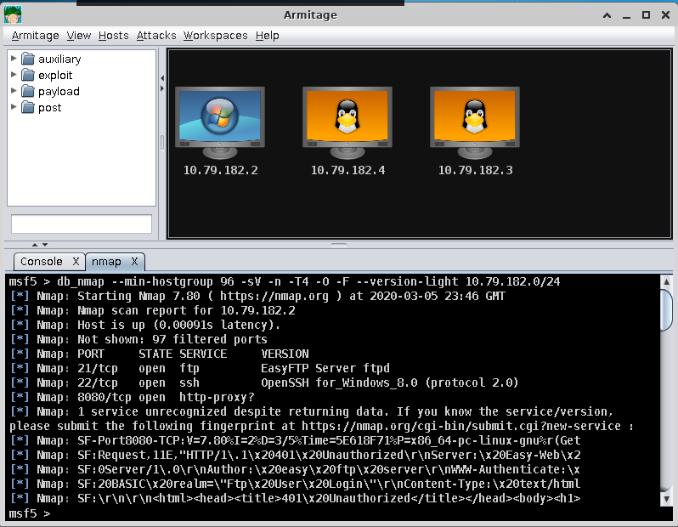
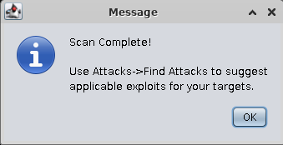
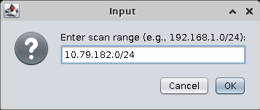
Scanning for Hosts and Ports
Your IP range

Slide 23
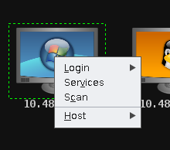

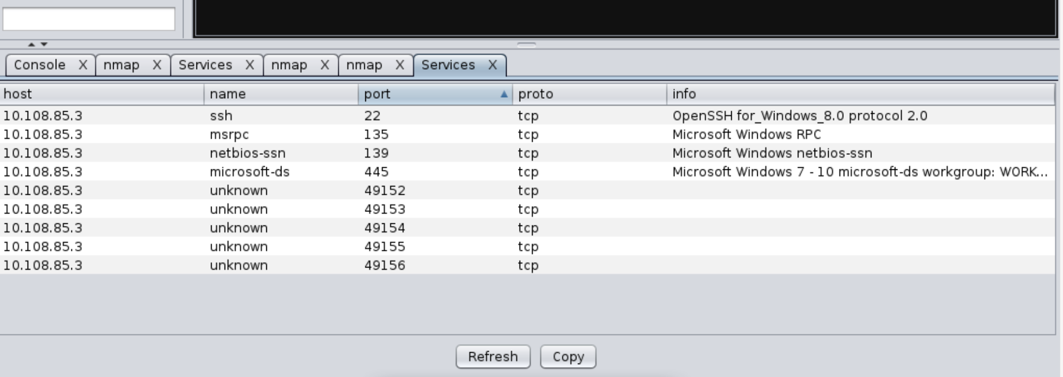
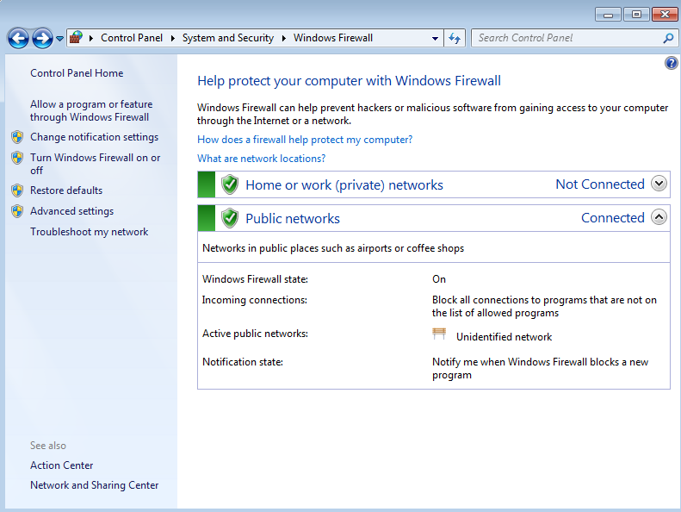
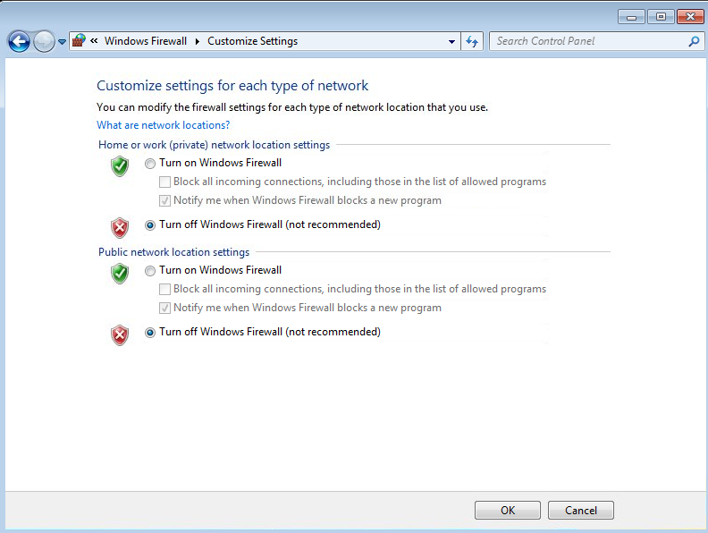

Check services and software on each target
You might need to log into the Windows 7 VM to disable the firewall and rescan the host.

Slide 24
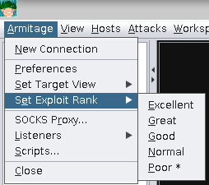
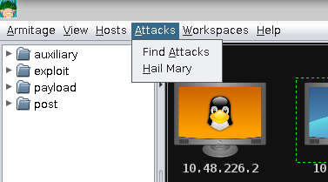
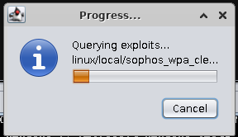
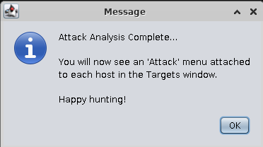
Ask Armitage to suggest attacks
Click the menu “Armitage”, “Set Exploit Rank”, “Poor”
Click menu “Attacks”, “Find attacks”.

Slide 25
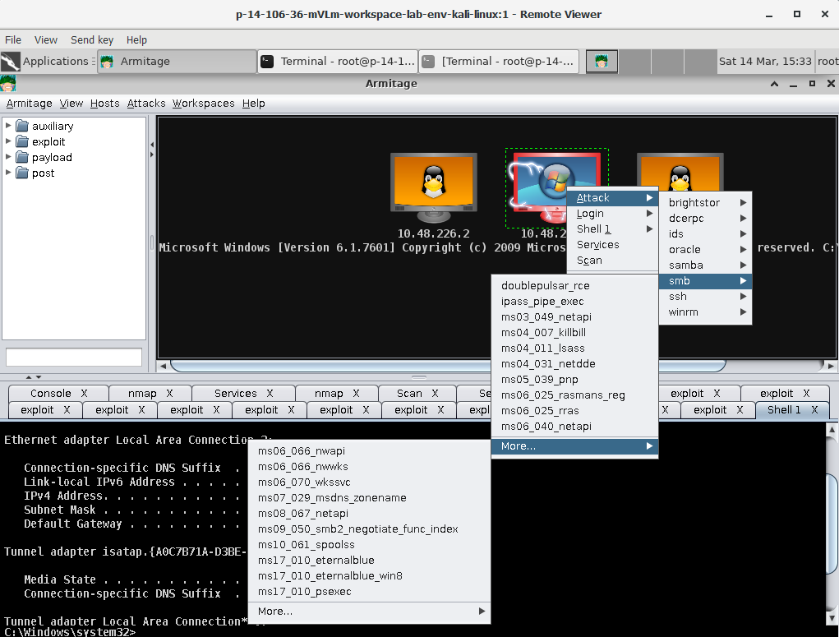
Try different exploits to attack your target
Windows 7 OS is vulnerable to one of the exploits displayed in the screenshot.
If you can not find a vulnerability in the OS itself, you may need to install vulnerable software to demonstrate a successful attack.

Slide 26
Tips when using your own environment

Slide 27
Creating your environment
Read the instructions.
Download VMs from Google Drive into separate folders on your PC.
Run VMware Workstation Player and chose ‘Open a Virtual Image’.
Browse to the .vmx file; say you copied it if asked; play it.
Open the 4 VMs (Kali, Windows XP, Windows 2000, Metasploitable2 Linux).

Slide 28
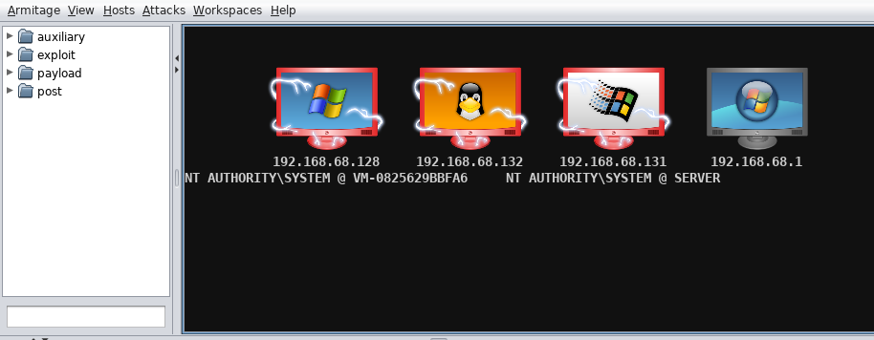
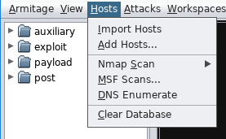
Run Armitage and scan your network
Scan the network range and look for live hosts.
You may need to clear previous scanning results beforehand.

Slide 29
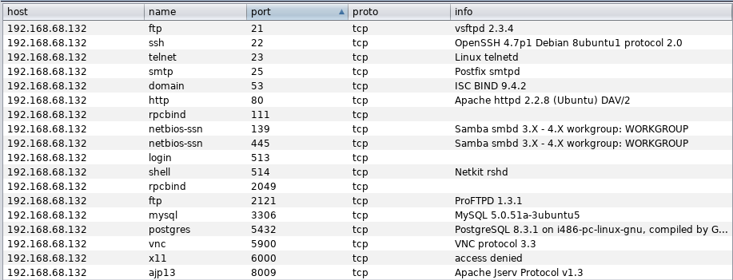
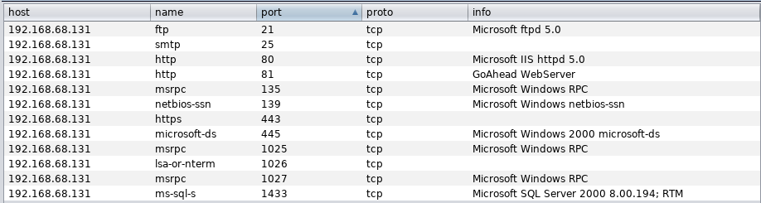
Scan the hosts
Look for services and software running on open ports.
Windows XP
Metasploitable2 Linux
These are your targets!!!
Windows 2000

Slide 30
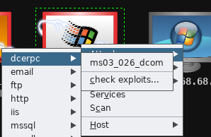
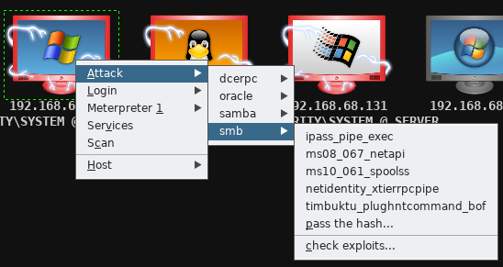
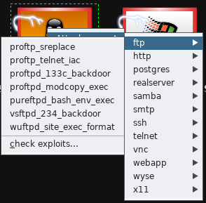
Search for exploits
Windows 2000
Windows XP
Working exploits are somewhere here, but not only!!!
Happy hunting! ☺
Metasploitable2 Linux

Slide 31
Important
Armitage can come in handy when looking for an exploitable vulnerability quickly, but it is a noisy tool and easily detected by IDS.
Armitage should not be used in professional testing.
You should use nmap and msf in your report.
Do not use Armitage for the report, or you will be given less marks!!!
You should mention Armitage in the ‘Related software’ section only.

Slide 32
Any questions?

