Slide 1

Report Notes
Finding an exploitable vulnerability
© Anatoliy Gorbenko

Slide 2
General Notes
Report is your individual independent assessment component
Purely based on (i) scanning, (ii) exploitation and (iii) post-exploitation labworks
You need to describe a vulnerability of your choice (just one) and demonstrate a successful attacks targeting that vulnerability going through
(i) scanning, (ii) exploitation and (iii) post-exploitation stages
Report template, examples, and assessment criteria are available for you from VLE
Use nmap and msf in your report. Do not use Armitage or you will be given less marks!!! (Though, Armitage can come in handy to find an exploitable vulnerability quickly. You should also mention Armitage in the ‘Related software’ section.)
Avoid plagiarism!!! (if a plagiarism check reports plagiarism level higher than 30%, the official investigation will be run according to LBU policy)

Slide 3
Finding an executable vulnerability
Hacktivity environment (Assignment workspace lab environment challenge).
Virtual environment on your desktop/laptop
Chose one of vulnerabilities covered in labsheets.

Slide 4
Finding an executable vulnerability
Virtual environment on your desktop/laptop
  Use VM manager like VMware Workstation Player or Oracle Virtual Box
  Read an instruction https://drive.google.com/file/d/1ZwKjXvww0ds6ShG_48LoSLyORx6NdVpe/view.
  Download ready-to-use VMs (Kali Linux, Windows 2k, Windows XP, Metasploitable2 Linux) from https://drive.google.com/open?id=1uMXMWdVswIIuMUnAQMxdJ1OaxA3tivpT

Slide 5
Finding an executable vulnerability
Hacktivity environment (Assignment workspace lab environment challenge).
  It offers Kali (attacker) + blank state Debian Linux and Windows 7 (potential targets).
  You have admin rights on all of these VMs.
  You might need to install some vulnerable software (e.g. a vulnerable web server, file server, etc.) and attack it if you fail attacking those OSes in their current state.
  There is an instruction on how to access the Internet if you need to download and install some software.

Slide 6
Finding an executable vulnerability
Write about one of vulnerabilities covered in labsheets
  see Scanning, Exploitation, and Post-exploitation labsheets
  you can use Hacktivity environment for that labs
  you will need to repeat some of tasks described in those labsheets.
  Though, you will be given less marks!!!

Slide 7

Hacktivity Demo
Finding a vulnerability – A Quick Guide

Slide 8
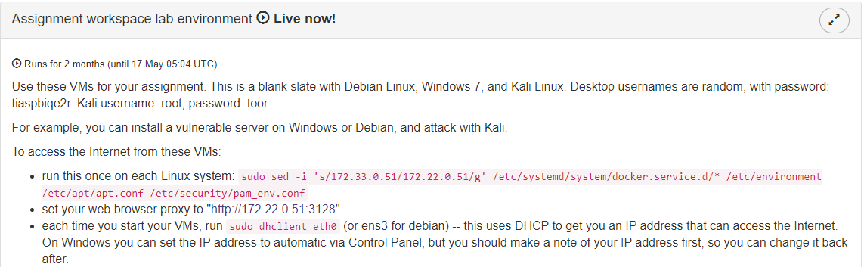
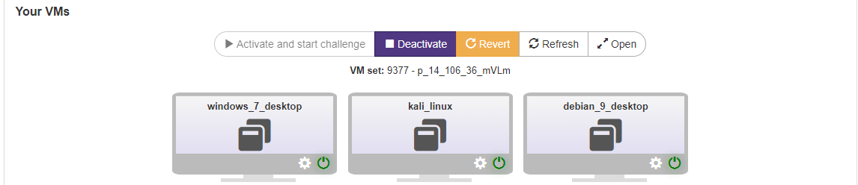
Read the Instruction

Slide 9
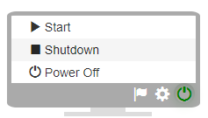
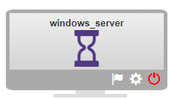
Preparation
Once, started restart the Windows VM by shutting it down, and starting it again – the first time it boots it has the wrong IP address.

Slide 10
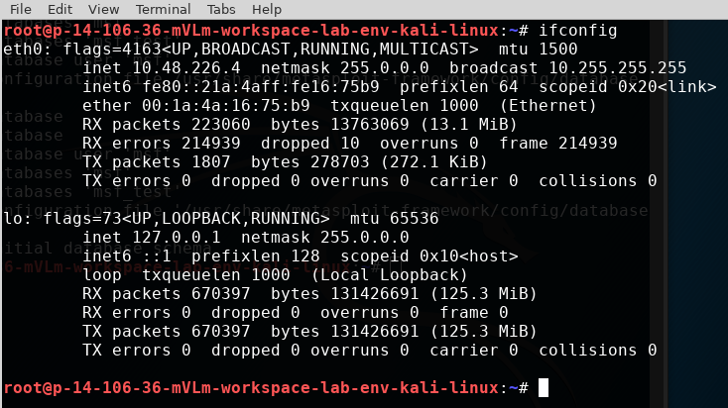
Identify your IP and a network range

Slide 11
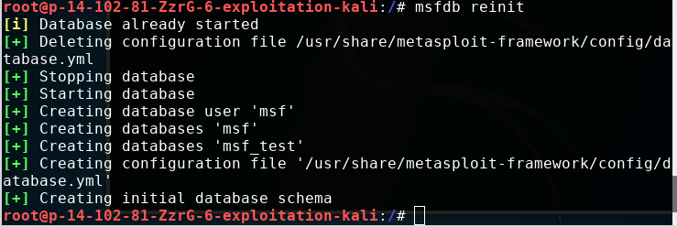
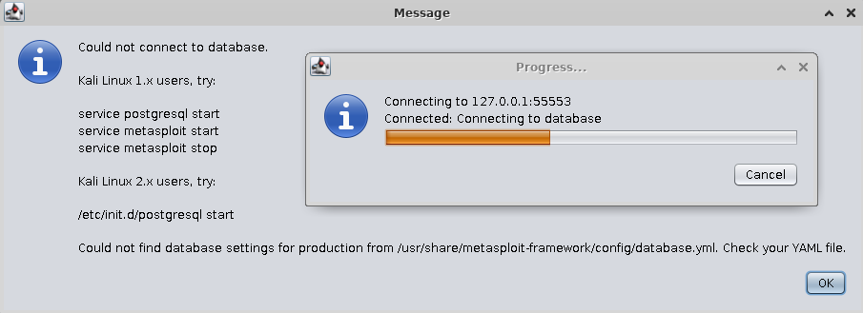
Reinit MSF database
If you see this error message =>
You have forgotten to reinin msf database

Slide 12
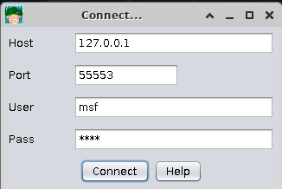
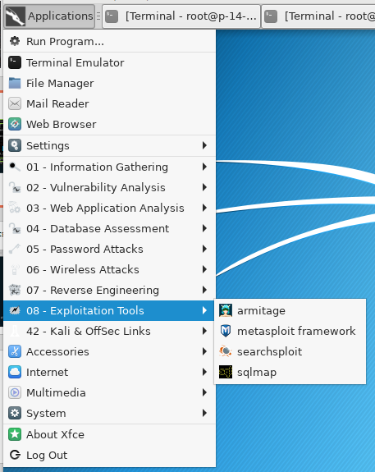
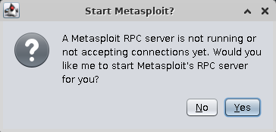
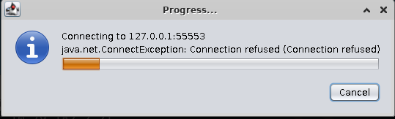
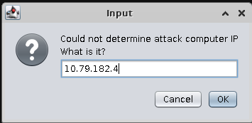
Running Armitage
Your Kali IP

Slide 13
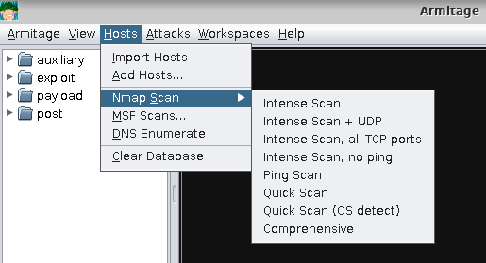
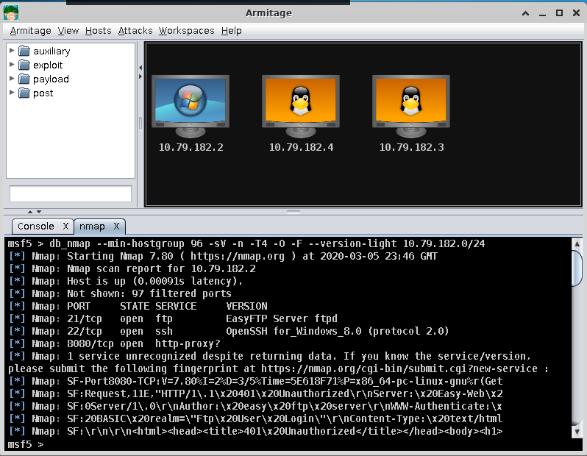
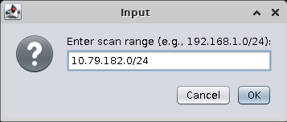
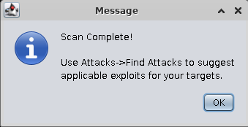
Scan for hosts and ports
Your IP range

Slide 14
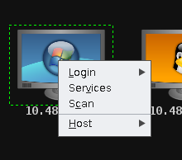
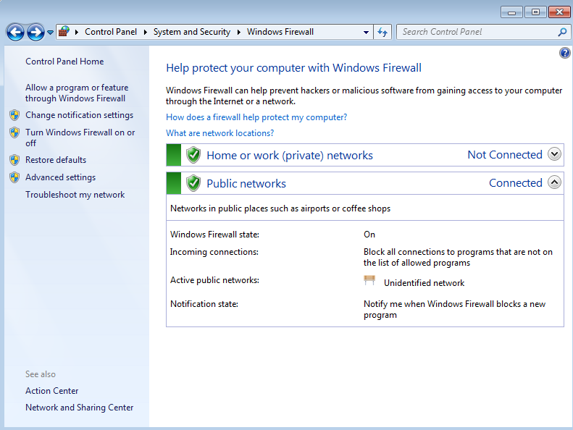
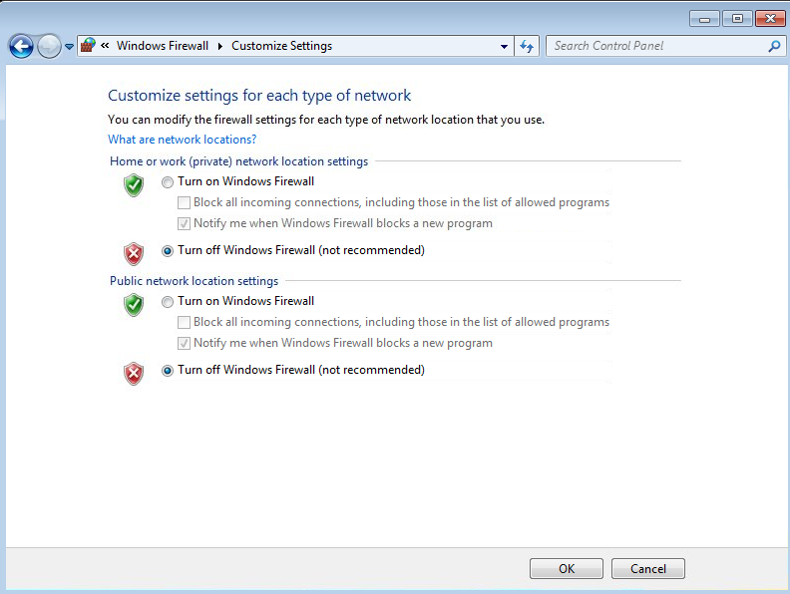
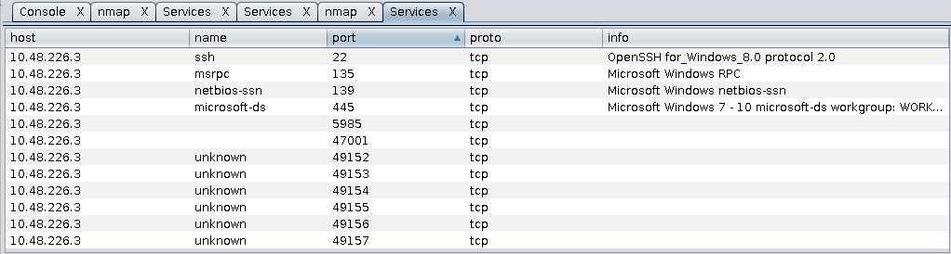
Check services and software on the target
You might need to login on Windows7 to disable a firewall and rescan the host.

Slide 15
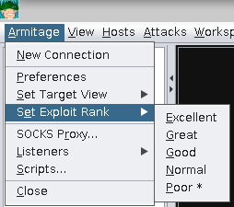
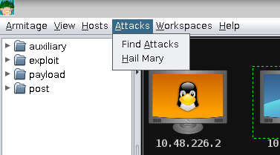
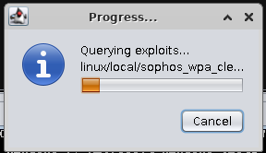
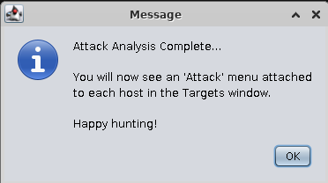
Ask Armitage to suggest attacks
Click the menu “Armitage”, “Set Exploit Rank”, “Poor”
Click menu “Attacks”, “Find attacks”.

Slide 16
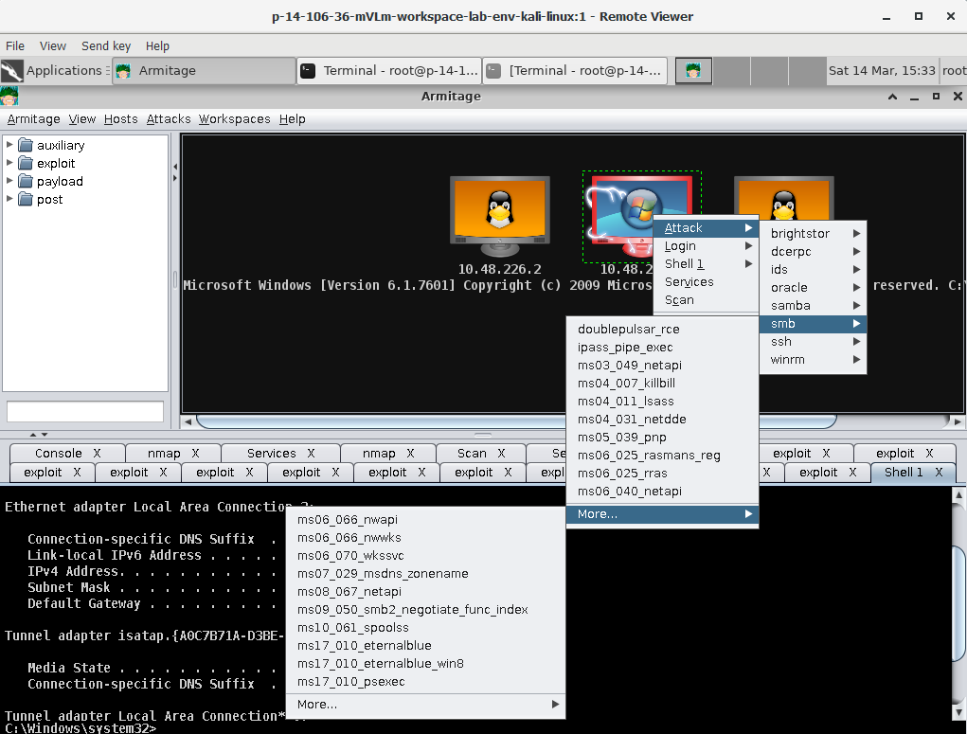
Try different exploits to attack you target
Windows 7 OS is vulnerable to one of those exploits displayed on the screenshot.
If you can not find a vulnerability in OS itself, you might need to install a vulnerable software (e.g. a vulnerable version of IIS) to demonstrate a successful attack => Read an instruction on getting access to the internet from Hacktivity’s VM (Slide 8).

Slide 17
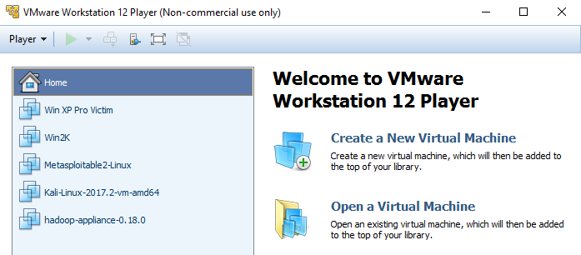
VMware on your home PC Demo
Finding a vulnerability – A Quick Guide

Slide 18
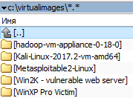
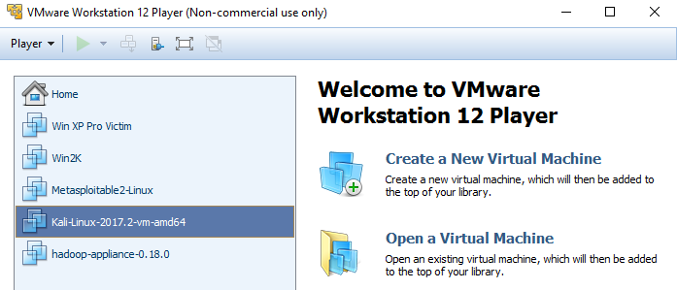
Create your environment
Read an instruction https://drive.google.com/file/d/1ZwKjXvww0ds6ShG_48LoSLyORx6NdVpe/view
Download VMs from Google drive to separate folders on your PC
Run VMware workstation player and chose ‘Open a Virtual Image’
Browse to .vmx file; say you copied it if asked; play it
Open 4 VMs (Kali, WinXP, Win2k, Metasploitable2 Linux)
3
2
1

Slide 19
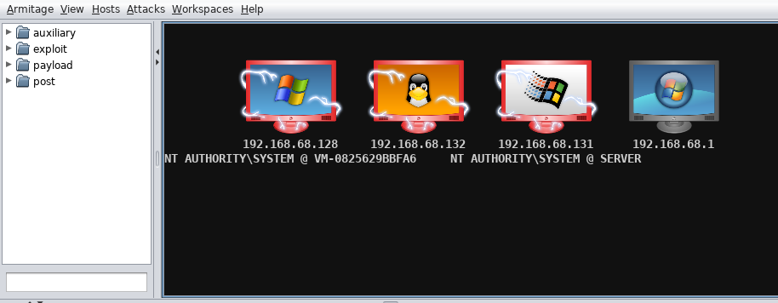
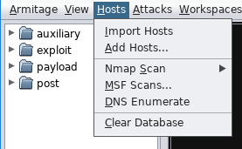
Run Armitage and scan for your network
You might need to clear previous scanning results beforehand

Slide 20
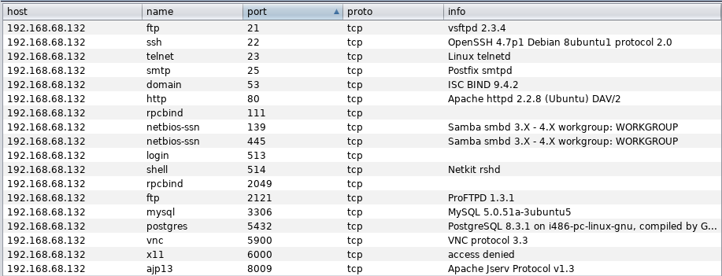
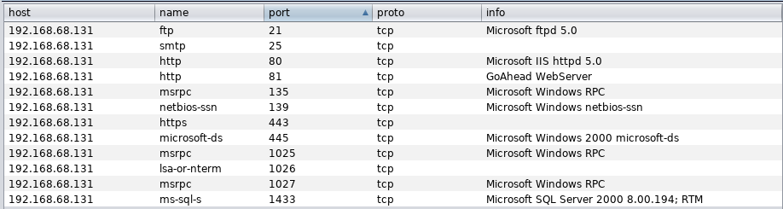
Check VMs services and software
Windows XP
Metasploitable2 Linux
These are your targets!!!
Windows 2000

Slide 21
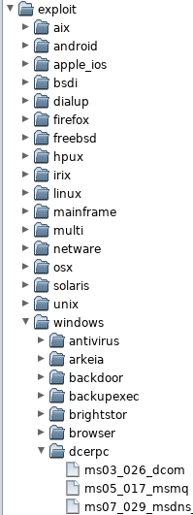
Search for exploits
You can manually browse through exploits on the left panel, or ask Armitage to suggest exploits for you

Slide 22
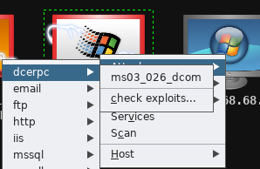
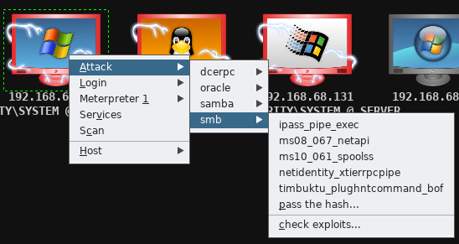
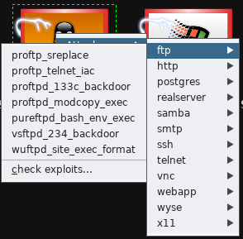
Search for exploits
Working exploits are somewhere here but not only!!!
Good luck with hunting!!!
Windows XP
Windows 2000
Metasploitable2 Linux

