Slide 1
Testing and Debugging

Slide 2
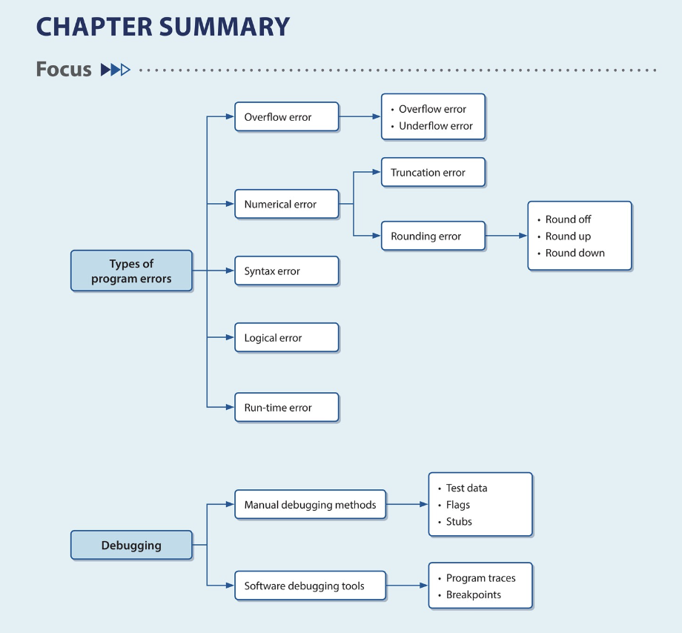
Concepts:
Particularly
  Syntax
    Your syntax!
  Logical
    Expected vs unexpected
  Run-time
    Occur when the programing is executing

Slide 3
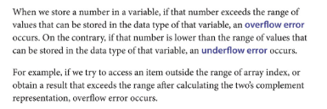
Overflow errors

Slide 4
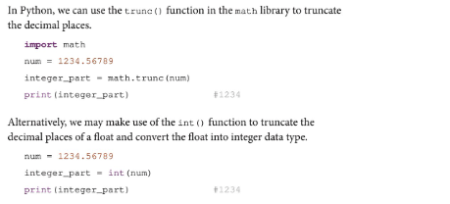
Numerical errors

Slide 5
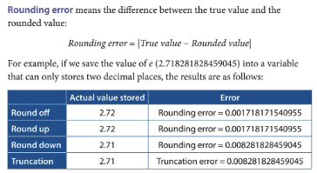
Rounding errors

Slide 6
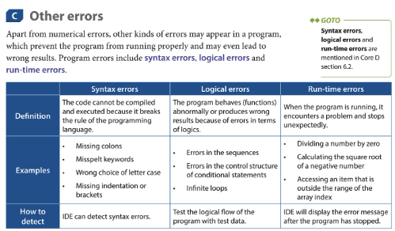
More importantly

Slide 7
Lesson 2
Purpose:
  Identify different kinds of programming error
  Draw a test table

Slide 8
Revision
Nearpod:
  56s8n

Slide 9
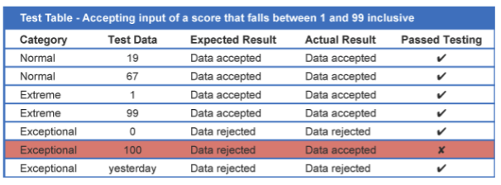
Test table – example 1
In this example, the program should only accept a score if the value entered is between 1 and 99 inclusive.

Slide 10
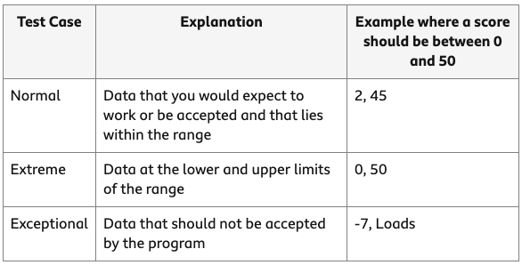
Example 2
a program to process students' test scores out of 50, then normal, extreme and exceptional data might be as follows:

Slide 11
Sources
https://www.bbc.co.uk/bitesize/guides/zx9vxfr/revision/1

Slide 12
Test table
A test table should include:
at least two items of normal data
at least two items of exceptional data
both extreme values if testing a range of numbers
Also, boundary case!!

