Slide 1

More about Selection and Insertion Sort
Mr. Lee WS

Slide 2
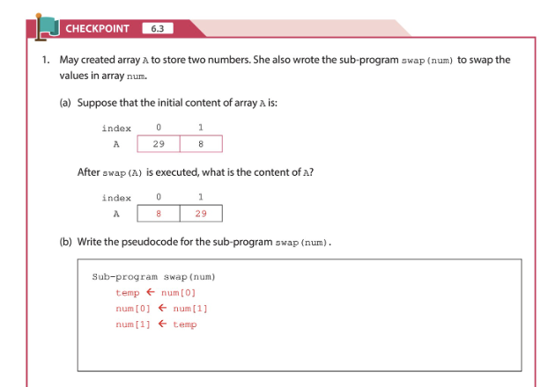
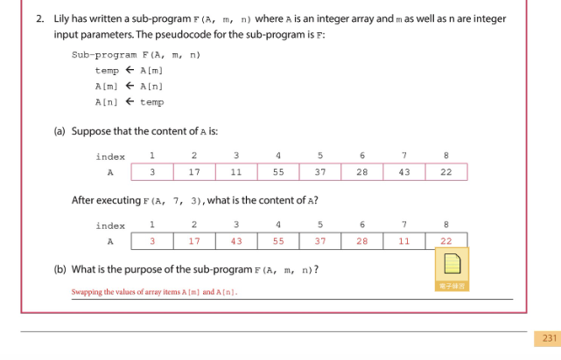
Revision - Swapping

Slide 3
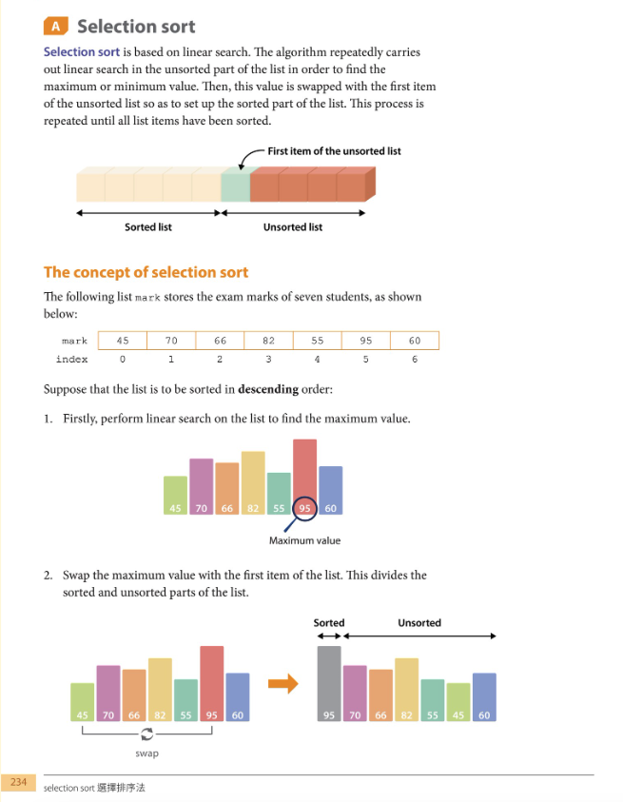
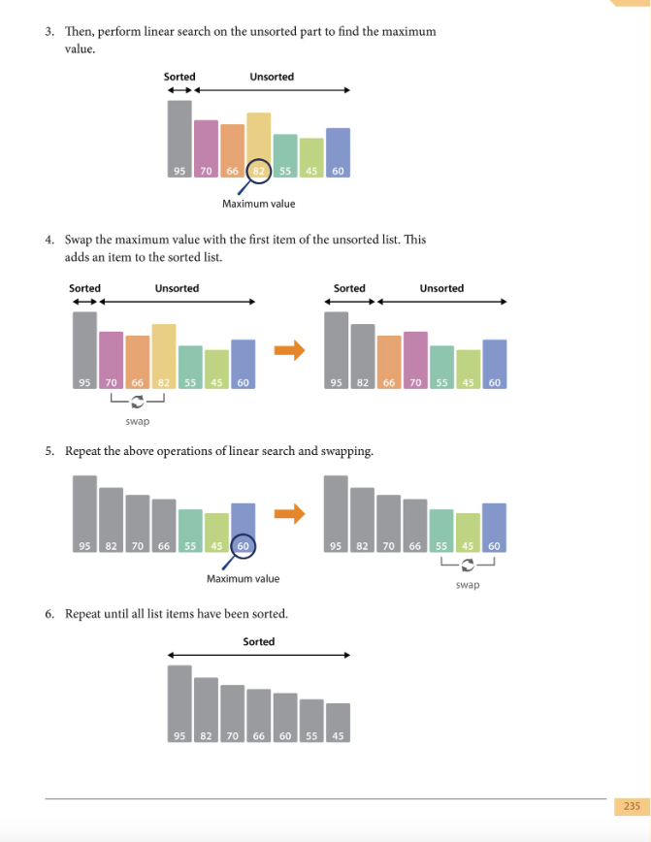
Main idea
- Linear search (max/min) → put to the sorted area (left)
- You need to dry-run successfully!!!

Slide 4
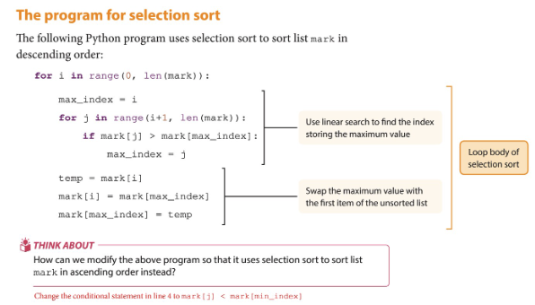

Slide 5
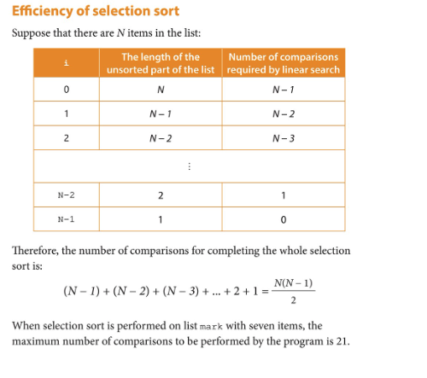
Effectiveness?? (New)
Questions:
How to determine the effectiveness of an algorithm?

Slide 6
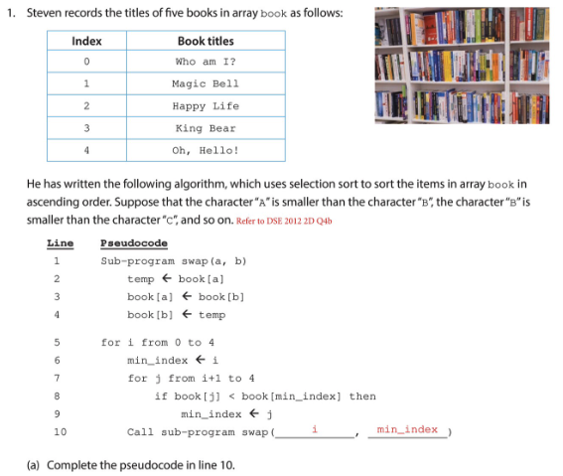
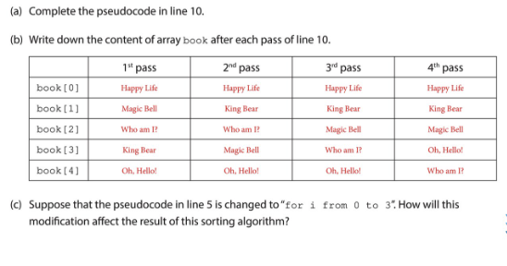
How to read the table?

Slide 7
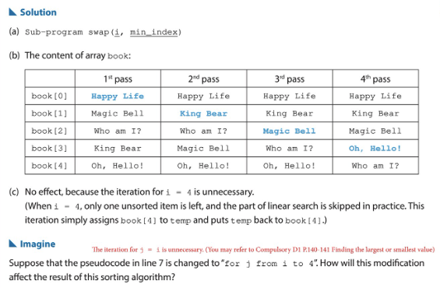
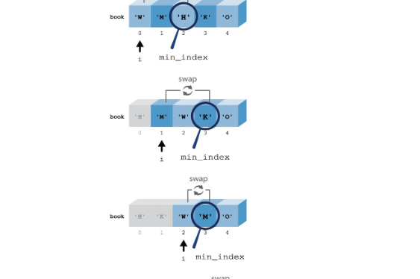

Slide 8
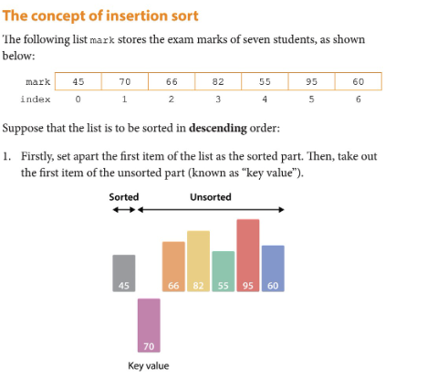
Insertion sort

Slide 9
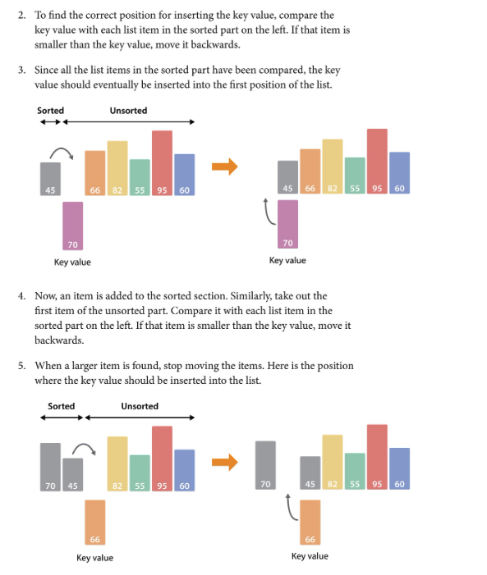
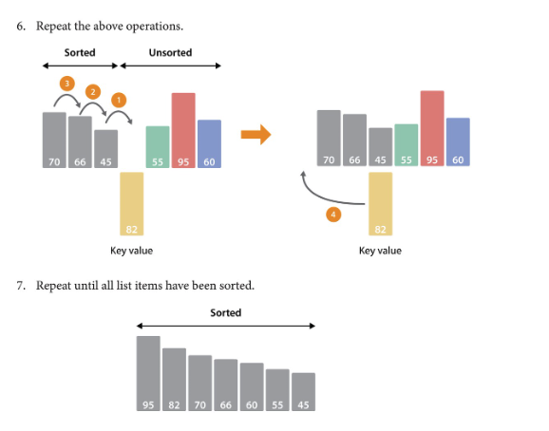
Can you see the ideas?
- Pick a key
- Compare with the previous one
- Larger? Smaller?

Slide 10
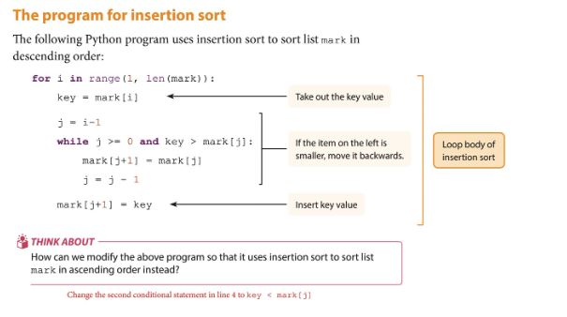

Slide 11
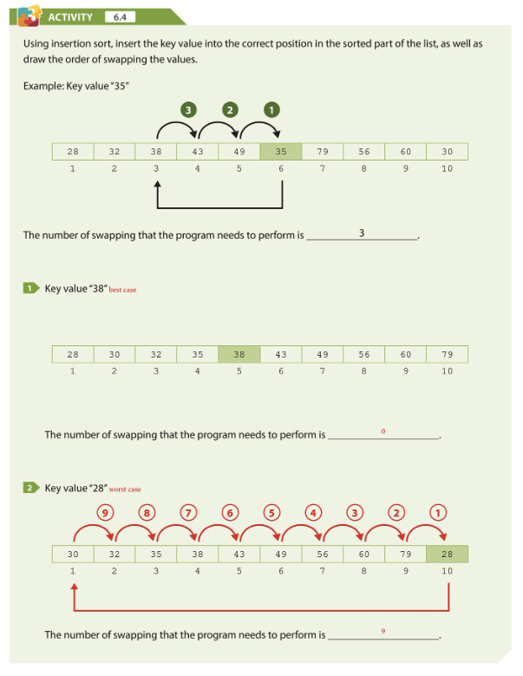
Questions~

Slide 12
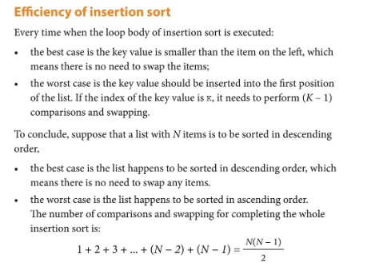
Effectiveness??

Slide 13
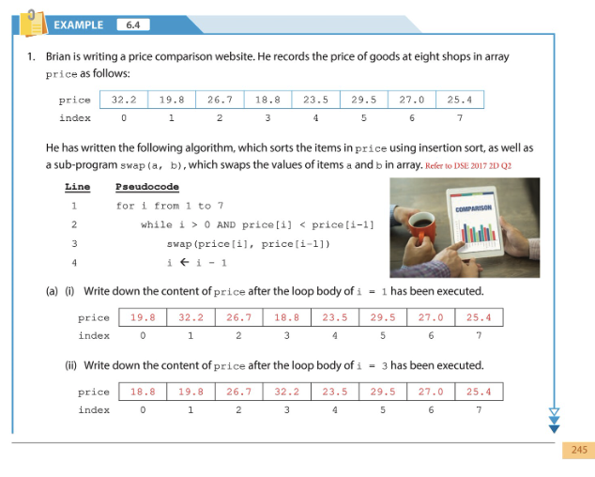
Dry run!

Slide 14
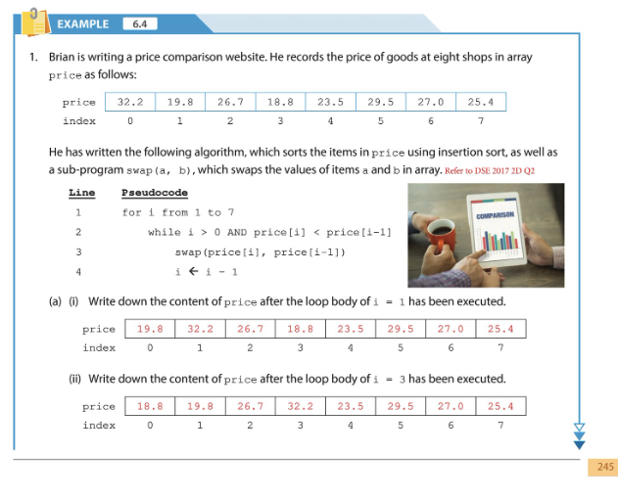
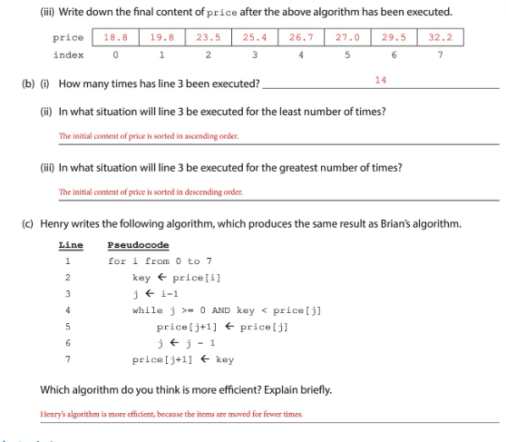

Slide 15
Summary
- No. of comparison
- Effectiveness
- Dry-run

Slide 16
Next lesson
- Bubble sort
- Please read p.249 - … before next lesson

