Slide 1
2023
Version 1 as of 12DEC23

Slide 4
















On time performance
Schedule completion
Average speed of answer
Source: July Report Network Planning
Source: Avianca indicators July 2023,

Slide 5


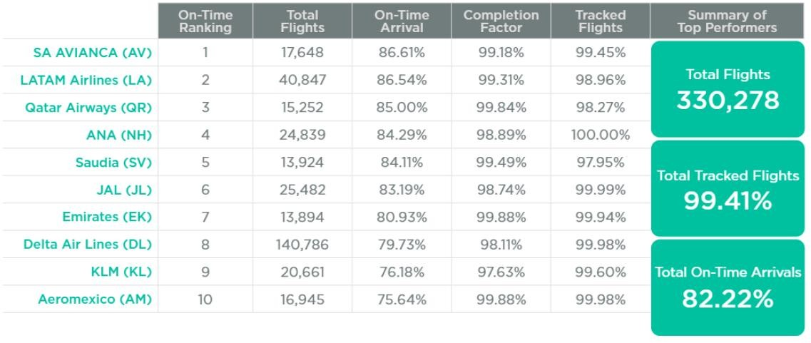

With more than 17,648 flights completed by our operational teams, we obtained an OTP (On Time Performance) indicator of 86.61%. Since May, we have been ranked the world's most punctual global airline, and thanks to our operational excellence and the synergy of our areas, we improved our results and maintained our position in this ranking.
The on-time performance monthly report - Airlines (May 2023)

Slide 6
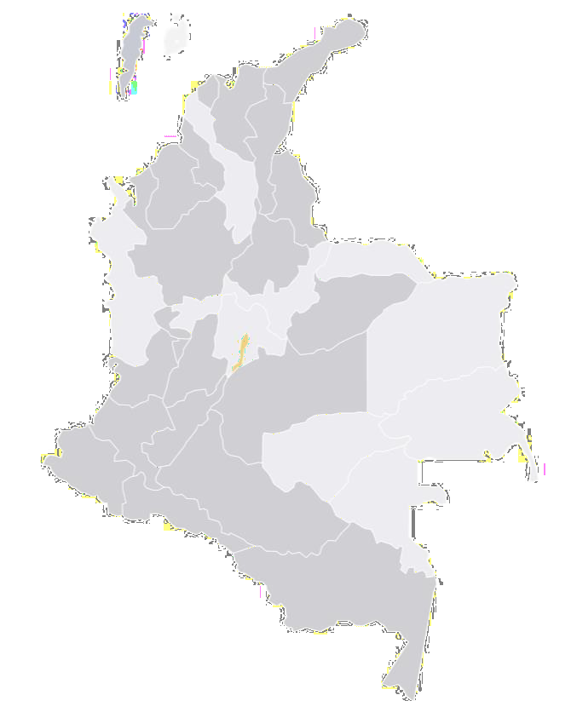





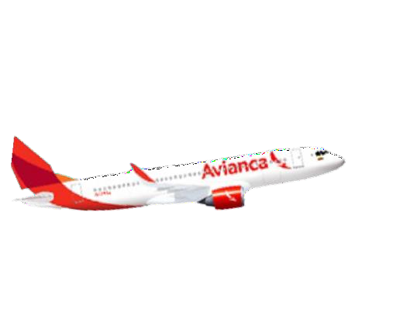

July Frequencies - Domestic Colombia
BAQ
Santa Marta
Region | Origin | Destina tion | Freq. weekly | Total Freq.
Domestic Colombia |  | MDE | 141
 |  | CLO | 118
 |  | CTG | 108
 |  | BAQ | 80
 |  | BGA | 73
 |  | PEI | 64
 |  | SMR | 57
 |  | CUC | 56
 |  | MTR | 33
 | BOG | VUP | 29
 |  | ADZ | 31
 | (23 |  |  | 934
 |  | AXM | 23
 | destination | PSO | 26
 | s) | RCH | 20
 |  | NVA* | 13
 |  | IBE* | 12
 |  | EJA* | 12
 |  | PPN* | 7
 |  | LET | 10
 |  | VVC* | 7
 |  | EYP* | 7
 |  | IPI | 4
 |  | FLA* | 3
 | PEI | CTG | 8 | 8
Origin | Destinatio n | Freq. weekly | Total Freq.
 | CLO | 42
 | CTG | 44
 | SMR | 15
MDE | BGA | 7
(9 destinations | MTR | 6 | 138
 | PEI | 10
)
 | AXM | 4
 | CUC | 7
 | RCH | 3
 | CTG | 12
CLO | PSO | 7
 | CUC | 1
(6 destinations |  |  | 34
 | RCH | 4
)
 | SMR | 6
 | ADZ | 4
BAQ | CLO | 3 | 22
 | MDE | 19
BGA | CTG | 4 | 4
Cartagena
From Bogotá
From Medellin
From Barranquilla
From Cali
From BC/asrlteaegveena
Montería
BGA
MED
PEI
BOG
CLO
Pasto
1250
1200
1150
1190
1142
1150
1165
1140
1100
1076
1090
1127
1111 1111
2022
2023
1050
1094
1000
1035
950
900
964
988
*As of June 2023 - Operation subject to change
JAN
FEB MAR APR MAY JUN
JUL
Source: Report June Network Planning

Slide 7
August Frequencies - Domestic Colombia
BAQ
Santa Marta
Region | Origin | Destina tion | Freq. weekly | Total Freq.
Domestic Colombia |  | MDE | 141
 |  | CLO | 118
 |  | CTG | 106
 |  | BAQ | 80
 |  | BGA | 73
 |  | PEI | 64
 |  | SMR | 57
 |  | CUC | 56
 |  | MTR | 33
 | BOG | VUP | 29
 |  | ADZ | 31
 | (23 |  |  | 932
 |  | AXM | 23
 | destination | PSO | 26
 | s) | RCH | 20
 |  | NVA* | 13
 |  | IBE* | 12
 |  | EJA* | 12
 |  | PPN* | 7
 |  | LET | 10
 |  | VVC* | 7
 |  | EYP* | 7
 |  | IPI | 4
 |  | FLA* | 3
 | PEI | CTG | 8 | 8
Origin | Destinatio n | Freq. weekly | Total Freq.
 | CLO | 42
 | CTG | 49
 | SMR | 15
MDE | BGA | 7
(9 destinations | MTR | 7 | 145
 | PEI | 11
)
 | AXM | 4
 | CUC | 7
 | RCH | 3
 | CTG | 12
CLO | PSO | 7
 | CUC | 1
(6 destinations |  |  | 39
 | RCH | 4
)
 | SMR | 11
 | ADZ | 4
BAQ | CLO | 3 | 22
 | MDE | 19
BGA | CTG | 4 | 4
Cartagena
From Bogotá
From Medellin
From Barranquilla
From Cali
From CB/asrlteaegveena
Montería
BGA
MED
PEI
BOG
CLO
Pasto
1250
1200
1150
1190
1142
1150
1165
1133
1150
1100
1076
1090
1127
1111 1111
1115
2022
2023
1050
1094
1000
1035
950
900
964
988
*As of June 2023 - Operation subject to change
JAN FEB MAR APR MAY JUN JUL AGO
Source: Report June Network Planning

Slide 8

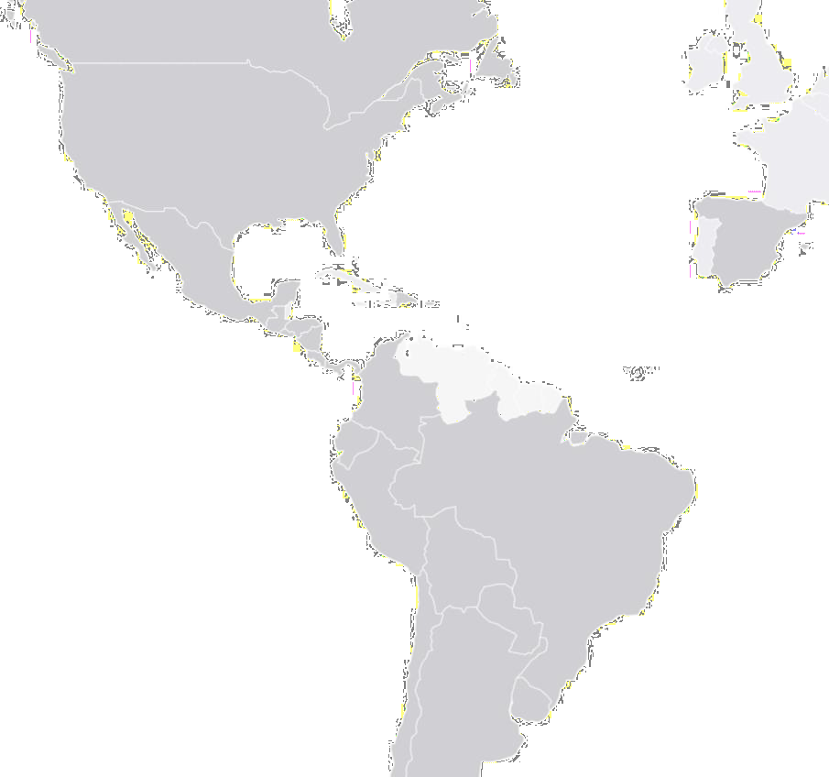





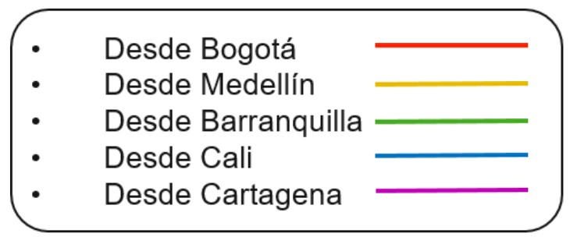
July Frequencies - Inter Colombia
Region | Origin | Destinati on | Freq. weekly | Total Freq.
Inter Colombia |  | LIM | 28
 |  | MIA | 28
 |  | UIO | 29
 |  | GRU | 21
 |  | MAD | 28
 |  | MEX | 21
 |  | SCL | 21
 |  | JFK | 21
 |  | SJO | 21
 |  | CUN | 21
 |  | GYE | 23
 |  | PUJ | 14
 | BOG | EZE | 7
 |  | PTY | 7
 | (35 | SAL | 14
 |  | AUA | 11
 | destinati |  |  | 434
 |  | SDQ | 10
 | ons)
 |  | CUR | 8
 |  | BCN | 14
 |  | GIG | 7
 |  | IAD | 7
 |  | LAX | 7
 |  | LHR | 7
 |  | VVI | 7
 |  | LPB | 7
 |  | MCO | 11
 |  | YYZ | 7
 |  | SJU | 11
 |  | GUA | 6
 |  | MVD | 4
 |  | ASU | 3
 |  | FLL | 3
Origin | Destina tion | Freq. Weekly | Total Freq.
BOG | CNF | 5 | 14
 | MAO | 4
 | BOS | 5
MDE (8 destinations) | CUN | 7 | 59
 | PUJ | 7
 | MAD | 4
 | MEX | 7
 | SJO | 3
 | JFK | 14
 | MIA | 14
 | MCO | 3
CLO | MAD | 4 | 14
 | MIA | 7
 | JFK | 3
CTG | JFK | 5 | 16
 | MIA | 6
 | SCL | 1
 | SJO | 4
BAQ | MIA | 7 | 7
PEI | MIA | 4 | 8
 | JFK | 4
BGA | MIA | 3 | 3
SMR | MIA | 2 | 2
New York
Miami
Madrid
Cancun
Punta Cana
Mexico
San Jose
Quito
Lima
La Paz
*As of June 2023 - Operation subject to change
Asunción
Sao Paulo
550
450
350
250
491
486
537
557
477
462
2022
2023
Montevideo Buenos Aires
403
457
447
469
465
Santiago de
Chile
342
307
342
JAN FEB MAR APR MAY JUN JUL
Source: Report June Network Planning

Slide 9
August Frequencies - Inter Colombia
Region | Origin | Destinati on | Freq. weekly | Total Freq.
Inter Colombia |  | LIM | 28
 |  | MIA | 28
 |  | UIO | 29
 |  | GRU | 21
 |  | MAD | 28
 |  | MEX | 21
 |  | SCL | 21
 |  | JFK | 21
 |  | SJO | 21
 |  | CUN | 21
 |  | GYE | 27
 |  | PUJ | 14
 | BOG | EZE | 7
 |  | PTY | 7
 | (35 | SAL | 14
 |  | AUA | 11
 | destinati |  |  | 436
 |  | SDQ | 10
 | ons)
 |  | CUR | 8
 |  | BCN | 14
 |  | GIG | 7
 |  | IAD | 7
 |  | LAX | 7
 |  | LHR | 7
 |  | VVI | 7
 |  | LPB | 7
 |  | MCO | 11
 |  | YYZ | 7
 |  | SJU | 8
 |  | GUA | 7
 |  | MVD | 4
 |  | ASU | 3
 |  | FLL | 3
Origin | Destina tion | Freq. Weekly | Total Freq.
BOG | CNF | 5 | 14
 | MAO | 4
 | BOS | 5
MDE (8 destinations) | CUN | 7 | 59
 | PUJ | 7
 | MAD | 4
 | MEX | 7
 | SJO | 3
 | JFK | 14
 | MIA | 14
 | MCO | 3
CLO | MAD | 4 | 14
 | MIA | 7
 | JFK | 3
CTG | JFK | 5 | 16
 | MIA | 6
 | SCL | 1
 | SJO | 4
BAQ | MIA | 7 | 7
PEI | MIA | 4 | 8
 | JFK | 4
BGA | MIA | 3 | 3
SMR | MIA | 2 | 2
New York
Miami
Madrid
Cancun
Punta Cana
Mexico
San Jose
Quito
Lima
La Paz
*As of June 2023 - Operation subject to change
Asunción
Sao Paulo
550
450
350
250
491
486
537
557 559
477
462
2022
2023
Montevideo Buenos Aires
403
457
447
469
465 465
Santiago de
Chile
342
307
342
JAN FEB MAR APR MAY JUN JUL AGO
Source: Report June Network Planning

Slide 10
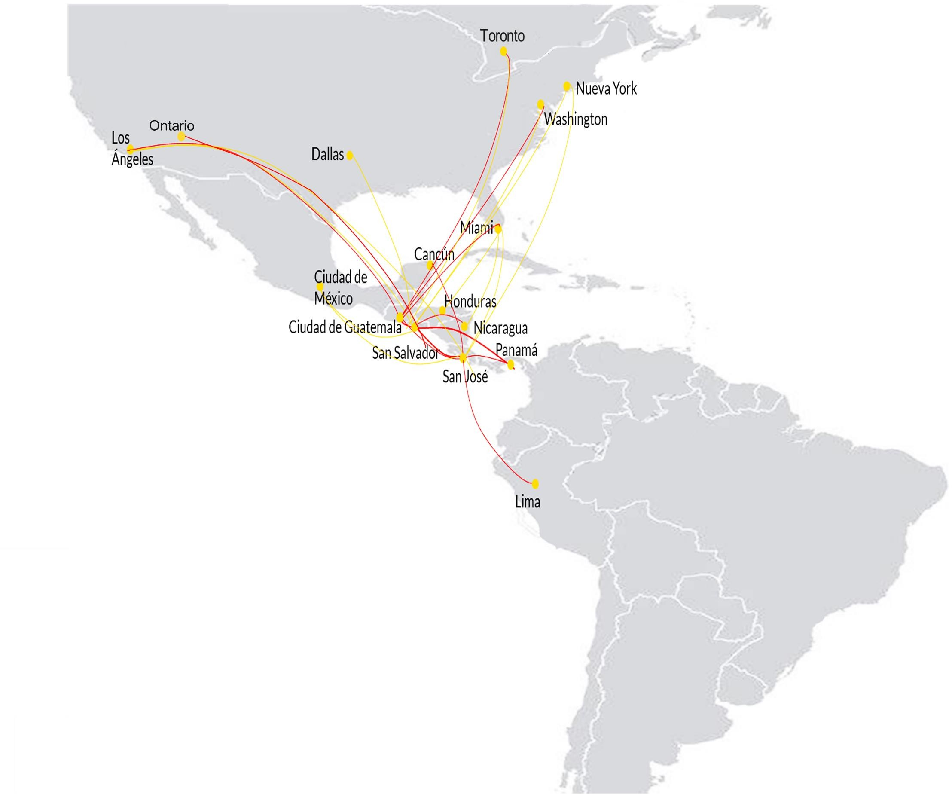







July Frequencies - Central America / North America
Region | Origin | Destinati on | Freq. weekly | Total Freq.
Central America | CUN | SJO | 4 | 151
 | CUN | SAL | 3
 | GUA | LAX | 7
 | GUA | SAL | 16
 | GUA | SJO | 16
 | GUA | XPL | 4
 | GUA | FRS | 3
 | GUA | SAP | 3
 | GUA | IAD | 3
 | GUA | JFK | 3
 | MGA | SAL | 25
 | SAL | SAP | 7
 | SAL | SFO | 14
 | SAL | SJO | 23
 | SAL | YYZ | 7
 | SAL | XPL | 10
 | SAL | MAD | 3
North America | DFW | SAL | 7 | 124
 | IAD | SAL | 25
 | IAD | SJO | 4
 | IAH | SAL | 7
 | JFK | SAL | 17
 | LAX | SAL | 19
 | MEX | SAL | 14
 | MEX | SJO | 7
 | MIA | MGA | 19
 | MIA | SAL | 3
 | ONT | SAL | 5
 | BOS | SAL | 3
 | MCO | SAL | 4
 |  | 280
 |  | 270
 |  | 260
 |  | 250
 |  | 240
 |  | 230
 |  | 220
*As of June 2023 Operation subject to change
Quito
267
275
262
275
260
263
256
2022
2023
238
237
240
229
229
Buenos Aires
234
223
JAN FEB MAR APR MAY JUN JUL
Central America
North America
Source: Report June Network Planning

Slide 11

August Frequencies - Central America / North America
Region | Origin | Destinati on | Freq. weekly | Total Freq.
Central America | CUN | SJO | 4 | 151
 | CUN | SAL | 3
 | GUA | LAX | 7
 | GUA | SAL | 16
 | GUA | SJO | 16
 | GUA | XPL | 4
 | GUA | FRS | 3
 | GUA | SAP | 3
 | GUA | IAD | 3
 | GUA | JFK | 3
 | MGA | SAL | 25
 | SAL | SAP | 7
 | SAL | SFO | 14
 | SAL | SJO | 23
 | SAL | YYZ | 7
 | SAL | XPL | 10
 | SAL | MAD | 3
North America | DFW | SAL | 7 | 124
 | IAD | SAL | 25
 | IAD | SJO | 4
 | IAH | SAL | 7
 | JFK | SAL | 17
 | LAX | SAL | 19
 | MEX | SAL | 14
 | MEX | SJO | 7
 | MIA | MGA | 19
 | MIA | SAL | 3
 | ONT | SAL | 5
 | BOS | SAL | 3
 | MCO | SAL | 4
 |  | 280
 |  | 270
 |  | 260
 |  | 250
 |  | 240
 |  | 230
 |  | 220
*As of June 2023 Operation subject to change
Quito
267
271
275
275
262
260
263
256
253
2022
2023
238
237
240
229
229
Buenos Aires
234
223
JAN FEB MAR APR MAY JUN JUL AGO
Central America
North America
Source: Report June Network Planning

Slide 12











































July Frequencies - Ecuador
Region | Origin | Destination | Freq. weekly | Total Freq.
Domestic Ecuador | UIO | MEC | 14 | 97
 |  | GYE | 42
 |  | GPS | 8
 |  | CUE | 9
 | GYE | SCY | 10
 |  | GPS | 12
 | MEC | GPS | 2
Ecuador International | GYE | JFK | 6 | 34
 |  | SAL | 3
 |  | CTG | 1
 |  | MDE | 1
 |  | LIM | 1
 | UIO | JFK | 5
 |  | SAL | 3
 |  | SJO | 4
 |  | EZE | 4
 |  | MDE | 3
 |  | CUN | 3
Baltra
San Cristóbal
Quito
Manta
Guayaquil
* As of June 2023 Operation subject to change
Cuenca
140
130
133
127
127
126
131
131
120
110
100
90
80
113
114
125
127
125
2022
2023
From Quito
From Guayaquil
96
94
96
JAN FEB MAR APR MAY JUN JUL
Source: Report June Network Planning

Slide 13
August Frequencies - Ecuador
Region | Origin | Destination | Freq. weekly | Total Freq.
Domestic Ecuador | UIO | MEC | 14 | 97
 |  | GYE | 42
 |  | GPS | 8
 |  | CUE | 9
 | GYE | SCY | 10
 |  | GPS | 12
 | MEC | GPS | 2
Ecuador International | GYE | JFK | 6 | 34
 |  | SAL | 3
 |  | CTG | 1
 |  | MDE | 1
 |  | LIM | 1
 | UIO | JFK | 5
 |  | SAL | 3
 |  | SJO | 4
 |  | EZE | 4
 |  | MDE | 3
 |  | CUN | 3
Baltra
San Cristóbal
Quito
Manta
Guayaquil
* As of June 2023 Operation subject to change
Cuenca
140
130
133
127
127
126
131
131
120
110
100
90
80
113
114
125
127
125
2022
2023
From Quito
From Guayaquil
96
94
96
JAN FEB MAR APR MAY JUN JUL
Source: Report June Network Planning

Slide 14


Slide 15



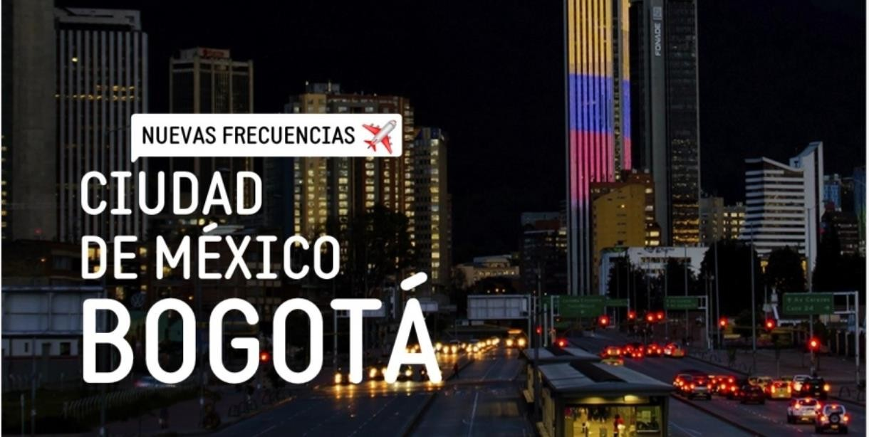
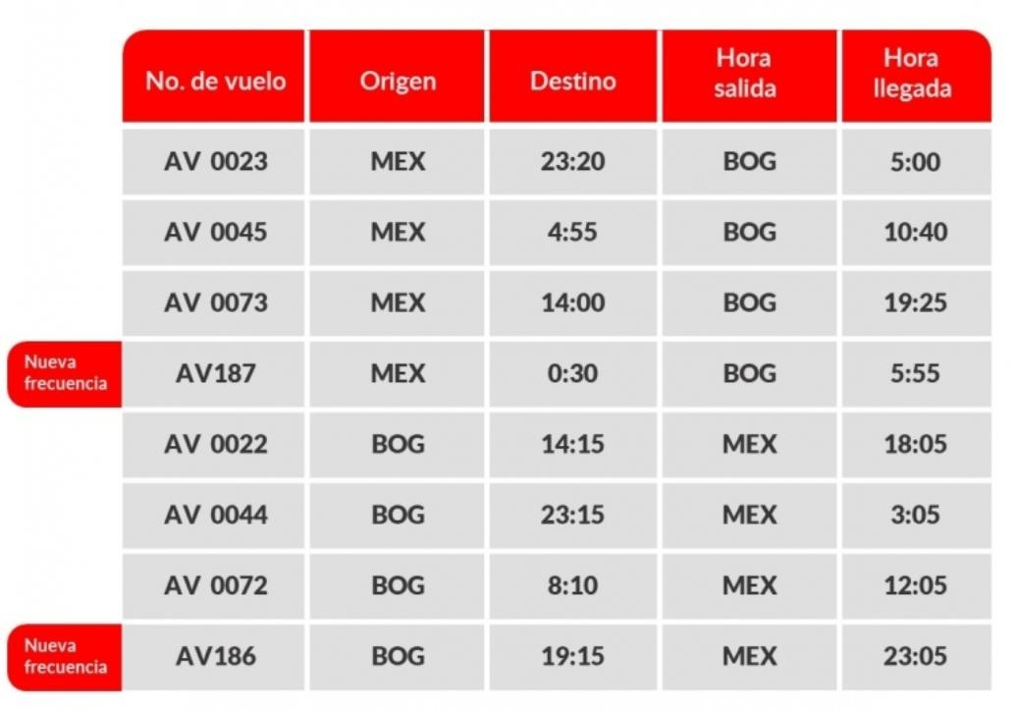
Now there are more opportunities to get to know Bogota! A dynamic, creative city with a culture that will amaze your travelers.
We have added a frequency between the two cities from September 1st for a total of 4 daily frequencies.

Slide 16





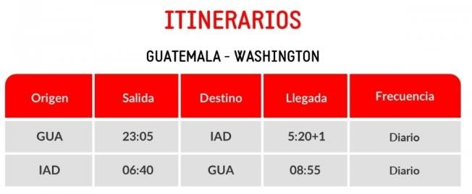
Now your customers will be able to travel from Guatemala to Washington with our new daily frequency to the United States starting September 3rd.

Slide 17



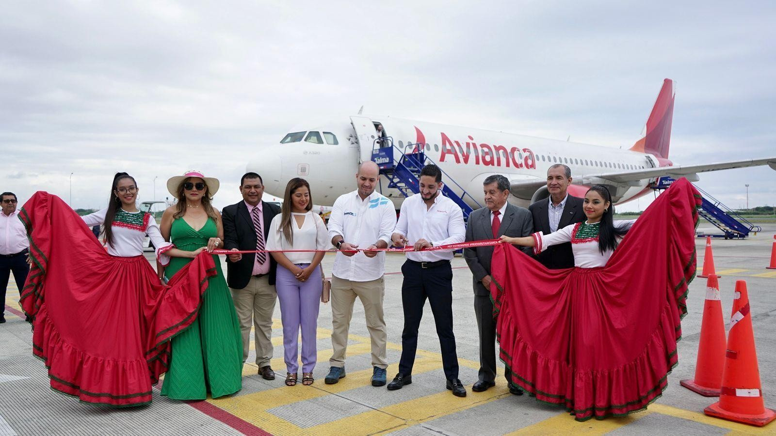
We continue to grow our operation in Ecuador. On July 2, we started the direct route from Manta to the Galapagos Islands, which will have 2 weekly flights in Airbus A320 aircraft with capacity for 180 passengers.
New Manta - Baltra route

Slide 18
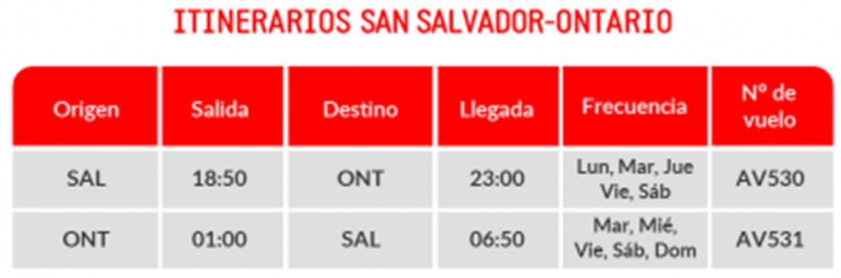
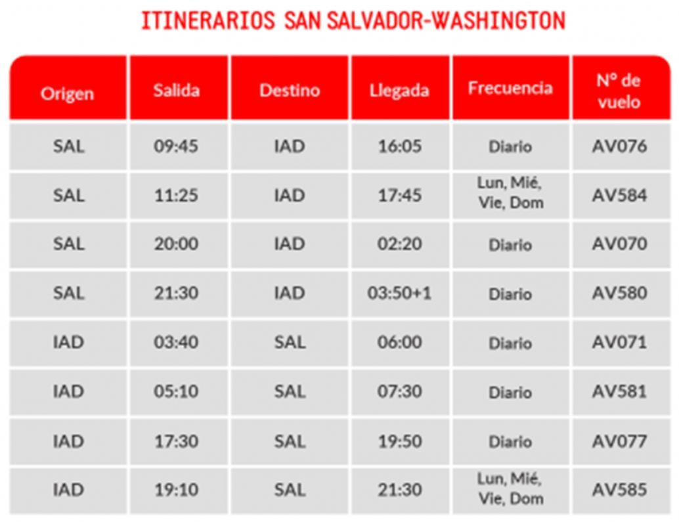
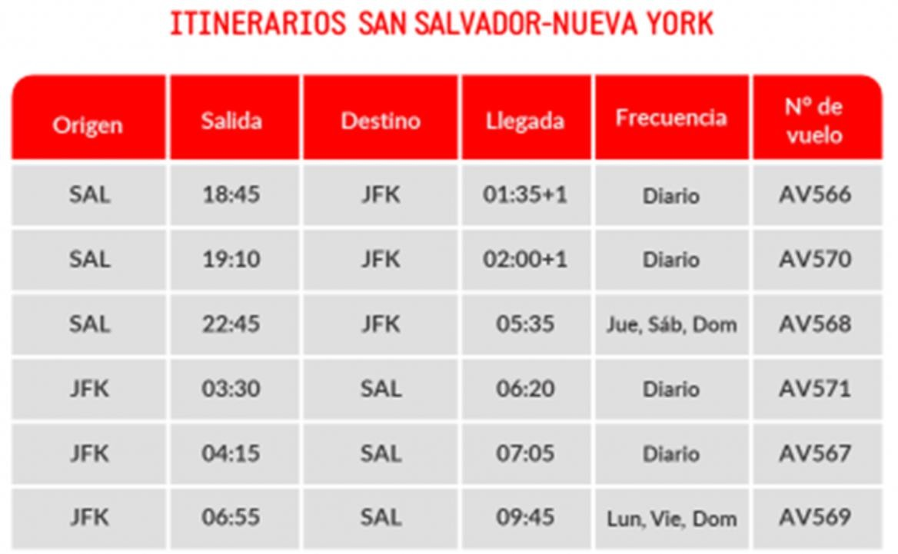
It's time to explore new horizons with our new frequencies to 3 incredible destinations in North America:

Slide 19




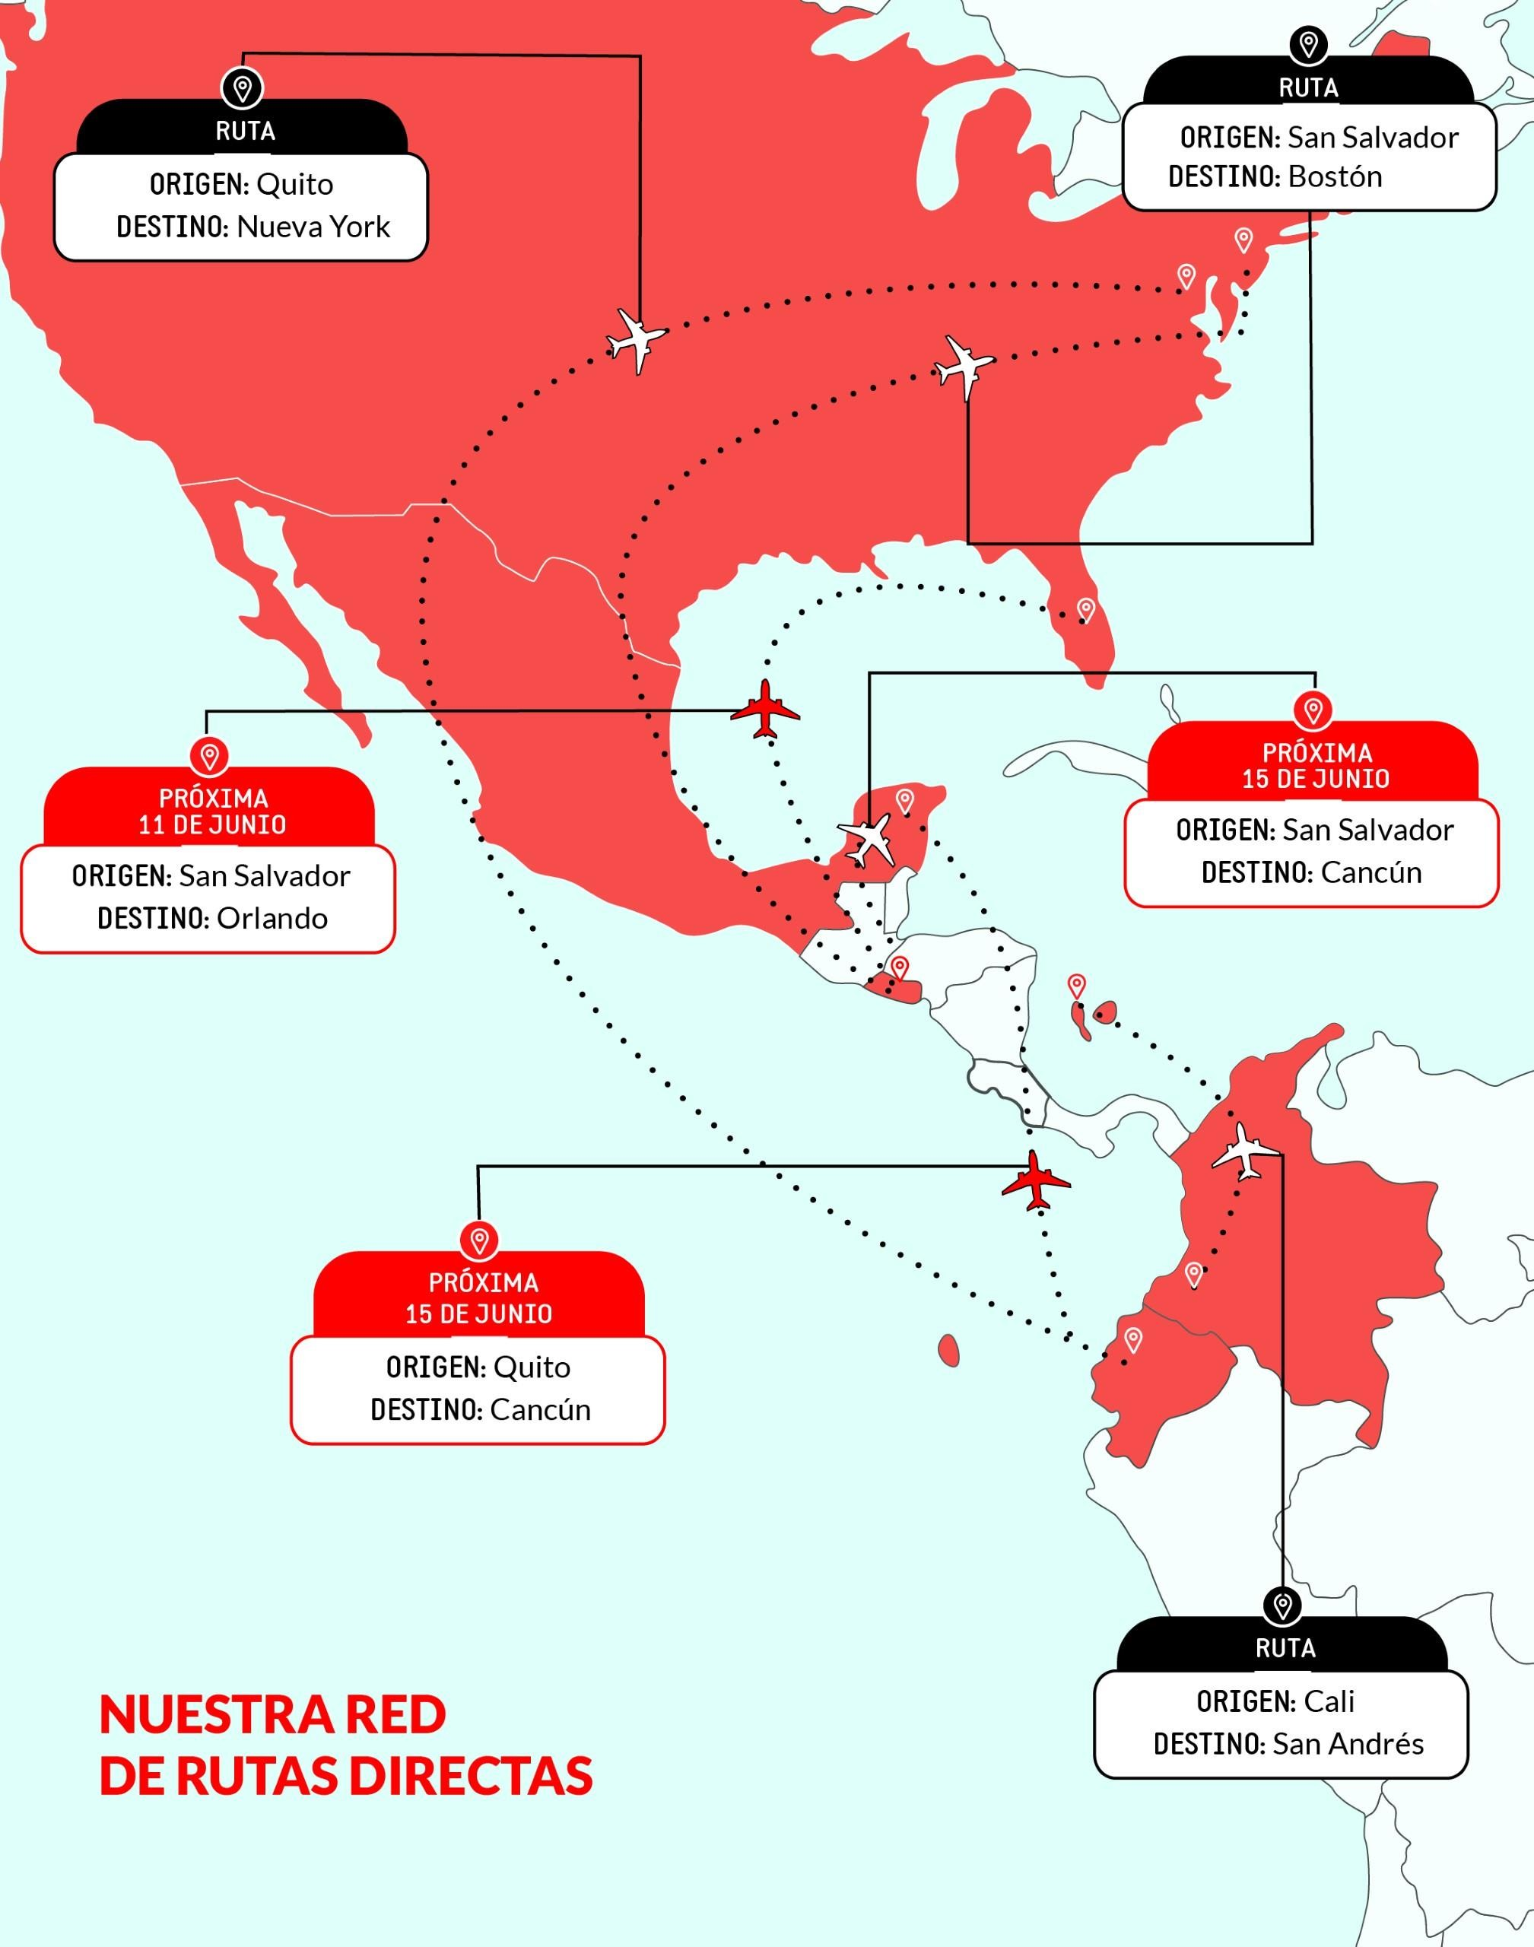


From El Salvador, we have established new direct routes to Boston, Cancun and Orlando. But that's not all, we will also have 5 weekly direct flights from the Big Apple and Quito.
New Boston and Orlando routes
New direct flights to Cancun
New route Cancun
New direct flights to Cancun

Slide 20









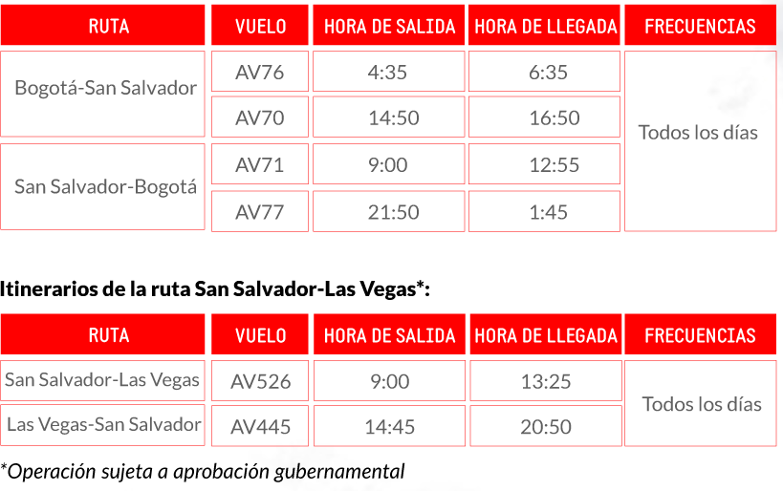




We will fly from Bogotá to Las Vegas with a stopover in San Salvador.
The Bogota-San Salvador-Las Vegas route, which will be available as of July 15, 2023, was created with the objective of allowing our customers to access a world-class tourist destination to enjoy attractions such as the Grand Canyon, the Seven Wonders, the Valley of Fire, visit the famous casinos and enjoy the magic of the place.

Slide 21




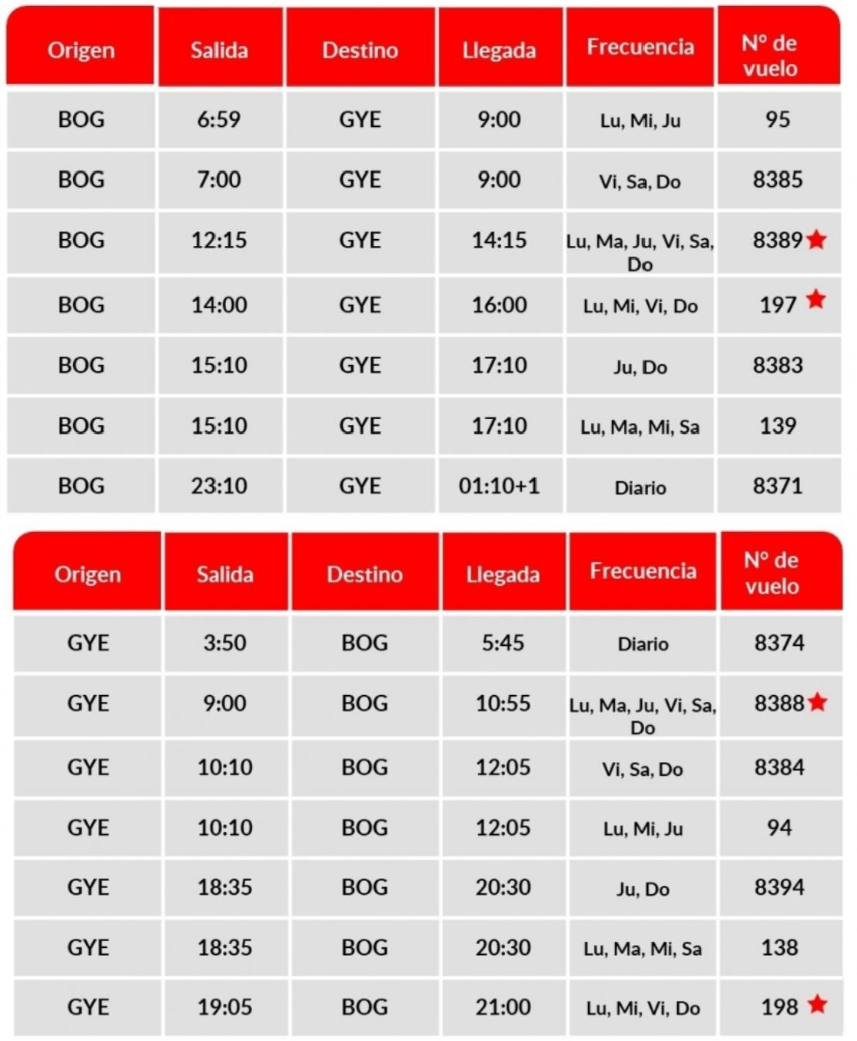


Slide 22







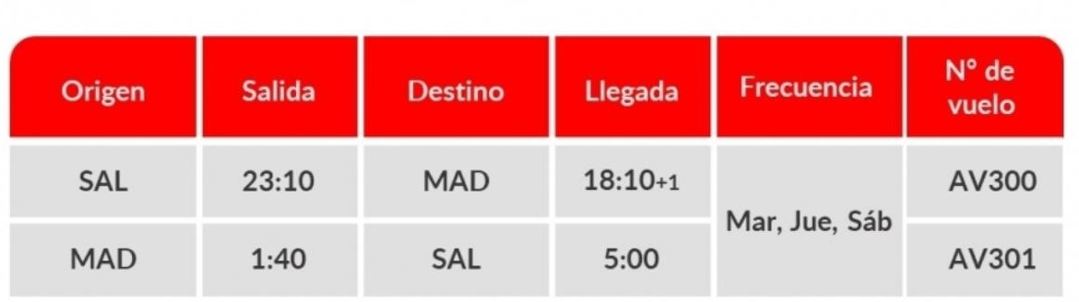




Local Time
Itinerary subject to government approval
Operated by Wamos Air
From San Salvador to the Puerta de Alcalá!
Now from Central America they will be able to travel to the Spanish capital and connect with all of Europe via El Salvador. In addition, travelers will have access to the executive cabin and will have the following onboard services

Slide 23
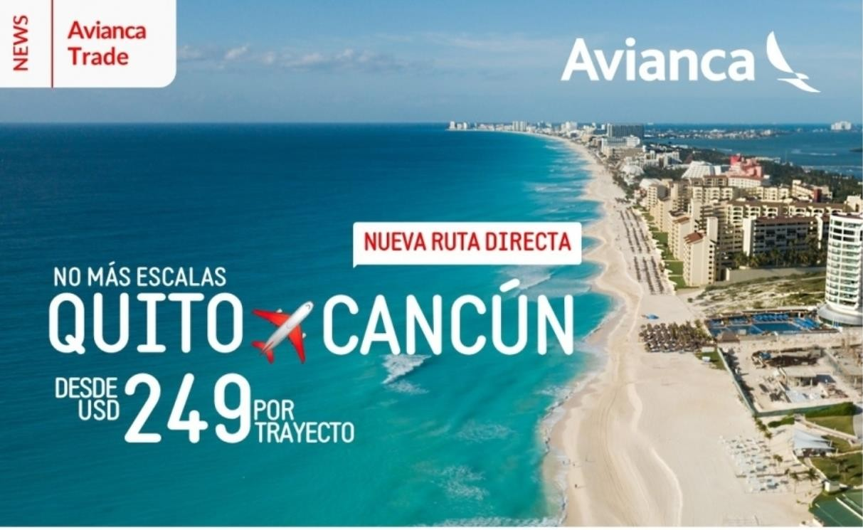
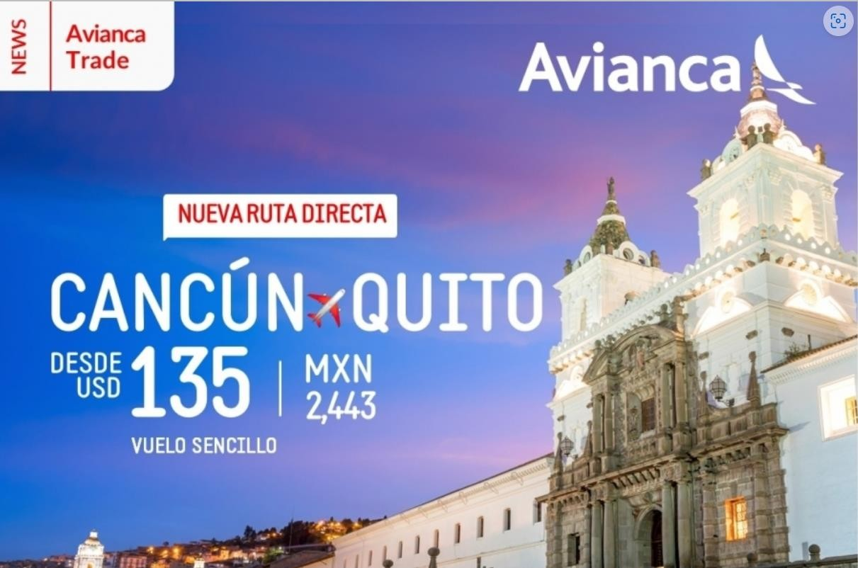
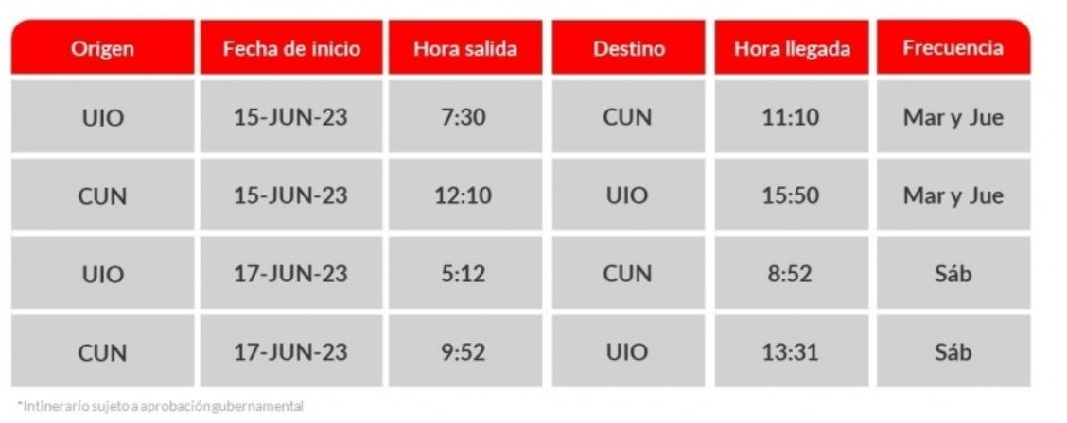

Quito-Cancun-Quito will take off and will be available to fly from
June 15.

Slide 24
















**From Bogota to: Boston Manaos
Belo Horizonte
Ipiales"
From Medellín to:
Quito Guayaquil Aruba Armenia:
From New York to:
Quito*
Within Colombia:
Medellín - Pereira*
Miami - Cartagena* New York - Cartagena* B/manga - Cartagena*
Pereira - Cartagena Orlando - Medellin* Cancun - Medellin Medellin - Riohacha
Miami - Cali New York - Cali Santa Marta - Cali Miami - Barranquilla San Jose - Cancun
Washington - Cancun
Lima - Guayaquil
From Cartagena to: Santiago de Chile Sao Paulo Guayaquil
Itinerarios sujetos a aprobación gubernamental.
Itinerarios sujetos a aprobación gubernamental.
* Seasonal routes - JFKUIO available from June 1st to November 1st.
**

Slide 25


Slide 26










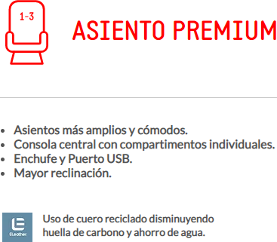
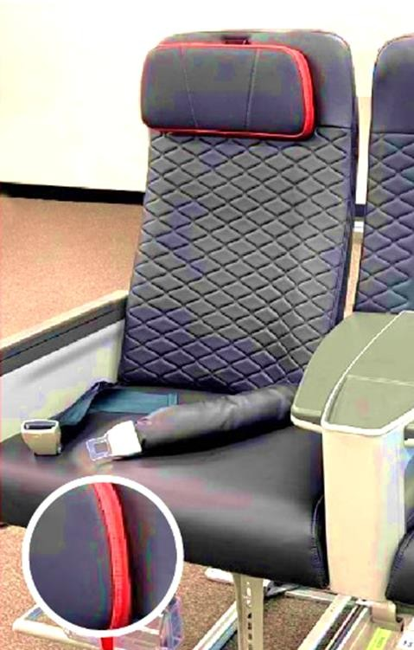
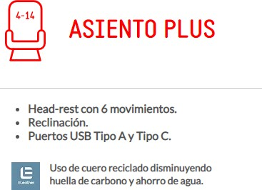
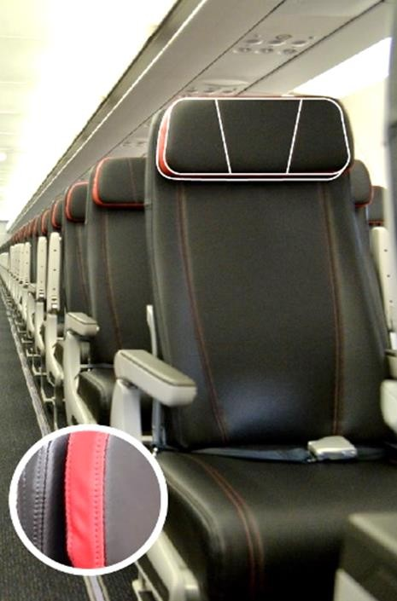
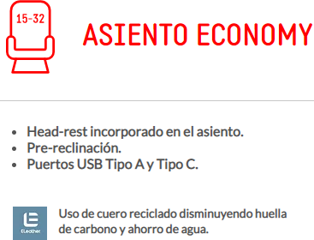
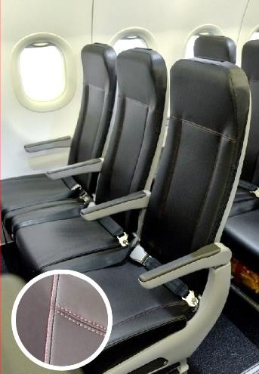


Now your customers can enjoy on some international flights, domestic Colombia and domestic Ecuador, the new Plus, Economy and Premium seats
on our A320 aircraft. .
Widest seat for passengers who prefer traveling with the most comfort.
For those who like to sit closer to the door when deboarding.
Customers will have access to a better price, which will allow them to purchase additional services and choose how they want to fly.
In record time: Avianca completes 104 Airbus A320 aircraft reconfigured to offer 20% more capacity.

Slide 27

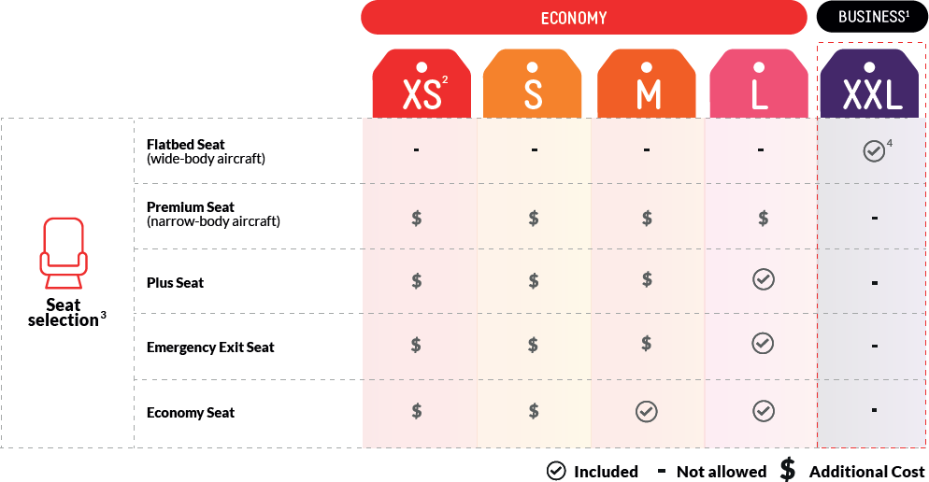






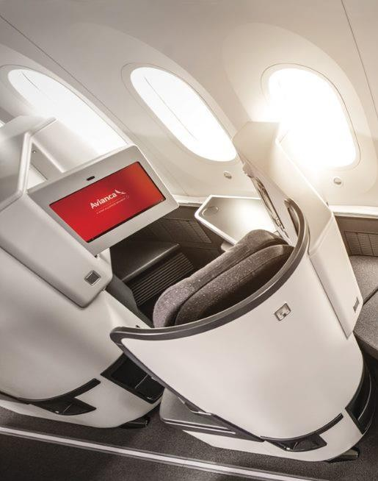




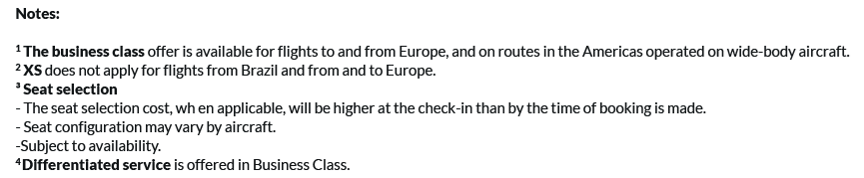

The business class cabin will be maintained on flights to/from Europe and the Bogota-Los Angeles route. In addition, on July 18, we will start selling this cabin on some routes in the Americas operated on wide-body aircraft to fly from August 15, 2023
On B787 aircraft, the first seven rows will be sold as Flatbed seats.
Independent seat
180° recline
16" entertainment system
Plug and USB port
Work table
Adjustable headrests with supports
side
On A330 aircraft, the first five rows will be sold as Flatbed seats.
Spacious and comfortable seats
161° recline
16" entertainment system
USB port

Slide 28





Continuing with the process of simplifying the company to be more efficient and give our customers more options, allowing them to travel paying only for what they need, as of November 1, 2022 we have the following changes:
Customers wishing to travel in the first three rows may purchase their seat at the time of booking, check-in or at the airport, subject to availability.
All tickets purchased in L fare before November 1, 2022 will be able to select their seat in the first three rows free of charge at any time. However, if the customer voluntarily changes the ticket, the conditions in effect on the date of the change will apply.
Remember that Avianca offers three types of seats (Rows 1-3, Plus and Economy).
The airline is in the process of changing cabins, so customers traveling on A320 fleet aircraft may encounter different types of seats during this period.
Tickets purchased in L fare to travel on single-aisle aircraft will also have the option to purchase seats in the first three rows - the seat selection attribute rows 1-3 will no longer be included in L fare.
Elite customers can purchase the first three rows with Elite Points through
the LifeMiles website up to two days before the flight date.
Upgrade Q&A Changes in the "Tailor-made flights" scheme

Slide 29

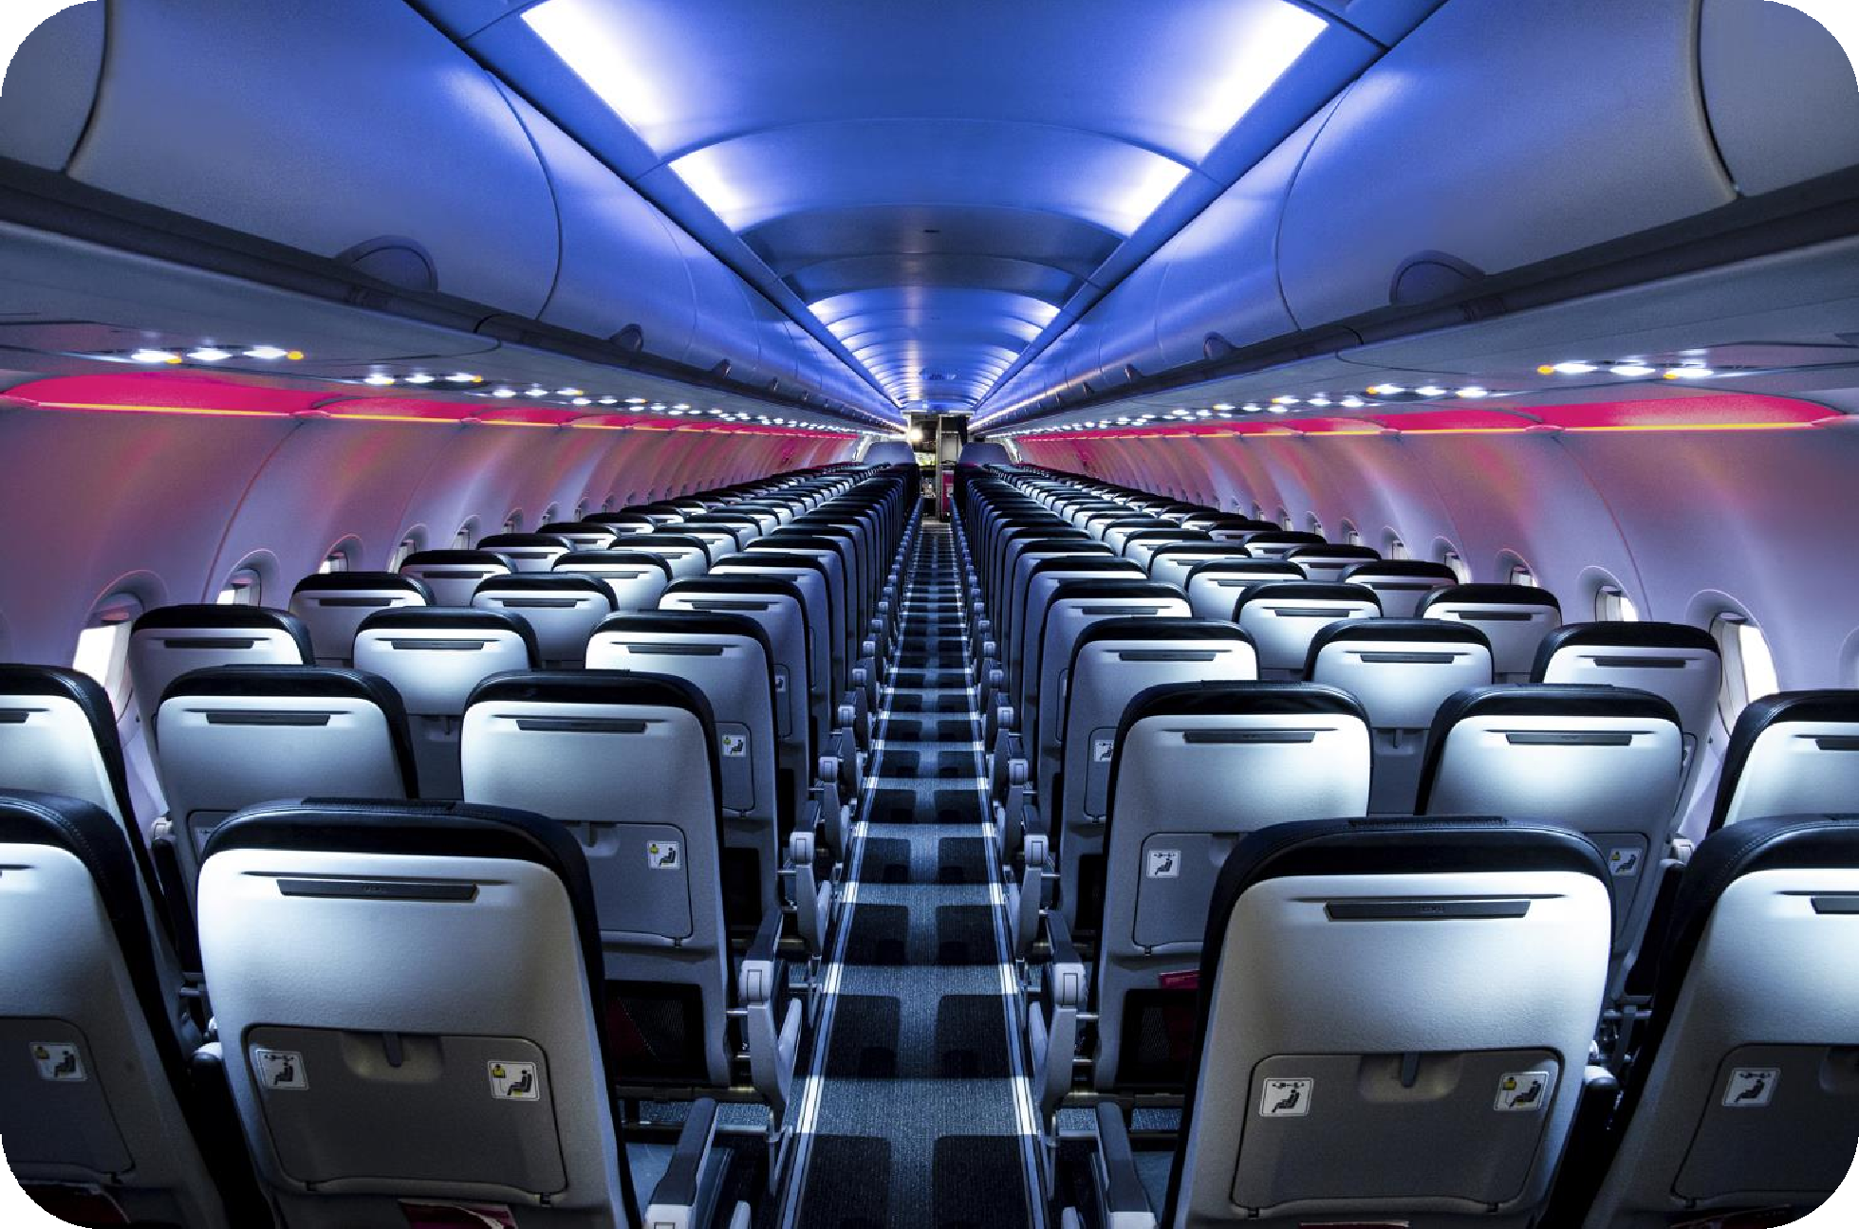
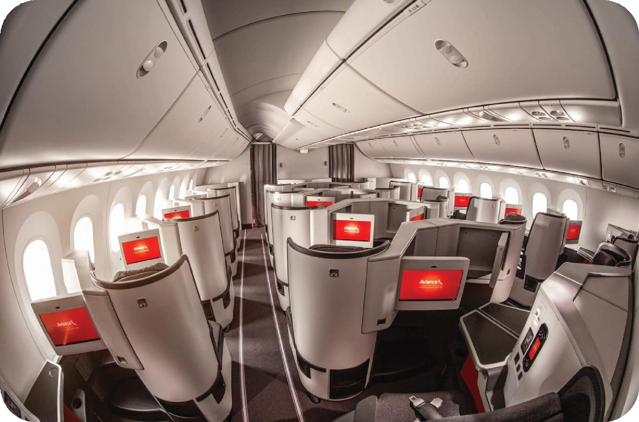



Slide 30





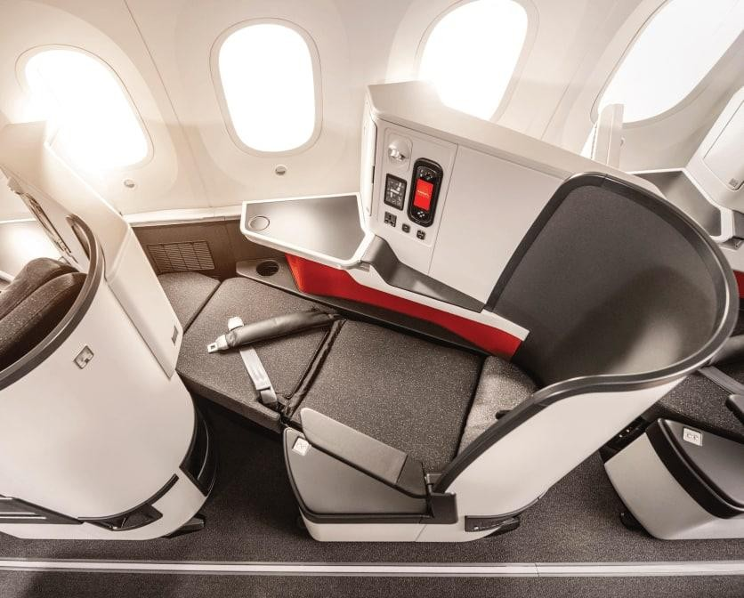
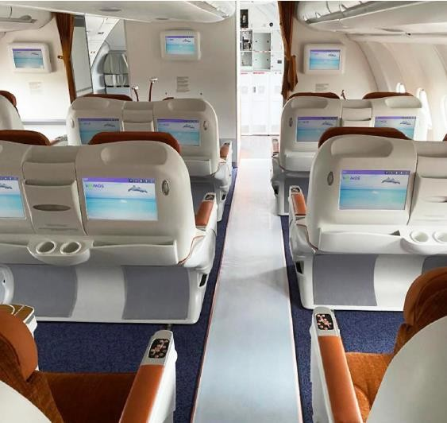


As of July 18, in addition to the routes to Europe, our customers have the option of purchasing the XXL Business Class fare for travel to 4 destinations in the Americas on those flights operated on double-aisle aircraft as of August 15. The routes on which this service is available are:
Bogota - Buenos Aires
Bogota - Sao Paulo
Bogota - Miami
San Salvador - Los Angeles
On July 1, we also enabled the possibility of traveling in Business Class on the Bogota - Los Angeles route.
Business Class in-flight service:
Food service included
Blanket + pillow kit on night flights
Amenity kit on night flights
Free entertainment system
Downgrade Compensation:
In case of an equipment downgrade, the CPC team will make the defined compensation for cabin downgrade.
Avianca Lounge access
Priority Counters
(includes Elite members)
30

Slide 31



Short and long haul
Being at 36,000 feet it's normal to feel hungry Don't get the munchies! Find out what options you will have available to enjoy your flight even more and complement it with what you like.
FOOD AND BEVERAGE
Our new on-board sales service will be available as of December 1, 2022. In it you will find several options such as: drinks, sweet and salty snacks, combos, among other snacks.
Two services: (Depending on the flight schedule, 2 of the following apply)
Dinner/lunch with 2 options to choose from and pre-packaged dessert
Breakfast with 2 options to choose from
Snack service
Hot/cold beverages and liquor offerings
Please note that:
You can pay only with credit or debit cards (Visa or MasterCard).
The in-flight sales service will be available for domestic and international flights on single-aisle aircraft.
This service is provided directly by Versilia Solutions Limited who is also responsible for the personal data collected in the sales process.

Slide 32

Short and long haul
Planning a trip should be relaxing enough to enjoy it from start to finish. Prepare all your senses and let the flight begin.
ENTERTAINMENT ON BOARD
Enjoy the best content on your own device (cell phone, tablet and laptop) with our new in-flight entertainment system, Avianca On Air. Our digital platform is in the process of being configured in our narrow-body aircraft.
All wide-body aircraft feature an entertainment system with built- in screens to enjoy series, flight information and much more.

Slide 33
For the Bogotá - Los Angeles - Bogotá route, we have contracted the airline Wamos Air under the wet lease modality, who will be operating this route between April 20, 2023 and October 28, 2023 (subject to government approval).
Flight | Arrival Time | Departure Time | Destinati on | Origin | Frequency
AV83 | 5:45 | 20:25 | BOG | LAX | 1234567
AV84 | 19:00 | 13:10 | LAX | BOG | 1234567
The operation schedule will not change, therefore, it does not affect the connection with other flights that the customer has booked with Avianca or other Star Alliance member airlines.
Wamos Air's aircraft seats have 62" seat spacing in the first six rows and 31- 32" from row 11 to row 37.
*Local Time
The Wamos fleet has 34 Flatbed seats to cover the BOGLAX route.
Wamos Air is a member of the International Air Transport Association (IATA) and being a Spanish airline operator, is regulated by the European Aviation Safety Agency (EASA), as well as by the FAA (Federal Aviation Administration) and is accredited by the IATA Operational Safety Audit (IOSA).
All travelers will be able to access a selection of movies and TV series with the in-flight entertainment system through screens.
The food and beverage menu will be the one traditionally offered by Avianca.
Wamos Air has served us on previous occasions and for this new operation Avianca has worked together to ensure that its safety and service standards are maintained during this temporary period.
The processes before and after the flight must be handled as usual with Avianca.
Find out more at Avianca Trade

Slide 35
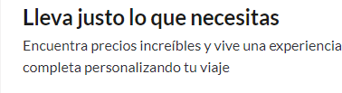



XS
We offer different options so that your customers can fly according to their needs, so that they can choose the one that best suits their travel needs, live an unforgettable experience and find what they are looking for at the best price.
S
Travel lighter and practically
Travel smoothly and without complications, ideal fo travelers who enjoy carrying only the essentials.
r
M
Pre select your seat Economy or preferred seat
Carry more luggage
Take advantage of the benefits of traveling and carry everything you need with you
Pre select your seat Plus or emergency exit
L
Fly with more flexibility and
benefits
Take advantage of all-inclusive travel services and the ease of adjusting your flight when you need to.
Online check-in (web, app, kiosks) is available free of charge on all fares

Slide 36
Offer your customers our fares
XXL
Fly all-inclusive
Travel without complications, with more lugg enjoy an exclusive service.
Travel with 70 pounds (32kg) Checked baggage *2 +
22 pounds (10kg) carry-on luggage + one personal item
age and
*
Beginning July 18, 2023, XXL fare Business Class will be available on twin-aisle aircraft in the Americas, for flights beginning August 15, 2023.
*The offer of this cabin may vary by market.

Slide 38
That is why Avianca offers a wide portfolio of products and services so that our customers can fly according to their needs.
Services that can be purchased additionally to complement our clients' trip.
38

Slide 39
Remember that your clients can complement their trip with our additional services.
Inform your customers that they can add the luggage they need to the reservation, if not included in the rate they have purchased.
Avianca Plus: They are located in the first rows of the aircraft, it is a preferential seat with more space, exclusive luggage rack to store your hand luggage and be one of the first to disembark.
Front row or preferential seat: Disembark quickly and be the first to get off the plane. Enjoy the best location!
Emergency Exit: Travel with more space and comfort for your legs. Ideal for long flights.
Standard seat: This is the ideal option when traveling with several companions to travel with your family or friends. Applies for the S and Super Promo fares, for the XS fare it is subject to availability.
Do your customers need to bring sporting goods on their trip? They can add in the reservation the items they need both sports equipment and musical instruments, only the packing and transportation requirements for items in the cabin and in the hold must be complied with.
In partnership with Iké Asistencia, your clients can purchase medical assistance and travel safely to their international destination. This service features virtual doctor and 24/7 global coverage.

Slide 42
1. Display booking
In the services menu, select the option "add service".
In the options bar, select the service you wish to purchase.
Select the book service option followed by the price Service option.
Issue the service, generate EMD associated with the booking
42

Slide 43
43

Slide 44
44
Example from agency portal

Slide 45
45
Example from agency portal

Slide 47
It is now easier to reach Elite status with Avianca!
Elite Members will now have more benefits
A simpler way to access your AV Lounge benefits, seat selection and business class upgrades

Slide 48
Every LifeMiles you earn brings you closer to classifying to a status.
JANUA
RY
Starting in 2023, earn qualifying miles on all accruals of LifeMiles
Earn more qualifying miles when you fly on Avianca, use your Avianca
LifeMiles credit cards or join the LifeMiles club
Flights on Avianca
and Star Alliance
Credit or debit card purchases Club LifeMiles LifeMiles Pay
Other miles
Commercial partners miles purchases
A new direct route to your Elite Status where each mile accelerates your path

Slide 49
Avianca Flights (Base Miles) | Purchases with AV LM credit card | Other Miles
Avianca Ancillaries | LifeMiles Club
Star Alliance Airlines | LifeMiles Pay
GOL Flights | Multiply your miles
 | Purchase Miles
 | Partner Merchants
Does not apply: Earn miles with Iberia, Aeromexico, (compensations for frauds in validation)

Slide 50
Find out how your customers can earn and redeem LifeMiles
When flying with Avianca or Star Alliance member airlines, your customers can additionally protect their travel with Miles Care or redeem miles when they have excess baggage.
We have lounges in international terminals in Bogota and El Salvador and domestic terminals in Colombia, with Wi-Fi services, work and rest areas, and coffee and food stations.
For purchases or use of the Uber Gift Card.
We have different alternatives for upgrades in LifeMiles:
Avianca upgrades, Star Alliance upgrades, LifeMiles e-Coupons and Diamond partner upgrades.
For each night booked in hotel search engines, partner hotel chains.
By renting a car with our partners.
Earn LifeMiles on everyday purchases at partner stores.
Purchase LifeMiles to complete your trip. Multiply your miles through one of our programs.
Find all the offers in allied merchants using LifeMiles credit cards.
They can earn LifeMiles at more than 30 partner restaurants.
Purchase LifeMiles card and receive welcome bonus and benefits for each purchase you make.
They earn LifeMiles or they can use them to buy their favorite products online.

Slide 51
We have decreased Avianca's qualifying mileage requirements by up to 81% compared to 2022.
2022
2023
2022
2023
2022
2023
2022
2023
Qualifying Miles
6.500
6.000
11.500
12.000
6.000
(-35%)
23.500
24.000
40.000
40.000
Minimum miles flown
with AV
5,200
1.000
(-81%)
9.200
18.800
12.000
(-36%)
32.000
20.000
(-38%)
Less than 2022 Equal to 2022 Greater than 2022
To qualify for Elite status, a LifeMiles member must meet the following two qualifying mileage requirements in a calendar year
Reach the goal of total qualifying miles on flights with Avianca or Star Alliance airlines.
Ensure that a minimum of these qualifying miles are accrued on flights with Avianca

Slide 53
From February 2023
Renewed image
Help Center with updated information and quick search
with keywords: products, waivers, latest news, policies,
From 18 April 2023
1. News center with
Help Center with information and
quick search .
All requests in a single portal .
Activation of plates, new Iatas
New functionalities for groups and
servicing
updated information:
products, waivers, latest news
3. Portal to manage requests,
formerly AGS360
4. Activation of plates, new Iatas.

Slide 54
From April 18, you will have new forms available in the support module and you will have a support team that will attend your requests, simplifying the Servicing and Group management processes.

Slide 55
- Support for refund and/or customer service cases, which are not answered within the established timeframes (Refunds >30days Customer Service >20 calendar days)
- A case number is required to request support.
- You can file up to 9 tickets
- Support for reaccommodations not self-manageable by the travel agency
- Cases that have not been resolved through the self-management channels.
- For this form apply tickets for routes operated by Avianca or Interline.
- Support to cases filed for lost and found requests in VIP lounges and/or Avianca's own aircraft.
- The case number must be available
- Frequently asked questions about Avianca products will be answered.
- Issuance of commercial certifications of No Sanction and Paz y Salvo for travel agencies.

Slide 56
- Request the quotation and/or blocking of a group, only when GSO generates an error.
Notify the EMD of payment by deposit or final payment to ensure the group is blocked.
The EMD must be submitted before 14:00 COL time Monday through Friday .
Request the creation of the TST (fare mask) and assign the reservation when the issuance process is to be done in the GDS, must be sent before 14:00 COL time Monday to Friday.
Request confirmation of no penalty, in order to process the refund of the EMD deposit and/or final payment of a group.
Request itinerary change, name correction or name change, before the start of the trip, must be sent
before 14:00 COL time Monday through Friday.
To request an extension of any of the contract terms, rate revision, the competitor's offer must be attached without exception, or to reinstate a cancelled blockade.
- Form to request to add fiscal number, corporate agreement, infant, cancel a ticket, reinstate a cancelled reservation (subject to availability), cancel a blockage due to error in GSO, reduce quotas, reservation protection (Colombia only), request a ticket by mail, pre-assignment of seats.

Slide 57
Type of requests through Avianca Trade
Voluntary changes | Group Management - New
Voluntary changes due to loss of control Name Corrections | Quotes
 | Payments
 | Issuance
Voluntary Changes
 | Refunds
Change fee waiver Operational Events
 | Changes to group tickets
 | Time extension - Fare reevaluation - Reinstall blocking
Avianca Direct
 | Other requests
PNR Split - AviancaDirect Changes to PNR not available in Avianca Direct Agencies portal signature management Avianca Direct Incident Reports Reversals of APM ticket payments Avianca Direct (Non IATA Agencies)
 | Other Servicing requests - New
 | Functional failure report Unanswered refunds and customer service
 | Reaccommodations not self-managed by the agency without response
 | Request for forgotten items in VIP lounges and aircrafts
Queries and certificates
 | Frequent queries
Ticket status query Refund status query Flight certificates
Avianca Empresas
Name change and correction Waiver redemption Upgrade Redemption

Slide 59
Change of Benefits
Termination
Mass
Sales
Classic
30-Mar-22
30-Apr-22
Silver, Prime,
Classic Gov
15-Jan-23
15-Feb-23
Gold
13-Feb-23
15-Mar-23
Diamond
13-Apr-23
15-May-23
IRR/RFPs
01-Nov-22
On demand

Slide 60
DIAMOND
(from 700KUSD sale per year)
GOLD
(from 200K USD sales per year)
Discounts LM Elite cards
(HM CO,EC, CAM & IRR only)
Personalized Service
Portal access Name change
Purchasing Channels
20% in L and XXL
15 % in L and XXL
Diamond 3 | Gold 5
Gold 3
Sales Executive
Travel management Employee self-management
Unlimited free of charge according to Avianca Empresas Policy
Agencies, Portal, CCE
*Excludes classes U, T and G - Does not apply to offline routes

Slide 62
In order to offer a more competitive, self-manageable, efficient and user-friendly product, as of November 30, 2022 we will have the following new features in our group policy
We standardize the validity of offers to 48 hours for regular agencies and 72 hours for diamond agencies.
We eliminated the Tour Conductor in all Group products.
Accept the offer by generating the block of the seats and paying the deposit 7 days later.
Creates the deposit EMD according to the percentage to be applied on the value of the fare plus fuel of the group.
Regular 30% - Diamond15% - Maximum capacity
50%.
* Now in GSO with a single CLICK you can issue after
entering names
The tickets will be issued in CASH and will be reported through the BSP in the agency's IATA.
If there are no cancellations or changes, we will authorize the refund of the deposit EMD.
We eliminate the final payment with EMD and leave it for payment against the sales report.
Issues tickets 3 days prior to flight departure
Total/partial cancellations or changes will be penalized according to their date:
All quotes are made in the currency of issue defined by Avianca in each country.
With the value of the deposit per customer from the date of the blocking date
With the total of the fare plus fuel per customer from
DOM: 21 days - INTER: 30 days - EUR: 60 days.
Learn more information on Avianca Trade
* GSO ticketing does not apply to agencies in the United States.

Slide 64
Our distribution and direct sales channel for travel agencies that offers the best content of Avianca's products and services.
Avianca Sync: the way to access Avianca's content through certified third parties.
Agency Portal: a web portal that will allow connected agencies to book and issue tickets directly with the airline.
Avianca Link: technology used to provide Avianca's content to third parties.
Agility and dynamism in the communication between Avianca and travel agencies.
Reduction of unproductives which generates savings for the agencies.
Illustrative sale of ancillaries and optimization of your process.
Rich content of products and services through photos and videos.
Innovative solution that allows travel agencies to be at the forefront of technological developments.
Greater access to Avianca's entire portfolio of products and services.
Prioritized care model for effective solutions.

Slide 65
Access to differentiated content depends exclusively on the type of contract of each agency.
XS S M L XXL
AviancaDirect (NDC - GDS)
AviancaDirect and direct channels
GDS Edifact Opt-in (**) - Full Content
GDS Edifact Opt-out(**) (***) (***)
Colombia
AviancaDirect and direct channels. / NDC - GDS (*) - Full Content
Traditional EDIFACT (***)
Rest of the world
Notes: (*) Avianca Link - Avianca Sync - Portal Agencias. More information: https://www.avianca.com/co/es/ndc/ ; https://retailing.iata.org/armi/registry/av/; (**) XL and XXL applies only for flights to and from Europe.
(***) $8.00 surcharge per fare component

Slide 67
The Star Alliance network allows you to connect to more than 195 countries around the world.
Convenient schedules and optimized connections.
Easy check-in, combined ticketing, accessible check-in counters and baggage facilities, and support staff for connections at major airports.
Easy booking for multi-destination tickets.
Customized products for business travelers.
It is valid for worldwide travel to and from countries served by Star Alliance member airlines.
Flexible fare that offers excellent value for money, and you can visit 98% of the countries in the world.
The fare is determined by the total number of miles of the planned flight, the
total number of stopovers in your itinerary and the country in which the trip begins (country of origin).
Star Alliance Silver and Gold are two status levels that allow customers to enjoy special Star Alliance premium benefits and privileges such as:
Priority check-in
Preferential baggage handling
Access to more than 1,000 VIP lounges worldwide.
Priority boarding
Priority in waiting lists
Heathrow Express Upgrades
A Single Contract covering all Star Alliance member airlines participating in an account.
A Single point of contact throughout the entire process, from contract negotiation to lifecycle management.
Consolidated report with simplified performance tracking while maintaining
the confidentiality of the terms offered by each participating member airline.

Slide 68
Find out about the destinations that we can currently access, remember that our main connection points with the Star partners are: London - Madrid - Los Angeles, New York - Mexico and Panama
AIRLINE | DESTINATION | OPS/WEEK
A3 - Aegean Airlines | ATH | 21
IC - Air India | AMD | 3
AI - Air India | ATQ | 3
Air India | BOM | 7
Air India | COK | 3
Air India | DEL | 11
Air India | GOI | 3
Air India | HYD | 3
BR - EVA Airways | BKK | 3
ET - Ethiopian Airlines Enterprise | ADD | 7
LH - Lufthansa | FRA | 84
 | MUC | 49
LOT – Polish Airlines | WAW | 21
LX - Swiss International Air Lines | GVA | 34
 | ZRH | 42
MS - Egyptair | CAI | 14
NH - All Nippon Airways | HND | 7
Austrian Airlines | VIE | 28
OU - Croatia Airlines | SPU | 1
 | ZAG | 3
OZ - Asiana Airlines | ICN | 3
AIRLINE | DESTINATION | OPS/WEEK
SK - Scandinavian Airlines | ARN | 40
 | CPH | 32
 | OSL | 33
 | SVG | 6
SN – SABENA | BRU | 20
SQ - Singapore Airlines | SIN | 28
TG - Thai Airways | BKK | 11
 | HKT | 3
TK- Turkish Airlines | IST | 39
TP - TAP – Air Portugal | LIS | 44

Slide 70
Since 2021 we have implemented the Self Reaccommodation service, which allows customers to choose a new itinerary that fits their travel plan in an agile and online way.
Digital self-management allows us to:
Improved customer service
Contact Center decongestion
Irregularity management customized for each passenger
Faster reaction
The reserves that are within the scope of self- management are:

Slide 71
Version 1 as of 12DEC23

