Slide 1
Namespace and Scope,
Module, Package,
Try Except structure
Chapter 09
Programming Fundamentals
ITP3915

Slide 2
Lesson Intended Learning Outcomes
Upon completion of this lesson, you should be able to:
  Basic Knowledge in Namespace and Scope in Python
  Basic Knowledge in package and module
  Basic syntax in using a module
  Basic try except structure
  Using os and subprocess modules

Slide 3
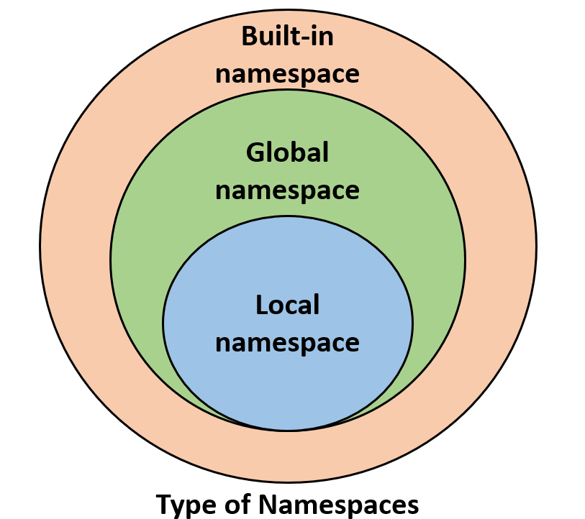
Namespace and Scope
When a variable name is created in Python, the name is stored in a namespace.
Variable names also have a scope
The scope determines the visibility of that variable name to other parts of code.
x in global namespace
Program:
x = 25
def display ():
x = 50
return x
print ( x )
print ( display() )
Output:
25
50
x in local namespace

Slide 4
Variable Scope (Cont.)
Python has a set of rules it follows to decide what variables (such as x in this case) you are referencing in your code.
In simple terms, the idea of scope can be described by 3 general rules:
  Name assignments will create or change local names by default.
  Name references search (at most) four scopes, these are:
    local
    enclosing functions
    global
    built-in
  Names declared in global and nonlocal statements map assigned names to enclosing module and function scopes.

Slide 5
LEGB Rules
The statement in #2 above can be defined by the LEGB rule.
  L: Local — Names assigned in any way within a function, and not declared global in that function.
  E: Enclosing function locals — Name in the local scope of any and all enclosing functions, from inner to outer.
  G: Global (module) — Names assigned at the top-level of a module file, or declared global in a def within the file.
  B: Built-in (Python) — Names preassigned in the built-in names module : open, range, SyntaxError, ...

Slide 6
Local Scope
The local scope or function scope is a Python scope created at function calls.
Every time a function is called, a new local scope is created
By default, parameters and names assigned inside a function exist only within the function or local scope associated with the function call.
Program:
def square(base):
result = base ** 2
print(f"The square of {base} is: {result}")
square(10)
Output:
The square of 10 is: 100
result and base are not accessible from outside square()

Slide 7
Enclosing Scope
Enclosing or nonlocal scope is observed when there are nest functions inside other functions.
It takes the form of the local scope of any enclosing function's local scopes
Names defined in the enclosing Python scope are commonly known as nonlocal names
Program:
def outer_func():
# This block is the Local scope of outer_func()
var = 100 # A nonlocal var
# It's also the enclosing scope of inner_func()
def inner_func():
# This block is the Local scope of inner_func()
print(f"Printing var from inner_func(): {var}")
inner_func()
print(f"Printing var from outer_func(): {var}")
outer_func()
Accessing var from enclosing scope
Accessing var from local scope
Output:
Printing var from inner_func(): 100
Printing var from outer_func(): 100

Slide 8
Global Scope
There’s only one global Python scope per program execution. This scope remains in existence until the program terminates and all its names are forgotten.
The value of any global name can be accessed or referenced from any place of code. This includes functions and classes.
To access a global variable inside a function, use the global keyword.
Avoid using global variables except it is a must or the global variable is used to store constants
A global variable
Program:
var = 100
def func ( ):
global var
var *= 2
print ( var )
print ( var )
func ()
print ( var )
Output:
100
200
200
Use the global variable var inside function
Value of global variable var is multiplied by 2
Updated value of var (i.e. 200) is printed
Initial value of var (i.e. 100) is printed
Global variable var is updated inside function
Updated value of var (i.e. 200) is printed

Slide 9
What is a Module?
In Python, a module is a self-contained file with Python statements and definitions
  E.g. mymodule.py, can be consider a module named mymodule
Modules help us break down large programs into small files that are more manageable
With modules, code reusability becomes a reality
  For a function that is frequently used in different programs. This function can be defined in a module then import it into the various programs without having to copy its code each time
Reference: Creating and Importing Modules in Python
https://stackabuse.com/creating-and-importing-modules-in-python/

Slide 10
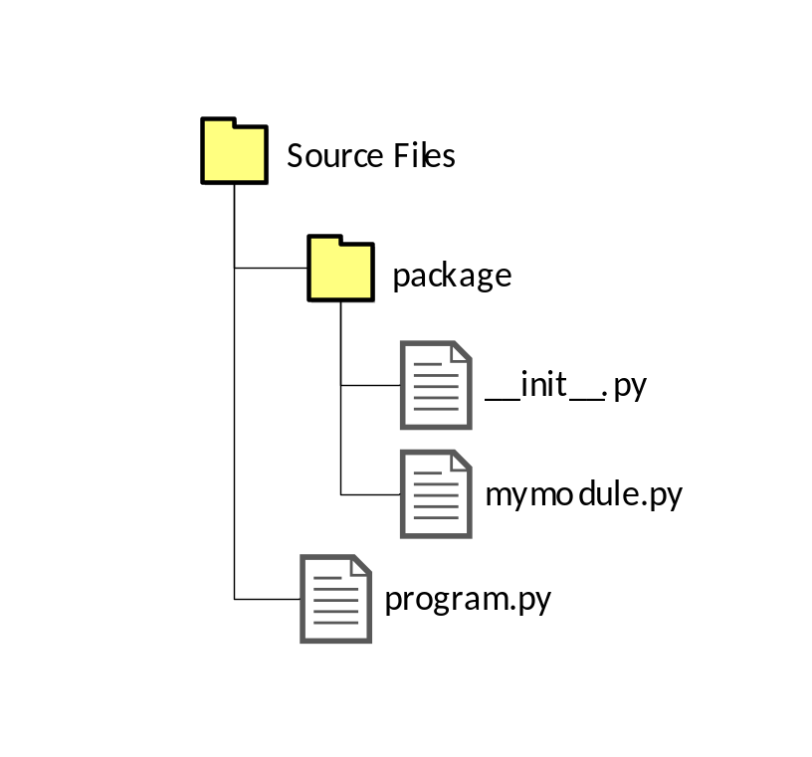
Module Basics
A Python file is called either a script or a module, depending on how it's run:
Script: Run file as a top-level script
  python mymodule.py
Module: Import file as a module
  python program.py
__name__ is a field containing module name
Program (mymodule.py):
print ( __name__ )
Output:
__main__
Program (program.py):
import ( package.mymodule )
Output:
package.mymodule

Slide 11
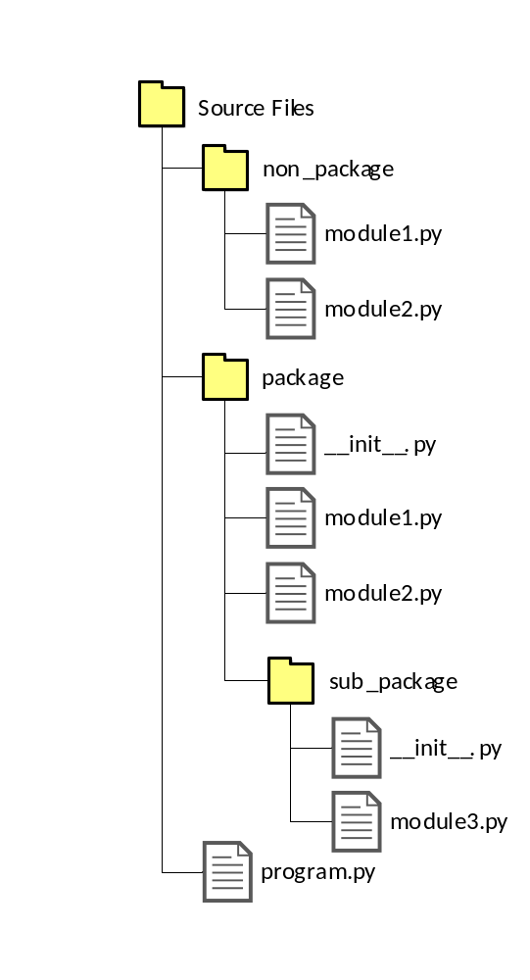
Package Basics
Python packages are collections of modules. In a directory structure, in order for a folder containing Python files to be recognized as a package, an __init__.py file is needed (even if empty)
Cannot be accessed from program.py using non_package.module1
Can be accessed from program.py using package.subpackage.module3

Slide 12
Using a Built-in module
Use the import keyword to import the module
Functions and variables names in the module must be qualified with the module name. e.g. math.pi
Use the dir ( ) function to list all the function names or variable names in a module
Program:
import math
radius = 2.0
area = math.pi * ( radius ** 2 )
print ( area )
print ( dir (math) )
Output:
12.5663706144
['__doc__', '__loader__', '__name__', '__package__', '__spec__', 'acos', 'acosh', 'asin', 'asinh', 'atan', 'atan2', 'atanh', 'ceil', 'comb', 'copysign', 'cos', 'cosh', 'degrees', 'dist', 'e', 'erf', 'erfc', 'exp', 'expm1', 'fabs', 'factorial', 'floor', 'fmod', 'frexp', 'fsum', 'gamma', 'gcd', 'hypot', 'inf', 'isclose', 'isfinite', 'isinf', 'isnan', 'isqrt', 'ldexp', 'lgamma', 'log', 'log10', 'log1p', 'log2', 'modf', 'nan', 'perm', 'pi', 'pow', 'prod', 'radians', 'remainder', 'sin', 'sinh', 'sqrt', 'tan', 'tanh', 'tau', 'trunc']

Slide 13
Create a Module
To create a module just save the code you want in a file with the file extension .py:
Program 1 (mymodule.py):
def greeting ( name ):
print ( "Hello, " + name)
Output:
Hello, Kelvin
Program 2 (program.py):
import mymodule
mymodule.greeting("Kelvin")
Note: When using a function from a module, use the syntax: module_name . function_name

Slide 14
Import Module using keyword from
The from keyword can be used to import only parts from a module
To import all objects (functions, variables, classes, etc.) from a module, import * statement can be used (Not recommended)
  E.g. from mymodule import * (Not recommended)
Program 1 (mymodule.py):
def greeting ( name ):
print ( "Hello, " + name )
person1 = {
"name" : "Kelvin",
"email" : "kelvinyip@vtc.edu.hk",
"tel" : 25952537,
"room" : 302
}
Program 2 (program.py):
from mymodule import person1
print ( person1 ["email"] )
Output:
kelvinyip@vtc.edu.hk
Note: When importing using the from keyword, do not use the module name when referring to elements in the module.
e.g. person1["email"], not mymodule.person1["email"]

Slide 15
Basic Syntax of import
Syntax 1:
import [module]
# Import the whole 'random' module
import random
# Use 'randint' function
# under 'random' module
print ( random.randint (0, 5) )
Syntax 2:
from [module] import [name1, name2, …]
# Import a function 'randint' from 'random' module
from random import randint
# No need to refer to 'random' when using 'randint'
print ( randint (0, 5) )
Syntax 3:
import [module] as [new_name]
# Import the whole 'random' module
# The module name is changed to 'rd'
# to avoid conflict
import random as rd
# Use 'rd' to replace the original
# module name 'random'
print ( rd.randint( 0, 5 ) )
Syntax 4: (Strongly not recommended)
from [module] import *
# Import the whole 'random' module
from random import *
# No need to refer to 'random' when using 'randint'
print (randint (0, 5) )

Slide 16
The try / except structure
Dangerous section of code should be surround with try and except
The try block allow us to test a block of code for errors
The except block allow us to handle the error
  If the code in the try works – the except is skipped
  If the code in the try fails – it jumps to the except section
The finally block will always be executed regardless of the result of the try and except blocks

Slide 17
The try / except structure
Without the try block, the program will crash and raise an error:
Program:
test_word = "Kelvin"
result = int ( test_word )
print ( "First", result )
test_word = "123"
result = int ( test_word )
print ("Second", result)
Output:
Traceback (most recent call last):
File "try.py", line 2, in <module>
result = int(test_word)
ValueError: invalid literal for int() with base 10: 'Kelvin'
This program crashed because of this error, named ValueError

Slide 18
The try / except structure
Program:
test_word = "Kelvin"
try:
result = int ( test_word )
except ValueError:
result = "Not a number"
print ( "First,", result )
test_word = "123"
try:
result = int ( test_word )
except ValueError:
result = "Not a number"
print ( "Second,", result )
When the first conversion fails - it just drops into the except: clause and the program continues.
When the second conversion succeeds - it just skips the except clause and the program continues.
Output:
First, Not a number
Second, 123

Slide 19
The try / except structure
Program:
while True:
try:
word = input ( "> " )
result = int ( word )
break
except ValueError:
print ( "Input again" )
print ( "Finish with value", result )
True ?
Yes
word = input ("> ")
result = int ( word )
ValueError exception occured
break
Output:
> a
Input again
> 10
Finish with value 10
print ( "Input again" )
print ( "Finish with value", result )

Slide 20
os, subprocess modules

Slide 21
os module
Provides a portable way of using operating system dependent functionality. E.g. run system commands
  All functions in this module may raise OSError

Slide 22
os module example
Obtain OS information
import os
print ("OS: " + os.name)
print ("Login as: " + os.getlogin())
print ("Your current directory is " + os.getcwd())
print ("Your current directory contains:")
while True:
try:
content = os.scandir(os.getcwd())
for item in content:
if os.path.isdir(item):
print (item, "<Directory>")
elif os.path.isfile(item):
print (item, "<File>")
else:
print (item, "<Cannot Identified>")
curr=input("Enter your new current directory :")
os.chdir(curr)
print ("Your new current directory is " + os.getcwd())
except OSError:
print ("OSError occurred")
Obtain current folder path
Return iterator of current folder objects
Loop for each item of current folder objects
Check if this object is a directory, file or symbolic link
Allow user to change folder
Functions in os module may raise OSError exception

Slide 23
os module example
Obtain OS information
import os
print ("OS: " + os.name)
print ("Login as: " + os.getlogin())
print ("Your current directory is " + os.getcwd())
print ("Note: This program only returns output to command shell")
while True:
try:
command = input("Enter a command \
you'd like to execute in shell:")
if command == "exit":
break;
else:
os.system(command)
except OSError:
print ("OSError occurred")
This Program must be executed in command shell
C:\Program Files\Python\Python38-32>python oscommand.py
OS: nt
Login as: Kelvin
Your current directory is C:\Program Files\Python\Python38-32
Note: This program only returns output to command shell
Enter a command you'd like to execute in shell: ping google.com
Pinging google.com [172.217.163.238] with 32 bytes of data:
Reply from 172.217.163.238: bytes=32 time=2ms TTL=117
Reply from 172.217.163.238: bytes=32 time=2ms TTL=117
Reply from 172.217.163.238: bytes=32 time=2ms TTL=117
Reply from 172.217.163.238: bytes=32 time=2ms TTL=117
Ping statistics for 172.217.163.238:
Packets: Sent = 4, Received = 4, Lost = 0 (0% loss),
Approximate round trip times in milli-seconds:
Minimum = 2ms, Maximum = 2ms, Average = 2ms
Enter a command you'd like to execute in shell: exit
C:\Program Files\Python\Python38-32>
Execute the command

Slide 24
os module example
Bufsize
If the buffering value is set to 0, no buffering will take place.
If the buffering value is 1, line buffering will be performed while accessing a file. If the buffering value is an integer greater than 1 (e.g. 4096), then buffering action will be performed with the indicated buffer size. If negative (e.g. -1), the buffer size is the system default(default behavior).
Obtain OS information
import os
print ("OS: " + os.name)
print ("Login as: " + os.getlogin())
print ("Your current directory is " + os.getcwd())
while True:
try:
command = input("Enter a command you'd like to execute in shell:")
result = os.popen(command,'r',-1)
for item in result:
print (item.rstrip())
except OSError:
print ("OSError occurred")
OS: nt
Login as: Kelvin
Your current directory is C:\Program Files\Python\Python38-32
Enter a command you'd like to execute in shell: ipconfig
Windows IP Configuration
Ethernet adapter Ethernet:
Connection-specific DNS Suffix . :
Link-local IPv6 Address . . . . . : fe80::240a:a7ad:12e7:bd9a%10
IPv4 Address. . . . . . . . . . . . . . : 192.168.1.1
Subnet Mask . . . . . . . . . . . . . : 255.255.255.0
Default Gateway . . . . . . . . . . : 192.168.1.254
Enter a command you'd like to execute in shell:
Execute the command
Remove all trailing characters

Slide 25
subprocess module
The subprocess module provides a consistent interface to creating and working with additional processes.
It offers a higher-level interface than some of the other available modules, and is intended to replace functions such as os.system(), os.spawn.*(), os.popen.*(), popen2.*() and commands.*().

Slide 26
subprocess module example
Prepare command and parameters
The run, check_output and check_call functions in subprocess module are different!
import subprocess
command = "dir"
parameters = "/w"
result1 = subprocess.run([command, parameters], shell=True)
result2 = subprocess.check_output([command, parameters], shell=True)
result3 = subprocess.check_call([command, parameters], shell=True)
print ("subprocess.run:")
print (result1)
print ("\n===================")
print ("subprocess.check_output:")
print (result2)
print ("\n===================")
print ("subprocess.check_call:")
print (result3)
Allows to execute shell commands like dir in Windows or ls in Linux
subprocess.run:
CompletedProcess(args=['dir', '/w'], returncode=0)
=====================================
subprocess.check_output:
b' Volume in drive C has no label.\r\n Volume Serial Number is BA57-898D\r\n\r\n Directory of C:\\Users\\Kelvin\\AppData\\Local\\Programs\\Python\\Python38-32\r\n\r\n[.] [..] [DLLs] [Doc]\r\n[include] [Lib] [libs] LICENSE.txt\r\nNEWS.txt python.exe python3.dll python38.dll\r\npythonw.exe [Scripts] [tcl] temp.py\r\n[Tools] vcruntime140.dll \r\n 8 File(s) 5,337,202 bytes\r\n 10 Dir(s) 378,317,004,800 bytes free\r\n'
=====================================
subprocess.check_call:
0
0 is success. Otherwise the value is 1 and CalledProcessError occurs

Slide 27
Reference:
Introduction to Python's Collections Module
  https://stackabuse.com/introduction-to-pythons-collections-module/
Writing Python Libraries
  https://platanios.org/assets/pdf/teaching/writing_python_libraries.pdf
Python 的 Import 陷阱
  https://medium.com/pyladies-taiwan/python-%E7%9A%84-import-%E9%99%B7%E9%98%B1-3538e74f57e3
What’s in a (Python’s) __name__?
  https://www.freecodecamp.org/news/whats-in-a-python-s-name-506262fe61e8/

Slide 28
End

