Slide 1
Database Connection
Chapter 06
Advanced Scripting Technology
ITP4459

Slide 2
Lesson Intended Learning Outcomes
Upon completion of this lesson, you should be able to:
  Install MySQL Connector/Python
  Establishing a connection with MySQL Server
  Create Table
  Insert Records
  Reading Records from the Database

Slide 3
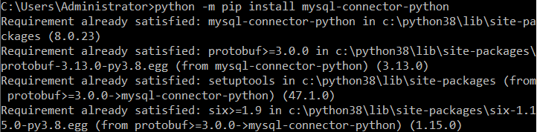
Install MySQL Driver
Python can be used in database applications
One of the most popular databases is MySQL
Python needs a MySQL driver to access the MySQL database. In this lecture, MySQL Connector is used and it is easy to be installed by the PIP command
Already installed

Slide 4
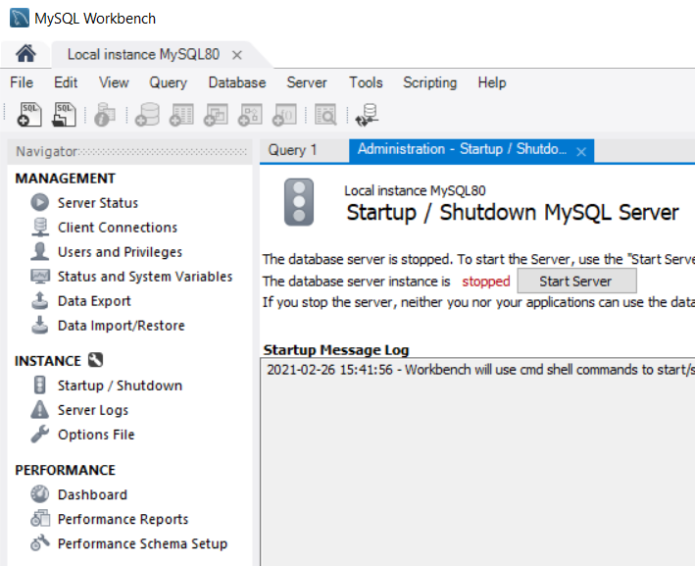

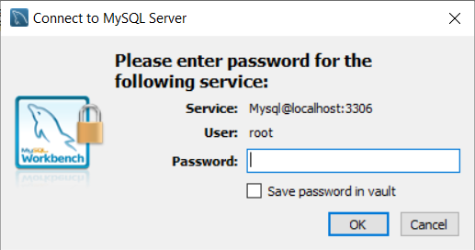
Starting a database server in lab environment
Type "net start MySQL80" in PowerShell
Try empty password or P@$$word in our lab environment
2.
1.

Slide 5
Test MySQL Connector
The following code can be used to test whether MySQL Connector is successfully installed
MySQL Connector is installed and ready to used if the above code was executed with no errors
import mysql.connector

Slide 6
Create Connection
The following code can be used to create a connection to the database
A MySQLConnection object should be printed if the connection is succeed. An error message is generated otherwise
Program:
import mysql.connector
if __name__=="__main__":
try :
mydb = mysql.connector.connect(
host="localhost",
user="root",
password=""
)
print (mydb)
except mysql.connector.Error as e:
print (e)
Success Output:
<mysql.connector.connection_cext.CMySQLConnection object at 0x000001177C626EE0>
Failed Output (incorrect username / password):
1045 (28000): Access denied for user 'root'@'localhost' (using password: YES)
Failed Output (cannot connect database):
2003 (HY000): Can't connect to MySQL server on '192.168.1.1' (10060)

Slide 7
Create a New Database
The following SQL statement will create a new database with the name shapes_db
MySQL Connector / Python automatically appends a semicolon at the end of queries
CREATE DATABASE shapes_db;
Program:
import mysql.connector
if __name__=="__main__":
try :
mydb = mysql.connector.connect(
host="localhost",
user="root",
password=""
)
mycursor = mydb.cursor()
query = "CREATE DATABASE IF NOT EXISTS shapes_db"
mycursor.execute(query)
except mysql.connector.Error as e:
print (e)
A database shapes_db should be created if no output or error message is generated
No error message would be generated by using the SQL keyword "IF NOT EXISTS"

Slide 8
Show Database
The following SQL statement will show databases in your server
Program:
import mysql.connector
if __name__=="__main__":
try :
mydb = mysql.connector.connect(
host="localhost",
user="root",
password=""
)
mycursor = mydb.cursor()
query = "SHOW DATABASES"
mycursor.execute(query)
for line in mycursor:
print (line)
except mysql.connector.Error as e:
print (e)
Output:
('mysql',)
('performance_schema',)
('sakila',)
('shapes_db',)
('sys',)
('world',)
Database created
Looping is used to retrieve all records in the executed query
Each recorded is represented by a tuple

Slide 9
Connect to an Existing Database
The following SQL statement will connect to an existing database
Program:
import mysql.connector
if __name__=="__main__":
try :
mydb = mysql.connector.connect(
host="localhost",
user="root",
password="",
database="shapes_db"
)
mycursor = mydb.cursor()
query = "SHOW TABLES"
mycursor.execute(query)
for line in mycursor:
print (line)
except mysql.connector.Error as e:
print (e)
Output:
('circles',)
Output depends on the tables you have in database
One more parameter is included to connect with selected database
Each table is displayed this time instead of database

Slide 10
Create Table
The following SQL statement will create a table in database
Program:
import mysql.connector
if __name__=="__main__":
try :
mydb = mysql.connector.connect(
host="localhost",
user="root",
database="shapes_db"
)
mycursor = mydb.cursor()
query = """
CREATE TABLE IF NOT EXISTS circles (
id INT NOT NULL AUTO_INCREMENT,
name VARCHAR(100),
radius DOUBLE,
PRIMARY KEY (id)
)"""
mycursor.execute(query)
mydb.commit()
except mysql.connector.Error as e:
print (e)
No output would be generated for statements like Create Database, Create Table, Insert, Update and Delete statements
Modifications of a transaction occur only when a commit command is used in the end

Slide 11
Insert Records using .execute()
Usually, cursor.execute() method only writes one records into table
Program:
import mysql.connector
if __name__=="__main__":
try :
radius = float(input("Please input radius of Circle:"))
mydb = mysql.connector.connect(
host="localhost",
user="root",
database="shapes_db"
)
mycursor = mydb.cursor()
query = f"INSERT INTO circles (name, radius) VALUES ('Circle', {radius})"
mycursor.execute(query)
mydb.commit()
except mysql.connector.Error as e:
print (e)
except ValueError as e:
print (e)
Obtain radius input by user
Insert query

Slide 12
Insert Records using .executemany()
cursor.executemany() method maybe used to write many records at once. It would be more efficient if you have many records to write.
Program:
import mysql.connector
if __name__=="__main__":
try :
radius = (('circle', 1.0),('circle', 2.0),('circle', 3.0))
mydb = mysql.connector.connect(
host="localhost",
user="root",
database="shapes_db"
)
mycursor = mydb.cursor()
query = "INSERT INTO circles (name, radius) VALUES (%s, %s)"
mycursor.executemany(query, radius)
mydb.commit()
except mysql.connector.Error as e:
print (e)
This string formatter used in query must be %s
This parameter must be
[(1,2,3),(4,5,6),(7,8,9)] (list of tuple)
or ((1,2,3),(4,5,6),(7,8,9)) (tuple of tuple)

Slide 13
Read Records
To retrieve records, a SELECT query is sent to cursor.execute() method. Then a cursor.fetchall() method can be used to extract the retrieved table in the form of list of rows or records.
Program:
import mysql.connector
if __name__=="__main__":
try :
mydb = mysql.connector.connect(
host="localhost",
user="root",
password = "",
database="shapes_db"
)
mycursor = mydb.cursor()
query = "SELECT * FROM circles"
mycursor.execute(query)
result=mycursor.fetchall()
for row in result:
print (row)
except mysql.connector.Error as e:
print (e)
Sample Output:
(1, 'Circle', 1.0)
(2, 'Circle', 2.0)
(3, 'Circle', 3.0)
Output depends on number of records in database
SELECT query
fetchall method used to obtain the result (list)
Looping used to obtain database records row by row

Slide 14
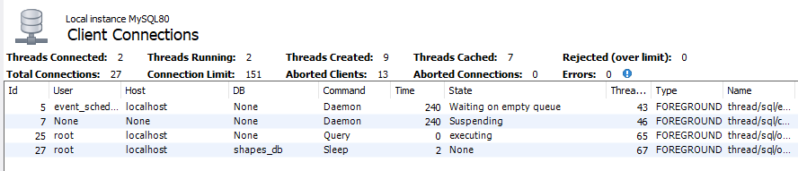
Close Database Connection
It is always a good practice to close the database connection before program termination
Program:
import mysql.connector
if __name__ == "__main__":
try :
mydb = mysql.connector.connect (
host = "localhost",
user = "root",
password = "",
database = "shapes_db"
)
mycursor = mydb.cursor()
query = "SELECT * FROM circles"
mycursor.execute(query)
result = mycursor.fetchall()
for row in result:
print (row)
except mysql.connector.Error as e:
print (e)
finally :
if mydb.is_connected():
mycursor.close()
mydb.close()
A connection to database would always exist and in sleep mode if database connection is NOT closed after using
Apart from try and except block, there is a finally block, all the codes in there will always be executed
is_connected() is a method in MySQL database object. It is used to check whether a mysql database connection is exist or not

Slide 15
with … as … statements
By using with, this tool allows creating a temporary connection once the code returns to previous indentation level
Program:
import mysql.connector
if __name__ == "__main__":
try :
with mysql.connector.connect (
host = "localhost",
user = "root",
password="",
database = "shapes_db"
) as mydb:
mycursor = mydb.cursor()
query = "SELECT * FROM circles"
mycursor.execute(query)
result = mycursor.fetchall()
for row in result:
print (row)
except mysql.connector.Error as e:
print (e)
Both mydb connection and mycursor cursor are context managers, nowadays it would be more convenient (and preferable to write by using with … as … statements
mydb.commit() will automatically be called when Python leaves the outer with statement if necessary
Both mycursor.close() or mydb.close() will be called upon leaving the with statement

Slide 16
Database Application in Shape
It is a good practice to group all database operations into a single class
Program (ConnectDB class):
import mysql.connector
class ConnectDB:
def execute_query(query):
with mysql.connector.connect(
host="localhost",
user="root",
password="",
database="shapes_db"
) as mydb:
mycursor = mydb.cursor()
mycursor.execute(query)
result = mycursor.fetchall()
mydb.commit()
return result
def create_table():
query = """
CREATE TABLE IF NOT EXISTS circles (
id int NOT NULL AUTO_INCREMENT,
name VARCHAR(100),
radius DOUBLE,
PRIMARY KEY (id)
)"""
ConnectDB.execute_query(query)
All operations related to database are grouped inside this class
All operations related to query execution are handled by this method
fetchall method is used to handle select query statements. Result set is always returned to the caller function
Program (ConnectDB class continue):
def create_circle(circle):
query = (f"INSERT INTO circles (name, radius) "
f"VALUES ('{circle.get_name()}', {circle.get_radius()})")
ConnectDB.execute_query(query)
def read_shapes():
query = f"SELECT * FROM circles"
result = ConnectDB.execute_query(query)
list_shapes = list()
for row in result:
list_shapes.append(Circle(row[2], "Circle", True))
return list_shapes
commit method is used to handle insert and update query statements
Circle objects created from database are marked True

Slide 17
Database Application in Shape
Supplier class and Client Program interact with static methods in ConnectDB class
Client Program:
if __name__=="__main__":
try :
ConnectDB.create_table()
while True:
print("Shapes in database:")
list_shapes = ConnectDB.read_shapes()
for circle in list_shapes:
print (circle)
radius = float(input("Please input radius of Circle:"))
Circle(radius)
except mysql.connector.Error as e:
print (e)
except ValueError as e:
print (e)
Program (Shape and Circle class):
from abc import ABC, abstractmethod
from math import pi
class Shape(ABC):
def __init__(self, name="Shape"):
self.__name = name
def get_name(self):
return self.__name
@abstractmethod
def find_area(self):
return NotImplemented
def __str__(self):
return f"name={self.__name}"
class Circle(Shape):
def __init__(self, radius, name="Circle", create_from_db=False):
super().__init__(name)
self.__radius = radius
if create_from_db == False:
ConnectDB.create_circle(self)
def get_radius(self):
return self.__radius
def find_area(self):
return self.__radius ** 2 * pi
def __str__(self):
return super().__str__() + f" radius={self.__radius:.1f} area={self.find_area():.2f}"
Circle objects created from user's input are marked False by default
Sample Output:
Shapes in database:
name=Circle radius=1.0 area=3.14
name=Circle radius=2.0 area=12.57
Please input radius of Circle:3
name=Circle radius=1.0 area=3.14
name=Circle radius=2.0 area=12.57
name=Circle radius=3.0 area=28.27
User's input
This statement will not be executed by circle objects created from database

Slide 18
Store objects in database
Normally, it is quite troublesome to use object-oriented paradigm in relational database, especially when the program interacts different kind of objects stored in database
Object-relational mapping (ORM) is a technique that allows query and manipulate data from a database directly using an object-oriented language.
An ORM library encapsulates the code needed to manipulate data, which eliminates the need to use even a tiny bit of SQL. E.g. SQLAlchemy

Slide 19
References
References:
  Python MySQL
    https://www.w3schools.com/python/python_mysql_getstarted.asp
  Python and MySQL Database: A Practical Introduction
    https://realpython.com/python-mysql/#defining-the-database-schema

Slide 20
End

