Slide 1
Tkinter
Chapter 07a
Advanced Scripting Technology
ITP4459

Slide 2
Lesson Intended Learning Outcomes
Upon completion of this lesson, you should be able to:
  Introduction to Python GUI frameworks
  Tkinter Hello World
  Using classes with Tkinter
  Basic Tkinter Widgets, such as Label, Button, Entry, OptionMenu, Radiobutton, Checkbutton, ScrolledText
  Variable Classes in Tkinter Library

Slide 3
Python GUI frameworks
Python has a lot of GUI frameworks, popular ones including Tkinter and PyQt5
Tkinter is used as introduction to GUI in Python
  It is the only framework that's built into the Python standard library
  It is cross-platform, the same code works on Windows, macOS, and Linux
  Visual elements are rendered using native operating system elements, hence applications built with Tkinter look like they belong on the platform where they're run

Slide 4

Tkinter Hello World
The following is the simplest GUI programming in Hello World
Program:
from tkinter import Label, mainloop
Label(text="Hello World").pack()
mainloop()

Slide 5

Tkinter Hello World
Program:
import tkinter as tk
root = tk.Tk()
label = tk.Label (root, text="Hello World", padx=100, pady=10)
label.pack()
root.mainloop()
1. It is usual to rename rename imported tkinter library to tk
2. Creates the overall tk window
5. Horizontal and vertical paddings of label
3. Creates the Label Tk widget
4. Parent Tk widget (i.e. put in root instance in this case)
6. Placing the label into the root
7. Responsible for showing the window

Slide 6
Using Classes with Tkinter
It is better to use a class to keep track of all individual widgets
Without doing this, you need to rely on global or nonlocal variable, which gets ugly as your app grows
It also allows for much finer controls once your app gets more complex, allowing you to override default behaviours of Tkinter’s own objects

Slide 7
Using Classes with Tkinter
Import the Tkinter package
import tkinter
class Application(tkinter.Tk):
def __init__(self):
super().__init__()
label = tkinter.Label(self, text="Hello World", padx=100, pady=10)
label.pack()
if __name__ == "__main__":
app = Application()
app.mainloop()
Application class inheriting from Tkinter’s Tk class
Create a main frame
Create a label with suitable text and size
Put label in Tk window
Make the label visible on the frame
The label now belong to the Application, rather than being an independent variable
This allows referencing it easily within methods of the Application class, such as an action we may bind to a Button later
Make the application running

Slide 8
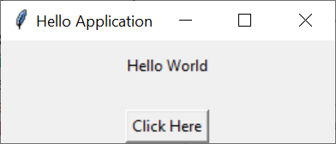
Simple Button Click
app
Program:
import tkinter
class Application(tkinter.Tk):
def clicked():
print ("Clicked")
def __init__(self):
super().__init__()
self.title("Hello Application")
self.geometry("260x80")
label1 = tkinter.Label(self, text="Hello World",
padx=100, pady=10)
label1.pack()
button1 = tkinter.Button(self, text="Click Here",
command=Application.clicked)
button1.pack(side="bottom")
if __name__ == "__main__":
app = Application()
app.mainloop()
:Application(Tk)
label1
button1
This method is called when the button is clicked
Create a main frame with a title and size 260x80
:Label
:Button
text="Hello World"
padx = 100
pady = 10
text="Click Here"
command = clicked
Put label in Tk window
Create a button with suitable text and a command to call when the button is pressed
Make the button visible at the bottom of the frame

Slide 9
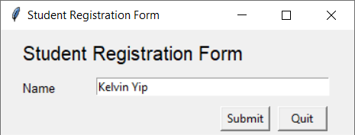
Entry Widget
Program:
import tkinter
class Application (tkinter.Tk):
def submit (self):
student = Student(self.__ent_name.get())
print (student)
def __init__ (self):
super().__init__()
self.title("Student Registration Form")
self.geometry("370x110")
lbl_reg_form = tkinter.Label(self, text="Student Registration Form", font=("bold",15))
lbl_reg_form.place(x=20, y=10)
lbl_name = tkinter.Label(self, text="Name", font=("bold",10))
lbl_name.place(x=20, y=50)
self.__ent_name = tkinter.Entry(self, width=40)
self.__ent_name.place(x=100, y=50)
btn_confirm = tkinter.Button(self, text="Submit", width=6, command=self.submit)
btn_confirm.place (x=230,y=80)
btn_quit = tkinter.Button(self, text="Quit", width=6, command=self.destroy)
btn_quit.place(x=290,y=80)
if __name__ == "__main__":
app = Application()
app.mainloop()
class Student:
def __init__ (self, name):
self.__name = name
def __str__ (self):
return f"Name: {self.__name}"
Output:
Name: Kelvin Yip
Create Label widget
Used by submit method
Create Label widget
Create Entry widget
Call submit function
Destroy current widget (Tk)
Create the two Button widget

Slide 10
Variable Classes
Some widgets (like text entry widgets, radio buttons and so on) can be connected directly to application variables by using special options:
  variable, textvariable, onvalue, offvalue, and value.
This connection works both ways:
  if the variable changes for any reason, the widget it's connected to will be updated to reflect the new value.
  These Tkinter control variables are used like regular Python variables to keep certain values.
  It's not possible to hand over a regular Python variable to a widget through a variable or textvariable option.

Slide 11
Variable Classes
The only kinds of variables for which this works are variables that are subclassed from a class called Variable, defined in the Tkinter module.
  x = tkinter.IntVar()
    Holds an integer; default value 0
  x = tkinter.DoubleVar()
    Holds a float; default value 0.0
  x = tkinter.BooleanVar()
    Holds a boolean, returns 0 for False and 1 for True
To read the current value of such a variable, call the method get()
The value of such a variable can be changed with the set() method

Slide 12
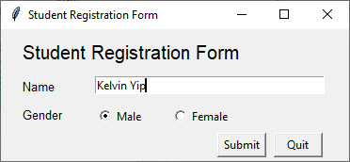
Radiobutton Widget
Program:
import tkinter
class Application(tkinter.Tk):
def submit(self):
student = Student(self.__var_name.get(), self.__var_gender.get())
print (student)
def __init__(self):
super().__init__()
self.title("Student Registration Form")
self.geometry("370x140")
lbl_reg_form = tkinter.Label(self, text="Student Registration Form", font=("bold",15))
lbl_reg_form.place(x=20, y=10)
lbl_name = tkinter.Label(self, text="Name", font=("bold",10))
lbl_name.place(x=20, y=50)
self.__var_name = tkinter.StringVar()
ent_name = tkinter.Entry(self, textvariable=self.__var_name, width=40)
ent_name.place(x=100, y=50)
lbl_gender = tkinter.Label(self, text="Gender", font=("bold",10))
lbl_gender.place(x=20, y=80)
self.__var_gender = tkinter.StringVar()
rdo_gender_m = tkinter.Radiobutton(self, text="Male", variable=self.__var_gender, value="Male")
rdo_gender_m.place(x=100,y=80)
rdo_gender_f = tkinter.Radiobutton(self, text="Female", variable=self.__var_gender, value="Female")
rdo_gender_f.place(x=180,y=80)
self.__var_gender.set(" ")
btn_confirm = tkinter.Button(self, text="Submit", width=6, command=self.submit)
btn_confirm.place(x=230,y=110)
btn_quit = tkinter.Button(self, text="Quit", width=6, command=self.destroy)
btn_quit.place(x=290,y=110)
if __name__ == "__main__":
app = Application()
app.mainloop()
5. Obtain value from var_gender
class Student:
def __init__(self, name, gender):
self.__name = name
self.__gender = gender
def __str__(self):
return f"Name: {self.__name}\nGender: {self.__gender}"
Submit method no need to reference to entry box anymore
Size of form extended a little bit
Output:
Name: Kelvin Yip
Gender: Male
String variable also used in entry widget
ent_name is no longer an instant variable
3. Value "Male" would be set to var_gender if this radio button is clicked
1. Create StringVar var_gender
2. Set radiobutton selects nothing
4. Value "Female" would be set to var_gender if this radio button is clicked
5. Call submit function when this button is clicked
Button moved down a little bit

Slide 13
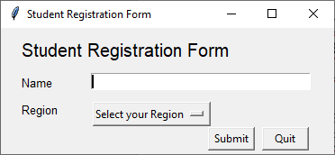
OptionMenu Widget
Program:
import tkinter
class Application(tkinter.Tk):
def reset_form (self):
self.__var_name.set("")
self.__var_region.set ("Select your Region")
def submit(self):
student = Student(self.__var_name.get(), self.__var_region.get())
print (student)
self.reset_form()
def __init__(self):
super().__init__()
self.title("Student Registration Form")
self.geometry("370x140")
## lbl_reg_form, lbl_name, self.__var_name and ent_name omitted here
lbl_region = tkinter.Label(self, text="Region", font=("bold",10))
lbl_region.place(x=20, y=80)
list_of_region=["Hong Kong", "Macau", "US", "UK", "Japan"]
self.__var_region = tkinter.StringVar()
om_region=tkinter.OptionMenu(self, self.__var_region, *list_of_region)
om_region.config(width=15)
om_region.place(x=100,y=80)
btn_confirm = tkinter.Button(self, text="Submit", width=6, command=self.submit)
btn_confirm.place(x=230,y=110)
btn_quit = tkinter.Button(self, text="Quit", width=6, command=self.destroy)
btn_quit.place(x=290,y=110)
self.reset_form()
if __name__ == "__main__":
app = Application()
app.mainloop()
5. Reset Entry Widget and OptionMenu Widget
Form values will be reset to original look after submission
Output:
Name: Kelvin Yip
Region: Hong Kong
4. Obtain value from var_region
class Student:
def __init__(self, name, region):
self.__name = name
self.__region = region
def __str__(self):
return f"Name: {self.__name}\nRegion: {self.__region}"
1. OptionMenu usually use StringVar too
2. String of selected region in list_of_region would be set to self.__var_region
List would be unpacked to string
3. Call submit function when this button is clicked
Initialize form value, especially the selected value of OptionMenu

Slide 14
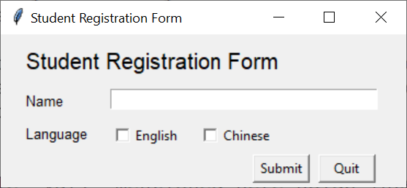
Checkbutton Widget
Program:
import tkinter
class Application(tkinter.Tk):
def reset_form (self):
self.__var_name.set("")
self.__var_lang_eng.set(0)
self.__var_lang_chi.set(0)
def submit(self):
list_language = list()
if self.__var_lang_eng.get()==1:
list_language.append("English")
if self.__var_lang_chi.get()==1:
list_language.append("Chinese")
student = Student(self.__var_name.get(), list_language)
print (student)
self.reset_form()
def __init__(self):
super().__init__()
self.title("Student Registration Form")
self.geometry("370x140")
## lbl_reg_form, lbl_name, self.__var_name and ent_name omitted here
lbl_language = tkinter.Label(self, text="Language", font=("bold",10))
lbl_language.place(x=20, y=80)
self.__var_lang_eng = tkinter.IntVar()
chk_lang_eng = tkinter.Checkbutton(self,text="English", variable=self.__var_lang_eng)
chk_lang_eng.place(x=100,y=80)
self.__var_lang_chi = tkinter.IntVar()
chk_lang_chi = tkinter.Checkbutton(self,text="Chinese", variable=self.__var_lang_chi)
chk_lang_chi.place(x=180,y=80)
btn_confirm = tkinter.Button(self, text="Submit", width=6, command=self.submit)
btn_confirm.place(x=230,y=110)
btn_quit = tkinter.Button(self, text="Quit", width=6, command=self.destroy)
btn_quit.place(x=290,y=110)
self.reset_form()
if __name__ == "__main__":
app = Application()
app.mainloop()
Form values will be reset to original look after submission
class Student:
def __init__(self, name, list_language):
self.__name = name
self.__list_language = list_language
def __str__(self):
language_output = ""
for i in self.__list_language:
if self.__list_language.index(i) == 0:
language_output += i
else:
language_output += ", " + i
return f"Name: {self.__name}\nLanguage: {language_output}"
4. Check whether if each Checkbutton is selected
5. Append selected item(s) from Checkbutton into list
6. Reset form value after submission
Output:
Name: Kelvin Yip
Language: English, Chinese
1. Checkbutton usually use IntVar
2. Integer value of selected Checkbutton would be set to 1
3. Call submit function when this button is clicked
Initialize form value

Slide 15
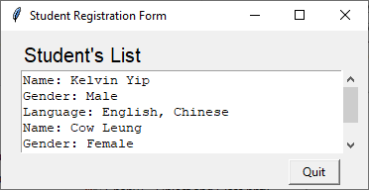
ScrolledText Widget
Program:
import tkinter
import tkinter.scrolledtext
class Application(tkinter.Tk):
def __init__(self):
super().__init__()
self.title("Student Registration Form")
self.geometry("370x160")
list_student = [Student("Kelvin Yip", "Male", ["English","Chinese"]),
Student("Cow Leung", "Female", ["English",])]
lbl_stu_list = tkinter.Label(self, text="Student's List", font=("bold",15))
lbl_stu_list.place(x=20, y=10)
txt_output = tkinter.scrolledtext.ScrolledText(self, width=40, height=5)
txt_output.place(x=20, y=40)
txt_output.delete("0.0", tkinter.END)
for i in list_student:
txt_output.insert(tkinter.INSERT,i)
btn_quit = tkinter.Button(self, text="Quit", width=6, command=self.destroy)
btn_quit.place(x=290,y=130)
if __name__ == "__main__":
app = Application()
app.mainloop()
1. A list of student objects is prepared for output display
class Student:
def __init__(self, name, gender, list_language):
self.__name = name
self.__gender = gender
self.__list_language = list_language
def __str__(self):
language_output = ""
for i in self.__list_language:
if self.__list_language.index(i) == 0:
language_output += i
else:
language_output += ", " + i
return (f"Name: {self.__name}\n"+
f"Gender: {self.__gender}\n"+
f"Language: {language_output}\n")
2. Create ScrolledText Widget with specified width and height
3. delete method usually used to reset the ScrolledText to empty
4. Insert every returned strings from student objects in list into output area of ScrolledText
The above content is sheer fabrication and any resemblance with any real names herein is purely coincidental. Do not put yourself in someone else’s place.

Slide 16
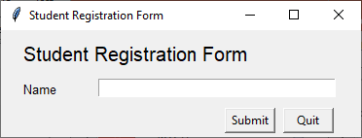
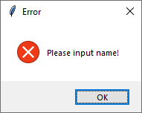
Message box
Program:
import tkinter
import tkinter.messagebox
class Application (tkinter.Tk):
def submit (self):
if len(self.__var_name.get().strip())==0:
tkinter.messagebox.showerror("Error", "Please input name!")
return
student = Student(self.__var_name.get())
print (student)
def __init__ (self):
super().__init__()
self.title("Student Registration Form")
self.geometry("370x110")
lbl_reg_form = tkinter.Label(self, text="Student Registration Form", font=("bold",15))
lbl_reg_form.place(x=20, y=10)
lbl_name = tkinter.Label(self, text="Name", font=("bold",10))
lbl_name.place(x=20, y=50)
self.__var_name = tkinter.StringVar()
ent_name = tkinter.Entry(self, textvariable=self.__var_name, width=40)
ent_name.place(x=100, y=50)
btn_confirm = tkinter.Button(self, text="Submit", width=6, command=self.submit)
btn_confirm.place (x=230,y=80)
btn_quit = tkinter.Button(self, text="Quit", width=6, command=self.destroy)
btn_quit.place(x=290,y=80)
if __name__ == "__main__":
app = Application()
app.mainloop()
tkinter.messagebox must be imported
Submit is clicked with empty name
Check length of name variable
class Student:
def __init__ (self, name):
self.__name = name
def __str__ (self):
return f"Name: {self.__name}"
Leave this method

Slide 17
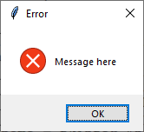
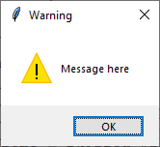
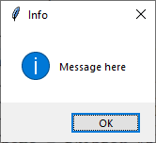
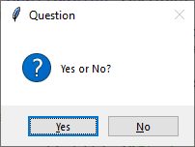
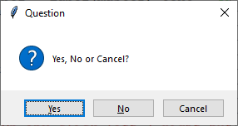
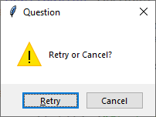
Other message boxes
tkinter.messagebox.showerror("Error", "Message here")
tkinter.messagebox.showwarning("Error", "Message here")
tkinter.messagebox.showinfo("Error", "Message here")
tkinter.messagebox.askquestion("Question", "Yes or No?")
tkinter.messagebox.askyesnocancel("Question", "Yes, No or Cancel?")
tkinter.messagebox.askretrycancel("Question", "Retry or Cancel?")

Slide 18
References
Python Tkinter Course
  https://www.python-course.eu/tkinter_variable_classes.php
Tkinter By Example
  https://github.com/Dvlv/Tkinter-By-Example/blob/master/Tkinter-By-Example.pdf
How to Create an Entry Box using Tkinter
  https://datatofish.com/entry-box-tkinter/
Switch between frames
  https://stackoverflow.com/questions/7546050/switch-between-two-frames-in-tkinter

Slide 19
End

