Slide 1
Tkinter
Chapter 07b
Advanced Scripting Technology
ITP4459

Slide 2
Lesson Intended Learning Outcomes
Upon completion of this lesson, you should be able to:
  Introduction on different layout managers in Python
    Place geometry layout manager
    Pack geometry layout manager
    Grid geometry layout manager
  Container Widgets: Canvas and Frame
    Multiple Page

Slide 3
Layout Manager

Slide 4
Place Layout Manager
The place geometry manager is used to place widget in parent container (window / frame / canvas) in specific position
In absolute positioning, the position of widget is specified by position and size in pixels
The size and position of widget do NOT change if the window is resized

Slide 5
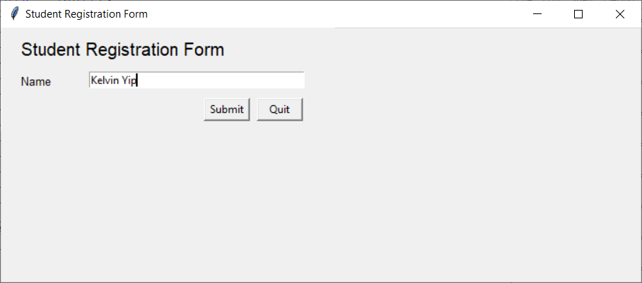
Place Layout Manager - Example
Program:
import tkinter
class Application (tkinter.Tk):
def submit (self):
print (f"Name: {self.__var_name.get()}")
def __init__ (self):
super().__init__()
self.title("Student Registration Form")
self.geometry("370x110")
self.lbl_reg_form = tkinter.Label(self, text="Student Registration Form", font=("bold",15))
self.lbl_reg_form.place(x=20, y=10)
self.lbl_name = tkinter.Label(self, text="Name", font=("bold",10))
self.lbl_name.place(x=20, y=50)
self.__var_name = tkinter.StringVar()
self.ent_name = tkinter.Entry(self, textvariable=self.__var_name, width=40)
self.ent_name.place(x=100, y=50)
self.btn_confirm = tkinter.Button(self, text="Submit", width=6, command=self.submit)
self.btn_confirm.place (x=230,y=80)
self.btn_quit = tkinter.Button(self, text="Quit", width=6, command=self.destroy)
self.btn_quit.place(x=290,y=80)
if __name__ == "__main__":
app = Application()
app.mainloop()
Resizing the window may generate a lot of empty spaces
Output:
Name: Kelvin Yip
Every widgets need to assigned an absolute position

Slide 6
Pack Layout Manager
pack() is one of the oldest and most used layout manager in Python's tkinter package
pack() has 3 options to use
  fill: used to fill extra spaces. fill option has dimensions like:
    NONE (default)
    X (fill horizontally)
    Y (fill vertically)
    BOTH (fill horizontally and vertically)
  side: used to specify the side to which widget must be packed in parent container. side option has dimensions like:
    TOP(default), BOTTOM, LEFT or RIGHT
  expand: used to take up the full height / width until content ends

Slide 7
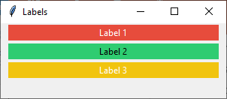
pack manager with fill attribute
Program:
import tkinter
class Application(tkinter.Tk):
def __init__(self):
super().__init__()
self.geometry("300x100")
self.title("Labels")
frm_base = tkinter.Frame(self)
frm_base.pack(fill=tkinter.BOTH, expand=True)
lbl_1 = tkinter.Label(frm_base, text="Label 1", bg="#E74C3C", fg="white")
lbl_1.pack(fill=tkinter.X, padx=10, pady=2)
lbl_2 = tkinter.Label(frm_base, text="Label 2", bg="#2ECC71", fg="black")
lbl_2.pack(fill=tkinter.X, padx=10, pady=2)
lbl_3 = tkinter.Label(frm_base, text="Label 3", bg="#F1C40F", fg="white")
lbl_3.pack(fill=tkinter.X, padx=10, pady=2)
if __name__ == "__main__":
app = Application()
app.mainloop()
2 pixels padding on y-axis
A base frame is normally used to hold all the widgets
10 pixels padding on x-axis
Colours can be denoted by colour code or name
Fill the widgets along x-axis. Options include X, Y and BOTH

Slide 8
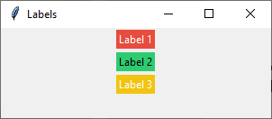
pack manager with fill attribute
Program:
import tkinter
class Application(tkinter.Tk):
def __init__(self):
super().__init__()
self.geometry("300x100")
self.title("Labels")
frm_base = tkinter.Frame(self)
frm_base.pack(fill=tkinter.BOTH, expand=True)
lbl_1 = tkinter.Label(frm_base, text="Label 1", bg="#E74C3C", fg="white")
lbl_1.pack(fill=tkinter.Y, padx=10, pady=2)
lbl_2 = tkinter.Label(frm_base, text="Label 2", bg="#2ECC71", fg="black")
lbl_2.pack(fill=tkinter.Y, padx=10, pady=2)
lbl_3 = tkinter.Label(frm_base, text="Label 3", bg="#F1C40F", fg="white")
lbl_3.pack(fill=tkinter.Y, padx=10, pady=2)
if __name__ == "__main__":
app = Application()
app.mainloop()
2 pixels padding on y-axis
padx is useless in this case
No effect for fill=tkinter.Y here because the side attribute = TOP by default.
Result is equals to NOT to use any fill attributes

Slide 9
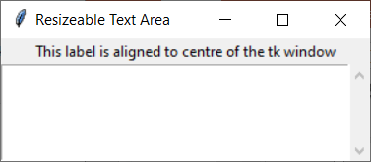
pack manager with fill and expand attribute
Program:
import tkinter
import tkinter.scrolledtext
class Application(tkinter.Tk):
def __init__(self):
super().__init__()
self.geometry("300x100")
self.title("Resizeable Text Area")
frm_base = tkinter.Frame(self)
frm_base.pack(fill=tkinter.BOTH, expand=True)
str_text = "This label is aligned to centre of the tk window"
lbl_output = tkinter.Label(frm_base, text=str_text)
lbl_output.pack(side=tkinter.TOP)
txt_output = tkinter.scrolledtext.ScrolledText(frm_base)
txt_output.pack(fill=tkinter.BOTH, expand=True)
if __name__ == "__main__":
app = Application()
app.mainloop()
This label is aligned to center
Resize this window to see the effect
Some tricks required to align this label to left
This scrolled text element will be filled in both X and Y direction during resize. You may replace this value with X or Y and resize the window to see the effect.

Slide 10
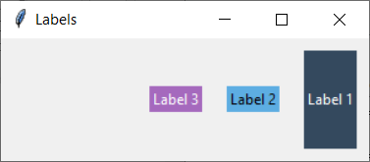
pack manager with side and fill attribute
Program:
import tkinter
class Application(tkinter.Tk):
def __init__(self):
super().__init__()
self.geometry("300x100")
self.title("Labels")
frm_base = tkinter.Frame(self)
frm_base.pack(fill=tkinter.BOTH, expand=True)
lbl_1 = tkinter.Label(frm_base, text="Label 1", bg="#34495E", fg="white")
lbl_1.pack(side=tkinter.RIGHT, fill=tkinter.Y, padx=10, pady=10)
lbl_2 = tkinter.Label(frm_base, text="Label 2", bg="#5DADE2", fg="black")
lbl_2.pack(side=tkinter.RIGHT, padx=10)
lbl_3 = tkinter.Label(frm_base, text="Label 3", bg="#A569BD", fg="white")
lbl_3.pack(side=tkinter.RIGHT, padx=10)
if __name__ == "__main__":
app = Application()
app.mainloop()
Labels with padx=10
Effect on Label 1 fill along y-axis with 10 pixels padding
Label 1 is packed to the right first, then followed by Label 2 and Label 3

Slide 11
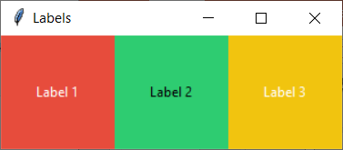
pack manager with side, fill and expand attribute
Program:
import tkinter
class Application(tkinter.Tk):
def __init__(self):
super().__init__()
self.geometry("300x100")
self.title("Labels")
frm_base = tkinter.Frame(self)
frm_base.pack(fill=tkinter.BOTH, expand=True)
label1 = tkinter.Label(frm_base, text="Label 1", bg="#E74C3C", fg="white")
label1.pack(side=tkinter.LEFT, fill=tkinter.BOTH, expand=True)
label2 = tkinter.Label(frm_base, text="Label 2", bg="#2ECC71", fg="black")
label2.pack(side=tkinter.LEFT, fill=tkinter.BOTH, expand=True)
label3 = tkinter.Label(frm_base, text="Label 3", bg="#F1C40F", fg="white")
label3.pack(side=tkinter.LEFT, fill=tkinter.BOTH, expand=True)
if __name__ == "__main__":
app = Application()
app.mainloop()
Labels are aligned to left one by one, filled in both X and Y direction and expanded to occupied the whole frame

Slide 12
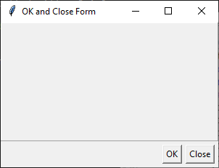
Example on pack layout manager
fill = BOTH, expand = True
fill = BOTH, expand = True, relief = tkinter.RIDGE, borderwidth = 1
tk window
frm_base
frm_top
relief = tkinter.RIDGE and borderwidth = 1 are used to set this border frame
btn_ok
btn_close
side = tkinter.RIGHT is enough for this widget
side = tkinter.RIGHT, padx=5, pady=5

Slide 13
Example on pack layout manager
Program:
import tkinter
class Application(tkinter.Tk):
def __init__(self):
super().__init__()
self.geometry("300x200")
self.title("Buttons")
frm_base = tkinter.Frame(self)
frm_base.pack(fill=tkinter.BOTH, expand=True)
frm_top = tkinter.Frame(frm_base, relief=tkinter.RIDGE, borderwidth=1)
frm_top.pack(fill=tkinter.BOTH, expand=True)
btn_close = tkinter.Button(frm_base, text="Close")
btn_close.pack(side=tkinter.RIGHT, padx=5, pady=5)
btn_ok = tkinter.Button(frm_base, text="OK")
btn_ok.pack(side=tkinter.RIGHT)
if __name__ == "__main__":
app = Application()
app.mainloop()
frm_base frame put on Tk window
Expand in BOTH X and Y direction
frm_top frame put on frm_base frame
There are five types of relief attributes. One of them is RIDGE
Align on right with padx and pady
Align on right. Use of padx and pady is optional in this case

Slide 14
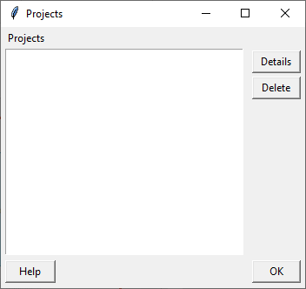
Grid Layout manager
Column 0
Column 1
Column 2
The grid geometry manager places widgets in a two dimensional grid
The master widget (e.g. windows / frame / canvas) is split into a number of rows and columns, and each "cell" in the resulting table can hold a widget
Grid manager is the most flexible of the geometry managers in Tkinter
Row 0
Row 1
Row 2
Row 3
Row 4

Slide 15
Grid Layout Manager - Example
Program:
import tkinter
class Application(tkinter.Tk):
def __init__(self):
super().__init__()
self.title("Projects")
self.geometry("350x300")
frm_base = tkinter.Frame()
frm_base.pack(fill=tkinter.BOTH, expand=True)
frm_base.columnconfigure(0, pad=10)
frm_base.columnconfigure(1, weight=1)
frm_base.columnconfigure(2, pad=10)
frm_base.rowconfigure(0, pad=4)
frm_base.rowconfigure(1, pad=4)
frm_base.rowconfigure(2, pad=4)
frm_base.rowconfigure(3, weight=1)
frm_base.rowconfigure(4, pad=4)
The minimum width of column 0 and 2
Weight is set to a value greater than 1 where the element would be resized according to the window's size
Config the row and column properties on the container would use grid layout

Slide 16
Grid Layout Manager - Example Cont.
Program:
lbl_project = tkinter.Label(frm_base, text="Projects")
lbl_project.grid(row=0, column=0, sticky=tkinter.W, padx=5)
txt_area = tkinter.Text(frm_base, width=1)
txt_area.grid(row=1, column=0, columnspan=2, rowspan=3, padx=5,
sticky=tkinter.E+tkinter.W+tkinter.S+tkinter.N)
btn_details = tkinter.Button(frm_base, text="Details")
btn_details.grid(row=1, column=2, padx=5, sticky=tkinter.E+tkinter.W)
btn_delete = tkinter.Button(frm_base, text="Delete")
btn_delete.grid(row=2, column=2, padx=5, sticky=tkinter.E+tkinter.W)
btn_help = tkinter.Button(frm_base, text="Help")
btn_help.grid(row=4, column=0, padx=5, pady=4, sticky=tkinter.E+tkinter.W)
btn_ok = tkinter.Button(frm_base, text="OK")
btn_ok.grid(row=4, column=2, padx=5, pady=4, sticky=tkinter.E+tkinter.W)
if __name__ == "__main__":
app = Application()
app.mainloop()

Slide 17
Container Widgets: Canvas and Frame
Both Canvas and Frame are containers to hold many widgets
Canvas
  Support graphical capabilities
  Support scrolling
Frame
  Layout component used to group multiple other widgets together

Slide 18
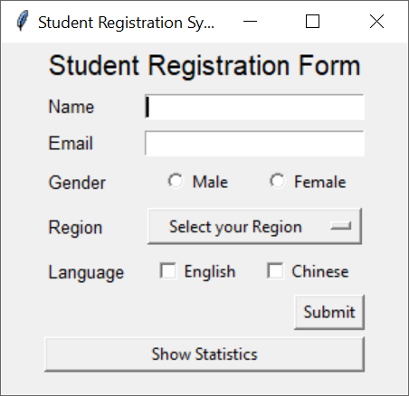
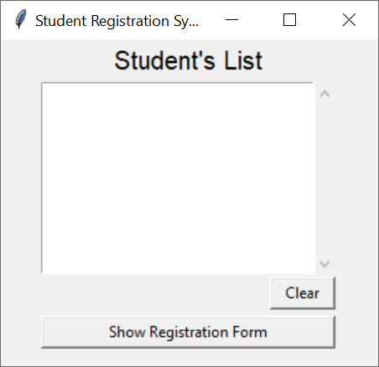
Multiple Page Example
Program:
class Application(tkinter.Tk):
def __init__(self):
super().__init__()
self.title("Student Registration System")
self.geometry("300x260")
container = tkinter.Frame(self)
container.pack()
self.__frames = dict()
self.__frames["RegistrationFrame"] = RegistrationFrame(parent=container, controller=self)
self.__frames["StudentListFrame"] = StudentListFrame(parent=container, controller=self)
self.__frames["RegistrationFrame"].grid(row=0, column=0, sticky=tkinter.E+tkinter.S+tkinter.W+tkinter.N)
self.__frames["StudentListFrame"].grid(row=0, column=0, sticky=tkinter.E+tkinter.S+tkinter.W+tkinter.N)
self.show_frame("RegistrationFrame")
def show_frame(self, page_name):
frame = self.__frames[page_name]
frame.tkraise()
if __name__ == "__main__":
app = Application()
app.mainloop()
A bunch of frames would be stacked on top of each other in this container. The one raised above the others would be visible
All frames are put in the same location. the one on the top of the stacking order will be the one that is visible.
First frame to be displayed
tk window
Show a frame for the given page name
container (frame) (pack)
Registration (frame) (grid)
Raise the selected frame to the top
StudentList (frame) (grid)

Slide 19
Registration Frame
Program:
class RegistrationFrame(tkinter.Frame):
def show_statistics(self):
self.__controller.show_frame("StudentListFrame")
def submit(self):
#details in submit method omitted
def __init__(self, parent, controller):
super().__init__(parent)
self.__controller = controller
#self.columnconfigure and self.rowconfigure omitted here
lbl_reg_form = tkinter.Label(self, text="Student Registration Form", font=("bold",15))
lbl_reg_form.grid(row=0, column=0, columnspan=3)
#detail implementation of other widgets in this form omitted here
btn_statistics = tkinter.Button(self, text="Show Statistics", width=6, command=self.show_statistics)
btn_statistics.grid(row=7, column=0, columnspan=3, sticky=tkinter.W + tkinter.E)
This is a frame
call Application class show_frame method to display corresponding frame
Parent is the empty frame created by Application class
Controller is the application class object used to call methods in Application class, e.g. show_frame
Button used to display another frame

Slide 20
Student List Frame
Program:
class StudentListFrame(tkinter.Frame):
def show_registration(self):
self.__controller.show_frame("RegistrationFrame")
def __init__(self, parent, controller):
super().__init__(parent)
self.__controller = controller
#self.columnconfigure and self.rowconfigure omitted here
lbl_stu_list = tkinter.Label(self, text="Student's List", font=("bold",15))
lbl_stu_list.grid(row=0, column=0)
#detail implementation of other widgets in this form omitted here
btn_statistics = tkinter.Button(self, text="Show Registration Form", width=6, command=self.show_registration)
btn_statistics.grid(row=3, column=0, sticky=tkinter.W + tkinter.E)
This is a frame
call Application class show_frame method to display corresponding frame
Button used to display another frame

Slide 21
References
Layout management in Tkinter
  https://zetcode.com/tkinter/layout/

Slide 22
End

