Slide 1
Web Scraping
Chapter 08
Advanced Scripting Technology
ITP4459

Slide 2
Lesson Intended Learning Outcomes
Upon completion of this lesson, you should be able to:
  Use request and Beautiful Soup for scraping and parsing data from the web
  Walk through a web scraping pipeline from start to finish

Slide 3
Introduction
Web provides us with more data than any of us can read and understand
Often need to work with web information programmatically in order to make sense of it
Sometimes, data is provided to us by website creators via .csv (comma-separated values file) or through an API (Application Programming Interface)
Other times, we need to collect text from the web ourselves

Slide 4
Requests module
In order to work with web pages, we're going to need to request the page
The Request library allows us to make use of HTTP within Python programs in human readable way
Request library is not installed in Python's standard library, and is required to installed by pip installer

Slide 5
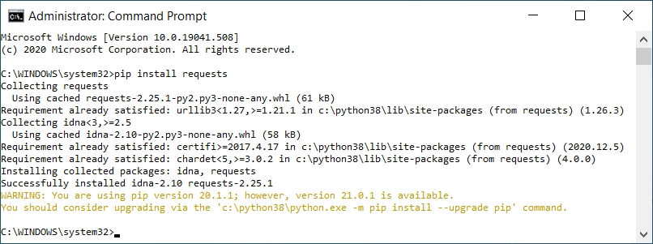
Installing Requests
Type the following command to install Requests with pip
  pip install requests
Message similar to "Successfully installed requests-x.xx.x" would be displayed
Type "pip install requests" in command prompt
Installed successfully
You may consider updating pip to latest version

Slide 6
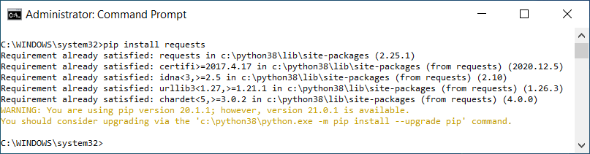
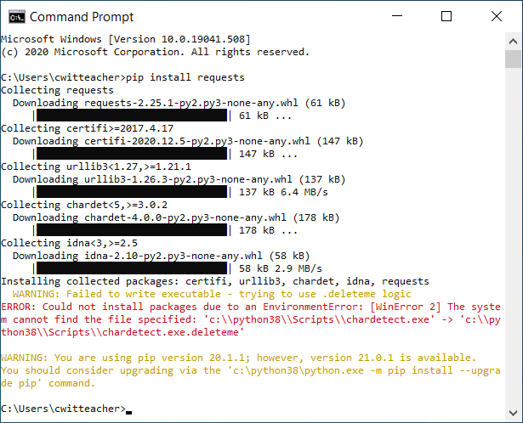
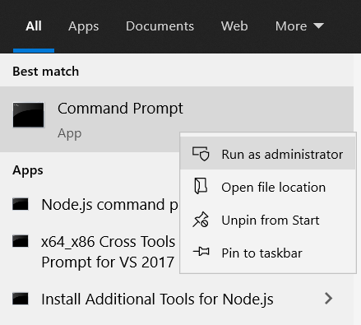
Installing Requests
Requirement already satisfied
If error message occurred, please select "Run as administrator" for running the command prompt

Slide 7
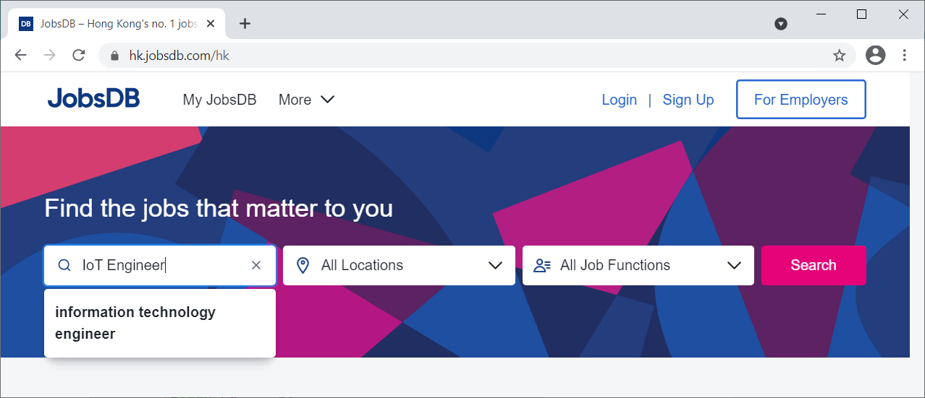
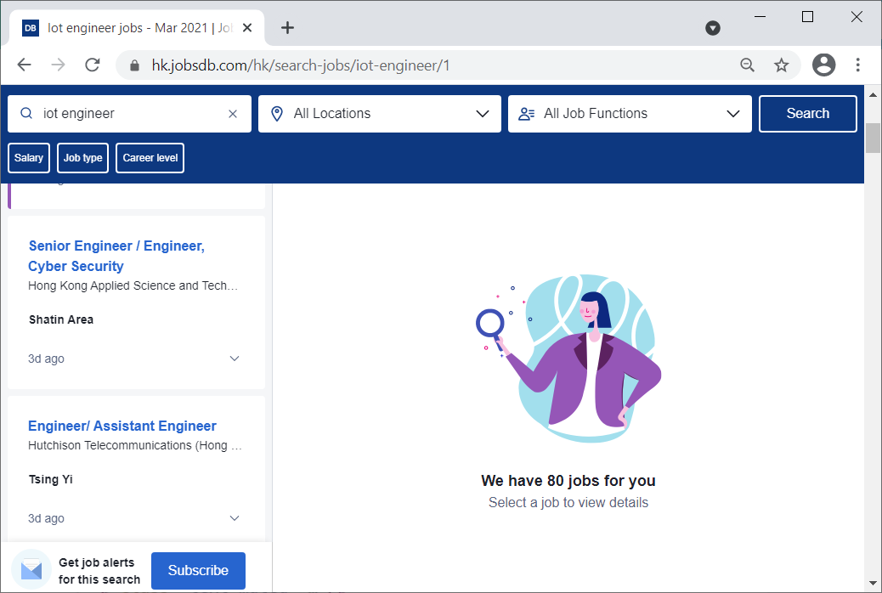
Scraping a website
Part 1: Inspect your data source
1. Go to the website. i.e. hk.jobsdb.com in this case
3. Inspect the url
2. Type "IoT Engineer"

Slide 8
Scraping a website
Part 2: Scrape HTML Content From a Page
Program:
import requests
url = "https://hk.jobsdb.com/hk/search-jobs/iot-engineer/1"
page = requests.get(url)
print(page)
print(page.content)
Output:
<Response [200]>
All contents in this page would be get
Squeezed text (2560 lines).
Double click to view this output with caution!
Always right click and copy it to notepad for display and search

Slide 9
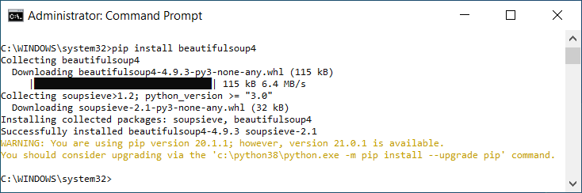
Scraping a website
Part 3: Parse HTML Code with Beautiful Soup
Beautiful Soup is a Python library for parsing structured data.
It exposes a couple of intuitive functions to explore the HTML received
Type "pip install beautifulsoup4" in command prompt

Slide 10
Scraping a website
Part 3: Parse HTML Code with Beautiful Soup
Import the library and create a Beautiful Soup object
Program:
import requests
from bs4 import BeautifulSoup
url = "https://hk.jobsdb.com/hk/search-jobs/iot-engineer/1"
page = requests.get(url)
soup = BeautifulSoup(page.content, "html.parser")
print (soup)
Once again, do not try to double click to view this output!
Output:
Parser can be used in Beautiful Soup when you created a Beautiful Soup object
Squeezed text (7619 lines).

Slide 11
Find Elements by ID
Part 3: Parse HTML Code with Beautiful Soup
  In an HTML web page, every element can have an id attribute assigned
  As the name already suggests, that id attribute makes the element uniquely identifiable on the page
  The page can be parsed by selecting a specific element by its id

Slide 12
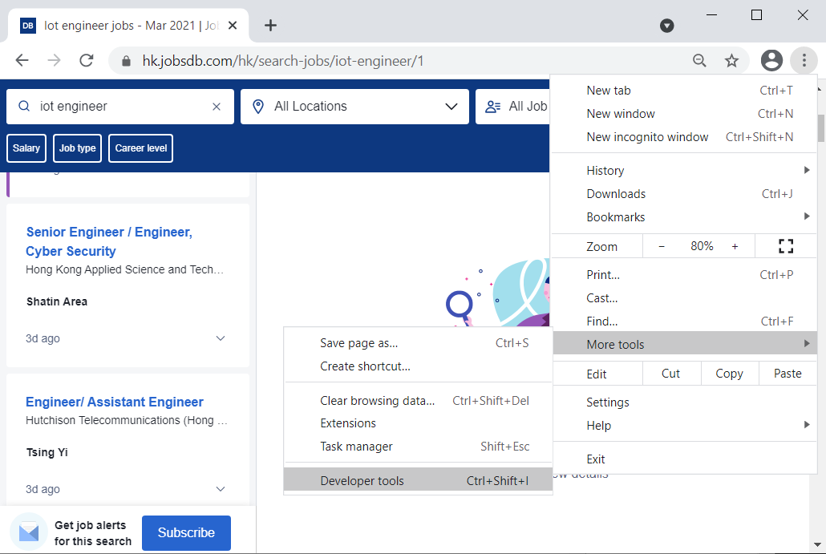
Find Elements by ID
Part 3: Parse HTML Code with Beautiful Soup
In Chrome browser, click … button and select More tools → Developer tools

Slide 13
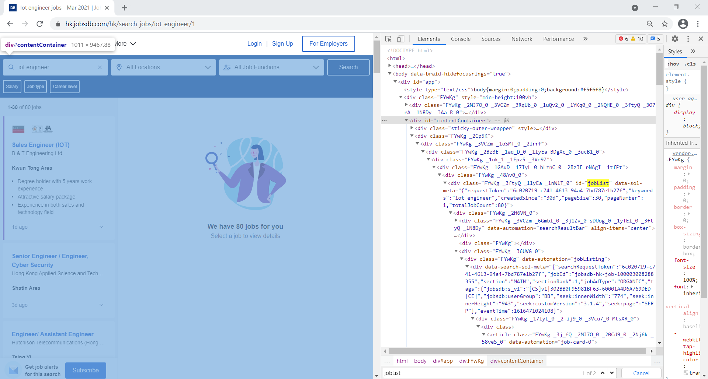
Find Elements by ID
Part 3: Parse HTML Code with Beautiful Soup
Try to identify the element with id attribute covers the contents you'd like to parse. In this case <div> element with id "jobList" is better than <div> element with id "contentContainer" or "app"
Content should be covered by your selected element (i.e. div in this case)

Slide 14
Scraping a website
Right click and copy all the contents to notepad for display
Part 3: Parse HTML Code with Beautiful Soup
Program:
import requests
from bs4 import BeautifulSoup
url = "https://hk.jobsdb.com/hk/search-jobs/iot-engineer/1"
page = requests.get(url)
soup = BeautifulSoup(page.content, "html.parser")
results = soup.find(id="contentContainer")
print ( results.prettify() )
Output:
Squeezed text (7619 lines).
Beautiful Soup can find specific element easily by its id
.prettify() method is usually called before printing out all Beautiful Soup objects for humans to read easily

Slide 15
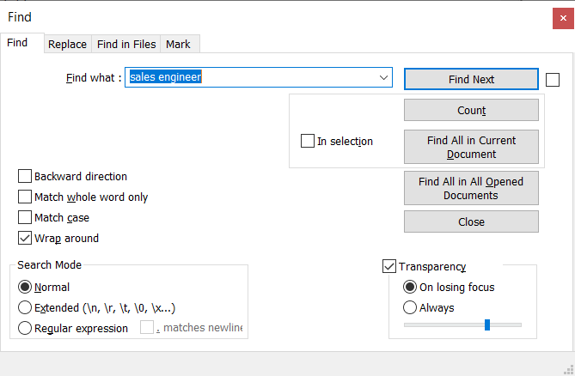

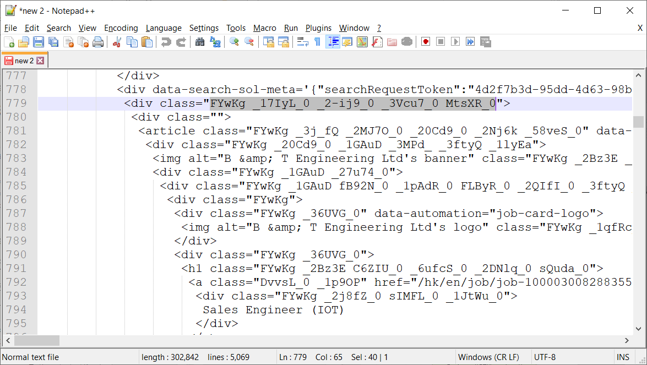
Scraping a website
Part 3: Parse HTML Code with Beautiful Soup
Locate a suitable class name and try to used it to search the whole page
If there are other matches in this source, most likely it is the information you want
1. From the prettified source code, try to locate "Sales Engineer (IOT)" as of on the web page

Slide 16
Scraping a website
Part 3: Parse HTML Code with Beautiful Soup
Program:
import requests
from bs4 import BeautifulSoup
url = "https://hk.jobsdb.com/hk/search-jobs/iot-engineer/1"
page = requests.get(url)
soup = BeautifulSoup(page.content, "html.parser")
results = soup.find(id="contentContainer")
job_elements = results.find_all("div", class_="FYwKg _2j8fZ_0 sIMFL_0 _1JtWu_0")
for job_element in job_elements:
print (job_element, end="\n"*2)
Another class name may have to be used to include other information you want
How to display other information, such as company name, district, how many days ago of this post?
Beware of the underline here
Output:
<div class="FYwKg _2j8fZ_0 sIMFL_0 _1JtWu_0">Software Engineer/ Senior Software Engineer (IoT)</div>
<div class="FYwKg _2j8fZ_0 sIMFL_0 _1JtWu_0">Golang Software Engineer (Smart Building &amp; IoT)</div>
<div class="FYwKg _2j8fZ_0 sIMFL_0 _1JtWu_0">Software R&amp;D Engineer (IoT, AI, Big Data)</div>
<div class="FYwKg _2j8fZ_0 sIMFL_0 _1JtWu_0">Sales Engineer (IOT)</div>
…

Slide 17
Scraping a website
Part 3: Parse HTML Code with Beautiful Soup
Program:
import requests
from bs4 import BeautifulSoup
url = "https://hk.jobsdb.com/hk/search-jobs/iot-engineer/1"
page = requests.get(url)
soup = BeautifulSoup(page.content, "html.parser")
results = soup.find(id="contentContainer")
job_elements = results.find_all("div", class_="FYwKg _1GAuD fB92N_0 _1pAdR_0 FLByR_0 _2QIfI_0 _3ftyQ _1lyEa _1N8Dy")
for job_element in job_elements:
print (job_element.prettify(), end="\n"*2)
Add one more line break to read the contents even more easily
You may find the contents difficult to read if you forgot to call .prettify() method here

Slide 18
Scraping a website
Part 3: Parse HTML Code with Beautiful Soup
Output:
…
<div class="FYwKg _36UVG_0">
<h1 class="FYwKg _2Bz3E C6ZIU_0 _6ufcS_0 _2DNlq_0 sQuda_0">
<a class="DvvsL_0 _1p9OP" href="/hk/en/job/job-100003008288355?token=0~4d2f7b3d-95dd-4d63-98b4-c93b0c1340d7&amp;sectionRank=4&amp;jobId=jobsdb-hk-job-100003008288355" rel="noopener noreferrer" target="_top">
<div class="FYwKg _2j8fZ_0 sIMFL_0 _1JtWu_0">
Sales Engineer (IOT)
</div>
</a>
</h1>
<span class="FYwKg _2Bz3E C6ZIU_0 _6ufcS_0 _2DNlq_0 _29m7__0">
B &amp; T Engineering Ltd
</span>
</div>
<span class="FYwKg _2Bz3E C6ZIU_0 _1_nER_0 _2DNlq_0 sQuda_0">
<span class="FYwKg _3MPd_ _2Bz3E And8z">
Kwun Tong Area
</span>
…

Slide 19
Scraping a website
Part 3: Parse HTML Code with Beautiful Soup
Program:
import requests
from bs4 import BeautifulSoup
url = "https://hk.jobsdb.com/hk/search-jobs/iot-engineer/1"
page = requests.get(url)
soup = BeautifulSoup(page.content, "html.parser")
results = soup.find(id="contentContainer")
job_elements = results.find_all("div", class_="FYwKg _1GAuD fB92N_0 _1pAdR_0 FLByR_0 _2QIfI_0 _3ftyQ _1lyEa _1N8Dy")
for job_element in job_elements:
title_element = job_element.find("div", class_="FYwKg _2j8fZ_0 sIMFL_0 _1JtWu_0")
company_element = job_element.find("span", class_="FYwKg _2Bz3E C6ZIU_0 _6ufcS_0 _2DNlq_0 _29m7__0")
district_element = job_element.find("span", class_="FYwKg _3MPd_ _2Bz3E And8z")
days_ago_element = job_element.find("span", class_="FYwKg _2Bz3E C6ZIU_0 _1_nER_0 _3KSG8_0 _29m7__0")
print (title_element)
print (company_element)
print (district_element)
print (days_ago_element)

Slide 20
Scraping a website
Part 4: Extract Text From HTML Elements
Output:
Title :Software Engineer/ Senior Software Engineer (IoT)
Company :Tom Mak Design Limited
District :Tsim Sha Tsui
8d ago
Title :Golang Software Engineer (Smart Building & IoT)
Company :En-trak Hong Kong Limited
District :Wan Chai
13d ago
…
Program:
import requests
from bs4 import BeautifulSoup
url = "https://hk.jobsdb.com/hk/search-jobs/iot-engineer/1"
page = requests.get(url)
soup = BeautifulSoup(page.content, "html.parser")
results = soup.find(id="contentContainer")
job_elements = results.find_all("div", class_="FYwKg _1GAuD fB92N_0 _1pAdR_0 FLByR_0 _2QIfI_0 _3ftyQ _1lyEa _1N8Dy")
for job_element in job_elements:
title_element = job_element.find("div", class_="FYwKg _2j8fZ_0 sIMFL_0 _1JtWu_0")
company_element = job_element.find("span", class_="FYwKg _2Bz3E C6ZIU_0 _6ufcS_0 _2DNlq_0 _29m7__0")
district_element = job_element.find("span", class_="FYwKg _3MPd_ _2Bz3E And8z")
days_ago_element = job_element.find("span", class_="FYwKg _2Bz3E C6ZIU_0 _1_nER_0 _3KSG8_0 _29m7__0")
if None in (title_element, company_element, district_element, days_ago_element):
continue
print (f"Title :{title_element.text}")
print (f"Company :{company_element.text}")
print (f"District :{district_element.text}")
print (f" {days_ago_element.text}")
Prevent NoneType AttributeError occur
Text are extracted by reading from the .text attribute

Slide 21
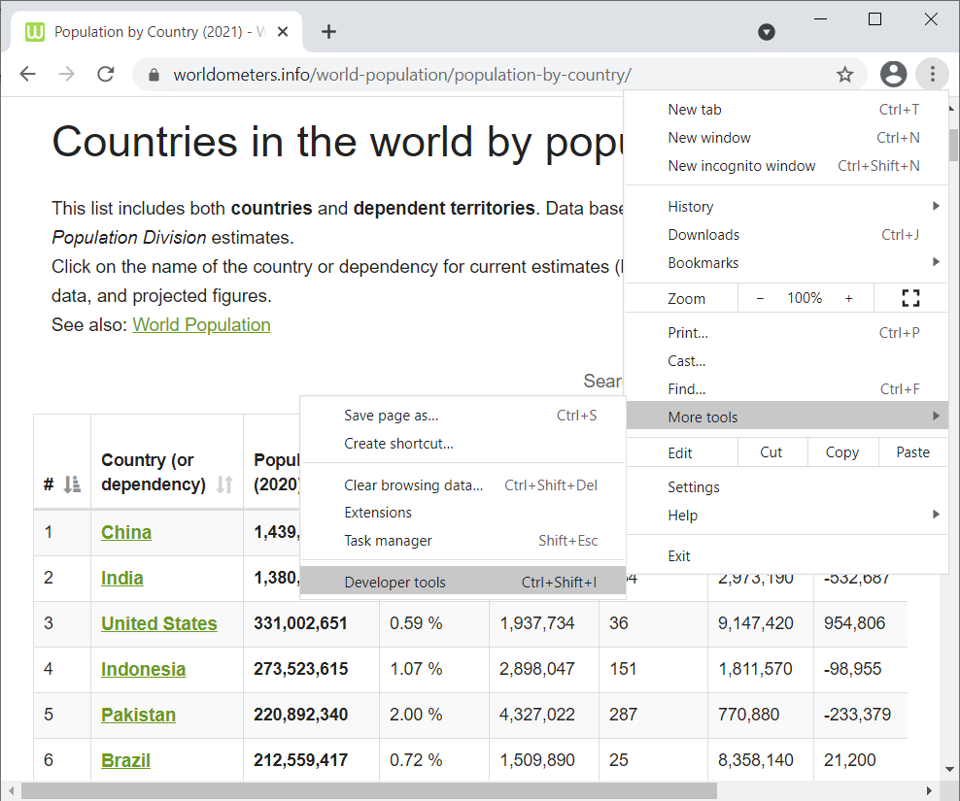
Another example:
Go to the website. i.e. https://www.worldometers.info/world-population/population-by-country/ in this case
2. Inspect the website by using developer tools

Slide 22
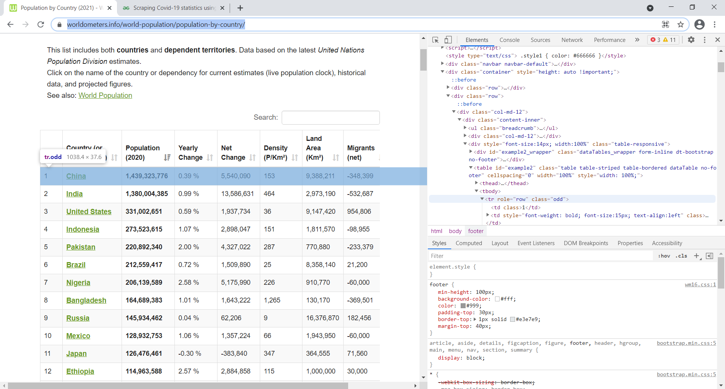
Another example:
3. Follow the elements in this webpage, you will notice that data in every rows are embedded in the <tr> element

Slide 23
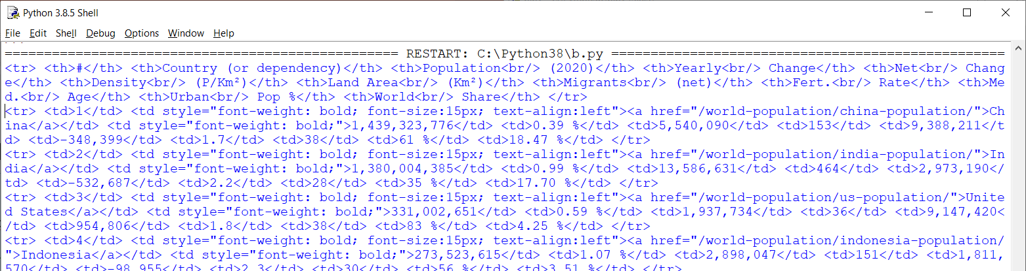
Another example:
Program:
import requests
from bs4 import BeautifulSoup
url = "https://www.worldometers.info/world-population/population-by-country/"
page = requests.get(url)
soup = BeautifulSoup(page.text, "html.parser")
row_elements = soup.find_all("tr")
for row_element in row_elements:
print (row_element)
4. After further inspection, you will discover that all data field are embedded in the <td> element from every single row of country information

Slide 24
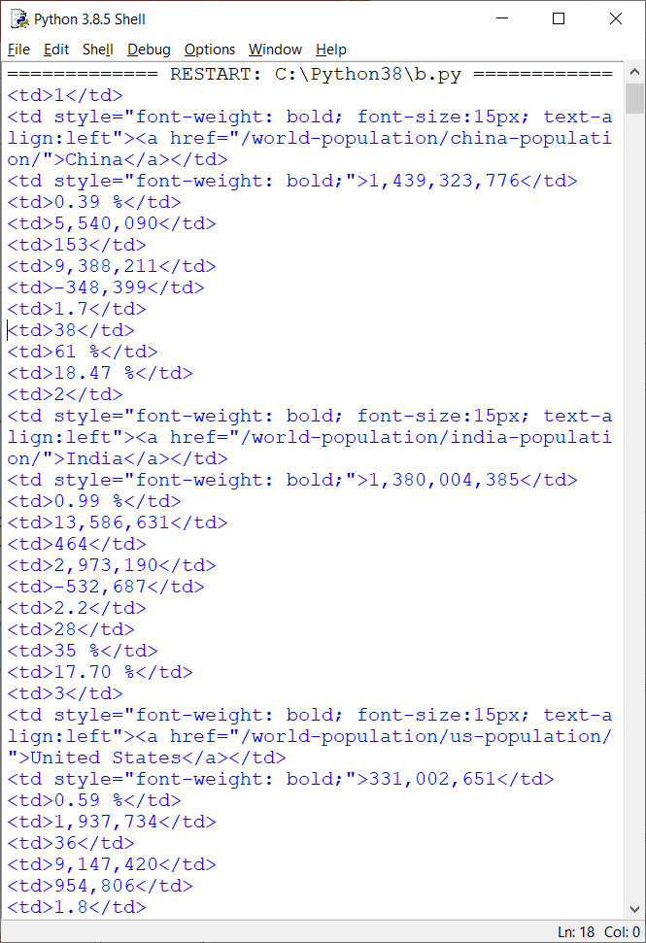
Another example:
Program:
import requests
from bs4 import BeautifulSoup
url = "https://www.worldometers.info/world-population/population-by-country/"
page = requests.get(url)
soup = BeautifulSoup(page.text, "html.parser")
row_elements = soup.find_all("tr")
for row_element in row_elements:
col_elements = row_element.find_all("td")
for col_element in col_elements:
print (col_element)
5. Extracting all data in <td> element in every <tr> rows. During this inspection, the no. of <td> elements in each record and their corresponding meaning should be discovered.

Slide 25
Another example:
Program:
import requests
from bs4 import BeautifulSoup
url = "https://www.worldometers.info/world-population/population-by-country/"
page = requests.get(url)
soup = BeautifulSoup(page.text, "html.parser")
total_population = 0
row_elements = soup.find_all("tr")
for row_element in row_elements:
col_elements = row_element.find_all("td")
data_list = list()
for col_element in col_elements:
data_list.append(col_element.text)
if len(data_list) == 0:
continue
print (f"{data_list[1]} has population {data_list[2]}")
data_list[2] = data_list[2].replace(",", "")
total_population += int(data_list[2])
print (f"Total population in the world is {total_population}")
Output:
China has population 1,439,323,776
India has population 1,380,004,385
United States has population 331,002,651
…
Total population in the world is 7795232630
6. Extract all data in <td> elements into a list
Avoid any Error if some columns is missing
7. Only selected contents is printed out
8. Numeric values are extracted for calculation

Slide 26
References
Beautiful Soup: Build a Web Scraper With Python
  https://realpython.com/beautiful-soup-web-scraper-python/#scraping-the-monster-job-site
How To Work with Web Data Using Requests and Beautiful Soup with Python 3
  https://www.digitalocean.com/community/tutorials/how-to-work-with-web-data-using-requests-and-beautiful-soup-with-python-3

Slide 27
End

