Slide 1
Python Web Framework
Chapter 09a
Advanced Scripting Technology
ITP4459

Slide 2
Lesson Intended Learning Outcomes
Upon completion of this lesson, you should be able to:
  Use Flask Application Web Framework to create a web application
  Use the routing technique to help a user remember application URLs
  Build URL dynamically by adding variable parts to the rule parameter
  Dynamically building a URL for a specific function
  Route Flask responds to different HTTP methods
  Using Flask Templates

Slide 3
Introduction
Flask is a web application framework
Web application framework, or simply Web Framework, represents a collection of libraries and modules that enables a web application developer to write applications without having to bother about low-level details such as protocols, thread management, etc.
Flask is often referred to as micro framework. It aims to keep the core of an application simple yet extensible.
Flask does not have built-in abstraction layer for database handling, nor does it have form a validation support. Instead, Flask supports the extensions to add such functionality to the application.

Slide 4
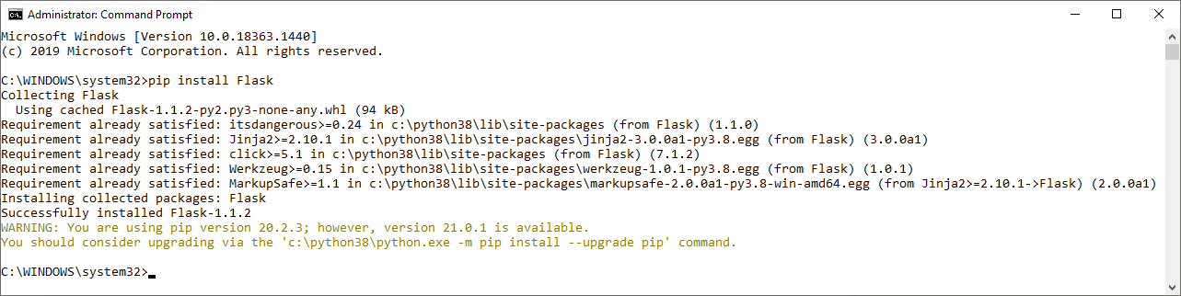
Installing Flask
Type the following command to install Flask with pip
  pip install Flask
Message similar to "Successfully installed Flask-x.xx.x" would be displayed
Type "pip install Flask" in command prompt
Installed successfully
You may consider updating pip to latest version

Slide 5
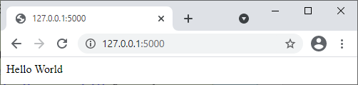
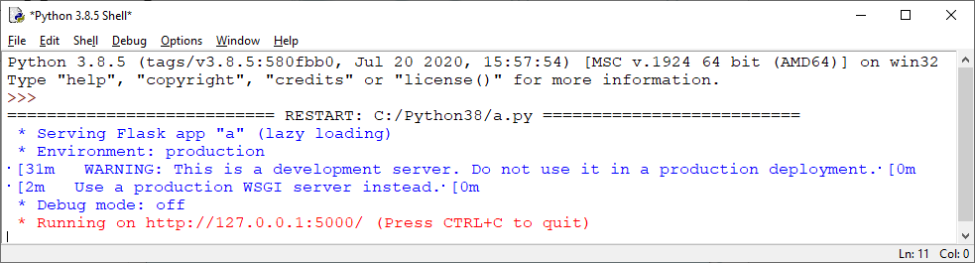
First Flask Application
In order to test Flask installation, type the following code in the editor as Hello.py
An object of Flask class is our WSGI application
Program:
from flask import Flask
app = Flask(__name__)
@app.route("/")
def hello_world():
return "Hello World"
if __name__ == "__main__":
app.run()
The route() function of the Flask class is a decorator, which tells the application which URL should call the associate function
"/" URL is bound with hello_world() function. When the home page of web server is opened in browser, the output function will be rendered.
Runs the application on the local development server
app.run(host, port, debug, options)
host – defaults to 127.0.0.1 (localhost) Set to 0.0.0.0 to have server available externally
port – defaults to 5000
Open in browser

Slide 6
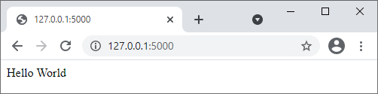
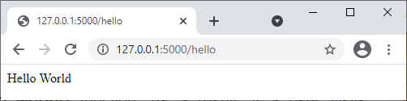
Flask - Routing
Modern web frameworks use the routing technique to help a user remember application URLs. It is useful to access the desired page directly without having to navigate from the home page.
The route() decorator in Flask is used to bind URL to a function
Program:
from flask import Flask
app = Flask(__name__)
@app.route("/")
@app.route("/hello")
def hello_world():
return "Hello World"
if __name__ == "__main__":
app.run()
URL "/hello" rule is also bound to the hello_world() function
When user visits http://localhost:5000/hello URL, the output of the hello_world() function will be rendered in the browser.

Slide 7
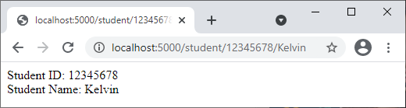
Flask – Variable Rules
It is possible to build a URL dynamically by adding variable parts to the rule parameter. This variable part is marked as <variable_name>. It is passed as a keyword argument to the function with which the rule is associated
Program:
from flask import Flask
app = Flask(__name__)
@app.route("/student/<int:id>/<name>")
def student(id, name):
return f"Student ID: {id}<br>Student Name: {name}"
if __name__ == "__main__":
app.run()
The rule parameter of route() decorator contains <int:id> and <name> variable part attached to URL "/student"
id is supplied as integer
Result when user visits http://localhost:5000/student/12345678/Kelvin in the browser, "12345678" and "Kelvin" will be supplied to student() function as argument

Slide 8
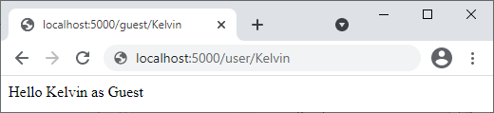
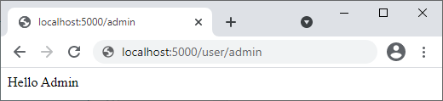
Flask – URL Building
The url_for() function is useful for dynamically building a URL for a specific function. The function accepts the name of a function as first argument, and one or more keyword arguments, each corresponding to the variable part of URL
Program:
from flask import Flask, redirect, url_for
app = Flask(__name__)
@app.route("/admin")
def hello_admin():
return "Hello Admin"
@app.route("/guest/<guest>")
def hello_guest(guest):
return f"Hello {guest} as Guest"
@app.route("/user/<name>")
def hello_user(name):
if name == "admin":
return redirect(url_for("hello_admin"))
else:
return redirect(url_for("hello_guest",guest = name))
if __name__ == "__main__":
app.run()
The function hello_user(name) accepts a value to its argument from the URL
The hello_user() function checks if an argument received matches "admin" or not. If it matches, the application is redirected to the hello_admin() function using url_for(), otherwise to the hello_guset() function passing the received argument to guest parameter to it.
Name of function
Parameter(s) of function

Slide 9
Flask – HTTP methods
HTTP protocol is the foundation of data communication in world wide web. Different methods of data retrieval from specified URL are defined in this protocols
The following table summarizes different http methods:
By default, the Flask route responds to the GET requests. However, this preference can be altered by providing methods argument to route() decorator.
Methods | Description
GET | Sends data in unencrypted form to the server. Most common method
HEAD | Same as GET, but without response body
POST | Used to send HTML form data to server. Data received by POST method is not cached by server
PUT | Replaces all current representations of the target resource with the uploaded content
DELETE | Removes all current representations of the target resource given by a URL

Slide 10
Flask – HTTP methods
1. Compile and run this python program (in IDLE)
2. Double-click this file to start
Program (login.py):
from flask import Flask, redirect, url_for, request
app = Flask(__name__)
@app.route("/success/<name>")
def success(name):
return f"Welcome {name}"
@app.route("/login",methods = ["POST", "GET"])
def login():
if request.method == "POST":
user = request.form["nm"]
return redirect(url_for("success",name = user))
else:
user = request.args.get("nm")
return redirect(url_for("success",name = user))
if __name__ == "__main__":
app.run()
Program (login.html):
<html>
<body>
<form action = "http://localhost:5000/login" method = "post">
<p>Enter Name:</p>
<p><input type = "text" name = "nm" /></p>
<p><input type = "submit" value = "submit" /></p>
</form>
</body>
</html>
http://localhost/login is mapped to the login function
Server receive data by POST method
Obtain value of "nm" parameter from form data
Obtain value of "nm" parameter from form data by GET method
Value corresponding to "nm" parameter is passed on to "success" function with parameter "name" same as before

Slide 11
Flask – Templates
In previous examples, HTML content are generated by the return string of a function call
Generating HTML content from Python code is cumbersome, especially when variable data and Python language elements like conditionals or loops need to be put.
Flask is based on the advantage of Jinja2 template engine. Instead of returning hardcode HTML from the function, a HTML file can be rendered by the render_template() function
Program (hello.py):
from flask import Flask
app = Flask(__name__)
@app.route("/")
def index():
return "<html><body><h1>Hello World</h1></body></html>"
if __name__ == "__main__":
app.run()
Putting all the HTML contents in this return string
Are you serious?

Slide 12
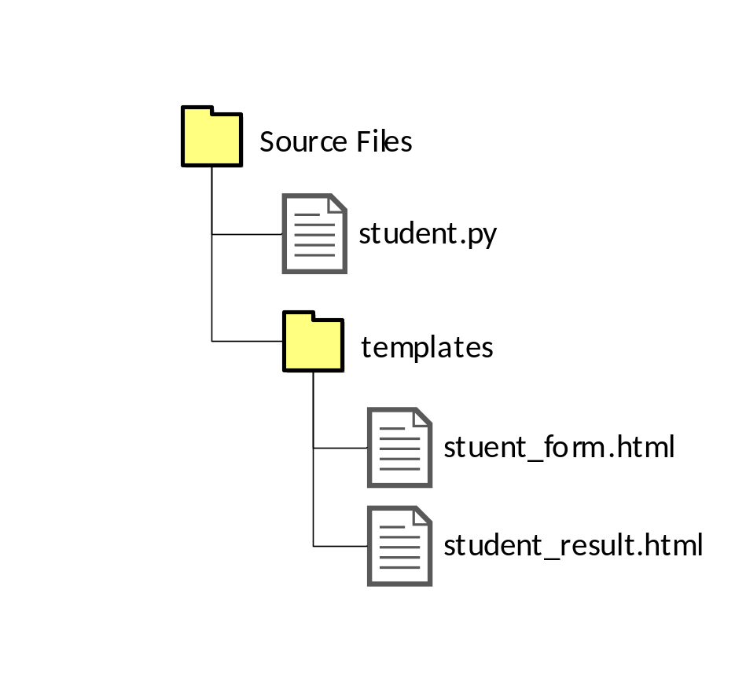
Flask – Templates
Flask will try to find the HTML file in the templates folder, in the same folder which this script is present
The term "web templating system" refers to designing an HTML script in which the variable data can be inserted dynamically. A web template system comprises of a template engine, some kind of data source and a template processor
Flask uses jinja2 template engine. A web template contains HTML syntax interspersed placeholders for variables and expressions (in these case Python expressions) which are replaced values when the template is rendered
Script you're going to execute
Templates this script would be used

Slide 13
Flask – Templates
Program (student_form.html):
<html>
<body>
<form action = "http://localhost:5000/student" method = "get">
<p>Enter Name:<input type = "text" name = "html_name" /></p>
<p>Enter Marks:<input type = "text" name = "html_marks" /></p>
<p><input type = "submit" value = "Submit" /></p>
</form>
</body>
</html>
Client submit data by GET method
Program (student.py):
from flask import Flask, request, render_template
app = Flask(__name__)
@app.route("/")
def student_form():
return render_template("student_form.html")
@app.route("/student", methods = ["GET"])
def student_result():
name = request.args.get("html_name")
marks = int(request.args.get("html_marks"))
return render_template("student_result.html", html_name = name, html_marks = marks)
if __name__ == "__main__":
app.run()
Student Input form is rendered from student_form.html template by render_template() function
Server receive data by GET method
Obtain value of "html_name" parameter from form data by GET method
Program (student_result.html):
<html>
<body>
{% if html_marks >= 40 %}
<h1> The result of student {{html_name}} is pass!</h1>
{% else %}
<h1> The result of student {{html_name}} is fail</h1>
{% endif %}
</body>
</html>
Statements are included in {%...%} blankets
Important Note:
For any modification made in any template files (html files), the python program must be executed again in order to make the update effective
Expressions to be printed to the template output are included in {{...}} blankets

Slide 14
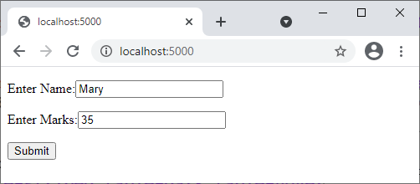
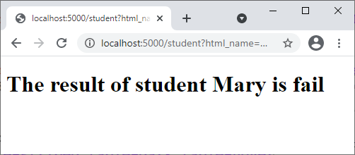
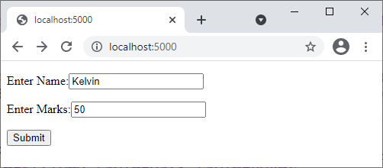
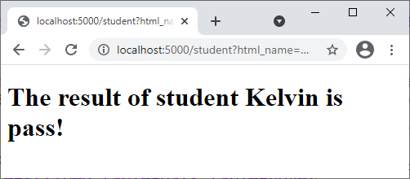
Flask – Templates
Outputs from previous example:
1
2

Slide 15
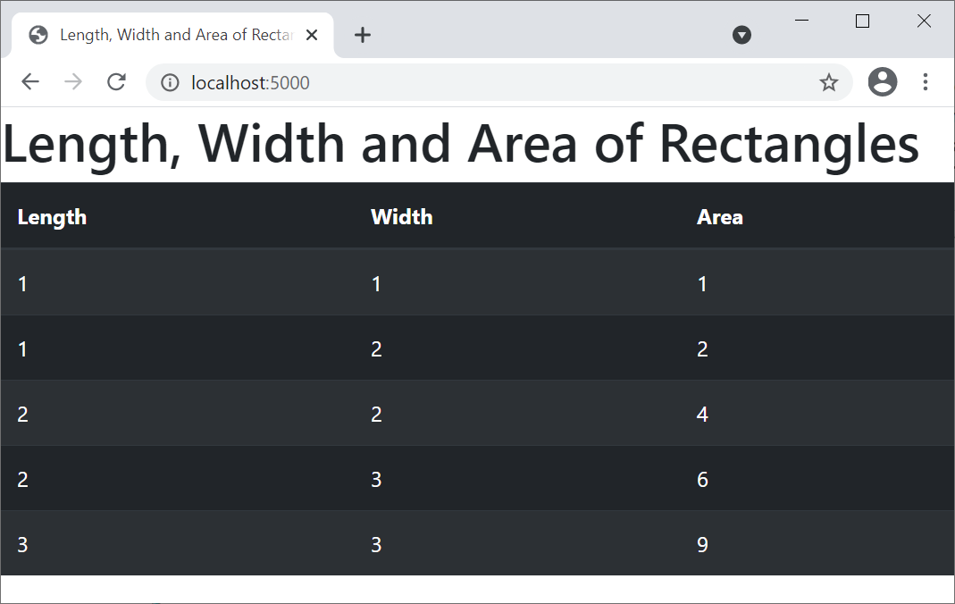
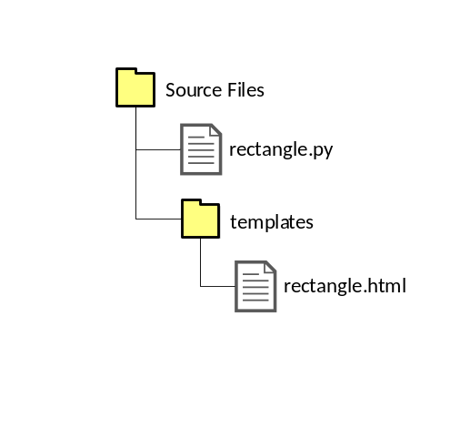
Flask – Templates with iterative elements
Program (rectangle.py):
from flask import Flask, render_template
class Rectangle:
def __init__(self, length, width):
self.__length = length
self.__width = width
def get_length(self):
return self.__length
def get_width(self):
return self.__width
def find_area(self):
return self.__length * self.__width
list_rectangle = list()
list_rectangle.append(Rectangle(1,1))
list_rectangle.append(Rectangle(1,2))
list_rectangle.append(Rectangle(2,2))
list_rectangle.append(Rectangle(2,3))
list_rectangle.append(Rectangle(3,3))
app = Flask(__name__)
@app.route("/")
def index():
return render_template("rectangle.html", html_list = list_rectangle)
if __name__ == "__main__":
app.run()
Program (rectangle.html):
<!doctype html>
<html lang="en">
<head>
<!-- Required meta tags -->
<meta charset="utf-8">
<meta name="viewport" content="width=device-width, initial-scale=1, shrink-to-fit=no">
<!-- Bootstrap CSS -->
<link rel="stylesheet" href="https://maxcdn.bootstrapcdn.com/bootstrap/4.0.0/css/bootstrap.min.css" integrity="sha384-Gn5384xqQ1aoWXA+058RXPxPg6fy4IWvTNh0E263XmFcJlSAwiGgFAW/dAiS6JXm" crossorigin="anonymous">
<title>Length, Width and Area of Rectangles</title>
</head>
<body>
<h1>Length, Width and Area of Rectangles</h1>
<table class="table table-striped table-dark table-hover">
<thead>
<tr>
<th scope="col">Length</th>
<th scope="col">Width</th>
<th scope="col">Area</th>
</tr>
</thead>
<tbody>
{% for i in html_list %}
<tr>
<td>{{ i.get_length() }}</td>
<td>{{ i.get_width() }}</td>
<td>{{ i.find_area() }}</td>
</tr>
{% endfor %}
</tbody>
</table>
<!-- jQuery first, then Popper.js, then Bootstrap JS -->
<script src="https://code.jquery.com/jquery-3.2.1.slim.min.js" integrity="sha384-KJ3o2DKtIkvYIK3UENzmM7KCkRr/rE9/Qpg6aAZGJwFDMVNA/GpGFF93hXpG5KkN" crossorigin="anonymous"></script>
<script src="https://cdnjs.cloudflare.com/ajax/libs/popper.js/1.12.9/umd/popper.min.js" integrity="sha384-ApNbgh9B+Y1QKtv3Rn7W3mgPxhU9K/ScQsAP7hUibX39j7fakFPskvXusvfa0b4Q" crossorigin="anonymous"></script>
<script src="https://maxcdn.bootstrapcdn.com/bootstrap/4.0.0/js/bootstrap.min.js" integrity="sha384-JZR6Spejh4U02d8jOt6vLEHfe/JQGiRRSQQxSfFWpi1MquVdAyjUar5+76PVCmYl" crossorigin="anonymous"></script>
</body>
</html>
HTML statements included for using Bootstrap
Python for loop statement in Flask Template
Pass list_rectangle to variable in Flask Template

Slide 16
References
Flask – Quick Guide
  https://www.tutorialspoint.com/flask/flask_quick_guide.htm

Slide 17
End

