Slide 1
Python Web Framework
Chapter 09b
Advanced Scripting Technology
ITP4459

Slide 2
Lesson Intended Learning Outcomes
Upon completion of this lesson, you should be able to:
  Using Cookies in Flask Framework
  Using Session in Flask Framework
  Using MySQL database in Flask Framework

Slide 3
Flask - Cookies
A cookie is stored on a client's computer in form of text file
Its purpose is to remember and track data pertaining to a client's usage for better visitor experience and site statistics
A request object contains a cookie's attribute. It is a dictionary object of all the cookies variables and their corresponding values a client has transmitted. In addition, a cookie also stores its expiry time, path and domain name of the site
In Flask, cookies are set on response object
  Use make_response() function to get response object from return value of a view function (e.g. render_template() or redirect()). After that, use the set_cookie() function of response object to store a cookie.
  The get() method of request.cookies attribute is used to read a cookie

Slide 4
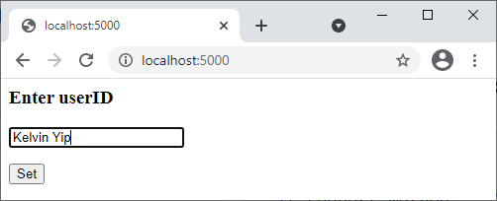
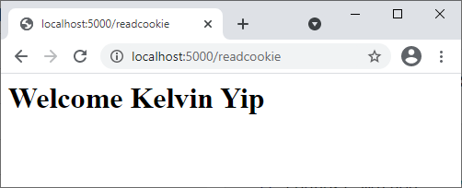
Flask - Cookies
Program (set_cookie.py):
from flask import Flask, request, render_template, make_response, url_for, redirect
app = Flask(__name__)
@app.route("/")
def index():
return render_template("setcookie.html")
@app.route("/setcookie", methods = ["POST"])
def setcookie():
if request.method == "POST":
user = request.form["id"]
resp = make_response(redirect(url_for("readcookie")))
resp.set_cookie("userID", user)
return resp
@app.route("/readcookie")
def readcookie():
if "userID" in request.cookies:
name = request.cookies.get("userID")
return f"<h1>Welcome {name}</h1>"
else:
return f"<h1>Cookie 'userID' NOT found</h1>"
if __name__ == "__main__":
app.run()
A simple form opens up as user visit "/" URL
In Flask, cookies are set on response object
Return of view functions, such as redirect() or render_template() methods, can be used as input parameter of make_response() method
set_cookie() function is used to store a cookie named userID in response object
Program (setcookie.html):
<html>
<body>
<form action = "/setcookie" method = "POST">
<p><h3>Enter userID</h3></p>
<p><input type = "text" name = "id"/></p>
<p><input type = "submit" value = "Set"/></p>
</form>
</body>
</html>
This Form is posed to "/setcookie" URL
Check item existence in cookies
Read data from cookie by using get() method

Slide 5
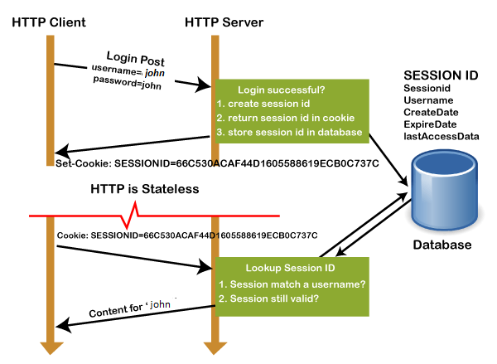
Flask - Session
Like Cookie, Session data is
stored on client
Session is the time interval
when a client logs into a server and logs out of it
A session with each client is assigned a Session ID. The Session data is stored on top of cookies and the server signs them cryptographically. Flask application needs a defined SECRET_KEY for this encryption
Session object is also a dictionary object containing key-value pairs of session variables and associated values
pop() method can be used to release a session variable

Slide 6
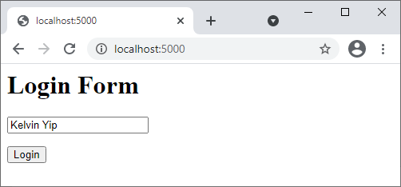
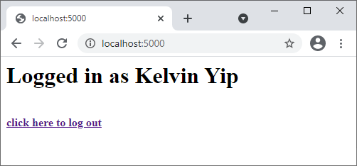
Flask - Session
Program (set_session.py):
from flask import Flask, session, redirect, url_for, request, render_template
app = Flask(__name__)
app.secret_key = "any random string"
@app.route("/")
def index():
if "username" in session:
username = session["username"]
return render_template("content.html", nm=username)
return render_template("login.html")
@app.route("/login", methods = ["POST"])
def login():
if request.method == "POST":
session["username"] = request.form["username"]
return redirect(url_for("index"))
@app.route("/logout")
def logout():
session.pop("username", None)
return redirect(url_for("index"))
if __name__ == "__main__":
app.run()
Program (content.html):
<html>
<body>
<h1>Logged in as {{nm}}</h1><br>
<b><a href = "/logout">click here to log out</a></b>
</body>
</html>
Render content page for a user has logged in already with it's username
Prompts user to login in if session variable "username" is not set
Obtain username from login form and assign it to "username" session variable
Redirect to index page to display content page
Program (login.html):
<html>
<body>
<h1>Login Form</h1>
<form action = "/login" method = "post">
<p><input type = "text", name = "username"/></p>
<p><input type = "submit", value = "Login"/></p>
</form>
</body>
</html>
Remove username from session if it is there
Redirect to index page to display login form while "username" is removed in session

Slide 7
Flask - MySQL
Program (student.py – ConnectDB class):
def create_table():
try:
mycursor = ConnectDB.mydb.cursor()
query = """
CREATE TABLE IF NOT EXISTS student (
id VARCHAR(100),
name VARCHAR(100),
addr VARCHAR(1000),
tel VARCHAR(100)
)"""
mycursor.execute(query)
ConnectDB.mydb.commit()
print ("Table created successfully");
except mysql.connector.Error as e:
print (e)
def insert_student(id, name, addr, tel):
mycursor = ConnectDB.mydb.cursor()
query = (f"INSERT INTO student (id,name,addr,tel) "+
f"VALUES ('{id}','{name}','{addr}','{tel}')")
mycursor.execute(query)
ConnectDB.mydb.commit()
def read_students():
try:
mycursor = ConnectDB.mydb.cursor()
query = f"SELECT * FROM student"
mycursor.execute(query)
result=mycursor.fetchall()
return result
except mysql.connector.Error as e:
print (e)
Program (student.py – ConnectDB class):
from flask import Flask, render_template, request
import mysql.connector
class ConnectDB:
try:
mydb = mysql.connector.connect(
host="localhost",
user="root",
password="",
database="student_db"
)
print ("Opened database successfully");
except mysql.connector.Error as e:
print (e)
Operations related to database are usually grouped into a single class
Remember to create the student_db database before executing this program
Return all rows as result
Columns in rows are extracted directly in web page

Slide 8
Flask - MySQL
Program (student.py):
app = Flask(__name__)
@app.route("/enternew")
def new_student():
return render_template("student_form.html")
@app.route("/addrec",methods = ["POST"])
def addrec():
if request.method == "POST":
msg = ""
try:
id = request.form["id"]
name = request.form["name"]
addr = request.form["addr"]
tel = request.form["tel"]
ConnectDB.insert_student(id, name, addr, tel)
msg = "Record successfully added"
except mysql.connector.Error as e:
msg = "Error in insert operation"
return render_template("student_result.html", msg = msg)
new_student() function is bound to the URL rule ("/enternew"). It renders an HTML file containing student information form
Program (student.py):
@app.route("/list")
def list():
result = ConnectDB.read_students()
return render_template("student_list.html",rows = result)
@app.route("/")
def home():
return render_template("student_home.html")
if __name__ == "__main__":
ConnectDB.create_table()
app.run()
This method populates "rows" as a MultiDict object containing all records in the student table
Entry point of the application
MultiDict object is passed to the list.html template
Retrieves form's data by POST method
Insert into student table
Message corresponding to success or error in insert operation is rendered to "student_result.html"

Slide 9
Flask - MySQL
Program (student_form.html):
<!doctype html>
<html>
<body>
<form action = "{{ url_for('addrec') }}" method = "POST">
<h1>Student Information</h1>
ID<br>
<input type = "text" name = "id" /></br>
Name<br>
<input type = "text" name = "name" /></br>
Address<br>
<textarea name = "addr" ></textarea><br>
Telephone<br>
<input type = "text" name = "tel" /><br>
<input type = "submit" value = "Submit" /><br>
</form>
</body>
</html>
Program (student_list.html):
<!doctype html>
<html>
<body>
<h1>Student List</h1>
<table border = 1>
<thead>
<td>ID</td>
<td>Name</td>
<td>Address</td>
<td>Telephone</td>
</thead>
{% for row in rows %}
<tr>
<td>{{row[0]}}</td>
<td>{{row[1]}}</td>
<td>{{row[2]}}</td>
<td>{{row[3]}}</td>
</tr>
{% endfor %}
</table>
<a href = "/">Go back to home page</a>
</body>
</html>
Form data is posted to the "/addrec" URL which binds the addrec() function
A template iterates over the row set and renders the data in an HTML table
Program (student_result.html):
<!doctype html>
<html>
<body>
{{ msg }}<br>
<a href = "/">Back to Home Page</a>
</body>
</html>
Displays the result of Insert operation
Program (student_home.html):
<!doctype html>
<html>
<body>
<h1>Home Page</h1>
<a href="/enternew">Add New Record</a><br>
<a href="/list">Show List</a>
</body>
</html>

Slide 10
References
Flask – Quick Guide
  https://www.tutorialspoint.com/flask/flask_quick_guide.htm
What is the difference between session and cookies?
  https://www.tutorialspoint.com/What-is-the-difference-between-session-and-cookies

Slide 11
End

