Slide 1
Chapter 1: Create a Userform with Excel Visual Basic for Applications

Slide 2
Chapter Objectives
After completing this chapter, you will be able to:
  create a Userform which contains Label controls, TextBox controls, and CommandButton controls.
  show a Userform at run time;
  save and open an Excel workbook that contains a VBA program (or macro or application);
  use variables to store information at the run time of the VBA program;
  write code to perform simple computations;
  make use of VBA functions in a program.

Slide 3
An Example of Excel VBA
Example 1.1. CityU Cars uses an Access database to store customers’ and sales data. The manager of CityU Cars needs to
  report the make and models of cars sold;
  Report the net profits resulting from vehicle sales for each of the three dealerships;
  Report the commissions generated by sales reps at each dealership; and
  Enter new /updated existing customers’ information.

Slide 4
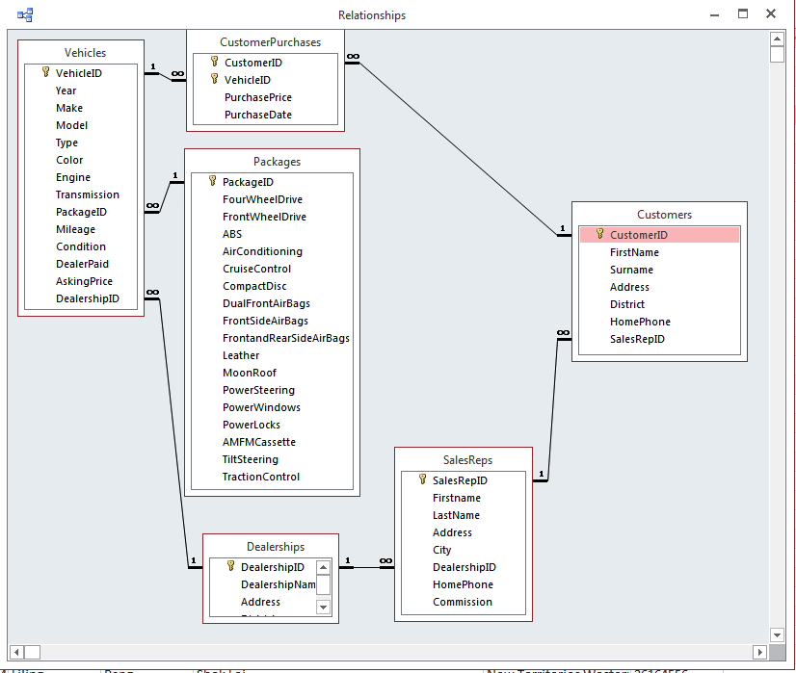
An Example of Excel VBA
Example 1.1 (Cont’d)
  Example of Data tables in Access file CityUCars.accdb:

Slide 5
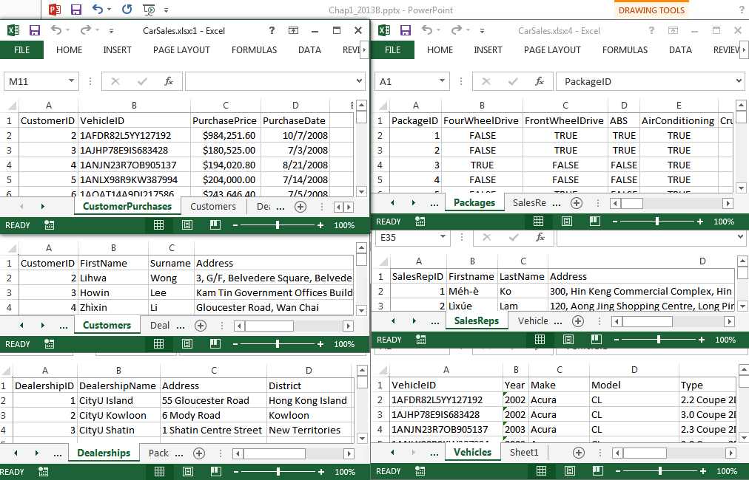
An Example of Excel VBA
Example 1.1 (Cont’d)
  Manual Excel operation
    To generate the required reports manually, the manager first imports each data table into a new worksheet in an Excel workbook.

Slide 6
An Example of Excel VBA
Example 1.1 (Cont’d)
  Manual Excel operation
    The records in these worksheets will be combined to generate the required reports.
    For example, to report the net profits for each dealership, the manager needs to do the following data manipulations:
      For each record in the CustomerPurchases worksheet:
        Extract the respective value of DealerPaid, and DealershipID from the worksheet “Vehicles” with matching VehicleID.
        Extract the respective value of SalesRepID from the worksheet “Customers” with a matching CustomerID.
        Extract the respective value of CommissionRate from the worksheet “SalesReps” with a matching SalesRepID.
        Compute respective net profit of the sales = PurchasePrice – Dealerpaid – PurchasePrice*CommissionRate.
      Then report the net profits for each dealership.

Slide 7
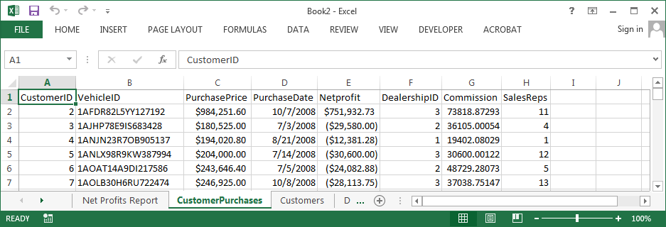
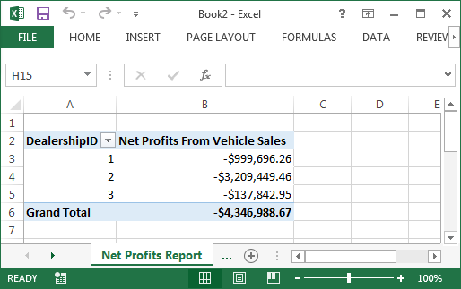
An Example of Excel VBA
Example 1.1 (Cont’d)
  Manual Excel operation
    Compute the NetProfit for each record in the worksheet “CustomerPurchases”
    Report net profit for each dealership

Slide 8
An Example of Excel VBA
Example 1.1. (Cont’d)
  Manual Excel operation
    Computing the net profits, sales commissions, etc., for the sales is relatively easy but time-consuming and error-prone.
    The manager needs to know how to create Pivot Tables and draw charts.
    The manager needs to know how to operate Access data tables to enter new or modify existing customer information.

Slide 9
An Example of Excel VBA
Example 1.1 (Cont’d)
  How can Excel Visual Basic for Applications be helpful in this case?
    An application should allow the manager (or anyone) to generate the required reports and update the information without knowledge of data manipulations, pivot tables, chart drawings, and Access tables.
    Specifically,
      The application should import the Access data tables into Excel automatically.
      The application should automatically compute the net profit and commission for each record.
      The application should automatically report the summary statistics of the sales by the makes and models, net profits for each dealership, and the commission for each sales rep.
      The application should update the Access data table automatically based on the new customer’s information provided by the user at runtime.

Slide 10
An Example of Excel VBA
Example 1.1. (Cont’d)
  The tasks of the application:
    To import the data tables from the user-specified Access file into the designated worksheet of a new Excel workbook.
    To create a report on the makes and models of cars sold.
    To create a report on the net profits for each dealership.
    To create a report on commissions for each sales rep at each dealership.
    To enter new customer information into the respective Access table.
    To update existing customers’ information in the respective Access table.

Slide 11
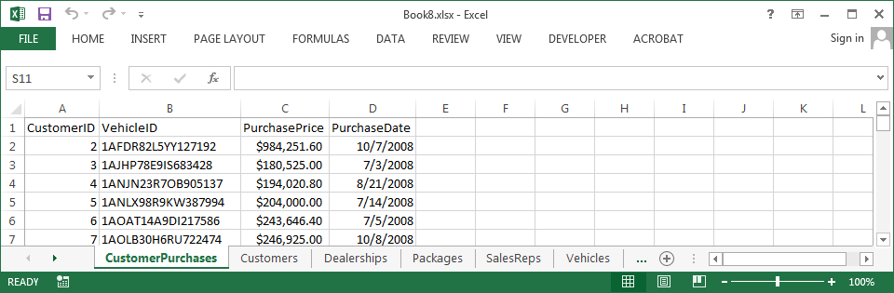
An Example of Excel VBA
Example 1.1 (Cont’d)
  The design of the application
    A new Excel workbook will be created at run time for holding the imported data from the Access file. There will be one worksheet for each data table.

Slide 12
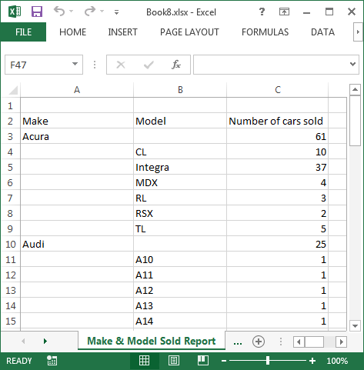
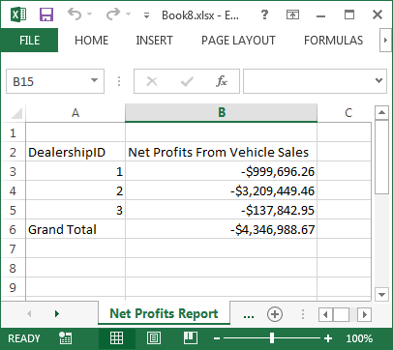
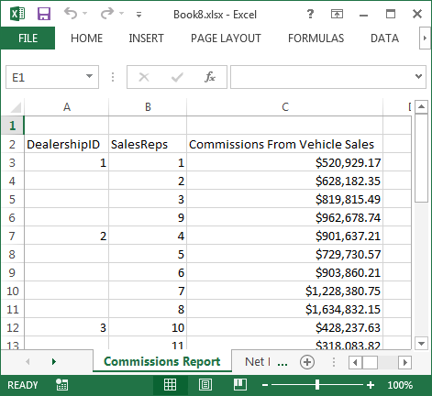
An Example of Excel VBA
Example 1.1 (Cont’d)
  The design of the application
    The same workbook will also contain the reports to be generated, one worksheet for each report.

Slide 13
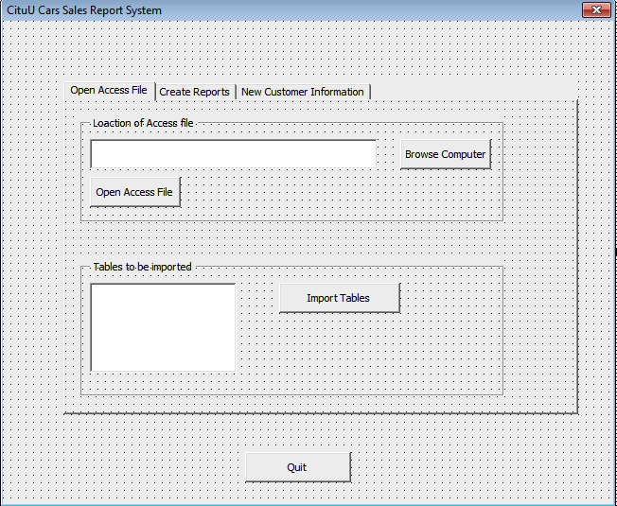
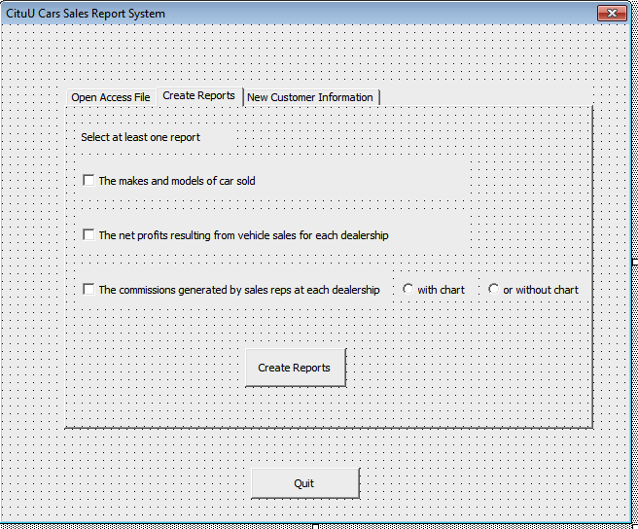
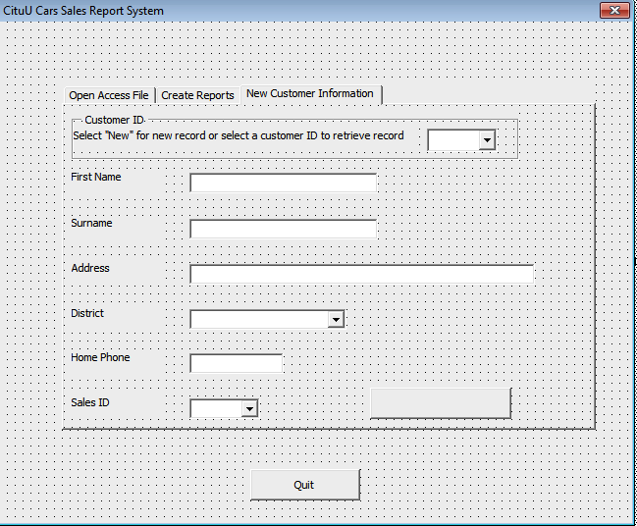
An Example of Excel VBA
Example 1.1 (Cont’d)
  The design of the application
    Design of the Userform
For Task 1
For Tasks 2, 3, & 4
For Tasks 5, & 6

Slide 14
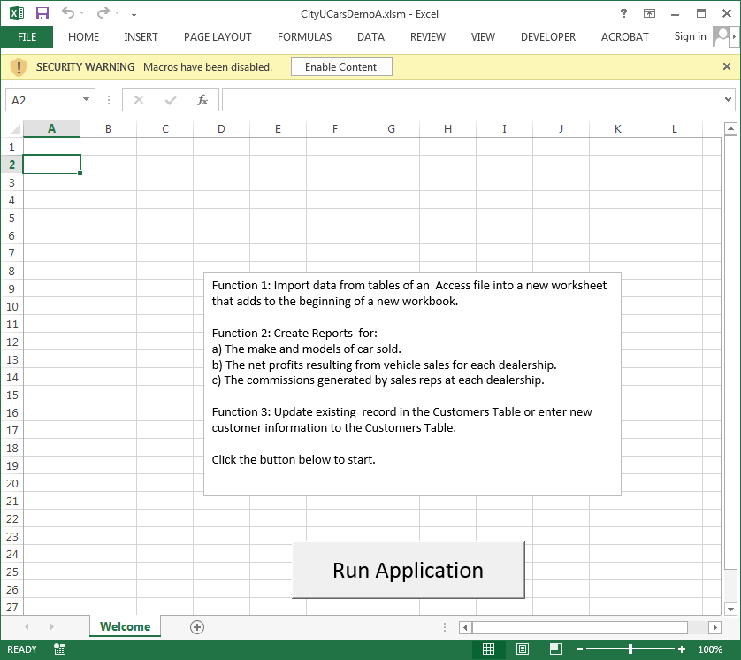
An Example of Excel VBA
Example 1.1 (Cont’d)
  Run the application
    Open the Excel file CityUCarsDemo.xlsm, and confirm enabling of macros. Then click the Run button on the Welcome sheet to run the Application.
      The user is assumed to have access to the required data file CityUCars.accdb at the application’s run time.

Slide 15
How to Be a Successful VBA Programmer?
To be successful in automating a reporting process with VBA, you will need at least the following skills and knowledge:
  You must thoroughly understand the reporting process that you want to automate. You need the answers to many questions: Who is the application user? What are the available data sets? What kind of data manipulations need to be applied? What are the required results? How to work out the results manually (i.e., without using VBA)?
  You must be capable of creating the required report manually (i.e., without using VBA) in an organised and repeatable manner.
    That is the same procedure can be applied to another set of data
  You must be familiar with the VBA programming language (i.e., the syntax and the features).
  You must convert your manual approach into a set of programmable steps. To do that, you must develop sound programming logic.

Slide 16
How to Be a Successful VBA Programmer?
Effective programming does not necessarily require using sophisticated algorithms and code. Clean and straightforward code allows one to use lesser complex logic. Some tips to improve the logic in your programs and effectively write better code:
  Check solutions by other people
    The best way to build programming logic is by understanding how others build it, ensuring you can reproduce the process when required.
  Practice
    Building logic repeatedly allows you to build logic more effectively over time.

Slide 17
How to Be a Successful VBA Programmer?
  Use a pen and paper to work out solutions
    Breaking down solutions and thinking about them is much easier when you write them down.
  Keep learning new things
    By tackling new topics and challenges, you can expand your knowledge and logic-building skills.
  Face problems head-on
    It would help if you actively tried solving new challenges by referring to solutions and books. New problems provide good learning opportunities.
  Don't lose motivation
    Practice regularly and persistently are the determining factors of successful logic-building and programming skill development.

Slide 18
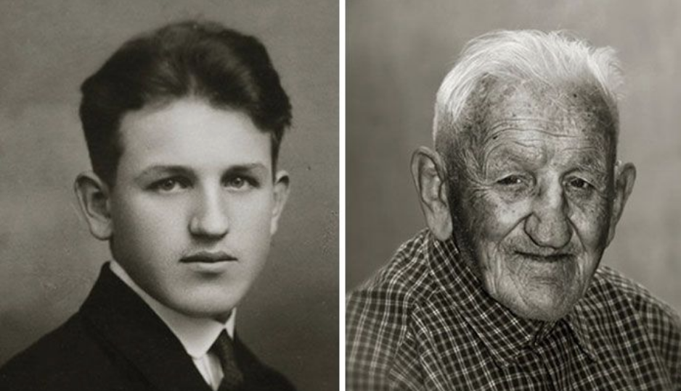
How to Be a Successful VBA Programmer?
  Know the difference between a human brain and a computer
    The computer is faster at doing logical things and computations. However, the brain is better at interpreting the outside world and developing new ideas. The brain is capable of imagination.
Who is older?
What is the answer?
234 x 456 = ?

Slide 19
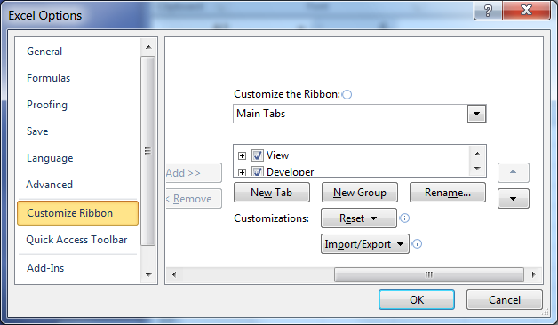
Visual Basic Editor
Enable the Developer tab in Ribbon:
  Click the File tab.
  Click Options on the left.
  Click Customize Ribbon on the left.
  In the area on the right, Check the box next to Developer.
  Click OK.

Slide 20
Visual Basic Editor
Nearly every application developed requires a user interface for displaying information to the user or collecting information from the user.
Excel offers several user interface elements:
  Worksheet Form Controls: From Ribbon, Developer | Insert | Form Controls.
  Worksheet ActiveX Controls: From Ribbon, Developer | Insert | ActiveX Controls.
  Built-in dialogue box functions: Such as MsgBox, or InputBox.
  VBA Userform object: Dialog box that you can design and control.

Slide 21
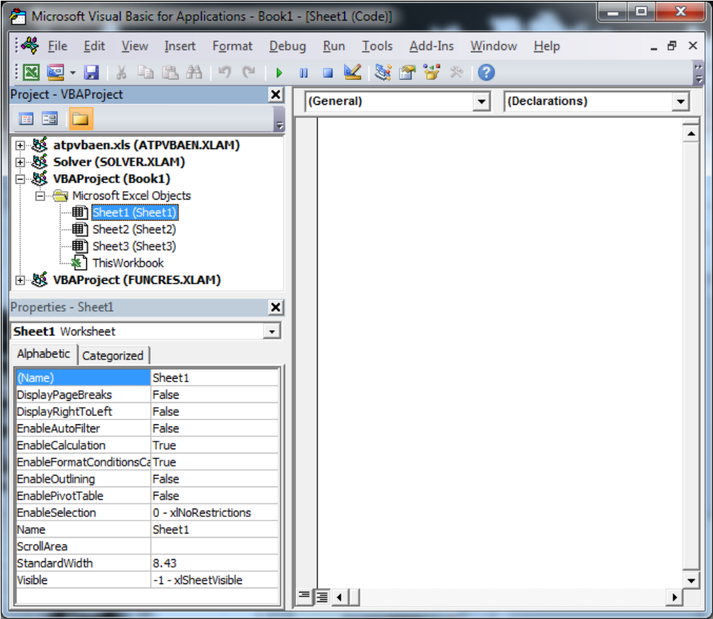
Visual Basic Editor
Display Visual Basic Editor application window
  Click Visual Basic under the Developer tab to open the VB Editor window
Project Explorer
Window
Code
Window
Properties Window

Slide 22
Visual Basic Editor
VBA Projects
  Each Excel workbook is a VBA project.
    The default project name is in the form of VBAProject, followed by the workbook name in parentheses.
    If more than one workbook is opened, you will see more than one VBA project in Project Explorer Window.
      All VBA projects share the same Visual Basic Editor application window.

Slide 23
Visual Basic Editor
VBA Projects
  Each VBA project may contain up to 4 types of objects:
    1. Microsoft Excel Objects
      Contains at least one Worksheet object and ThisWorkbook object.
        The Worksheet object contains event codes that are related to the associated worksheet.
          Each Worksheet object has its own set of event codes. The system runs event codes automatically according to the type of events.
        The ThisWorkbook object contains event codes that are related to the entire workbook. The system runs event codes automatically according to the type of events.

Slide 24
Visual Basic Editor
VBA Projects
  Each VBA project may contain up to 4 types of objects:
    2. Module object
      It contains the macros (or procedures or programs) that you wrote. These macros will only run by the system once some statements call them at runtime.
    3. Forms object
      It contains Userforms and associated event codes that you created.
    4. Class modules
      It contains special objects created (not in the syllabus) by the application developer.

Slide 25
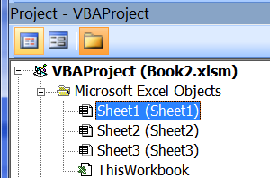
Visual Basic Editor
VBA code window
  Each of the four types of objects has its own VBA code window for storing the associated program.
  You can view the code window associated with an object by selecting the object in Project Explorer and clicking the View Code button.
    E.g. Select object Sheet1 (Sheet1) and view the associated code window.

Slide 26
Creating a Userform (self-study)
Managing your project
  Removing components
    Right-click the object to be removed in the Project Explorer and choose Remove YourCompnentName.
    Confirm whether you want to export the selected component before removing it.
    A removed component is not recoverable.
  Importing and Exporting Components
    An individual component can be imported or exported.
      To Export a component, right-click the component in the Project Explorer and choose Export File.
      To Import a component, right-click the project in the Project Explorer and choose Import File.
    An individual component can be copied from one project into another project.
      To copy a component, drag the component in the Project Explorer to another project.

Slide 27
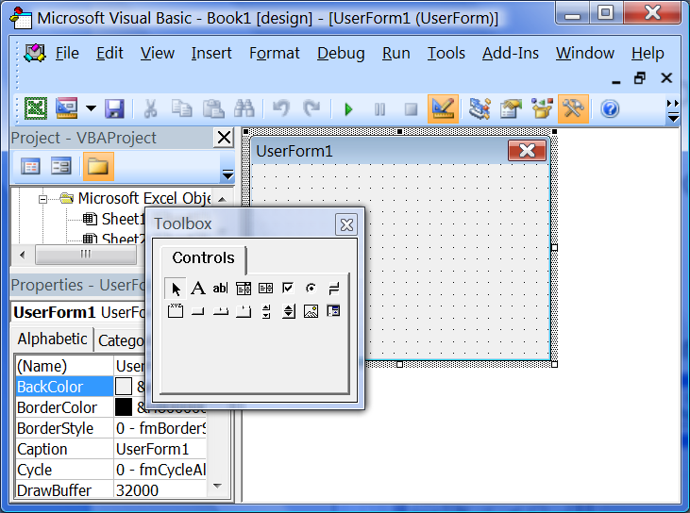
Creating a Userform
Example 1.2
  Adding a Userform object to your application
    From Ribbon, click Developer | Visual Basic to activate Visual Basic Editor
    Click Insert from the Tool Bar and select Userform from the menu.
(The completed application for Examples 1.2 -1.6 can be found in CityUDemo.xlsm)

Slide 28
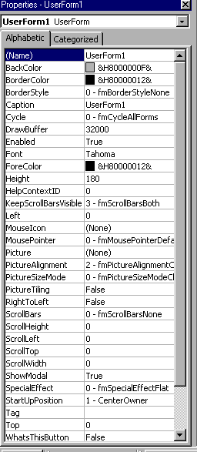
Creating a Userform
Example 1.2 (Cont’d)
  Setting a Userform's Properties
    If the properties window is not displayed, press F4.
    Naming the Userform: Select the Name property, and enter “frmEx1”.
      frmEx1 is the object name of the newly created form.
      Refer to this form programmatically by this name in this application.
    Defining the Caption: Select the Caption property, and enter “City University of Hong Kong”.
      This is the title to be displayed on the form.

Slide 29
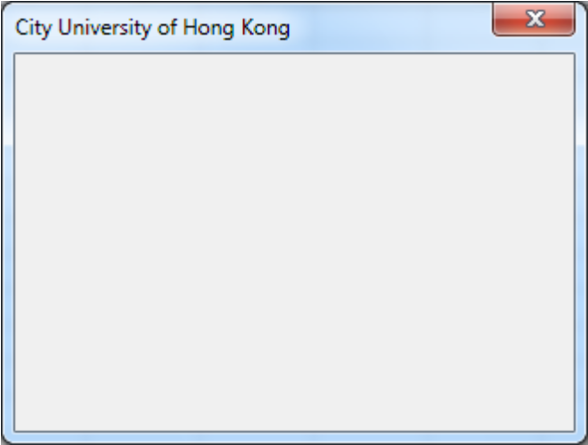
Creating a Userform
Example 1.2 (Cont’d)
  Running the Userform
    Running a Userform means seeing it display as it would in your application.
    Click the Userform to select it.
    Press F5 or click the Run Sub button on the Toolbar.
Click the close button (X) on the form's title bar to close the Userform.

Slide 30
Creating a Userform
Example 1.2 (Cont’d)
  Saving the application
    Save the workbook as CityU1.xlsm.
      All Userforms and macros will be saved with the workbook automatically.
    A workbook with Userforms or macros must be saved in the format of “Excel Macro-Enabled Workbook”, or else all Userforms and macros will be erased by the system.
  Opening the workbook that contains macros
    By default, all macros are disabled unless you have changed the security level to Minimum (not recommended).
    Click the Enable Content in Security Warning to enable the running of attached macros.

Slide 31
Creating a Userform
Userform controls
  Controls (also called ActiveX Controls) are the elements of a Userform (or dialogue box) that enable the user to interact with the application at run time.
  Userform object can be considered as a control by itself. It is mainly used to contain other controls.
  Every type of control (or object) comes with a set of properties, methods, and events.
    Properties can be set at program design time or run time. It allows you to manipulate the appearance (such as size, or colour etc.), and the features (such as visible or not, or enable or not etc.) of a control.
    Methods are the actions that a control can perform (such as coping, deleting, or selecting).
    The action applied to a control by is called an event. For example, when a CommandButton control is clicked, the click triggers the Click event of the control.
      A triggered event will cause the system to run a predefined program. It is called an event procedure.

Slide 32

Creating a Userform
Userform controls
  If the Toolbox is not displayed, select View | Toolbox.
Label (or text)
Combobox
Checkbox
Togglebutton
Commandbutton
Multipage
Spinbutton
Refedit
Textbox
Listbox
Optionbutton
Frame
Tabstrip
Scrollbar
Image

Slide 33
Label Control
Label control is used to display text at run time. The user cannot edit the text while the application is running.
  Example 1.3. Open workbook CityU1.xlsm and go to the editor window of frmEx1.
    Click and drag a Label control from the toolbox to the bottom of the form frmEx1.
    In the Properties list of the Label control:
      Click ‘(Name)’. Type “lblName” in the Setting box.
      Click ‘Caption’. Type “City University of Hong Kong” in the Setting box.
      Click ‘Autosize’. Select True from the drop list so the system automatically sizes the lblName control to fit its current contents.

Slide 34
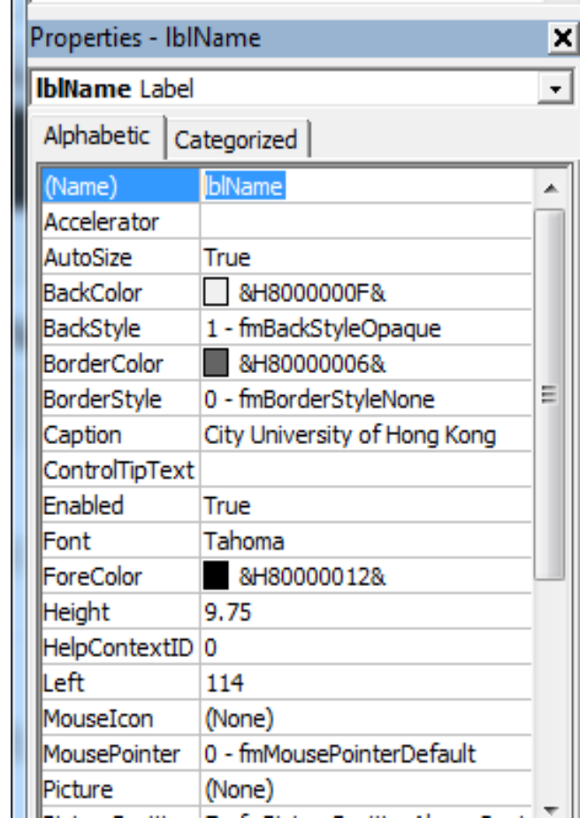
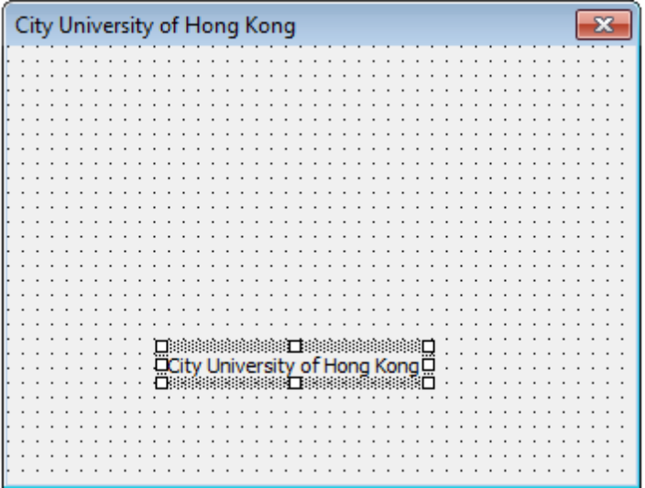
Label Control
Example 1.3 (Cont’d)

Slide 35
Label Control
Example 1.3 (Cont’d)
  Click and drag another Label control from the toolbox to frmEx1 and place it below lblName.
  In the Properties list of the Label control:
    Click ‘(Name)’. Type “lblWelcome” in the Setting box.
    Click ‘Caption’. Type “Welcome to the world-class education centre!” In the Setting box.
    Click ‘Autosize’. Select True from the drop list so that the editor automatically sizes the lblWelcome control to fit its current contents.
    Click ‘Wordwrap’. Select False from the drop list so that the editor will not wrap the texts into multiple lines.
  Use the Format menu to align the two label controls as needed.

Slide 36
Image Control
Image control displays an image on a Userform at run time.
Example 1.4
  Drag an Image control from the toolbox to the upper part of the form frmEx1 in CityU1.xlsm.
  Name this control imgCityU.
  Click Picture Property and select the image file CityUSmall.jpg.
  Adjust the size of the control as needed.
    Explore associated properties such as BorderStyle, PictureSizeMode etc.

Slide 37
CommandButton Control
CommandButton control is mostly used to perform predetermined actions when clicked.
Example 1.5
  Drag a CommandButton control from the Toolbox to the form frmEx1 in CityU1.xlsm. Position the control in the lower-right corner of the form.
  Name this control btnExit.
  Click the Caption property of btnExit and type “Exit”.
  This button is used for exiting the application when it is clicked.

Slide 38
CommandButton Control
All event procedures of the controls on a Userform are contained in the same Code Editor window of the form. Each Userform has only 1 Code Editor window.
To open the corresponding Code Editor window, select the Userform in the Project Explorer and click View Code on the context menu.

Slide 39
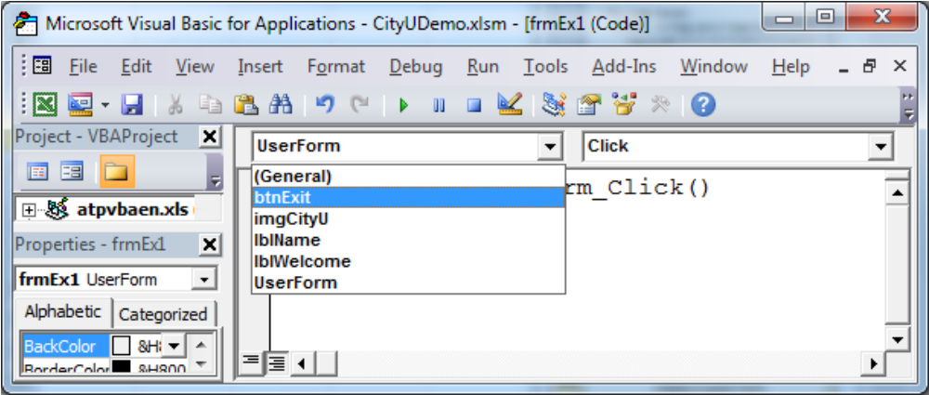
CommandButton Control
Example 1.5 (Cont’d)
  To write the code for the Click event of btnExit:
    Click the Class Name list arrow and then select btnExit in the list.
    Then click the Event Name list arrow and select Click in the list if the editor has not already selected it.
Class Name list
Event Name list

Slide 40
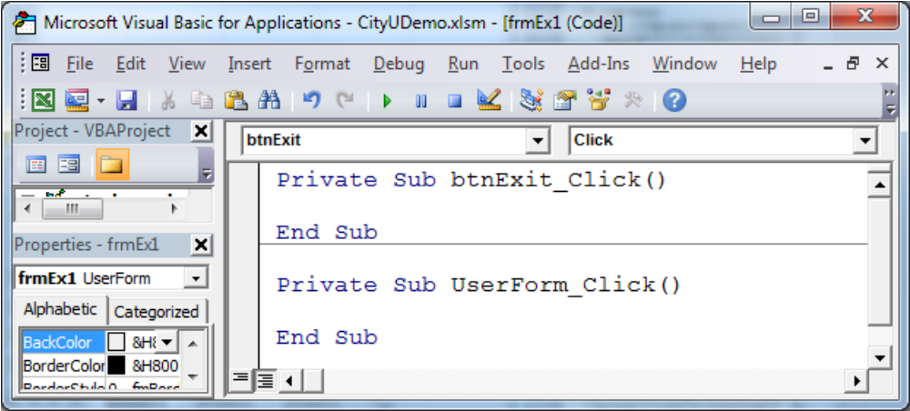
CommandButton Control
Example 1.5 (Cont’d)
  A code template for the selected event is provided by default.
  The first line in the code template is called the procedure header (E.g. Private Sub xxx). The last line is called the procedure footer (E.g. End Sub).

Slide 41
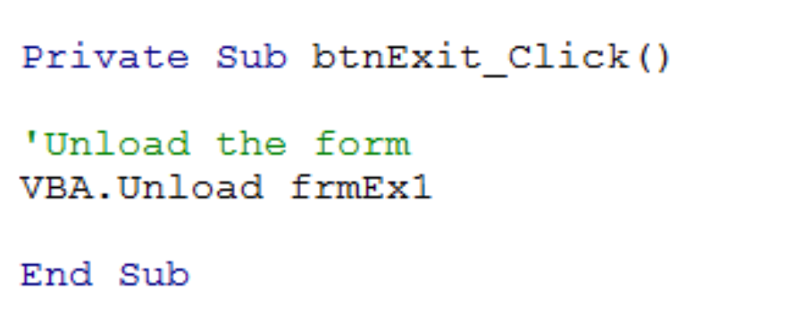
CommandButton Control
Example 1.5 (Cont’d)
  Type the statement “VBA.Unload frmEx1” between the procedure header and footer of btnExit_Click.
  Unload is a method of the VBA object that can be called upon for closing a running form.
    When an object is unloaded, it's removed from memory, and all associated memories are reclaimed. It can't be manipulated programmatically anymore.

Slide 42
Launching a Userform Programmatically
Method I: At the users’ request
  Example 1.6
    In Sheet1 of the workbook CityU1.xlsm, insert a CommandButton (Active X control) from the Insert of Developer Tab.
    Double-click the inserted CommandButton to view the code window of the Sheet1 object.
      All code of inserted Active X controls is contained in this code window.
    Type the statement frmEx1.Show between the procedure header and footer of CommandButton1_Click.
      Show is one of the methods that are associated with a Userform.
      A method is a predefined procedure that you can call when needed.
    In the property window of control CommandButton1, click Caption and type Click Me! to change the text that appears on the button.

Slide 43
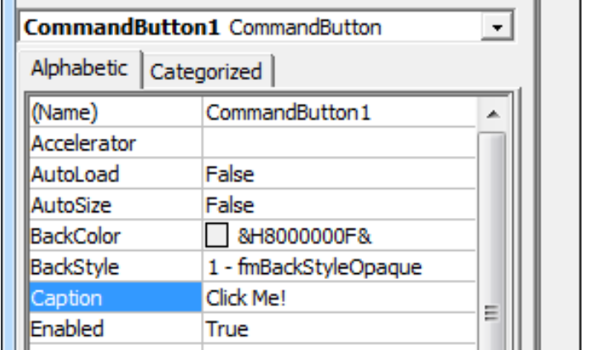
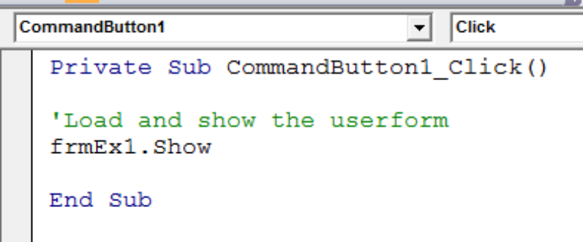
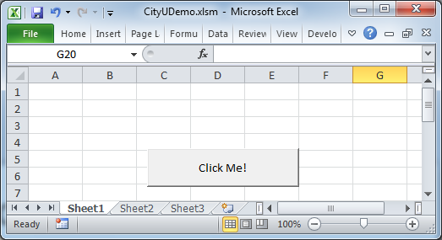
Launching a Userform Programmatically
Method I: At users’ request
  Example 1.6 (Cont’d)
        Click the CommandButton on Sheet1 to show the form. If the form does not display, turn off the Design Mode under the Developer Tab.

Slide 44
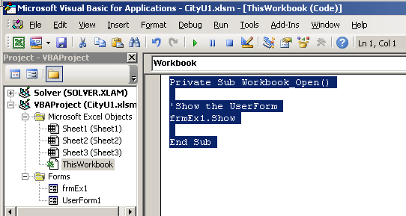
Launching a Userform Programmatically
Method II: Show the form automatically when the workbook is opened.
  Example 1.6 (Cont’d)
    Double Click ThisWorkbook from the property list of CityU1.xlsm to view the code window of the Thisworkbook object.
    Type the statement frmEx1.Show in the event Workbook_Open.

Slide 45
Changing Control Properties Programmatically
Control properties can be defined at design time as well as run time.
To define a control property programmatically, an assignment statement is used to assign a value to the property of a control (or an object) while an application is running.
Syntax of an assignment statement:
      ControlName.Property = expression
  All assignment statements must contain an assignment operator (=). The assignment operator can be thought of as meaning “is assigned the result”.
  expression can be any combination of constants, operators, other object properties, and functions.

Slide 46
Changing Control Properties Programmatically
Some basic operators that can be used in the expression of an assignment statement are:
    + addition - subtraction
    * multiplication / floating-point division
    \ integer division ^ exponentiation
    & string concatenation
    _ line continuation character
  *, /, \, ^ have precedence over + and –. Parentheses ( ) may be used to group terms.
  Characters must be quoted with a pair of double quotation marks. For example, "David".

Slide 47
Changing Control Properties Programmatically
Example 1.7. Insert a new Userform into a workbook. Drag a Label control and a CommandButton control onto the form. Name the Label control as lblStatement and the CommandButton control as cmdRun. Insert the following statement into the procedure of the cmdRun_Click event:
lblStatement.Caption = "My Userform!" & _
"Today is " & vba.date() & ", " & _
vba.weekdayname(vba.weekday(vba.date()))

Slide 48
Changing Control Properties Programmatically
Initialize event of Userform
  When launching a Userform, a series of events occur. One of these events is called Initialize.
  Initialize event happens before the concerned Userform is drawn to the screen.
  Properties of controls can be defined programmatically when the Userform containing the controls is being initialized (i.e., being prepared by the computer before showing it to the user).

Slide 49
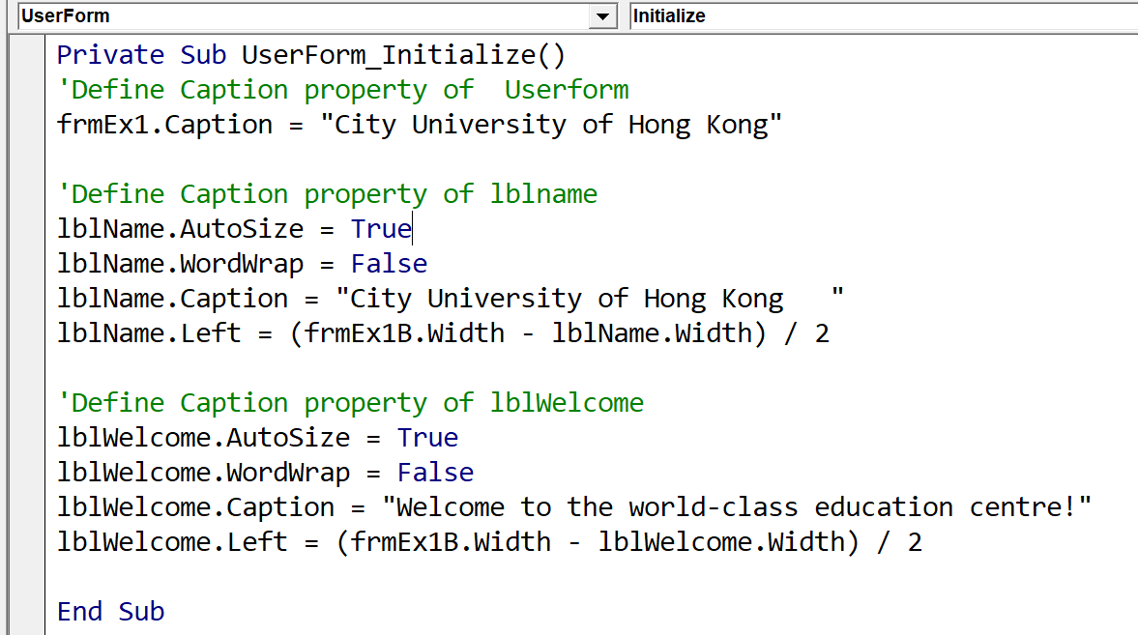
Changing Control Properties Programmatically
Example 1.8: Refer to the Userform frmEx1B in CityUDemo.xlsm. The properties of lblName and lblWelcome are defined programmatically when the form frmEx1B is Initialized.

Slide 50
Changing Control Properties Programmatically
TextBox control
  A TextBox control is used to get the user’s input or display text at run time.
    A user can enter any text into a TextBox control at run time. The Value property of TextBox control will automatically hold the entered value. The entered value will stay in the TextBox throughout the run time until it is changed.
    The Value property is the most commonly deployed property of a TextBox control.

Slide 51
Changing Control Properties Programmatically
TextBox control
  Example 1.9. Insert a new Userform into a workbook. Drag a TextBox control, a CommandButton control, and a Label control onto the form. Name the controls as txtInput, cmdRun, and lblEcho respectively.
    Enter the following statement into the cmdRun_Click procedure:
    lblEcho.Caption = txtInput.value

Slide 52
Creating a VBA Project
Example 1.10. Suppose you are asked to create a VBA application for CityU Phone, a small company that sells mobile phones. The phones are priced at $2,000 each and are available in two colours: black and white. The application will allow the salespeople to enter the customer’s name and address and the number of black and white phones ordered. It will then calculate and display the number of phones ordered and the total price of the order. The salespeople may use the application again for another order without quitting the application.

Slide 53
Creating a VBA Project
Example 1.10 (Cont’d)
  Tasks of the application:
    Get the following information from the user: customer’s name, street address, region, number of black phones ordered, and number of white phones ordered.
    Compute and display the total number of phones ordered and the total price of the order.
    Re-set the application so that the user can use it for another order.
    Allow the user to quit the application.

Slide 54
Creating a VBA Project
Example 1.10 (Cont’d)
  For Task 1, the following controls will be used to get the required information from the user at run time:
Information: | Type & Name of Control
Customer's name | TextBox, txtName
Street address | TextBox, txtAddress
Region | TextBox, txtRegion
Number of black phones ordered | TextBox, txtBlack
Number of white phones ordered | TextBox, txtWhite

Slide 55
Creating a VBA Project
Example 1.10 (Cont’d)
  For Task 2, the following controls will be used to compute and display the total number of phones and the total price at run time:
Activity: | Type & Name of Control
Compute the total number of phones ordered and the total price | CommandButton, btnCal
Display the total number of phones ordered | Label, lblTotalPhones
Display the total cost | Label, lblTotalPrice

Slide 56
Creating a VBA Project
Example 1.10 (Cont’d)
  For Task 3, the following control will be used to reset the application:
  For Task 4, the following control will be used to quit the application:
Activity: | Type & Name of Control
Re-set the application | CommandButton, btnClear
Activity: | Type & Name of Control
Quit the application | CommandButton, btnExit

Slide 57
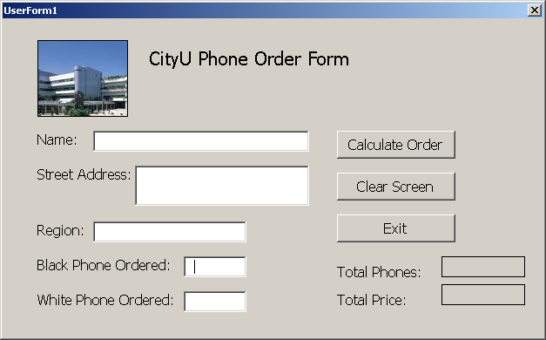
Creating a VBA Project
Example 1.10 (Cont’d)
  Design of the UseForm
    The file CityuPhonePartial.xlsm contains a partially completed application for CityU Phone.

Slide 58
Creating a VBA Project
Coding the application
  Before coding an object’s event procedure, you should plan it with a tool such as pseudocode or flowchart.
  For a simple task, pseudocode works just fine. For a complex task, the procedure’s steps may be easier to understand in a flowchart.

Slide 59
Creating a VBA Project
Coding the application
  Pseudocode
    It uses short phrases of plain language to describe the steps a procedure must take to accomplish the goal.
    It allows the designer to focus on the logic of the program without being distracted by details of programming language syntax.
    It can be used no matter what programming language is used.

Slide 60
Creating a VBA Project
Coding the application
  Example 1.10 (Cont’d)
    Pseudocode for the Click event of btnCal :
      The caption of lblTotalPhones equals the number of black phones ordered + the number of white phones ordered.
      The caption of lblTotalPrice equals the total number of phones ordered * price.

Slide 61
Creating a VBA Project
Coding the application
  Example 1.10 (Cont’d)
    Pseudocode for the Click event of btnClear :
      Clear the Value property of the five textbox controls.
      Clear the Caption property of the lblTotalPhones and lblTotalPrice controls.
      Send the focus to the txtName control so the user can begin entering the next order.
    Pseudocode for the Click event of btnExit:
      End the application.

Slide 62
Creating a VBA Project (self-study)
Coding the application
  Flowchart
    Use standardized symbols to show the steps of a procedure must follow to reach its goal.
    Commonly used symbols are:
      Start/Stop symbol
      Process symbol
      Input/Output symbol
    The lines connecting the symbols are called flowlines which indicates the direction of flow of the program.

Slide 63
Creating an Application (self-study)
Coding the application
  Example 1.10 (Cont’d)
btnCal Click event
btnClear Click event
btnExit Click event
Start
Start
Start
Caption of lblTotalPhones = black phones ordered + white phones ordered
Clear the Value property of the six textbox controls
End the application
Clear the Caption property lblTotalPhones and lblTotalPrice controls
Stop
Caption of lblTotalPrice = total phones ordered * phone price
Send the focus to the txtName control
Stop
Stop

Slide 64
Creating a VBA Project
Coding the application
  Example 1.10 (Cont’d). Enter the following code for the Click event of btnCal and test run the application for five black phones and five white phones:
    'Define caption of lblTotalPhones
    lblTotalPhones.Caption = txtBlack.Value + txtWhite.Value
    'Define caption of lblTotalPrice
    lblTotalPrice.Caption = lblTotalPhones.Caption * 2000

Slide 65
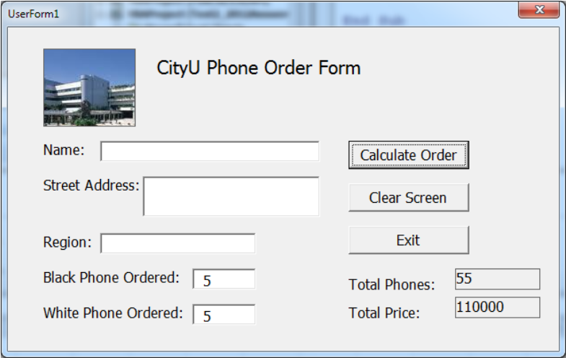
Creating a VBA Project
Coding the application
  Example 1.10 (Cont’d).
    The displayed results are incorrect.
    Instead of mathematically adding the two order quantities, the second order was appended to the first order quantity.

Slide 66
Creating a VBA Project
Coding the application
  The system treats the value stored in a TextBox as a string. Adding two strings together is equivalent to joining them up.
  To add the contents from the two TextBox controls, you must tell the computer to treat the contents as numbers.
  Use VBA.Val function to convert a string to a numeric value
    Syntax: VBA.Val(string)
      Val function ignores spaces in the supplied string but continue to read the characters after any space.
      The Val function stops reading the string once it encounters the first non-numeric and non-space character. For example VBA.Val(“ 34 Tat Chee Avenue”) returns 34.
      Val returns a 0 value or “Type mismatch” error message if no numeric is found. Characters that cannot be recognised as parts of numbers include currency symbols, the % symbol, and commas.
  Other functions that can be used to convert a string are VBA.CDbl, VBA.CSng, VBA.CCur etc. See Convert.xlsm for an example.

Slide 67
Creating a VBA Project
Coding the application
  Example 1.10 (Cont’d). Modify the statements in the bthCal_Click procedure as follows:
  'Define caption of lblTotalPhones
  lblTotalPhones.Caption = VBA.Val(txtBlack.Value) + VBA.Val(txtWhite.Value)
  'Define caption of lblTotalPrice
  lblTotalPrice.Caption = VBA.Val(lblTotalPhones.Caption) * 2000

Slide 68
Creating a VBA Project
Coding the application
  Use VBA.Format function to display an amount with a dollar sign, a thousand separator, and in two decimal places.
    Syntax VBA.Format(expression, "$#,##0.00")
      # is a digit placeholder for displaying a digit or nothing.
      0 is a digit placeholder for displaying a digit or 0.
  Example 1.10 (Cont’d). Modified the lblTotalPrice.Caption statement as
    lblTotalPrice.Caption = VBA.Format(VBA.Val(lblTotalPhones.Caption) * _ 2000 , "$#,##0.00")

Slide 69
Creating a VBA Project
Coding the application
  Example 1.10 (Cont’d). Enter the following code for the Click event of btnClear
  'Clear the value property of the 5 TextBox controls
  txtName.Value = ""
  txtAddress.Value = ""
  txtRegion.Value = ""
  txtBlack.Value = ""
  txtWhite.Value = ""
  'Clear the caption property of lblTotalPhones and lblTotalPrice
  lblTotalPhones.Caption = ""
  lblTotalPrice.Caption = ""
  'Send the focus to the Name textbox
  txtName.SetFocus

Slide 70
Creating a VBA Project
Coding the application
  Example 1.10 (Cont’d). Enter the following code for the Click event of btnExit
    'End the application
    VBA.Unload Me

Slide 71
Creating a VBA Project (self-study)
Controlling the tab order
  A number represents the order in which the control was added to the form.
  The first control added to a form has a TabIndex value of 0. The second control has a TabIndex of 1, and so on.
  The TabIndex values determine the tab order, which is the order in which each control receives the focus when the user presses the Tab key.
    Some controls, such as a label control, have its TabStop property set to False by default so that it will not receives the focus.

Slide 72
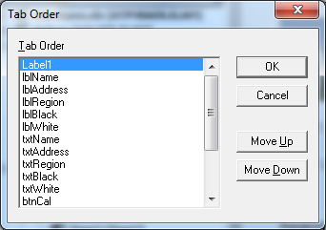
Creating a VBA Project (self-study)
To set the TabIndex values, select the Userform, click View on the menu bar and then click ‘Tab Order’.
You can specify the desired tab order for each control by clicking the ‘Move Up’ or ‘Move Down’ buttons.

Slide 73
Using Variables to Store Information
Example 1.11. Preview file CityuPhoneVersion2.xlsm. A dialogue box asks for the salesperson’s name. Click the Calculate Order button to calculate the order 2 or 3 times. Then click the Exit button. Another dialogue box appears. It displays the number of phones, the prices of all calculated orders, and the salesperson’s name.
  How to display the two dialogue boxes?
  How to store the order information so that the total number of phones, the total price of all calculated orders and the salesperson’s name can be displayed at the end?

Slide 74
Using Variables to Store Information
Data can be stored temporarily in a memory location inside the computer. The memory locations are called variables because the contents of the locations can change as the application runs.
Assigning a control’s property, such as the Value of a TextBox control, to a variable allows you to recall such value even if the corresponding property value has been changed at run time.

Slide 75
Using Variables to Store Information
Creating a variable
  A name must be assigned to each variable.
  Variable names for prime variables should be descriptive.
    For example, to represent total monthly sales, acceptable variable names are Sales, TotalSales, or TotalMonthlySales etc.
  Single character names, such as i, j, k, or x, y, and z, are mostly used for auxiliary variables.
  Some rules for naming variables:
    A name must begin with a letter.
    A name may contain a combination of letters, numbers, and the underscore character.

Slide 76
Using Variables to Store Information
Creating a variable
  An assignment statement is often used to assign a value to a variable during run time. The syntax is:
      variableName = expression
    The expression can be a mathematical expression consisting of a combination of these: constants, operators, variables, object properties, and system functions.
    Examples:
      intQuantity = 100
      strFirstName = "Mary"
      dblCommission = dblSales * 0.1
      dblPrice = txtTotalPrice.Value / 10

Slide 77
Using Variables to Store Information
Declaring a variable
  Created variables should be declared at the runtime of the application.
  Declaring a variable tells the computer to set aside a section of its internal memory for holding a specified type of values for the variable at run time. The variable’s data type determines the allocated size of the section.
  Use the Dim statement to declare variables. The syntax is:
  Dim varname1 [As datatype], varname2 [As datatype], …
    varnameX represents the name of the variable you are creating.
    As datatype refers to the data type of varnameX. It is optional.
    A comma must separate two variables in the same Dim statement.

Slide 78
Using Variables to Store Information
Declaring a variable
  Each variable used in an application should be assigned a data type in the Dim statement. The data type determines the kind of data that the variable can take.
  Some commonly used data types are:
    Boolean True or False
    Integer -32,768 to 32,767
    Long -2,147,483,648 to 2,147,483,647
    Single -3.402…E38 to 3.403… E38 (7 significant digits)
    Double -1.797…E308 to 1.797…E308 (15 significant digits)
    String Characters (0 to approximately 65,000
    characters)

Slide 79
Using Variables to Store Information
Declaring a variable
  Examples:
    Dim intHours As Integer, intIncome As Long, blnValid As _ Boolean
  Each declared variable will be initialized to its default value according to the declared data type. For examples,
    The default value of a floating point variable or an integer variable equals 0.
    The default value of a character variable equals an empty string.
    The default value of a Boolean variable equals False.

Slide 80
Using Variables to Store Information
Declaring a variable
  Variable declared but without a data type is given a Variant data type by default.
    A Variant is a special type of variable that can take any type of value.
    Great, we can declare all variables as Variant!
      A very bad programming practice.
  Each variable must be assigned with a data type explicitly even though the set of variables in a Dim statement all belong to the same data type.
    For example, these two Dim statements are not equivalent:
  Dim Var1, Var2 As Integer
  Dim Var1 As Integer, Var2 As Integer

Slide 81
Using Variables to Store Information
Declaring a variable
  A Dim statement can be placed anywhere between Sub and End Sub statements within a sub.
    It is customary to include them right after the Sub line.
    It must be placed before the occurrence of the declared variables.
    Variables declared in such a Dim statement are called procedure-level variables.
      They can be accessed only by the sub containing the respective Dim statement.
      They are removed from memory when the sub in which they are declared ends.
  There can be more than one Dim statement within each sub.

Slide 82
Using Variables to Store Information
Declaring a variable
  Variables can also be declared in a module's declarations section (the top) in the Code Editor Window before any Sub statement.
    Variables declared in such Dim statements are called module-level variables.
      They can be accessed (read & write) by all subs within the same module.
      They retain their values and remain in the computer’s internal memory until the application ends.
  Suppose a variable has been declared at both the module and procedure levels (not recommended). In that case, the variable will be treated as a procedure-level variable in the sub containing the respective Dim statement. Its value will be removed from the memory when the sub in which it is declared ends.

Slide 83
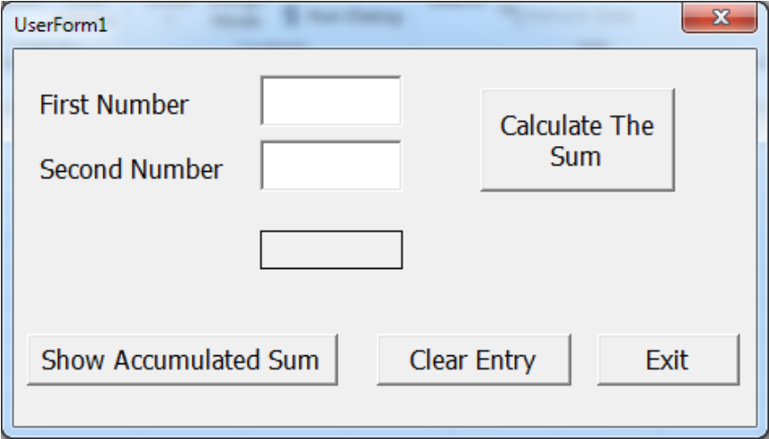
Using Variables to Store Information
Example 1.12. File VarDeclareDemo.xlsm contains an application for computing the sum of two given numbers. When the user clicks the Calculate The Sum button in the Userform, the procedure-level variable dblCurrentSum will be added to the module-level variable dblAccSum.

Slide 84
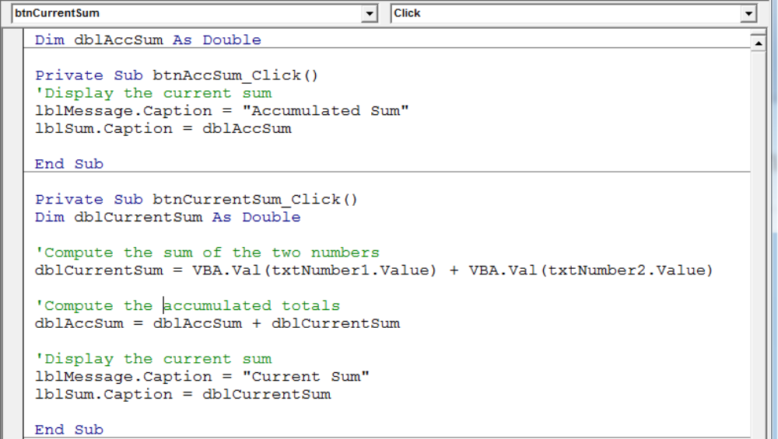
Using Variables to Store Information
Example 1.12 (Cont’d)
Module-level variable
Procedure-level variable

Slide 85
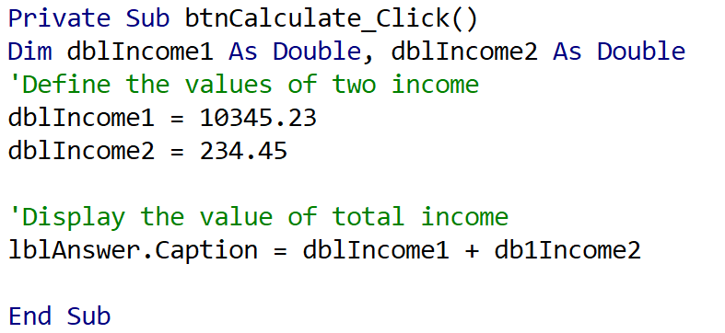
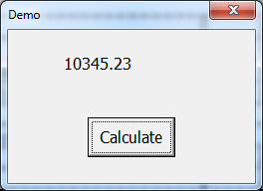
Using Variables to Store Information
Option Explicit
  It is easy to misspell a variable's name while coding.
  If your code contains the name of an undeclared variable, the system assigns the Variant data type to it.
  Example 1.13: Run Userform Demo1 in OptionExplicitDemo.xlsm:

Slide 86
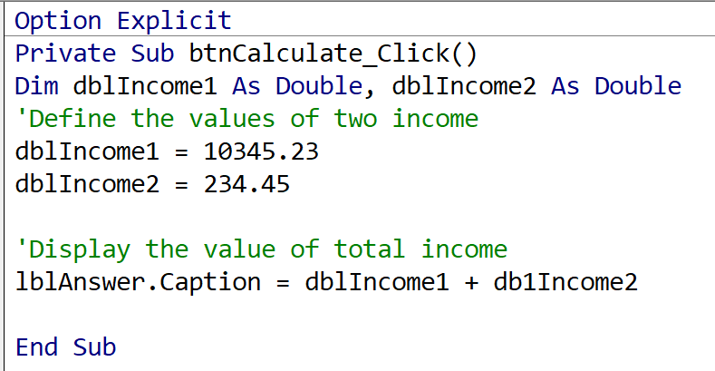
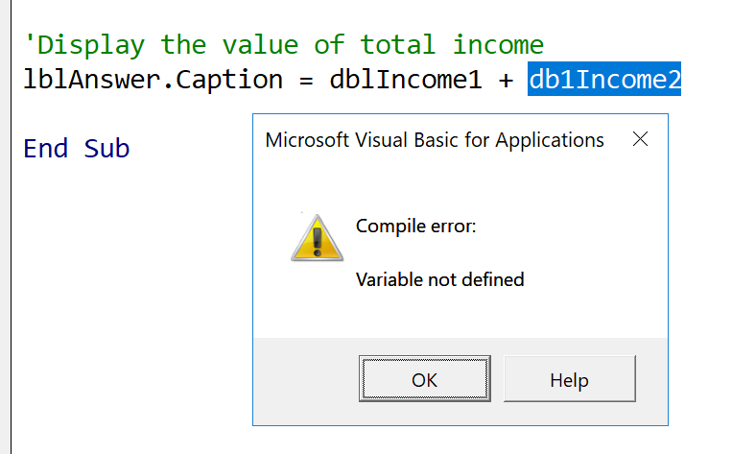
Using Variables to Store Information
Option Explicit
  Enter the statement Option Explicit into the Declaration section of the code editor of the Userform to prevent the system from using undeclared variables.
  Example 1.13 Cont'd. Run the Userform Demo2 in the OptionExplicitDemo.xlsm:

Slide 87
Using Variables to Store Information
The VBA.InputBox function
  It displays an input dialogue box. By default, it contains a message, an OK button, a Cancel button, and an input area where the user can enter information.
  The syntax is
    strVariable = VBA.InputBox ([Prompt:=]”message to be display” _
    [, Title:=“new title”] )
    The prompt argument contains the message to display inside the dialogue box.
    The optional title arguments control the text that appears in the dialogue box’s title bar.
    The return value from the InputBox is always treated as a string.
    If the user clicks either the Cancel button or the Close button on the dialog box’s title bar, the InputBox returns an empty string.

Slide 88
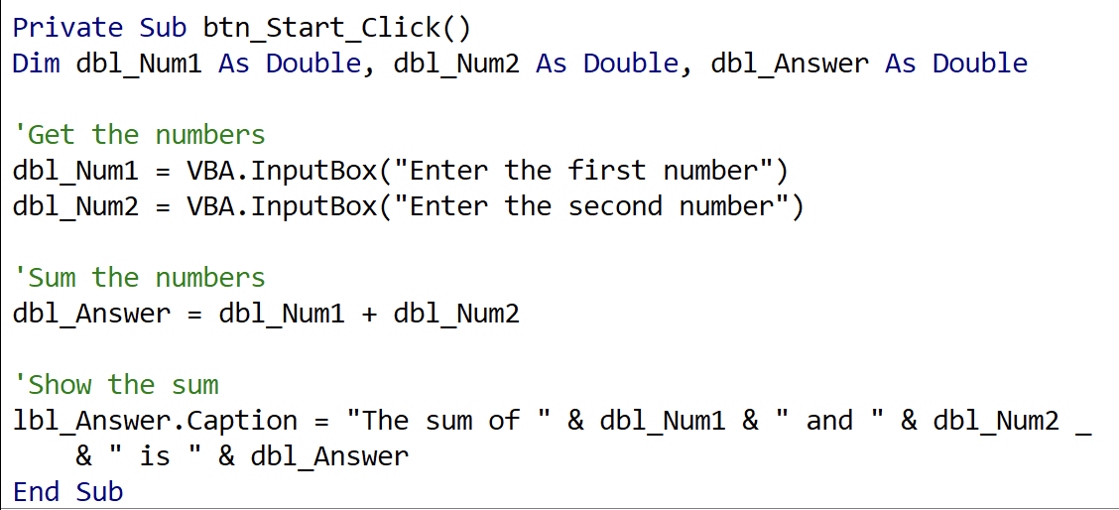
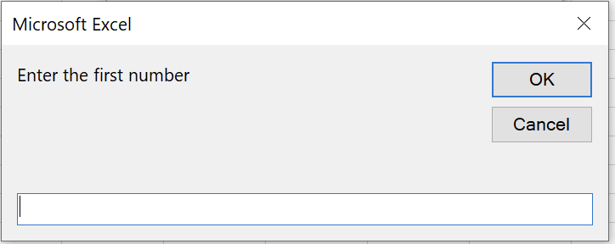
Using Variables to Store Information
The VBA.InputBox function
  Example 1.14. Run the Userform Sum_Inputbox in Sum_2_Numbers.xlsm.

Slide 89
Using Variables to Store Information
The VBA.MsgBox function
  It default displays a message and an OK button in a dialogue box.
  The syntax is
    VBA.Msgbox [Prompt:=]"message to be displayed" _
    [, Title:="new title"]
    The MsgBox function can display other types of buttons and also returns an integer value to indicate which button is clicked by the user (to be discussed later).

Slide 90
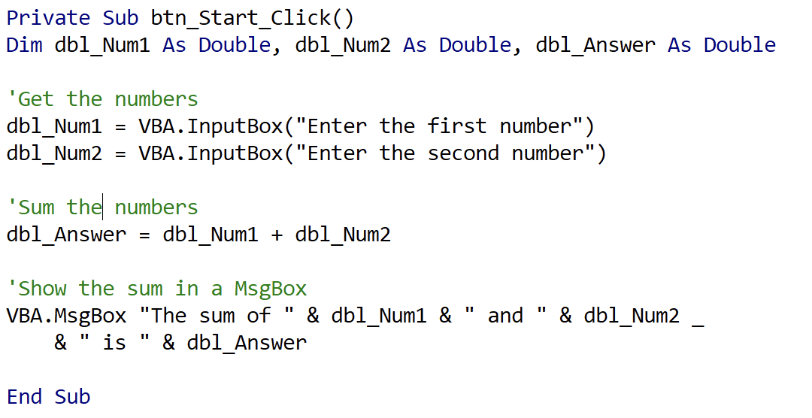
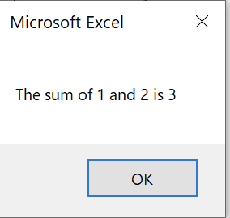
Using Variables to Store Information
The VBA.MsgBox function
  Example 1.15 Run the Userform Sum_Msgbox in Sum_2_Numbers.xlsm.

Slide 91
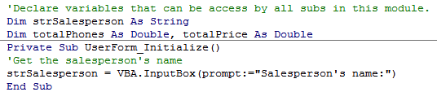
Using Variables to Store Information
(self-study)
Example 1.16. View the event code of the Userform in CityUPhoneVersion2.xlsm. In comparison to those in CityUPhone.xlsm, the following modifications can be noted:
  It includes code in the Userform Initialization event so that an InputBox appears for the salesperson’s name before the Userform is shown. The entered name can be recalled at a later time.

Slide 92
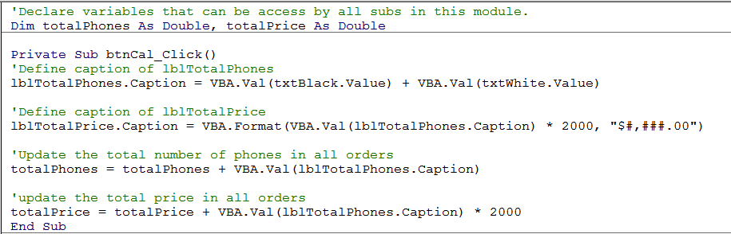
Using Variables to Store Information
(self-study)
Example 1.16. (Cont’d)
  It modifies the codes in btnCal_Click procedure so that the total number of phones and the total price from the current order can be kept.

Slide 93
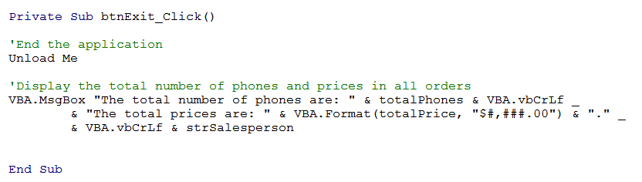
Using Variables to Store Information
(self-study)
Example 1.16. (Cont’d)
  It modifies the codes in the btnExit_Click procedure so that a message box will appear and display the accumulated total number of phones and accumulated prices from all orders.
      VBA.vbCrLf represents a carriage-return character combined with a linefeed character.

