Slide 1
CDS1001 – Lecture 11
Acquiring and Exploring Data -
Basics of Data Analytics

Slide 2
Case Study:
Explore Shipping Rates

Slide 3
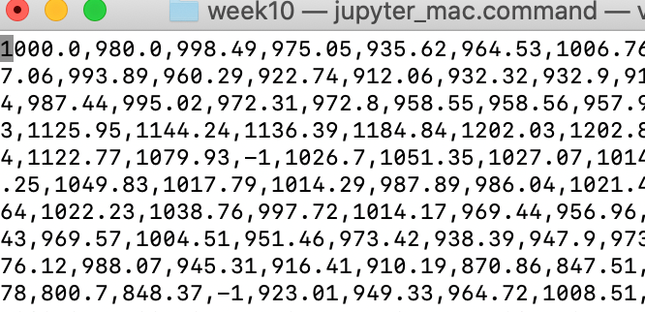
Case Study: Explore shipping rates
Company FE would like to explore the trend of shipping rates based on the past 300-day historical data stored in a text file (rates.csv)
  The text file has one line of 300 float numbers separated by commas
  Rates may be missing for some days, where -1 are placed
Company FE needs to
  Access the data
  Fix missing data
  Compute summary statistics
  Plot a line chart to observe trends

Slide 4
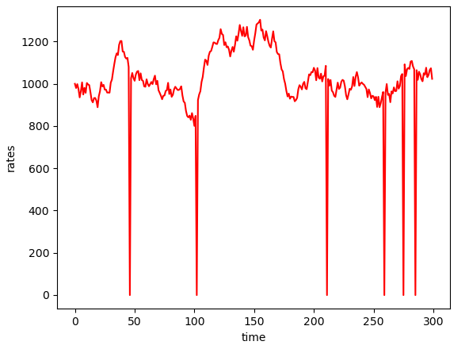
Case Study: Algorithm and Data Structure
Company FE needs to
  Access/acquire the data
  Fix missing data
  Compute summary statistics
    Mean, min, max, standard deviation
  Plot a line chart to observe trends
Data structure
  rates: list of rates
How to fix missing data?
Rate of time t<0
Yes
t>=2
No
Yes
Set rate of t = 1000 by default
Set rate of t = rate of t-1

Slide 5
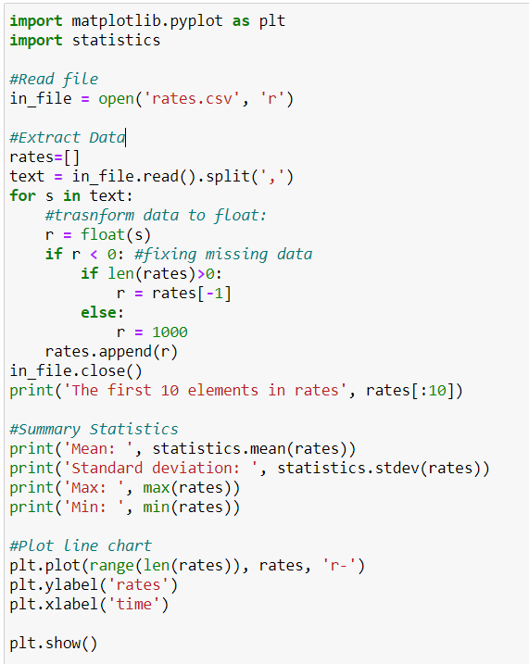
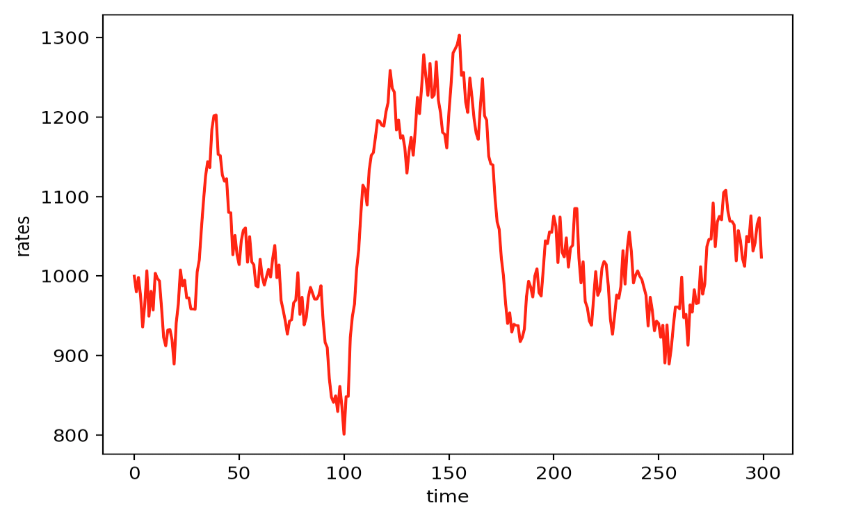
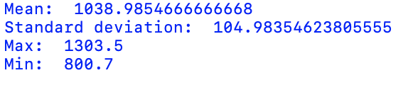
Case Study:
Code and Results

Slide 6
Acquiring data

Slide 7
Acquiring data
Acquiring data from data sources is necessary before data analysis
There are many sources to access data
  Input
    module: sys
  Text files
    module: csv, pandas
  Excel files
    module: openpyxl, pandas
  HTML files
    modules: requests, bs4, pandas
  Database
    modules: sqlite3, pandas
  JSON (JavaScript Object Notation)
    module: json, pandas
  API (application programming interface) – called to obtain data from internet (e.g., twitter …)
    modules: requests, json

Slide 8
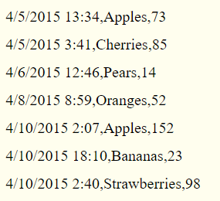
Acquiring data from Delimited Files
Text files for data analysis are very often either comma-separated or tab-separated
  Each line has several fields, with a comma or a tab indicating where one field ends and the next field starts
Such delimited files are often in CSV (comma-separated values) format
  Each line in a CSV file represents a row in the spreadsheet, and commas separate the cells in the row.
field
field
field

Slide 9
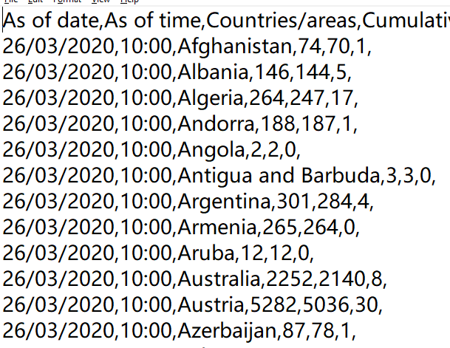
Advantages of CSV Flies
CSV files are simple, but lacking many of the features of an Excel spreadsheet. For example, CSV files:
  Don’t have types for their values—everything is a string
  Don’t have settings for font size or color
  Don’t have multiple worksheets
  Can’t specify cell widths and heights
  Can’t have merged cells
  Can’t have images or charts embedded in them
Covid-19 data
https://data.gov.hk/en-data/dataset/hk-dh-chpsebcddr-novel-infectious-agent

Slide 10
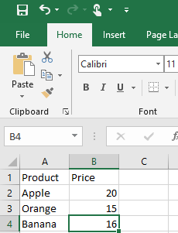
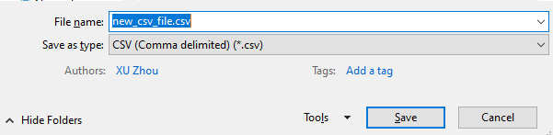
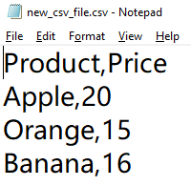
Create a CSV file from Excel
In Excel, create a new workbook
Edit the workbook
When saving the workbook, choose “CSV (Comma delimited)” as “Save as type”
Use notepad to open the newly saved CSV file

Slide 11
Parsing CSV files using split() of strings
Since CSV files are just text files, you might be tempted to read them in as a string and then process that string using the techniques in Python
It can be more complicated: what if the field contains comma?
file = open('input.csv', 'r')
for line in file:
product, price, quantity = line.split(sep=',')
print(product, price, quantity, end='')
file.close()

Slide 12
Using csv Module: Reader Objects
To read data from a CSV file with the csv module, you need to create a reader object.
A reader object lets you iterate over lines (rows) of data in the CSV file.
  import csv module; open csv file as a text file; create reader object
>>> import csv
>>> exampleFile = open('example.csv', 'r')
>>> exampleReader = csv.reader(exampleFile)

Slide 13
Reading data from reader object as a list
The most direct way to access the values in the reader object is to convert it to a plain Python list by passing it to list()
  Each element in the list is a list representing a row of data
  you can then access the value at a particular row and column from the list
>>> exampleData = list(exampleReader)
>>> exampleData
[['4/5/2015 13:34', 'Apples', '73'], ['4/5/2015 3:41', 'Cherries', '85'],
['4/6/2015 12:46', 'Pears', '14'], ['4/8/2015 8:59', 'Oranges', '52'],
['4/10/2015 2:07', 'Apples', '152'], ['4/10/2015 18:10', 'Bananas', '23'],
['4/10/2015 2:40', 'Strawberries', '98’]]
>>> exampleData[0][0]
'4/5/2015 13:34’
>>> exampleData[6][1]
'Strawberries'

Slide 14
Reading data from reader object in a for loop
For large CSV files, you’ll want to use the reader object in a for loop to iterate over lines (rows) of data
  This avoids loading the entire file into memory at once, but row by row
>>> import csv
>>> exampleFile = open('example.csv')
>>> exampleReader = csv.reader(exampleFile)
>>> for row in exampleReader:
print('Row #' + str(exampleReader.line_num) + ' ' + str(row))
Row #1 ['4/5/2015 13:34', 'Apples', '73']
Row #2 ['4/5/2015 3:41', 'Cherries', '85']
Row #3 ['4/6/2015 12:46', 'Pears', '14']
Row #4 ['4/8/2015 8:59', 'Oranges', '52']
Row #5 ['4/10/2015 2:07', 'Apples', '152']
Row #6 ['4/10/2015 18:10', 'Bananas', '23']
Row #7 ['4/10/2015 2:40', 'Strawberries', '98']
An attribute of the reader indicating the last line that has been read

Slide 15
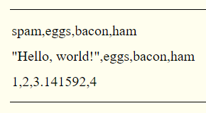
Using csv Module: Write Objects
A writer object lets you write data to a CSV file.
To create a writer object, you use the csv.writer() function.
  On Windows, you’ll also need to pass a blank string for the open() function’s newline keyword argument.
The writerow() method takes a list argument. Each value in the list is placed in its own cell in the output CSV file.
  The return value is the number of characters written to the file for that row
>>> import csv
>>> outputFile = open('output.csv', 'w', newline='')
>>> outputWriter = csv.writer(outputFile)
>>> outputWriter.writerow(['spam', 'eggs', 'bacon', 'ham'])
21
>>> outputWriter.writerow(['"Hello, world!"', 'eggs', 'bacon', 'ham'])
32
>>> outputFile.close()

Slide 16
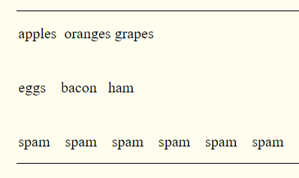
The delimiter and lineterminator Keyword Arguments
The delimiter is the character that appears between cells on a row.
  By default, the delimiter for a CSV file is a comma.
The line terminator is the character that comes at the end of a row.
  By default, the line terminator is a newline.
You can change characters to different values by using the delimiter and lineterminator keyword arguments with csv.writer().
import csv
csvFile = open('output2.csv', 'w', newline='')
csvWriter = csv.writer(csvFile, delimiter='\t', lineterminator='\n\n')
csvWriter.writerow(['apples', 'oranges', 'grapes'])
csvWriter.writerow(['eggs', 'bacon', 'ham'])
csvWriter.writerow(['spam'] * 6)
csvFile.close()

Slide 17
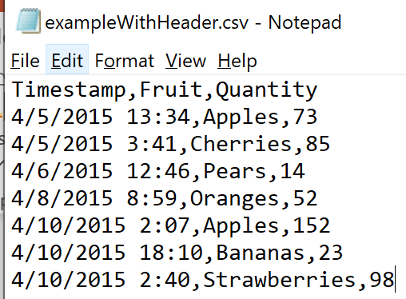
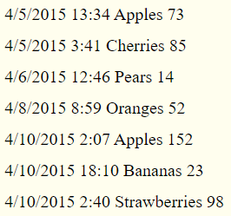
DictReader and DictWriter CSV Objects (1)
For CSV files that contain header rows, it’s often more convenient to work with DictReader and DictWriter objects
DictReader and DictWriter CSV objects perform the same functions but use dictionaries instead of lists
  Using the first row of the CSV file as the keys of these dictionaries.
>>> import csv
>>> exampleFile = open('exampleWithHeader.csv')
>>> exampleDictReader = csv.DictReader(exampleFile)
>>> for row in exampleDictReader:
... print(row['Timestamp'], row['Fruit'], row['Quantity'])

Slide 18
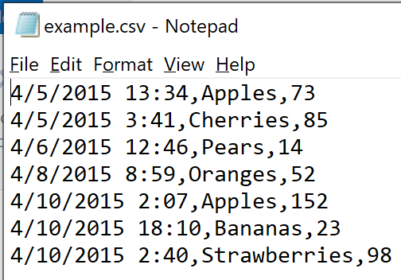
DictReader and DictWriter CSV Objects (2)
For CSV files that do not contain header rows, you can supply the DictReader() function with a second argument containing made-up header names, which can be used as keys
>>> import csv
>>> exampleFile = open('example.csv')
>>> exampleDictReader = csv.DictReader(exampleFile, ['time', 'name','amount'])
>>> for row in exampleDictReader:
... print(row['time'], row['name'], row['amount'])

Slide 19
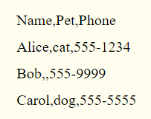
DictReader and DictWriter CSV Objects (3)
DictWriter objects use dictionaries to create CSV files.
  Using writerow() method
If you want your file to contain a header row, write that row by calling writeheader() method
  missing keys will be empty in the csv file.
>>> import csv
>>> outputFile = open('output3.csv', 'w', newline='')
>>> outputDictWriter = csv.DictWriter(outputFile, ['Name', 'Pet', 'Phone'])
>>> outputDictWriter.writeheader()
>>> outputDictWriter.writerow({'Name': 'Alice', 'Pet': 'cat', 'Phone': '555-1234'})
20
>>> outputDictWriter.writerow({'Name': 'Bob', 'Phone': '555-9999'})
15
>>> outputDictWriter.writerow({'Phone': '555-5555', 'Name': 'Carol', 'Pet': 'dog'})
20
>>> outputFile.close()

Slide 20
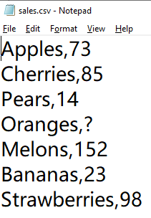
Data Cleaning and Munging
Real-world data is dirty.
You’ll have to do some work on the data before using it:
  Data Cleaning for missing values and bad data
    E.g. missing sales (‘?’)→ default sales (20)
  Data Munging for wrongly formatted data
    E.g. for sales: string value (‘152’)→ float values (152.0)
import csv
exampleFile = open('sales.csv')
exampleReader = csv.reader(exampleFile)
default_sales = 20
sales={}
for line in exampleReader:
col2 = line[1]
if col2 == '?': #Fixing missing data
sales[line[0]] = default_sales
else: #Converting string to float
sales[line[0]] = float(col2)
print(sales)

Slide 21
Overview of Matplot library

Slide 22

Python Libraries for Data Science
matplotlib:
  python 2D plotting library which produces publication quality figures in a variety of hardcopy formats
  a set of functionalities similar to those of MATLAB
  line plots, scatter plots, barcharts, histograms, pie charts etc.
  relatively low-level; some effort needed to create advanced visualization

Slide 23
Summary Charts by matplotlib module
A fundamental part of the data analytics is data visualization
matplotlib module contains a wide variety of tools for visualizing data, and is widely used
  Installation: pip install matplotlib
pyplot is a useful submodule contained in matplotlib and is frequently used.
  We often import matplotlib.pyplot using the alias plt:
  import matplotlib.pyplot as plt

Slide 24
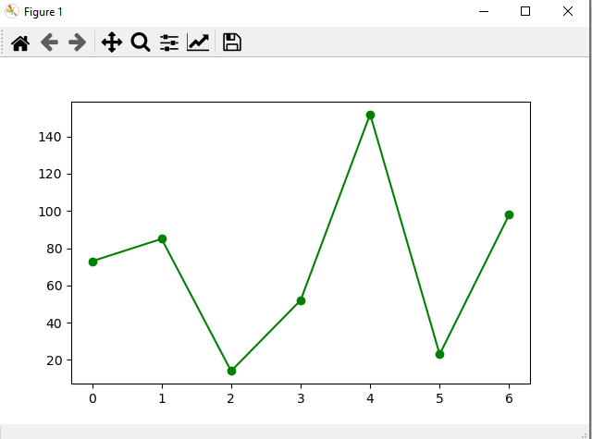
Making a chart using pyplot
pyplot maintains an internal state in which we can build up a visualization step by step
Once you are done, you can save it with savefig() method or display with show() method
>>>import matplotlib.pyplot as plt
>>>y = [73.0, 85.0, 14.0, 52.0, 152.0, 23.0, 98.0]
>>>plt.plot(y, color='green', marker='o', linestyle='solid’)
>>>plt.savefig('plot.png')
>>>plt.show()

Slide 25
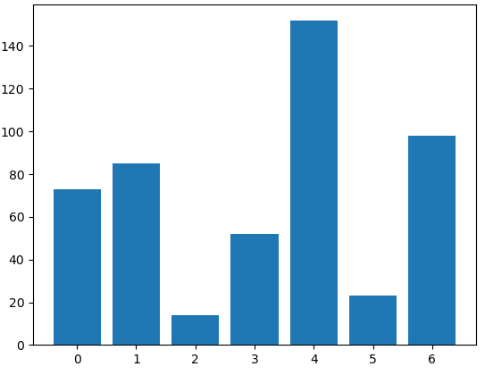
Bar Charts
A bar chart is a good choice when you want to show how some quantity varies among some discrete set of items
  For example, sales quantities of different products
matplotlib.pyplot.bar(positions, height, width=0.8) method
  The bars are positioned at points in positions with sizes given by height and width
>>>import matplotlib.pyplot as plt
>>>y = [73.0, 85.0, 14.0, 52.0, 152.0, 23.0, 98.0]
>>>x = list(range(len(y)))
>>>plt.bar(x,y)
>>>plt.show()
width
height
positions

Slide 26
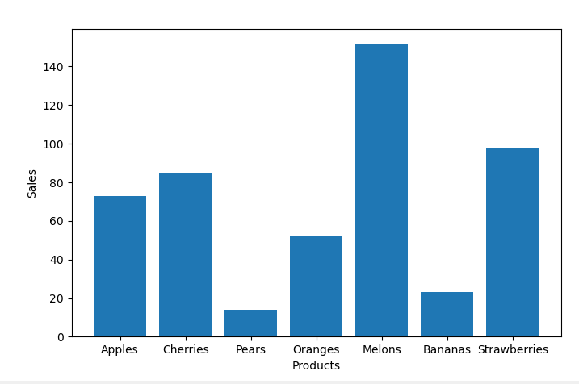
Add Labels and Ticks
Labels: Get or set the current labels of the x-axis and y-axix
  xlabel(text), ylabel(text)
Ticks: Get or set the current ticks of the x-axis and y-axix
  xticks(ticks, labels), yticks(ticks, labels)
yticks
import matplotlib.pyplot as plt
y = [73.0, 85.0, 14.0, 52.0, 152.0, 23.0, 98.0]
products=['Apples', 'Cherries', 'Pears', 'Oranges', 'Melons', 'Bananas', 'Strawberries']
plt.bar(range(len(y)),y)
plt.ylabel('Sales')
plt.xlabel('Products')
plt.xticks(range(len(products)),products)
plt.show()
ylabels
xticks
xlabels

Slide 27
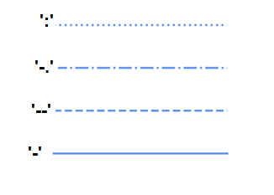
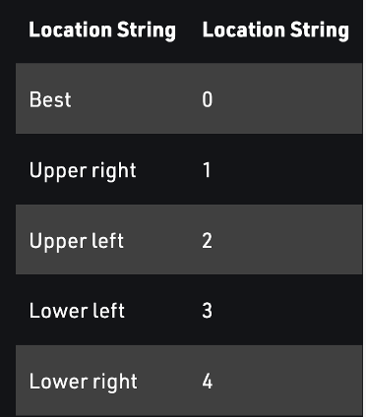
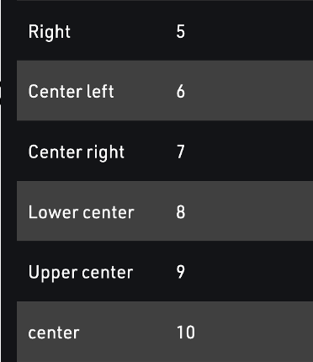
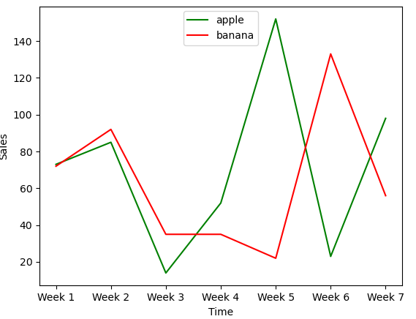
Line Charts
A line chart is for showing trends
  E.g., sales of the same product for different weeks
matplotlib.pyplot.plot(x,y,fmt,label):
  Plot y versus x as lines and/or markers.
  fmt is a parameter specifying the format of the line
  label is a parameter specifying the label of the line
'b', 'g', 'r', 'c', 'm', 'y', 'k', ’w’ for blue, green, red, cyan, magenta, yellow, black, white.
legend
import matplotlib.pyplot as plt
y1 = [73.0, 85.0, 14.0, 52.0, 152.0, 23.0, 98.0]
y2 = [72.0, 92.0, 35.0, 35.0, 22.0, 133.0, 56.0]
weeks=['Week 1', 'Week 2', 'Week 3', 'Week 4', 'Week 5', 'Week 6', 'Week 7']
plt.plot(weeks,y1,'g-', label='apple') #green solid line
plt.plot(weeks,y2,'r-', label='banana') #red solid line
plt.legend(loc=9) #loc=9 means top center
plt.ylabel('Sales')
plt.xlabel('Time')
plt.show()

Slide 28
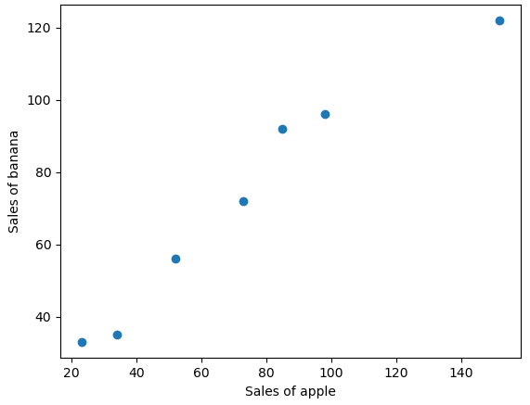
Scatterplots
A scatterplot is for visualizing the relationship between two paired sets of data
  For example, relationship between sales of two products
matplotlib.pyplot.scatter(data1, data2): A scatter plot of data1 vs. data2, where data1 and data2 are of the same size
import matplotlib.pyplot as plt
y1 = [73.0, 85.0, 34.0, 52.0, 152.0, 23.0, 98.0]
y2 = [72.0, 92.0, 35.0, 56.0, 122.0, 33.0, 96.0]
plt.scatter(y1,y2)
plt.xlabel('Sales of apple')
plt.ylabel('Sales of banana')
plt.show()

Slide 29
Future Study: Data Visualization by Python
The matplotlib Gallery (https://matplotlib.org/2.0.2/gallery.html) will give you a good idea of all sorts of things you can do with matplotlib (and how to do them)
seaborn package (https://seaborn.pydata.org/) is a built on top of matplotlib and allows you to easily produce prettier (and more complex) visualization

Slide 30
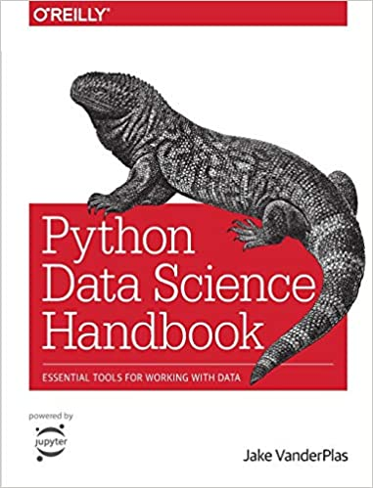
Future Study: Data Analytics by Python
Data Acquiring
  Pandas
Summary Statistics
  Scipy
Data Manipulation
  Pandas
Statistical Hypothesis Testing
  Scipy
Time Series Analysis
  Pandas
Machine Learning
  Scikit-Learn
Data Visualization
  Matplotlib

Slide 31
Summary
Various sources / formats for acquiring data
Access data from csv files
  csv files
  csv module for reading and writing data
Data cleaning and munging
  Parse → extract → edit
Summary statistics for data
  Use of statistics module
Charts for data
  Use of matplotlib.pyplot module
  Line, bar, scatterplot

Slide 32
CDS1001: Tutorial Exercises
Basics about Python Coding:
Tutorial 1: Coding environment for Python
Tutorial 2: Variables and simple data types
Tutorial 3: Conditions and flowcharts
Tutorial 4: Functions
Tutorial 5: Iterations
Tutorial 6: Strings and Files
Tutorial 7: Lists
Tutorial 8: Dictionaries and Structured Data
  Deadline: 21 Nov 2023
Basic Applications:
Tutorial 9: Working with Excel Files
  Deadline: 21 Nov 2023
Tutorial 10: Acquiring and Exploring Data
  Deadline: 30 Nov 2023
Individual Assignment:
Deadline: 23 Nov 2023
Final Examination:
13 Dec 2023 14:00 – 16:00 (SEKG03)

