Slide 1

Bubble Sort
Mr. Lee WS

Slide 2
Objectives
Prior knowledge:
Students can dry run and identify Selection and Insertion Sort
Objectives:
After this lesson, students should be able to
dry run a bubble sort algorithm
articulate the feature of the bubble sort

Slide 3
Revision – Nearpod time!
What did we learn?
  Selection / Insertion Sort
  Nearpod!

Slide 4
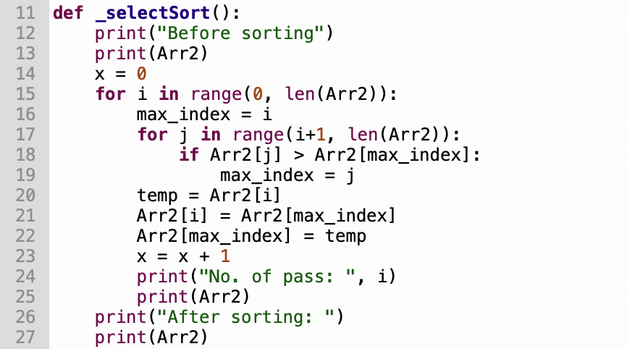
Selection or Insertion??
  [45, 70, 66, 82, 55, 95, 60]
  [95, 70, 66, 82, 55, 45, 60]
  [95, 82, 66, 70, 55, 45, 60]
  [95, 82, 70, 66, 55, 45, 60]
  [95, 82, 70, 66, 55, 45, 60]
  [95, 82, 70, 66, 60, 45, 55]
  [95, 82, 70, 66, 60, 55, 45]
  [95, 82, 70, 66, 60, 55, 45]

Slide 5
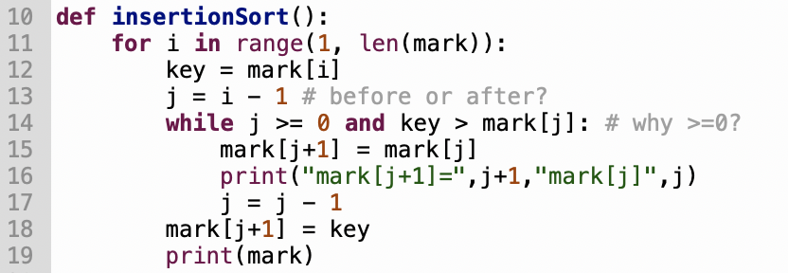
Selection or Insertion??
Insertion
Original: [45, 70, 66, 82, 55, 95, 60]
[70, 45, 66, 82, 55, 95, 60]
[70, 66, 45, 82, 55, 95, 60]
[82, 70, 66, 45, 55, 95, 60]
[82, 70, 66, 55, 45, 95, 60]
[95, 82, 70, 66, 55, 45, 60]
[95, 82, 70, 66, 60, 55, 45]

Slide 6

Bubble Sort! How does it work??

Slide 7
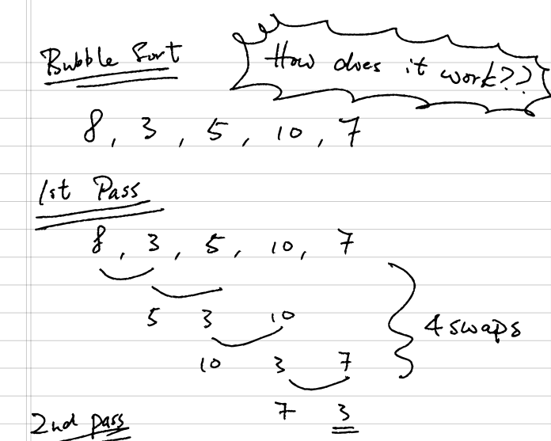
How?
Scan from the left to the right
If the left one is smaller than the right one → swap
Nearpod!
Can you do the first 2nd passes?
Try to do the rest if you can!

Slide 8
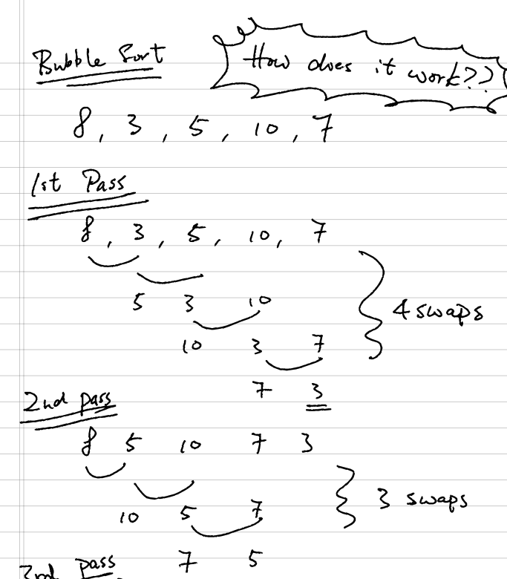
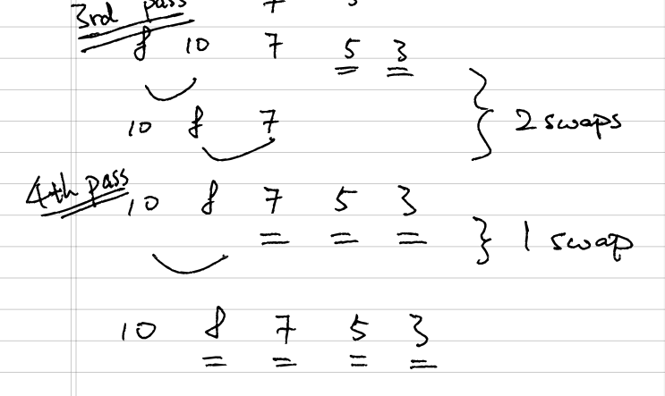
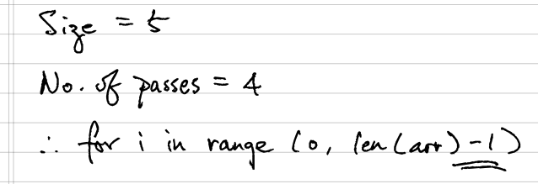
2 swaps
1 swap
4 swaps
3 swaps

Slide 9
Bubble Sort
Original: [8, 3, 5, 10, 7]
[8, 3, 5, 10, 7]
[8, 5, 10, 7, 3]
[8, 10, 7, 5, 3]
[10, 8, 7, 5, 3]
[10, 8, 7, 5, 3]
Can you see the feature?

Slide 10
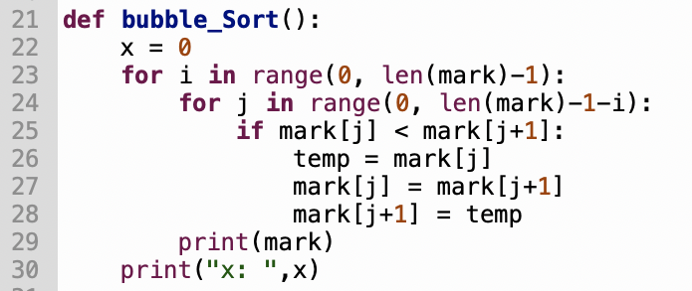
More questions

Slide 11
Summary
Bubble sort
Features
  The min/max goes to one side for each pass
  In the algorithm
  Two iterations (for)
  One swap
  Next lesson,
  Compare the effectiveness of Selection, Insertion, and Bubble Sort

Slide 12
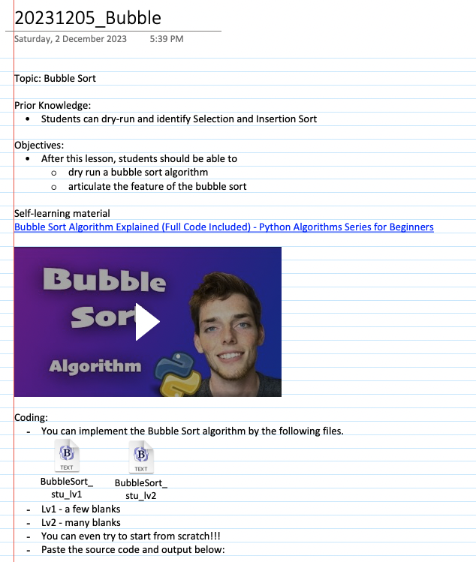
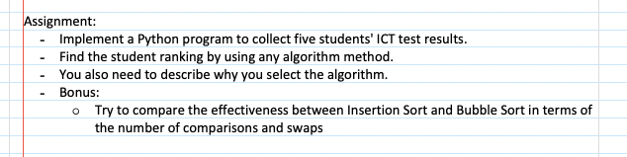
Now, coding!!

