Slide 1
2.1 Flowchart follow-though (breakpoints)
2.2 Program(explanation + Variable/constant declaration)

Slide 2
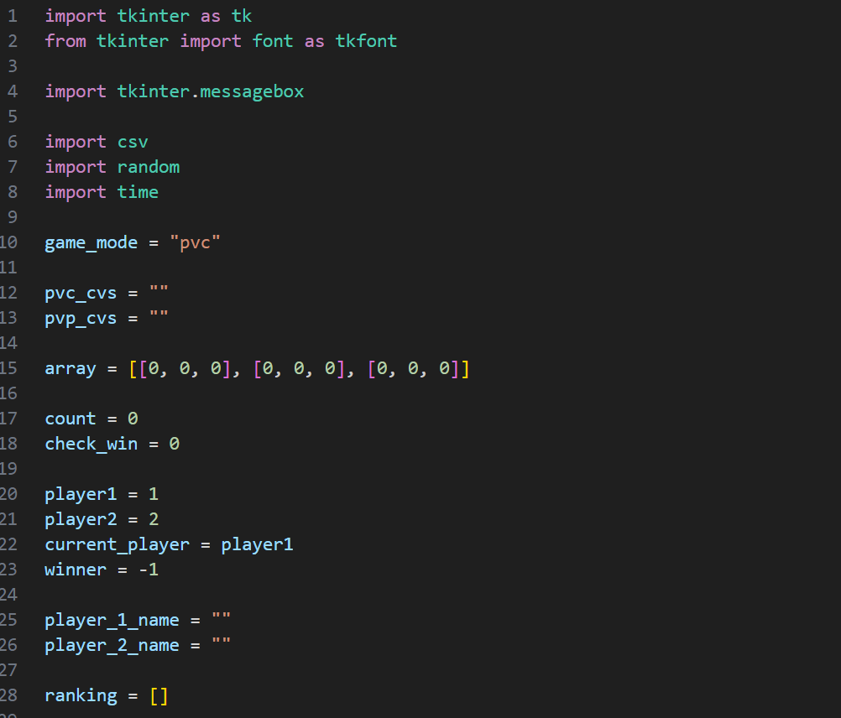
tkinter ,a library specific for GUI, shorten the name to “tk” for easier coding Import messagebox,along with some other modules like filedialog random, a module random pick up number time, a module can count time
Global variables

Slide 3
Global Varibles | Set as
game_mode | pvc | Specify the current game mode is Player vs computer(pvc)
pvc_cvs | “”
pvp_cvs | “”
array | [[0,0,0], [0,0,0], [0,0,0]] | The array control the game board. 0 = empty, 1 = Player1’s mark, 2 = Player2’s mark or computer’s mark
count | 0 | Count steps ( when count=9, game ends either win or tie)
check_win | 0 | Use in a for loop to check win
player1 | 1 | Define 1=player1
player2 | 2 | Define 2=player2
current_player | player1 | Default the first input belongs to player1, also use for tracking player1 or player2’s turn
winner | -1 | Store the final game result
player_1_name | “” | The names of the player 1. Stored here to let the value across frames
player_2_name | “” | The names of the player 2. Stored here to let the value across frames
ranking | [] | to temporarily store the ranking read from file and process across frames

Slide 4
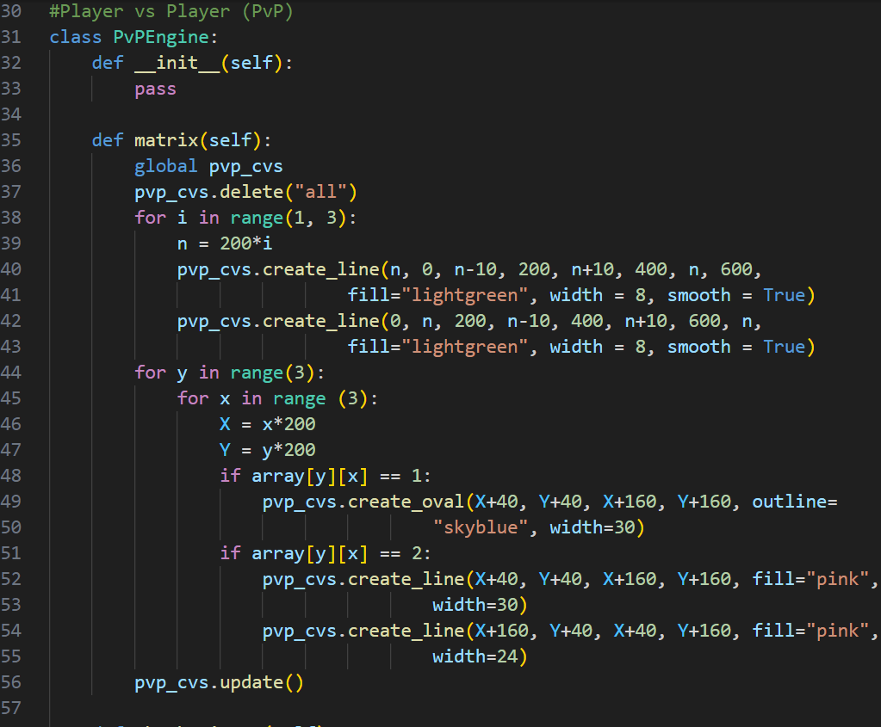
Game engine for Player vs player mode Help manage the game state and handles logic __init__ method is a class constructor Use pass as a placeholder Global it for using this variable in whole program Clean the contents remain in the cvs of pvp Using for loop to draw vertical line Using for loop to draw horizontal lines Calculate the “O” and “X” coordinates Drawing “O” Drawing “X” Update the cvs, prepare for the game
Draw the game board

Slide 5
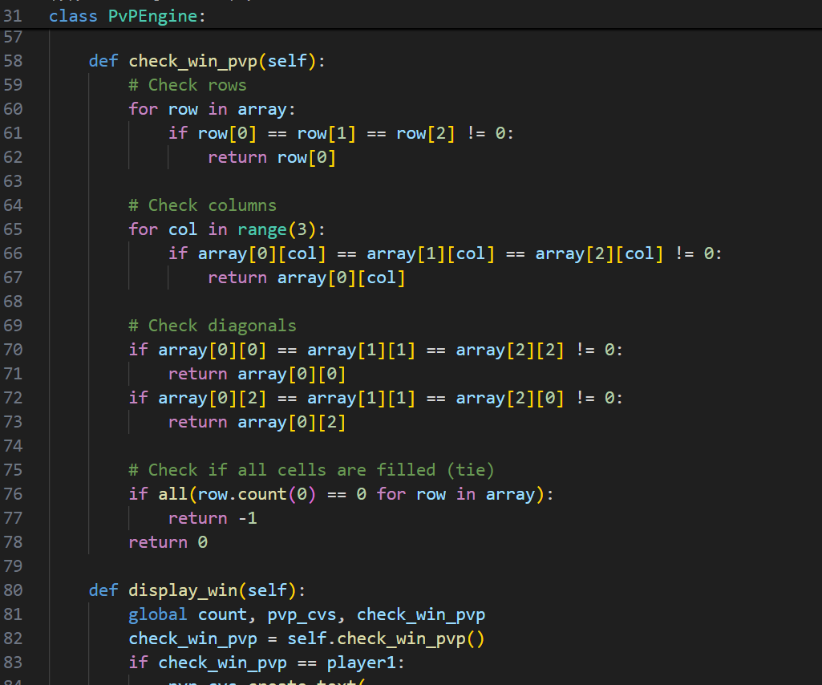
Check whether there is a line formed Check if any rows contains three identical marks and returns the winning player Check if any column contains three identical marks and returns the winning player Check the two diagonals for three identical marks and returns the winning player Check if all cells are filled, and then result in tie Return 0 if the game is still ongoing

Slide 6
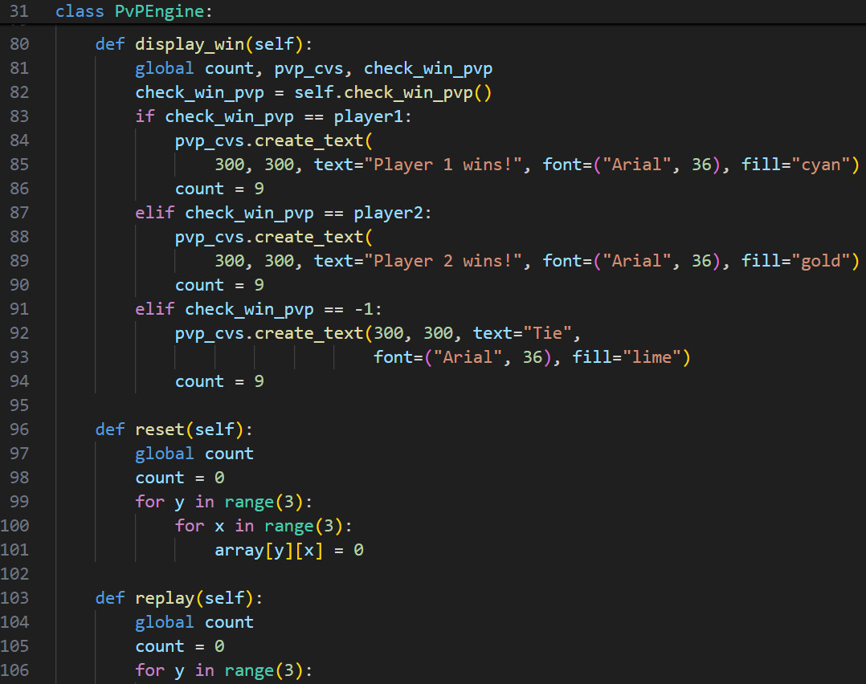



Displays the result on the canvas(cvs) Call check_win_pvp to determine the winner and updates the winner variable If player1 wins, display “Player 1 wins!” on the middle of the canvas and set count=9 If player1 wins, display “Player 2 wins!” on the middle of the canvas and set count=9 Display “Tie” if there’s no winner and set count=9
Remarks “Arial” is a text type 36 is the text size “cyan”, “gold”, “lime” are the color of the text

Slide 7
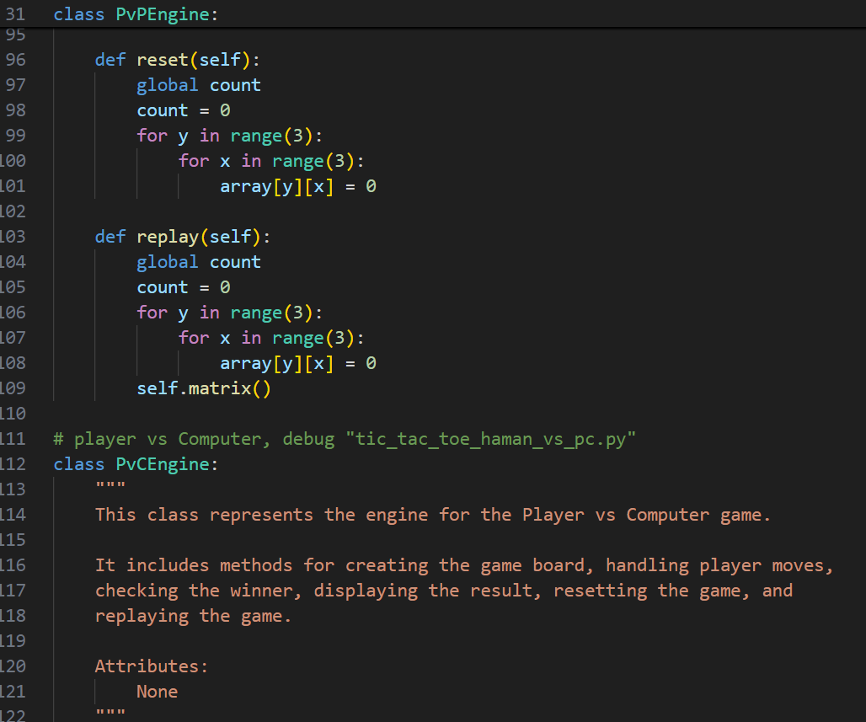
Reset the game state by setting count=0 and clearing all cells in the array matrix Reset the game and redraws the empty board using matrix

Slide 8
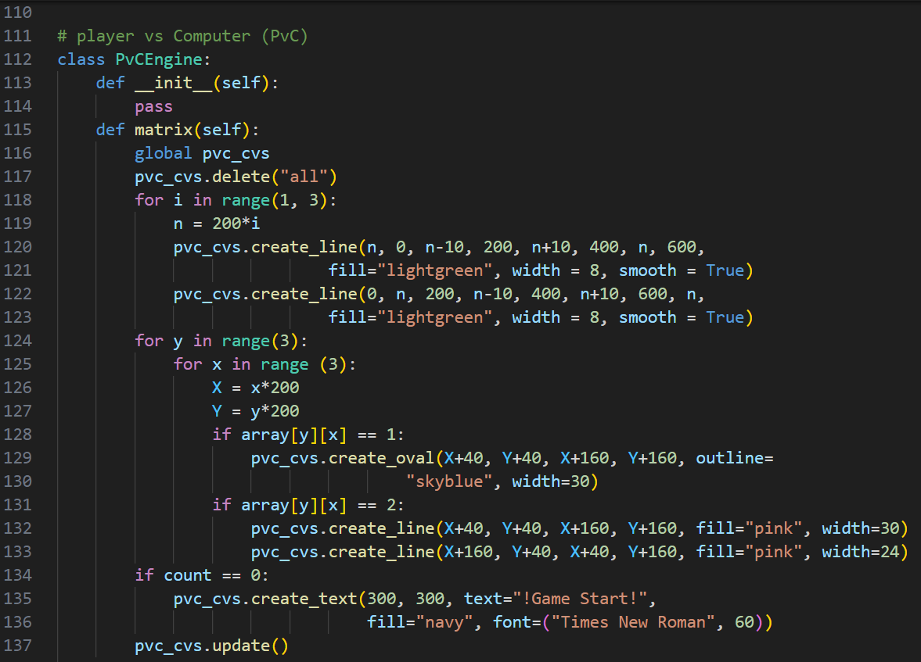

Slide 9
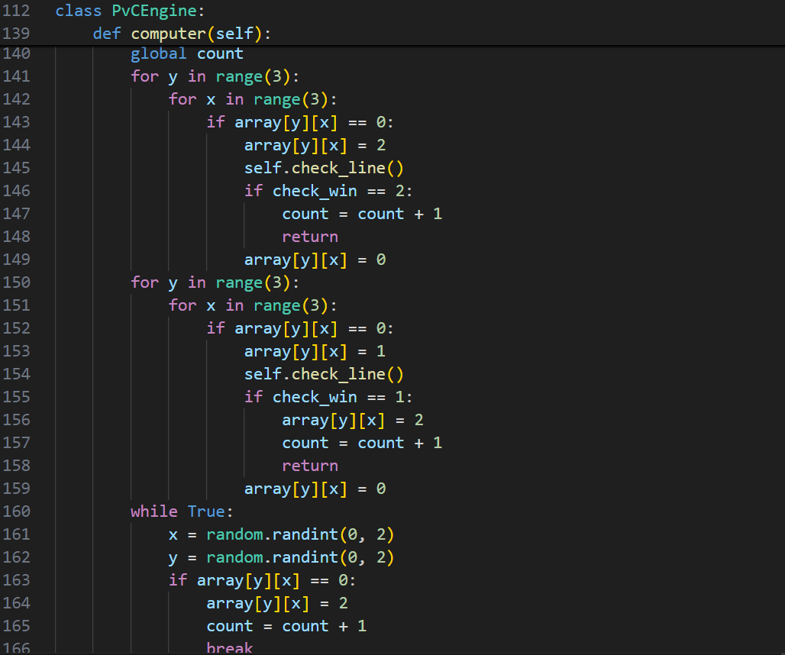

Slide 10
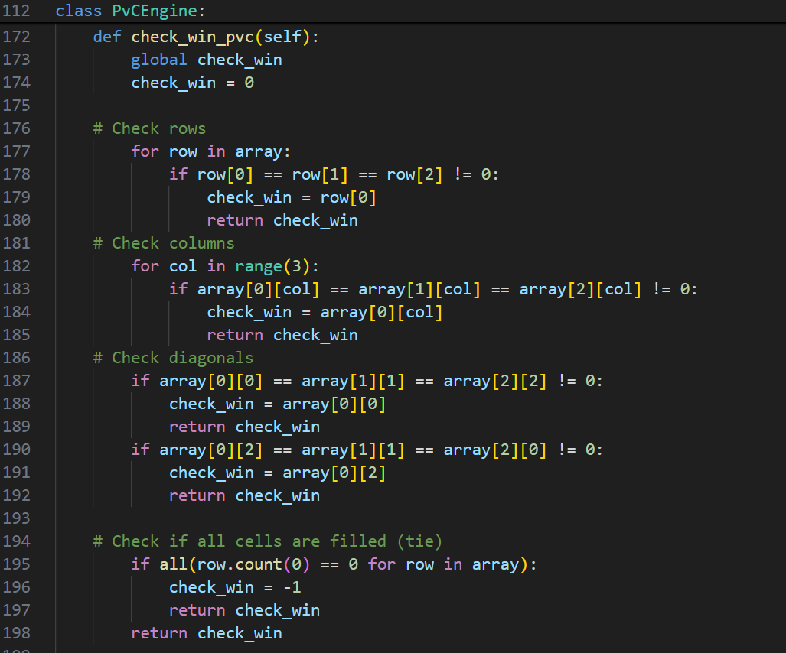

Slide 11
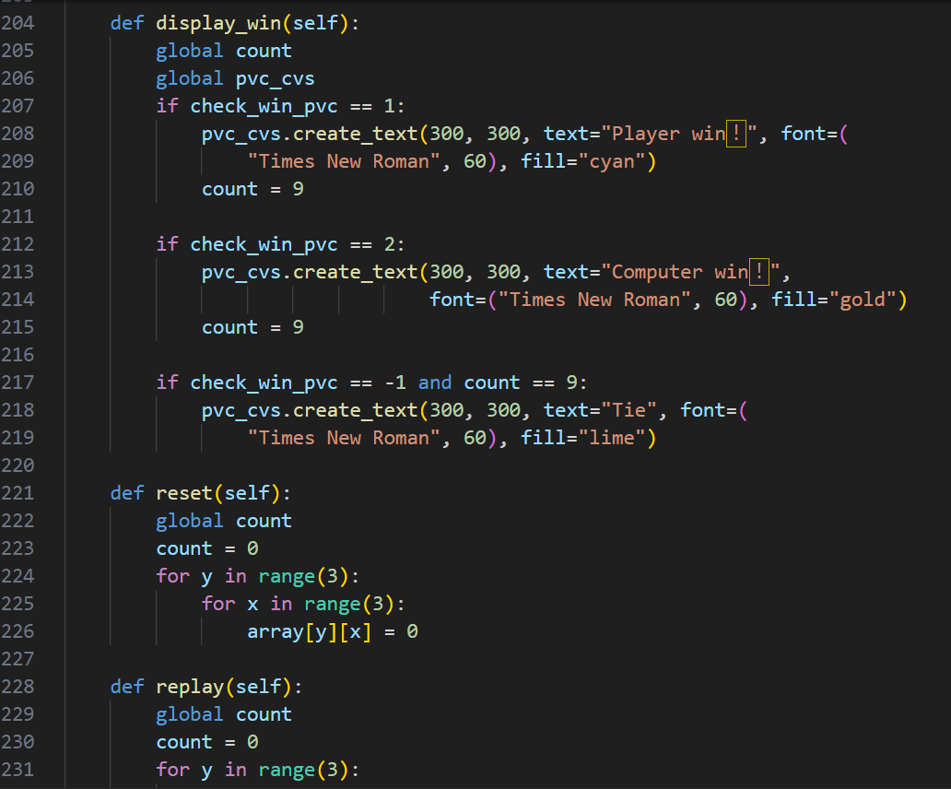

Slide 12
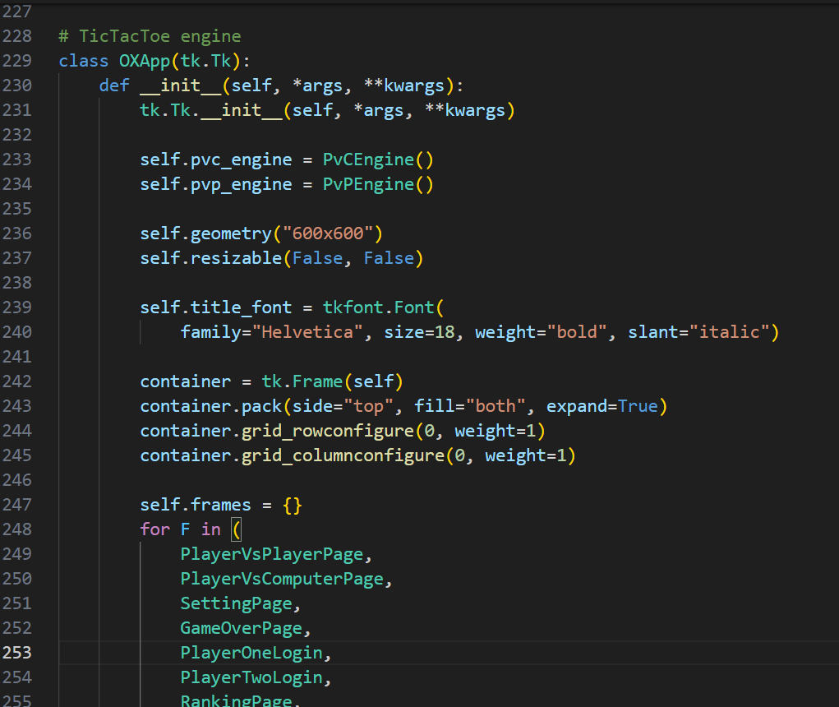
The main application frame Initializes the main application windows Creates an instance of two engines which manages the logic for gameplay Sets the dimensions of the application window to 600x600 and not resizable Define a shared font style for page titles A frame being a parent of all other frames Define the positions of container Evenly place the rows and columns of frames and pages
OXApp Class = It is the main application controller. It contains all other frames. It is responsible for creating the frames and lay outing them. The frames it creates are: - SettingPage -GameOverPage -PlayerOneLogin -PlayerTwoLogin - PlayerVsComputerPage -PlayerVsPlayerPage -RankingPage - StartPage It also creates the game engine objects and stores them in the instance variables.

Slide 13
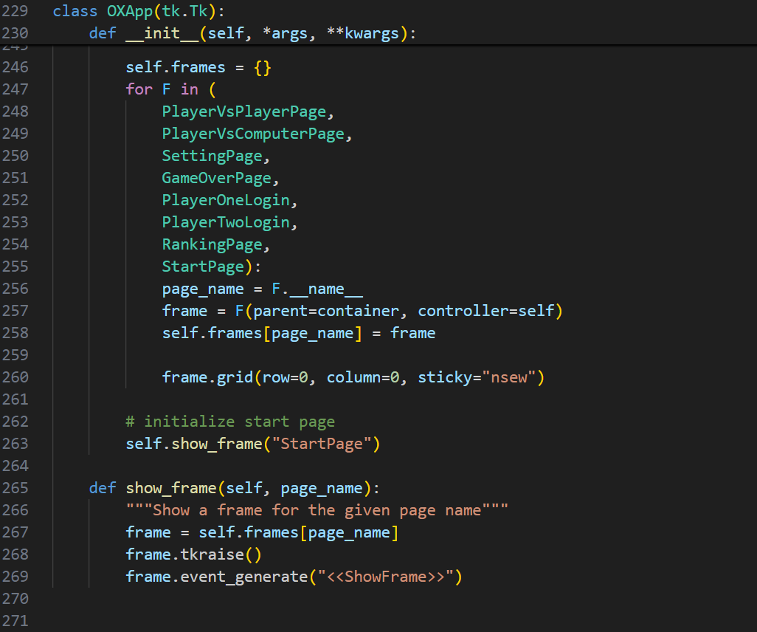
Initializes an empty dictionary to store frames instance Iterates over a tuple of frame classes (Colored in Green) Take the class name of the current frame as string Create an instance of the current frame class Store the frame instance in self.frame dictionary Position the frame with the container Display the StartPage
Show a frame for the given page name Put the frame on the top of the stack Allows the frame to make actions

Slide 14
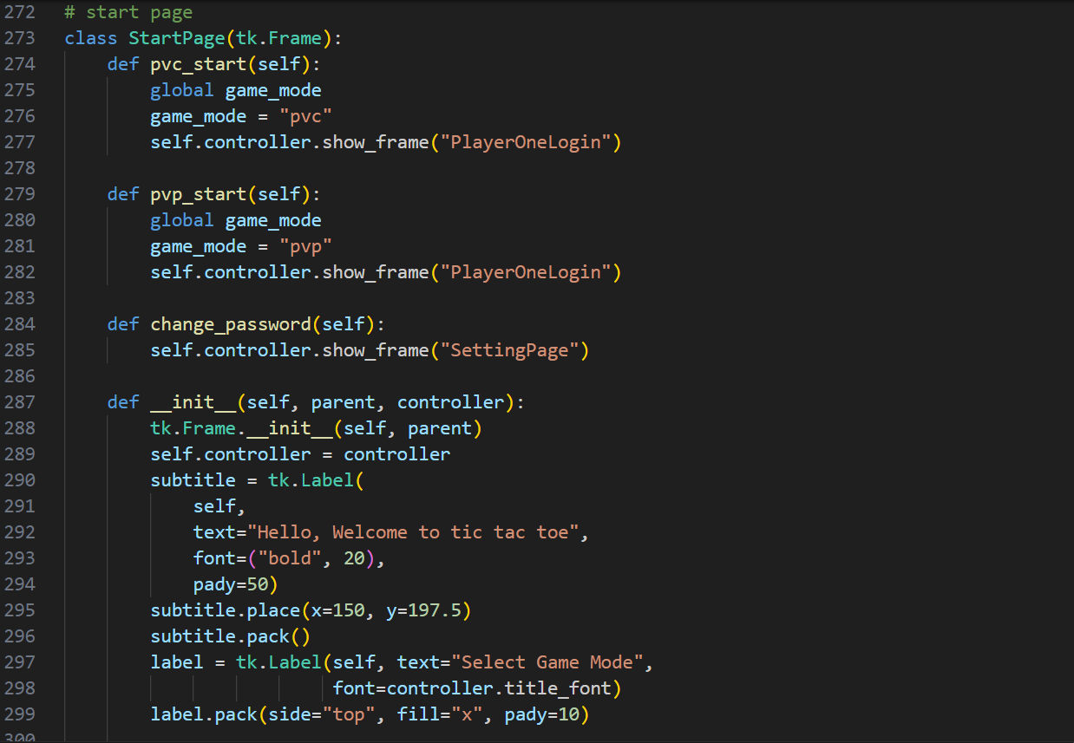
Act as a container Set the game_mode to pvc Navigates to the PlayerOneLogin frame
Set the game_mode to pvp Navigates to the PlayerOneLogin frame
Navigates to the SettingPage frame for changing passwords
Initialize the StartPage frame and its widgets Call tk.Frame Stores a reference to the controller for navigation Create a label widget Place the string in the middle Display this subtitle

Slide 15
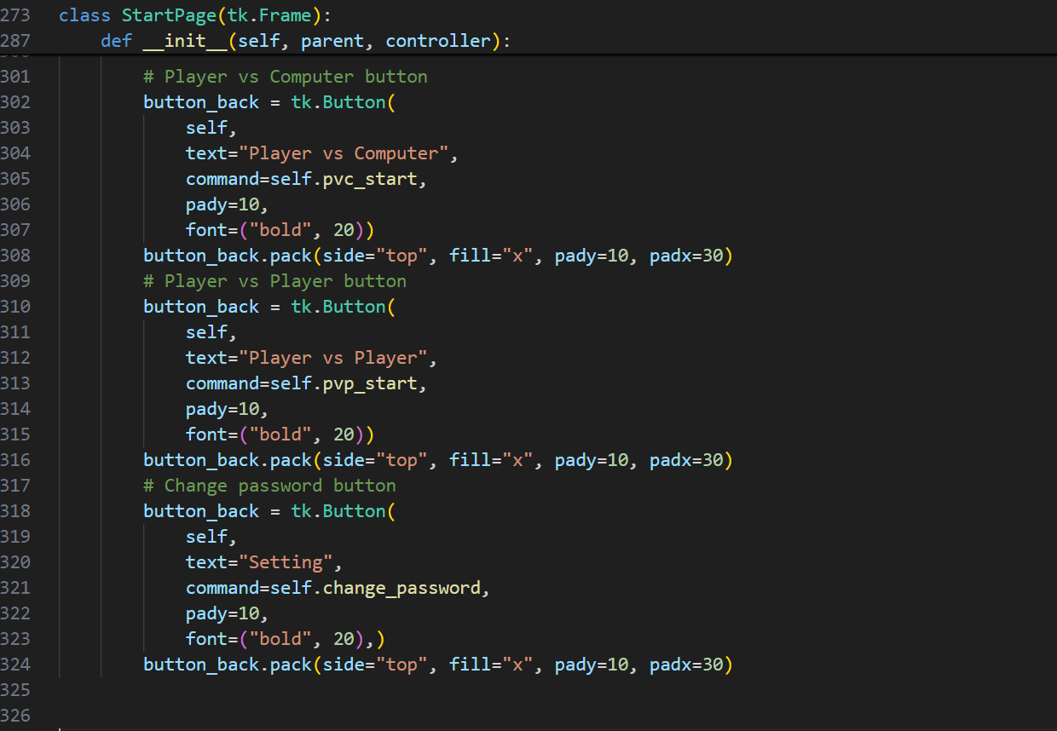
Create a button for selecting Player vs Computer mode
Create a button for selecting Player vs Player mode
Create a button for navigating to the setting page

Slide 16
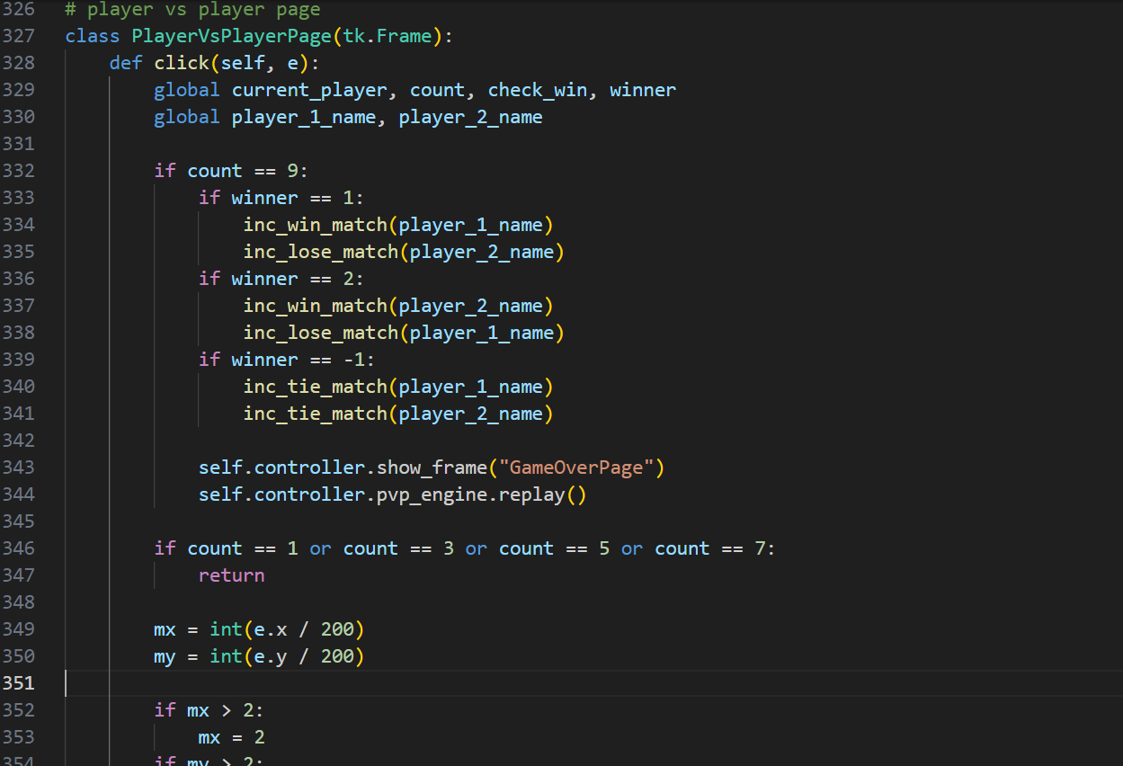
Define the class The function handle the click event on this frame Checking if the game is over(count=9), check there is a winner or tie and updating the statistic. refer to the GameOverPage Reset the game for new round ensures that players can only make a move when it’s their turn
Inc_win_match =

Slide 17
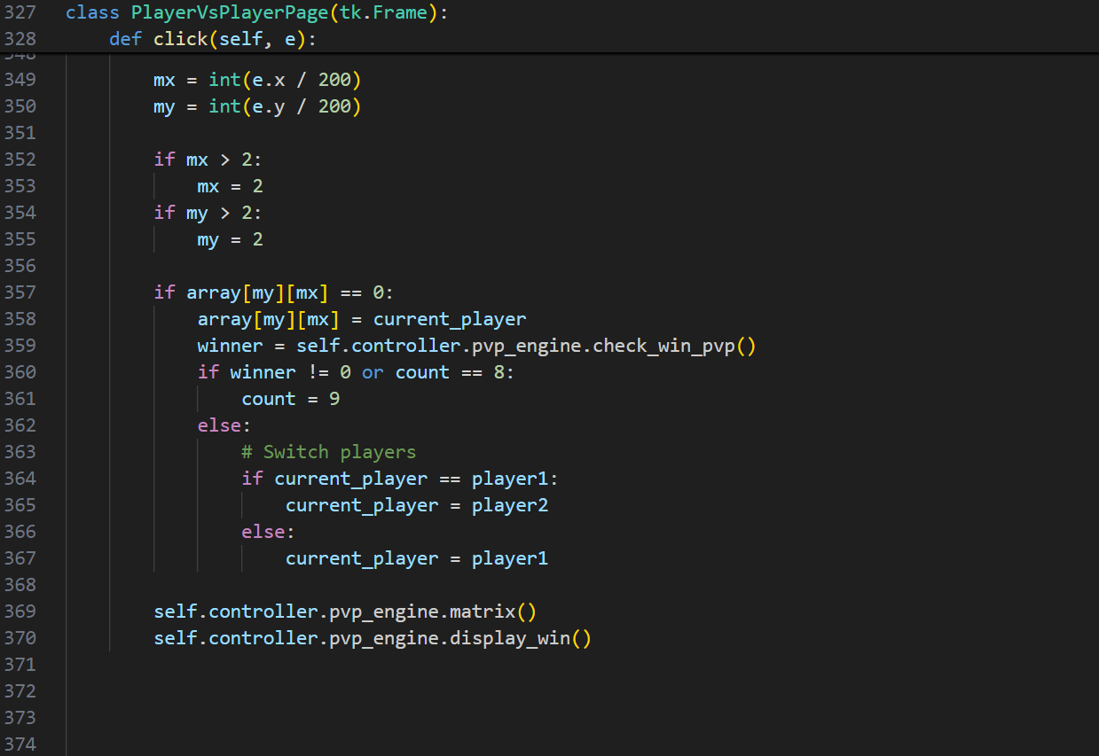
converts the mouse click coordinates into coordinates ensures that the calculated mx and my values are within the bounds of the 3x3 checks if the cell the player clicked on is empty and updates the game boardnto reflect the current player's move Check winner or the board is full If no winner and board is not full, switch the turn of two players These two lines refresh the game board and display the result after each move and update the canvas to show the latest game state display_win() shows the result of the game

Slide 18
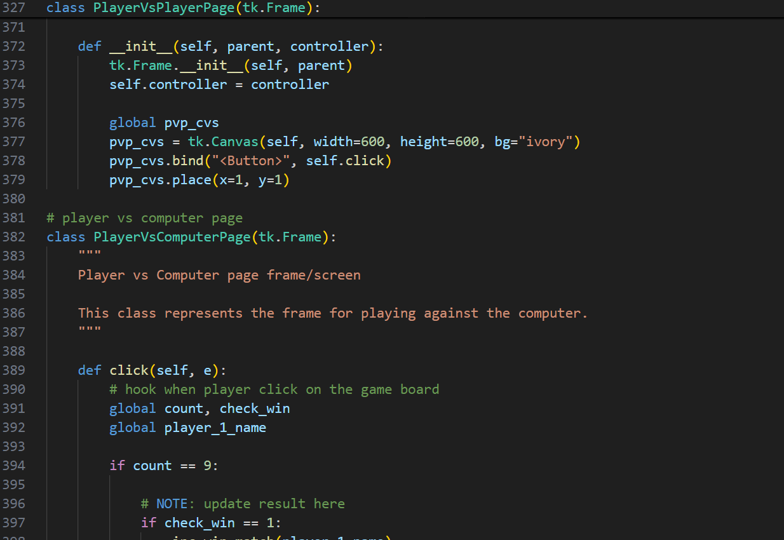
Initialize the frame Store the controleer into an instance variable for direct interaction within other pages Create the canvas Bind the butten evnt to the click method Maintain the position of the frame to the top left

Slide 19
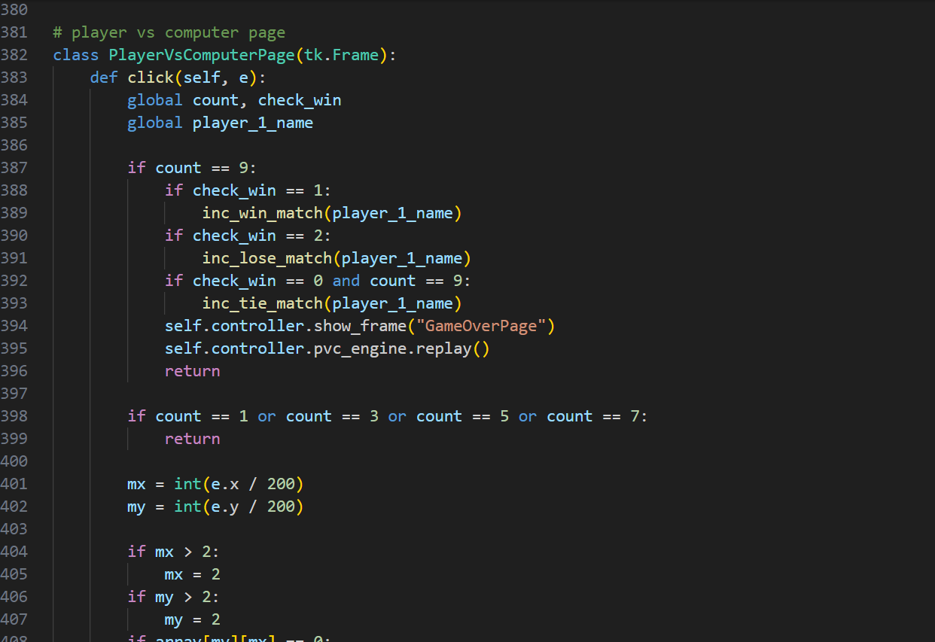
This class represents the frame of player vs computer The function operate when mouse is clicked Checking if the game is over(count=9), check there is a winner or tie and updating the statistic. refer to the GameOverPage Reset the game for new round ensures that players can only make a move when it’s their turn
e: contain the coordinate when the mouse is clicked(e.x and e.y)

Slide 20
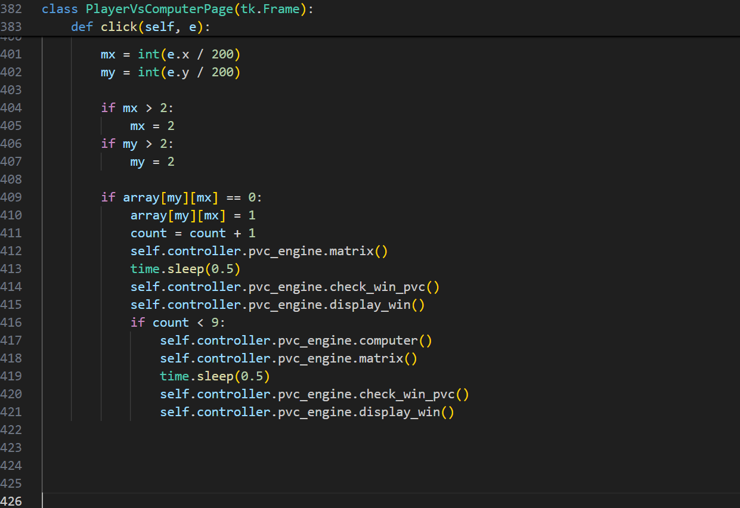
converts the mouse click coordinates into coordinates ensures that the calculated mx and my values are within the bounds of the 3x3 checks if the cell is empty. If yes, record the player’s move Computer wait for 0.5s before placing to prevent error If no winner and board is not full, computer will take the next step These two lines refresh the game board and display the result after each move and update the canvas to show the latest game state display_win() shows the result of the game

Slide 21
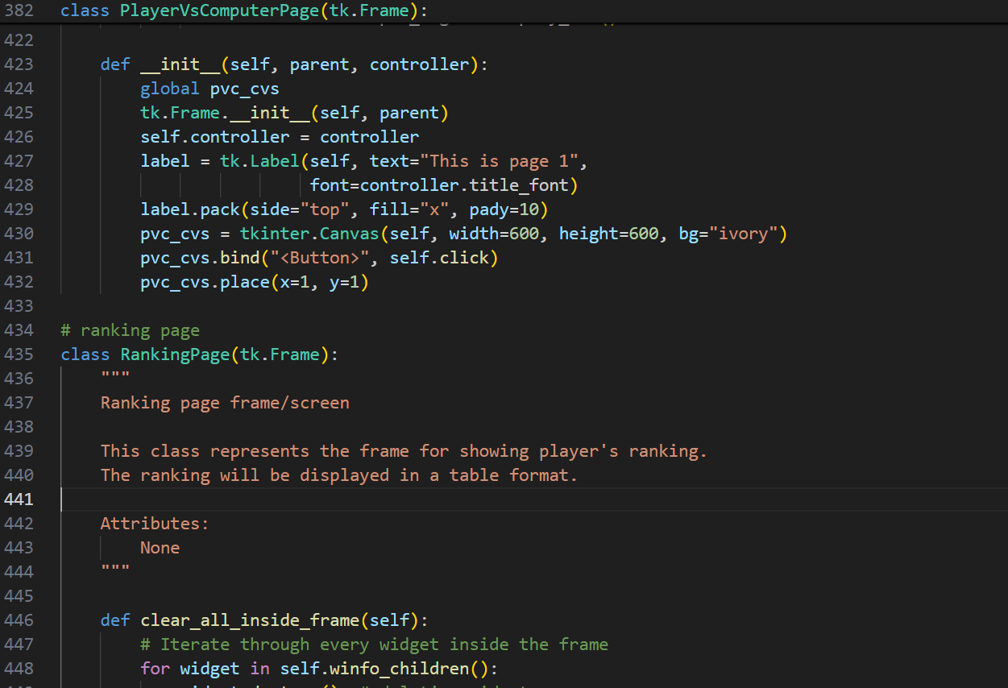

Initialize the frame Store the controleer into an instance A temporary line for debugging and check which page Create the canvas Bind the butten evnt to the click method Maintain the position of the frame to the top left

Slide 22
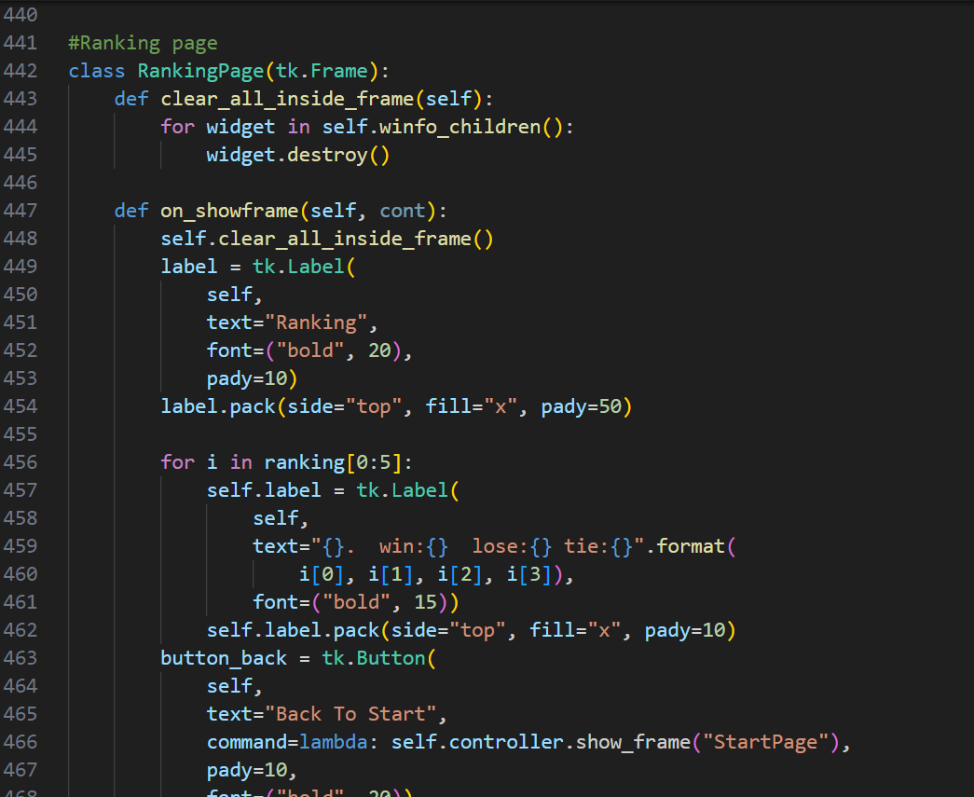
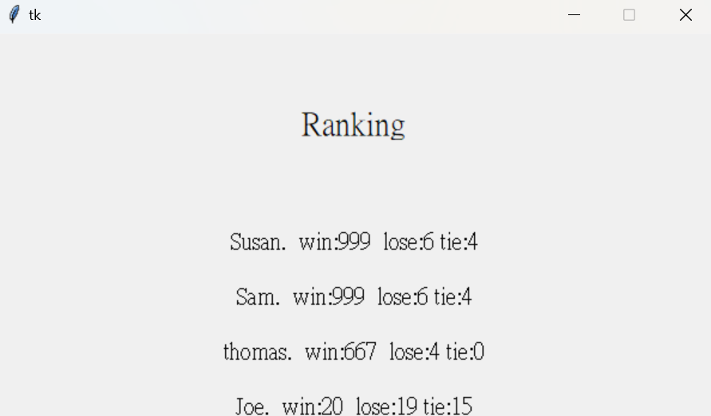
Define the RangingPage class Purpose is clear all widgets in the current frame Return all the widgets current inside the frame And remove all frame
To clear the widgets inside the frame To add a string at the top of the page Ensure the string is place in the middle on the top

Slide 23
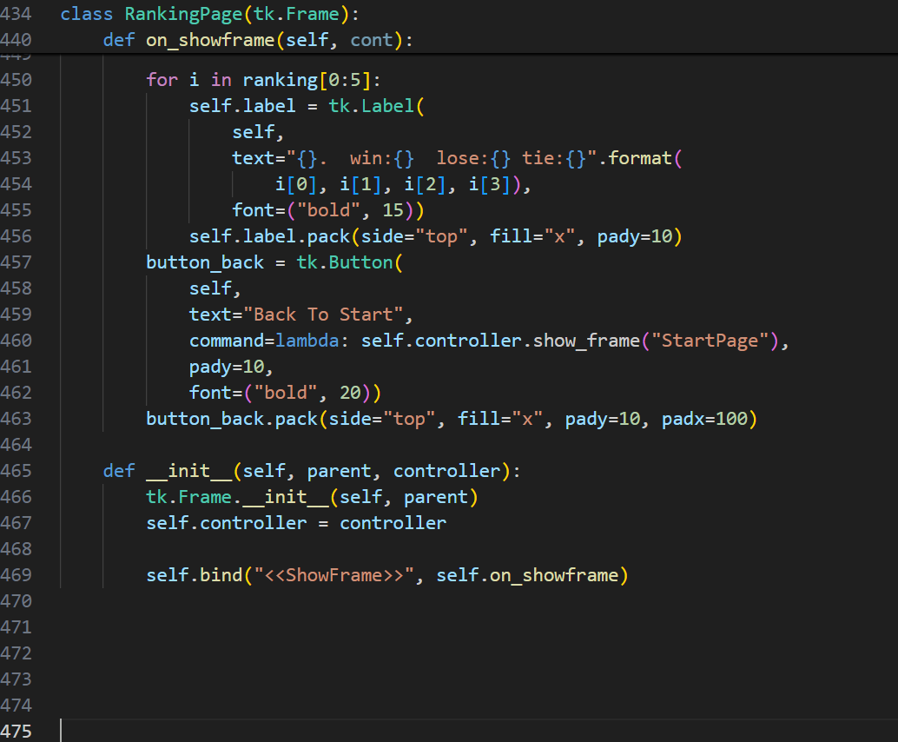
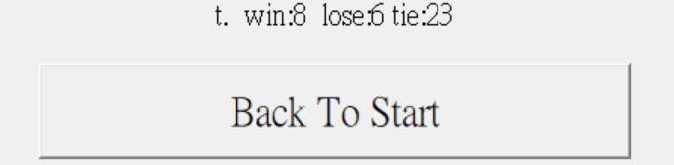
Loops through the first 5 elements in ranking Creates a new label display results Confirm the label is in the middle and 50 below Add a button named “Back To Start” When click, back to “StartPage” The place of the button
Purpose is initializing the RankingPage Initialize RankingPage as a child of parent Stores the controller Refresh the frame content

Slide 24
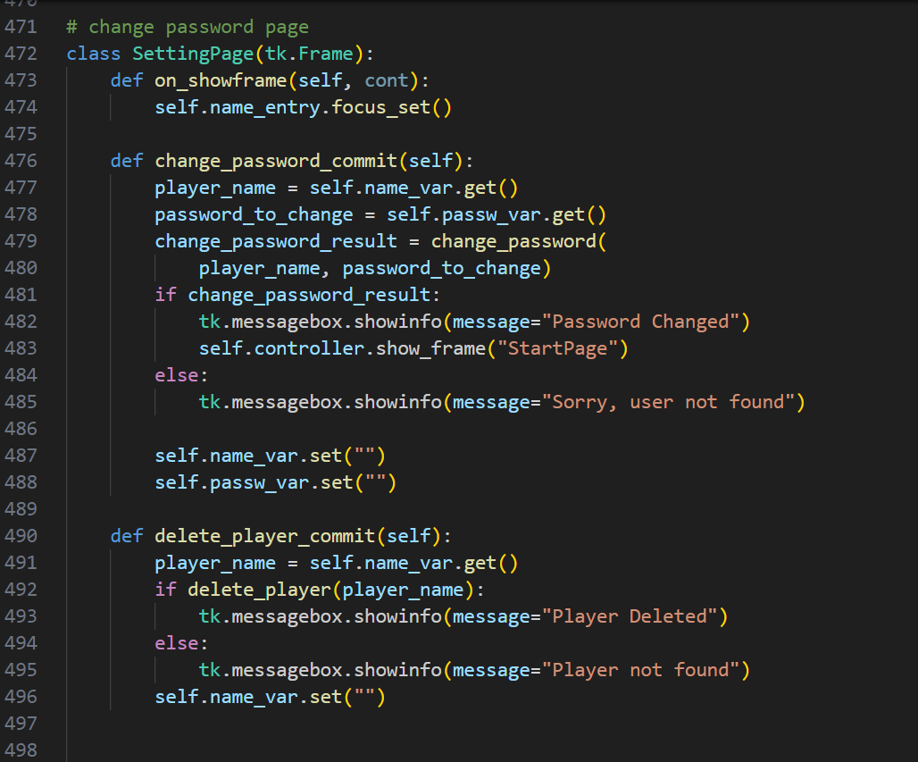

Slide 25
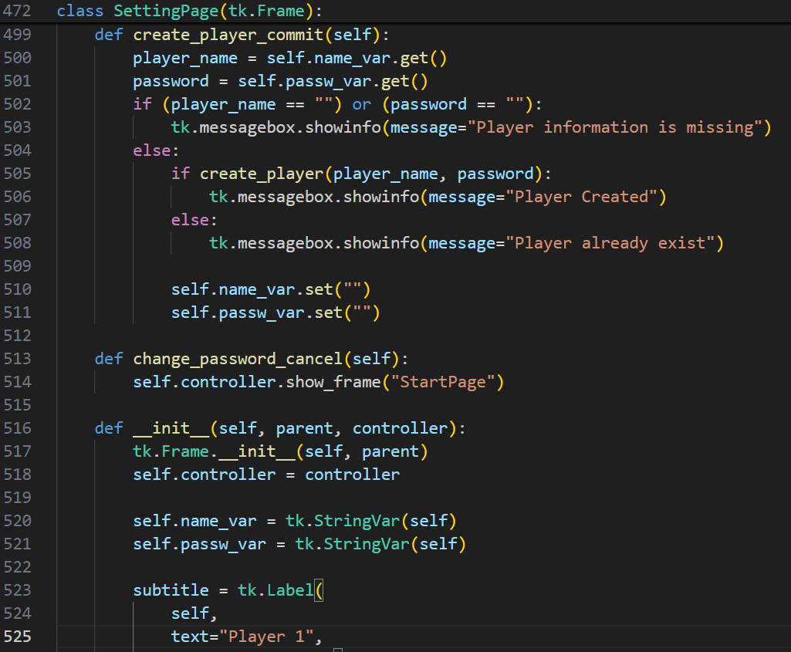

Slide 26
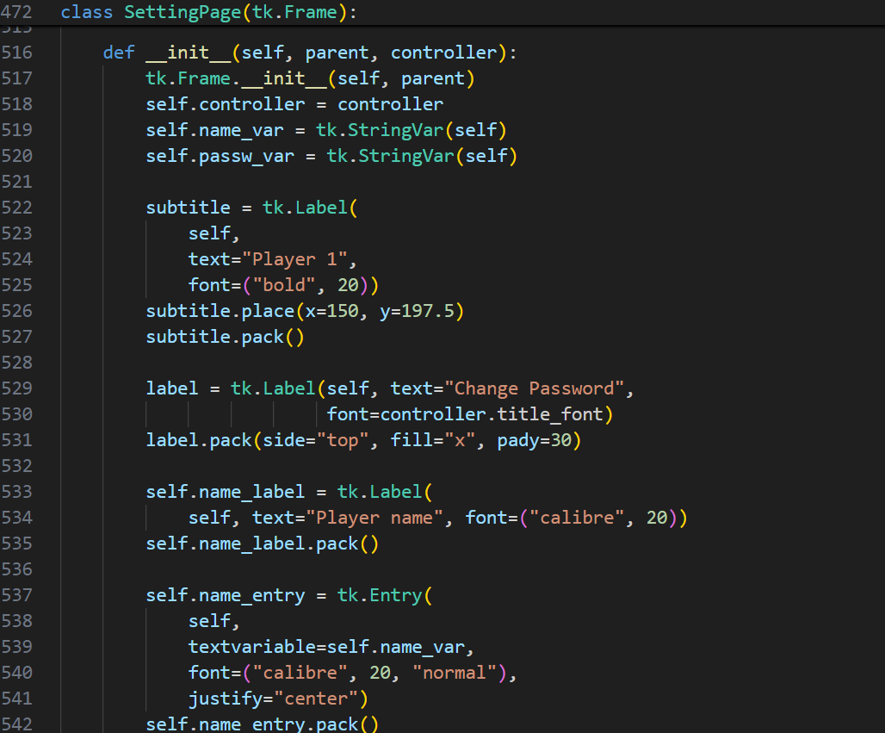

Slide 27
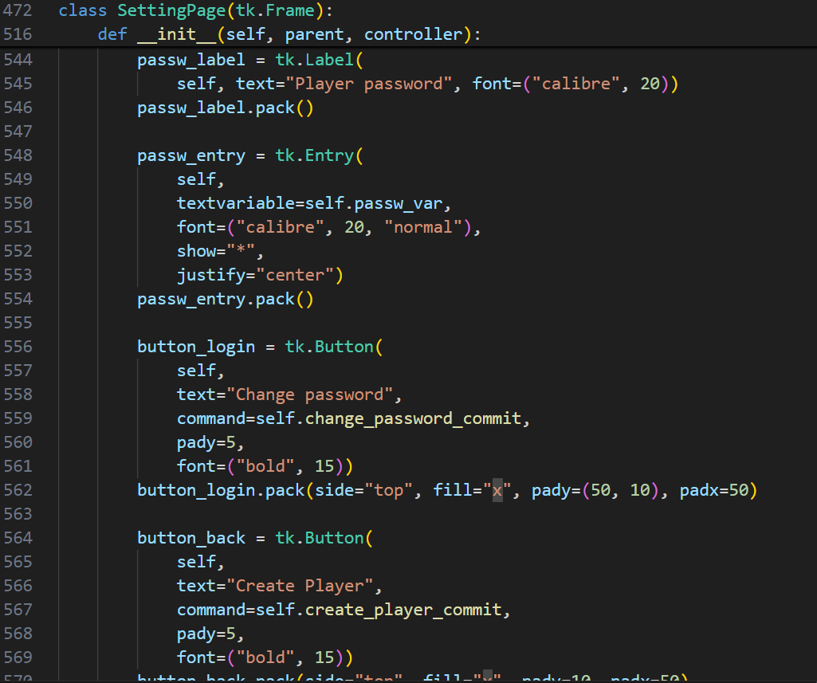

Slide 28
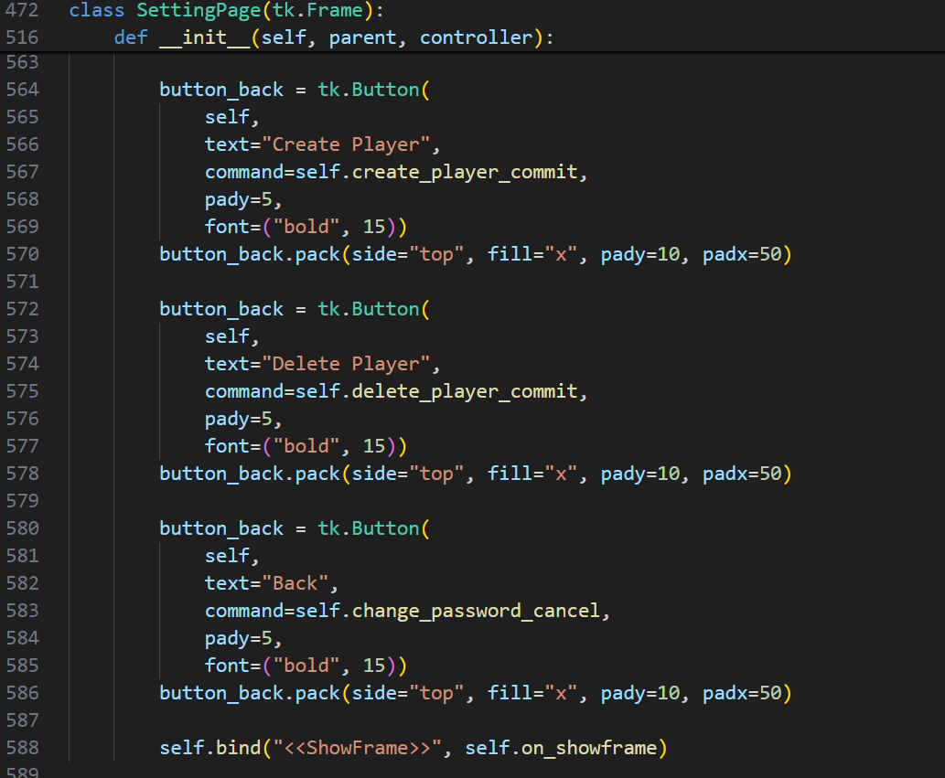

Slide 29
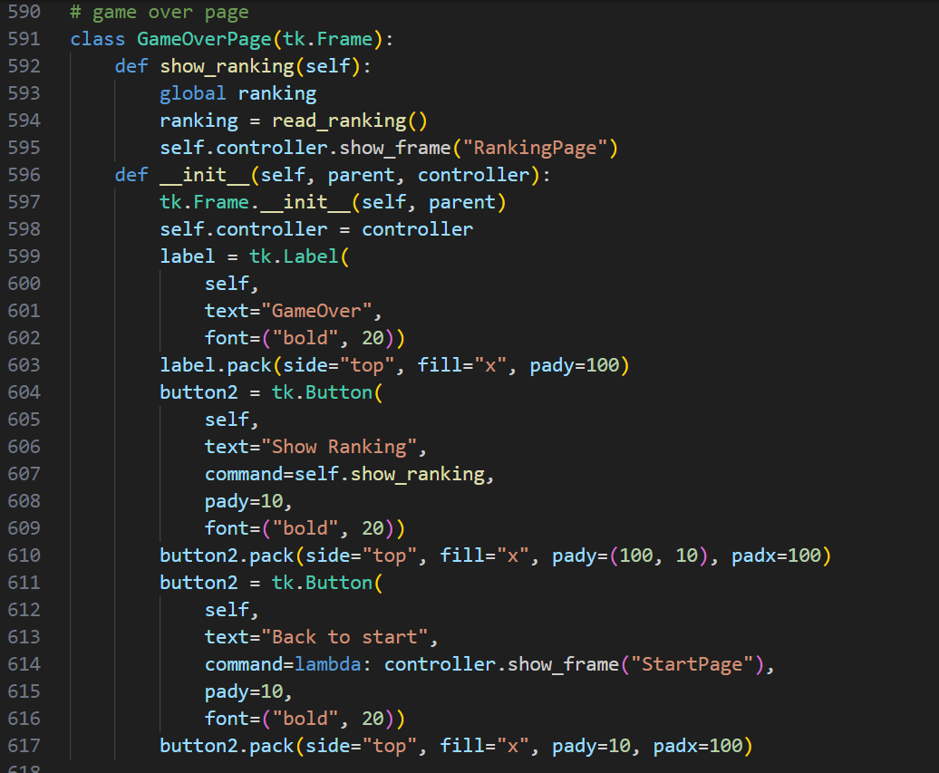
This frame will be display after the match It will be triggered when the player clicks the button Copy the ranking data into ranking Allow user to view the ranking after the match
This function will be called when opening this page Initializing the frame and set it as parent Copy to self.controller Create a string “GameOver” Create a button called “Show Ranking” Create a button called “StartPage”

Slide 30
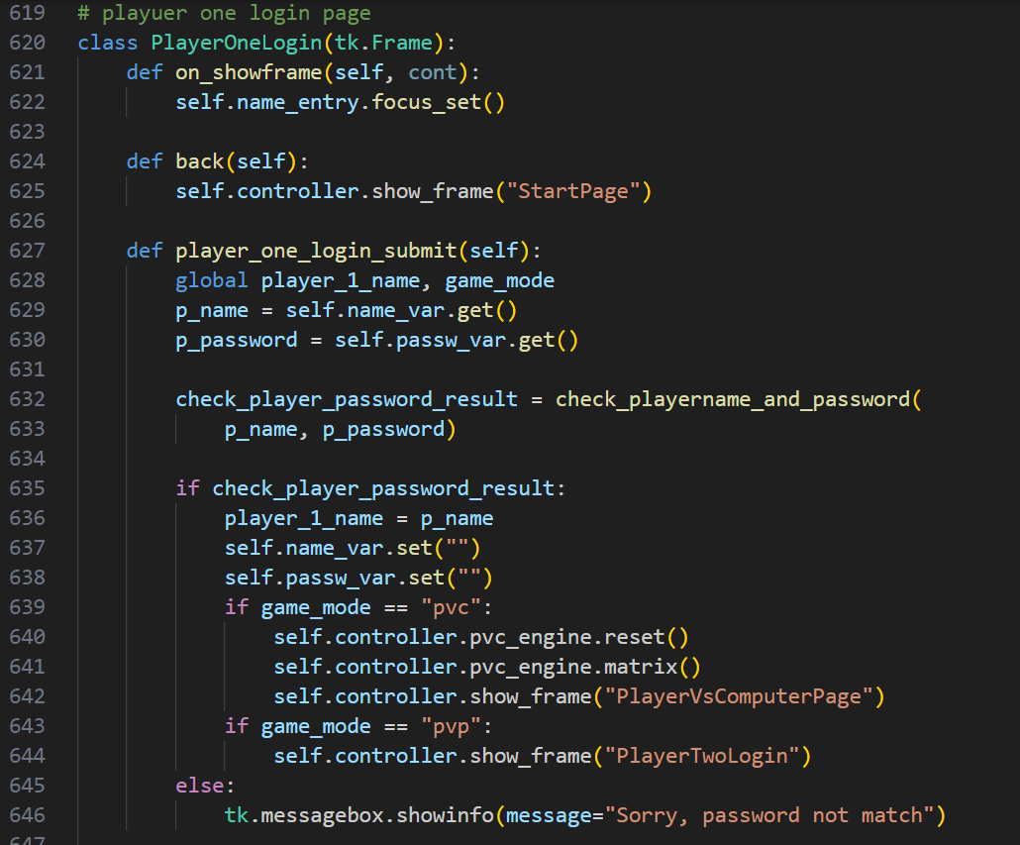
The frame allows player to login page for player one Player can immediately type when the frame starts
It will work when “Back” button is clicked Switch back to the “StartPage”
Allow player to fill name and password Retrieves the player’s entered string Retrieves the player’s entered password Calls the function to verify Clears the name_var fields Clear the passw_var fields Resets the game state Prepare the matrix for a new match Switch to the frame PlayerVsComputerPage Switch to the frame PlayerVsPlayerPage Display a message box that tell password not match

Slide 31
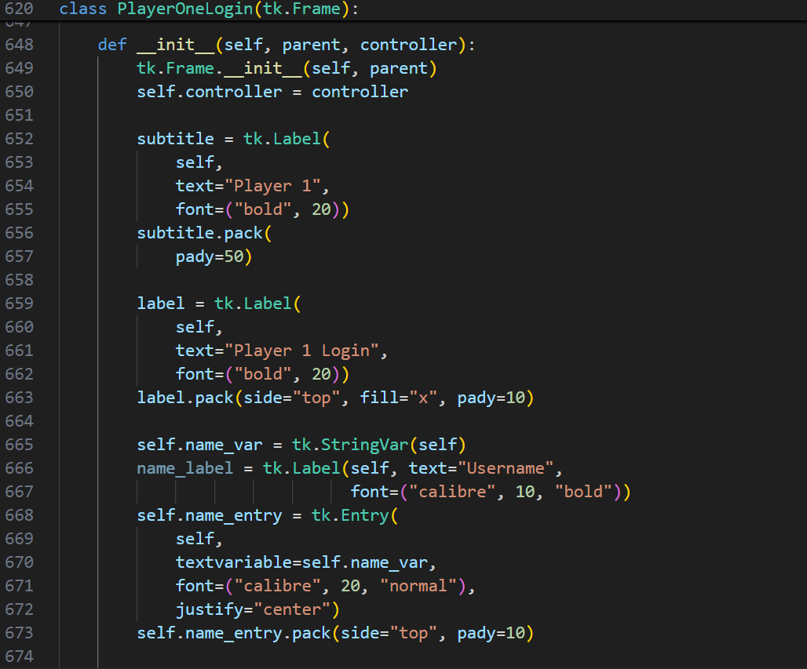


Initializes the home screen Set up the Store the controller to self.controller Create a label string “Player 1” Create a label string “Player1 Login” StraightVar is a tkinter variable updates automicatically Create a label displaying the player’s input Create a text box for player type their username

Slide 32
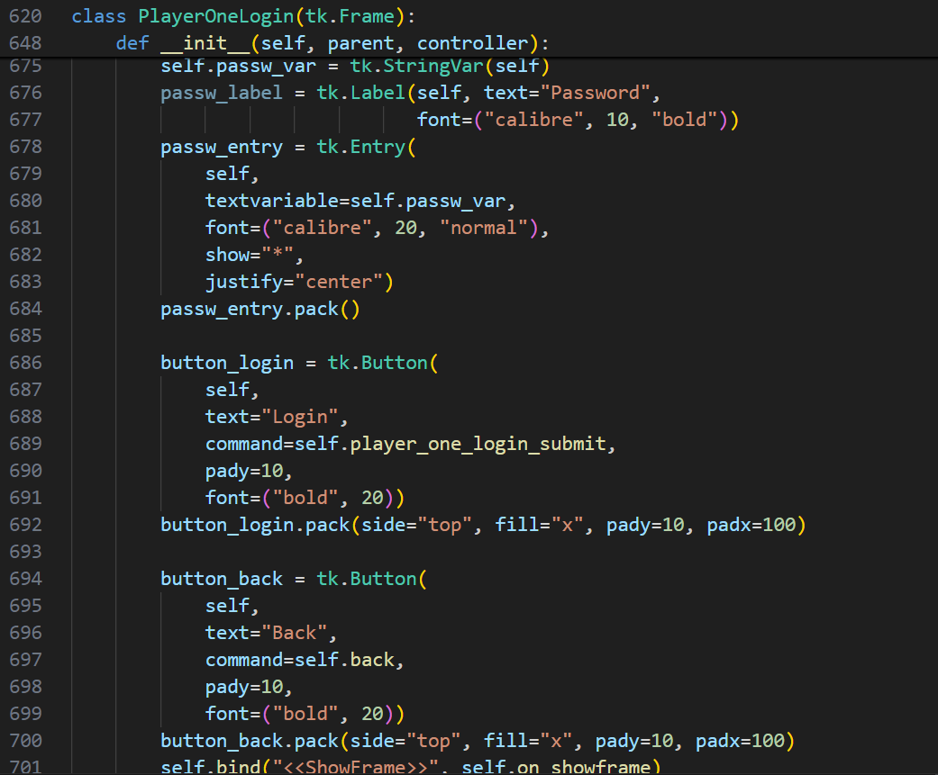

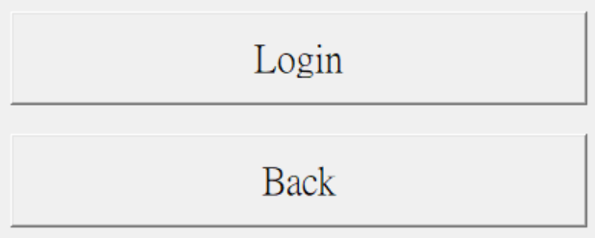
Create a label displaying the password input Create a widget for player to input (Display with *) Create a button Called “Login” create a button called “Back”

Slide 33
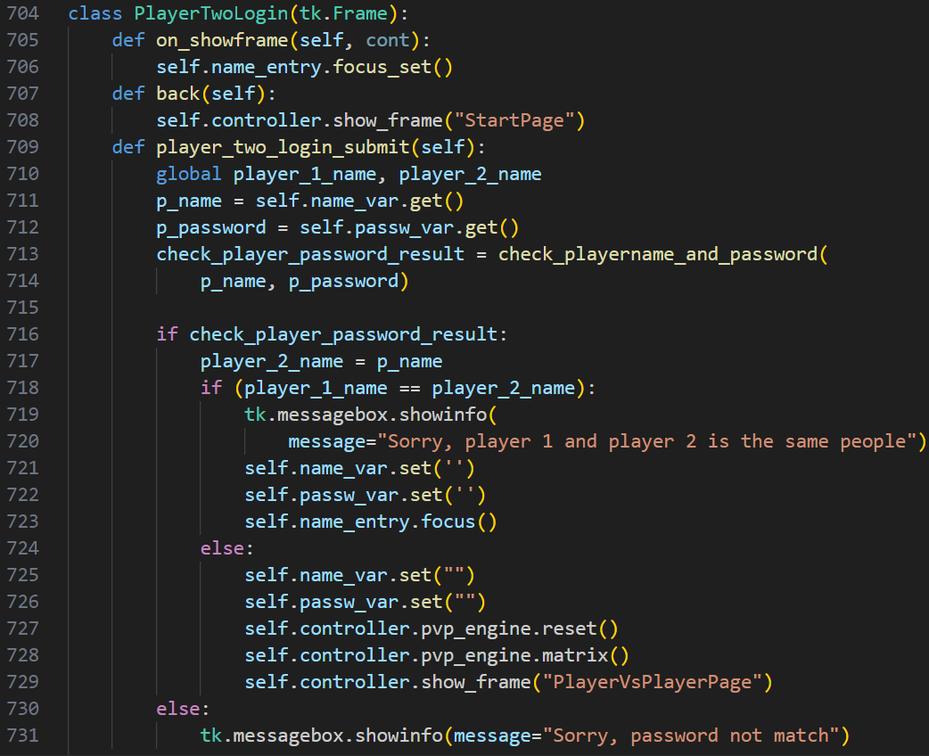
The login screen for player 2 Player can immediately type when frame starts
It will work when “Back” button is clicked Switch back to the “StartPage”
Retrieves the player’s entered string Retrieves the player’s entered password Calls the function to verify Check player1 and 2 are same account Display error Clears the name_var fields Clear the passw_var fields Set the focus back to the box for re-entry Clears the name_var fields Clear the passw_var fields Resets the game state Prepare the matrix for a new match Switch to the frame PlayerVsComputerPage Display a message box that tell password not match

Slide 34
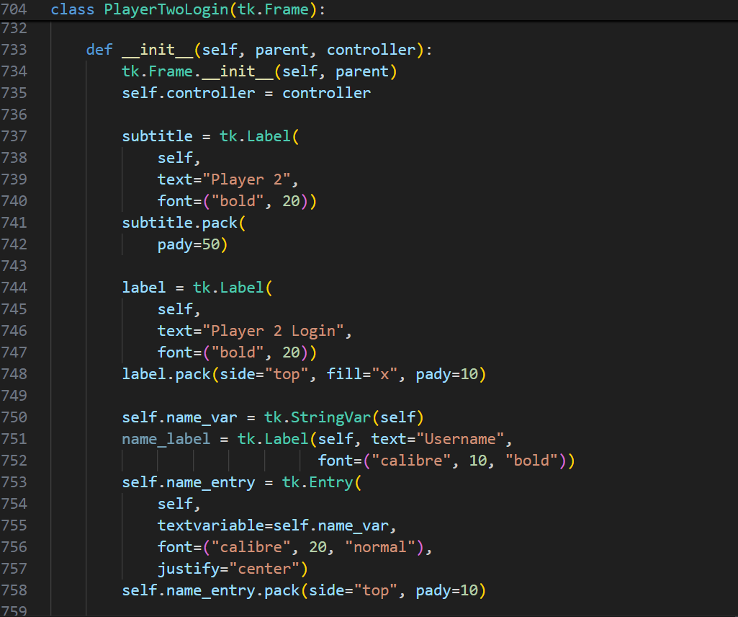



Initializes the home screen Set up the Store the controller to self.controller Create a label string “Player 2” Create a label string “Player2 Login” StraightVar is a tkinter variable updates automicatically Create a label displaying the player’s input

Slide 35
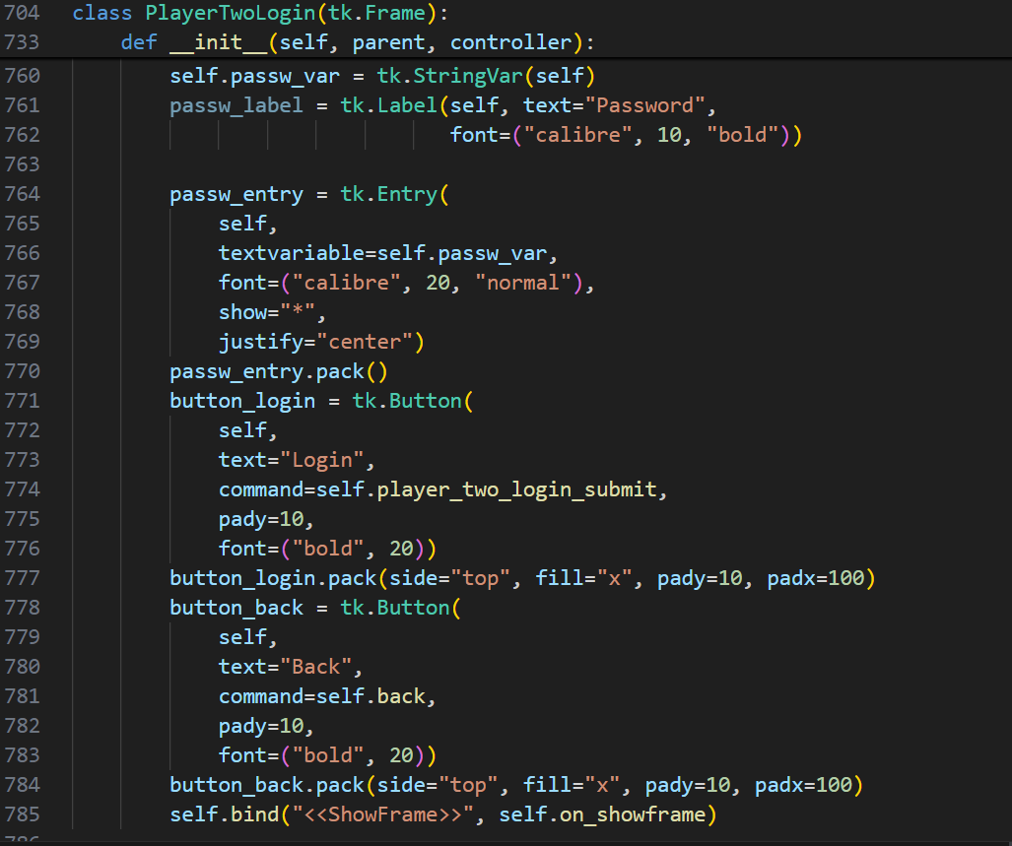
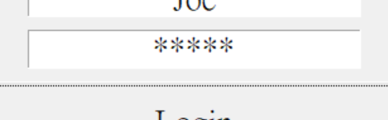
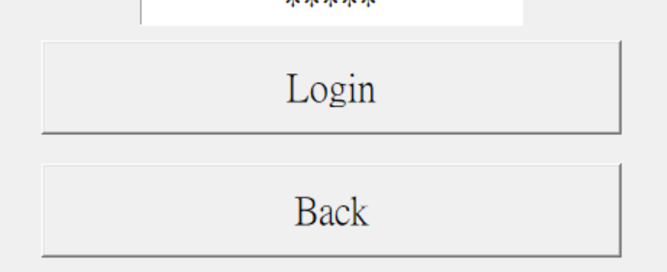
Create a label displaying the password input Create a widget for player to input (Display with *) Create a button Called “Login” Create a button called “Back”

Slide 36
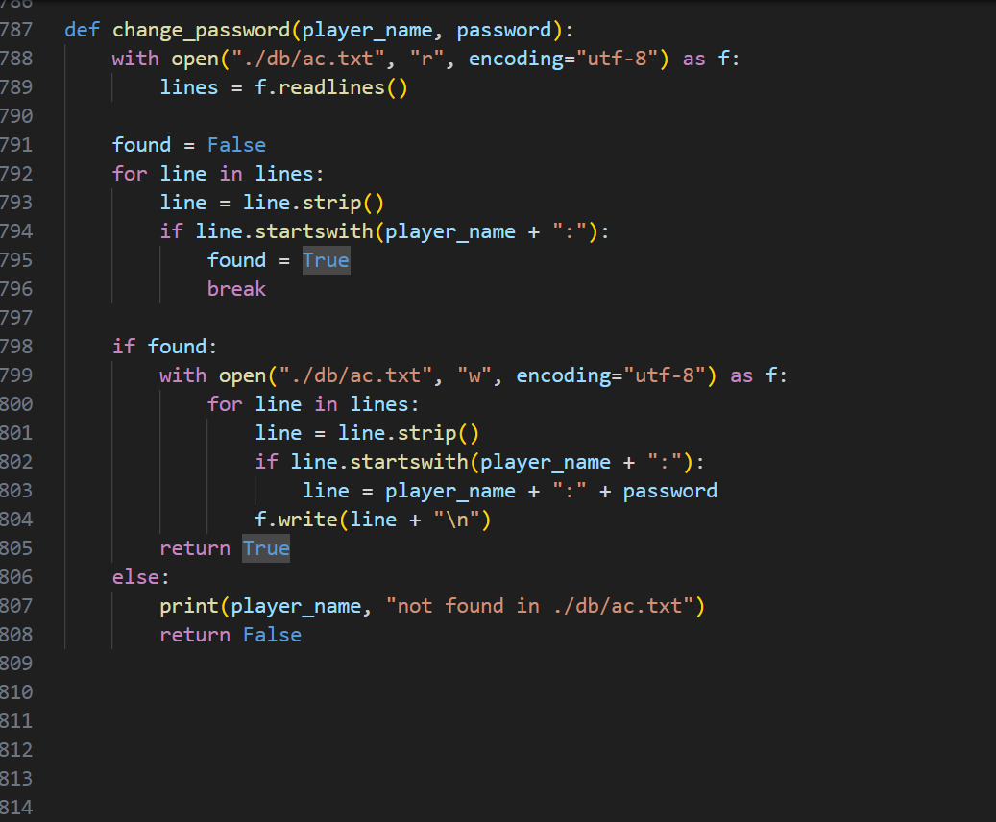
Purpose: Change password of a player in the "./db/ac.txt" file. opens the "./db/ac.txt" file in read mode, reads the lines into a list, searches for the player's name in the lines. (Strip: remove the space) opens the "./db/ac.txt" file in write mode If the player's name is found, the function changes the player's password to the given password. If the player's name is not found, a messagebox will come out
Player_name | The name of the player whose password will change
password | The new password for the player

Slide 37
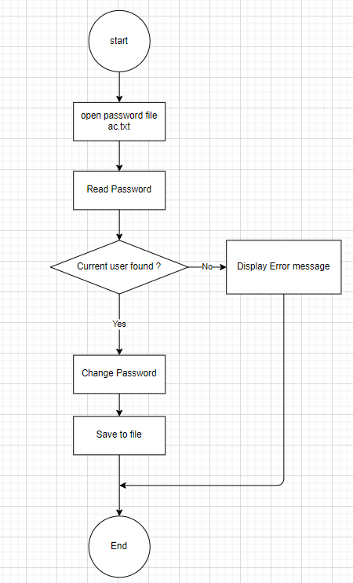
Change Password flowchart

Slide 38
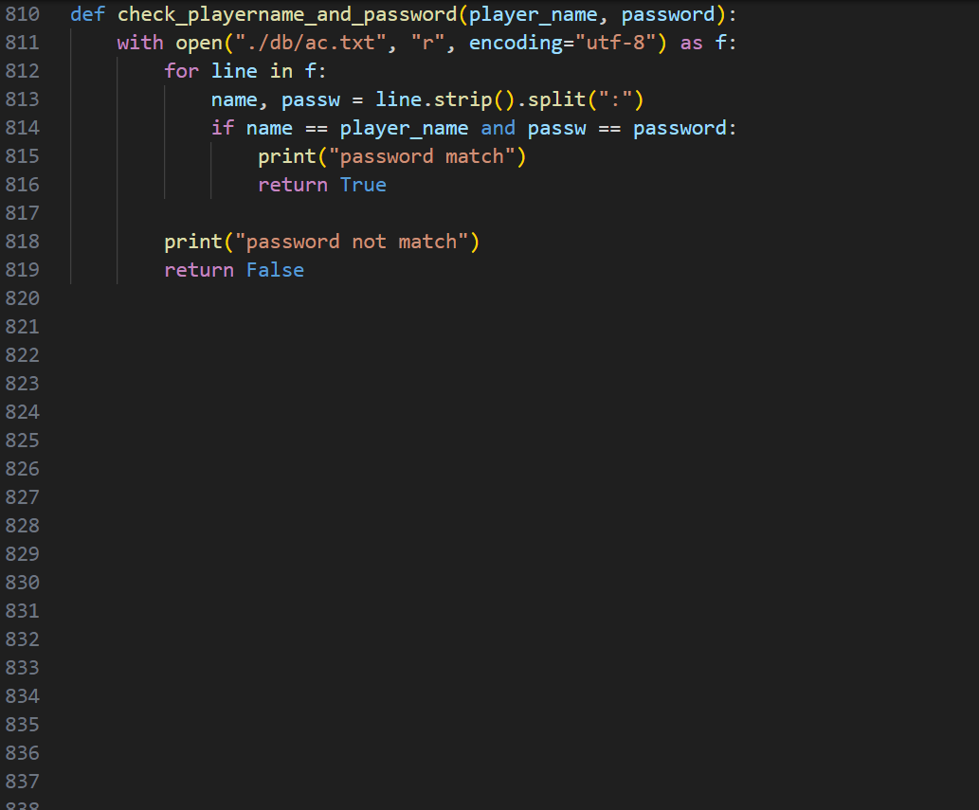
Check if the given player's name and password are in the "./db/ac.txt" file. This function opens the "./db/ac.txt" file in read mode, reads its lines into a list, and then searches the list for a line that starts with the player's name and contains the same password. If such a line is found, the function returns True. If no such line is found, the function returns False. Returns True if the given player's name and password are found in the "./db/ac.txt" file, False otherwise.
Player_name | The name of the player
password | The password of the player

Slide 39
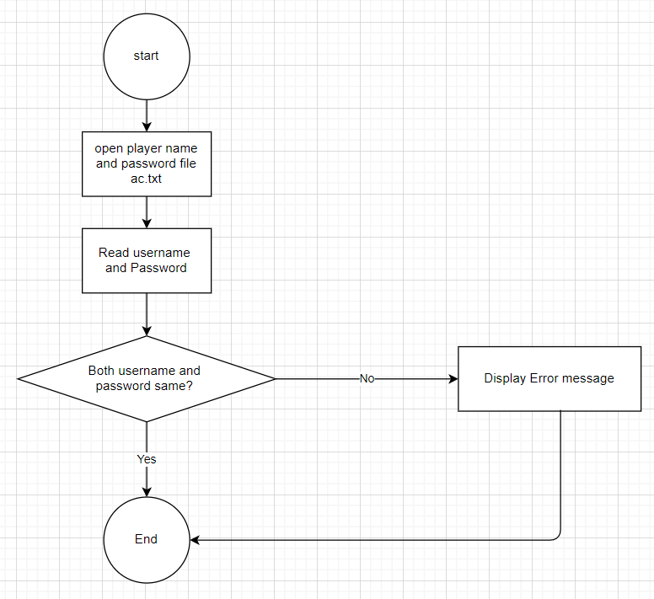
Check player_name and password flowchart

Slide 40
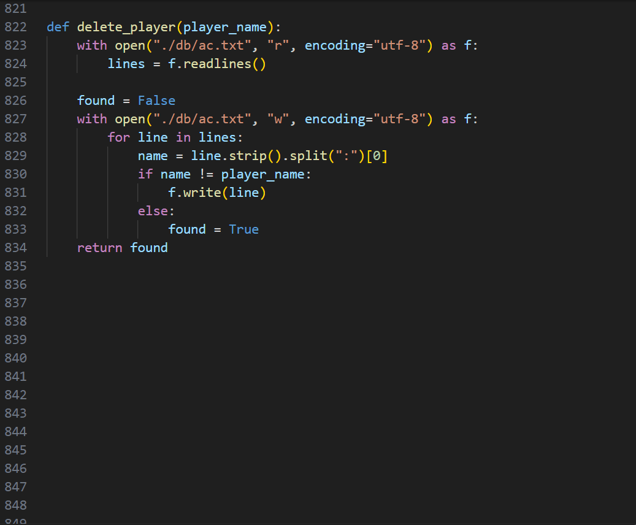
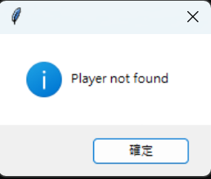
Delete player from ./db/ac.txt file. This function opens the "./db/ac.txt" file in read mode, reads the lines into a list, and then searches for the player's name in the lines. If the player's name is found, the function removes the line from the list. If the player‘s name is not found, a message box with string “Player not found” will come out
Player_name | The name of the player to be deleted

Slide 41
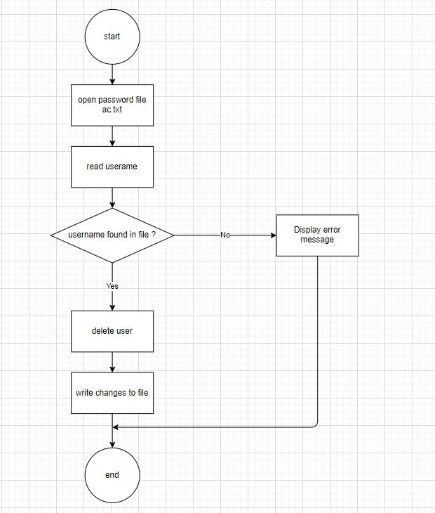
Delete player flowchart

Slide 42
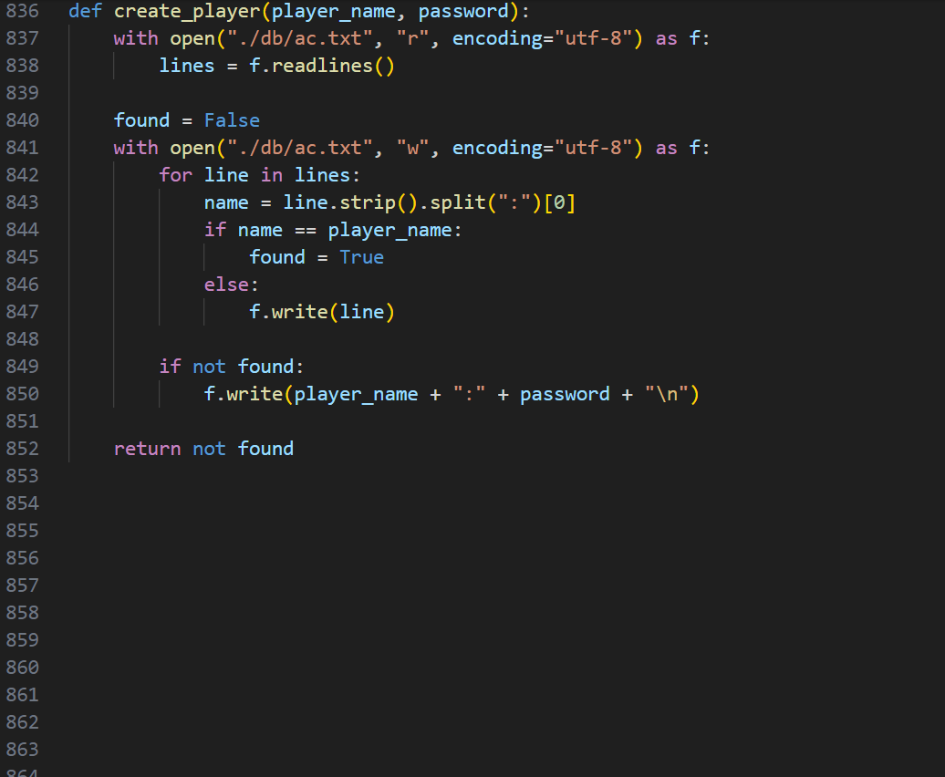
Create a new player by appending a new row to the ./db/ac.txt file with the player's name and password. Returns True if the player is created successfully, False otherwise.
Player_name | The name of the player to be created
password | The password of the player to be created

Slide 43
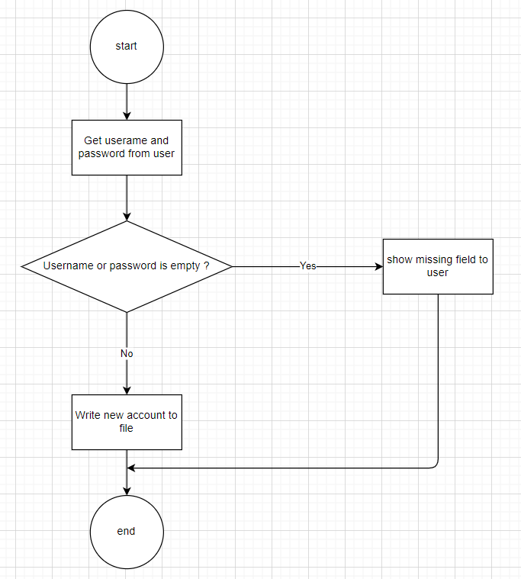
Create player and password flowchart

Slide 44
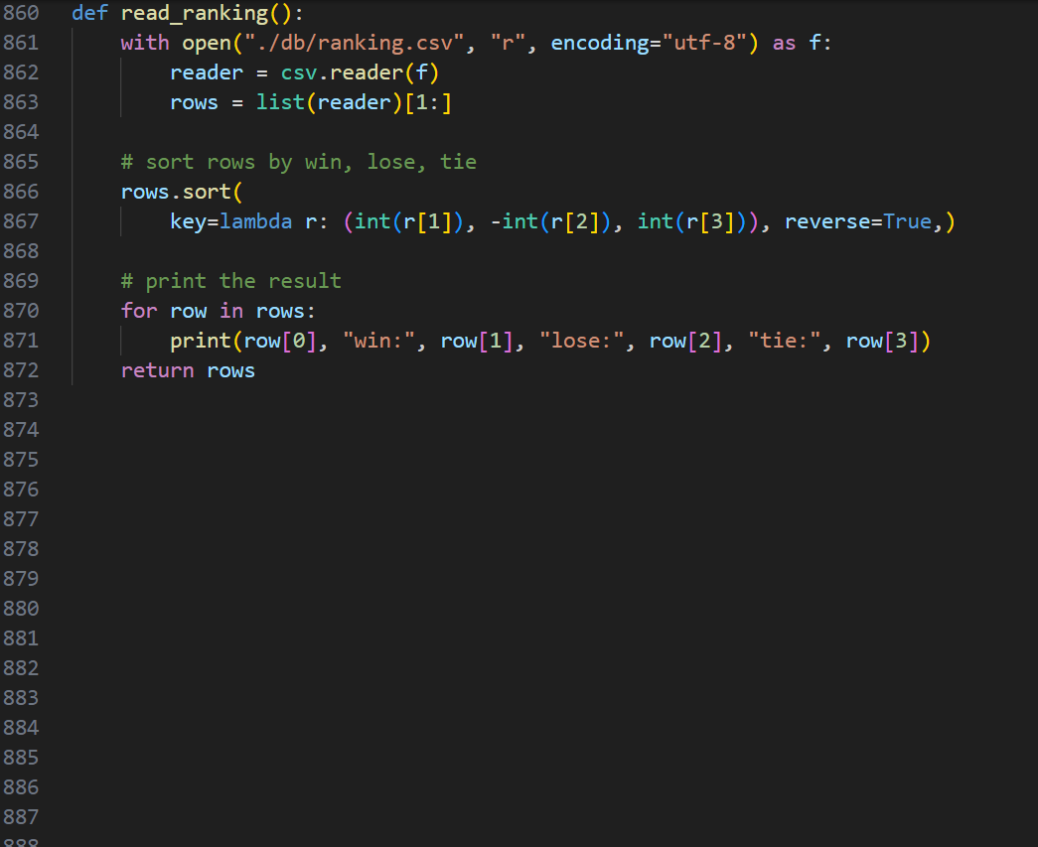
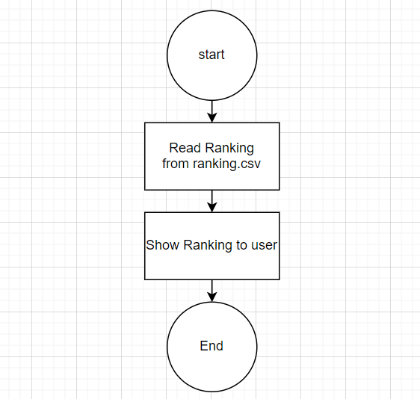
Read ranking.csv and sort it by win, lose, tie. This function reads the rows from "./db/ranking.csv" into a list, sorts the list by win, lose, tie, and prints the sorted result. Print out the ranking

Slide 45
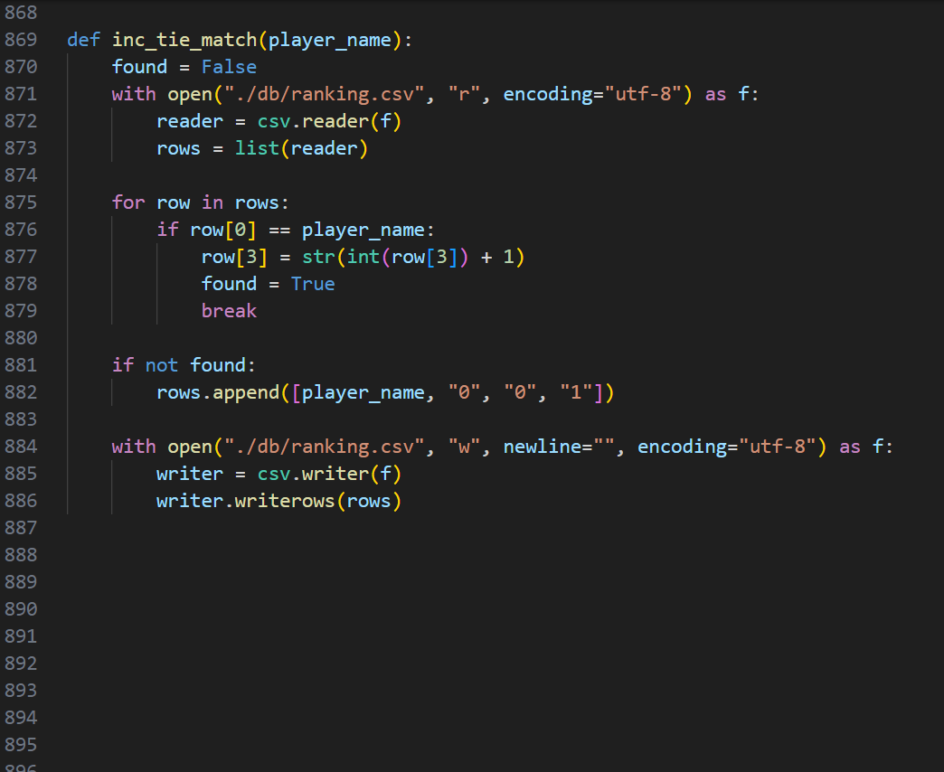
Increment the player's tie count by 1 in the ranking CSV file. This function opens the "./db/ranking.csv" file in read mode, reads the rows into a list, and then searches for the player's name in the rows. If the player's name is found, the function increments the player's tie count by 1. If the player's name is not found, the function appends a new row to the list with the player's name, all other values set to 0, and the tie count set to 1.
Player_name | The name of the player whose tie count should be added

Slide 46

Increment the player's lose count by 1 in the ranking CSV file. This function opens the "./db/ranking.csv" file in read mode, reads the rows into a list, and then searches for the player's name in the rows. If the player's name is found, the function increments the player's lose count by 1. If the player's name is not found, the function appends a new row to the list with the player's name, all other values set to 0, and the lose count set to 1.
Player_name | The name of the player whose lose count should be added

Slide 47

Increment the player's win count by 1 in the ranking CSV file. This function opens the "./db/ranking.csv" file in read mode, reads the rows into a list, and then searches for the player's name in the rows. If the player's name is found, the function increments the player's win count by 1. If the player's name is not found, the function appends a new row to the list with the player's name, all other values set to 0, and the win count set to 1. Check if the python file is run directly Debug + start the tkinter
Player_name | The name of the player whose win count should be added

