Slide 1

Ch3 – Nested loop
Mr. Lee WS

Slide 2
Nested loop
Objective:
  After this lesson:
  You should be able to dry-run a normal nested loop algorithm / pseudocode

Slide 3
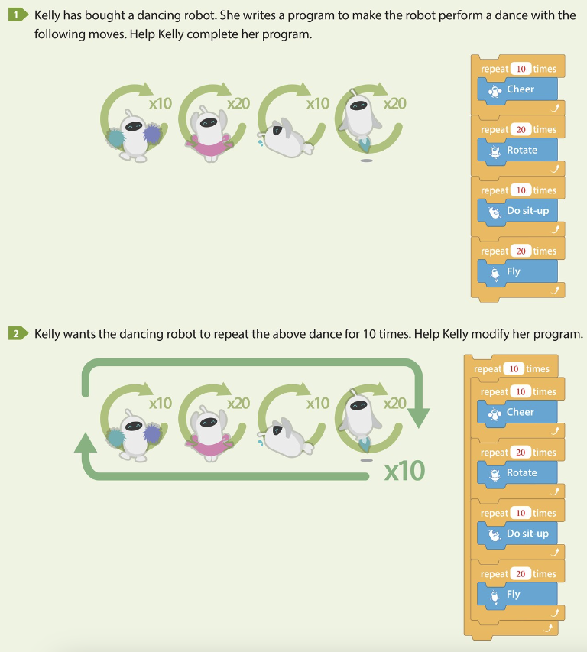
What is the difference between these two algorithms?
Write your answer in Nearpod

Slide 4
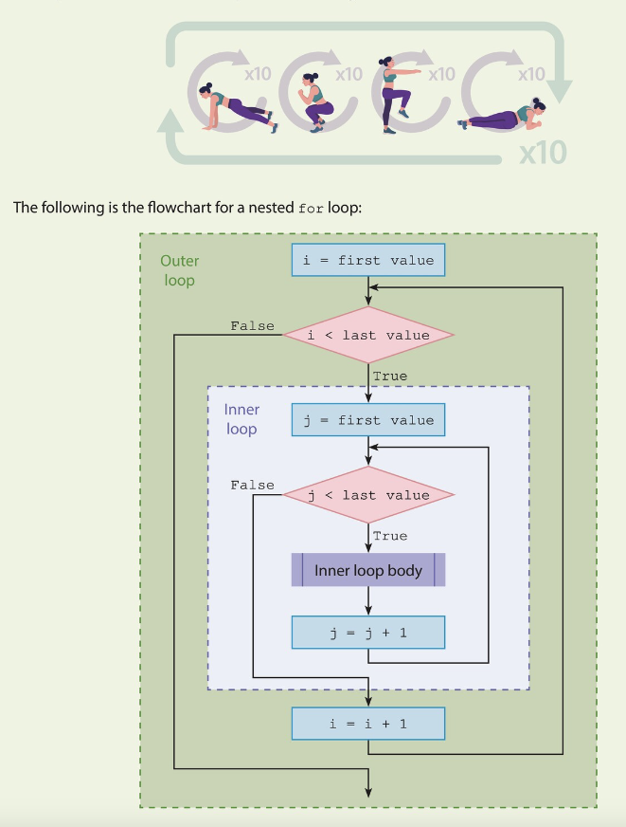
Complicated? Nested loop?

Slide 5
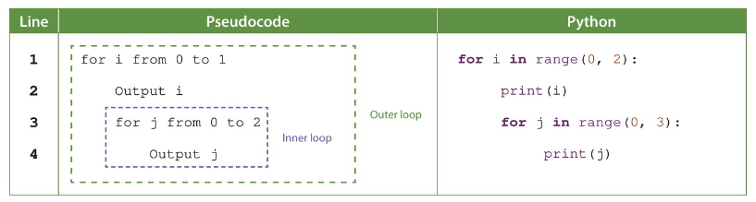
Dry-run this!

Slide 6
How to get the answer?
1. Code it and print the variable in the inner and outer loop
2. Design a dry-run table
3. Write the value next to the variable
4. DON’T just sit and think. Never work!!

Slide 7
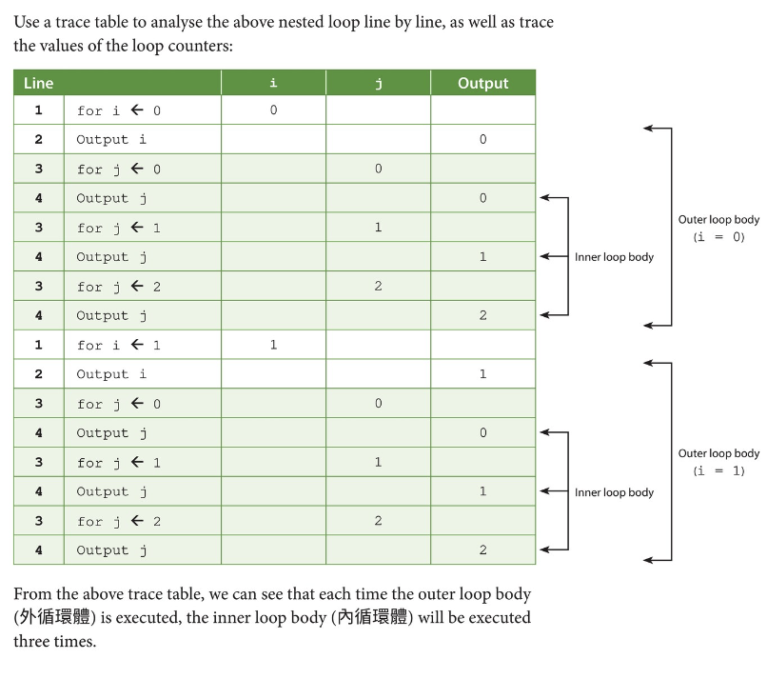
Trace-table

Slide 8
Classwork
See my demo first
OneNote classwork
You can choose the source file according to the level you want to challenge 👍👍👍

