Slide 1
Chapter 3:
Working with Workbooks, Worksheets, and Range Objects

Slide 2
Chapter Objectives
After completing this chapter, you will be able to:
  use the macro recorder to create a VBA program for Excel operation
  manipulate Excel Workbooks, Worksheets, and Range objects programmatically
  make use of Excel Worksheet functions in VBA
  manipulate the following UserForm controls: ComboBox, RefEdit, and MultiPage
  understand Event handler procedures (self-study)

Slide 3
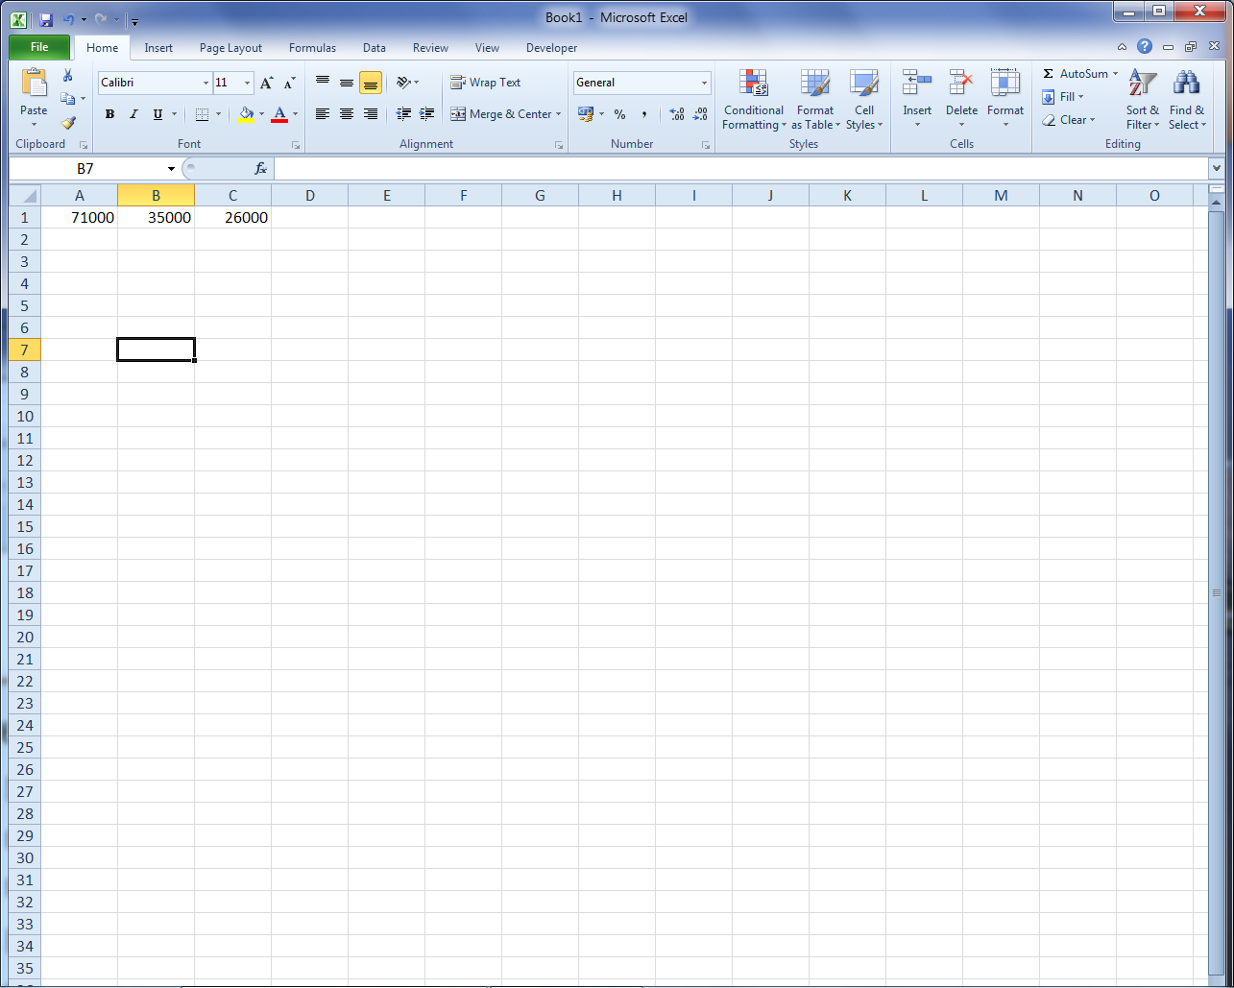
Create A Macro For Excel Operation
Creating a macro using the Macro Recorder
  Macro Recorder is an action recorder that will automatically record the user’s actions on the Excel objects and convert these recorded actions to a VBA macro.
  Example: Create a macro that formats the selected cells as Currency, but without decimal places.
    Entered the following values into cells A1:C1

Slide 4

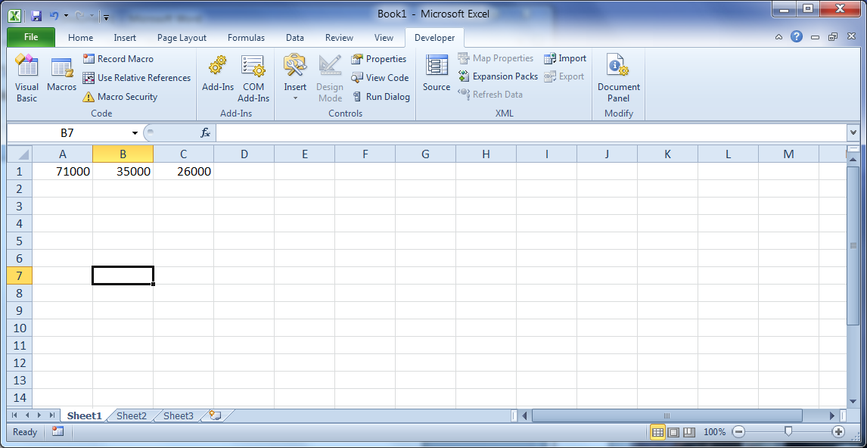
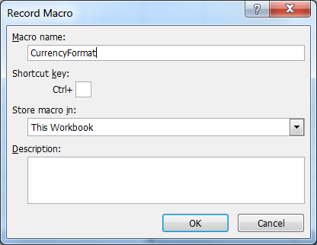
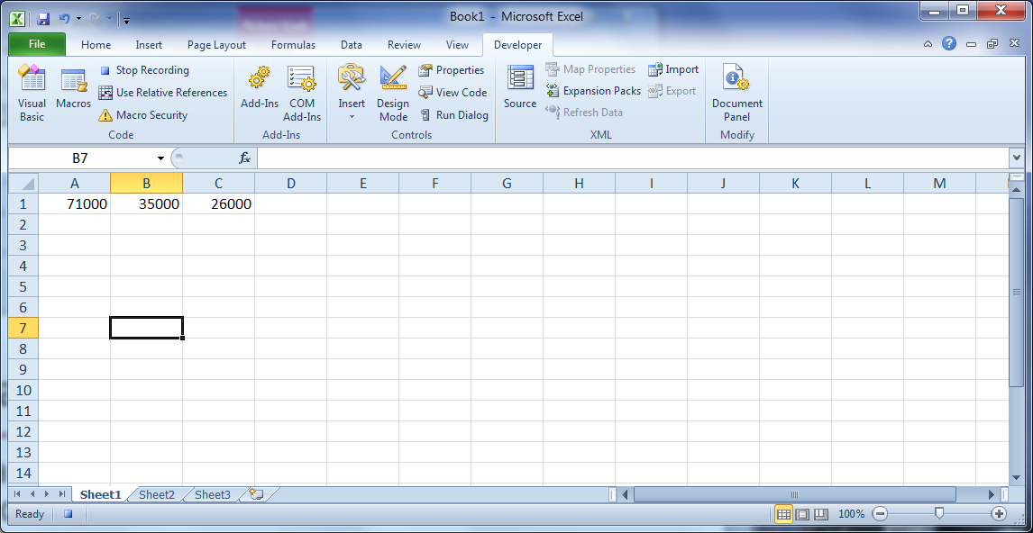
Create A Macro For Excel Operation
Example: Cont’d
    Steps to create a macro:
      Select the cells A1:C1.
      On the status bar or Developer tab, click the Record Macro button.
      Replace the default macro name with CurrencyFormat and then click OK.
      Right-click in the selected range and click Format cells. Make all the necessary changes.
      On the status bar, click the Stop Recording button.
    A macro is created, and you can use it to format any selected cells.

Slide 5
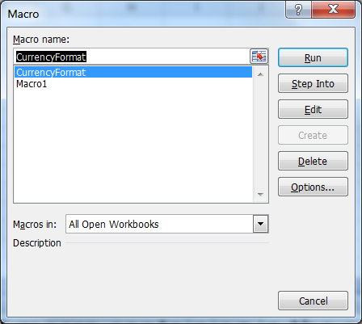
Create A Macro For Excel Operation
Example: Cont’d
  Running a macro
    To run a macro that is contained in the same Workbook:
      From Ribbon, select Developer | Macros.
      Select the name of the macro from the list and then click the Run button.

Slide 6
Introduction To Excel Objects
Example 3.1: CityUCorp operates sales through its branches. The sales manager in the main office needs to generate a sales report daily for the previous day’s sales of all branches. The sales of each branch are stored in a workbook for the branch. There is one worksheet for each sales day. Each record in a worksheet includes the product sold, the price per unit, the number of units sold, and the salesperson’s ID. Each worksheet is named by the date of the respective sales. The columns in each worksheet are identical, but the number of records varies. The number of worksheets in each workbook varies too. The name of the workbooks is in the form of BranchWSales.xlsx, where W is the name of the branch (A-Z).

Slide 7
Introduction To Excel Objects
Example 3.1 (Cont'd): The file SalesReport.xlsm contains an application for the following tasks:
  Allow the user to select one or more sales workbooks for reporting.
  Allow the user to report sales by product or by salesperson based on the sales records from one or more worksheets in each selected workbook.
  Allow the user to decide whether the reports will be saved.
  (The sales records are contained in BranchASales.xlsx, BranchBSales.xlsx, BranchCSales.xlsx, and BranchDSales.xlsx.)

Slide 8
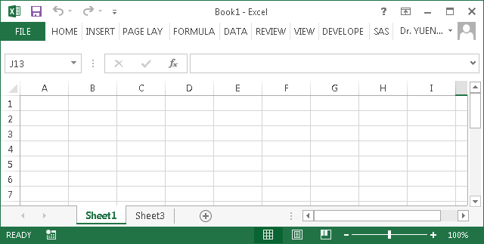
Introduction To Excel Objects
Excel objects hierarchy (Partial)
Application
Workbooks
Application
Windows
Windows
Range
Workbooks
Windows
Worksheets
Range
Chartsheets
Worksheets
Charts
Pivot Tables

Slide 9
Introduction To Excel Objects
Excel Objects are distinguished by:
  Their relationship with other objects (parent and child)
  The properties they possess (properties).
  The things they can do (methods).
  Their responses to certain activities (events).

Slide 10
Introduction To Excel Objects
Application object refers to the host application of Excel.
The application object is at the top of the object hierarchy, and moving down, one can access the objects from Application to Workbook to Worksheet to Range (Cells) and further on.
Different levels of objects are connected with a period (dot)
  Example:
Application.Workbooks("Sales.xlsx").Worksheets(”March").Range(“A1”).Value = _
1000

Slide 11
Introduction To Excel Objects
The Application object is the default Excel object. Excel assumes it even when it is not specified.
  For example, Application.Workbooks.Add and Workbooks.Add will have the same effect as adding a new workbook.
  In most situations, there is no need to specify the Application object explicitly in the VBA code.
  The Application qualifier is required when it is necessary to change the properties of the Excel object as a whole.
    For example:
      Application.DisplayFullScreenProperty = True
  More of the properties and methods of the Application object will be introduced in due course.

Slide 12
Workbooks Object
Referencing Workbook
  The workbooks object is a collection of all opened workbook objects. You can refer to an opened workbook through the Workbooks collection.
  Syntax: Workbooks(Index)
    The index can be the name of the workbook. For examples: Workbooks("book1")
      All newly created workbooks are named in the form of BookX without extension until they are saved.
      Workbooks(“book2.xlsx”), Workbooks(“book3.xlsm”)
    The index can be the index number assigned to the opened workbook by the system.
      The first opened workbook has an index value of 1, and the second opened workbook has an index value of 2, and so on. For example: Workbooks(1)
      If Workbooks(1) is closed, Workbooks(2) becomes Workbook(1), and so forth.
      Use this index number reference with caution.

Slide 13
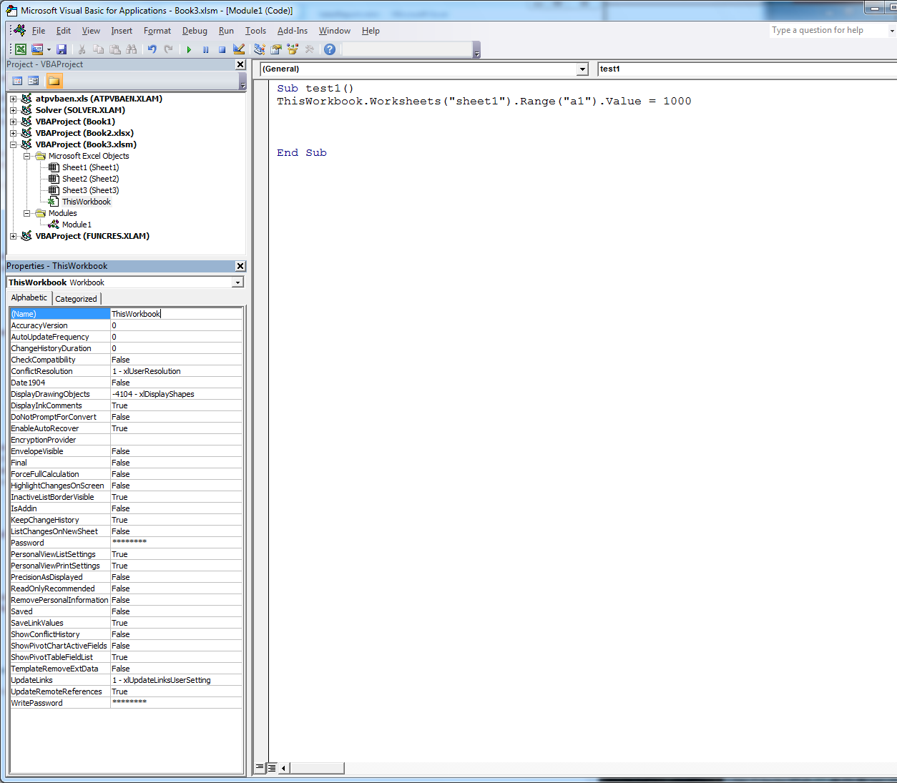
Workbooks Object (Self-Study)
Referencing Workbook
  Code name
    The default code name of a workbook is ThisWorkbook.
      Do not confuse this with the ThisWorkbook object. See the later discussion.
    To change the code name, select ThisWorkbook module from the Project Explorer window and change the Name property.
    Cannot use code name to refer to another workbook from a running procedure.

Slide 14
Workbooks Object
Referencing Workbook
  ThisWorkbook object
    Refers to the workbook containing the running code.
  ActiveWorkbook object
    Refers to the workbook in the active window. It may or may not contain the running code.
    There can only be one active workbook for the Excel application.
  Workbook object variable
    Assigns a Workbook object to a variable. The variable can then be referred to as the assigned workbook.
    Syntax
    Dim workbookvariable as Workbook
      Set workbookvariable = workbookobject

Slide 15
Workbooks Object
Some commonly used Workbooks methods
  Activate
    Activate the window associated with the workbook. Place the activated workbook on top of the others.
    E.g., Workbooks("Book3.xlsx").Activate
  Add
    Creates a new workbook in another window.
    A newly added workbook becomes the active workbook by default.
    E.g., Workbooks.Add
  Open
    Opens an existing workbook in another window.
    Syntax:
  Workbooks.Open Filename:= "filename.xlsx_with_full_path"
    A newly opened workbook becomes an active workbook by default.

Slide 16
Workbooks Object
Some commonly used workbooks methods
  Save
    Saves an opened workbook without changing its name and path.
    E.g., ActiveWorkbook.Save, ThisWorkbook.Save.
  SaveAs
    Saves an opened workbook with a new name and path.
    Syntax:
      Workbookobject.SaveAs Filename:= "full_path\filename" _
    [, FileFormat:= formattype ]
      Default formattype is xlsx type.
    Examples:
    ThisWorkbook.SaveAs Filename:= "c:\myexcelfile.xlsx"
    ActiveWorkbook.SaveAs Filename:= "c:\myexcelfile”
    workbookvariable.SaveAs Filename:= "c:\myexcelfile”
    ThisWorkbook.SaveAs Filename:= "c:\myexcelfile”, _
    FileFormat:= xlOpenXMLWorkbookMacroEnabled

Slide 17
Workbooks Object
Some commonly used workbooks methods
  Close
    Closes an opened workbook. Syntax:
    workbookobject.Close [Savechanges := True / False]
    For examples:
  Workbooks("mybook.xlsx").Close Savechanges := True
  ThisWorkbook.Close Savechanges := False
  ActiveWorkbook.Close Savechanges := True
  workbookvariable.Close Savechanges := True
    If the Savechanges argument is not provided, Excel will prompt to confirm whether to save the workbook if the workbook has been modified in any way but not yet been saved before the execution of the Close statement either by using the Save method, or the SaveAS method, or manually.

Slide 18
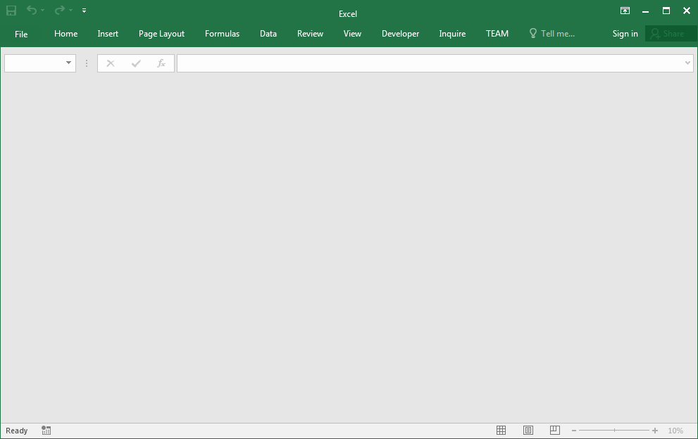
Workbooks Object
Some commonly used workbooks methods
  Closing the only opened workbook will leave behind an empty Workbook container.
  Use Application.Quit method to close the only opened workbook after saving it (if appropriate). Be aware that the Quit method closes all opened Workbooks, and prompts to confirm saving for each one as needed.

Slide 19
Workbooks Object
Some commonly used workbooks methods
  Example 3.2A: Saving a workbook under a new path and new name. Consider the Userform1 in WorkbookDemo1.xlsm.

Slide 20
Workbooks Object
Some commonly used workbooks methods
  Example 3.2B: Using standard Open and Save As dialogue boxes for getting a file name, including the path. Consider the Userform2 in WorkbookDemo1.xlsm.

Slide 21
Workbooks Object
Some commonly used workbooks methods
  Example 3.2c: Replacing an existing file without warning from the system. Consider the Userform3 in WorkbookDemo1.xlsm.

Slide 22
Workbooks Object
Some commonly used Workbooks properties
  Name
    Returns the name of a workbook.
    E.g., VBA.MsgBox ThisWorkbook.Name
  VBA.MsgBox ActiveWorkbook.Name
  VBA.MsgBox Workbooks("MyBook.xlsx").Name
  VBA.MsgBox workbookvariable.Name
    You cannot use this property to change the name of a workbook.
  Path
    Returns the path of a workbook.
    E.g., VBA.MsgBox ThisWorkbook.Path
  VBA.MsgBox ActiveWorkbook.Path
  VBA.MsgBox Workbooks(“MyBook.xlsx”).Path
  VBA.MsgBox workbookvariable.Path
    You cannot use this property to change the path of a workbook.

Slide 23
Workbooks Object
Some commonly used Workbooks properties
  Count
    Returns the number of opened workbooks.
  Windows(index)
    Each workbook has its window (single document interface).
      The same workbook can be opened in more than one window. (At Ribbon, Click View | New Window)
    Windows property represents all the windows of the specified workbook.
    Windows property controls the appearance of a window, such as visibility, caption, scroll bars, size etc.

Slide 24
Workbooks Object
Some commonly used Workbooks properties
  Windows(index)
    Use workbookobject.Windows(index) for referring to the concerned window, where the index is the index number or the caption of the window.
      For the active window of the specified workbook, the index equals 1. The index of the preceding active window of the specified workbook equals 2, and so forth.
      The caption is the name that appears in the window’s title bar. E.g., "My new caption" is the caption of the window.

Slide 25
Workbooks Object
Some commonly used Workbooks properties
  Windows(index).Caption
    Returns the name that appears in the title bar of the specified window
      E.g., ActiveWorkbook.Windows(1).Caption = “New Caption”
      E.g., VBA.MsgBox "Name of the workbook is " _
      & ActiveWorkbook.Name & VBA.vbCrLf _
      & "Title of the window is ” _
      & ActiveWorkbook.Windows(1).Caption

Slide 26
Workbooks Object
Some commonly used Workbook properties
  Windows(index).Visible
    Set the visibility of a window. Syntax:
      workbookobject.Windows(index).Visible = True / False
    An invisible window can only become visible when the Visible property of the window is set to True programmatically, or by clicking the Unhide button on the View tab.
    An invisible workbook is not an active workbook by default. It can be activated programmatically. A re-visible workbook is an active workbook by default.
    The contents of an invisible workbook can be accessed via the usual object reference.
    A saved and closed workbook in an invisible window will still be invisible when the workbook is opened again.

Slide 27
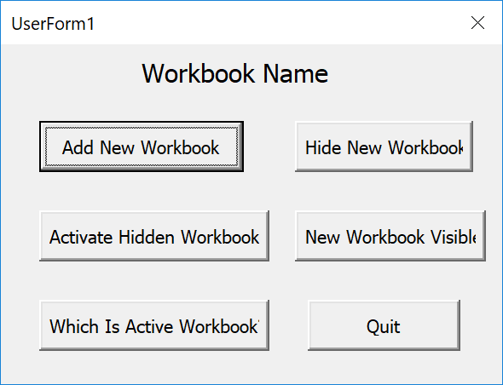
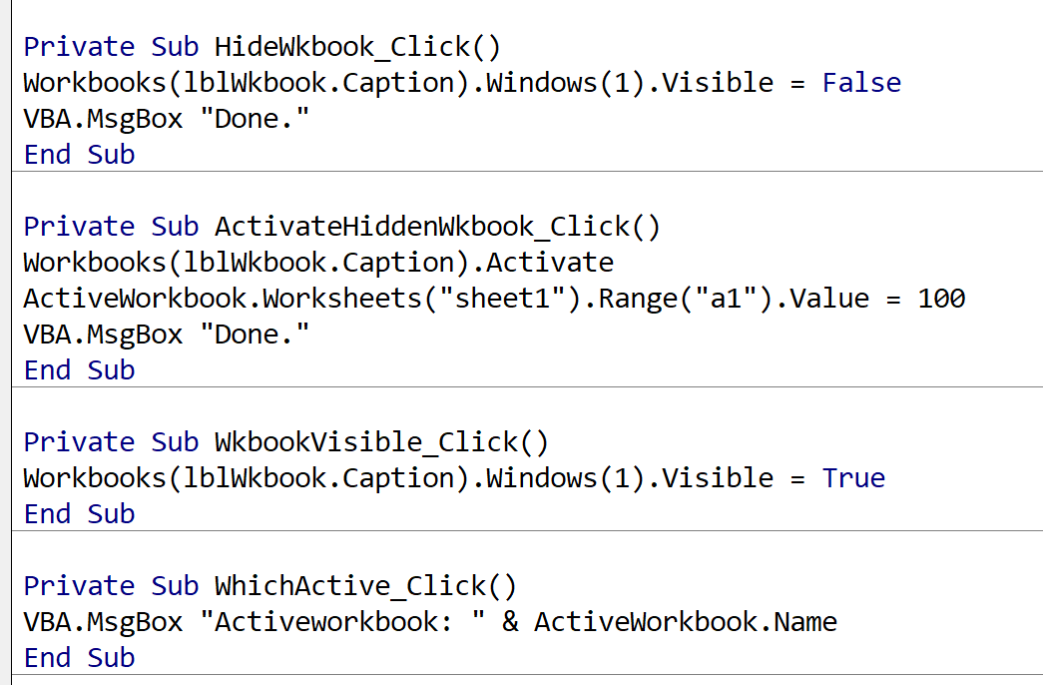
Workbooks Object
Some commonly used Workbook properties
  Windows(index).Visible
    Making the only opened workbook invisible will leave behind an empty Workbook container.
      Set property Application.Visible = False / True for making all opened workbooks invisible or visible. Apply this property setting with care.
    Example 3.3: Consider the Userform1 in WindowsDemo.xlsm.

Slide 28
Workbooks Object
Example 3.4: Recall the Initialize event of frmSalesReport in Example 3.1: Ask user to select a folder containing all the sales data files.

Slide 29
Workbooks Object
Example 3.4: (Cont'd) List all BranchWSales.xlsx sales data files in a ListBox control.

Slide 30
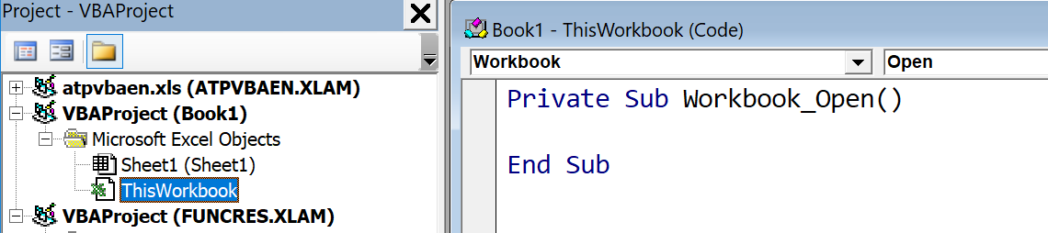
Workbooks Object (Self-Study)
Workbook_Open event of ThisWorkbook object
  To be trigged immediately when the workbook is opened.
  Example: Type the following statements in the code window of ThisWorkbook object:
Private Sub Workbook_Open()
'Display a greeting message.
VBA.MsgBox "Welcome user " & Application.UserName & ".", _
Buttons:=vbOKOnly, Title:="Greeting"
End Sub

Slide 31
Workbooks object (Self-Study)
  Workbook_BeforeClose event of ThisWorkbook object
    To be trigged before the workbook is closed.
    Example: Type the following statements in the code window of the ThisWorkbook object:
Private Sub Workbook_BeforeClose(Cancel As Boolean)
If ThisWorkbook.Name <> "abc.xlsm" Then
Cancel = True 'Stop the Close event
VBA.MsgBox "Must save this workbook as abc.xlsm."
Else
Cancel = False 'Default value
End If
End Sub

Slide 32
Worksheets Object
Worksheets collection
  A Worksheets object is a collection of all Worksheet objects in a workbook. Each Worksheet object represents a worksheet.
Charts collection
  A Charts object is a collection of all chart sheets in a workbook.
Sheets collection
  A Sheets object is a collection of all types of sheets in a workbook, including chart sheets and worksheets.
In most situations, the Sheets object and Worksheets object can be used interchangeably in VBA.

Slide 33
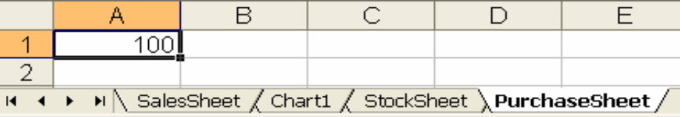
Worksheets Object
Referencing a Worksheet object
  You can refer to a worksheet in an active workbook through the Worksheets collection.
  Syntax: Worksheets(Index)
    The index can be the tab name of a worksheet. For example: Worksheets(“PurchaseSheet”)
    The index can be the index number assigned by the system to a worksheet according to its listed position. The first listed worksheet has an index of 1, and so on.
      Chart sheets are not indexed under the indexing of worksheets.
      If Worksheets(1) is removed, then Worksheets(2) becomes Worksheets(1), and so forth. Use index number reference with caution.
Index 1
Index 2
Index 3

Slide 34
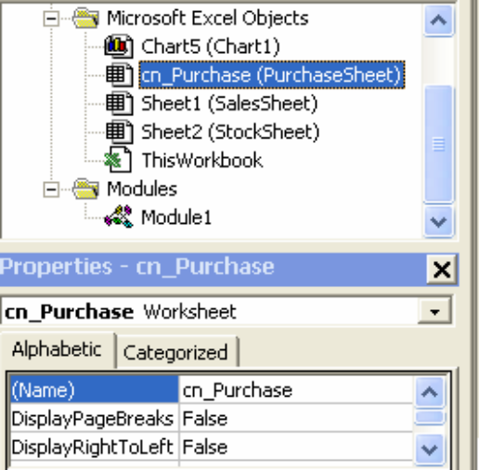
Worksheets Object (Self-Study)
Referencing Worksheet
  Code name
    It can only be set through the property window in VB Editor at design time or programmatically.
    The user cannot change the code name if the VB editor is protected.
    Changing the Tab name will not affect the code name or vice versa.
    The worksheet can still be deleted by the user unless the workbook structure is protected.
    You cannot use a code name to refer to a worksheet in another workbook from a running procedure.

Slide 35
Worksheets Object
Referencing Worksheet
  ActiveSheet
    Refers to the active workbook’s active worksheet (or chart sheet).
    ActiveWorksheet object does not exist.
  Worksheet variable
    Example:
    'Define a variable that refers to a Worksheet object
    Dim wbkNewSheet as Worksheet
    'Assign worksheet "Purchase" in the active workbook to wbkNewSheet
    Set wbkNewSheet = Worksheets("purchase")
    The Sheet object type does not exist in the Dim statement.

Slide 36
Worksheets Object
Some commonly used worksheets properties
  Name
    Returns or sets the Tab name of a worksheet.
      Example: Worksheets("OldName").Name = "NewName"
      Example: MsgBox ActiveSheet.Name
  Visible
    Sets the visibility of a worksheet.
    Syntax:
    worksheetobject.Visible = value
      where value = xlSheetHidden, xlSheetVeryHidden, or xlSheetVisible.
      A workbook must have at least one worksheet visible at any time.
      A programmatically visible worksheet is not the active worksheet of the workbook.
  Count
    Returns an integer that equals the number of worksheets (exclude Chart sheets) in the referred workbook.
    Example: MsgBox Worksheets.Count

Slide 37
Worksheets Object
Some commonly used worksheets methods
  Add
    Adds a worksheet to the referred workbook.
    A newly added worksheet is the active worksheet of the referred workbook by default.
    A newly added worksheet is inserted before the current active sheet of the referred workbook by default.
    Can include appropriate argument (Before or After) to specify the position of the newly added worksheet.
      Example: Add a worksheet to the end of the existing list of worksheets
      Worksheets.Add After:= Worksheets(Worksheets.count)

Slide 38
Worksheets Object
Some commonly used worksheets methods
  Delete
    Deletes a worksheet of the referred workbook.
    Example: ActiveSheet.Delete
      By default, Excel will prompt the user for confirming the deletion of a worksheet. To delete a worksheet without such prompt, execute the following statement before the action: Application.DisplayAlerts = False
  Activate
    Makes the specified worksheet the active sheet of the referred workbook
    Example: Worksheets("sheet2").Activate
    A hidden worksheet can still be activated and referred as the Activesheet.

Slide 39
Worksheets Object
Some commonly used worksheets methods
  Copy
    Copies the specified worksheet to another location.
    Syntax:
      worksheetsource.Copy [newposition := location]
      worksheetsource is the worksheet object to be copied.
      newposition equals to either Before or After.
      location is the worksheet object before or after which the copied worksheet will be placed. It could be a worksheet in another workbook.
      If newposition argument is not provided, a new workbook is created.
    E.g.: Copy Sheet1, placing the copy after Sheet3.
    Worksheets("sheet1").Copy after:= Worksheets("sheet3")

Slide 40
Worksheets Object
Some commonly used worksheets methods
  Move
    Moves the specified worksheet to another location.
    Syntax:
      worksheetsource.Move [newposition := location]
    The syntax is similar to that of Copy method.
    If newposition argument is not provided, a new workbook is created.

Slide 41
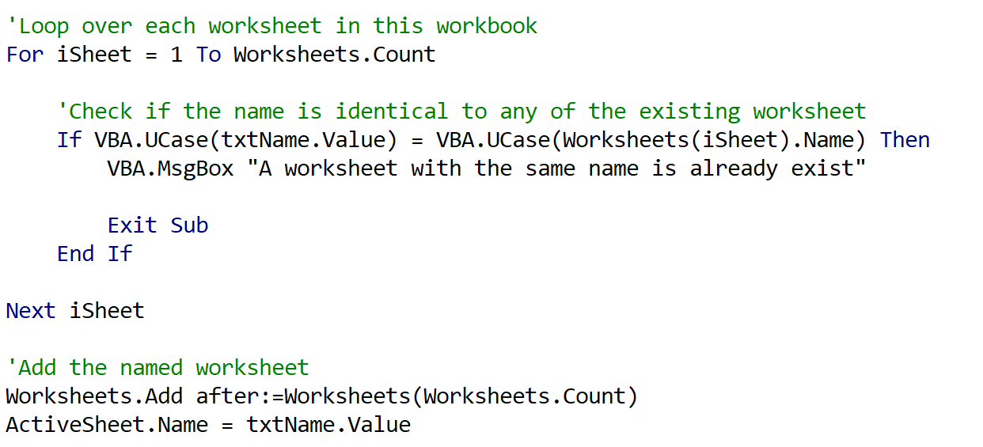
Worksheets Object
Some commonly used worksheets methods
  Example 3.5: Add a named worksheet at the end of all worksheets. The name of the added worksheet must not be identical to the existing one. Refer to WorksheetsAdd.xlsm
    Partial code:

Slide 42
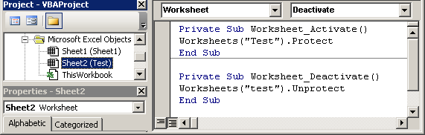
Worksheets Events (Self-Study)
Worksheet_Activate (_Deactivate) event
  To be run when the associated worksheet is being activated (or deactivated).
  Each worksheet has its own set of events.
  Example: To protect (unprotect) the content of the worksheet Test programmatically.

Slide 43
Worksheets Object
Referring to a worksheet in any opened workbook
  To access a worksheet object of a workbook object (active or not), the corresponding workbook reference must be included in the worksheet reference.
  Examples:
    ThisWorkbook.Worksheets("sheet1").Activate
    ActiveWorkbook.ActiveSheet.Delete
    Workbooks("Book2.xlsx").Worksheets.Add
    Workbooks("Book2.xlsx").Worksheets("sheet2").Visible = _
    xlSheetHidden
    VBA.MsgBox Workbooks("Book2.xlsx").Worksheets.Count
    Workbooks("Book1.xlsx").Worksheets("sheet1").Copy After := _ Workbooks("Book2.xlsx").Worksheets("sheet3")
    Set worksheetvariable = ActiveWorkbook.Worksheets("purchase")

Slide 44
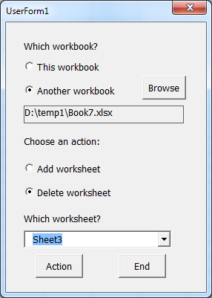
Worksheets Object
Example 3.6: WorksheetsDemo1.xlsm contains an application that allows the user to delete a worksheet from a selected workbook or to add a new worksheet to a selected workbook.

Slide 45
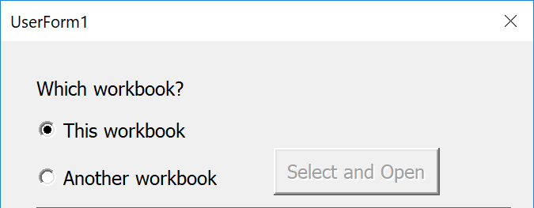
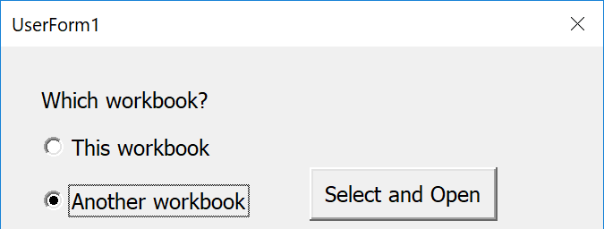
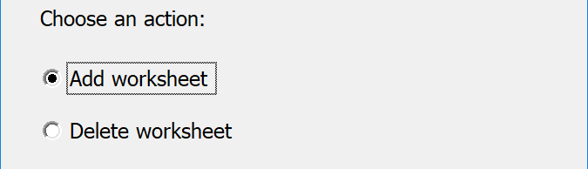
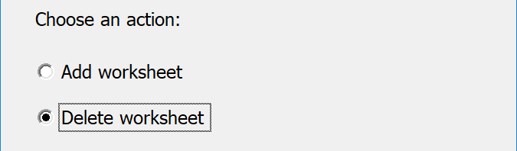
Worksheets Object
Example 3.6: Cont'd. When an Optionbutton is selected (clicked), the respective Click event is triggered.
optThisWkbook_Click event
optOtherWkbook_Click event
optAdd_Click event
optDelete_Click event

Slide 46
Worksheets Object
ComboBox Control
  It displays a list of items in a drop-down box.
  Only a single item can be selected.
  It also allows the user to enter texts like a TextBox control.
    If the entered texts match one of the items in the list, the item will be selected automatically.
      Set Style property to:
        fmstyleDropDownCombo for allowing text entry.
        fmstyleDropDownList for not allowing text entry.

Slide 47
Worksheets Object
ComboBox Control
  Value property returns a string that contains the text in the textbox.
    When text entry is not allowed, the Value property can only be "" or contain the selected item’s text.
  ListIndex property returns an integer representing the position of the currently selected item.
    Value of ListIndex range from -1 to the number of items in the list - 1.
      -1 indicates no item is selected or the entered text does not match any one of the items in the list
      0 indicates the first item is selected, 1 indicates the second item is selected etc.
  Methods, such as AddItem, Clear, and RemoveItem etc., and properties, such as List, and ListCount etc, are similar to those of a ListBox control.

Slide 48
Worksheets Object
ComboBox Control
  Example 3.6 (Cont'd).
    Partial code of optDelete Click event:
    …
    If optThisWkbook.Value = True Then
    'Display the list of worksheets in this workbook
    For Each wksheet In ThisWorkbook.Worksheets
    cbxWksheet.AddItem wksheet.Name
    Next wksheet
    …
    End If
    …

Slide 49
Worksheets Object
ComboBox Control
  Example 3.6 (Cont'd).
    Partial code of cmdAction Click event:
    …
    If optAdd.Value = True Then
    If optThisWkbook.Value = True Or lblWorkbook.Caption <> "" Then
    'Add a new worksheet to theWkbook object
    theWkbook.Worksheets.Add
    VBA.MsgBox "A worksheet is added."
    …
    End If
    ...

Slide 50
Worksheets Object
ComboBox Control
  Example 3.6 (Cont'd).
      Partial code of cmdAction Click event:
    …
  If optDelete.Value = True Then
  If optThisWkbook.Value = True Or lblWorkbook.Caption <> "" Then
  If cbxWksheet.ListIndex > -1 Then
  'Delete the selected worksheet in theWkbook
  theWkbook.Worksheets(cbxWksheet.Value).Delete
  VBA.MsgBox "The worksheet is deleted."
  …

Slide 51
Range Object
Referring to cells in the active worksheet
  Range object represents a cell or a group of cells in the active worksheet.
  Range object in the active worksheet of the active workbook can be referred to as:
    Range("A1")
    Range("A1","B10") , or equivalently Range("A1:B10")
    Range ("A1, B2, C4"), Range ("A1:B2, A9:B10")
    Range("rangename")
    Range(rangeaddress_var)
    Selection
    ActiveCell
      ActiveCell is a single cell inside a Selection. The Selection may contain more than 1 cell, but only one is the ActiveCell.
    An object variable. For example:
      Dim objectvariable as Range
      Set objectvariable = Range("A1", "A10”)

Slide 52
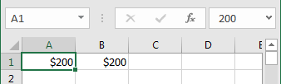
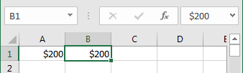
Range Object
Some commonly used Range properties
  Value property
    It holds the value of the referred cell.
    E.g. cvalue = Range("A1").Value
      Range("A1").Value = cvalue
      ActiveCell.Value =100
      Range("A1","A10").Value =100. 'Assign a constant to all cells
      Selection.Value = 100
    Value is the default property of a Range object. It can be omitted but not recommended.
    Value property returns a numeric or a character type, depending on the content of the referred cell. For example, returns from Range("A1").Value and Range("B1").Value are not the same type.
numeric
character

Slide 53
Range Object
Some commonly used Range properties
  Offset property
    It returns a cell located at the specified offset from the referred cell.
    Syntax:
      rangeobject.Offset(rowoffset, columnoffset)
        rowoffset – number of rows by which the range is to be offset. Positive values are offset downward. Negative values are offset upward.
        columnoffset – number of columns by which the range is to be offset. Positive values are offset to the right. Negative values are offset to the left.
        It cannot offset beyond the boundary of the worksheet.

Slide 54
Range Object
Some commonly used Range properties
  Offset property
    Examples:
      Range("A5").Offset(2,3) returns a cell at 2 rows down from A5, and 3 columns to the right, i.e. cell D7.
      Range("A5").Offset(2,3).Value = 100 is equivalent to Range("D7").Value = 100.
      Range("A1","C3").Offset(1,1).Value = 100 is equivalent to Range("B2","D4").Value = 100.
      Range(Range("A1").Offset(1,1) , Range("A1").Offset(3,3)) is equivalent to Range("B2" , "D4").
    Since the rowoffset and columnoffset are both numeric, it is convenient using Offset to loop over a group of cells one by one.

Slide 55
Range Object
Some commonly used Range properties
  End property
    It returns the first nonempty cell from the referred cell to the left or right in the source row, or the above or below in the source column that is either preceded or followed by a blank cell.
    If no cell is occupied, it returns the very beginning or end of the source row or the very top or bottom of the source column, depending on the direction of the argument.
    Syntax
      rangeobject.End(direction)
      The direction takes one of the four values: xlDown, xlUp, xlToLeft, or xlToRight.
      They are equivalent to pressing End|Down Arrow, End|Up Arrow, End|Left Arrow, or End|Right Arrow, respectively, for moving the cell cursor in a worksheet.

Slide 56
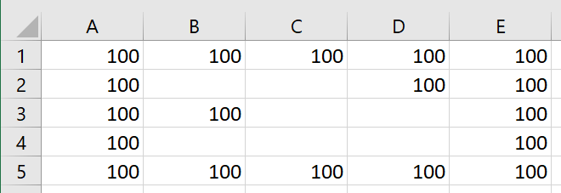
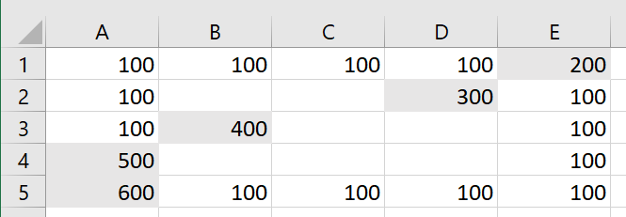
Range Object
Some commonly used Range properties
  End property
    For examples:
    Range("a1").End(xlToRight).Value = 200
    Range("a2").End(xlToRight).Value = 300
    Range("a3").End(xlToRight).Value = 400
    Range("e4").End(xlToLeft).Value = 500
    Range("e1").End(xlDown).End(xlToLeft) = 600

Slide 57
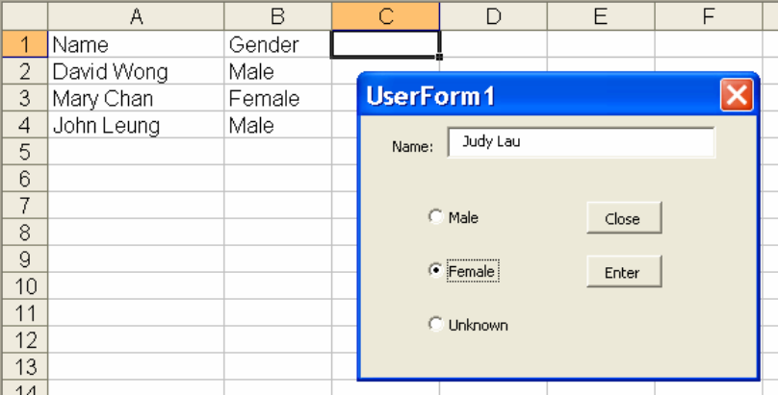
Range Object
Some commonly used Range properties
  Example 3.7: RangeDemo1.xlsm contains a UserForm that collects user-entered name and gender information. Provided information at run time is added to the bottom of a list in the active worksheet.

Slide 58
Range Object
Some commonly used Range properties
  Example 3.7 (Cont'd): Partial code of CommandButton cmdEnter Click event
    'Enter name to the last of column A
    Range("a1048576").End(xlUp).Offset(1, 0).Value = tbxName.Value
    'Enter the subject's gender to the last of column B
    If optMale.Value = True Then
    Range("b1048576").End(xlUp).Offset(1, 0).Value = "Male"
    ElseIf optFemale.Value = True Then
    Range("b1048576").End(xlUp).Offset(1, 0).Value = "Female"
    Else
    Range("b1048576").End(xlUp).Offset(1, 0).Value = "Unknown"
    End If

Slide 59
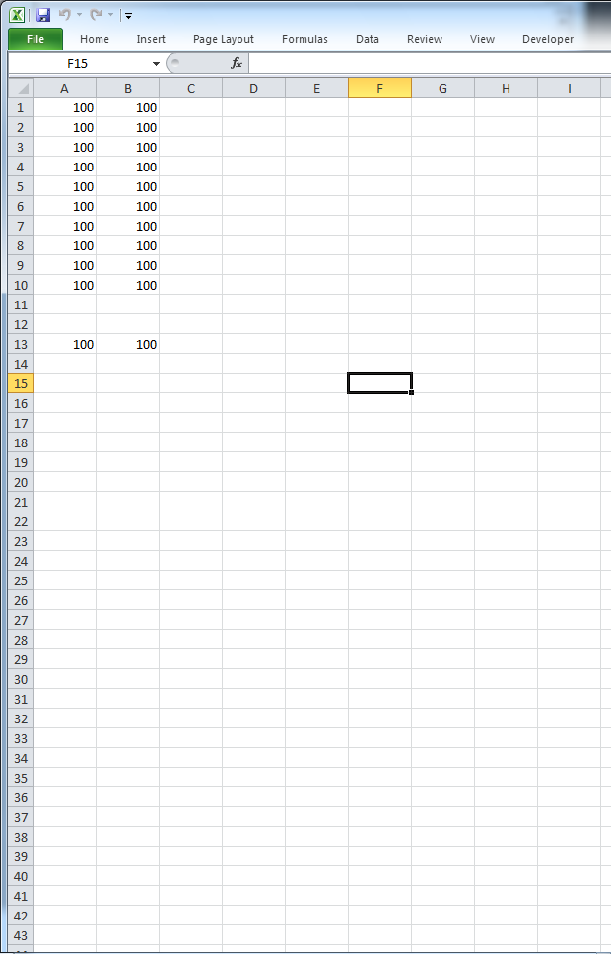
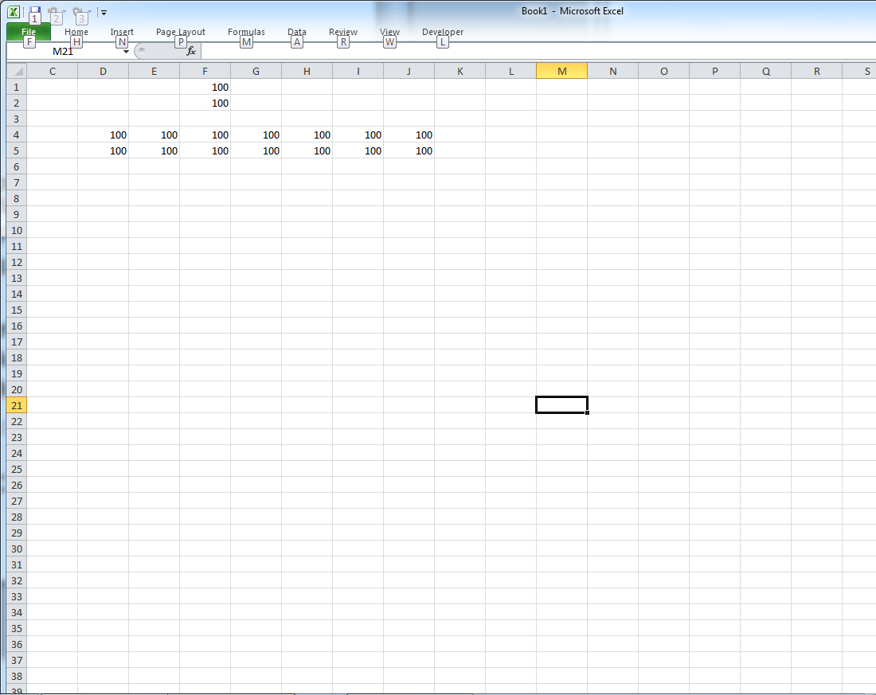
Range Object
Some commonly used Range properties
  Rows property
    Returns a range object that represents a row of cells or all rows of cells in the specified range.
      E.g. Range("A11", "B21").Rows(3).Value = 100
      E.g. Range("A1", "B10").Rows.Value =100
  Columns property.
    Similar to Rows property but refers to the columns.
      E.g. Range("D1", "J2").Columns(3).Value = 100
      E.g. Range("D4", "J5").Columns.Value=100

Slide 60
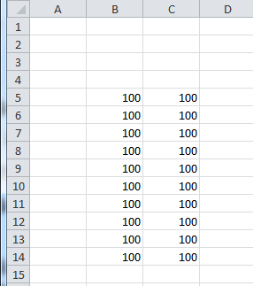
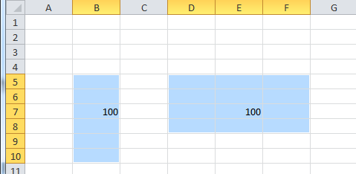
Range Object
Some commonly used Range properties
  Cells property
    It returns a range object that represents all the cells in the specified range if it is used without an index.
      E.g., Range ("B5:C14").Cells.Value = 100
      This is equivalent to Range("B5:C14").Value=100
    It returns a range object that represents a specified cell if it is used with an index, in the form of Cells(index) or Cells(rowindex, columnindex).
      Examples:
      Range("B5" , "B10").Cells(3).Value = 100
      Range("D5" , "F8").Cells(3,2).Value =100
      Range("D5" , "F8").Cells(8).Value = 100

Slide 61
Range Object
Some commonly used Range properties
  Cells property
    The Cells property is also a property of the Worksheets object. It works just like a Range object. Both have similar properties and methods.
    In most statements, the Range object may be replaced by the Cells object.
      You cannot declare a Cells object variable in the Dim statement
      Range indexes may include multiple cells, whereas the Cells indexes only refer to a single cell.
    For examples:
      Worksheets(1).Cells(2,1).Value = 100 Worksheets(1).Range("A2").Value = 100
      Worksheets(1).Cells(100).Value = 100
      Worksheets(1).Range("OJ1”).Value = 100

Slide 62
Range Object
Some commonly used Range properties
  Cells property
    Sometimes it is more convenient to use Cells than Range for a single cell reference.
    For example, one can loop through a set of cells of the active worksheet quickly using the Cells property:
      For iYear = 1 To 5
      Cells(1, iYear).Value = 2000 + iYear
      'Range("A1").Offset(0, iYear-1).Value = 2000 + iYear
      Next iYear

Slide 63
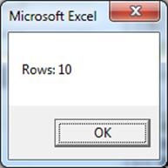
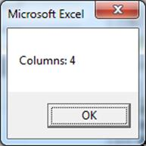
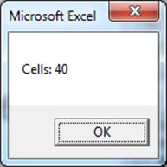
Range Object
Some commonly used Range properties
  Count property
    It returns the number of cells (rows, columns, or cells) within the specified range of cells.
    Examples:
      VBA.Msgbox "Rows: " & Range("a1" , "d10").Rows.Count
      VBA.Msgbox "Columns: " & Range("a1" , "d10").Columns.Count
      VBA.Msgbox "Cells: " & Range("a1" , "d10").Cells.Count

Slide 64
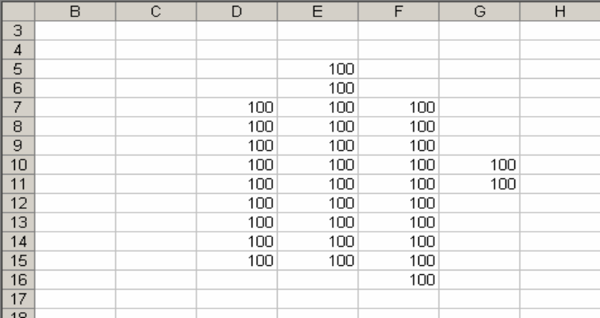
Range Object
Some commonly used Range properties
  CurrentRegion property
    Returns a range object that includes a block of cells containing the specified range object. It is the smallest rectangular block of cells that an empty row and an empty column of cells can surround.
    E.g. vba.Msgbox Range("D5").CurrentRegion.Rows.Count

Slide 65
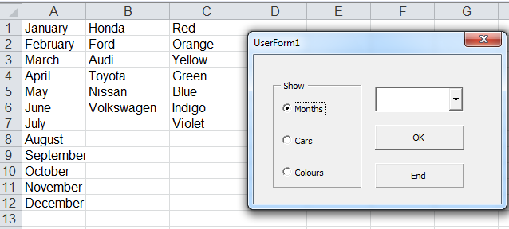
Range Object
Some commonly used Range properties
  Example 3.8: RangeDemo3.xlsm contains a UserForm that displays a list according to the user's selection from a group of Option buttons.

Slide 66
Range Object
Some commonly used Range properties
  Example 3.8 (Cont'd)
    Partial Code of OptionButton optMonths Click event:
  …
  'Clear the existing items in the Combobox
  cbxItems.Clear
  'Add items to the list of the ComboBox
  For iRow = 1 To Range("a1", Range("a1").End(xlDown)).Rows.Count
  cbxItems.AddItem Range("a1").Offset(iRow - 1, 0).Value
  Next iRow
  …

Slide 67
Range Object
Some commonly used Range properties
      Example 3.8 (Cont'd)
        Partial code of button cmbOk Click event:
    …
    'Display the selected item in a message box
    If cbxItems.ListIndex > -1 Then
    VBA.MsgBox "Item selected: " & cbxItems.ListIndex + 1 & " - " & _
    cbxItems.Value
    Else
    VBA.MsgBox "No selected item."
    End If
    …

Slide 68
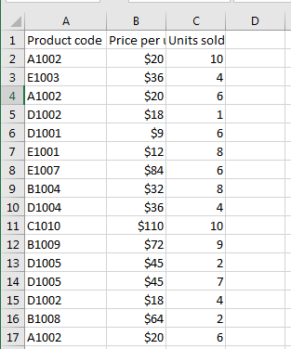
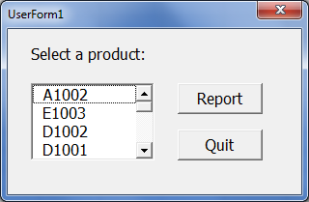
Range Object
Some commonly used Range properties
  Example 3.9: Populate a ListBox with unique values in a Range of cells. Refer to PopulateListBox1.xlsm.

Slide 69
Range Object
Some commonly used Range properties
  Example 3.9: Cont’d
    Partial Pseudocode in UserForm_Initialize event
      Repeat for each cell in the Product Code column, starting from row 2
      Set the value of the Match Found indicator to 0
      Repeat for each item in the product ListBox
      If current cell value = current item text then
      Set the value of the Match Found indicator to 1
      Exit this repetition
      End If
      End Repeat item in ListBox
      If the value of the Match Found indicator equals 0 then
      Add the current cell value to product ListBox
      End If
      End Repeat cell in Product Code column

Slide 70
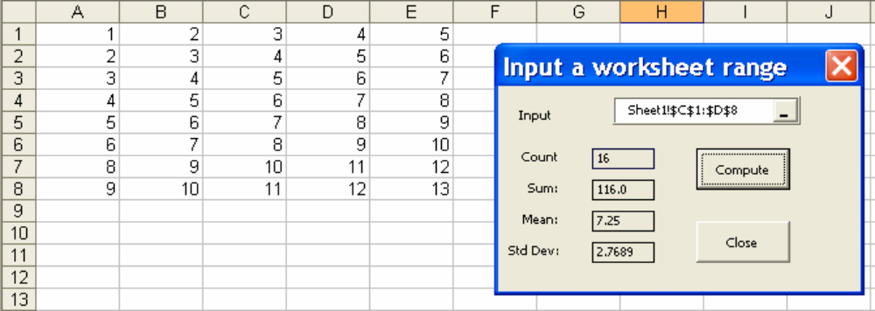
Range Object
Some commonly used Range properties
  Example 3.10: RangeDemo2.xlsm contains an application that allows the user to select a range of cells from a worksheet and then displays the respective statistics.

Slide 71
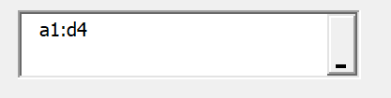
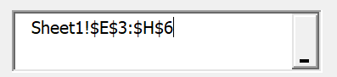
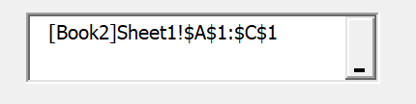
Range Object
Some commonly used Range properties
  Example 3.10 (Cont'd)
    RefEdit control allows the user to enter the address of cells directly.
      The Value property returns the specified cell address as a string. For example: “a1:d4”.
    Users can also select a range of cells from a worksheet.
      Click the button to collapse the UserForm and select the range of cells as needed.
      The Value property returns the specified cell address and worksheet reference as a string. Workbook reference will also be included if the workbook containing the selected cells is not active.

Slide 72
Range Object
Some commonly used Range properties
  Example 3.10 (Cont'd)
    WorksheetFunction property
      Most Excel worksheet functions can be used in a VBA program.
        Examples: Average( ), Sum( ), Max( ), Min( ), Log10( ), Ln( ).
        See “List of Worksheet functions available to Visual Basic” in VBA Help.
      Syntax:
      Application.WorksheetFunction.FunctionName(ArgumentList)
        The Application reference can be omitted.
        The WorksheetFunction reference can be omitted but not recommended. For Example, the Log function appears in both VBA and WorksheetFunction method lists, but it works differently in each object.
        ArgumentList may contain none, one, or more arguments. It may be in the form of a numeric value, string, address of cells, or mathematical formula, depending on the type of function.

Slide 73
Range Object
Some commonly used Range properties
    Example 3.10 (Cont'd): Partial code of button cmdComp Click event
    labCount.Caption = " " & _
    WorksheetFunction.Count(Range(rftRange.Value))
    labSum.Caption = " " & _
    VBA.Format(WorksheetFunction.Sum(Range(rftRange.Value)), "0.0###")
    labMean.Caption = " " & _
    VBA.Format(WorksheetFunction.Average(Range(rftRange.Value)), "0.0###")
    labStddev.Caption = " " & _
    VBA.Format(WorksheetFunction.StDev(Range(rftRange.Value)), "0.0###")

Slide 74
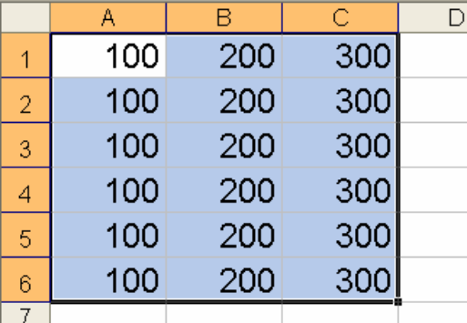
Range Object
Some commonly used Range methods
  Select / Activate method
    Select the specified range of cells (equivalent to manually highlighting the range of cells). The specified range of cells must be contained in the active worksheet of the active workbook.
    A selected range of cells can be referred as a Selection object in subsequence code as long as the selected cells have not been changed and its parent worksheet and workbook are still the active worksheet and active workbook, respectively.
      Examples:
        Range("A1","C6").Select
        'Range("A1","C6").Activate
      Cells.Select
      Worksheets(1).Range("a1","xfd1048576").Select
        Selection.Font.Size =18

Slide 75
Range Object
Some commonly used Range methods
  Clear method
    Deletes everything (value and formatting) contained in the specified range.
    E.g. Range("A1" , "B2").Clear
  ClearContents method
    Clear only the values, but do not change the format of the cells.
  Copy method
    Copy the contents of a range of cells. It requires a Destination argument.
    E.g. Range("A1" , "B2").Copy Destination:=Range("A5")
      It only needs to specify the position of the first cell in the Destination.

Slide 76
Range Object (Self-Study)
More properties of the Range object
  Name property
    Returns the range name for the specified range.
    Examples:
    Range("A1:B3").Name = "Sales"
    Range("Sales").Value=100
      Vname = Range("A1:B3").Name
  Address property
    Returns the address of the range of cells.
    Example: Range(“A1”, “B5”).Address returns a $A$1:$B$5 string. The string does not contain the workbook name and worksheet name.

Slide 77
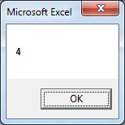

Range Object (Self-Study)
More properties of the Range object
  Column property
    Returns the first column number of the specified range object. Column A returns 1, column B returns 2, and so on.
    E.g.: VBA.Msgbox Range(“d1”,”f1”).Column
    E.g.: VBA.Msgbox Range(“c1”, Range(“c1”).End(xlToRight)).Column
  Row property
    Similar to the Column property but refers to the row.

Slide 78
Range Object (Self-Study)
More methods of Range object
  Sort method
    Sorts a range of values.
    Syntax:
      Rangeobject.Sort Key1:= firstsortfield , Order1 := sortorder , _
      Header := withheaderornot
      The Rangeobject specifies the range to be sort.
      The Firstsortfield specifies the range as the first sort field.
      The Sortorder determines the sort order for the values specified in firstsortfield.
      The Withheaderornot specifies whether the first row of the rangeobject contains header information or not.
      Example: Range("A1:D10").Sort Key1:=Range("A1:A10"), Order1 := xlDescending, Header:= xlYes

Slide 79
Range Object
Referring to cells in a non-active worksheet
  It is possible to activate the needed worksheet and workbook before referring to the range of cells in the needed worksheet. But the code can be confusing without proper workbook and worksheet reference.
  If an operation involves cells in multiple worksheets and workbooks, it may not be feasible to activate each in turn.
  To refer to cells in a non-active worksheet of an active workbook, the syntax is:
  worksheetreference.rangereference
    For example: Worksheets("Sheet1").Range("A1").Value = 100
  To refer to cells in a non-active worksheet of a non-active workbook, the syntax is:
    workbookreference.worksheetreference.rangereference
    For example:
Workbooks("Book1.xlsx").Worksheets("Sheet1").Range("A1").Value = 100

Slide 80
Range Object
Referring to cells in a non-active worksheet
  Suppose Sheet1 is the active worksheet of an active workbook, and you need to count the rows of a block of cells in Sheet2 of the same workbook. The following statement will not work:
Worksheets("Sheet2").Range("a1", Range("a1").End(xlDown)).Rows.Count
    Excel assumes Range("a1") refers to cell A1 of Sheet1.
  The correct statement should be
Worksheets("Sheet2").Range("a1",Worksheets("Sheet2").Range("a1"). _ End(xlDown)).Rows.Count
    Or
  With Worksheets("Sheet2")
  .Range("a1", .Range("a1").End(XlDown)).Rows.Count
  End With

Slide 81
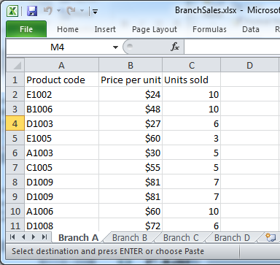
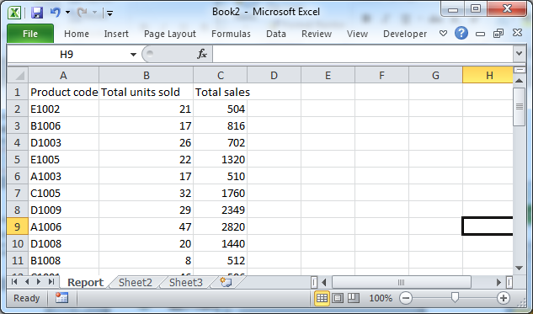
Range Object
Example 3.11: SalesSummary.xlsm contains an application that asks the user to locate a workbook of sales records. It then generates a report of each product’s total sales from the workbook’s sales records.
  Assume:
    The name and the location of the sale workbook are unknown at the design time.
    The sales workbook (BranchSales.xlsx) contains only the sales records of each branch. One worksheet for each branch. The format of each worksheet is fixed and identical.
    A product may have multiple records in 1 or more branch worksheets.

Slide 82
Range Object
Example 3.11 (Cont'd). Partial pseudocode of btnReport button Click event:
  Repeat for each worksheet in the sales record workbook.
  Repeat for each record in the current worksheet.
  Repeat for each summary in the report worksheet.
  Update the current summary in the report worksheet or add a new record to the end list of the report worksheet.
  End Repeat.
  End Repeat.
  End Repeat.

Slide 83
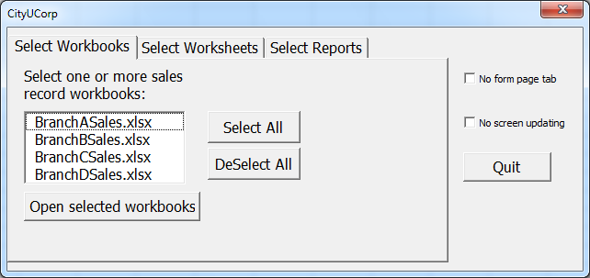
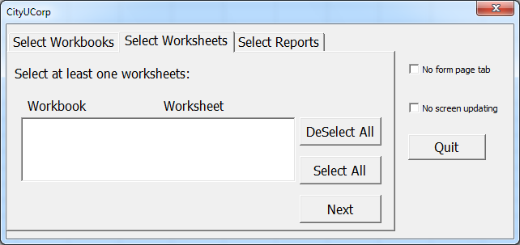
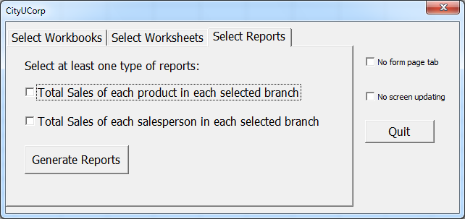
MultiPage Control
Recall Example 3.1: The UserForm frmSalesReport consists of three pages of forms inside a MultiPage control. Each page is a UserForm that contains its own set of controls.

Slide 84
MultiPage Control
MultiPage control contains multiple pages of forms under one UserForm.
Each page works just like an individual UserForm.
Advantages:
  Put a large number of controls into different pages of one UserForm so that the size of the UserForm can be smaller and less cluttered.
  It is much easier to pass the value of a control on one page to another page of a MultiPage control than from a UserForm to another independent UserForm.
  The user only works with one UserForm containing the Multiplage control instead of multiple UserForms scattered on the screen.

Slide 85
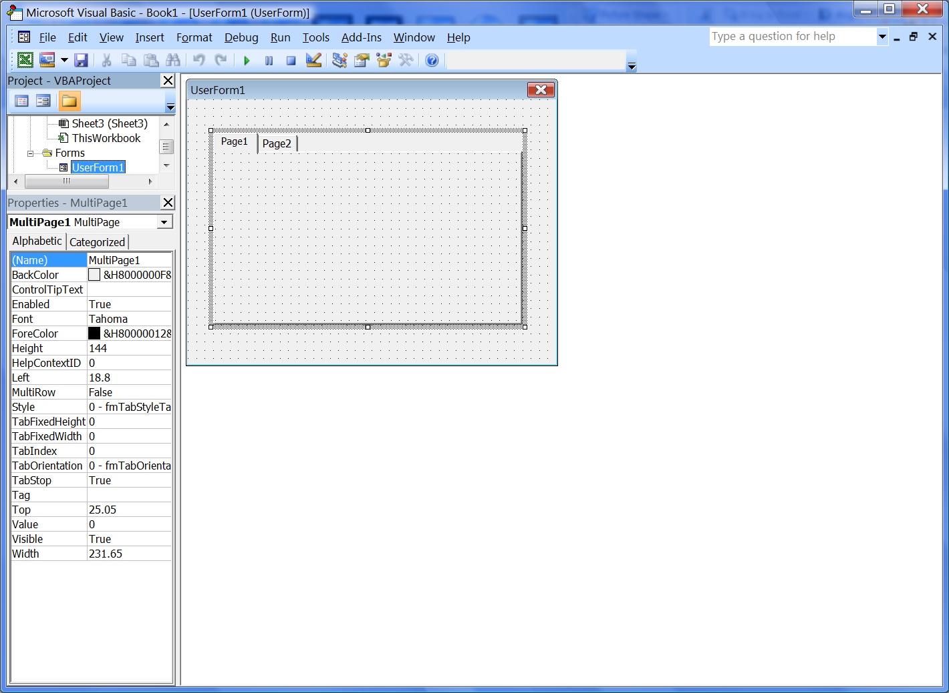
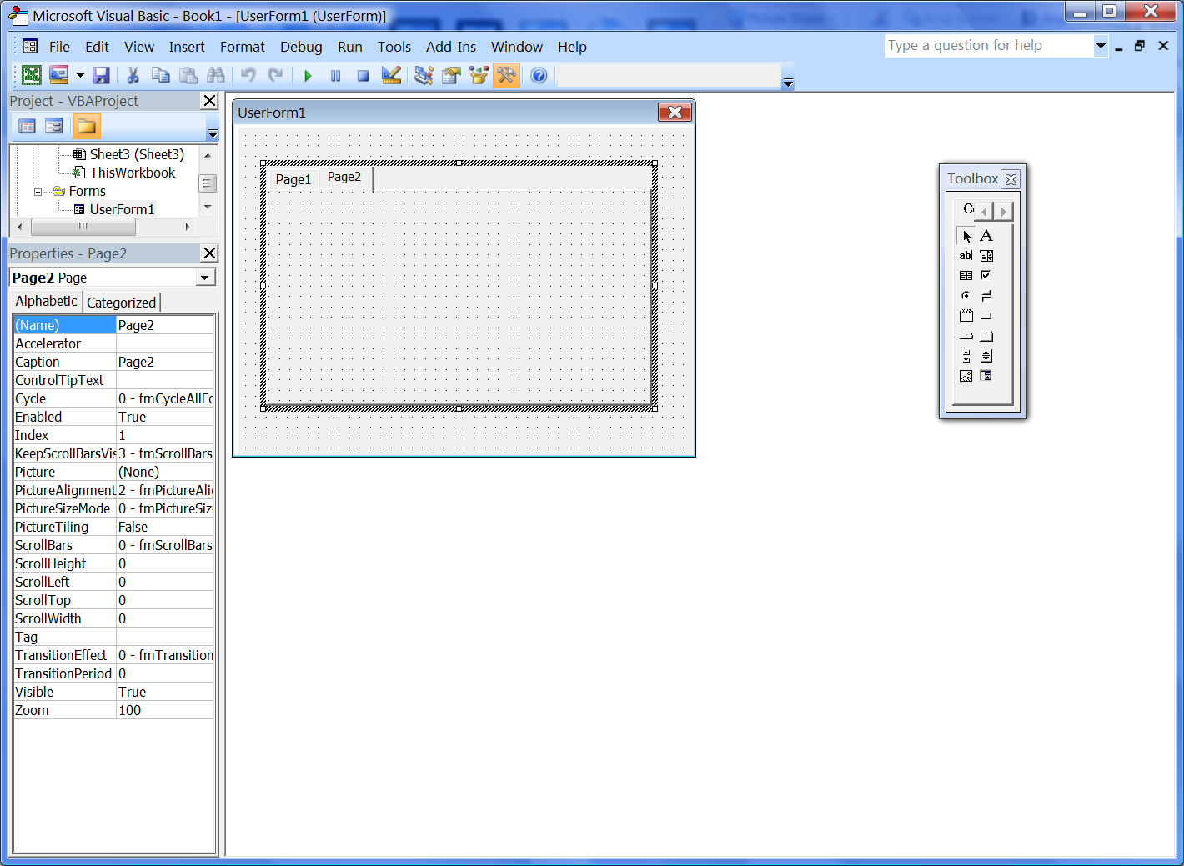
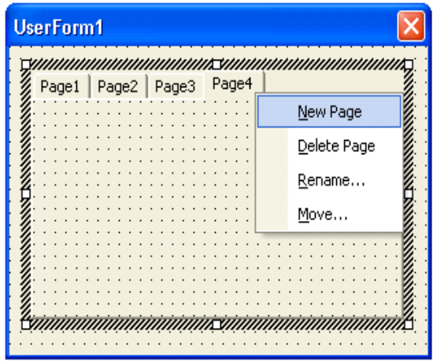
MultiPage Control
To set the properties at design time:
  Click the boundary of the MultiPage control to set the properties for the entire MultiPage control.
  Click a tab to set the properties for that particular page.
  Right-click a tab and select New Page from the short-cut menu to add a new page at design time.

Slide 86

MultiPage Control
Pages property
  You can refer to a page of a MultiPage through its Pages collection.
  The syntax is multipageref.Pages(index)
    The index can be the index number assigned by the system to a page according to its listed position. The first page has an index of 0, and the second page has an index of 1, and so forth.
    The index can be a name assigned to a page. The name must be double-quoted in the argument.
    For example, the first page of Multipage1 has an index number 0, and the index name mtPage1.
Caption

Slide 87
MultiPage Control
Enabled property of Pages
  To enable or disable a page tab of a MultiPage control.
  The syntax is:
    multipageref.Pages(index).Enabled = True / False
Visible property of Pages
  To make a page tab of a MultiPage control visible or invisible.
  The syntax is:
    multipageref.Pages(index).Visible = True / False

Slide 88


MultiPage Control
Example 3.12: Refer to MultiPageDemo3.xlsm

Slide 89
MultiPage Control
Value property
  The Value property of the MultiPage control determines the page of a MultiPage control displayed upfront.
    For example, multipageref.Value = 0 displays the first page, multipageref.Value = 1 displays the second page, and so forth.
  When a page tab is clicked at run time, the Value property changes its value to the value of that page automatically and displays the page.
  Example 3.13: Display the third page of the MultiPage control on form frmMultiPage1 in MultiPageDemo1.xlsm when the form is initialized.
Private Sub UserForm_Initialize()
'Display the third page of MultiPage1
MultiPage1.Value = 2
End Sub

Slide 90
MultiPage Control
Change event
  When the Value of MultiPage changes (either due to the execution of code or the user's action), this triggers the Change event of the MultiPage control.
  Warning: The Value property of a MultiPage control must not be changed within the Change event of the same MultiPage control. Otherwise, the MultiPage control may not operate properly.
  Example 3.14: Consider the form frmMultiPage1 in MultipageDemo1.xlsm. The contents of Page3 are not displayed properly when the Value property of MultiPage1 changes its value within the Change event of MultiPage1.

Slide 91

MultiPage Control
Hiding all tabs
  Page tabs can be hidden so the user cannot access the pages by clicking the respective tab at an undesired sequence.
  To hide the page tabs, set the Style property of the MultiPage control to 2-fmTabStyleNone at design time or programmatically.
    Keeping the tabs visible at the design time until the code is completed is more convenient.
    Code will be more complicated as more code and controls will be needed to display the designated page correctly.
At design time:
Or programmatically:
MultiPage1.Style=2

Slide 92


MultiPage Control
Hiding all tabs
  Example 3.14: Consider the form frmMultiPage2 in MultiPageDemo1.xlsm. The page tabs are hidden at design time. The user needs to use the Back button and the Next button to navigate through the pages of the MultiPage control. This provides more controls on the page displaying at run time.

