Slide 1
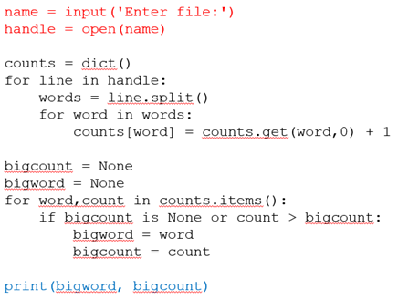
Summary of Lecture 2
Coding is to build tools for automation of information processing
Code is a sequence of instructions for computers to work as the tool
Python is a coding language for expression of the instructions
Code
Input
Process
Output

Slide 2
Summary of Lecture 3
Values cannot be changed (Constant value)
  E.g. 1, 2, ‘hello’
Variables store values for retrieval
  E.g. name=‘Alice’
Mnemonic and legal variable names
A statement is a unit of instruction
A print statement displays data
  E.g. print(x), print(‘hello world’)
An assignment statement stores a value in a variable
  x = 1
An expression is a combination of values, variables, and operators
  E.g. 1+2*x/4+(5-6)*y
Values have different types, which are different in operations and can be converted
  E.g., 1+2, ‘1’+’2’, int(‘1’)
Input statement returns a string, which can be converted to numbers
  E.g., int(input(‘what’s your age?’))
Object oriented thinking about type as class
Comments (anything after #) are ignored in execution, but they are useful for coding
Possible Errors
  Syntax error
    e.g., illegal variable names
  Runtime error
    e.g., wrong spelling of variable names
  Semantic error
    e.g., wrong evaluation order in expression

Slide 3
Summary of Lecture 4
Comparison operators:
  == <= >= > < !=
Logic operators:
  and or not
Indentation:
  use space not tab
One-way Decisions
  if condition: statements
Two-way decisions:
  if: statements else: statements
Multi-way decisions:
  If: statements elif: statements else: statements
Nested Decisions
  Better to avoid / simply
Problem→Flowchart→Code
try / except to compensate for errors
tracekback information for “what” and “where” about errors

Slide 4
Review: Shipping Cost with Volume Discounts
Flowchart
Start
Input quantity
Set total cost = 1000 * quantity
quantity <200 and >=100
True
False
Reduce total cost by 10%
quantity >= 200?
False
True
End
Output total cost
Reduce total cost by 20%

Slide 5
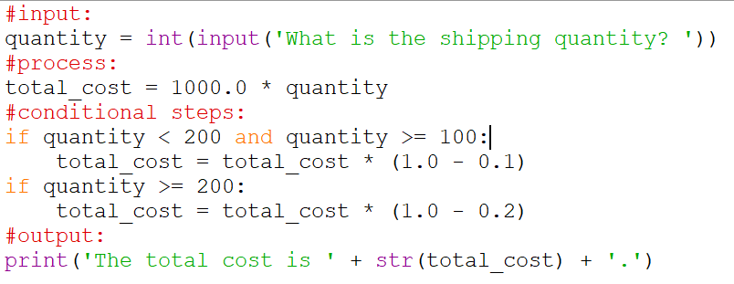
Review: Shipping Cost with Volume Discounts
Code using conditions

Slide 6
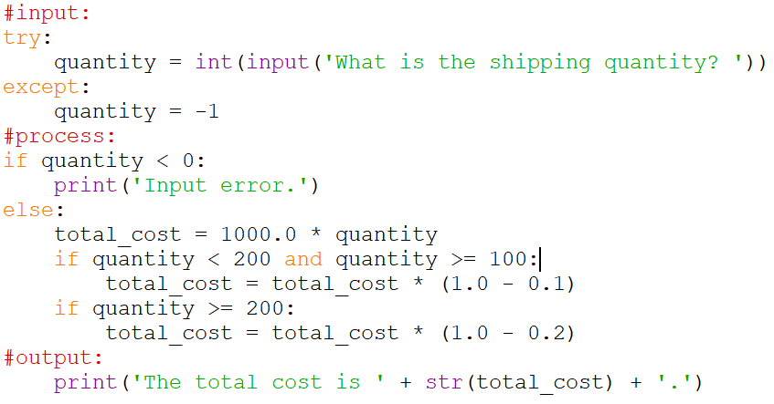
Review: Shipping Cost with Volume Discounts
Code with try/except

Slide 7
CDS1001 – Functions
The session will be recorded!

Slide 8
Built-in Functions
  input()
  print()
User-defined functions

Slide 9
User-defined Functions:
Stored and Reusable Steps
Definition of thing():
Program with a user-defined function:
def thing():
print('Hello')
print('Fun')
thing()
print('Zip')
thing()
print('Hello')
Output:
Hello
Fun
Zip
Hello
Fun
print('Fun')
thing()
print('Zip')
thing()

Slide 10
Case study: Computing Shipping Cost with Volume Discounts - Continue

Slide 11
Computing Shipping Cost with Volume Discounts: Original Python Code
A carrier quotes a shipping rate (USD/container) and volume discounts:
  If shipping volume > a given threshold (100,200), then a discount (10%,20%) is applied
  shipping rate = 1000 USD/container;
Question: What if you want to compute the cost for two different quantities?

Slide 12
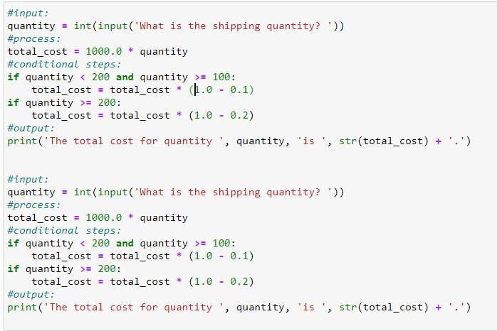
Computing Shipping Cost with Volume Discounts: Python Code
Question: What if you want to compute the cost for two different quantities?
Duplicate the code
  Lengthy
  Hard to maintain

Slide 13
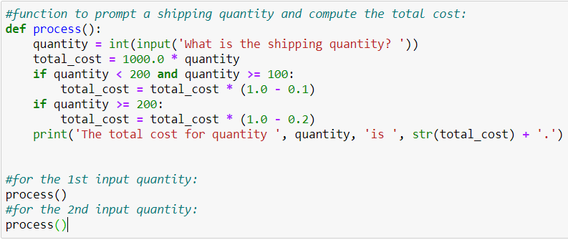
Computing Shipping Cost with Volume Discounts: Python Code
Question: What if you want to compute the cost for two different quantities?
Define Function
Call Function
Call Function
How to reuse the code?
  Functions
  Shorten the code
  Easy to understand, edit, test, debug, maintain, …

Slide 14
Functions:
Basic Concepts

Slide 15
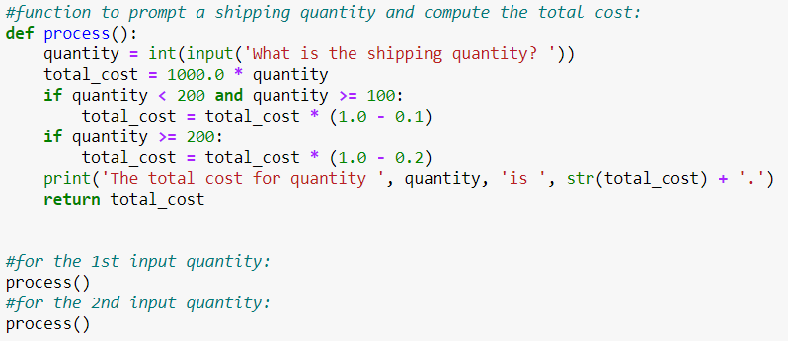
Python Functions
A function is a named sequence of statements that performs a computation.
There are two kinds of functions in Python.
  Built-in functions: functions that are provided as part of Python - print(), input(), type(), float(), int(), max(), min(), len(), ...
  User-defined Functions: functions that we define ourselves and then use
We treat the built-in function names as “new” reserved words
(i.e., we avoid them as variable names)

Slide 16
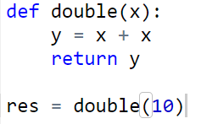
Function Definition
In Python, a function is some named reusable code that takes argument(s) as input parameters, does some computation, and then returns a result or results
We define a function using the def reserved word in its header
We call/invoke the function by using the function name, parentheses, and arguments in an expression
name
parameters
header
body
indentation
call
arguments

Slide 17
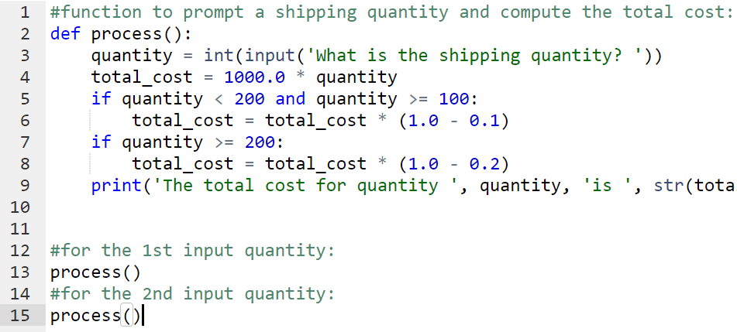
Function Definition: Example
Header, Name, Parameter, Body, Return
Call, Arguments

Slide 18
Summary
What’s function?
  to store and reuse codes
  define, header, name, arguments, body, return, call, parameters

Slide 19
Built-in functions: functions provided in functions as part of Python

Slide 20
Argument (input)
big = max (“hello”)
Assignment
'o'
>>> big = max(‘hello’)
>>> print(big)
o
>>> tiny = min(‘hello’)
>>> print(tiny)
e
>>> num = len(‘hello’)
>>> print(num)
>>> 5
Result

Slide 21
Max Function
A function is some stored code that we use. A function takes some input and produces an output.
>>> big = max(‘hello')
>>> print(big)
o
max()
function
‘hello’
(a string)
'o'
(a string)

Slide 22
Max Function
A function is some stored code that we use. A function takes some input and produces an output.
>>> big = max(‘hello')
>>> print(big)
o
def max(inp):
blah
blah
for x in inp:
blah
blah
'hello'
(a string)
'o'
(a string)

Slide 23
Type Conversion Functions: Numbers→Strings
When you put an integer and floating point in an expression, the integer is implicitly converted to a float
You can control this with the built-in functions int() and float()
>>> x = 3
>>> print(type(x+4.0))
<class 'float’>
>>> print(float(99) / 100)
0.99
>>> i = 42
>>> type(i)
<class 'int’>
>>> f = float(i)
>>> print(f)
42.0
>>> type(f)
<class 'float'>

Slide 24
Type Conversion Functions: Strings → Numbers
You can also use int() and float() to convert between strings and integers
You will get an error if the string does not contain numeric characters
>>> sval = '123'
>>> type(sval)
<class 'str'>
>>> print(sval + 1)
Traceback (most recent call last):
File "<stdin>", line 1, in <module>
TypeError: cannot concatenate 'str' and 'int’
>>> ival = int(sval)
>>> type(ival)
<class 'int'>
>>> print(ival + 1)
124
>>> nsv = 'hello bob'
>>> niv = int(nsv)
Traceback (most recent call last):
File "<stdin>", line 1, in <module>
ValueError: invalid literal for int()

Slide 25
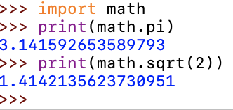
Other Built-in Functions: Math Functions
math.pi: value of pi
math.sqrt(2): square root of 2
All these functions are from a module math
Module math needs to be imported before its use

Slide 26
Other Built-in Functions: Math Functions
Python has a math module that provides most of the familiar mathematical functions.
Before we can use the module, we have to import it:
>>> import math
The module object contains the functions and variables defined in the module, which can now be used in your code

Slide 27
Other Built-in Functions: Math Functions
>>> import math
To access one of the functions, you have to use dot notation:
  specify the name of the module and the name of the function, separated by a dot (also known as a period)
  >>> print(math.pi)
  >>> 3.141592653589793
  >>> print(math.sqrt(2))
  >>> 1.4142135623730951

Slide 28
Package, Modules, Functions, …
Python codes can be reused through modules and packages
A package consists of related modules
  To install package: pip install scipy
A module consists of related functions, classes, objects, etc.
  To import modules: import math
Package
Module
Function
Function
Function
Function
Class
Object
Module
Module
Module

Slide 29
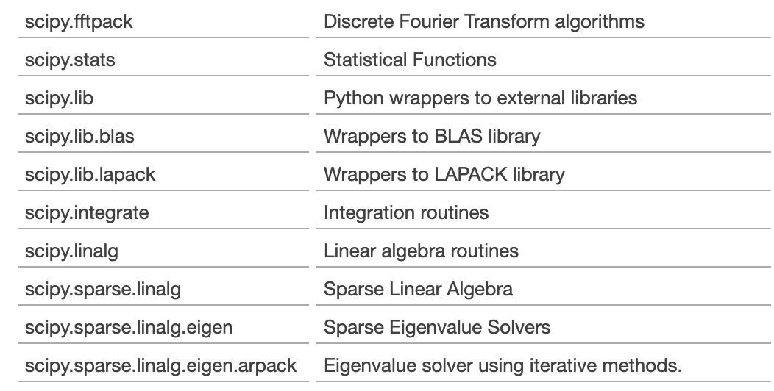
Modules, Functions, …
For example, SciPy for for scientific computing and technical computing, containing hundreds of modules
Package
Module
Function
Function
Function
Function
Class
Object
Module
Module
Module
https://docs.scipy.org/doc/scipy/reference/py-modindex.html

Slide 30
Computing Shipping Cost with Volume Discounts: Python Code
Question: What if you want to compute the cost for two different quantities?
What built-in functions used in this code?
  input()
  int()
  print()
  str()
How to know their usage?

Slide 31
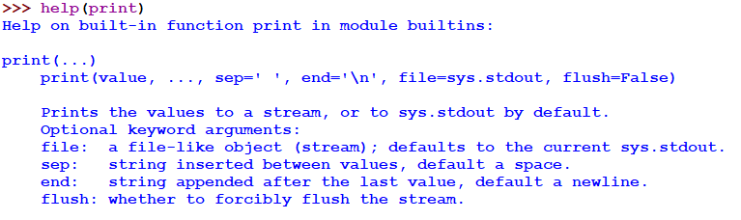
How to know all built-in functions and their usage
In Shell:
  Use dir(__builtins__) to list all built-in functions
  [… 'abs', 'all', 'any', 'ascii', 'bin', 'bool', 'breakpoint', 'bytearray', 'bytes', 'callable', 'chr', 'classmethod', 'compile', 'complex’,…]
  Use help(f) to show the usage of function f
Parameter sep has a default value ‘ ‘
Parameter end has a default value ‘\n’ (new line)

Slide 32
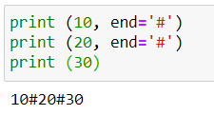

How to Pass Multiple Arguments to Functions
We sometimes need to pass more than one parameter to a function
Positioned arguments are used to identify arguments by their positions in the function call
Keyword arguments are used to set arguments to values other than their default values
print (10, end=‘#’): 10 for value, and end = ‘#’
max (10, 20): 10 for arg1 and 20 for arg2

Slide 33
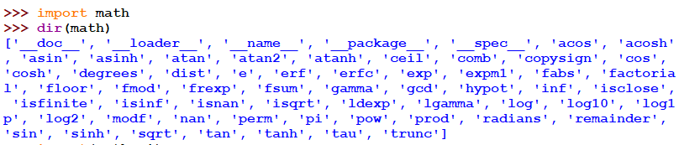
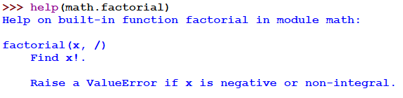


Slide 34
Summary
What’s function?
  to store and reuse codes
  define, header, name, arguments, body, return, call, parameters
Built-in functions
  import module before using its functions / variables
  usage of dir() and help()
  Passing arguments

Slide 35
User-defined Functions

Slide 36
Building our Own Functions
We create a new function using the def keyword followed by optional parameters (arguments) in parentheses in the header
The body of the function is indented
This defines the function but does not execute the body of the function
def print_lyrics():
print("I'm a lumberjack, and I'm okay.")
print('I sleep all night and I work all day.')

Slide 37
x = 5
print('Hello')
def print_lyrics():
print("I'm a lumberjack, and I'm okay.")
print('I sleep all night and I work all day.')
print('Yo')
x = x + 2
print(x)
Hello
Yo
7
print("I'm a lumberjack, and I'm okay.")
print('I sleep all night and I work all day.')
print_lyrics()
I'm a lumberjack, and I'm okay.
I sleep all night and I work all day.

Slide 38
Definitions and Uses
Once we have defined a function, we can call (or invoke) it
as many times as we like
This is the store and reuse pattern
Function definition must be executed before it is called.
def print_lyrics():
print("I'm a lumberjack, and I'm okay.")
print('I sleep all night and I work all day.')
print_lyrics()
print_lyrics()
I'm a lumberjack, and I'm okay.
I sleep all night and I work all day.
I'm a lumberjack, and I'm okay.
I sleep all night and I work all day.

Slide 39
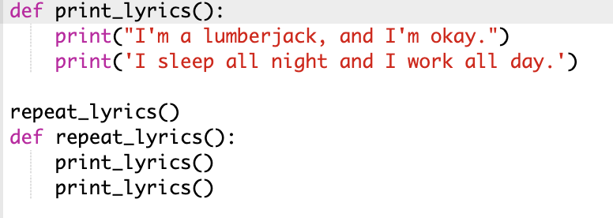
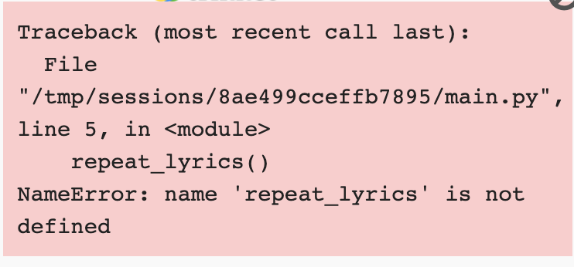
Function definition must be executed before it is called.

Slide 40
Flow of Execution
Execution begins at the first statement of the program.
Statements are executed one by one, from top to bottom.
Function definitions do not alter the flow of execution of the program
Statements inside the function are not executed until the function is called.
A function call is like a detour in the flow of execution.
  the flow jumps to the body of the function, executes all the statements there, and then comes back to pick up where it left off.
thing():
print('Hello')
print('Fun')
thing()
Program:
def thing():
print('Hello')
print('Fun')
thing()
print('Zip')
thing()
print('Zip')
thing()

Slide 41
Flow of Execution
Program:
def thing2():
print(‘Bang’)
def thing1():
print('Hello’)
thing2()
print('Fun')
thing1()
print('Zip')
One function can call another.
  While in the middle of one function, the program might have to execute the statements in another function.
  While executing that new function, the program might have to execute yet another function!
  Each time a function completes, the program picks up where it left off in the function that called it.
When it gets to the end of the program, it terminates.
thing2():
print(‘Bang’)
thing1():
print('Hello’)
thing2()
print('Fun')
thing1()
print('Zip')
thing1()

Slide 42
Arguments
An argument is a value we pass into the function as its input when we call the function
We use arguments so we can direct the function to do different kinds of work when we call it at different times
We put the arguments in parentheses after the name of the function
Argument (input)
big = max_num(“hello”)

Slide 43
Parameters
A parameter is a variable which we use in the function definition to access arguments.
  It is a “handler” that allows the code in the function to access the arguments for a particular function invocation.
>>> def greet(lang):
... if lang == 'es':
... print('Hola')
... elif lang == 'fr':
... print('Bonjour')
... else:
... print('Hello')
...
>>> greet('en')
Hello
>>> greet('es')
Hola
>>> greet('fr')
Bonjour
>>>

Slide 44
Return Value
Often a function will take its arguments, do some computation, and return a value to be used as the value of the function call in the calling expression.
  The return keyword is used for this.
def greet():
return "Hello"
print(greet(), "Glenn")
res = greet ()
print(res, "Sally")
Hello Glenn
Hello Sally

Slide 45
Return Value
A “fruitful” function is one that produces a result (or return value)
The return statement ends the function execution and “sends back” the result of the function
>>> def greet(lang):
... if lang == 'es':
... return 'Hola'
... elif lang == 'fr':
... return 'Bonjour'
... else:
... return 'Hello'
...
>>> print(greet('en'),'Glenn')
Hello Glenn
>>> print(greet('es'),'Sally')
Hola Sally
>>> print(greet('fr'),'Michael')
Bonjour Michael
>>>

Slide 46
Arguments, Parameters, and Results
>>> big = max(‘hello')
>>> print(big)
o
Parameter
def max(inp):
blah
blah
for x in inp:
blah
blah
return ‘w’
'hello'
(a string)
'o'
(a string)
Argument
Result
Guido (creator of Python) wrote this code

Slide 47
Multiple Parameters / Arguments
We can define more than one parameter in the function definition
We simply add more arguments when we call the function
We match the number and order of arguments and parameters
def addtwo(a, b):
added = a + b
return added
x = addtwo(3, 5)
print(x)
8
3 in arguments matches variable a in parameters
5 in arguments matches variable b in parameters

Slide 48
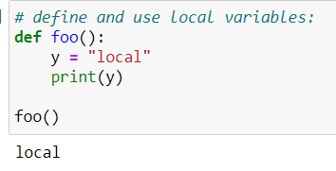
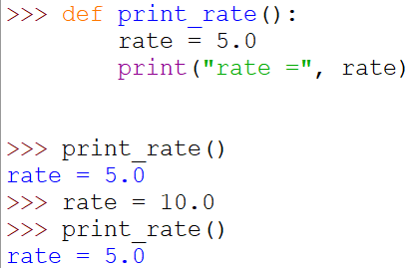
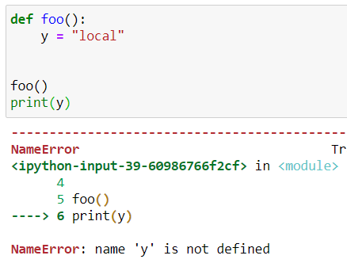
Local Variables
Local variables: variables declared inside a function
  can be accessed only inside the function
  the function is the (local) scope of such a variable

Slide 49
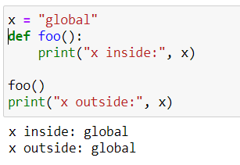
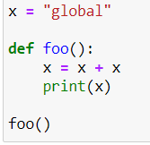
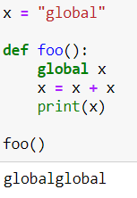
Global Variables
Global variables: variables declared outside of a function
  can be accessed inside or outside a function
  have a global scope
  need to be declared as ‘global’ if changing its value in a function

Slide 50
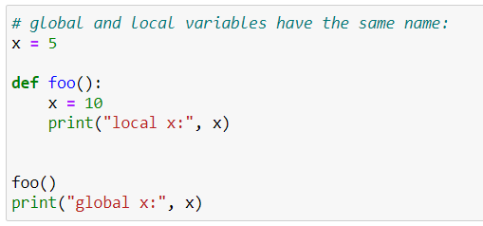
Global and Local Variables
For variables with the same name inside and outside of a function, Python will treat them as two separate variables
  one available in the global scope (outside the function) and
  one available in the local scope (inside the function)

Slide 51
Void (non-fruitful) Functions
When a function does not return a value, we call it a “void” function
Functions that return values are “fruitful” functions
Void functions are “not fruitful”
#a void function:
def print_line():
print('==========')
print_line()
print('LGT3109')
print_line()
#another void function:
def print_line():
print('==========‘)
return
print_line()
print('LGT3109')
print_line()

Slide 52
To function or not to function...
Organize your code into “paragraphs” - capture a complete thought and “name it”
Don’t repeat yourself - make it work once and then reuse it
If something gets too long or complex, break it up into logical chunks and put those chunks in functions
Make a library of common stuff that you do over and over - perhaps share this with your friends...

Slide 53
Computing Shipping Cost with Volume Discounts: Python Code
Question: How to further improve the organization of the code?

Slide 54
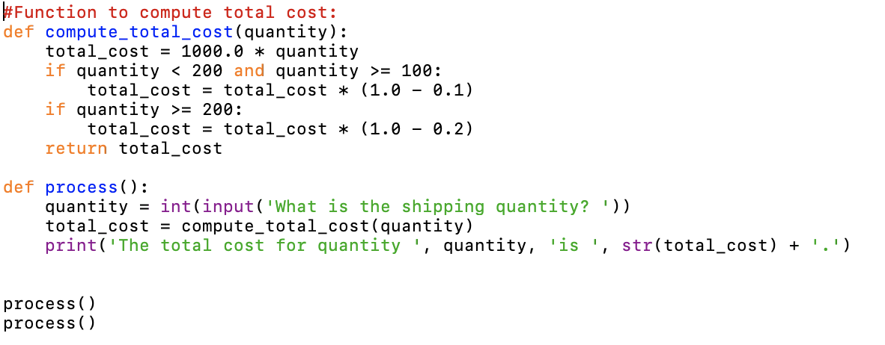
Computing Shipping Cost with Volume Discounts: Python Code
break it up into logical chunks:
Chunk (Paragraph) 1
Chunk 2

Slide 55
Summary
What’s function?
  to store and reuse codes
  define, header, name, arguments, body, return, call, parameters
Built-in functions
  Import module before using its functions / variables
  Usage of dir() and help()
  Passing arguments
User-defined functions
  Define and use - def and call
  Local variables defined in a function
  Flow of execution – detour
  Arguments, parameters, return values
  Multiple parameters / arguments
  Void functions and fruitful functions
  Why/How to organize functions
    Break into logical chunks
    Reusable, and easy to maintain

Slide 56
Positional Arguments and Keyword Arguments
Positional Arguments
  Match each argument with a parameter in function definition based on the order
def combine_name(first_name, last_name):
res = first_name + ‘ ‘ + last_name
return res
full_name = combine_name(‘Ken’, ‘Fong’)
print(full_name)

Slide 57
Positional Arguments and Keyword Arguments
Keyword Arguments
  Pass name-value pairs to a function
  Directly associate the name and the value within the argument of the function
def combine_name(first_name, last_name):
res = first_name + ‘ ‘ + last_name
return res
full_name = combine_name(first_name=‘Ken’, last_name=‘Fong’)
print(full_name)

Slide 58
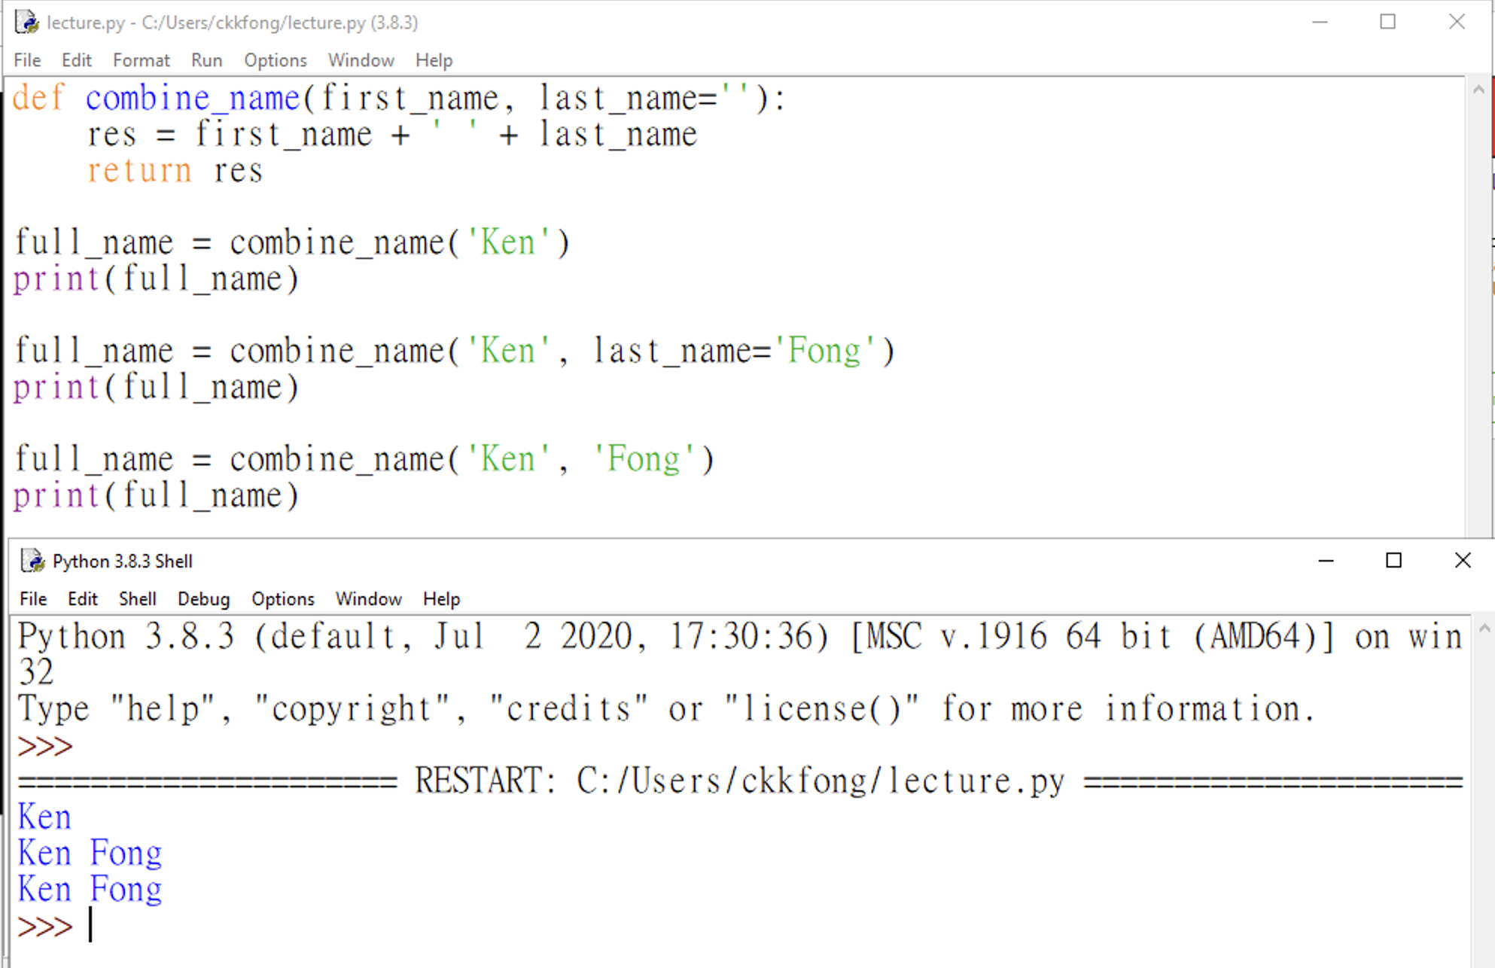
Positional Arguments and Keyword Arguments
Default Values
  When writing a function, you can define a default value for each parameter
  If an argument’s value for a parameter is provided in the function call, the value is used, otherwise, the default value is used.
  Default arguments must be specified after non-default arguments

Slide 59

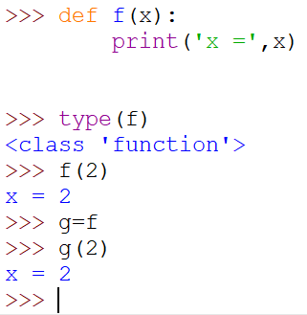
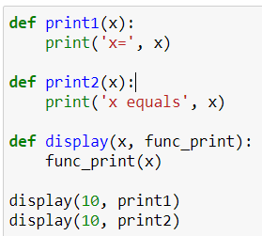

Object Oriented Thinking of Function as an Object
Python is an Object-Oriented thinking
In Python, everything is an object
In Python, a function is also an object
  which can be assigned or passed to a variable

Slide 60
Summary
What’s function?
  to store and reuse codes
  define, arguments, return, call
Built-in functions
  Import module before using its functions / variables
  Usage of dir() and help()
  Passing arguments
User-defined functions
  Define and use - def and call
  Local variables defined in a function
  Flow of execution – detour
  Arguments, parameters, return values
  Multiple parameters / arguments
  Void functions and fruitful functions
  Why/How to organize functions
    Break into logical chunks
    Reusable, and easy to maintain
Positioned arguments and keyword arguments
Functions are objects

Slide 61
Debugging
Don't forget to save your program before you run it.
  Some development environments do this automatically, but some don’t. IDLE do
Define an object before using it
Make sure that the code you are looking at is the code you are running.
  If you're not sure, put something like print("hello") at the beginning of the program and run it again.
  If you don't see hello, you're not running the right program!
print('hello code')
blah blah
Blah blah
Print('bye code')
def f():
print('hello f’)
blah blah
Blah blah
print('bye f')

Slide 62
Summary
What’s function?
  to store and reuse codes
  define, header, name, arguments, body, return, call, parameters
Built-in functions
  Import module before using its functions / variables
  Usage of dir() and help()
  Passing arguments
Debugging
  Save before run, define before use
  Use print() to checking whether a code is executed during debugging
User-defined functions
  Define and use - def and call
  Local variables defined in a function
  Flow of execution – detour
  Arguments, parameters, return values
  Multiple parameters / arguments
  Void functions and fruitful functions
  Why/How to organize functions
    Break into logical chunks
    Reusable, and easy to maintain
Positioned arguments and keyword arguments
Functions are objects

Slide 63
Exercise (to be investigated in Tutorial 4)
Rewrite your pay computation with time-and-a-half for overtime, and create a function called computepay which takes two parameters ( hours and rate).
Enter Hours: 45
Enter Rate: 10
Pay: 475.0
475 = 40 * 10 + 5 * 15

Slide 64
Objectives of Tutorial 4
Understand why functions are used in coding
Be able to understand and use user-defined functions
Understand basic usage of some built-in functions
Be able to understand and draw flow charts

Slide 65
Guidelines for Tutorial 4
Follow the tutorial instruction to launch Python IDLE through Anaconda Navigation, and download files from Moodle for Tutorial 4
Complete Parts 1-3 led by the lecturer
Complete Part 4 independently
Follow Section 3 of the tutorial instruction to save the report and zip the report folder.
  The zip file is named as CDS1001T4Report{your student_id}.zip
Submit the zip file of the report folder to the Moodle. The submission due date is 17 Oct 2023 23:55

Slide 66
Reminders
Submit your zip file for tutorial 2 by 3 Oct 2023 23:55
Submit your zip file for tutorial 3 by 10 Oct 2023 23:55
Submit your zip file for tutorial 4 by 17 Oct 2023 23:55
Feel free to contact the instructor if you have problems
  By email: kenfong@ln.edu.hk

