Slide 1
Review of Lecture 5
What’s function?
  to store and reuse codes
  define, header, name, arguments, body, return, call, parameters
Built-in functions
  Import module before using its functions / variables
  Usage of dir() and help()
  Passing arguments
Debugging
  Save before run, define before use
  Use print() to checking whether a code is executed during debugging
User-defined functions
  Define and use - def and call
  Local variables defined in a function
  Flow of execution – detour
  Arguments, parameters, return values
  Multiple parameters / arguments
  Void functions and fruitful functions
  Why/How to organize functions
    Break into logical chunks
    Reusable, and easy to maintain
Positioned arguments and keyword arguments
Functions are objects

Slide 2
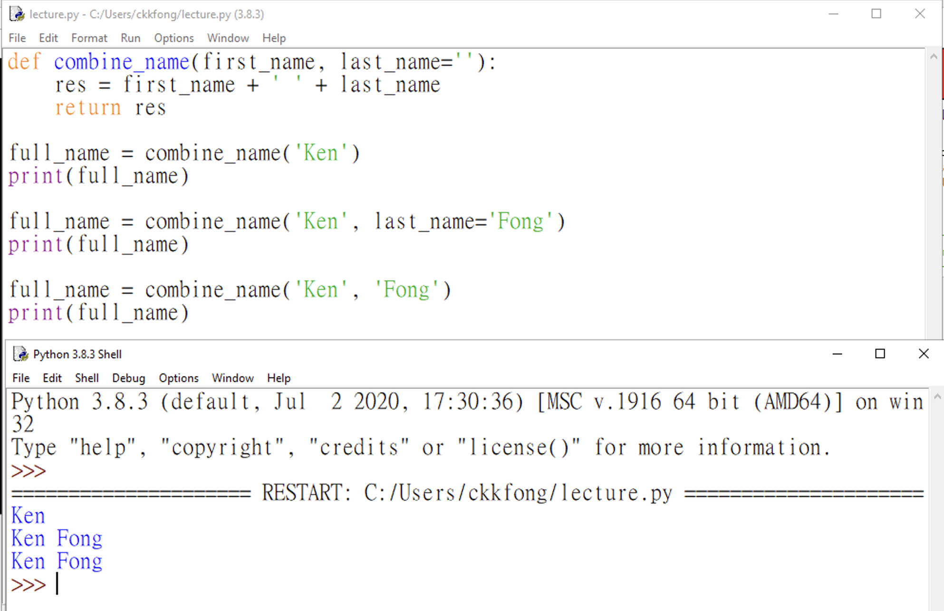
Review: Positional Arguments and Keyword Arguments
Default Values
  When writing a function, you can define a default value for each parameter
  If an argument’s value for a parameter is provided in the function call, the value is used, otherwise, the default value is used.
  Default arguments must be specified after non-default arguments

Slide 3
CDS1001 – Iterations
The session will be recorded!

Slide 4
Case Study: Computing Shipping Cost with Volume Discounts for Multiple Cargoes

Slide 5
Computing Shipping Cost with Volume Discounts for multiple cargoes: Problem Description
FE plans to ship cargoes from Hong Kong to Los Angeles every month
A carrier quotes a shipping rate (USD/container) and a volume discount:
  shipping rate = 1000 USD/container
  If 200> shipping volume >= 100 containers, then 10% discount is applied
  If shipping volume >= 200 containers, then 20% discount is applied
FE wants to know the total shipping cost for the following six months
Input:
Enter shipping quantity for month 1: 150
Enter shipping quantity for month 2: 160
Enter shipping quantity for month 3: 240
Enter shipping quantity for month 4: 250
Enter shipping quantity for month 5: 180
Enter shipping quantity for month 6: 170
Output:
Total cost: 986000.0

Slide 6
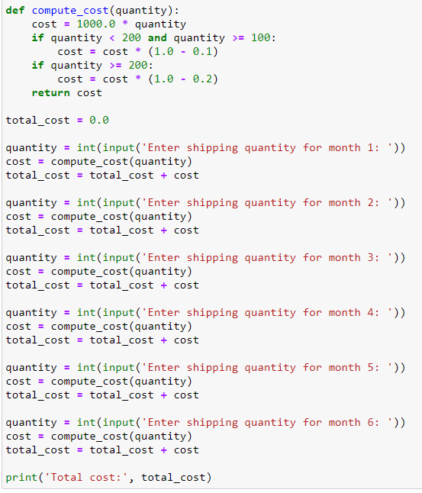
Repeated Code
FE wants to know the total shipping cost for the following six months
Drawbacks of repeated code:
  Lengthy, boring
  Hard to test and maintain

Slide 7
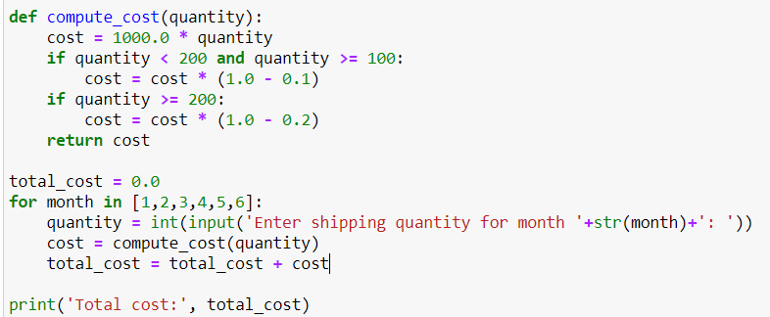
Python Code with Iterations
FE wants to know the total shipping cost for the following six months
Iterations: repeat the same action (reusable code):

Slide 8
Loop (iterations): Basics and indefinite loop

Slide 9
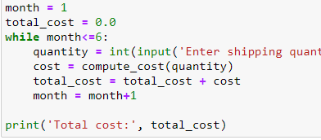
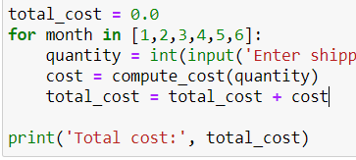
Loop: Repeat the same steps
Computers are often used to automate repetitive tasks.
Repeating identical or similar tasks without making errors is something that computers do well and people do poorly.
Python provides several language features to make it easier.
  while loop (indefinite loop) and for loop (definite loop)

Slide 10
while (indefinite) loop
while condition :
statements in the body
Evaluate the condition, yielding True or False.
If the condition is false, exit the while statement and continue execution at the next statement.
If the condition is true, execute the statements in the (indented) body, and then go back to Step 1.
condition
False
True
Statements
in the body
Each time we execute an iteration of the body of the loop
Statements
outside the body

Slide 11
while loop for repeated steps
n = 5
Program:
n = 5
while n > 0 :
print(n)
n = n - 1
print('Blastoff!')
print(n)
Output:
5
4
3
2
1
Blastoff!
0
No
n > 0 ?
Yes
print(n)
n = n -1
print('Blastoff')
When a logic condition is not satisfied, the loop stops
Loops (repeated steps) have iteration variables that are updated each time through a loop.

Slide 12
Updating Variables
The body of the loop needs to change the value of some iteration variables so that
  eventually the condition becomes false and the loop terminates.
Iteration variable: variable that
  is updated each iteration of the loop
  controls when the loop finishes
An assignment statement to update an iteration variable
  the new value of the variable depends on the old.
Before updating an iteration variable, it needs to be initialized
Program:
n = 5 #initialize
while n > 0 : #condition
print(n)
n = n – 1 #update
print('Blastoff!')
print(n)

Slide 13
An Infinite Loop
n = 5
n = 5
while n > 0 :
print('Lather')
print('Rinse')
print('Dry off!')
No
n > 0 ?
Yes
print('Lather')
print('Rinse')
What is wrong with this loop?
print('Dry off!')

Slide 14
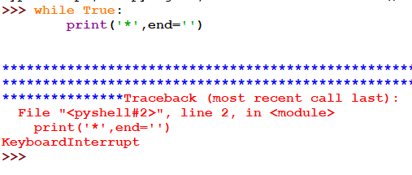
Infinite Loop: Interrupt your code
In Python Shell or Prompt Terminal:
  Press Ctrl + C
In Jupyter Notebook
  Click Stop Button in the Toolbar

Slide 15
Another Loop
n = 0
The body of the loop below will never be executed:
No
n > 0 ?
Yes
n = 0
while n > 0 :
print('Lather')
print('Rinse’)
n = n + 1
print('Dry off!')
print('Lather')
print('Rinse')
What is this loop doing?
print('Dry off!')

Slide 16
Breaking Out of a Loop
The break statement ends the current loop and jumps to the statement immediately following the loop
It is like a loop test that can happen anywhere in the body of the loop
while True:
line = input('> ')
if line == 'done' :
break
print(line)
print('Done!')
> hello there
hello there
> finished
finished
> done
Done!
Without break, this is an infinite loop

Slide 17
while True:
line = input('> ')
if line == 'done' :
break
print(line)
print('Done!')
No
True ?
Yes
....
line== ‘done’
Yes
> hello there
hello there
> finished
finished
> done
Done!
No
...
break
print('Done!')

Slide 18
Finishing an Iteration with continue
The continue statement ends the current iteration and jumps to the top of the loop and starts the next iteration
while True:
line = input('> ')
if line[0] == '#' :
continue
if line == 'done' :
break
print(line)
print('Done!')
> hello there
hello there
> # don't print this
> print this!
print this!
> done
Done!
line[0] is the first character of the string line

Slide 19
No
True ?
Yes
while True:
line = input('> ')
if line[0] == '#' :
continue
if line == 'done' :
break
print(line)
print('Done!')
....
line[0]== ‘#’
Yes
No
...
continue
print('Done!')

Slide 20
Indefinite Loops
While loops are called “indefinite loops” because they keep going until a logical condition becomes False
Codes with “Indefinite loops” are often hard to be rewritten by using repeated codes
The loops we have seen so far are pretty easy to examine to see if they will terminate or if they will be “infinite loops”
Sometimes it is a little harder to be sure if a loop will terminate
while True:
line = input('> ')
if line[0] == '#' :
continue
if line == 'done' :
break
print(line)
print('Done!')

Slide 21
Using a Flag variable
Instead of using “break”, we can also use a variable as a flag to stop
  indicating whether or not the stopping condition is satisfied
while True:
line = input('> ')
print(line)
if line == 'done' :
break
print('Done!')
flag_done = False
while not flag_done:
line = input('> ')
print(line)
if line == 'done' :
flag_done = True
print('Done!')

Slide 22
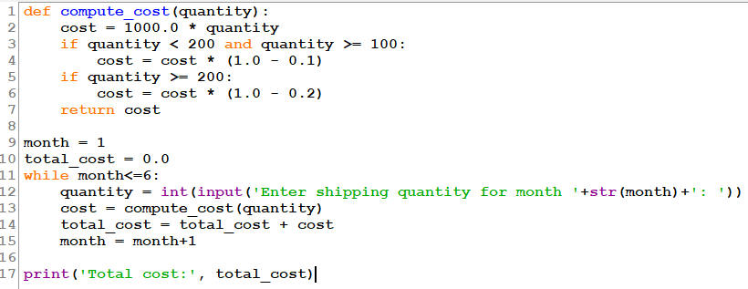
Case Study: Python Code with a While Loop
Where is the while loop? What’s the condition to stop the loop? What’s the iteration variable? How does the loop initialize and update the iteration variable?
Draw the flowchart of the while loop in the code.

Slide 23
Initialize: month=0, total_cost = 0.0
False
month<=6
True
Input quantity
Update: month=month+1
Compute cost for quantity
Add cost to total_cost
print total_cost

Slide 24
Loop (iterations): definite loop

Slide 25
Definite Loops: Iterating over a set of items…
Sometimes we want to loop through a sequence of things (items)
  E.g., a list of words, the lines in a file, or a list of numbers.
We need to repeat the processing of each item in the sequence
  E.g., count each word, modify each line, sum up each number, etc.
We can write a loop to run it once for each of the items in a list
These loops are called “definite loops” because they execute an exact number of times
  We say that “definite loops iterate through the members of a list”

Slide 26
A Simple Definite Loop
for i in [5, 4, 3, 2, 1] :
print(i)
print('Blastoff!')
5
4
3
2
1
Blastoff!
[5,4,3,2,1] indicates a list of numbers, 5, 4, 3, 2, 1
We will discuss “list” in more details in the future lectures

Slide 27
A Definite Loop with Strings
Happy New Year: Joseph
Happy New Year: Glenn
Happy New Year: Sally
Done!
friends = ['Joseph', 'Glenn', 'Sally']
for friend in friends :
print('Happy New Year:', friend)
print('Done!')

Slide 28
for (definite) loop
for iteration_variable in a sequence :
statements in the body
For each item in a sequence, repeat:
Store the item in the iteration variable, and
Execute the statements in the indented body
Last Item?
False
True
Update iteration variable by the next item in the sequence
Statements in the body
Statements outside the body

Slide 29
A Simple Definite Loop
Yes
Done?
No
Move i ahead though the sequence
5
4
3
2
1
Blastoff!
for i in [5, 4, 3, 2, 1] :
print(i)
print('Blastoff!')
print(i)
Definite loops (for loops) have explicit iteration variables that change each time through a loop.
These iteration variables move through the sequence or set.
print('Blast off!')

Slide 30
Looking at in...
The iteration variable “iterates” through the sequence (ordered set)
The block (body) of code is executed once for each value in the sequence
The iteration variable moves through all of the values in the sequence
Five-element sequence
Iteration variable
for i in [5, 4, 3, 2, 1] :
print(i)
Body to be executed

Slide 31
Yes
No
Done?
The iteration variable “iterates” through the sequence (ordered set)
The block (body) of code is executed once for each value in the sequence
The iteration variable moves through all of the values in the sequence
Move i ahead
print(i)
for i in [5, 4, 3, 2, 1] :
print(i)

Slide 32
i = 5
No
print(i)
Yes
Done?
Move i ahead
i = 4
print(i)
print(i)
i = 3
print(i)
i = 2
for i in [5, 4, 3, 2, 1] :
print(i)
print(i)
i = 1
print(i)

Slide 33
Loop Patterns: What we do in loops?
Even though these examples are simple, the patterns apply to all kinds of loops

Slide 34
Making “smart” loops
The trick is “knowing” something about the whole loop when you are stuck writing code that only sees one entry at a time
Set some variables to initial values
for entry in data:
Look for something or do something to each entry separately, updating the variables
Look at the variables

Slide 35
Looping Through a Set
Before
9
41
12
3
74
15
After
print('Before')
for entry in [9, 41, 12, 3, 74, 15] :
#for each entry:
print(entry)
print('After')

Slide 36
What is the Largest Number?
3
41
12
9
74
15

Slide 37
What is the Largest Number?
largest_so_far
-1

Slide 38
What is the Largest Number?
3
largest_so_far
3

Slide 39
What is the Largest Number?
41
largest_so_far
41

Slide 40
What is the Largest Number?
12
largest_so_far
41

Slide 41
What is the Largest Number?
9
largest_so_far
41

Slide 42
What is the Largest Number?
74
largest_so_far
74

Slide 43
What is the Largest Number?
15
largest_so_far
74

Slide 44
What is the Largest Number?
3
41
12
9
74
15
largest_so_far
74

Slide 45
Finding the Largest Value
We make a variable that contains the largest value we have seen so far, and initialize it to be -1
We examine each value in the given list:
If the current value we are looking at is larger, it must be the new largest value we have seen so far, and the variable needs to be updated.
#Initialize the variable
largest_so_far = -1
print('Before', largest_so_far)
for the_num in [9, 41, 12, 3, 74, 15] :
#for each entry:
if the_num > largest_so_far :
#update the variable
largest_so_far = the_num
print(largest_so_far, the_num)
#Output the variable
print('After', largest_so_far)
largest_so_far | the_num
9 | 9
41 | 41
41 | 12
41 | 3
74 | 74
74 | 15
Before -1
After 74

Slide 46
Similarly, Counting in a Loop
We make a counting variable that contains the number of values we have seen so far and initialize it to be 0.
We examine each value in the given list, and update the counting variable by adding one to it each time through the loop
Before 0
After 6
#initialize the variable:
zork = 0
print('Before', zork)
for entry in [9, 41, 12, 3, 74, 15] :
#for each entry:
zork = zork + 1 #update the variable
print(zork, entry)
#output the variable:
print('After', zork)
zork | entry
1 | 9
2 | 41
3 | 12
4 | 3
5 | 74
6 | 15

Slide 47
Similarly, Summing in a Loop
We make a sum variable that contains the number of values we have seen so far and initialize it to be 0.
We examine each value in the given list, and update the sum variable by adding the value to it each time through the loop
#initialize the variable:
zork = 0
print('Before', zork)
for entry in [9, 41, 12, 3, 74, 15] :
#for each entry:
zork = zork + entry #update the variable
print(zork, entry)
#output the variable:
print('After', zork)
Before 0
After 154
zork | entry
9 | 9
50 | 41
62 | 12
65 | 3
139 | 74
154 | 15

Slide 48
Finding the Average in a Loop
An average just combines the counting and sum patterns and divides when the loop is done.
#initialize the variables:
count = 0
sum = 0
print('Before', count, sum)
for value in [9, 41, 12, 3, 74, 15] :
#for each entry, update the variables:
count = count + 1
sum = sum + value
print(count, sum, value)
#output the variables:
print('After', count, sum, sum / count)
count | sum | value
1 | 9 | 9
2 | 50 | 41
3 | 62 | 12
4 | 65 | 3
5 | 139 | 74
6 | 154 | 15
Before 0 0
After 6 154 25.666

Slide 49
Filtering in a Loop
We use an if statement in the loop to catch / filter the values we are looking for.
print('Before')
for value in [9, 41, 12, 3, 74, 15] :
#for each entry, check the condition:
if value > 20:
print('Large number',value)
print('After')
Before
Large number 41
Large number 74
After

Slide 50
Search Using a Boolean Variable
If we just want to search and know whether a value was found,
we can use a flag variable that starts at False and is set to True as soon as we find what we are looking for.
found = False
print('Before', found)
for value in [9, 41, 12, 3, 74, 15] :
if value == 3 :
found = True
print(found, value)
print('After', found)
Before False
False 9
False 41
False 12
True 3
True 74
True 15
After True
How to make the code more efficient (i.e., reducing the number of iterations)?

Slide 51
Search Using a Boolean Variable
If we just want to search and know whether a value was found,
we can use a flag variable that starts at False and is set to True as soon as we find what we are looking for.
Before False
False 9
False 41
False 12
True 3
True 74
True 15
After True
found = False
print('Before', found)
for value in [9, 41, 12, 3, 74, 15] :
if value == 3 :
found = True
break
print(found, value)
print('After', found)
How to make the code more efficient (i.e., reducing the number of iterations)?

Slide 52
largest_so_far | the_num
9 | 9
41 | 41
41 | 12
41 | 3
74 | 74
74 | 15
largest_so_far = -1
print('Before', largest_so_far)
for the_num in [9, 41, 12, 3, 74, 15] :
if the_num > largest_so_far :
largest_so_far = the_num
print(largest_so_far, the_num)
print('After', largest_so_far)
Before -1
After 74
How would we change this to make it find the smallest value in the list?

Slide 53
Finding the Smallest Value
Can we switch the variable name to smallest_so_far and switched the > to <?
smallest_so_far = -1
print('Before', smallest_so_far)
for the_num in [9, 41, 12, 3, 74, 15] :
if the_num < smallest_so_far :
smallest_so_far = the_num
print(smallest_so_far, the_num)
print('After', smallest_so_far)

Slide 54
Finding the Smallest Value
Can we switch the variable name to smallest_so_far and switched the > to <?
Before -1
After -1
smallest_so_far | the_num
-1 | 9
-1 | 41
-1 | 12
-1 | 3
-1 | 74
-1 | 15
smallest_so_far = -1
print('Before', smallest_so_far)
for the_num in [9, 41, 12, 3, 74, 15] :
if the_num < smallest_so_far :
smallest_so_far = the_num
print(smallest_so_far, the_num)
print('After', smallest_so_far)
Not correct, as we expect the result to be 3

Slide 55
Finding the Smallest Value
We still have a variable that is the smallest so far. The first time through the loop smallest is None, so we take the first value to be the smallest.
smallest = None
print('Before', smallest)
for value in [9, 41, 12, 3, 74, 15] :
if smallest == None :
smallest = value
elif value < smallest :
smallest = value
print(smallest, value)
print('After', smallest)
smallest | value
9 | 9
9 | 41
9 | 12
3 | 3
3 | 74
3 | 15
Before None
After 3
Remark: The None keyword is used to define a null value, or no value at all.
None is a data type of its own (NoneType) and only None can be None.

Slide 56
None Keyword
The is and is not Operators
The reserved keyword None is used to define a null value, or no value at all.
is operator:
  “is the same as”
  Similar to but stronger than ==
is not operator:
  “is not the same as”
smallest = None
print('Before')
for value in [9, 41, 12, 3, 74, 15] :
if smallest is None :
smallest = value
elif value < smallest :
smallest = value
print(smallest, value)
print('After', smallest)

Slide 57
Summary
Loop: Repeat
  Iteration, iteration variable
while loop: Indefinite
  Iteration until condition is violated
for loop: definite
  Iteration for each item of a sequence
break and continue
Loop Patterns:
  Initialize, Iteration over each entry of data, and repeat updates
    Maximum of data
    Sum of data
    Counting of data
  Filtering of data by conditions, and use of Flag variables
  Use of None, is, and is not
    Minimum

Slide 58
Debugging

Slide 59
“Debugging by print()"
largest_so_far = -1
for the_num in [9, 41, 12, 3, 74, 15] :
if the_num < largest_so_far :
largest_so_far = the_num
print(‘Largest is', largest_so_far)
Largest is -1
largest_so_far = -1
print('Before’, largest_so_far)
for the_num in [9, 41, 12, 3, 74, 15] :
if the_num < largest_so_far :
largest_so_far = the_num
print(‘Largest is', largest_so_far)
Before -1
Largest is -1
error must be after line 2
Since the last line is correct
error must be in the loop
change < to >

Slide 60
“Debugging by Bisection"
More code means more chances to make an error and more places for bugs to hide.
Try to break the problem in half each time
“Debugging by bisection" to cut debugging time
  Look at the middle of the program, or near it, for an intermediate value you can check by adding a print statement
  If the middle-point check is incorrect, the problem must be in the first half of the program (part I), otherwise, in the second half (part II)
In practice, think about places where there might be errors and places where it is easy to put a check.
print(…)
Part I
Part II

Slide 61
Summary
Loop: Repeat
  Iteration, iteration variable
while loop: Indefinite
  Iteration until condition is violated
for loop: definite
  Iteration for each item of a sequence
break and continue
Loop Patterns:
  Initialize, Iteration over each entry of data, and repeat updates
    Maximum of data
    Sum of data
    Counting of data
  Filtering of data by conditions, and use of Flag variables
  Use of None, is, and is not
    Minimum
Debugging
  print() and bisection debugging

Slide 62
About Tutorial 5
Understand why loops are used in coding
Be able to understand and use while loop and for loop
Be able to understand and apply the basic pattens of loops
Be able to understand and draw flow charts for loops
Be able to use print() in debugging

Slide 63
Guidelines for Tutorial 5
Follow the tutorial instruction to launch Python IDLE through Anaconda Navigation, and download files from Moodle for Tutorial 5
Complete Parts 1-5 led by the lecturer
Complete Part 6 independently
Follow Section 3 of the tutorial instruction to save the report and zip the report folder.
  The zip file is named as CDS1001T5Report{your student_id}.zip
Submit the zip file of the report folder to the Moodle. The submission due date is 24 Oct 23:55

Slide 64
Reminders
Submit your zip file for tutorial 3 by 10 Oct 23:55
Submit your zip file for tutorial 4 by 17 Oct 23:55
Submit your zip file for tutorial 5 by 24 Oct 23:55
Mid Term Examination is scheduled on 17 Oct (Tue 15:00-16:30)
Feel free to contact the instructor if you have problems
  By email: kenfong@ln.edu.hk

