Slide 1
Review of Week 6: Iterations
Loop: Repeat
  Iteration, iteration variable
while loop: Indefinite
  Iteration until condition is violated
for loop: definite
  Iteration for each item of a sequence
break and continue
Loop Patterns:
  initialize and repeat updates
  iteration over each entry of data
  Maximum of data
  Sum of data
  Counting of data
  Filtering of data by conditions
  Minimum
    None, is, is not
Debugging
  print() and bisection

Slide 2
Review of Week 7: String
String type : a sequence of characters
Read/Convert
Indexing strings []: forward and backward
Looping through strings
with for and while, and len()
Slicing strings [2:4]
Concatenating strings with +
Repeating a string with *
String comparison
String is immutable
String module in standard library
Searching in strings: find()
Replacing text: replace()
Stripping white space: strip(), lstrip(), rstrip()
String prefix and suffix: startswith(), endswith()
Parsing and Extracting
String Format: %
Debugging for “index out of range”

Slide 3
Review of Week 7: Files
Secondary storage, e.g., hard disk
A file can be treated as is a sequence of lines
Opening a file - file handle
  file_handle=open(file_name,’r’)
Closing a file
  File_handle.close()
File structure - newline character
  \n
  included when reading from a file (but not included from “input”)
Reading a file line by line with a
for loop
  for line in file_handle:
Read the whole file: read()
Searching for lines
  Use in, find, startswith, etc.
Reading file names
Dealing with bad files
  try and except
Writing files
  file_handle=open(file_name,’w’)
  file_handle.write()
Debugging white spaces: repr()

Slide 4
CDS1001 – Lists
The session will be recorded!

Slide 5
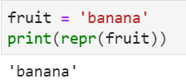


From String to List
String: an ordered sequence of characters
List: an ordered sequence of values (of any types)
fruit
b
a
n
a
n
a
0
1
2
3
4
5

Slide 6
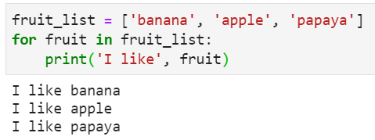
Example: Iteration over data in a list
List value: ['banana', 'apple’, 'papaya']
List variable: fruit_list

Slide 7
Case Study: Finding Some Carriers’ Shipping Rate from a File

Slide 8
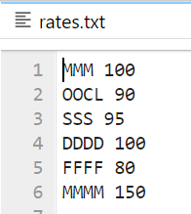
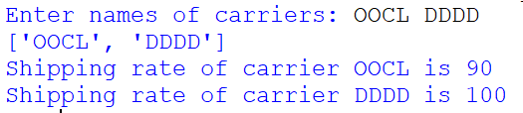
Finding Carriers’ Shipping Rates from a File: Problem Description
FE plans to ship cargoes from Hong Kong to Los Angeles every month
FE receives shipping rates from multiple carriers, and store the rates in a text file (rates.txt)
  Carrier’s ID consists of letters: MMM, OOCL
  Followed by a space and a shipping rate
FE wants to know the shipping rate for a given list of carriers
rates.txt
Output

Slide 9
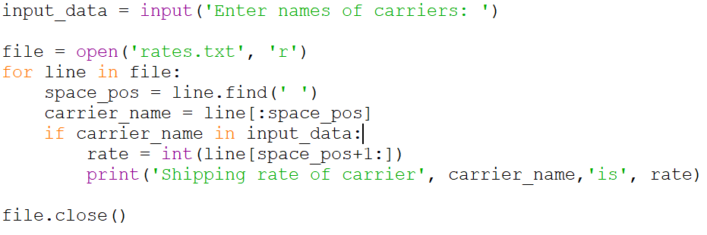
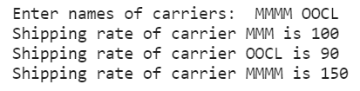
Finding Carriers’ Shipping Rates from a File
Read an input string of a list of carrier names
For each line of the file:
  Parse: If the line starts with a carrier_name in the input string
    Extract the shipping rate from the line, and print the rate
Is this code correct?
Wrong, because
“MMM” is in “MMMM OOCL”

Slide 10
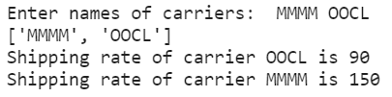
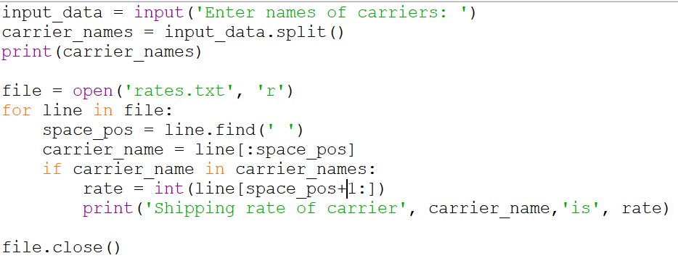
Finding Carriers’ Shipping Rates from a File: Code
Parse: transform input string to a list of carrier names
For each line of the file:
  Parse: If the line starts with a carrier_name in the input list
    Extract the shipping rate from the line, and print the rate
carrier_names is a list of strings
input_data.split() transforms a string to a list e.g., [‘MMMM’,’OOCL’]
carrier_name in carrier_names decides whether carrier_name is in the list
“MMM” is in “MMMM OOCL”
“MMM” is NOT in [“MMMM”, “OOCL”]

Slide 11
Programming = Algorithm + Data Structure
Algorithm
  A set of rules or steps used to solve a problem
Data Structure
  A particular way of organizing data in a computer
Algorithm
Parse: transform input string to a list of carrier names
For each line of the file:
  Parse: If the line starts with a carrier_name in the input list
    Extract the shipping rate from the line, and print the rate
Input_data: string
carrier_names: list of strings
Program
Line of a file: string
Shipping rate: float
carrier_name: string
Data Structure

Slide 12
Lists: Basic Concepts

Slide 13
List Constants
A list is a sequence of values
  similar to a string, but allowing elements of types other than characters
List constants are surrounded by square brackets and the elements in the list are separated by commas
A list element can be any Python object
  The elements of a list don't have to be the same type.
  A list within another list is nested
A list can be empty
>>> print([1, 24, 76])
[1, 24, 76]
>>> print(['red', 'yellow', 'blue'])
['red', 'yellow', 'blue']
>>> print(['red', 24, 98.6])
['red', 24, 98.6]
>>> print([ 1, [5, 6], 7])
[1, [5, 6], 7]
>>> print([])
[]

Slide 14
We Already Use Lists!
for i in [5, 4, 3, 2, 1] :
print(i)
print('Blastoff!')
5
4
3
2
1
Blastoff!

Slide 15
Lists and Definite Loops - Best Pals
friends = ['Joseph', 'Glenn', 'Sally']
for friend in friends :
print('Happy New Year:', friend)
print('Done!')
Happy New Year: Joseph
Happy New Year: Glenn
Happy New Year: Sally
Done!

Slide 16
Looking Inside Lists
Like strings, we can get at any single element in a list using an index (starting from 0) specified in square brackets:
Any integer expression can be used as an index
If you try to read or write an element that does not exist, you get an IndexError
If an index has a negative value, it counts backward from the end of the list
>>> friends = [ 'Joseph', 'Glenn', 'Sally' ]
>>> print(friends[1])
Glenn
>>> print(friends[-1])
Sally
>>> print(friends[3])
Traceback (most recent call last):
File "<pyshell#8>", line 1, in <module>
print(friends[3])
IndexError: list index out of range
-3
-2
-1
Joseph
Glenn
Sally
0
1
2
list variable: friends

Slide 17
Lists are Mutable, unlike String
Strings are “immutable” - we cannot change the contents of a string - we must make a new string to make any change
Lists are “mutable” - we can change an element of a list using the index operator
>>> fruit = 'Banana'
>>> fruit[0] = 'b'
Traceback
TypeError: 'str' object does not
support item assignment
>>> x = fruit.lower()
>>> print(x)
banana
>>> lotto = [2, 14, 26, 41, 63]
>>> print(lotto)
[2, 14, 26, 41, 63]
>>> lotto[2] = 28
>>> print(lotto)
[2, 14, 28, 41, 63]

Slide 18
A List is a Kind of Collection
A collection allows us to put many values in a single “variable”
  E.g., three values, ‘Joseph’, ‘Glenn’, ‘Sally’, in one variable friends
A collection is nice because we can carry all many values around in one convenient package.
friends = [ 'Joseph', 'Glenn', 'Sally' ]
carryon = [ 'socks', 'shirt', 'perfume' ]

Slide 19
Summary of Lecture 8
Programming = Algorithm + Data Structure
List is a sequence of any values
Access element of list using [index]
List is mutable, unlike string

Slide 20
Lists: Traverse

Slide 21
Traversing a list
The most common way to traverse the elements of a list is with a for loop and in
  Only work well for reading the elements of the list
An alternative way to traverse the elements of a list is with a for loop and index variable
  Work well to writing or updating the elements
friends = ['Joseph', 'Glenn', 'Sally']
for friend in friends :
print('Happy New Year:', friend)
print('Done!')
friends = ['Joseph', 'Glenn', 'Sally']
for i in range(len(friends)):
friend[i]=friend[i].lower()
print('Happy New Year:', friend[i])
print('Done!')
#len(friends) is 3
#range(len(friends)) is range(3) which generates a sequence of numbers of 0,1,2

Slide 22
How Long is a List?
Like string, the len() function can take a list as a parameter and returns the number of elements in the list
Actually len() tells us the number of elements of any set or sequence (such as a string...)
>>> greet = 'Hello Bob'
>>> print(len(greet))
9
>>> x = [ 1, 2, 'joe', 99]
>>> print(len(x))
4
>>> y = ['spam', 1, ['Brie', 'Roquefort', 'Pol le Veq'], [1, 2, 3]]
>>> print(len(y))
4

Slide 23
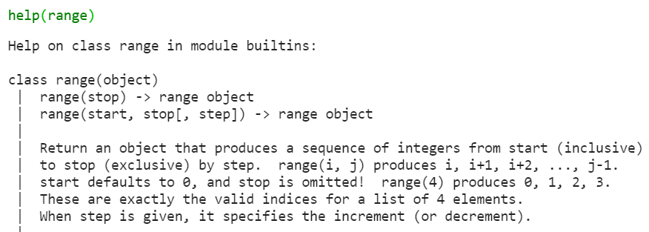
Using the range Function
The range function returns a sequence of numbers that range from zero to one less than the parameter
  The sequence of numbers generated by range() is like a list
Basic usage:
  range(stop) like [0, 1, … , stop-1]
We can construct an index loop using for and an integer iterator
>>> print(list(range(4)))
[0, 1, 2, 3]
>>> friends = ['Joseph', 'Glenn', 'Sally']
>>> print(len(friends))
3
>>> print(list(range(len(friends))))
[0, 1, 2]

Slide 24
How to simplify the for-loop over a sequence of numbers?
for i in [5, 4, 3, 2, 1] :
print(i)
print('Blastoff!')
5
4
3
2
1
Blastoff!
for i in range(5):
print(5-i)
print('Blastoff!')

Slide 25
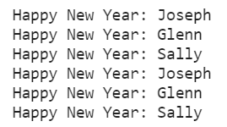
Traversing a list:
A Tale of Two Loops...
friends = ['Joseph', 'Glenn', 'Sally']
for friend in friends :
print('Happy New Year:', friend)
for i in range(len(friends)) :
friend = friends[i]
print('Happy New Year:', friend)
>>> friends = ['Joseph', 'Glenn', 'Sally']
>>> print(len(friends))
3
>>> print(range(len(friends)))
[0, 1, 2]
>>>

Slide 26
Summary of Lecture 8
Programming = Algorithm + Data Structure
List is a sequence of any values
Access element of list using [index]
List is mutable, unlike string
Two ways to traverse a list using in, len(), range()
Simplifying a for loop using range()

Slide 27
Lists: OPERATIONS

Slide 28
Concatenating Lists Using +,
Like String
We can create a new list by adding two existing lists together
>>> a = [1, 2, 3]
>>> b = [4, 5, 6]
>>> c = a + b
>>> print(c)
[1, 2, 3, 4, 5, 6]
>>> print(a)
[1, 2, 3]

Slide 29
Repeating Lists Using *,
Like String
We can create a new list by repeating a list a given number of times
>>> a = [1, 2]
>>> b = a*3
>>> print(b)
[1, 2, 1, 2, 1, 2]

Slide 30
Is Something in a List?
Like String
Python provides two operators, in and not in, that let you check if an item is in a list
These are logical operators that return True or False
They do not modify the list
>>> some = [1, 9, 21, 10, 16]
>>> 9 in some
True
>>> 15 in some
False
>>> 20 not in some
True
>>>

Slide 31
Summary of Week 8
List is a sequence of any values
Access element of list using [index]
List is mutable, unlike string
Two ways to traverse a list using in, len(), range()
Simplifying a for loop using range()
List Operations: +, * , in, not in

Slide 32
List Slices

Slide 33
Like String, Lists Can Be Sliced
Using [start:], [start:end], [:end]
>>> t = [9, 41, 12, 3, 74, 15]
>>> t[1:3]
[41,12]
>>> t[:4]
[9, 41, 12, 3]
>>> t[3:]
[3, 74, 15]
>>> t[:]
[9, 41, 12, 3, 74, 15]
Remember: Just like in strings, the second number is “up to but not including”

Slide 34
Summary of Lecture 8
Programming = Algorithm + Data Structure
List is a sequence of any values
Access element of list using [index]
List is mutable, unlike string
Two ways to traverse a list using in, len(), range()
Simplifying a for loop using range()
List Operations: +, * , in, not in
Slice of a list: [start:end], [start:], [:end]

Slide 35
List Methods

Slide 36
Methods for List
Like strings, Python also provides methods that operate on lists, available in a built-in module of the standard library.
>>> x = list()
>>> type(x)
<type 'list'>
>>> dir(x)
['append', 'count', 'extend', 'index', 'insert', 'pop', 'remove', 'reverse', 'sort']
>>>
http://docs.python.org/tutorial/datastructures.html

Slide 37
List is also a Class
A program needs to represent real-world objects (or things)
  E.g., 1, 2, 1.5, ‘everything’, [‘A’, ’B’, ’C’].
Class (or type) is used to define how a category of objects behave
  Value: how to represent the object, e.g., ‘joe’
  Methods: how to impose actions on the object, e.g., ‘JOE’.lower(), alist.append(‘a’)
A program can then create an object based on the class
>>> eee = 'hello ' + 'there'
>>> type(eee)
<class'str’>
>>> x = list()
>>> type(x)
<class 'list'>

Slide 38
Building a List from Scratch
We can create an empty list using list() or [ ]
We can add elements using the append method
The list stays in order and new elements are added at the end of the list
>>> stuff = list()
>>> stuff.append('book')
>>> stuff.append(99)
>>> print(stuff)
['book', 99]
>>> stuff.append('cookie')
>>> print(stuff)
['book', 99, 'cookie']

Slide 39
Append elements of another list
The extend method takes another list as an argument and appends all of the elements:
>>> t1 = ['a', 'b', 'c']
>>> t2 = ['d', 'e']
>>> t1.extend(t2)
>>> print(t1)
['a', 'b', 'c', 'd', 'e']
>>>

Slide 40
Lists are in Order
A list can hold many items and keeps those items in the order until we do something to change the order
A list can be sorted (i.e., change its order) using sort method
The sort method means “sort yourself” in ascending order by default. If reverse parameter is set to True, the list is sorted in descending order
>>> friends = [ 'Joseph', 'Glenn', 'Sally' ]
>>> friends.sort()
>>> print(friends)
['Glenn', 'Joseph', 'Sally']
>>> print(friends[1])
Joseph
>>> friends.sort(reverse=True)
>>> print(friends)
['Sally', 'Joseph', 'Glenn']

Slide 41
Delete Elements
If you know the index of the element to delete, use pop method
  which also returns the element to delete
If you don’t need the deleted element, you can use del operator
If you know the element to remove (not index), use remove method
To remove more than one element, use del with a slice index
>>> t = ['a', 'b', 'c']
>>> x = t.pop(1)
>>> print(t)
['a', 'c']
>>> t = ['a', 'b', 'c']
>>> del t[1]
>>> print(t)
['a', 'c']
>>> t = ['a','b','b','c']
>>> t.remove('b')
>>> print(t)
['a', 'b', 'c']
>>> t = ['a', 'b', 'c', 'd', 'e', 'f']
>>> del t[1:5]
>>> print(t)
['a', 'f']

Slide 42
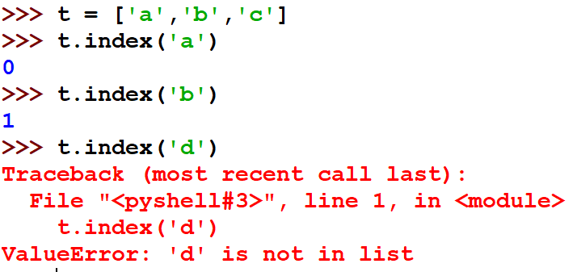
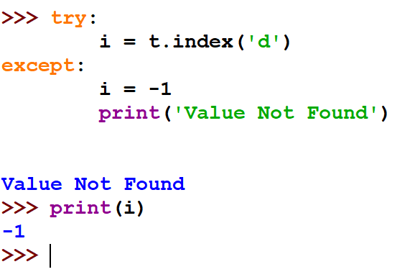
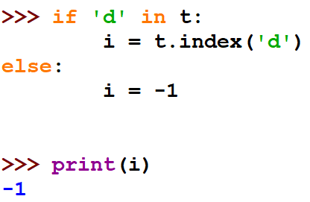
Find Index of Value
If you want to know the index of a value (object) in a list, use index(object)
  Which returns the first index of the object, and raised ValueError if the value is not in the list
How to handle ValueError?
  Use if statement and in operator
  Use try-exception

Slide 43
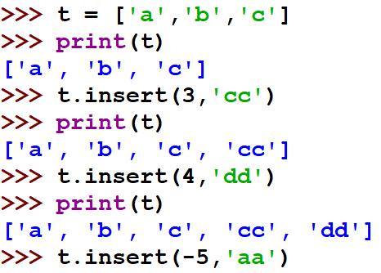

Insert Value before an Index
If you want to insert a value (object) before an index in a list, use insert(index , object)
  which insert object before index
  If index >= length of the list then insert the object at the end of the list
  If index <=-length of the list then insert the object at the beginning of the list

Slide 44
Summary of Week 8
Programming = Algorithm + Data Structure
List is a sequence of any values
Access element of list using [index]
List is mutable, unlike string
Two ways to traverse a list using in, len(), range()
Simplifying a for loop using range()
List Operations: +, * , in, not in
Slice of a list: [start:end], [start:], [:end]
Methods for List
  list(), append(), extend(), pop(), del, index(), insert()

Slide 45
Built-in functions for lists

Slide 46
Built-in Functions and Lists
There are a number of functions built into Python that take lists as parameters
Remember the loops we built in Lecture 6? These here are much simpler.
>>> nums = [3, 41, 12, 9, 74, 15]
>>> print(len(nums))
6
>>> print(max(nums))
74
>>> print(min(nums))
3
>>> print(sum(nums))
154
>>> print(sum(nums)/len(nums))
25.6

Slide 47
total = 0
count = 0
while True :
inp = input('Enter a number: ')
if inp == 'done’:
break
value = float(inp)
total = total + value
count = count + 1
average = total / count
print('Average:', average)
Using built-in functions sum:
numlist = list()
while True :
inp = input('Enter a number: ')
if inp == 'done’:
break
value = float(inp)
numlist.append(value)
average = sum(numlist) / len(numlist)
print('Average:', average)
Enter a number: 3
Enter a number: 9
Enter a number: 5
Enter a number: done
Average: 5.66666666667

Slide 48
Summary of Week 8
Programming = Algorithm + Data Structure
List is a sequence of any values
Access element of list using [index]
List is mutable, unlike string
Two ways to traverse a list using in, len(), range()
Simplifying a for loop using range()
List Operations: +, * , in, not in
Slice of a list: [start:end], [start:], [:end]
Methods for List
  list(), append(), extend(), pop(), del
Built-In functions for list
  max, min, sum, len

Slide 49
Lists and strings

Slide 50
Best Friends: Lists and Strings
Method split of a string breaks the string into parts based on a delimiter, so as to produces a list of strings.
We think of these parts as words.
We can access a particular word or loop through all the words.
>>> abc = 'With three words'
>>> stuff = abc.split()
>>> print(stuff)
['With', 'three', 'words']
>>> print(len(stuff))
3
>>> print(stuff[0])
With
>>> print(stuff)
['With', 'three', 'words']
>>> for w in stuff :
... print(w)
...
With
Three
Words
>>>

Slide 51
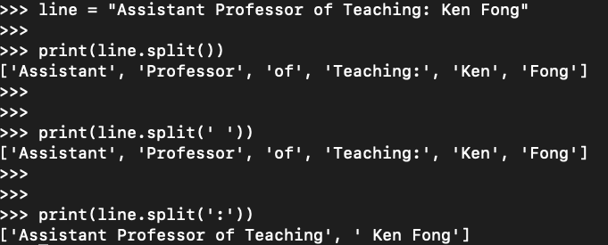
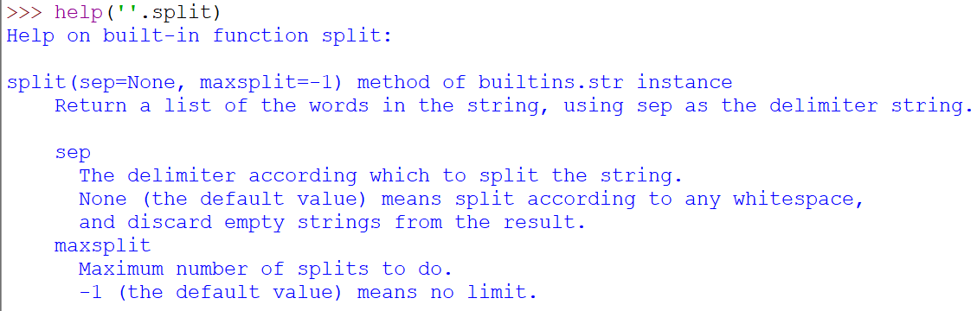
Use of split() method of a string
When you do not specify a delimiter in the parameter, multiple spaces are treated like one delimiter
You can specify what delimiter character to use in the splitting

Slide 52
Parsing Lines using if statement and split()
'From stephen.marquard@uct.ac.za Sat Jan 5 09:14:16 2008'
fhand = open('mbox-short.txt')
for line in fhand:
line = line.rstrip()
if not line.startswith('From ') :
continue
words = line.split()
print(words[2])
Sat
Fri
Fri
Fri
...
if-statement is to find “interesting lines”
split method is to find interesting part of the lines
>>> line = 'From stephen.marquard@uct.ac.za Sat Jan 5 09:14:16 2008'
>>> words = line.split()
>>> print(words)
['From', 'stephen.marquard@uct.ac.za', 'Sat', 'Jan', '5', '09:14:16', '2008']
>>>

Slide 53
The Double Split Pattern
Sometimes we split a line one way, and then grab one of the pieces of the line and split that piece again, using different delimiter for separation
From stephen.marquard@uct.ac.za Sat Jan 5 09:14:16 2008
words = line.split()
email = words[1]
pieces = email.split('@')
print pieces[1]

Slide 54
The Double Split Pattern
From stephen.marquard@uct.ac.za Sat Jan 5 09:14:16 2008
words = line.split()
email = words[1]
pieces = email.split('@')
print pieces[1]
stephen.marquard@uct.ac.za

Slide 55
The Double Split Pattern
From stephen.marquard@uct.ac.za Sat Jan 5 09:14:16 2008
words = line.split()
email = words[1]
pieces = email.split('@')
print pieces[1]
stephen.marquard@uct.ac.za
['stephen.marquard', 'uct.ac.za']

Slide 56
The Double Split Pattern
From stephen.marquard@uct.ac.za Sat Jan 5 09:14:16 2008
words = line.split()
email = words[1]
pieces = email.split('@')
print pieces[1]
stephen.marquard@uct.ac.za
['stephen.marquard', 'uct.ac.za']
'uct.ac.za'

Slide 57
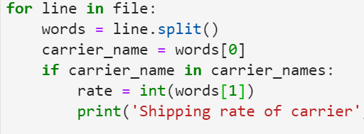
Finding Carriers’ Shipping Rates from a File: Code
Parse: transform input string to a list of carrier names
For each line of the file:
  Parse: If the line starts with a carrier_name in the input list
    Extract the shipping rate from the line, and print the rate
Apply Double Split Pattern:

Slide 58
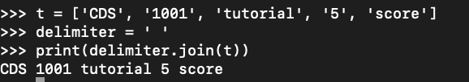
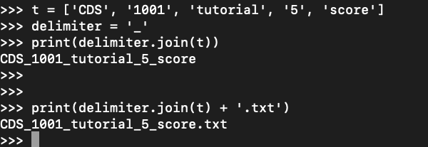
Join a list of strings to a new string
join is an inverse of split
join is a method of a string indicating the delimiter
join takes the list of strings as a parameter, and using the delimiter to concatenate them to obtain a new string

Slide 59
Summary of Week 8
Programming = Algorithm + Data Structure
List is a sequence of any values
Access element of list using [index]
List is mutable, unlike string
Two ways to traverse a list using in, len(), range()
Simplifying a for loop using range()
List Operations: +, * , in, not in
Slice of a list: [start:end], [start:], [:end]
Methods for List
  list(), append(), extend(), pop(), del
Built-In functions for list
  max, min, sum, len
List and string:
  Similarity: sequence; Difference: mutable and immutable
  String → List: split(); Double Split Pattern
  List → String: join()

Slide 60
References

Slide 61
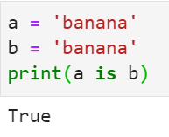
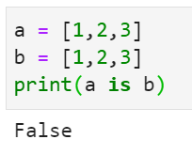
Objects and Values
a and b refer to two different list objects but having equivalent list values
a and b refer to the same string object
a
‘banana’
a
[1,2,3]
b
b
[1,2,3]

Slide 62
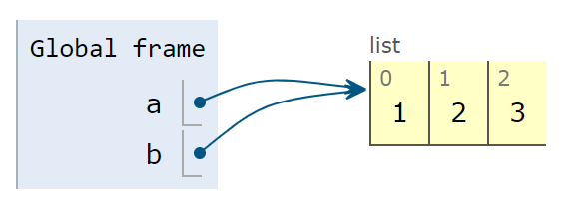
Aliasing
A variable refers to an object which has a value
The association of a variable with an object is called a reference
An object with more than one reference has more than one name, so we say that the object is aliased.
If the aliased object is mutable, changes made with one alias affect the other
>>> a = [1, 2, 3]
>>> b = a
>>> b is a
True
>>> b[0] = 17
>>> print(a)
[17, 2, 3]

Slide 63
List arguments (1)
When you pass a list to a function, the function gets a reference to the list.
  Changes will be made to the object that the parameter refers to
def delete_head(t):
del t[0]
>>> letters = ['a', 'b', 'c']
>>> delete_head(letters)
>>> print(letters)
['b', 'c']
Before del t[0] in delete_head:
t
['a', 'b', 'c’]
letters
After del t[0] in delete_head:
t
['b', 'c’]
letters

Slide 64
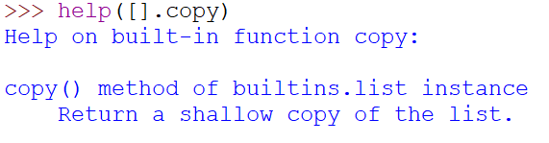
List arguments (2)
In a function, it is important to distinguish between operations that modify objects and operations that create new objects.
def bad_delete_head(t):
t = t[1:]
>>> letters = ['a', 'b', 'c’]
>>> bad_delete_head(letters)
>>> print(letters)
['a', 'b', ‘c’]
>>> t1 = [1, 2]
>>> t2 = t1.append(3)
>>> print(t1)
[1, 2, 3]
>>> print(t2)
None
>>> t3 = t1 + [3]
>>> print(t3)
[1, 2, 3, 3]
>>> t2 is t3
False
>>>
>>> t3 = [1,2,3]
>>> t2 = t3
>>> t2 is t3
True
>>> t2 = t3.copy()
>>> t2 is t3
False
Before del t[0] in delete_head:
t
['a', 'b', 'c’]
letters
After t = t[1:] in delete_head:
['b', 'c’]
t
[‘a’, 'b', 'c’]
letters

Slide 65
Summary of Week 8
Programming = Algorithm + Data Structure
List is a sequence of any values
Access element of list using [index]
List is mutable, unlike string
Two ways to traverse a list using in, len(), range()
Simplifying a for loop using range()
List Operations: +, * , in, not in
Slice of a list: [start:end], [start:], [:end]
Methods for List
  list(), append(), extend(), pop(), del
Built-In functions for list
  max, min, sum, len
List and string:
  Similarity: sequence; Difference: mutable and immutable
  String → List: split(); Double Split Pattern
  List → String: join()
Objects, values, references, aliasing
Passing list as reference to a function

Slide 66
DEBUGGING for lists
Careless use of lists (and other mutable objects) can lead to long hours of debugging

Slide 67
Pitfalls and Ways (1)
Most list methods modify the argument and return None
  List is mutable
String methods return a new string and leave the original alone
  String is immutable
To do things with lists/strings, pick an idiom and stick with it
  There are too many ways to do things
Make copies to avoid aliasing
astring = astring.strip() #correct
alist = alist.sort()# WRONG!
t.append([x]) # WRONG!
t = t.append(x) # WRONG!
t + [x] # correct
t = t + x # WRONG!
orig = t[:]
t.sort()

Slide 68
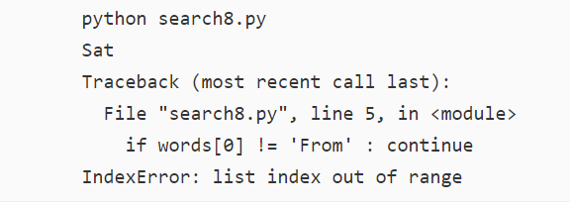
Pitfalls and Ways (2)
Lists, split, and files
  When we read and parse files, there are many opportunities to encounter input that can crash our program
  It is a good idea to revisit the guardian pattern when it comes writing programs that read through a file and look for the error
  Remember to use print() to help finding the location of the error
Example: Look for the day of the week in the ‘from’ lines of a file
fhand = open('mbox-short.txt')
for line in fhand:
words = line.split()
if words[0] != 'From’ :
continue
print(words[2])

Slide 69
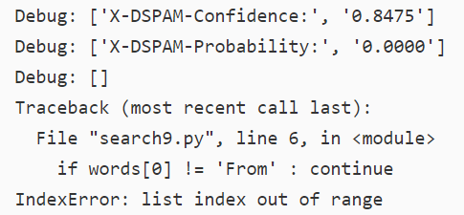
Pitfalls and Ways (2)
Lists, split, and files
  When we read and parse files, there are many opportunities to encounter input that can crash our program
  It is a good idea to revisit the guardian pattern when it comes writing programs that read through a file and look for the error
  Remember to use print() to help finding the location of the error
Example: Look for the day of the week on the from lines of a file
fhand = open('mbox-short.txt')
for line in fhand:
words = line.split()
print('Debug:', words)
if words[0] != 'From’:
continue
print(words[2])
empty lines

Slide 70
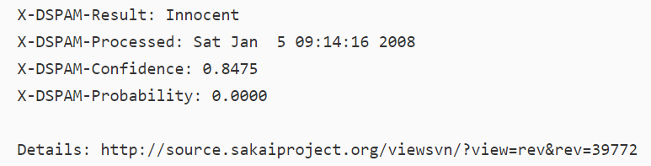
Pitfalls and Ways (2)
Lists, split, and files
  When we read and parse files, there are many opportunities to encounter input that can crash our program
  It is a good idea to revisit the guardian pattern when it comes writing programs that read through a file and look for the error
  Remember to use print() to help finding the location of the error
Example: Look for the day of the week on the from lines of a file
fhand = open('mbox-short.txt')
for line in fhand:
words = line.split()
print('Debug:', words)
if words[0] != 'From’:
continue
print(words[2])
Check the file:
An empty line

Slide 71
Pitfalls and Ways (2)
Lists, split, and files
  When we read and parse files, there are many opportunities to encounter input that can crash our program
  It is a good idea to revisit the guardian pattern when it comes writing programs that read through a file and look for the error
  Remember to use print() to help finding the location of the error
Example: Look for the day of the week on the from lines of a file
fhand = open('mbox-short.txt')
for line in fhand:
words = line.split()
#print('Debug:', words)
if len(words) == 0 :
continue
if words[0] != 'From’ :
continue
print(words[2])

Slide 72
Summary of Week 8
Programming = Algorithm + Data Structure
List is a sequence of any values
Access element of list using [index]
List is mutable, unlike string
Two ways to traverse a list using in, len(), range()
Simplifying a for loop using range()
List Operations: +, * , in, not in
Slice of a list: [start:end], [start:], [:end]
Methods for List
  list(), append(), extend(), pop(), del
Built-In functions for list
  max, min, sum, len
List and string:
  Similarity: sequence; Difference: mutable and immutable
  String → List: split(); Double Split Pattern
  List → String: join()
Objects, values, references, aliasing
Passing list as reference to a function
Debugging for lists:
  distinguish between modification and creation of an object
  check usage of methods and functions
  make copies
  check input file

Slide 73
Reminders
Submit your zip file for tutorial 6 by Nov 7 23:55
Submit your zip file for tutorial 7 by Nov 14 23:55
Feel free to contact the instructor if you have problems
  By email: kenfong@ln.edu.hk

