Slide 1
Review of Week 7: String
String type : a sequence of characters
Read/Convert
Indexing strings []: forward and backward
Looping through strings
with for and while, and len()
Slicing strings [2:4]
Concatenating strings with +
Repeating a string with *
String comparison
String is immutable
String module in standard library
Searching in strings: find()
Replacing text: replace()
Stripping white space: strip(), lstrip(), rstrip()
String prefix and suffix: startswith(), endswith()
Parsing and Extracting
String Format: %
Debugging for “index out of range”

Slide 2
Review of Week 7: Files
Secondary storage, e.g., hard disk
A file can be treated as is a sequence of lines
Opening a file - file handle
  file_handle=open(file_name,’r’)
Closing a file
  File_handle.close()
File structure - newline character
  \n
  included when reading from a file (but not included from “input”)
Reading a file line by line with a
for loop
  for line in file_handle:
Read the whole file: read()
Searching for lines
  Use in, find, startswith, etc.
Reading file names
Dealing with bad files
  try and except
Writing files
  file_handle=open(file_name,’w’)
  file_handle.write()
Debugging white spaces: repr()

Slide 3
Review of Week 8: Lists
Programming = Algorithm + Data Structure
List is a sequence of any values
Access element of list using [index]
List is mutable, unlike string
Two ways to traverse a list using in, len(), range()
Simplifying a for loop using range()
List Operations: +, * , in, not in
Slice of a list: [start:end], [start:], [:end]
Methods for List
  list(), append(), extend(), pop(), del
Built-In functions for list
  max, min, sum, len
List and string:
  Similarity: sequence; Difference: mutable and immutable
  String → List: split(); Double Split Pattern
  List → String: join()
Objects, values, references, aliasing
Passing list as reference to a function
Debugging for lists:
    distinguish between modification and creation of an object
    check usage of methods and functions
    make copies
    check input file

Slide 4
CDS1001 – Dictionaries and Tuples
The session will be recorded!

Slide 5
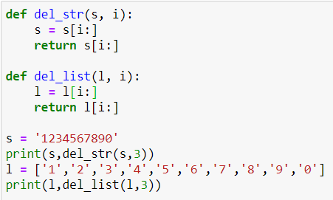
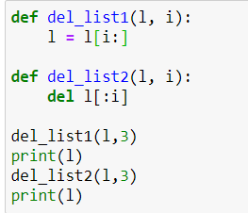
Discussion
Are the functions defined below correct to remove the third elements of a string or a list?
Will the value of l outside the functions be changed?

Slide 6
Case study: finding Some carriers’ shipping rate from a file

Slide 7
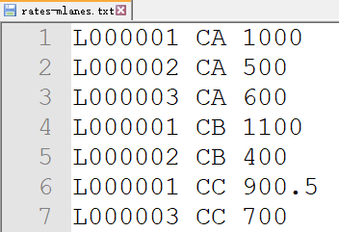

Lowest Shipping Rates for Multiple lanes: Problem Description
FE receives shipping rates from multiple carriers for multiple lanes, and store the rates in a text file (rates.txt)
  Lane’s ID consists of ‘L’ followed by six digits: L123456
  Carrier’s ID consists of letters: MMM, OOCL
  Shipping rate is a float number
  Separated by space
FE wants to know the lowest shipping rate for each lane
rates-mlanes.txt
Output

Slide 8
Lowest Shipping Rates for Multiple lanes: Analysis
Algorithm
For each line of the file:
  Parse: split the line to obtain lane_id, carrier_id, and rate
  Update: if rate is lower than the current lowest shipping rate of lane_id, then update the current lowest shipping of lane_id
Data Structure
How to keep the current lowest shipping rate for each lane_id?
  If the lane_id is an integer, we can use a list, as the index of the list is an integer
  However, lane_id is a string. We shall use a “list” with an index being a string – This is a dictionary in python
E.g. lowest_rate[0], lowest_rate[1], …
E.g. lowest_rate[‘L000000’], lowest_rate[‘‘L000001’], …

Slide 9
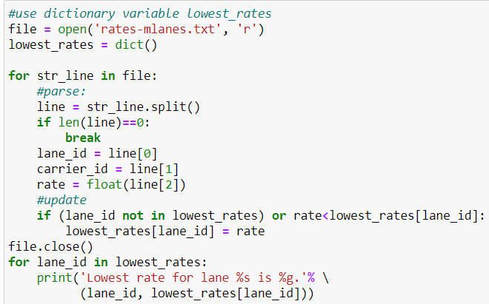
Lowest Shipping Rates for Multiple lanes: Code
lowest_rates is a dictionary variable
lane_id is a string, used as an index of lowest_rates
{‘L000001’:900.5, ‘L000002’:400.0, ‘L000003’:600.0} is a dictionary value

Slide 10
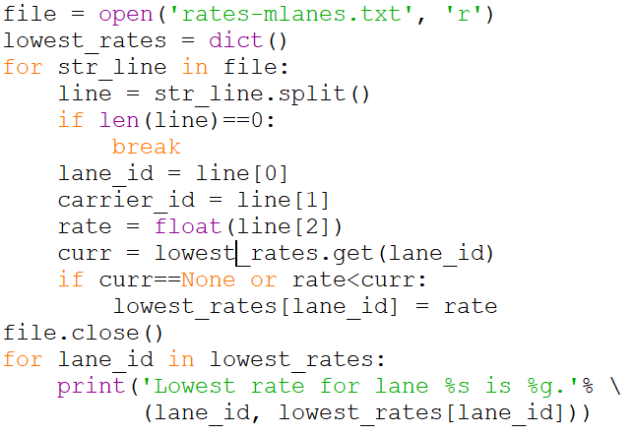
Programming = Algorithm + Data Structure
Algorithm
  A set of rules or steps used to solve a problem
Data Structure
  A particular way of organizing data in a computer
Algorithm
For each line of the file:
  Parse: split the line to obtain lane_id, carrier_id, and rate
  Update: if rate is lower than the current lowest shipping rate of lane_id, then update the current lowest shipping of lane_id
line of input file: string
Lowest_rates: Dictionary
Program
lane_id: string
rate: float
carrier_id: string
Data Structure

Slide 11
Dictionaries: Concepts

Slide 12
A dictionary is like a list, but more general.
In a list, the index positions have to be integers;
  votes = ['Joseph’, 'Sally’, 'Glenn', 'Sally’, 'Joseph’]
  print(votes[0])
In a dictionary, the indices can be (almost) any type.
  scores = {'Joseph’:2, 'Sally’: 1, 'Glenn’: 1}
  print(scores[‘Sally’])
Both list and dictionary are collections!

Slide 13
What is a Collection?
A collection is nice because we can put more than one value in it and carry them all around in one convenient package
We have a bunch of values in a single “variable”
We do this by having more than one place “in” the variable
We have ways of finding the different places in the variable

Slide 14
What is Not a “Collection”?
Most of our variables have one value in them - when we put a new value in the variable - the old value is overwritten
$ python
>>> x = 2
>>> x = 4
>>> print(x)
4

Slide 15
A Story of Two Collections..
List
  A linear collection of values that stay in order: e.g, 1st piece, 2nd piece, …
Dictionary
  A “bag” of values, each with its own label: e.g. ‘money’, ‘calculator’, …

Slide 16

Dictionaries
A dictionary is a mapping between a set of indices (which are called keys) and a set of values.
  Each key maps to a value.
  The association of a key and a value is called a key-value pair (separated by colon : ) or sometimes an item.
Dictionary:
bag={‘money’: 1000, ‘book’: 4, ‘candy’: 5}
Key: ‘money’
Value: 1000
Key-value pair: ‘money’:1000
bag[‘money’] = 1000

Slide 17
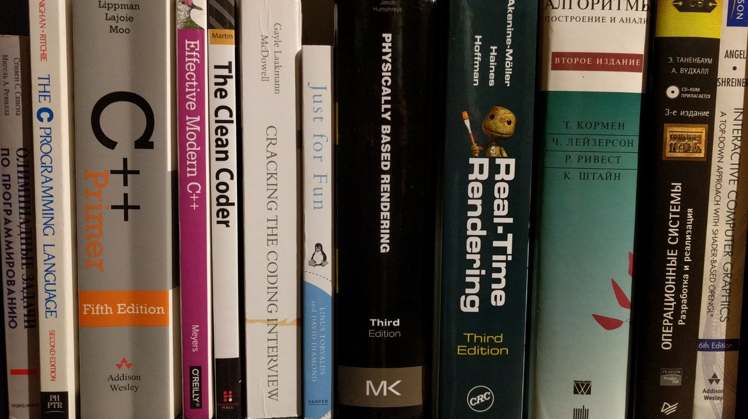
Dictionaries
ordered
No order but labeled
Lists index their entries based on the position in the list – like a book shelf
Dictionaries are like bags - no order
So we index the things we put in the dictionary with a “lookup tag” (key)
>>> purse = dict()
>>> purse['money'] = 12
>>> purse['candy'] = 3
>>> purse['tissues'] = 75
>>> print(purse)
{'money': 12, 'tissues': 75, 'candy': 3}
>>> print(purse['candy'])
3
>>> purse['candy'] = purse['candy'] + 2
>>> print(purse)
{'money': 12, 'tissues': 75, 'candy': 5}

Slide 18
Comparing Lists and Dictionaries
Dictionaries are like lists except that they use keys instead of numbers to look up values
>>> ddd = dict()
>>> ddd['age'] = 21
>>> ddd['height'] = 182
>>> print(ddd)
{'age': 21, 'height': 182}
>>> ddd['age'] = 23
>>> print(ddd)
{'age': 23, 'height': 182}
>>> lst = list()
>>> lst.append(21)
>>> lst.append(183)
>>> print(lst)
[21, 183]
>>> lst[0] = 23
>>> print(lst)
[23, 183]

Slide 19
>>> lst = list()
>>> lst.append(21)
>>> lst.append(183)
>>> print(lst)
[21, 183]
>>> lst[0] = 23
>>> print(lst)
[23, 183]
List
Key
Value
[0]
21
lst
[1]
183
>>> ddd = dict()
>>> ddd['age'] = 21
>>> ddd['height'] = 182
>>> print(ddd)
{'age': 21, 'height': 182}
>>> ddd['age'] = 23
>>> print(ddd)
{'age': 23, 'height': 182}
Dictionary
Key
Value
['age']
21
ddd
['height']
182

Slide 20
Dictionary Literals (Constants)
Dictionary literals use curly braces {} and have a list of key : value pairs (items)
You can make an empty dictionary using empty curly braces
You can use “=” to create an item that maps a key to a value
You cannot change the key using “=“
>>> jjj = { 'chuck' : 1 , 'fred' : 42, 'jan': 100}
>>> print(jjj)
{'jan': 100, 'chuck': 1, 'fred': 42}
>>> ooo = {}
>>> print(ooo)
{}
>>> jjj['test']=1
>>> print(jjj)
{'jan': 100, 'chuck': 1, 'fred': 42, 'test':1}

Slide 21
len Function : Like List
The len function for a dictionary returns the number of its key-value pairs:
>>> jjj = { 'chuck' : 1 , 'fred' : 42, 'jan': 100}
>>> print (len(jjj))
3

Slide 22
in operator: Like/Unlike List
Like/unlike list, the in operator for a dictionary tells whether something appears as a key in the dictionary
  appearing as a value is not good enough.
However, the in operator uses a faster algorithm (based on hash table) in dictionary than in list.
>>> jjj = { 'chuck' : 1 , 'fred' : 42, 'jan': 100}
>>> 'fred' in jjj
True

Slide 23
pop method and del operator: Like List
del D[k]
  to remove specified key (k)
D.pop(k) method for dictionary D
  to remove specified key (k) and return the corresponding value
D.pop(k,d) method for dictionary D
  to remove specified key (k) and return the corresponding value.
  If key is not found, d is returned if given, otherwise KeyError is raised
>>> jjj = { 'chuck' : 1 , 'fred' : 42, 'jan': 100}
>>> del jjj[‘chuck’]
>>> print(jjj)
{'fred' : 42, 'jan': 100}
>>> print(jjj.pop(‘fred’))
42
>>> print(jjj)
{'jan': 100}
>>> print(jjj.pop(‘chuck’,0))
0
>>> print(jjj)
{'jan': 100}

Slide 24
Summary of Dictionary
Dictionary vs List
Dictionary Basics
  definition, value, assignment, in operator, len function, pop method, del operator

Slide 25
Dictionary as a set of counters

Slide 26
Most Common Name?
marquard
cwen
cwen
zhen
zhen
marquard
csev
csev
zhen
marquard
zhen
csev
zhen

Slide 27
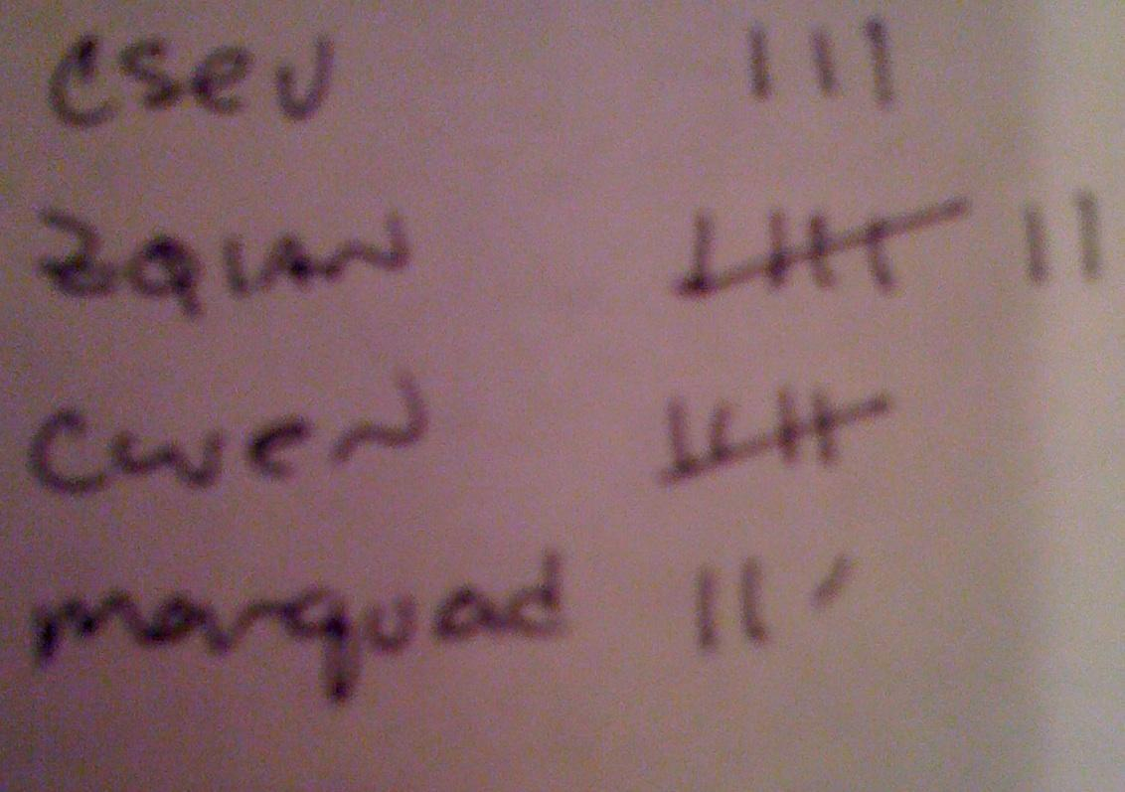
Many Counters with a Dictionary
One common use of dictionaries is counting how often we “see” something
Key
Value
>>> count = dict()
>>> count['csev'] = 1
>>> count['cwen'] = 1
>>> print(count)
{'csev': 1, 'cwen': 1}
>>> count['cwen'] = count['cwen'] + 1
>>> print(count)
{'csev': 1, 'cwen': 2}

Slide 28
Dictionary Tracebacks
It is an error to reference a key which is not in the dictionary
We can use the in operator to see if a key is in the dictionary
>>> count = dict()
>>> print(count['csev'])
Traceback (most recent call last):
File "<stdin>", line 1, in <module>
KeyError: 'csev'
>>> 'csev' in count
False

Slide 29
When We See a New Name
When we encounter a new name, we need to add a new entry in the dictionary
For the second or later time we have seen the name, we can simply add one to the count in the dictionary under that name
{'csev': 2, 'zqian': 1, 'cwen': 2}
counts = dict()
names = ['csev', 'cwen', 'csev', 'zqian', 'cwen']
for name in names :
if name not in counts:
counts[name] = 1
else :
counts[name] = counts[name] + 1
print(counts)

Slide 30
The get Method for Dictionaries
Method get() is for the pattern of
(i) checking to see if a key is already in a dictionary and
(ii) assuming a default value if the key is not there is so common
if name in counts:
x = counts[name]
else :
x = 0
>>>counts = {'csev': 2, 'zqian': 1, 'cwen': 2}
>>>print(counts[‘cwen’])
2
>>>print(counts[‘owen’])
KeyError: 'owen’
>>>print(counts.get('owen',0))
0
x = counts.get(name, 0)
0 is the default value if key does not exist (to avoid errors in Traceback).

Slide 31
Simplified Counting with get()
We can use get() and provide a default value of zero when the key is not yet in the dictionary - and then just add one
counts = dict()
names = ['csev', 'cwen', 'csev', 'zqian', 'cwen']
for name in names :
counts[name] = counts.get(name, 0) + 1
print(counts)
Default
{'csev': 2, 'zqian': 1, 'cwen': 2}

Slide 32
Counting Words in Text
Writing programs (or programming) is a very creative and rewarding activity. You can write programs for many reasons ranging from making your living to solving a difficult data analysis problem to having fun to helping someone else solve a problem. This book assumes that everyone needs to know how to program and that once you know how to program, you will figure out what you want to do with your newfound skills.
We are surrounded in our daily lives with computers ranging from laptops to cell phones. We can think of these computers as our “personal assistants” who can take care of many things on our behalf. The hardware in our current-day computers is essentially built to continuously ask us the question, “What would you like me to do next?”
Our computers are fast and have vast amounts of memory and could be very helpful to us if we only knew the language to speak to explain to the computer what we would like it to do next. If we knew this language we could tell the computer to do tasks on our behalf that were repetitive. Interestingly, the kinds of things computers can do best are often the kinds of things that we humans find boring and mind-numbing.

Slide 33
Counting Pattern
The general pattern to count the words in a line of text is to
split the line into words, then
loop through the words, and
use a dictionary to track the count of each word independently.
counts = dict()
print('Enter a line of text:')
line = input('')
words = line.split()
print('Words:', words)
print('Counting...')
for word in words:
counts[word] = counts.get(word,0) + 1
print('Counts', counts)

Slide 34
counts = dict()
line = input('Enter a line of text:')
words = line.split()
print('Words:', words)
print('Counting...’)
for word in words:
counts[word] = counts.get(word,0) + 1
print('Counts', counts)
python wordcount.py
Enter a line of text:
the clown ran after the car and the car ran into the tent and the tent fell down on the clown and the car
Words: ['the', 'clown', 'ran', 'after', 'the', 'car', 'and', 'the', 'car', 'ran', 'into', 'the', 'tent', 'and', 'the', 'tent', 'fell', 'down', 'on', 'the', 'clown', 'and', 'the', 'car']
Counting...
Counts {'and': 3, 'on': 1, 'ran': 2, 'car': 3, 'into': 1, 'after': 1, 'clown': 2, 'down': 1, 'fell': 1, 'the': 7, 'tent': 2}

Slide 35
Finding Minimums for Keys: Lowest Rates for Lanes
lowest_rates is a dictionary variable
lane_id is a string, used as an index of lowest_rates
{‘L000001’:900.5, ‘L000002’:400.0, ‘L000003’:600.0} is a dictionary value
How to simplify this by using get() method of the dictionary?

Slide 36
Summary of Dictionary
Dictionary vs List
Dictionary Basics
  definition, value, assignment, in operator, len function, pop method, del operator
Dictionary as a set of counters
  use of get method() to handle counting pattern

Slide 37
Looping and dictionaries

Slide 38
Definite Loops and Dictionaries
Even though dictionaries are not stored in order, we can write a for loop that goes through all the entries in a dictionary by keys
This loop goes through all of the keys in the dictionary and looks up the values
>>> counts = { 'chuck' : 1 , 'fred' : 42, 'jan': 100}
>>> for key in counts:
... print(key, counts[key])
...
jan 100
chuck 1
fred 42
>>>

Slide 39
Retrieving Lists of Keys, Values, and Items: keys(), values(), and items()
You can get a list of keys, values, or items (both) from a dictionary using methods keys(), values(), and items()
>>> jjj = { 'chuck' : 1 , 'fred' : 42, 'jan': 100}
>>> print(jjj.keys())
['jan', 'chuck', 'fred']
>>> print(jjj.values())
[100, 1, 42]
>>> print(jjj.items())
[('jan', 100), ('chuck', 1), ('fred', 42)]
>>>
What is a “tuple”?
- coming soon...

Slide 40
Bonus: Two Iteration Variables!
We can loop through the key-value pairs in a dictionary using two iteration variables
Each iteration, the first variable is the key and the second variable is the corresponding value for the key
jjj = { 'chuck' : 1 , 'fred' : 42, 'jan': 100}
for aaa,bbb in jjj.items() :
print(aaa, bbb)
jan 100
chuck 1
fred 42
aaa
bbb
[jan]
100
[chuck]
1
[fred]
42

Slide 41
Find the most frequent word in a file
name = input('Enter file:')
handle = open(name)
counts = dict()
for line in handle:
words = line.split()
for word in words:
counts[word] = counts.get(word,0) + 1
bigcount = None
bigword = None
for word,count in counts.items():
if bigcount is None or count > bigcount:
bigword = word
bigcount = count
print(bigword, bigcount)
Count words in a file by using two nested loops: a loop inside a loop
Find the most frequent words using two iteration variables
Enter file: words.txt
to 16

Slide 42
Summary of Dictionary
Dictionary vs List
Dictionary Basics
  definition, value, assignment, in operator, len function, pop method, del operator
Dictionary as a set of counters
  use of get method() to handle counting pattern
Traversing dictionary for their keys, values, and items
  Use of methods keys(), values(), and items()

Slide 43
Advanced text parsing

Slide 44
Text without punctuation or capitalization :
the clown ran after the car and the car ran into the tent and the tent fell down on the clown and the car
Text with punctuation and capitalization:
But, soft! what light through yonder window breaks?
It is the east, and Juliet is the sun.
Arise, fair sun, and kill the envious moon,
Who is already sick and pale with grief,
>>>line='But, soft! what light through yonder window breaks?'
>>>line.split()
['But,', 'soft!', 'what', 'light', 'through', 'yonder', 'window', 'breaks?']

Slide 45
maketrans and translate methods for a string
line.translate(str.maketrans(fromstr, tostr, deletestr))
  Return a new string that replaces the characters in fromstr with the character in the same position in tostr and delete all characters that are in deletestr.
  The fromstr and tostr can be empty strings and the deletestr parameter can be omitted.
>>>import string
>>>string.punctuation
'!"#$%&\'()*+,-./:;<=>?@[\\]^_`{|}~'
>>>line=‘But, soft! what light through yonder window breaks?’
>>> line.translate(str.maketrans('','',string.punctuation))
'But soft what light through yonder window breaks’
>>> line.translate(str.maketrans('','',string.punctuation)).lower()
'but soft what light through yonder window breaks'

Slide 46
Counting words with punctuations and capitalization
import string
fname = input('Enter the file name: ')
try:
fhand = open(fname)
except:
print('File cannot be opened:', fname)
exit()
counts = dict()
for line in fhand:
line = line.rstrip()
line = line.translate(str.maketrans('', '', string.punctuation))
line = line.lower()
words = line.split()
for word in words:
if word not in counts:
counts[word] = 1
else:
counts[word] += 1
print(counts)
Enter the file name: romeo.txt
{'but': 1, 'soft': 1, 'what': 1, 'light': 1, 'through': 1, 'yonder': 1, 'window': 1, 'breaks': 1, 'it': 1, 'is': 3, 'the': 3, 'east': 1, 'and': 3, 'juliet': 1, 'sun': 2, 'arise': 1, 'fair': 1, 'kill': 1, 'envious': 1, 'moon': 1, 'who': 1, 'already': 1, 'sick': 1, 'pale': 1, 'with': 1, 'grief': 1}

Slide 47
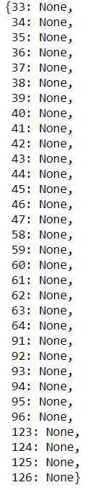
line.translate(str.maketrans('', '', string.punctuation)
str.maketrans('', '', string.punctuation) creates a dictionary that maps each punctuation symbol to None
This dictionary used in the translate method

Slide 48
Summary of Dictionary
Dictionary vs List
Dictionary Basics
  definition, value, assignment, in operator, len function, pop method, del operator
Dictionary as a set of counters
  use of get method() to handle counting pattern
Traversing dictionary for their keys, values, and items
  Use of methods keys(), values(), and items()
Advanced text parsing before using dictionary
  use of translate and maketrans methods of a string

Slide 49
Debugging for large datasets

Slide 50
Debugging for Large Datasets
Scale down the input
  If possible, starts with a small size of the dataset
  If there is an error,
    you can reduce the size to the smallest value that manifests the error, and
    then increase the size gradually as you find and correct errors
For example, if your program reads a large text file but has an error
  Create a new file that only contains the first 10 lines of the large file
  Test your program on this smaller file
  If your program still has errors when reading this smaller file:
    check and correct the errors of your program
  Else add more lines to the new file, and go to test it again

Slide 51
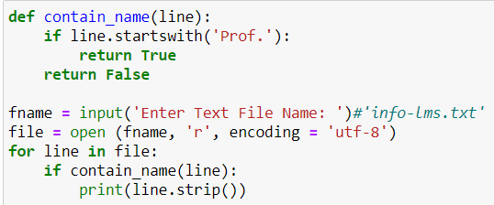
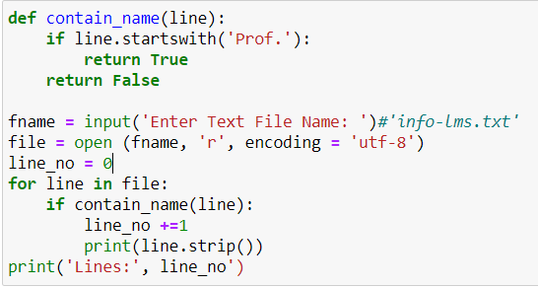
Debugging for Large Datasets
Check summaries and types
  Instead of printing and checking the entire dataset, consider printing summaries of the data
    E.g. the number of items in a dictionary (using len function) or the total of a list of numbers (using sum function)
  A common cause of runtime errors is a value that is not the right type.
    For debugging this kind of error, it is often enough to print the type of a value.
Count the number of staffs output, which must be the same for names, emails, phones, rooms, etc.

Slide 52

Debugging for Large Datasets
Write self-checks
  Sometimes you can write code to check for errors automatically.
  For example, suppose you are computing the average of a list of numbers
    You could check that the result is not greater than the largest element in the list or less than the smallest.
      This is called a "sanity check" because it detects results that are "completely illogical".
    Another kind of check compares the results of two different computations to see if they are consistent.
      This is called a "consistency check".

Slide 53
Debugging for Large Datasets
Pretty print the output
  Formatting debugging output can make it easier to spot an error.

Slide 54
Summary of Dictionary
Dictionary vs List
Dictionary Basics
  definition, value, assignment, in operator, len function, pop method, del operator
Dictionary as a set of counters
  use of get method() to handle counting pattern
Traversing dictionary for their keys, values, and items
  Use of methods keys(), values(), and items()
Advanced text parsing before using dictionary
  use of translate and maketrans methods of a string
Debugging for large data sets

Slide 55
Retrieving Lists of Keys, Values, and Items: keys(), values(), and items()
You can get a list of keys, values, or items (both) from a dictionary using methods keys(), values(), and items()
>>> jjj = { 'chuck' : 1 , 'fred' : 42, 'jan': 100}
>>> print(jjj.keys())
['jan', 'chuck', 'fred']
>>> print(jjj.values())
[100, 1, 42]
>>> print(jjj.items())
[('jan', 100), ('chuck', 1), ('fred', 42)]
>>>
What is a “tuple”?
- coming soon...

Slide 56
Tuples: concepts

Slide 57
Examples of Tuples
votes = ['Joseph’, 'Sally’, 'Glenn', 'Sally’, 'Joseph’]
scores = {'Joseph’:2, 'Sally’: 2, 'Glenn’: 1}
>>>scores.items()
dict_items([('Joseph', 2), ('Sally', 2), ('Glenn', 1)])
>>> joseph_item = (‘Joseph’, scores[‘Joseph’])
List value: ['Joseph’, 'Sally’, 'Glenn', 'Sally’, 'Joseph’]
  Index is integer
List variable: votes
Dictionary value: {'Joseph’:0, 'Sally’: 0, 'Glenn’: 0}
  Index can be any type
Dictionary variable: scores
Tuple value: ('Joseph', 2)
Tuple variable: joseph_item

Slide 58
Tuples
Syntactically, a tuple is a comma-separated list of values:
  E.g. , t = 'a', 'b', 'c', 'd', 'e'
Although it is not necessary, it is common to enclose tuples in parentheses to help us quickly identify tuples when we look at Python code:
  E.g. , t = ('a', 'b', 'c', 'd', 'e')
To create a tuple with a single element, you have to include the final comma:
  E.g. , t = ('a’,)
  If the last comma is included, the value is not a tuple: E.g., (‘a’) is a string ‘a’

Slide 59
Tuples Are Like Lists
Tuples are another kind of sequence that functions much like a list - they have elements which are indexed starting at 0
- elements can be accessed by index or slices or for loop
- functions len, max, min, sum and operators in, +, * are applicable
>>> x = ('Glenn', 'Sally', 'Joseph')
>>> print(x[2])
Joseph
>>> y = ( 1, 9, 2 )
>>> print(y)
(1, 9, 2)
>>> print(y[1:])
(9, 2)
>>> print(max(y))
9
>>> for iter in y:
... print(iter)
...
1
9
2
>>>

Slide 60
but... Tuples are “immutable”
Unlike a list, once you create a tuple, you cannot alter its contents - similar to a string
>>> x = [9, 8, 7]
>>> x[2] = 6
>>> print(x)
>>>[9, 8, 6]
>>>
>>> y = 'ABC'
>>> y[2] = 'D'
Traceback:'str' object does
not support item
Assignment
>>>
>>> z = (5, 4, 3)
>>> z[2] = 0
Traceback:'tuple' object does
not support item
Assignment
>>>

Slide 61
Things not to do With Tuples
>>> x = (3, 2, 1)
>>> x.sort()
Traceback:
AttributeError: 'tuple' object has no attribute 'sort'
>>> x.append(5)
Traceback:
AttributeError: 'tuple' object has no attribute 'append'
>>> x.reverse()
Traceback:
AttributeError: 'tuple' object has no attribute 'reverse'
>>>

Slide 62
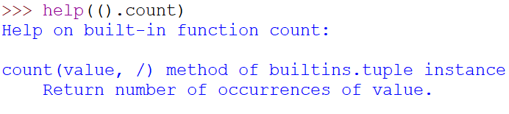
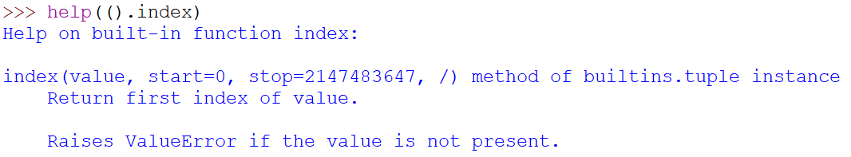
A Tale of Two Sequences
>>> l = [1,2,2]
>>> dir(l)
['append', 'count', 'extend', 'index', 'insert', 'pop', 'remove', 'reverse', 'sort']
>>> t = (1,2,2)
>>> dir(t)
['count', 'index’]
>>> print(t.count(2))
2
>>> print(t.index(2))
1
>>> print(t.index(2,2))
2

Slide 63
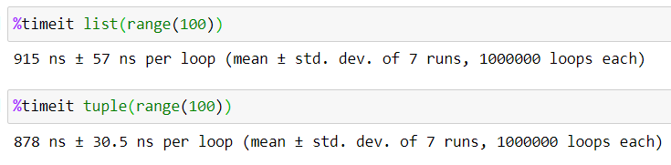
Tuples are More Efficient
Since Python does not have to build tuple structures to be modifiable, they are simpler and more efficient in terms of memory use and performance than lists
So in our program when we are making “temporary variables” or variables that will not be modified, we prefer tuples over lists
  For example: seasons=(‘spring’, summer’, ’fall’, ’winter’)

Slide 64
Tuples and Assignment
We can also put a tuple on the left-hand side of an assignment statement, the right hand side can be a tuple or a list
We can even omit the parentheses
>>> (x, y) = (4, 'fred')
>>> print(y)
fred
>>> a, b = (99, 98)
>>> print(a)
99
>>> m = [ 'have', 'fun' ]
>>> (x, y) = m
>>> x
'have’
>>> addr = 'monty@python.org'
>>> uname, domain = addr.split('@’)
>>> print(uname)
monty

Slide 65
Tuples and Dictionaries
>>> d = dict()
>>> d['csev'] = 2
>>> d['cwen'] = 4
>>> for (k,v) in d.items():
... print(k, v)
...
csev 2
cwen 4
>>> tups = d.items()
>>> print(tups)
dict_items([('csev', 2), ('cwen', 4)])
The items() method in dictionaries returns a list of (key, value) tuples
A nice code pattern for traversing the keys and values of a dictionary in a single for loop:
for key, val in d.items()

Slide 66
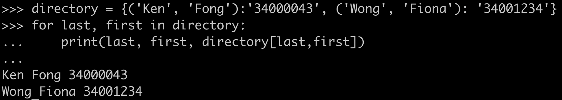
Using Tuples as Composite Keys in a Dictionary
If we want to create a composite key to use in a dictionary we must use a tuple as the key (not list)
For example, we want to create a telephone directory, mapping last-name and first-name to telephone numbers
  key: (last-name, first-name)
  value: telelphone number
directory[last,first] = number

Slide 67
Summary of Tuples
Tuples
  Like list, but Immutable
  Use as items or keys of dictionaries
  Assignment: (x,y) = (‘a’,’b’)

Slide 68
Tuples: comparing

Slide 69
Tuples are Comparable
The comparison operators work with tuples and other sequences.
If the first item is equal, Python goes on to the next element, and so on, until it finds elements that differ.
>>> (0, 1, 2) < (5, 1, 2)
True
>>> (0, 1, 2000000) < (0, 3, 4)
True
>>> ( 'Jones', 'Sally' ) < ('Jones', 'Sam')
True
>>> ( 'Jones', 'Sally') > ('Adams', 'Sam')
True
This is so called lexicographical order, which generalizes the alphabetical order

Slide 70
Sort Items of a Dictionary by Keys
Items of a dictionary can be sorted by keys by using built-in function sorted()
>>> d = {'a':10, 'b':1, 'c':22}
>>> d.items()
dict_items([('a', 10), ('c', 22), ('b', 1)])
>>> sorted(d)
['a', 'b', 'c']
>>> sorted(d.items())
[('a', 10), ('b', 1), ('c', 22)]
What’s the difference between these two sorts?
How to sort items of a dictionary by values?

Slide 71
Sort Items of a Dictionary by Values
We can take advantage of tuples to sort items of dictionary by their values
  If we could construct a list of tuples of the form (value, key) we could sort by value
  We do this with a for loop that creates a list of tuples
  >>> c = {'a':10, 'b':1, 'c':22}
  >>> tmp = list()
  >>> for k, v in c.items() :
  ... tmp.append( (v, k) )
  ...
  >>> print(tmp)
  [(10, 'a'), (22, 'c'), (1, 'b')]
  >>> tmp = sorted(tmp, reverse=True)
  >>> print(tmp)
  [(22, 'c'), (10, 'a'), (1, 'b')]

Slide 72
The top 10 most common words
fhand = open('romeo.txt')
counts = {}
for line in fhand:
words = line.split()
for word in words:
counts[word] = counts.get(word, 0) + 1
lst = []
for key, val in counts.items():
newtup = (val, key)
lst.append(newtup)
lst = sorted(lst, reverse=True)
for val, key in lst[:10] :
print(key, val)
A Pattern of Data Processing: DSU
Decorate
  build a list of tuples with one or more sort keys preceding the elements from the sequence
Sort
  sort the list
Undercorate
  Extract the sorted elements of the sequence.

Slide 73
Sort Items of a Dictionary by Values: Even a shorter version
>>> c = {'a':10, 'b':1, 'c':22}
>>> print( sorted( [ (v,k) for k,v in c.items() ] ) )
[(1, 'b'), (10, 'a'), (22, 'c')]
Use list comprehension to creates a dynamic list.
In this case, we make a list of tuples and then sort it.
https://realpython.com/list-comprehension-python/
http://wiki.python.org/moin/HowTo/Sorting

Slide 74
Summary of Tuples
Tuples
  Like list, but Immutable
  Use as items or keys of dictionaries
  Assignment: (x,y) = (‘a’,’b’)
Comparing Tuples
Using tuples for soring a dictionary
  DSU Pattern

Slide 75
Sequencing: strings, lists, and tuples

Slide 76
Strings, Lists, and Tuples are all Sequences
Strings are more limited than other sequences because the elements have to be characters.
  They are also immutable.
  If you need the ability to change the characters in a string (as opposed to creating a new string), you might want to use a list of characters instead.
“MMM” is in “MMMM OOCL”
“MMM” is NOT in [“MMMM”, “OOCL”]

Slide 77
Strings, Lists, and Tuples are all Sequences
Lists are more common than tuples, mostly because they are mutable.
But there are a few cases where you might prefer tuples:
  In some contexts, like a return statement, it is syntactically simpler to create a tuple than a list. In other contexts, you might prefer a list.
  If you want to use a sequence as a dictionary key, you have to use an immutable type like a tuple or string.
  If you are passing a sequence as an argument to a function, using tuples reduces the potential for unexpected behavior due to aliasing.

Slide 78
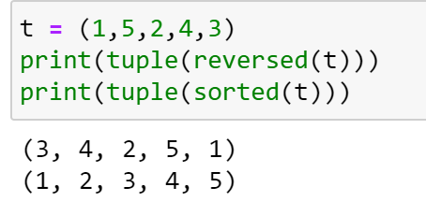
Strings, Lists, and Tuples are all Sequences
Because tuples are immutable, they don't provide methods like sort and reverse, which modify existing lists.
However, Python provides the built-in functions sorted and reversed, which take any sequence as a parameter and return a new sequence with the same elements in a different order.

Slide 79
Summary of Tuples
Tuples
  Like list, but Immutable
  Use as items or keys of dictionaries
  Assignment: (x,y) = (‘a’,’b’)
Comparing Tuples
Using tuples for soring a dictionary
  DSU Pattern
Comparing Strings, Lists, and Tuples

Slide 80
Debugging: “shape errors” and 4R Strategy

Slide 81
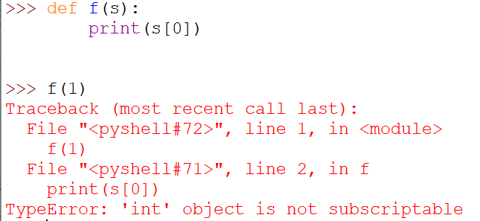
Shape Errors
Lists, dictionaries and tuples are known generically as data structures
Compound data structures, like lists of tuples, and dictionaries, contain tuples as keys and lists as values.
Compound data structures are prone to get shape errors
  Errors caused when a data structure has the wrong type, size, or composition, or
  You write some code and forget the shape of your data and introduce an error
For example, if you are expecting a list with one integer and I give you a plain old integer (not in a list), it won't work.

Slide 82
4R Debugging Strategy
Reading
  Examine your code, read it back to yourself, and check that it says what you meant to say.
Running
  Experiment by making changes and running different versions.
Ruminating
  Take some time to think! What kind of errors? What information can get from errors? What could be the causes? What have been changed? …
Retreating
  At some point, the best thing to do is back off, undoing recent changes, until you get back to a program that works and that you understand.
  Then you can start rebuilding.

Slide 83
Summary of Tuples
Tuples
  Like list, but Immutable
  Use as items or keys of dictionaries
  Assignment: (x,y) = (‘a’,’b’)
Comparing Tuples
Using tuples for soring a dictionary
  DSU Pattern
Comparing Strings, Lists, and Tuples
Debugging
  Shape Errors for compound data structure
  4R Debugging Strategy

Slide 84
Objectives of Tutorial 8
Understand why dictionaries and tuples are used in coding
Understand dictionaries as well as their basic operations and functions
Be able to use a dictionary as a set of counters
Be able to traverse keys, values, and key-value pairs of a dictionary
Be able to use translate and maketrans functions to parsing texts
Understand tuples as well their basic operations and functions
Understand how to compare tuples
Be able to use tuples as keys in a dictionary
Be able to sort keys of a dictionary, and to use tuples and lists to sort values of a dictionary (following the Decorate-Sort-Undecroate Pattern)

Slide 85
CDS1001: Tutorial Exercises
Basics about Python Coding:
Tutorial 1: Coding environment for Python
Tutorial 2: Variables and simple data types
Tutorial 3: Conditions and flowcharts
Tutorial 4: Functions
Tutorial 5: Iterations
Tutorial 6: Strings and Files
Tutorial 7: Lists
  Deadline: 14 Nov 23:55
Tutorial 8: Dictionaries and Structured Data
  Deadline: 21 Nov 23:55
Basic Applications:
Tutorial 9: Working with Excel Files
  Deadline: 21 Nov 23:55
Tutorial 10: Acquiring and Exploring Data
  Deadline: 28 Nov 23:55
Individual Assignment:
Deadline: 19 Nov 23:55
Final Examination:
13 Dec 14:00 – 16:00 (SEKG03)

