Slide 1
IERG 4210 Tutorial 2
Phase 2A Server Setup
2024 Spring
TA: CHEN Lin
cl022@ie.cuhk.edu.hk
(Modified from the previous version by Xie Siyue and Xiao Yi)
(Many thanks to TA Zhou Jiuqin for helping me to make this tutorial)

Slide 2
Outline
Amazon Web Service and EC2 Instance
Environment Setup
  Linux, Nginx, NodeJS and MySQL (or SQLite)
Security Configurations

Slide 3
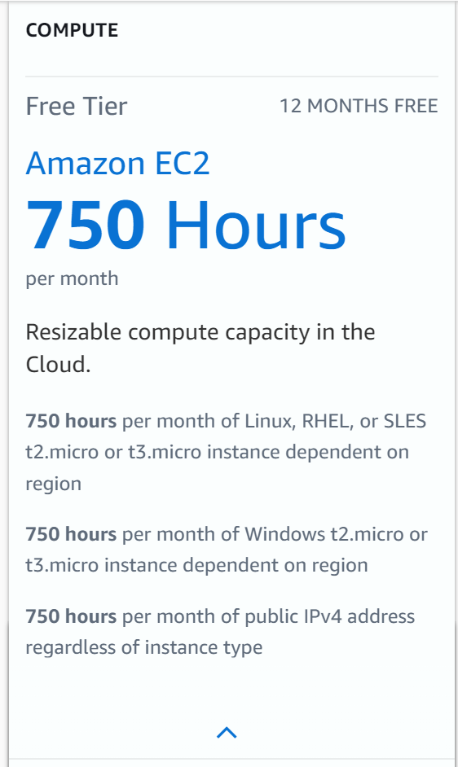
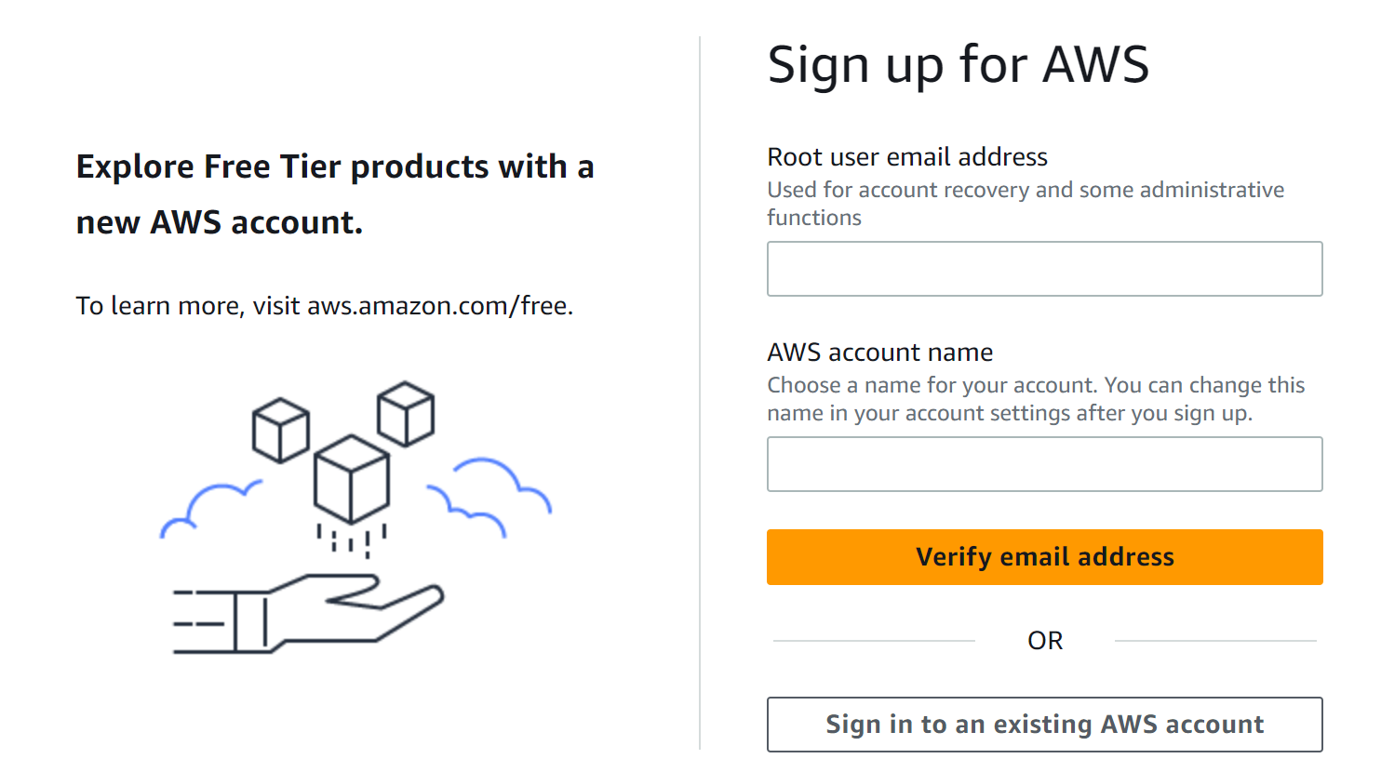
Amazon Web Service (AWS)
AWS provides the 12-month free EC2 instance for every newly registered user. If you have already used up
your free quota, you can register using a new email address.
AWS Free Usage
  http://aws.amazon.com/free
  https://portal.aws.amazon.com/billing/signup#/start
  You need to bind a credit card with your account

Slide 4
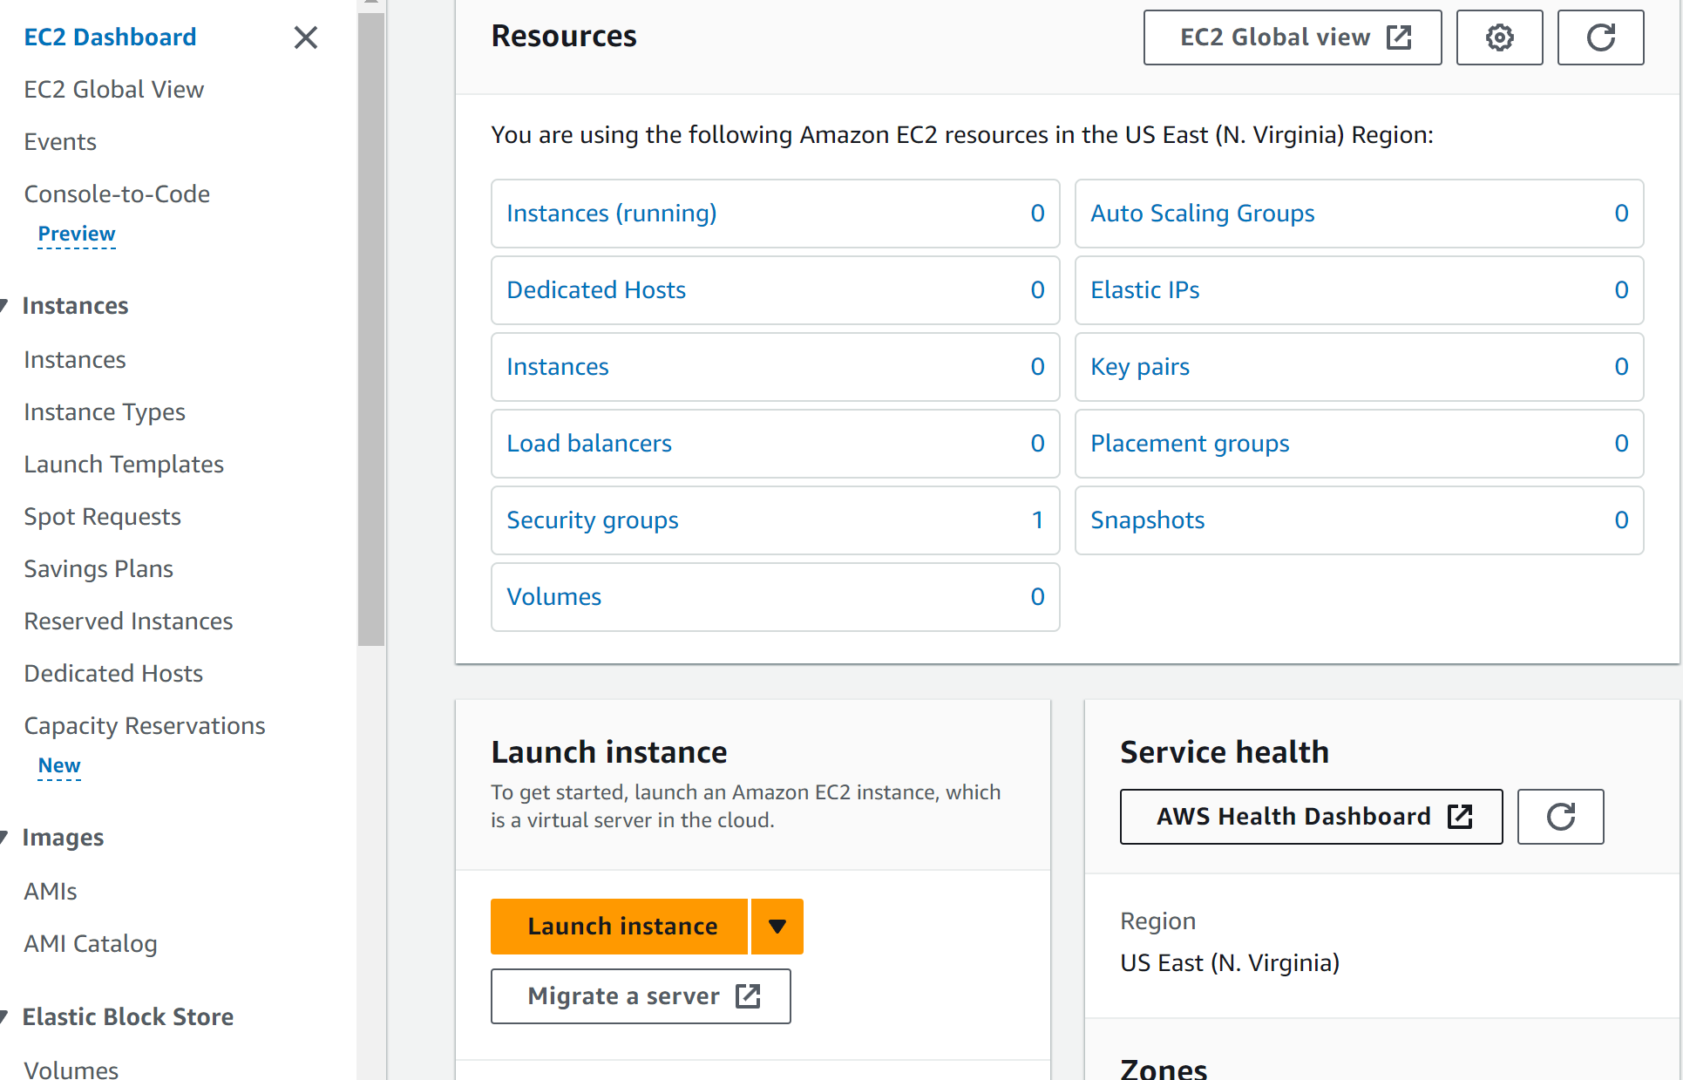
Create EC2 Instance
Login your AWS account
Enter EC2 Console
Create an EC2 virtual server
  Select Instance in the side panel
  Click Launch Instance

Slide 5
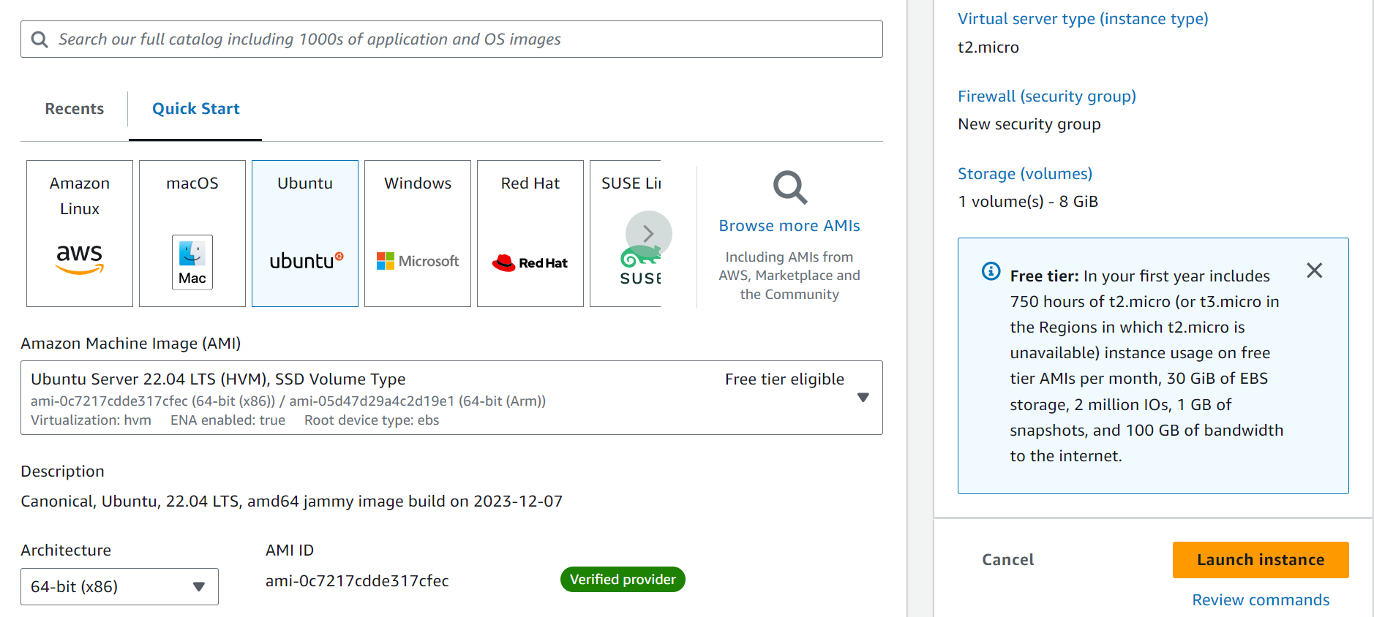
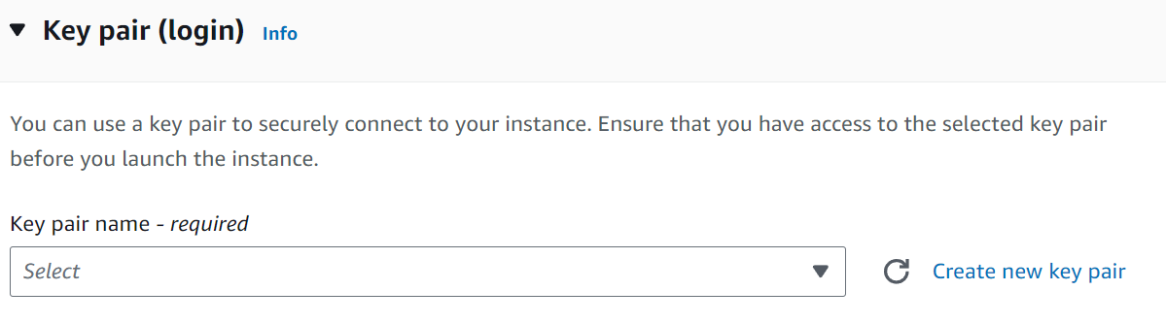
Create EC2 Instance
Login your AWS account
Enter Console
Create an EC2 virtual server
Select a free tier image
  Ubuntu Server 22.04 LTS (HVM), SSD Volume Type,
  t2.micro
Create a private key pair
Confirm and Launch
  IMPORTANT: save the private key pair to your local machine!

Slide 6
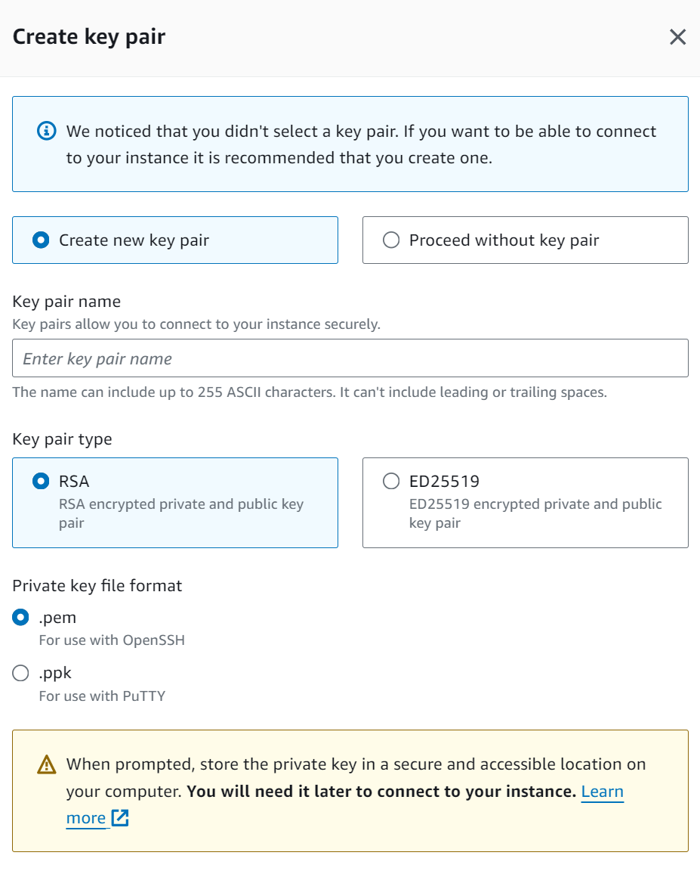
Create a private key pair
Select a free tier image
  Ubuntu Server 22.04 LTS (HVM), SSD Volume Type,
  t2.micro
Create a private key pair “xxx.pem”
Confirm and Launch
  IMPORTANT: save the private key pair to your local machine!

Slide 7
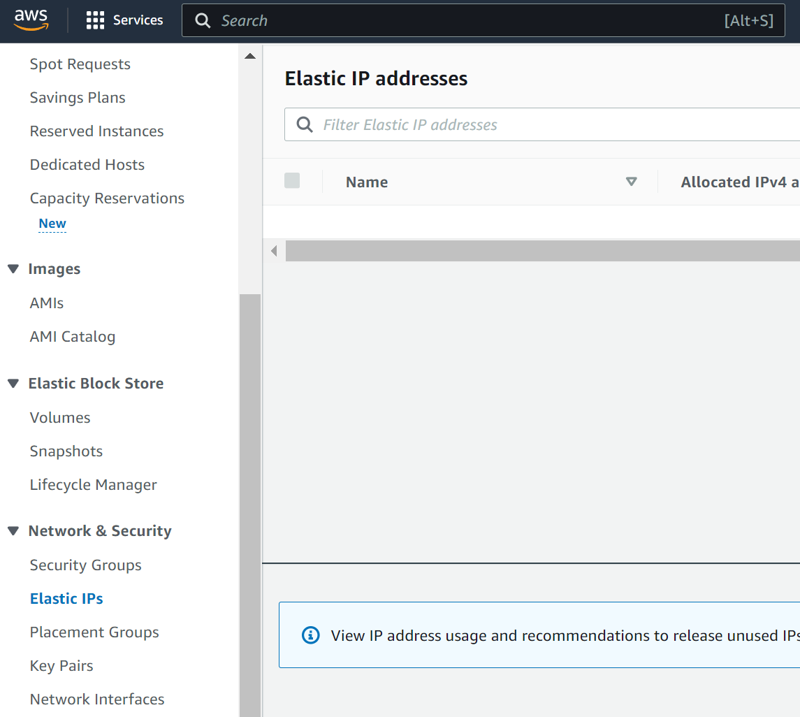
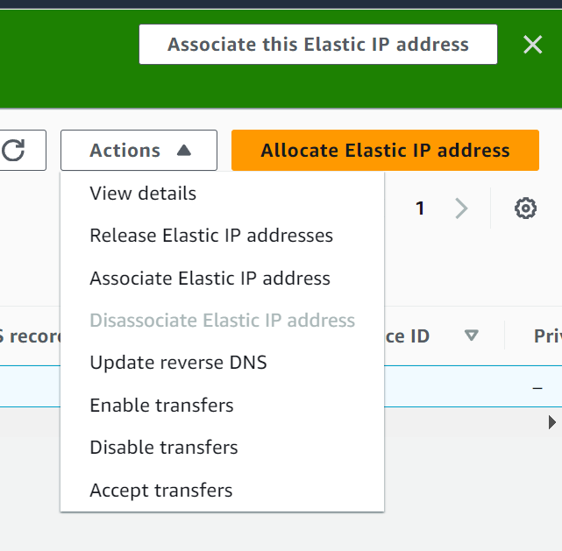
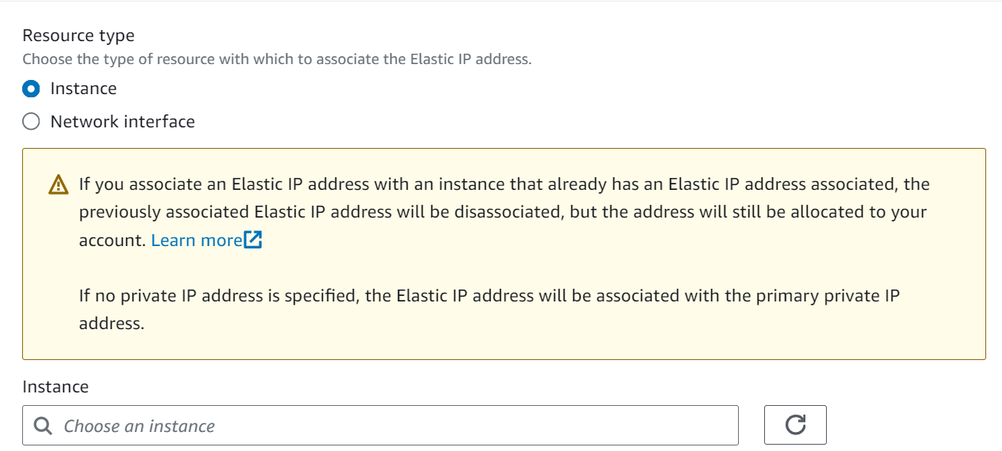
Elastic IP
Enter EC Console
Select Elastic IP in the side panel and
Click Allocate Address and confirm
Associate the IP address to the EC2 instance

Slide 8
Remotely Access via SSH
Default ssh tools (Linux, Mac, Winows) by opening Terminal
Other ssh tools
Putty (Windows), Xshell (Windows), MobaXterm (Windows), and Royal TSX (Mac), or IDE, e.g., VSCode Remote (Windows & Linux & Mac)
Type the following command to connect:
ssh -i “xxx.pem” ubuntu@[server IP address]
where “xxx.pem” is the path to your private key, and [server IP address] is the Elastic IP address of your EC2 instance.

Slide 9

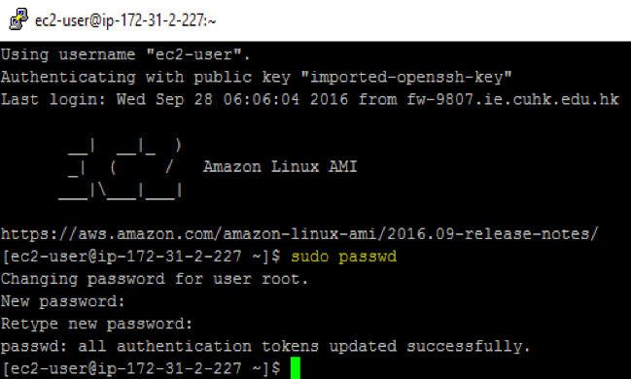
Potential Problems
Set permission for your private key
  chmod 400 xxx.pem
  can’t access? check whether port 22 is open
  https://superuser.com/questions/1296024/windows-ssh-permissions-for-private-key-are-too-open
Remember to set password for root
  First thing to do after login!
  sudo passwd

Slide 10
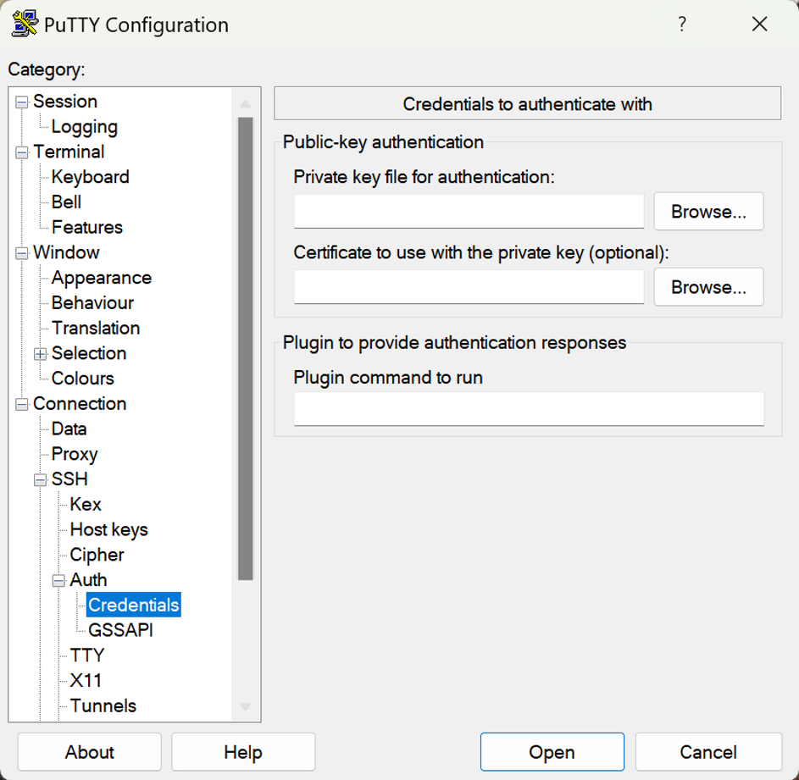
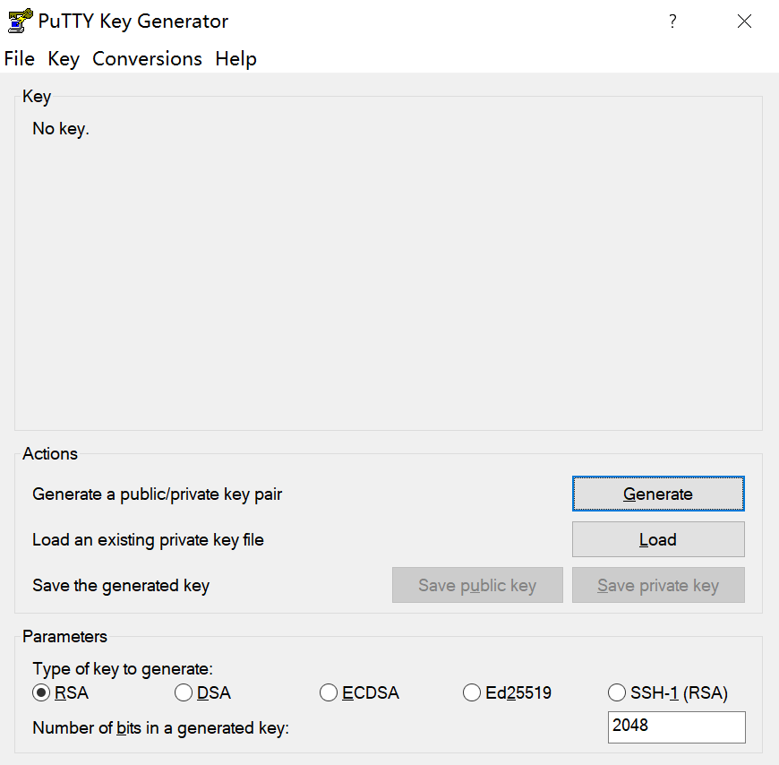
Remotely Access Your Server (Putty)
Step 1: key pair
  Launch puttygen.exe
  Import the private key (xxx.pem) and save it
  then you get an xxx.ppk file
Step 2:
  Launch putty.exe
  Session>Input the host name,
  e.g., ubuntu@[server IP]
  Use xxx.ppk file to login
    Connection>Auth>Credentials
  Save your session for future use
xxx.ppk

Slide 11
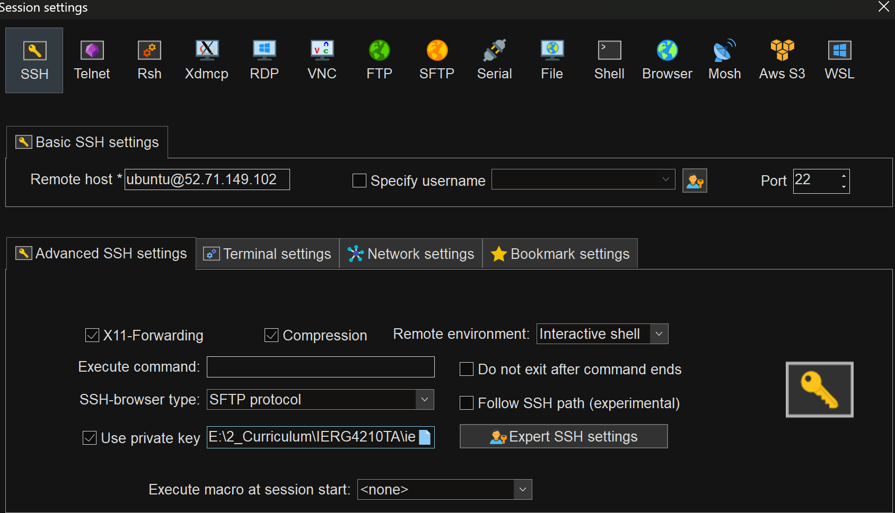
Remotely Access Your Server (MobaXterm)
  Session>Input the host name
  e.g., ubuntu@[server IP]
  Use xxx.pem file to login
    Connection>Auth>Credentials
ubuntu@[server IP]
xxx.pem

Slide 12
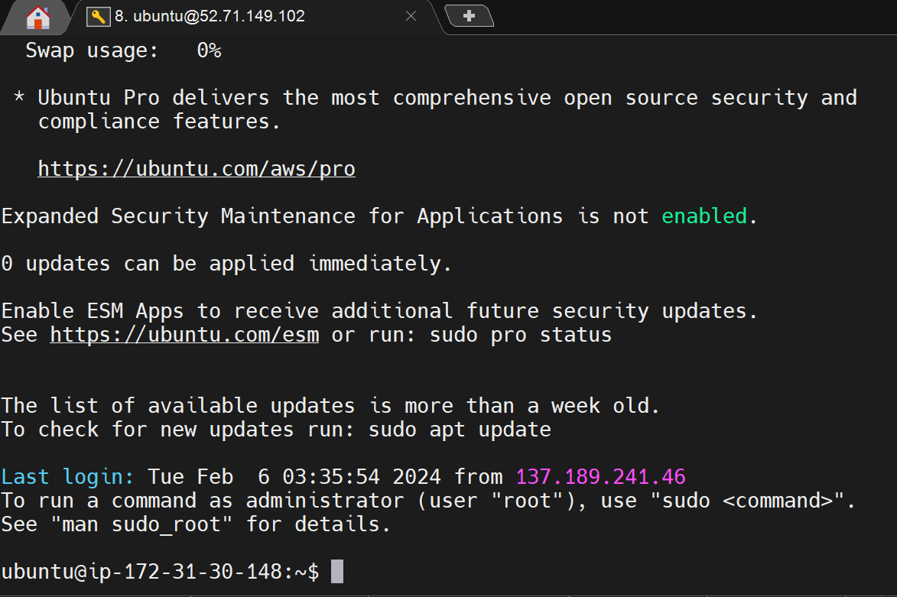
Remotely Access Your Server

Slide 13
Outline
Amazon Web Service and EC2 Instance
Environment Setup
  Linux, Nginx, NodeJS and MySQL (or SQLite)
Security Configurations

Slide 14
Environment Setup (Install Required Packages)
Install Nginx
sudo apt install -y nginx
sudo systemctl status nginx # check installation
Install MySQL
sudo apt install -y mysql-server
sudo systemctl status mysql # check installation
Install NodeJS
curl -fsSL https://deb.nodesource.com/setup_lts.x | sudo -E bash –
sudo apt-get install -y nodejs
node -v # check installation
npm -v # check installation

Slide 15
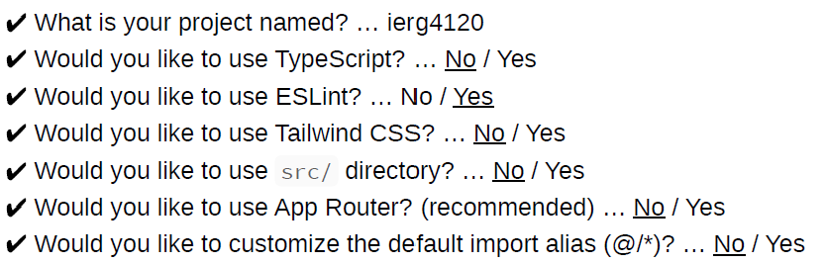
Environment Setup (Create a NodeJS Project)
Run the command to create a new Next.js project:
npx create-next-app@latest
Run the project in the background using screen
screen -S ierg4210
cd ~/ierg4210
npm run dev
  Detach from the screen session by pressing Ctrl + A followed by Ctrl + D .
Reattach to the screen session for further changes if necessary
screen -ls # show all screen sessions
screen -r ierg4210 # reattach to detached screen session

Slide 16
Environment Setup (Nginx Configuration)
Create a Nginx configuration file
touch /etc/nginx/sites-available/nextjs.conf
Edit the Nginx configuration file with nano
nano /etc/nginx/sites-available/nextjs.conf
Paste the modified content into the file.
server {
listen 80;
server_name your_domain.com; # Replace to your elastic IP
location / {
proxy_pass http://localhost:3000;
proxy_http_version 1.1;
proxy_set_header Upgrade $http_upgrade;
proxy_set_header Connection 'upgrade’;
proxy_set_header Host $host;
proxy_cache_bypass $http_upgrade;
}
}
Then press Ctrl+O to save modification, hit Enter, and press Ctrl+X to exit nano editor.

Slide 17
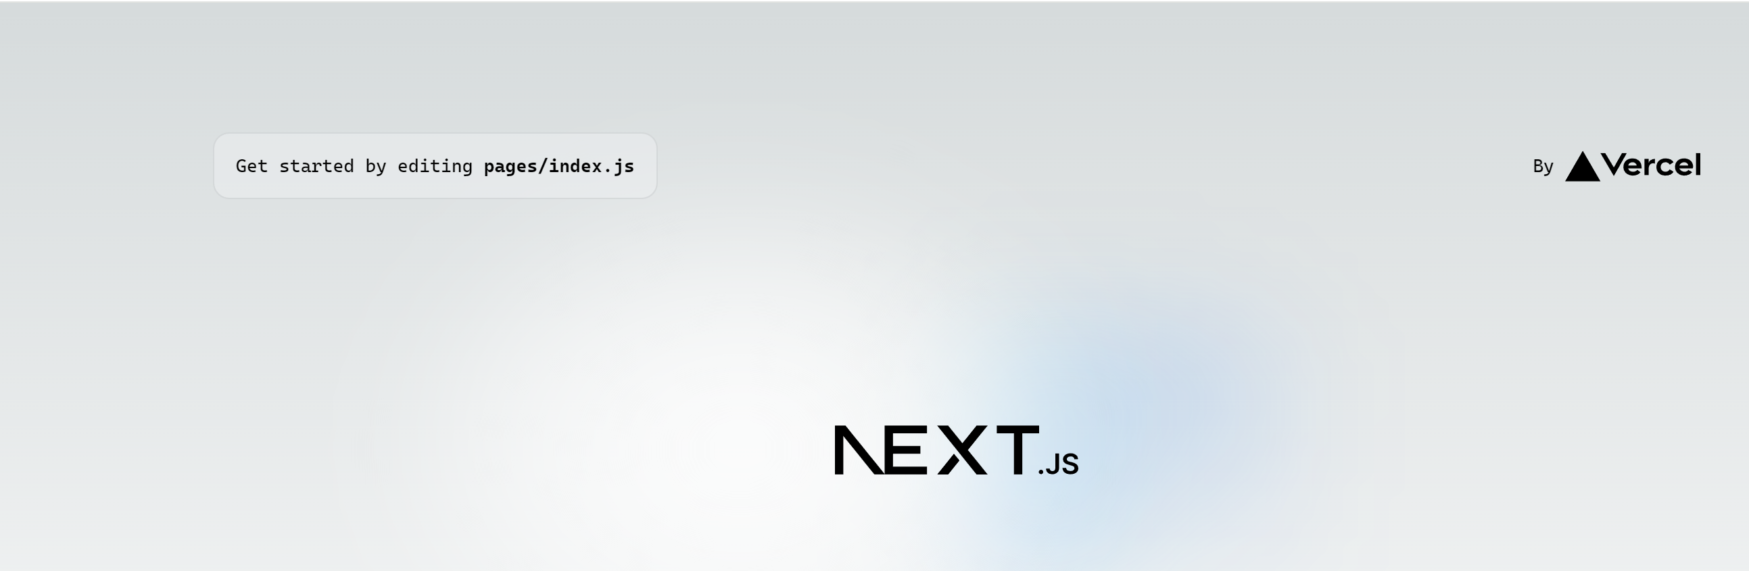
Environment Setup (Nginx Configuration)
Enable the Nginx configuration file and reload Nginx.
sudo ln -s /etc/nginx/sites-available/nextjs.conf /etc/nginx/sitesenabled/
sudo systemctl reload nginx
The website is now visible by typing its ip in the browser:
http://[server IP address]

Slide 18
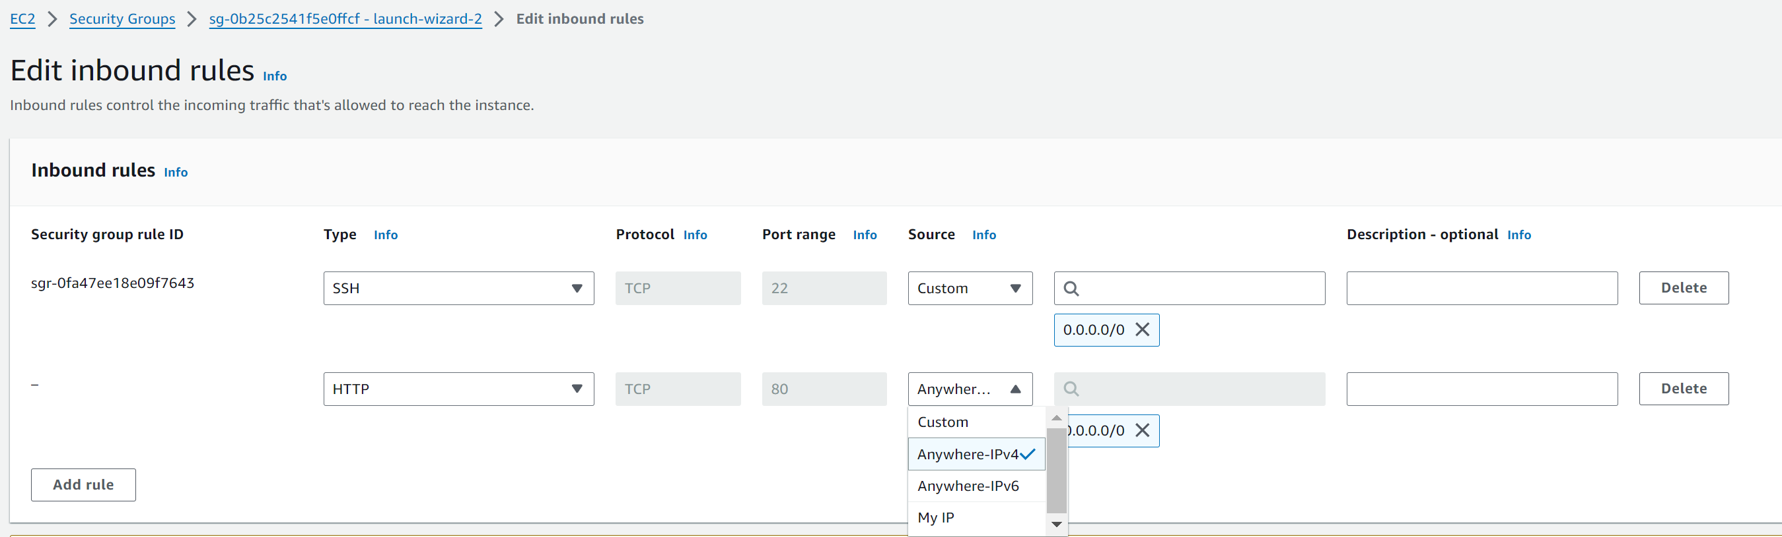
Environment Setup (Potential Problem)
Create a Nginx configuration file (Permission denied)
sudo chown -R root:ubuntu /etc/nginx/sites-available
sudo chmod 2775 /etc/nginx/sites-available && find /etc/nginx/sites-available -type d -exec sudo chmod 2775 {} \;
find /etc/nginx/sites-available -type f -exec sudo chmod 0664 {} \;
The website is not visible http://[server IP address]
Inbound Port 80 is by default closed in Amazon EC2. Edit Inbound rules to fix it.

Slide 19
Outline
Amazon Web Service and EC2 Instance
Environment Setup
  Linux, Nginx, NodeJS and MySQL (or SQLite)
Security Configurations

Slide 20
Security Settings
Open port 80 to let HTTP traffic pass through
  Set security Groups in AWS console
  We will open port 443 in later phases (HTTPS)
Upgrade the software regularly
Hide the versions of everything in HTTP headers
  OS, Nginx, NodeJS, …
  proxy_hide_header in nextjs.conf

Slide 21
About Assignment 2A (Deadline: Feb 17,2024)
Create Amazon EC2 virtual machine
Apply security configuration on the web server
  You should block port 443 until HTTPS is ready
  How? Set the security group
Attach an Elastic IP for your new server and submit (by 5pm, Feb 17,2024)
Then we will assign a domain name for you
  After associating the elastic IP with your instance, you can login by the elastic IP
Upload your website materials to the server and visit it
Important: DO NOT LEAK YOUR PRIVATE KEY!

