Slide 1
Chapter 2:
Selection and Repetition Structures

Slide 2
Chapter Objectives
After completing this chapter, you will be able to:
  create programs with single alternative, dual alternative, and multiple alternative selection structures;
  create programs with different types of repetition structures;
  manipulate the following controls: Frame, OptionButton, CheckBox, SpinButton, ScrollBar, and ListBox

Slide 3
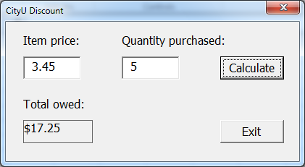

Selection Structure
Example 2.1. CityUDiscount.xlsm contains an application that allows the store clerk to enter an item's price and the quantity purchased by a customer. The application should calculate and display the customer’s amount owed. A 10% discount will be given to the customer when the quantity purchased is over five.

Slide 4
Selection Structure
Example 2.1 (Cont'd)
  Pseudocode for btnCalculate Click event
  Calculate total amount owed = price per item * quantity purchased
  If the quantity purchased is over 5, the total amount owed after discount = total amount owed * 0.9
  Display the total amount owed (with or without discount) in lblTotalOwe

Slide 5
Selection Structure (SS)
Example 2.1 (Cont'd)
  Flowchart for btnCalculate Click event
start
total amount owed = price * quantity purchased
quantity purchased over 5?
total amount owed after discount = total amount owed * 0.9
False
True
Display final total amount owed in lblTotalOwed
stop

Slide 6
Selection Structure
Example 2.1a
  Modify the CityUDiscount application so that a 5% discount is applied for a purchase of 5 or fewer.
    Modified Pseudocode for btnCalculate Click event:
      Calculate total amount owed = price per item * quantity purchased
      If the quantity purchased is over 5, the total amount owed after discount = total owed * 0.9
      If the quantity purchased is 5 or less, the total amount owed after discount = total owed * 0.95
      Display the full amount owed after discount in lblTotalOwed

Slide 7
Selection Structure (SS)
Example 2.1a (Cont'd)
  Modified flowchart for btnCalculate Click event
Start
Total amount owed = price * quantity purchased
Total amount owed after discount = total owed * 0.95
Quantity purchased over 5?
Total amount owed after discount = total owed * 0.9
False
True
Display total amount owed after discount in lblTotalOwed
Stop

Slide 8
Selection Structure
Visual Basic provides different structures for a single and dual alternative selection.
  Structure 1:
    If condition Then statement
  Structure 2:
  If condition Then
  statement block to be processed when the condition is true
  End If
  Structure 3
  If condition Then
    statement block to be processed when the condition is true
  Else
  statement block to be processed when the condition is false
  End If

Slide 9
Selection Structure
The condition in the selection structure must contain a comparison operator. Its form is
      operand operator operand
    operand can be a constant or a variable.
    operator can be one of the following:
      =, <>, >, >=, <, <=
  For examples:
    If varA > 0 Then
    If 0 <= VarA Then
    If varA - 3 < > VarB *2 Then
    If varA = "David" Then

Slide 10
Selection Structure
Refer to Example 2.1, CityUDiscount application with 10% discount. Partial code for btnCalculate_Click event:
  'Calculate the total amount owed
  dblAmountOwed = VBA.Val(txtItemPrice.Value) * _ VBA.Val(txtQuantity.Value)
  'Apply 10% discount if applicable
  If VBA.Val(txtQuantity.Value) > 5 Then
  dblAmountOwed = dblAmountOwed * 0.9
  End If
  The above 'If-Then-End If' can also be written as:
    If VBA.Val(txtQuantity.Value) > 5 Then dblAmountOwed = dblAmountOwed * 0.9

Slide 11
Selection Structure
Example 2.1a (Cont’d) Refer to CityUDiscount application with a 5% or 10% discount. Partial code for btnCalculate Click event:
  'Calculate the total amount owed.
  dblAmountOwed = VBA.Val(txtItemPrice.Value) * _ VBA.Val(txtQuantity.Value)
  'Apply 10% discount if applicable.
  If VBA.Val(txtQuantity.Value) > 5 Then
  'Compute the 10% discounted amount
  dblAmountOwed = dblAmountOwed * 0.9
  Else
  'Compute the 5% discounted amount
  dblAmountOwed = dblAmountOwed * 0.95
  End If

Slide 12
Selection Structure
These are incorrect 'If Then-Else-End If' structures:
  If VBA.Val(txtQuantity.Value) > 5 Then dblAmountOwed = _
  dblAmountOwed * 0.9
  End If
  If VBA.Val(txtQuantity.Value) > 5 Then dblAmountOwed = _
  dblAmountOwed * 0.9
  Else
  dblAmountOwed = dblAmountOwed * 0.95
  End If

Slide 13
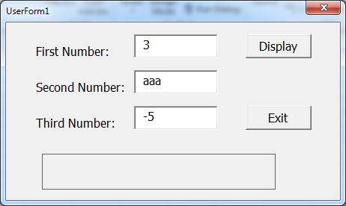
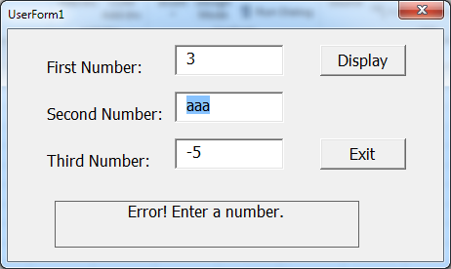
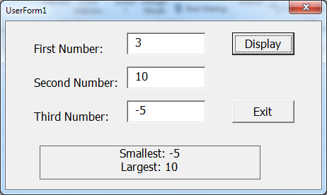
Selection Structure
Example 2.2. Compare3Numbers.xlsm contains an application that displays the smallest and the largest of the three numbers entered by the user. The application first checks whether the values entered by the user are all numeric before comparing them.

Slide 14
Selection Structure
Example 2.2 (Cont'd)
  Checking the content of a TextBox control and highlighting the content if it is non-numeric.
    'Check if the first number is indeed numeric
    If VBA.IsNumeric(txtNumber1.Value) = False Then
    'Highlight the text in the textbox
    txtNumber1.SetFocus
    txtNumber1.SelStart = 0
    txtNumber1.SelLength = VBA.Len(txtNumber1.Value)
    'Display a message to the user
    lblDisplay.Caption = "Enter a number!"
    'Exit the sub and return to the UserForm
    Exit Sub
    End If

Slide 15
Selection Structure
Example 2.2 (Cont'd)
  Using With / End With structure to execute a series of statements on the same object.
  'Check if the second number is indeed numeric
  With txtNumber2
  If VBA.IsNumeric(.Value) = False Then
  'Highlight the text in the textbox
  .SetFocus
  .SelStart = 0
  .SelLength = VBA.Len(.Value)
  'Display a message to the user
  lblDisplay.Caption= "Enter a number!"
  'Exit the sub and return to the UserForm
  Exit Sub
  End If
  End With

Slide 16
Selection Structure
Logical Operators
  Logical operator And
    When the conditions on both sides of the And operator are true, the result is true.
    Syntax: If condition1 And condition2 Then …
  Logical operator Or
    When either condition on both sides of the Or operator is true, the result is true.
    Syntax: If condition1 Or condition2 Then …
  Multiple And and Or operators can be used in the same IF or ElseIF statement, but And operator precedes Or operator.
  Parentheses ( ) may be used to group conditions.

Slide 17
Selection Structure
Logical Operators
  Some examples:
    To check if the value of Var1 is between 15 and 20, the statement is “If Var1 >= 15 And Var1 <= 20 Then”.
    To check if the value of Var1 is smaller than 15 or larger than 20, the statement is “If Var1 < 15 Or Var1 > 20 Then”.
    To check if the value of Var1 equals 5 and the value of Var2 is smaller than 15 or larger than 20. The statement is “If Var1 = 5 And (Var2 < 15 Or Var2 > 20) Then”

Slide 18
Selection Structure (Self-Study)
Nested Selection Structures
  When either a selection structure's true path or its false path contains another selection structure, the inner selection structure is referred to as a nested selection structure because it is contained within the other selection structure.
If … Then
…
If …Then
EndIf
Else
…
If … Then
If … Then
EndIf
EndIf
EndIf

Slide 19
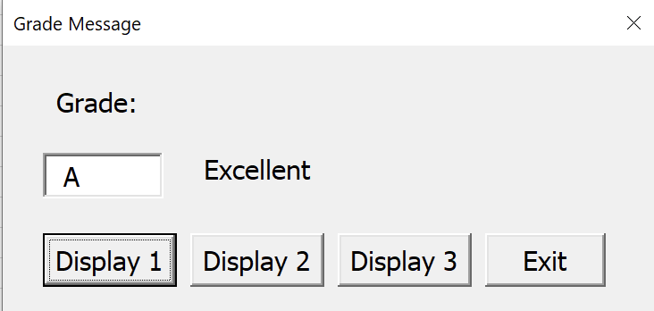
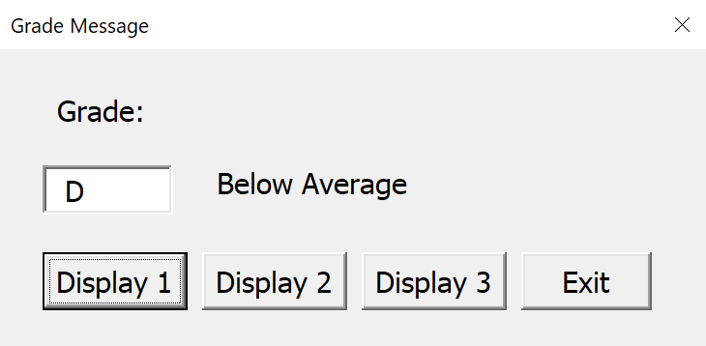

Selection Structure
Example 2.3. File MultipleAlt.xlsm contains an application that displays a message based on a letter grade entered by the user. The application displays the message “Excellent” when the letter grade is an A. When the letter grade is a B, the application displays the message "Above Average", and so on.

Slide 20
Selection Structure
Example 2.3 (Cont'd)
  Pseudocode of btnDisplay1_Click event:
    If the letter grade is A, then it displays “Excellent”
    If the letter grade is B, then it displays “Above Average”
    If the letter grade is C, then it displays “Average”
    If the letter grade is D or E, then it displays “Below Average”
    If the letter grade is not A, not B, not C, not D, and not E, then
    it displays "No Such Grade"

Slide 21
Selection Structure
Example 2.3 (Cont'd)
  Inefficient Code for btnDisplay1_Click event:
    Private Sub btnDisplay1_Click()
    'Display appropriate grade message
    If VBA.UCase(txtGrade.Value) = "A" Then
    lblGradeMessage.Caption = "Excellent"
    End If
    If VBA.UCase(txtGrade.Value) = "B" Then
    lblGradeMessage.Caption = "Above Average"
    End If
    If VBA.UCase(txtGrade.Value) = "C" Then
    lblGradeMessage.Caption = "Average"
    End If

Slide 22
Selection Structure
Example 2.3 (Cont'd)
  Inefficient Code for btnDisplay1_Click event:
      If VBA.UCase(txtGrade.Value) = "D" _
      Or VBA.UCase(txtGrade.Value) = "E" Then
      lblGradeMessage.Caption = "Below Average"
      End If
      If VBA.UCase(txtGrade.Value) <> "A" _
      And VBA.UCase(txtGrade.Value) <> "B" _
      And VBA.UCase(txtGrade.Value) <> "C" _
      And VBA.UCase(txtGrade.Value) <> "D" _
      And VBA.UCase(txtGrade.Value) <> "E" Then
      lblGradeMessage.Caption = "No Such Grade"
      End If
      End Sub

Slide 23
Selection Structure
Syntax of a multiple alternative selection structure is:
    If condition1 Then
    Statement block to be executed if condition1 is true
    ElseIf condition2 Then
    Statement block to be executed if condition2 is true
    [ElseIf condition3 Then
    Statement block to be executed if condition3 is true]
    :
    :
    [Else
    Statement block to be executed if all other conditions are false]
    End If
  The keyword ‘Then’ must be the last word in each ‘IF’ or ‘ElseIF’ statement.

Slide 24
Selection Structure
Example 2.3 (Cont'd)
  Code for btnDisplay3_Click event with multiple-alternative selection structure:
    If VBA.UCase(txtGrade.Value) = "A" Then
    lblGradeMessage.Caption = "Excellent"
    ElseIf VBA.UCase(txtGrade.Value) = "B" Then
    lblGradeMessage.Caption = "Above Average"
    ElseIf VBA.UCase(txtGrade.Value) = "C" Then
    lblGradeMessage.Caption = "Average”
    ElseIf VBA.UCase(txtGrade.Value) = "D" Or VBA.UCase(txtGrade.Value) = "E" Then
    lblGradeMessage.Caption = "Below Average"
    Else
    lblGradeMessage.Caption = "No Such Grade"
    End If

Slide 25
Selection Structure
Example 2.4. MathematicPractice.xlsm contains an application for practising mathematics. Users can choose the difficulty level and the type of operation (addition or subtraction). Assuming the user does not know how to handle negative numbers, the subtraction problems will not ask the user to subtract a larger number from a smaller one, and all involved numbers will not be negative. The application keeps track of the number of correct and incorrect answers made by the user. This assessment information will only be displayed by request.

Slide 26
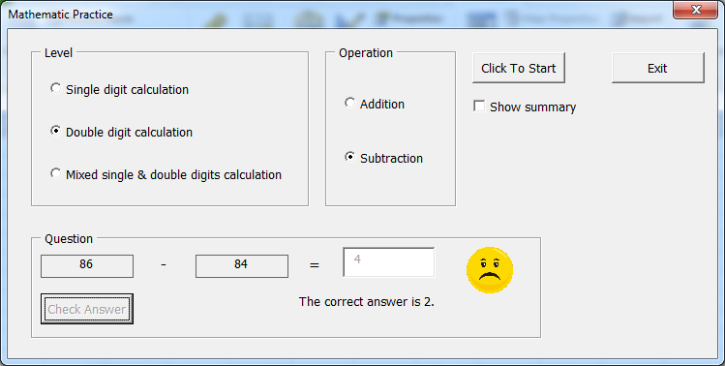
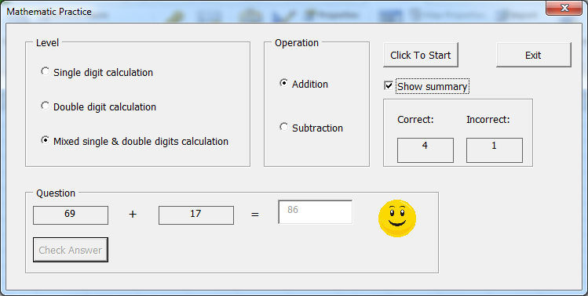
Selection Structure
Example 2.4 (Cont'd)
  The UserForm:

Slide 27
Selection Structure
Example 2.4 (Cont'd)
  Tasks for the application and the associated events:
    Load and show the UserForm. Event: UserForm_Initialize.
    Show a mathematical problem. Event: btnStart_Click.
    Compare the correct answer to the user's answer. Event: btnCheckAnswer_Click.
    Show or hide summary report. Event: chkSummary_Click.
    Terminate the application. Event: btnExit_Click.
  Refer to the Code Window of the UserForm for the details of the respective code.

Slide 28
Selection Structure
Frame Control
  Often used to group several controls.
    Either for aesthetic appeal or programming convenience.
  Frame control can be considered as a container which contains other controls.
  To contain controls inside a Frame control, the Frame control must be drawn first and then draw other controls inside the frame or drag other controls into the Frame.

Slide 29
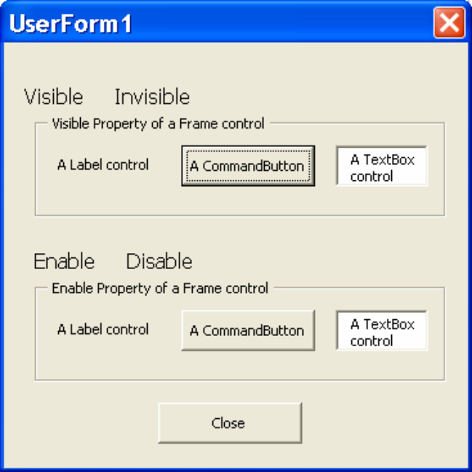
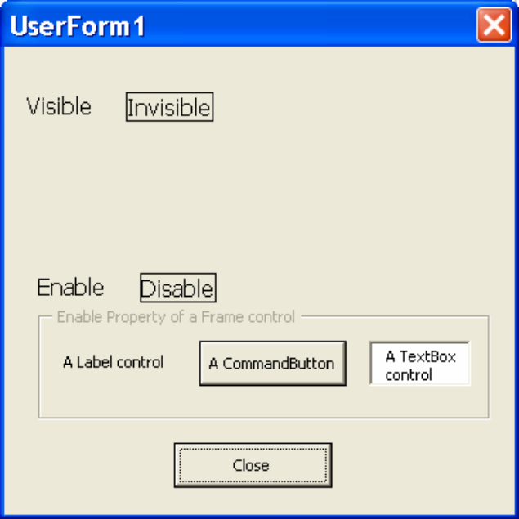
Selection Structure
Frame Control
    Example 2.5. Frame_demo.xlsm contains an application allowing users to set the Visible or Enable property of controls contained in Frame controls.

Slide 30
Selection Structure
OptionButton Control
  Allow the user to select one option from two or more options.
  They are often used in groups of at least two each.
  Only one OptionButton control can be selected in a group.
  Click the control to select. Once selected, one must choose another OptionButton control in the same group to de-select the current selected one.
  OptionButton has only two values:
    If selected, OptionButton.Value equals True.
    If unselected, OptionButton.Value equals False.
  Commonly used events include Click and Change events. See OptionButtonDemo3.xlsm.

Slide 31
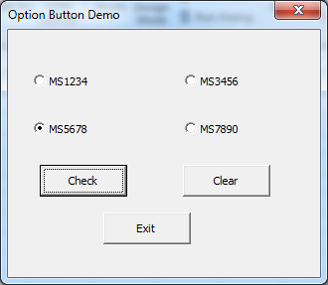
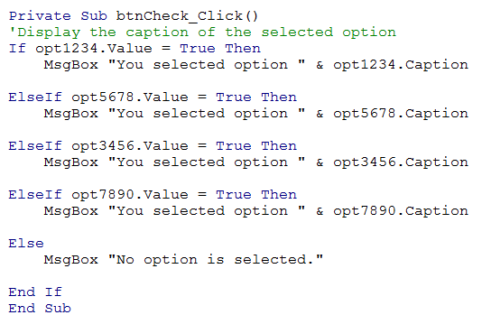
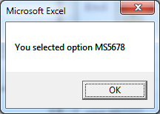
Selection Structure
OptionButton Control
  Example 2.6a. Run UserForm NoGrouping in optionButtonDemo1.xlsm.

Slide 32
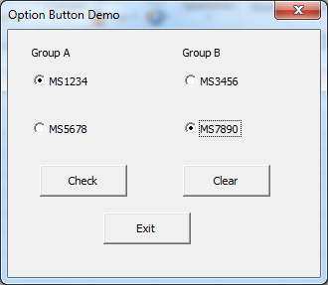
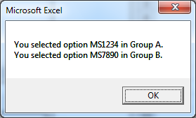
Selection Structure
OptionButton Control
  Example 2.6b: Run UserForm TwoGroups1 in OptionButtonDemo1.xlsm.
    Set the GroupName property of options MS1234 and MS5678 to Group A.
    Set the GroupName property of options MS3456 and MS7890 to Group B.

Slide 33
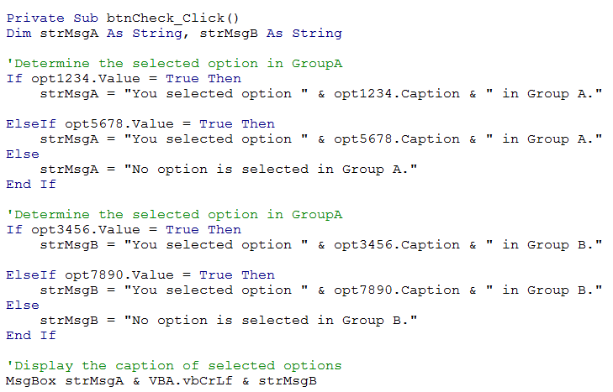
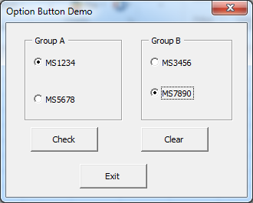
Selection Structure
OptionButton Control
  Example 2.6c: Run UserForm TwoGroups2 in OptionButtonDemo1.xlsm.
    Put options MS1234 and MS5678 in a Frame control.
    Put options MS3456 and MS7890 in another Frame control.

Slide 34
Selection Structure
CheckBox Control
  Click the CheckBox control to check or uncheck.
  Unlike OptionButton control, CheckBox control is not grouped.
  More than 1 CheckBox control can be selected.
  A CheckBox control has only two values:
    If checked, CheckBox.Value equals True.
    If unchecked, CheckBox.Value equals False.
  Commonly used events include Click and Change events. See CheckboxDemo2.xlsm.

Slide 35
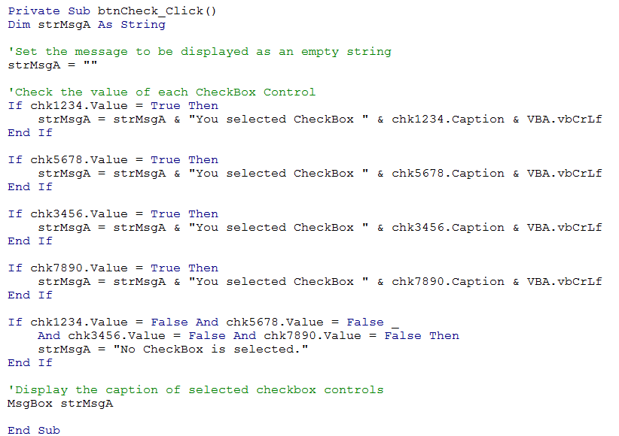
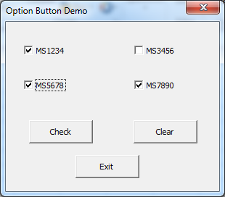
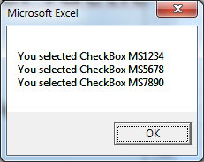
Selection Structure
CheckBox Control
  Example 2.7: CheckboxDemo1.xlsm

Slide 36
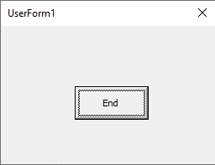
Selection Structure
Example 2.6d: Disable the Close button of a Userform.
Private Sub UserForm_QueryClose(Cancel As Integer, CloseMode As Integer)
If CloseMode <> 1 Then 'Unload statement is not involved
Cancel = 1 'Prevent userform to be unloaded
VBA.MsgBox "Click End button to quit."
End If
End Sub

Slide 37
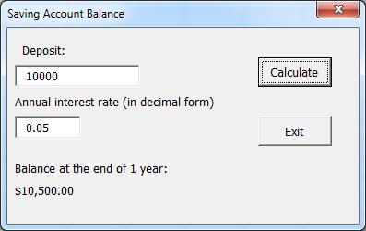
Repetition Structure
Example 2.8: SavingBalance.xlsm contains an application that shows the amount of balance in the saving account at the end of the year, assuming the interest is compounded annually, and no withdrawals or additional deposits are made.

Slide 38
Repetition Structure
Example 2.8 (Cont'd)
  Pseudocode of btnCalculate Click event:
    Assign deposit to variable dblBalance
    Assign interest rate to variable dblRate
    Calculate interest = dblBalance * dblRate
    Calculate new balance = dblbalance + interest
    Display the amount of the new balance
    How to modify the application to display the number of years required for the saving account to reach 1 million dollars and the account balance at that time?

Slide 39
Repetition Structure
Example 2.8 (Cont'd)
  For year 1:
    Calculate interest = dblBalance * dblRate
    Calculate new balance = dblbalance + interest
  For year 2:
    Calculate interest = dblBalance * dblRate
    Calculate new balance = dblbalance + interest
  For year 3:
    Calculate interest = dblBalance * dblRate
    Calculate new balance = dblbalance + interest
    .
    .
    .
  Continue until new balance >= $1 million.
Original Deposit

Slide 40
Repetition Structure
Example 2.8 (Cont'd)
  Modified the pseudocode of btnCalculate Click event to include a repetition structure (loop):
    Assign deposit to variable dblBalance
    Assign interest rate to variable dblRate
    Assign 0 value to number of years
    Repeat while dblBalance < 1000000
      Calculate interest = dblBalance * dblRate
        Calculate new dblBalance = dblBalance + interest
        Calculate new number of years = number of years + 1
    End Repeat
    Display the value of number of years and dblBalance.

Slide 41
Repetition Structure
Example 2.8 (Cont'd)
  Flowchart for btnCalculate Click event with repetition structure (loop):
start
dblBalance < 1000000?
False
True
Interest = dblBalance * dblRate
dblBalance = dblBalance + Interest
Add 1 to number of years
Display number of years and dblBalance
stop

Slide 42
Repetition Structure
Do While loop structure
  Syntax 1:
    Do While loopcondition
      Loop Body Statements
    Loop
    The loopcondition is similar to the condition in the selection structure.
    The loop body statements will be executed only if the loopcondition is true.

Slide 43
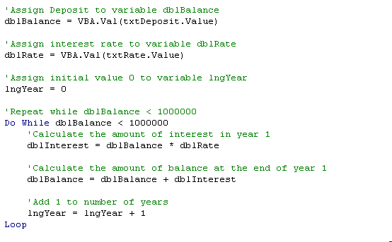
Repetition Structure
Example 2.8 (Cont'd)
  Partial code of procedure btnCalculate_Click of ModifiedForm1 in SavingBalance.xlsm.

Slide 44
Repetition Structure
Other Do loop structures
  Do While loop syntax 2:
    Do
      Loop Body Statements
    Loop While loopcondition
  Do Until loop Syntax 1:
    Do Until loopcondition
      Loop Body Statements
    Loop
  Do Until loop Syntax 2:
    Do
      Loop Body Statements
    Loop Until loopcondition
Loop body statements are executed at least once and continues to loop if the loopcondition is true.
Loop body statements are executed only if the loopcondition is false.
Loop body statements are executed at least once and continues to loop if the loopcondition is false.

Slide 45
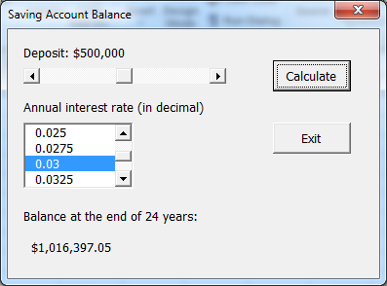
Repetition Structure
Example 2.9. SavingBalance2.xlsm contains an application that displays the number of years required for a saving account to reach 1 million dollars at a selected interest rate and the account balance at that time.

Slide 46
Repetition Structure
ScrollBar and SpinButton Controls
  Both allow the user to select a value by clicking on either of two arrows, one to increase the value and the other to decrease the value.
  Both can be displayed horizontally or vertically.
  Both have a Value property that returns an integer value only.
  Both have no Caption property to display their values. It is often used in conjunction with a TextBox control or Label control to display its value.
  ScrollBar control is often used for selecting a value that extends across a wide range of possible values.

Slide 47
Repetition Structure
ScrollBar and SpinButton Controls
  Important properties include Min, Max, SmallChange, and Value.
    Min: the smallest integer value to start with.
    Max: the largest integer value to end with.
    SmallChange: the amount of integer change at each click on either ends of the control.
    Value: existing integer value of the control.
    LargeChange for ScrollBar control: an integer value for the amount of change when the interior of ScrollBar is clicked once.

Slide 48
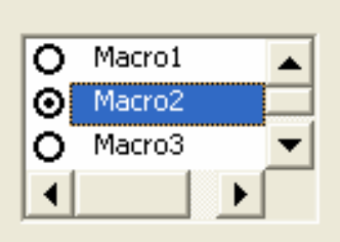
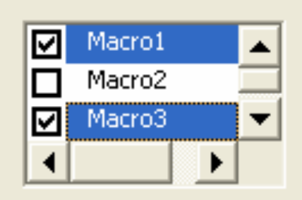
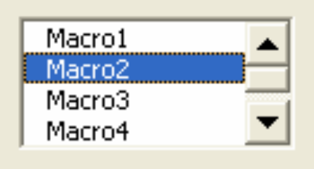
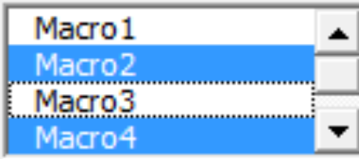
Repetition Structure
ListBox Control
  Presents a list of items for the user to select.
  The user may select at most 1 item or multiple items from the list if allowed.
  The items can also be displayed as checkboxes if multiple selections are allowed or as option buttons if only a single selection is allowed.

Slide 49
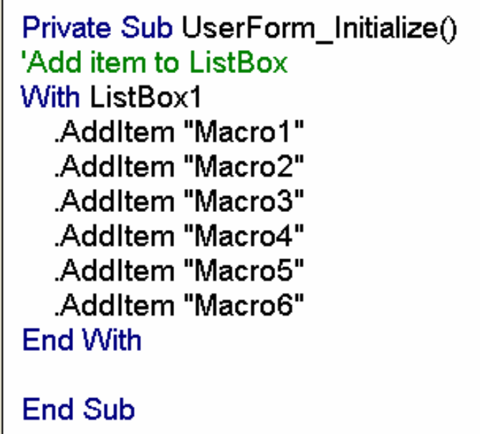
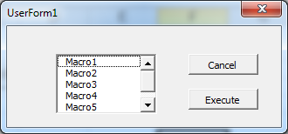
Repetition Structure
ListBox Control
  A list can be formed by adding items to the ListBox using the AddItem method.
  Example 2.10: Use the AddItem method to add items to a ListBox control when the form is initialized.

Slide 50
Repetition Structure
ListBox Control
  To allow only single item selection, set the MultiSelect property to 0.
  To allow multiple items selection, set the MultiSelect property to 1 or 2.
    1 fmMultiSelectMulti – allows an item to be selected/deselected by clicking on it, or
    2 fmMultiSelectExtended – allows the Ctrl and Shift keys to select multiple items.

Slide 51
Repetition Structure
ListBox Control
  Use the Selected(index) property to return or set the selection status of items.
    The Selected property is an array with the same number of elements as the number of rows in the ListBox.
    Selected(i) refers to the selection status of the (i+1)th row of the ListBox, i = 0, 1, …, number of items in the ListBox-1.
    Selected(i) = True if the (i+1)th row is selected; otherwise, it equals False.
    Changing the value of Selected(index) always triggers the Change event of the same ListBox control. The Click event of the same ListBox control may or may not be triggered after the Change event.

Slide 52
Repetition Structure
ListBox Control
  Example 2.11. Report the list of selected items in a message box (Listboxexample1a.xlsm | UserFormA)
    Set the MultiSelect property to 0 for single-item selection.
    Set the MultiSelect property to 1 or 2 multiple items selections.
    Partial code:
      'Check if the first item is selected
      If ListBox1.Selected(0) = True Then
      'Attach the selected item to msgSelect
      msgSelect = msgSelect & ListBox1.List(0) & VBA.vbCrLf
      End If
      .
      .
      .
      'Check if the sixth item is selected
      If ListBox1.Selected(5) = True Then
      'Attach the selected item to msgSelect
      msgSelect = msgSelect & ListBox1.List(5) & VBA.vbCrLf
      End If
Returns the text of the (0+1)th item in the list.

Slide 53
Repetition Structure
For loop structure
  The six If-Then structures in Example 2.11 can be combined into a single repetition structure so that each item in the list will be checked once iteratively. This can be done with a For loop structure. The syntax is:
    For counter = startvalue To endvalue [Step changevalue]
    statements to be executed repeatedly
    Next [counter]
    counter is the counter variable (numeric) in the loop.
    startvalue is the beginning value of the counter. It can be a numeric constant or a numeric variable.
    endvalue is the ending value of the counter. It can be a numeric constant or a numeric variable.
    changevalue is the amount of the counter changes each time through the loop. It can be a numeric constant or a numeric variable.
      If Step changevalue is not included, the default value of changevalue value equals 1.

Slide 54
Repetition Structure
For loop structure
  Each time the For statement is executed, the counter is compared to the endvalue.
    For positive changevalue, if counter <= endvalue, executes the loop. Otherwise stops the loop.
    For negative changevalue, , if counter >= endvalue, executes the loop. Otherwise stops the loop.
  Each time the Next statement is executed, the value of the counter is incremented by changevalue.

Slide 55
Repetition Structure
For Loop Structure
  Example 2.11 Re-visit
    Combine the six If-Then structures with a single For Loop Structure (Listboxexample1a.xlsm | UserFormB).
    Partial code:
    'Repeat for each item in the listbox control
    For intItem = 0 To ListBox1.ListCount - 1
    If ListBox1.Selected(intItem) = True Then
    'Attach the selected item to msgSelect
    msgSelect = msgSelect & ListBox1.List(intItem) & _
    VBA.vbCrLf
    End If
    Next intItem

Slide 56
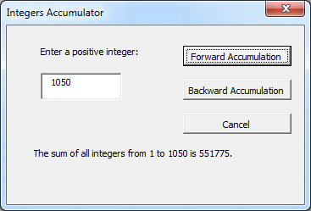
Repetition Structure
For loop structure
  Example 2.12. Sum up the first X integers where X is specified by the user (IntegersAccDemo.xlsm).
Private Sub btnForward_Click()
Dim intnum As Long, intAcc As Double
'Sum up the integers from 1 to the given number
For intnum = 1 To VBA.CDbl(txtNumber.Value)
intAcc = intAcc + intnum
Next intnum
'Display the accumulated value
lblAnswer.Caption = "The sum of all integers from 1 to " & _
txtNumber.Value & " is " & intAcc & "."
End Sub

Slide 57
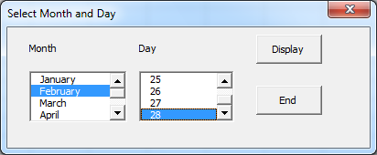
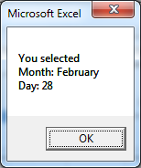
Repetition Structure
For loop structure
  Example 2.13: Select the month and day from the respective ListBox control. (Month&DayDemoA.xlsm)
    Note the use of the AfterUpdate event of ListBox control.

Slide 58
Repetition Structure
For loop structure
  Example 2.13: Partial Code

Slide 59
Repetition Structure
For loop structure
  Example 2.13: Partial Code
Returns the index of the last clicked item (selected or not) in the list.
For single item selection: ListIndex = -1 for nothing selected.
For multiple items selection: the smallest return value of ListIndex is 0.

Slide 60
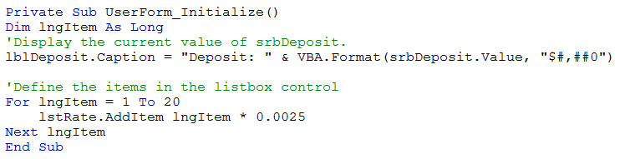
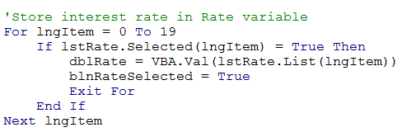
Repetition Structure (Self-Study)
For loop structure
  Example 2.9 Re-visit: Partial code
btnCalculate Click event (partial code):

Slide 61
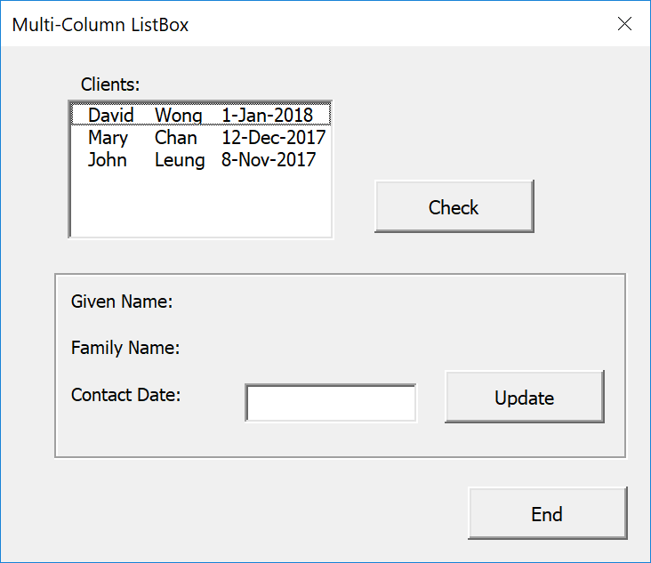
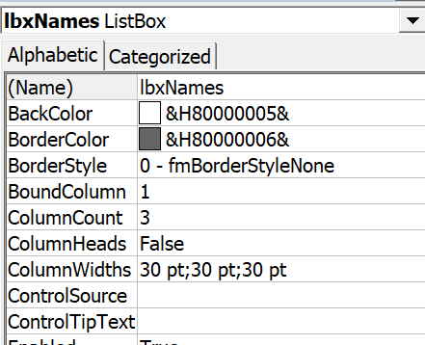
Repetition Structure
ListBox controls with multiple columns
  Example 2.14: A ListBox controls with multiple columns (MultiColumn.xlsm).
To create 3 columns, in the ListBox property window:
Or programmatically,
  ListBoxref.ColumnCount = 3
  ListBoxref.ColumnWidths="30;30;30"

Slide 62
Repetition Structure
ListBox controls with multiple columns
  To populate a ListBox with multiple columns,
    First, use the Additem method to add texts to column 1 of an item (a row).
    Then use the List(rowindex, columnindex) property to specify the texts of the other columns in the same row.
      Both rowindex and columnindex start from 0.
With lbxNames
.AddItem "David”
.List(0, 1) = "Wong”
.List(0, 2) = "1-Jan-2018”
.AddItem "Mary"
.List(1, 1) = "Chan"
.List(1, 2) = "12-Dec-2017”
.AddItem "John”
.List(2, 1) = "Leung"
.List(2, 2) = "8-Nov-2017”
End With

Slide 63
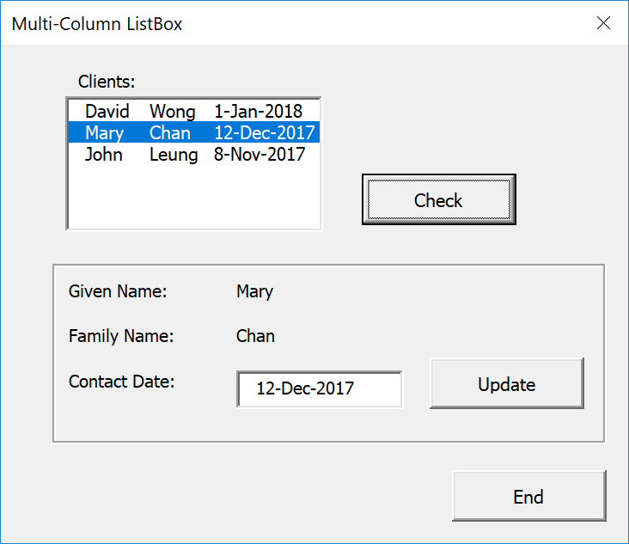
Repetition Structure
ListBox controls with multiple columns
  Example 2.14 (Cont’d)
    To get selected items from columns:
      First, use the Selected property to determine the selected item in ListBox control.
      Once the selected item is determined you can use the List property to get or change the contents of the desired column.
Click Check button to display the selected item.

Slide 64
Repetition Structure
ListBox controls with multiple columns
  Example 2.14 (Cont’d)
    Partial code of btnCheck_Click event
'Determine the selected item
With lbxNames
For intItem = 0 To .ListCount - 1
If .Selected(intItem) = True Then
'Display the name and contact date of the selected item
lblGivenName.Caption = .List(intItem, 0)
lblFamilyName.Caption = .List(intItem, 1)
tbxContactDate.Value = .List(intItem, 2)
'Keep record of the selected index
intIndex = intItem
'Enable fmeupdate
fmeUpdate.Enabled = True
End If
Next intItem
End With

Slide 65
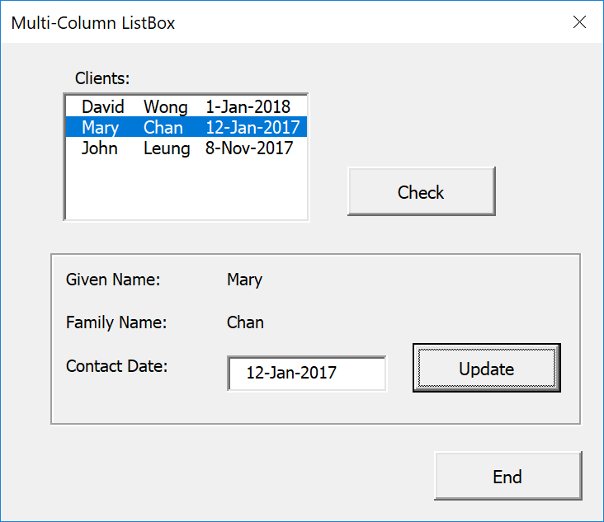
Repetition Structure
ListBox controls with multiple columns
  Example 2.14 (Cont’d)
    To change the value of desired column
Private Sub btnUpdate_Click()
'update the date value of the selected itemlbxNames.List(intIndex, 2) = _
tbxContactDate.Value
End Sub

Slide 66
Repetition Structure (Self-Study)
ListBox Control
  ListIndex Property
    Returns the index of the last clicked item in the ListBox.
    For a ListBox with MultiSelect property set to 0 (i.e. single item selection), ListIndex returns the index of the selected item for the single item selection setting. If no item is selected, ListIndex equals -1.
    For a ListBox with MultiSelect property set to 1 or 2 (i.e. multiple items selection), ListIndex returns the index of the last clicked item (selected or de-selected) for the multi-selection setting. If none of the items has been clicked, ListIndex equals 0.
      Therefore you cannot use ListIndex to determine whether an item is selected by checking its value if multi-selection is enabled.
  Example: Refer to ListBoxExample8.xlsm. Try to select and de-select items from each ListBox and check the respective ListIndex value.

