Slide 1
Auto-Pilot Betting

Slide 2
Introduction
Develop an auto-betting app take advantages of latest LLM technologies, particular on RLHF and VQA Capabilities
The same App should be able to apply to all scenarios with similar underlying logics principles
The entire project will split into 4 phrases.
  Phrase 1 -> Prompting App
    Key Deliverable → Measured different LLMs’ Confidence Level with the same parameters weight dataset
  Phrase 2 -> Auto-Pilot v1.0
    Key Deliverables → Dataset for SVM and Time-series Images Classification
  Phrase 3 -> Auto-Pilot v2.0
    Key Deliverables → SVM Odds monitoring implementation and Bet Placing featuring ”unit-bet” approach and Kelly Criterion bankroll management
  Phrase 4 -> VQA research & prototype implementation

Slide 3
Phrase 2

Slide 4
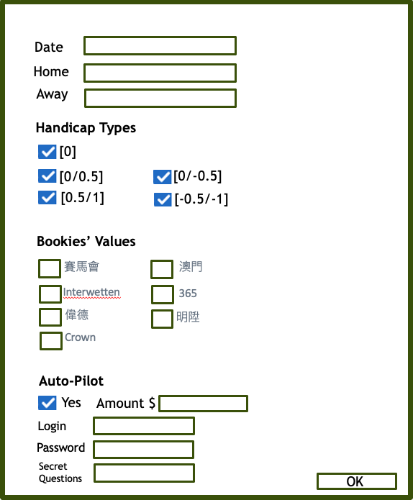
This App will go to two web sites and will get data from two web sites after entering Date of Match, Home team name and Away team name. Monitoring will start before the match starting in 60 mins.
Reporting
The End
No
App will auto go to the “pre-defined” two web sites to get data and under the App monitoring based on the “pre-set rules”
Call the Auto Bet Program and placing bet according to the inputs of the Match Info and Bet amount S.
Yes
Reporting
https://next.data4mula.com/
http://live.nowscore.com/1x2/
Monitoring Module
Auto-Bet Module
Input GUI
The End

Slide 5
Input GUI
Date
Home
Away
Handicap Types
[0]
# Handicap Types
+
-
[0/0.5]
[0/-0.5]
[0.5/1]
[-0.5/-1]
Bookies’ Values
賽馬會
澳門
Interwetten
365
偉德
明陞
# Bookies’ Values
+
-
=
N/A
Crown
Auto-Pilot
Yes
Amount $
Login
Password
Secret Questions
OK

Slide 6
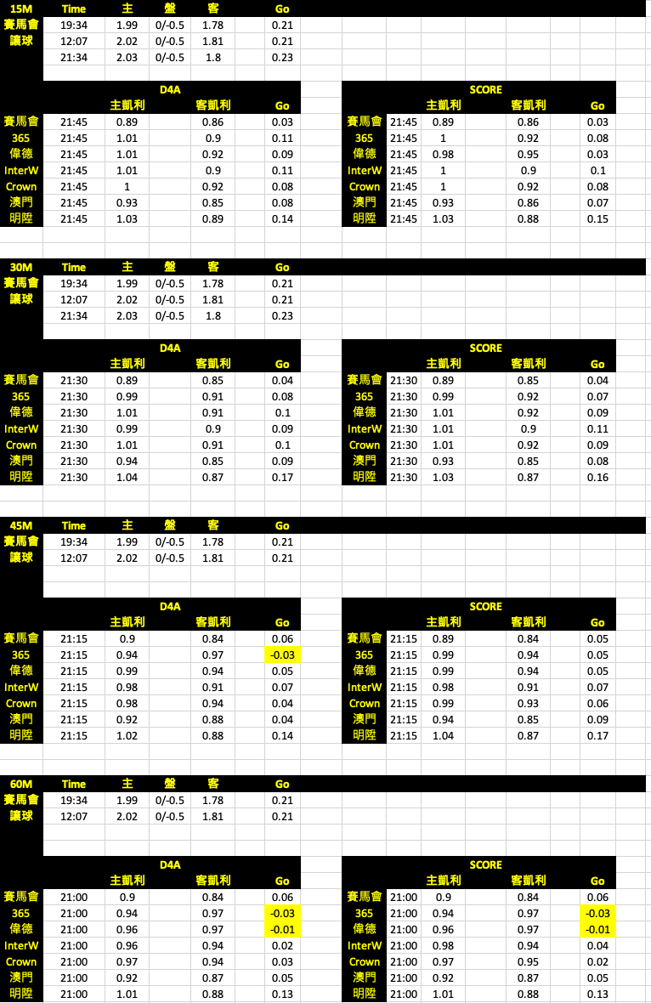
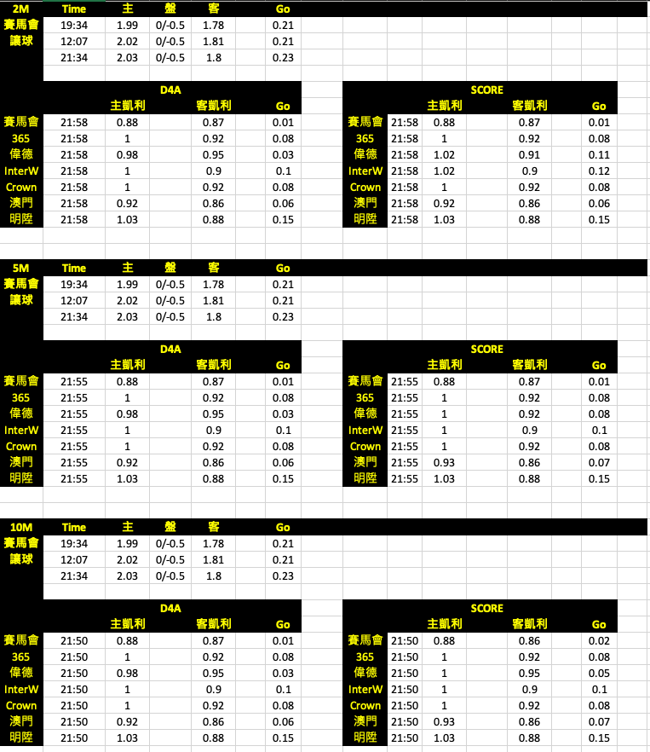

Slide 7
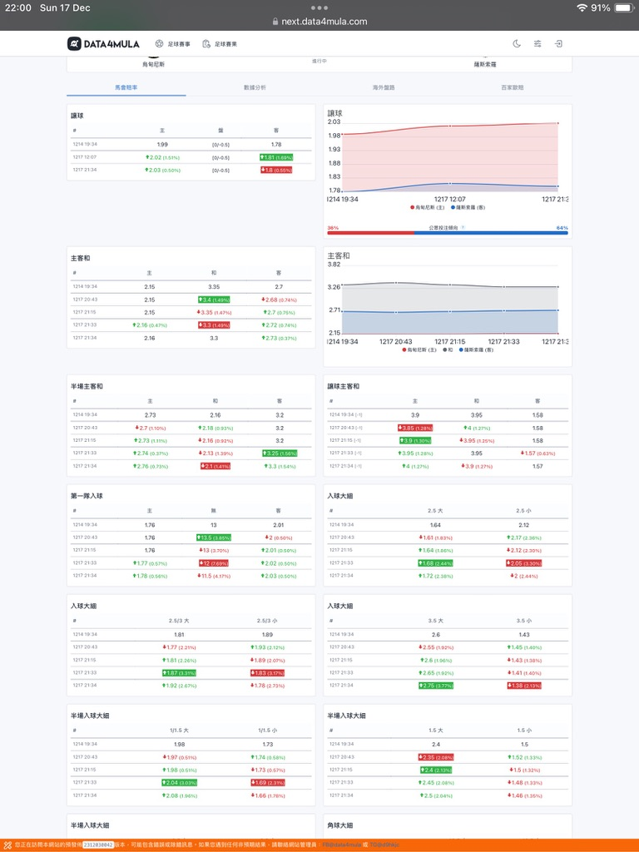
https://next.data4mula.com
Click this Tab
主 - 客
Monitor

Slide 8
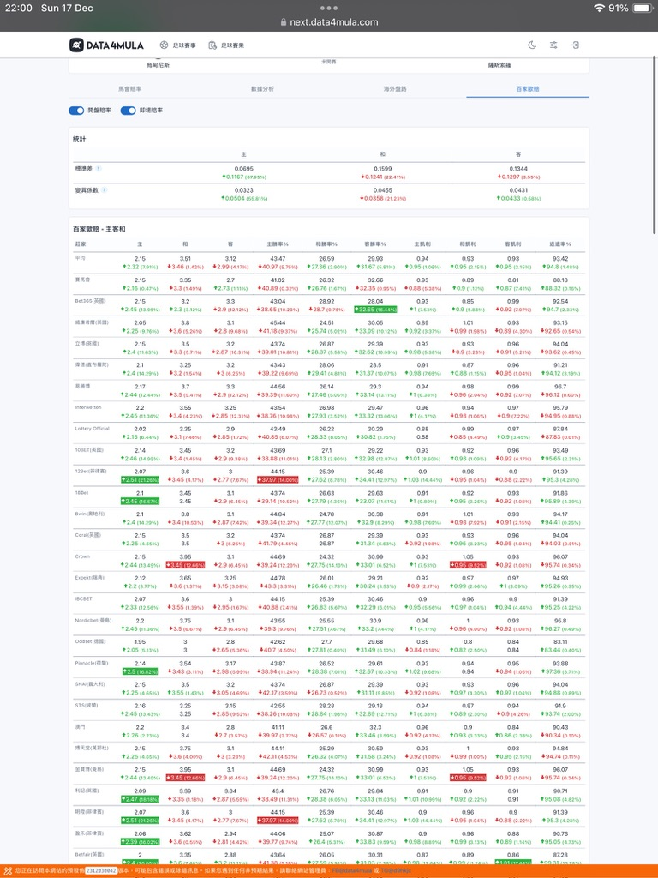
https://next.data4mula.com
Click this Tab
主凱利 - 客凱利
Only 7 Required
Only 7 bookies

Slide 9
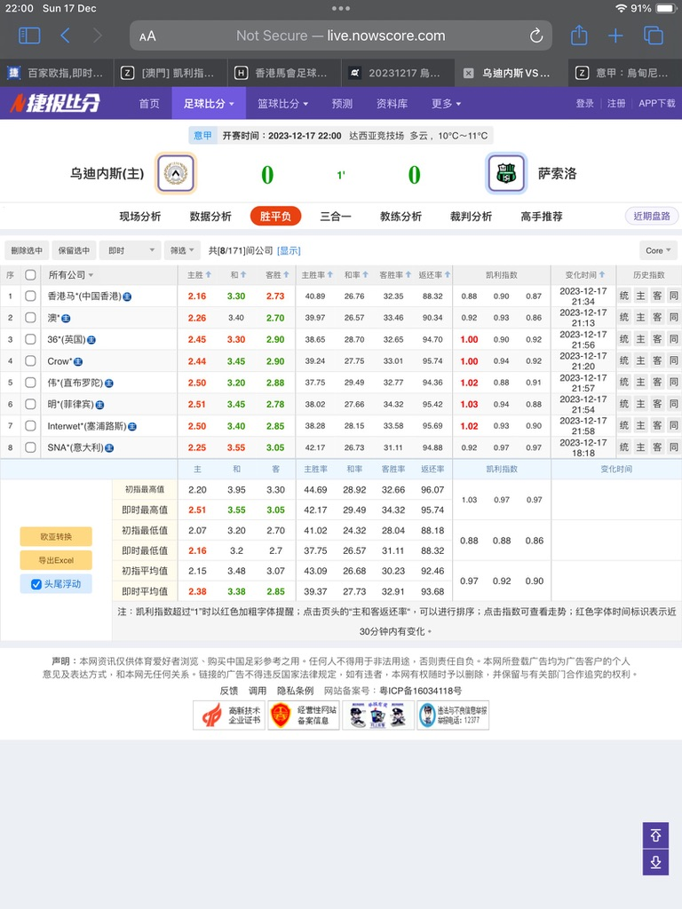
http://live.nowscore.com/1x2/
Click this Tab
This can customize or pick from 100+ bookies
主凱利 - 客凱利
Only 7 Required

Slide 10
Test Scenario 1:
User enters Date of the match, Home team name, and Away team name.
For the Handicap Types, User checks “ ”, Go Value checkbox appears, user enters “ ”
For Bookies , user enters " " for the Go values.
For Bookies user enters " " for the Go values.
For the Auto-Pilot, User checkmarks the ” Yes" checkbox. Enter the amount $5,000, and fill in all the Login, Password and Secret Questions’ Answers.
[0/-0.5]
賽馬會
澳門
Interwetten
明陞
365
偉德
Crown

Slide 11
Test Scenario 1:
Date
2023-12-14
Home
Away
Handicap Types
[0]
[0/0.5]
[0/-0.5]
Go Value
[0.5/1]
[-0.5/-1]
Bookies’ Go Values
賽馬會
澳門
Interwetten
365
偉德
明陞
Crown
Auto-Pilot
Yes
Amount $
5,000
Login
12524888
Password
********
Secret Questions
BMW, Rolex, Coffee
OK

