Slide 1
Auto-Pilot Betting

Slide 2
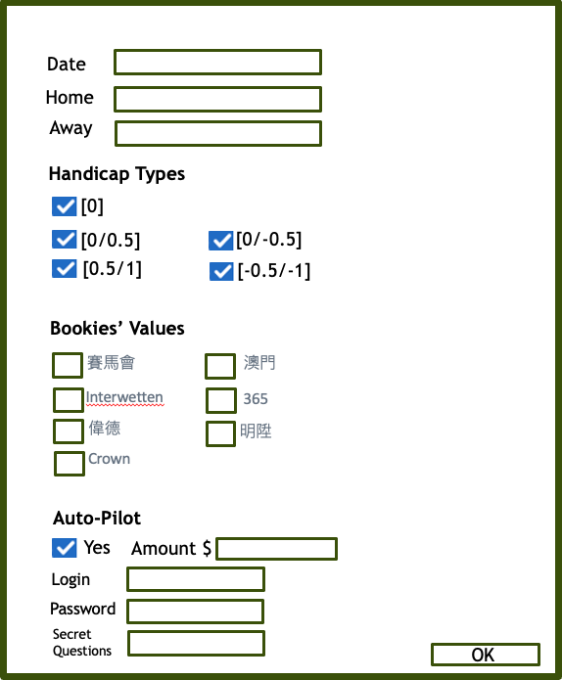
This App will go to two web sites and will get data from two web sites after entering Date of Match, Home team name and Away team name. Monitoring will start before the match starting in 60 mins.
Reporting
The End
No
App will auto go to the “pre-defined” two web sites to get data and under the App monitoring based on the “pre-set rules”
Call the Auto Bet Program and placing bet according to the inputs of the Match Info and Bet amount S.
Yes
Reporting
https://next.data4mula.com/
http://live.nowscore.com/1x2/
Monitoring Module
Auto-Bet Module
The End

Slide 3
Date
Home
Away
Handicap Types
[0]
[0/0.5]
[0/-0.5]
[0.5/1]
[-0.5/-1]
Bookies’ Values
賽馬會
澳門
Interwetten
365
偉德
明陞
# Bookies’ Values
+
-
=
N/A
Crown
Auto-Pilot
Yes
Amount $
Login
Password
Secret Questions
OK

Slide 4
