Slide 1
Project Title
Group: Gp#
[Name, SID]

Slide 2
02/09/2019 to xx/05/2020
09/19
9/19
11/19
12/19
1/20
2-4/20
5/20
Initial Report
Interim Report + Presentation
Final Report + Presentation
Preparation
Notes……
Notes……
Notes……
Notes……
Project Proposal
Prepare for Prototype
Bug Fix, Advanced features
Notes……
Notes……
Notes……

Slide 3




Infrastructure
Amazon Web Services
A variety of AWS services, including S3, CloudFront
ECR, ECS, RDS, CloudWatch, AWS Certificate Manager
Route53, SNS, AWS WAF, VPC
Python
Two branches of Python for building websites, Flask and Jango.
Jango works like a navy which contains lots of weapons
GoDaddy
Bought a Domain Name Service on Godaddy.com
Users can type in the Domain Name, car66car.com,
in order to go to my website
Github
Simple and rapid application development
framework built on top of Flask.

Slide 4
Scope the problem:

Slide 5
Solution:

Slide 6


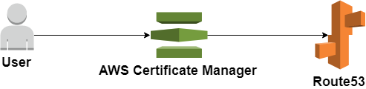
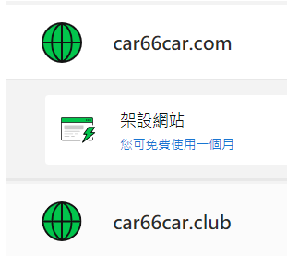
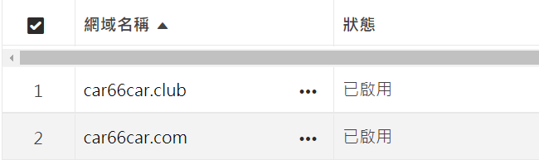
Tools(1) - (e.g.) Amazon Route 53
Domain name
GoDaddy information
Diagram
Diagram

Slide 7
Tools(2)

Slide 8
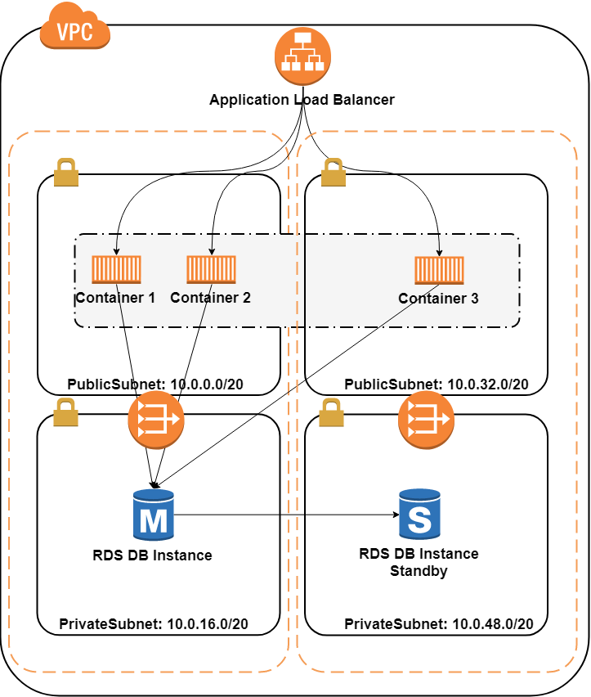
System
Architecture (e.g.)

Slide 9
Test Plan:

Slide 10
e.g. Function(1)

Slide 11
e.g. Function(2)

Slide 12
e.g. Function(3)

Slide 13
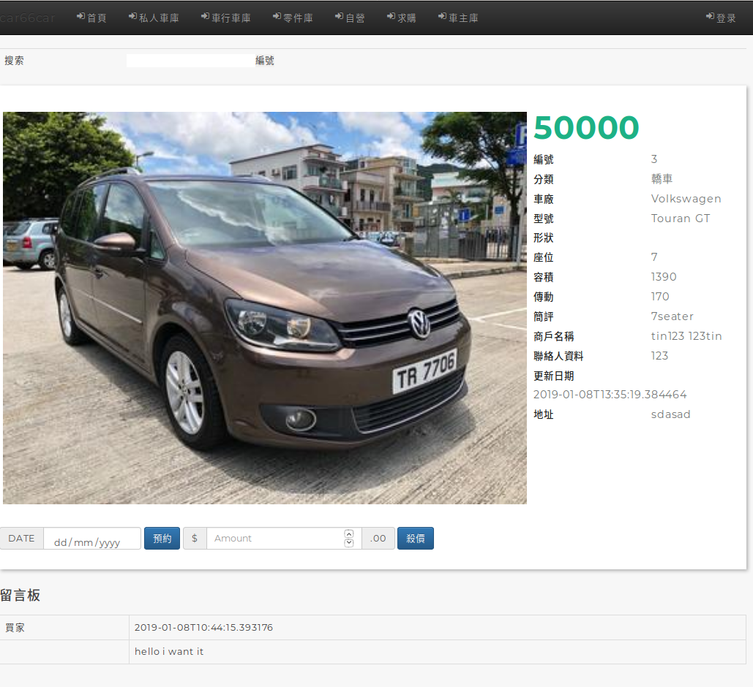
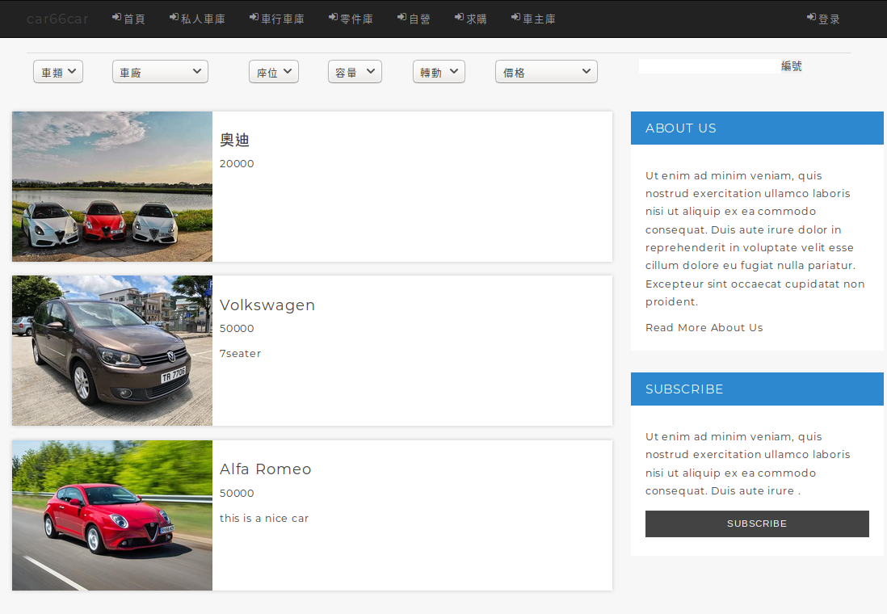
System Demo

Slide 14
Q&A

Slide 15
Thank You!!

